Slide 1
Office of the State Comptroller
Audit Division Update
December 1, 2016

Slide 2
Agenda
OSC History
How Audits are Selected
Recent Audit Findings
Impact of OSC Audits

Slide 3
Office of the State Comptroller
Independent office established in 2008
Comptroller - appointed by the Governor
Philip James Degnan, State Comptroller

Slide 4
Statute
N.J.S.A. 52:15C-1 et seq.
Responsibilities:
Conduct routine, periodic and random audits
Assess the performance and management of programs (extent to which they are achieving their goals and objectives)
Receive and investigate complaints concerning fraud, waste, abuse or mismanagement of State funds
Monitor award of certain contracts

Slide 5
Our Mission
To promote integrity and transparency at all levels of New Jersey government
Notes:
We strive to be a team of professionals that provides unbiased and objective information that government officials and New Jersey residents value.
Our Mission
To promote integrity and transparency at all levels of New Jersey government by auditing government finances, examining the efficiency of government programs, investigating misconduct by government officers, scrutinizing the legality of government contracts and recovering improperly expended Medicaid funds.

Slide 6
Our Mission
Audit government finance
Examine the efficiency of government programs
Investigate misconduct by government officers
Scrutinize the legality of government contracts
Recover improperly expended Medicaid funds

Slide 7
Our Values
Focus on Excellence
Innovation
Foster a Healthy Work Environment
Develop Staff

Slide 8
Responsibilities Extend to:
More than 2,500 units of government including:
All Executive Branch entities
Public Institutions of Higher Education
Independent State Authorities
Units of Local Government
Boards of Education

Slide 9
Office of the State Comptroller
Comprised of Four Divisions
Audit
Procurement
Investigations
Medicaid Fraud

Slide 10
Office of the State Comptroller
Audit Division
Conduct performance audits
Assist management in their responsibility of oversight
Assess adequacy of internal controls over financial management, contracting, financial reporting and the delivery of government programs and activities
Regard for efficiency, effectiveness and economy
Provide increased accountability, integrity and oversight

Slide 11
Office of the State Comptroller
Procurement Division
Reviews the legality of public contracts
Broad jurisdiction to review and monitor the process of soliciting proposals for and awarding contracts valued at $2 million or more
OSC reviews Invitations to Bid, Requests for Proposals, Requests for Qualifications, leases, land sales and concession agreements
Excludes negotiated bargaining agreements and certain redevelopment agreements
Requires notice from public entities:
Before advertising for a contract greater than $10 million
After a contract between $2 million and $10 million is awarded

Slide 12
Office of the State Comptroller
Investigations Division
Receives and investigates complaints regarding fraud, waste, abuse or misconduct
Investigates the performance of government officers, employees and programs

Slide 13
Office of the State Comptroller
Medicaid Fraud Division
Detects, prevents and investigates fraud, waste and abuse in the Medicaid, New Jersey Family Care and Charity Care programs
Recovers improperly expended Medicaid funds
Reviews the quality of care provided to Medicaid recipients
Excludes or terminates providers from the Medicaid program when necessary

Slide 14
AUDIT DIVISION
OSC

Slide 15
Audit Standards
Audits are conducted in accordance with prevailing national and professional standards, rules and practices
GAGAS - Yellow Book
Notes:
U.S. Government Accountability Office (GAO) published the Generally Accepted Government Auditing Standards (GAGAS) that guide the independence, transparency, accountability, and quality through the audit process
The Generally Accepted Government Auditing Standards, also known as the Yellow Book, provide a framework for conducting high quality audits with competence, integrity, objectivity, and independence. The Yellow Book is for use by auditors of government entities, entities that receive government awards, and other audit organizations performing Yellow Book audits.

Slide 16
Our Quality Control System
Provides reasonable assurance that:
Work is in compliance with standards
Evidence is complete and reliable
Conclusions are fair and balanced
Recommendations are appropriate
Subject to Peer Review by the National State Auditors Association (NSAA)

Slide 17
Audit Coordination
Coordination with other state audit entities
Avoid duplication and fragmentation of efforts
Optimize the use of resources
Promote effective working relationships
Avoid unnecessary expenditures of public funds

Slide 18
Performance Audits
Make Government Better
Improve program performance
Strengthen operations
Reduce costs
Facilitate decision making
Contribute to public accountability

Slide 19
Audit Selection Process
Risk-based analysis
Complaints received from public and/or local officials
OSC Hotline
Referrals from other State Agencies

Slide 20
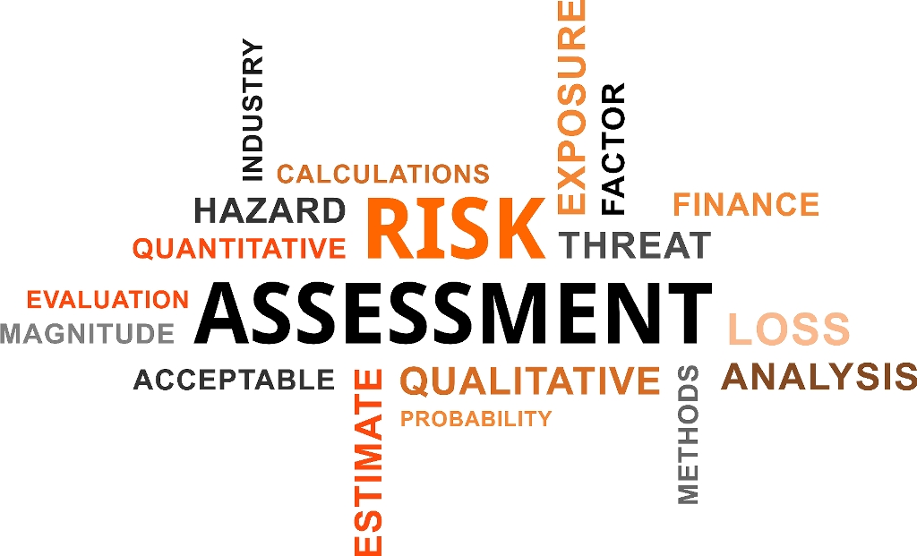

Slide 21
What is Risk Assessment?
Systematic process of evaluating the potential risks that may impact a projected activity
Includes identification and analysis of relevant factors and their impact on the achievement of an entity’s objectives
Focus on the 3 E’s

Slide 22
What Do the Results Tell Us?
Allows us to assess what programs/entities pose a high level of risk
Sets the foundation for the development of the audit objective and scope

Slide 23
Assessing Risk
Objective criteria for undertaking performance and other reviews consider such factors as:
Budget
Past performance
Audits
Assessment
Other credible information

Slide 24
Audit Process
A typical audit has several interrelated stages that include:
Opening Conference
Audit Survey
Field Work
Preliminary Audit Findings
Draft Report
Exit Conference
Final Audit Report
Follow Up

Slide 25
OSC audit RESULTs

Slide 26
Common Audit Findings
Top 5 Issues:
1. Policies and Procedures
2. Program Monitoring and Oversight
3. Training
4. Regulatory and State Compliance
5. Internal Control Monitoring

Slide 27
Auditor-Auditee Relationship
Top 5 Suggestions
Communicate
Listen
Professionalism - Respect
Responsive
Be Open to Constructive Criticism

Slide 28
Follow Up Reviews
Statutorily Required
Monitor the implementation of our recommendations
Require Management Response

Slide 29
Are We Making A Difference?
FY15 Annual Report - 93 percent compliance rate with recommendations
Significant improvement in internal controls resulting in more efficient operations
Significant cost recovery and cost avoidance

Slide 30
How can you help?
Consider the current process and suggest improvements
Be open to change
Report fraud, waste, abuse and mismanagement

Slide 31
Combating Waste, Fraud & Abuse
Purchasing agents are in a unique position to spot:
Bid-rigging schemes, such as rotating bids
Price-fixing
Vendor agreements regarding territories or market allocation
If you see something, say something:
1(855) OSC-TIPS

Slide 32
Combating Waste, Fraud & Abuse
Assist your departments in planning for procurements
Hurried bids often lead to waste
Emergency contracts must meet exception requirements
Encourage and assist in market research
Consult with legal counsel
Regularly update bid templates

Slide 33
Contact OSC
OSC Hotline: (855) OSC-TIPS or (855) 672-8477
Email: comptrollertips@osc.nj.gov
Website: http://www.nj.gov/comptroller
Telephone: (609) 984-2888
Location: 20 W. State St.
P.O. Box 024
Trenton, NJ 08628

Slide 34
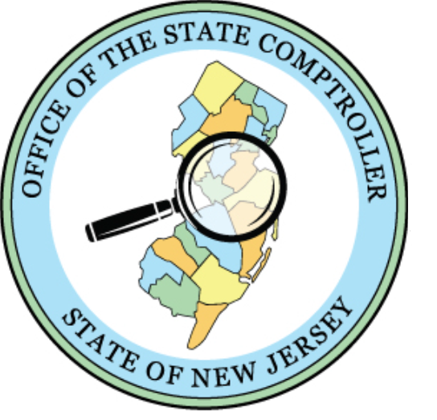
Questions/Comments

