Slide 1
Bidder’s Conference Division of Family and Community Partnerships Office of School Linked Services NJ School Based Youth Services Program Middle School Essex County
June 30, 2016

Slide 2
Today’s Overview
RFP Overview
Bidders Conference Structure
OSLS & SBYSP Highlightts
Q & A
Notes:
On page 2 of the RFP, it delineates funding being available to community based agency, hospital, school district, college and/or university. If the organization does not currently operate a SBYSP nor cannot demonstrate a similar SBYSP in place in a high school, is the organization disqualified to submit and receive the funding and would be disqualified for the RFP consideration? No. The organization would not be disqualified. Community based agencies, hospitals, school districts, colleges and/or universities are eligible.
Is it acceptable to target a school with grades K -8? The services would only be delivered to the 6-8 population. Or does the school need to be a grade 6-8 building only?
The school may be a K-8 but the services can be delivered to the 6-8 population.
The RFP reads “serving and safeguarding the most vulnerable children and families in the State.” How are you assessing/defining the “most vulnerable”?
Will consideration be given to the statistics surrounding challenges faced by LGBTQ youth living in Title One areas specifically or will you be focusing on the statistics relating to Title One youth as a whole?
The RFP reads “A memorandum of understanding (MOU) and/or letter of commitment is required with all proposals, except where the school district is the applicant.” Does the MOU and or letter of commitment need to come from both the district and the middle school or either or?
The MOU must clearly provide for the legal commitment to provide the services in the middle school. The Applicant must check to see which has the legal authority.
P.2, Section A, 1st bullet at top of page: Does the proposed middle school program need to be in the same school district as one of our existing SBYSP high school programs?
P.3, Section C, para.1: One of our potential district partners has a middle school which is grades 6 thru 9. The 9th graders in this school are already accessing SBYSP services at our physically adjacent high school SBYSP. Would we be allowed to serve all 4 grades under this new program or would we need to serve the 9th graders only through our adjacent high school SBYSP?
P.15, Section D. para.1 states that first year funding will be $120,000 for 9 months ($13.33k/month). Annual funding is earlier stated as $180,000 ($15k/month). Is there a typo somewhere?
P.15, Section D. last paragraph states that start-up costs of up to $60k are permitted and must be detailed in the Budget Narrative. P.26, Section 2.A.5., top of page states that budget proposal must also include start-up costs based on year 1 accruals.
Which is correct?
Are start-up costs to be detailed in both the “12-month Budget Form” AND in the Budget Narrative?
P.27, Part II, No.9: What are we supposed to do to/with the Resiliency Tool and Impact Evaluation in this Appendix?
As per the RFP on page 25-Outcome Evaluation section, reference the tool when providing a “clear statement that acknowledges the understanding that all grantees are expected to incorporate the OSLS’ Resiliency and Impact Evaluation tools in your overall outcome evaluation plan”.
P.27, Part II, No.12: Should all letters of support be from the proposed school district or can the also be from other districts in which we have SBYSP’s?
P.27, Part II, No.’s 21-36: For those applicants who already have SBYSP’s all of these required documents are already on file at DCF. Can these please be assigned only to applicants who do not already have an SBYSP/other DCF contract?

Slide 3
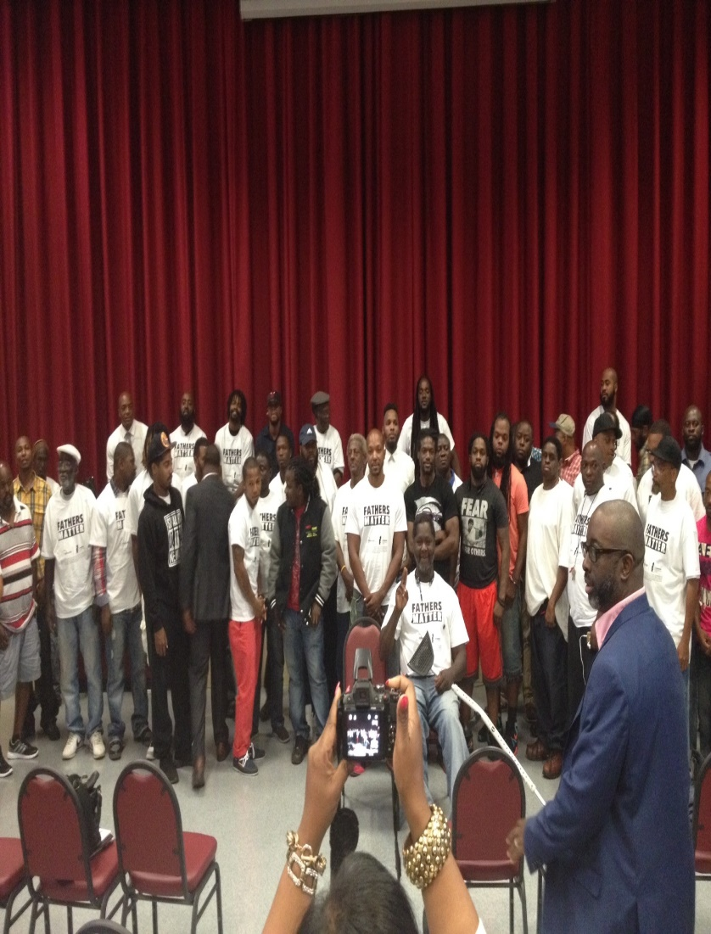
Principles: Focus on Families
Parents and families are a child’s first and most influential teachers — the primary source of social, emotional, physical, intellectual and spiritual development and maturity.
Family Support (prevention) should begin as early as possible, including prior to or during pregnancy, to ensure the best possible outcomes for infants, children, youth and families.

Slide 4
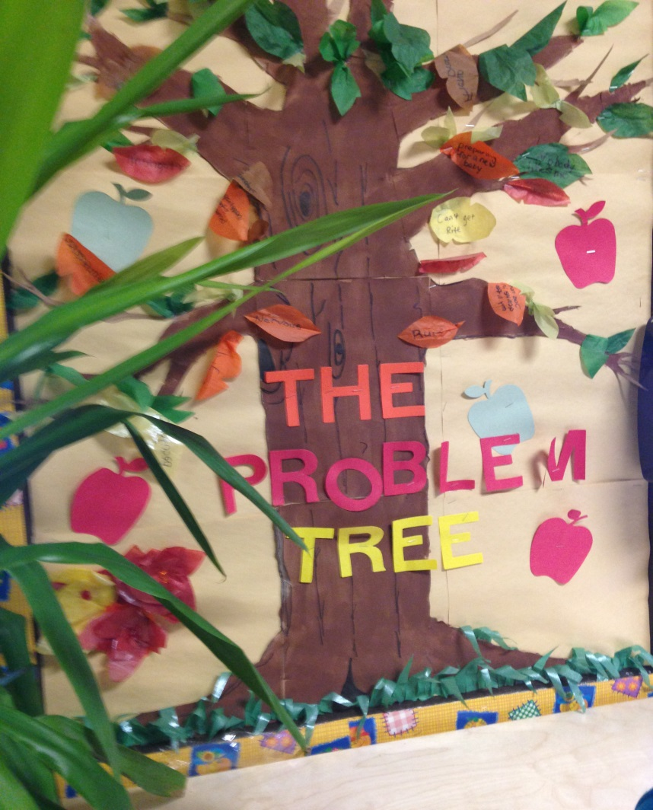
OSLS Service Purpose
OSLS oversees the implementation of prevention and intervention programs that are comprehensive, multifaceted, and
build on the strengths of young people and assist them in achieving their educational and life goals.
Notes:
The New Jersey School Based Youth Services Program (SBYSP) was started in 1987 to help young people navigate their adolescent years, finish their education, obtain skills leading to employment or continuing education, and graduate healthy and drug free
Originally under the DHS umbrella

Slide 5
Array of School Linked Services
OSLS
School Based Youth Services Programs (SBYSP)
Prevention of Juvenile Delinquency (PJD)
Family Friendly Centers (FFC)
2nd Floor Youth Helpline
Newark Health SBHC
Parent Linking Program (PLP)
NJ Child Assault Prevention
(NJ CAP)
Traumatic Loss Coalition
Adolescent Pregnancy Prevention Initiative (APPI)

Slide 6
The Why…SBYSP Purpose
Begin Prevention Work with Adolescents Early
Move Beyond Preventing Negative Outcomes
Focus on Building on adolescent’s existing assets, strengths and skills
Successful Emerging Adult and Beyond

Slide 7
Youth Thrive Promotive and Protective Factors Framework Center for the Study of Social Policy
Knowledge of Adolescent Development (including brain development and the impact of trauma
Youth Resilience
Social Connections
Manage Stress
Healthy Relationships
Concrete Supports
Positive help-seeking and High Quality Service Delivery
Cognitive and Social-Emotional Competence
Neurological, physical, psychological, cognitive, social and emotional transitions

Slide 8
SBYSPs…What Makes It Work? Partnership and Collaboration
SBYSP
School
Student
Parents
Community

Slide 9
Program Design: The Student
Mentor and Leadership Group (30)
Available to any enrolled MS student
30 Students that commit to be mentored for the school year.
Bi-weekly theme based activities: Service, Supports and Opportunities
General Student Support
Participate in one or more SBYSP activities available

Slide 10
Program Design: The Parent/Caregiver
Minimum 4 activities/events
Required father engagement

Slide 11
Questions and Answers
On page 2 of the RFP, it delineates funding being available to community based agency, hospital, school district, college and/or university. If the organization does not currently operate a SBYSP nor cannot demonstrate a similar SBYSP in place in a high school, is the organization disqualified to submit and receive the funding and would be disqualified for the RFP consideration?
No. The organization would not be disqualified.
It would be advised that this is addressed in some capacity.
Community based agencies, hospitals, school districts, colleges and/or universities are eligible.
Notes:
No. The organization would not be disqualified. Community based agencies, hospitals, school districts, colleges and/or universities are eligible.
Is it acceptable to target a school with grades K -8? The services would only be delivered to the 6-8 population. Or does the school need to be a grade 6-8 building only?
The school may be a K-8 but the services can be delivered to the 6-8 population.
The RFP reads “serving and safeguarding the most vulnerable children and families in the State.” How are you assessing/defining the “most vulnerable”?
Will consideration be given to the statistics surrounding challenges faced by LGBTQ youth living in Title One areas specifically or will you be focusing on the statistics relating to Title One youth as a whole?
The RFP reads “A memorandum of understanding (MOU) and/or letter of commitment is required with all proposals, except where the school district is the applicant.” Does the MOU and or letter of commitment need to come from both the district and the middle school or either or?
The MOU must clearly provide for the legal commitment to provide the services in the middle school. The Applicant must check to see which has the legal authority.
P.2, Section A, 1st bullet at top of page: Does the proposed middle school program need to be in the same school district as one of our existing SBYSP high school programs?
P.3, Section C, para.1: One of our potential district partners has a middle school which is grades 6 thru 9. The 9th graders in this school are already accessing SBYSP services at our physically adjacent high school SBYSP. Would we be allowed to serve all 4 grades under this new program or would we need to serve the 9th graders only through our adjacent high school SBYSP?
P.15, Section D. para.1 states that first year funding will be $120,000 for 9 months ($13.33k/month). Annual funding is earlier stated as $180,000 ($15k/month). Is there a typo somewhere?
P.15, Section D. last paragraph states that start-up costs of up to $60k are permitted and must be detailed in the Budget Narrative. P.26, Section 2.A.5., top of page states that budget proposal must also include start-up costs based on year 1 accruals.
Which is correct?
Are start-up costs to be detailed in both the “12-month Budget Form” AND in the Budget Narrative?
P.27, Part II, No.9: What are we supposed to do to/with the Resiliency Tool and Impact Evaluation in this Appendix?
As per the RFP on page 25-Outcome Evaluation section, reference the tool when providing a “clear statement that acknowledges the understanding that all grantees are expected to incorporate the OSLS’ Resiliency and Impact Evaluation tools in your overall outcome evaluation plan”.
P.27, Part II, No.12: Should all letters of support be from the proposed school district or can the also be from other districts in which we have SBYSP’s?
P.27, Part II, No.’s 21-36: For those applicants who already have SBYSP’s all of these required documents are already on file at DCF. Can these please be assigned only to applicants who do not already have an SBYSP/other DCF contract?

Slide 12
Questions and Answers
Is it acceptable to target a school with grades K -8? The services would only be delivered to the 6-8 population. Or does the school need to be a grade 6-8 building only?
The school may be a K-8 but the services would only be available to students defined as middle school students in the district.
Notes:
The school may be a K-8 but the services can be delivered to the 6-8 population.
The RFP reads “serving and safeguarding the most vulnerable children and families in the State.” How are you assessing/defining the “most vulnerable”?
Will consideration be given to the statistics surrounding challenges faced by LGBTQ youth living in Title One areas specifically or will you be focusing on the statistics relating to Title One youth as a whole?
The RFP reads “A memorandum of understanding (MOU) and/or letter of commitment is required with all proposals, except where the school district is the applicant.” Does the MOU and or letter of commitment need to come from both the district and the middle school or either or?
The MOU must clearly provide for the legal commitment to provide the services in the middle school. The Applicant must check to see which has the legal authority.
P.2, Section A, 1st bullet at top of page: Does the proposed middle school program need to be in the same school district as one of our existing SBYSP high school programs?
P.3, Section C, para.1: One of our potential district partners has a middle school which is grades 6 thru 9. The 9th graders in this school are already accessing SBYSP services at our physically adjacent high school SBYSP. Would we be allowed to serve all 4 grades under this new program or would we need to serve the 9th graders only through our adjacent high school SBYSP?
P.15, Section D. para.1 states that first year funding will be $120,000 for 9 months ($13.33k/month). Annual funding is earlier stated as $180,000 ($15k/month). Is there a typo somewhere?
P.15, Section D. last paragraph states that start-up costs of up to $60k are permitted and must be detailed in the Budget Narrative. P.26, Section 2.A.5., top of page states that budget proposal must also include start-up costs based on year 1 accruals.
Which is correct?
Are start-up costs to be detailed in both the “12-month Budget Form” AND in the Budget Narrative?
P.27, Part II, No.9: What are we supposed to do to/with the Resiliency Tool and Impact Evaluation in this Appendix?
As per the RFP on page 25-Outcome Evaluation section, reference the tool when providing a “clear statement that acknowledges the understanding that all grantees are expected to incorporate the OSLS’ Resiliency and Impact Evaluation tools in your overall outcome evaluation plan”.
P.27, Part II, No.12: Should all letters of support be from the proposed school district or can the also be from other districts in which we have SBYSP’s?
P.27, Part II, No.’s 21-36: For those applicants who already have SBYSP’s all of these required documents are already on file at DCF. Can these please be assigned only to applicants who do not already have an SBYSP/other DCF contract?

Slide 13
Questions and Answers
The RFP reads “serving and safeguarding the most vulnerable children and families in the State.” How are you assessing/defining the “most vulnerable”?
The applicant will be responsible for using existing data to qualify their target population as “most vulnerable”.
A good source may be the 2016 KIDS COUNT® Data Book from the Annie E. Casey Foundation but other data sources exist.
Notes:
The RFP reads “A memorandum of understanding (MOU) and/or letter of commitment is required with all proposals, except where the school district is the applicant.” Does the MOU and or letter of commitment need to come from both the district and the middle school or either or?
The MOU must clearly provide for the legal commitment to provide the services in the middle school. The Applicant must check to see which has the legal authority.
P.2, Section A, 1st bullet at top of page: Does the proposed middle school program need to be in the same school district as one of our existing SBYSP high school programs?
P.3, Section C, para.1: One of our potential district partners has a middle school which is grades 6 thru 9. The 9th graders in this school are already accessing SBYSP services at our physically adjacent high school SBYSP. Would we be allowed to serve all 4 grades under this new program or would we need to serve the 9th graders only through our adjacent high school SBYSP?
P.15, Section D. para.1 states that first year funding will be $120,000 for 9 months ($13.33k/month). Annual funding is earlier stated as $180,000 ($15k/month). Is there a typo somewhere?
P.15, Section D. last paragraph states that start-up costs of up to $60k are permitted and must be detailed in the Budget Narrative. P.26, Section 2.A.5., top of page states that budget proposal must also include start-up costs based on year 1 accruals.
Which is correct?
Are start-up costs to be detailed in both the “12-month Budget Form” AND in the Budget Narrative?
P.27, Part II, No.9: What are we supposed to do to/with the Resiliency Tool and Impact Evaluation in this Appendix?
As per the RFP on page 25-Outcome Evaluation section, reference the tool when providing a “clear statement that acknowledges the understanding that all grantees are expected to incorporate the OSLS’ Resiliency and Impact Evaluation tools in your overall outcome evaluation plan”.
P.27, Part II, No.12: Should all letters of support be from the proposed school district or can the also be from other districts in which we have SBYSP’s?
P.27, Part II, No.’s 21-36: For those applicants who already have SBYSP’s all of these required documents are already on file at DCF. Can these please be assigned only to applicants who do not already have an SBYSP/other DCF contract?

Slide 14
Questions and Answers
Will consideration be given to the statistics surrounding challenges faced by LGBTQ youth living in Title One areas specifically or will you be focusing on the statistics relating to Title One youth as a whole?
Both. MS students in the identified school will be consider as a whole.
Specific challenges should be highlighted in the proposal, as applicable.
Follow instructions in the needs justification section with specific emphasis on bullet 2 and 3.
Notes:
The RFP reads “A memorandum of understanding (MOU) and/or letter of commitment is required with all proposals, except where the school district is the applicant.” Does the MOU and or letter of commitment need to come from both the district and the middle school or either or?
The MOU must clearly provide for the legal commitment to provide the services in the middle school. The Applicant must check to see which has the legal authority.
P.2, Section A, 1st bullet at top of page: Does the proposed middle school program need to be in the same school district as one of our existing SBYSP high school programs?
P.3, Section C, para.1: One of our potential district partners has a middle school which is grades 6 thru 9. The 9th graders in this school are already accessing SBYSP services at our physically adjacent high school SBYSP. Would we be allowed to serve all 4 grades under this new program or would we need to serve the 9th graders only through our adjacent high school SBYSP?
P.15, Section D. para.1 states that first year funding will be $120,000 for 9 months ($13.33k/month). Annual funding is earlier stated as $180,000 ($15k/month). Is there a typo somewhere?
P.15, Section D. last paragraph states that start-up costs of up to $60k are permitted and must be detailed in the Budget Narrative. P.26, Section 2.A.5., top of page states that budget proposal must also include start-up costs based on year 1 accruals.
Which is correct?
Are start-up costs to be detailed in both the “12-month Budget Form” AND in the Budget Narrative?
P.27, Part II, No.9: What are we supposed to do to/with the Resiliency Tool and Impact Evaluation in this Appendix?
As per the RFP on page 25-Outcome Evaluation section, reference the tool when providing a “clear statement that acknowledges the understanding that all grantees are expected to incorporate the OSLS’ Resiliency and Impact Evaluation tools in your overall outcome evaluation plan”.
P.27, Part II, No.12: Should all letters of support be from the proposed school district or can the also be from other districts in which we have SBYSP’s?
P.27, Part II, No.’s 21-36: For those applicants who already have SBYSP’s all of these required documents are already on file at DCF. Can these please be assigned only to applicants who do not already have an SBYSP/other DCF contract?

Slide 15
Questions and Answers
The RFP reads “A memorandum of understanding (MOU) and/or letter of commitment is required with all proposals, except where the school district is the applicant.” Does the MOU and or letter of commitment need to come from both the district and the middle school or either or?
The MOU must clearly provide for the legal commitment to provide the services in the middle school. The Applicant must check to see which has the legal authority.
The proposal needs to include a true partnership between the school district and the applicant.
Notes:
P.2, Section A, 1st bullet at top of page: Does the proposed middle school program need to be in the same school district as one of our existing SBYSP high school programs?
P.3, Section C, para.1: One of our potential district partners has a middle school which is grades 6 thru 9. The 9th graders in this school are already accessing SBYSP services at our physically adjacent high school SBYSP. Would we be allowed to serve all 4 grades under this new program or would we need to serve the 9th graders only through our adjacent high school SBYSP?
P.15, Section D. para.1 states that first year funding will be $120,000 for 9 months ($13.33k/month). Annual funding is earlier stated as $180,000 ($15k/month). Is there a typo somewhere?
P.15, Section D. last paragraph states that start-up costs of up to $60k are permitted and must be detailed in the Budget Narrative. P.26, Section 2.A.5., top of page states that budget proposal must also include start-up costs based on year 1 accruals.
Which is correct?
Are start-up costs to be detailed in both the “12-month Budget Form” AND in the Budget Narrative?
P.27, Part II, No.9: What are we supposed to do to/with the Resiliency Tool and Impact Evaluation in this Appendix?
As per the RFP on page 25-Outcome Evaluation section, reference the tool when providing a “clear statement that acknowledges the understanding that all grantees are expected to incorporate the OSLS’ Resiliency and Impact Evaluation tools in your overall outcome evaluation plan”.
P.27, Part II, No.12: Should all letters of support be from the proposed school district or can the also be from other districts in which we have SBYSP’s?
P.27, Part II, No.’s 21-36: For those applicants who already have SBYSP’s all of these required documents are already on file at DCF. Can these please be assigned only to applicants who do not already have an SBYSP/other DCF contract?

Slide 16
Questions and Answers
P.2, Section A, 1st bullet at top of page: Does the proposed middle school program need to be in the same school district as one of our existing SBYSP high school programs?
No.
However if it does not operate in the same area of the existing HS SBYSP the applicant should follow the 2nd bullet and demonstrate a similar SBYSP support system will be in place for corresponding high school.
Notes:
P.3, Section C, para.1: One of our potential district partners has a middle school which is grades 6 thru 9. The 9th graders in this school are already accessing SBYSP services at our physically adjacent high school SBYSP. Would we be allowed to serve all 4 grades under this new program or would we need to serve the 9th graders only through our adjacent high school SBYSP?
P.15, Section D. para.1 states that first year funding will be $120,000 for 9 months ($13.33k/month). Annual funding is earlier stated as $180,000 ($15k/month). Is there a typo somewhere?
P.15, Section D. last paragraph states that start-up costs of up to $60k are permitted and must be detailed in the Budget Narrative. P.26, Section 2.A.5., top of page states that budget proposal must also include start-up costs based on year 1 accruals.
Which is correct?
Are start-up costs to be detailed in both the “12-month Budget Form” AND in the Budget Narrative?
P.27, Part II, No.9: What are we supposed to do to/with the Resiliency Tool and Impact Evaluation in this Appendix?
As per the RFP on page 25-Outcome Evaluation section, reference the tool when providing a “clear statement that acknowledges the understanding that all grantees are expected to incorporate the OSLS’ Resiliency and Impact Evaluation tools in your overall outcome evaluation plan”.
P.27, Part II, No.12: Should all letters of support be from the proposed school district or can the also be from other districts in which we have SBYSP’s?
P.27, Part II, No.’s 21-36: For those applicants who already have SBYSP’s all of these required documents are already on file at DCF. Can these please be assigned only to applicants who do not already have an SBYSP/other DCF contract?

Slide 17
Questions and Answers
P.3, Section C, para.1: One of our potential district partners has a middle school which is grades 6 thru 9. The 9th graders in this school are already accessing SBYSP services at our physically adjacent high school SBYSP. Would we be allowed to serve all 4 grades under this new program or would we need to serve the 9th graders only through our adjacent high school SBYSP?
If your school district defines your middle school as grades 6-9 then that will be your target population. Ensure your application clearly articulates this as the district’s designation.
Notes:
P.15, Section D. para.1 states that first year funding will be $120,000 for 9 months ($13.33k/month). Annual funding is earlier stated as $180,000 ($15k/month). Is there a typo somewhere?
P.15, Section D. last paragraph states that start-up costs of up to $60k are permitted and must be detailed in the Budget Narrative. P.26, Section 2.A.5., top of page states that budget proposal must also include start-up costs based on year 1 accruals.
Which is correct?
Are start-up costs to be detailed in both the “12-month Budget Form” AND in the Budget Narrative?
P.27, Part II, No.9: What are we supposed to do to/with the Resiliency Tool and Impact Evaluation in this Appendix?
As per the RFP on page 25-Outcome Evaluation section, reference the tool when providing a “clear statement that acknowledges the understanding that all grantees are expected to incorporate the OSLS’ Resiliency and Impact Evaluation tools in your overall outcome evaluation plan”.
P.27, Part II, No.12: Should all letters of support be from the proposed school district or can the also be from other districts in which we have SBYSP’s?
P.27, Part II, No.’s 21-36: For those applicants who already have SBYSP’s all of these required documents are already on file at DCF. Can these please be assigned only to applicants who do not already have an SBYSP/other DCF contract?

Slide 18
Questions and Answers
P.15, Section D. para.1 states that first year funding will be $120,000 for 9 months ($13.33k/month). Annual funding is earlier stated as $180,000 ($15k/month). Is there a typo somewhere?
Clarification. For the purpose of this initiative, the Department will make available prorated funds of $120,000 in federal and state funds for operational services to begin November 1, 2016- In addition, Operational start-up funds of no more than $60,000 is permitted for the first year of the contract ONLY.
Notes:
. For the purpose of this initiative, the Department will make available prorated funds of $120,000 in federal and state funds for operational services to begin November 1, 2016- In addition, Operational start-up funds of no more than $60,000 is permitted for the first year of the contract ONLY.
Which is correct?
Are start-up costs to be detailed in both the “12-month Budget Form” AND in the Budget Narrative?
P.27, Part II, No.9: What are we supposed to do to/with the Resiliency Tool and Impact Evaluation in this Appendix?
As per the RFP on page 25-Outcome Evaluation section, reference the tool when providing a “clear statement that acknowledges the understanding that all grantees are expected to incorporate the OSLS’ Resiliency and Impact Evaluation tools in your overall outcome evaluation plan”.
P.27, Part II, No.12: Should all letters of support be from the proposed school district or can the also be from other districts in which we have SBYSP’s?
P.27, Part II, No.’s 21-36: For those applicants who already have SBYSP’s all of these required documents are already on file at DCF. Can these please be assigned only to applicants who do not already have an SBYSP/other DCF contract?

Slide 19
Questions and Answers
P.15, Section D. last paragraph states that start-up costs of up to $60k are permitted and must be detailed in the Budget Narrative. P.26, Section 2.A.5., top of page states that budget proposal must also include start-up costs based on year 1 accruals.
Which is correct? Are start-up costs to be detailed in both the “12-month Budget Form” AND in the Budget Narrative?
Yes. The budget form provides a column to detail start-up funding request. A budget narrative is required both start-up costs and the on going operational costs for the year.
Notes:
P.27, Part II, No.9: What are we supposed to do to/with the Resiliency Tool and Impact Evaluation in this Appendix?
As per the RFP on page 25-Outcome Evaluation section, reference the tool when providing a “clear statement that acknowledges the understanding that all grantees are expected to incorporate the OSLS’ Resiliency and Impact Evaluation tools in your overall outcome evaluation plan”.
P.27, Part II, No.12: Should all letters of support be from the proposed school district or can the also be from other districts in which we have SBYSP’s?
P.27, Part II, No.’s 21-36: For those applicants who already have SBYSP’s all of these required documents are already on file at DCF. Can these please be assigned only to applicants who do not already have an SBYSP/other DCF contract?

Slide 20
Questions and Answers
P.27, Part II, No.9: What are we supposed to do to/with the Resiliency Tool and Impact Evaluation in this Appendix?
As per the RFP on page 25-Outcome Evaluation section, reference the tool when providing a “clear statement that acknowledges the understanding that all grantees are expected to incorporate the OSLS’ Resiliency and Impact Evaluation tools in your overall outcome evaluation plan”.
Notes:
P.27, Part II, No.12: Should all letters of support be from the proposed school district or can the also be from other districts in which we have SBYSP’s?
P.27, Part II, No.’s 21-36: For those applicants who already have SBYSP’s all of these required documents are already on file at DCF. Can these please be assigned only to applicants who do not already have an SBYSP/other DCF contract?

Slide 21
Questions and Answers
P.27, Part II, No.12: Should all letters of support be from the proposed school district or can the also be from other districts in which we have SBYSP’s?
Letters of support from students, school administration (including superintendent, teachers, guidance etc.) and parents.
Notes:
P.27, Part II, No.’s 21-36: For those applicants who already have SBYSP’s all of these required documents are already on file at DCF. Can these please be assigned only to applicants who do not already have an SBYSP/other DCF contract?

Slide 22
Questions and Answers
P.27, Part II, No.’s 21-36: For those applicants who already have SBYSP’s all of these required documents are already on file at DCF. Can these please be assigned only to applicants who do not already have an SBYSP/other DCF contract?
Unfortunately we will still need these forms submitted.

Slide 23
Thank You
Final Questions???
As additional inquires will not be accepted after the closing of today’s Bidder’s Conference.

