Slide 2
A Short Update on Perfluorinated Alkyl Substances (PFAS)
Keith R. Cooper
New Jersey Drinking Water Quality Institute
June 30, 2016

Slide 3
SCIENCE DRIVEN EVALUATION BY DWQI ADVISORY TO NJDEP
1,2,3-TCP
PFOA
PFOS

Slide 4
Overview of DWQI PFOA Health Effects Approach
Health-based goals from 1983 A-280 Amendments to NJ Safe Drinking Water Act
Non-cancer: No adverse physiological effects from ingestion
Cancer: One in one million risk from lifetime exposure
Risk assessment approach – based on USEPA guidance
Extensive literature search – more than 2,000 publications
Focused on key human and animal effects
Epidemiological data
Limitations preclude use as primary basis for Health-based MCL
Justify concern about substantial ↑ in blood levels from drinking water
Support public health protective approach based on animal data
Toxicological data - evaluated non-cancer and cancer effects
Mode of action and human relevance – thorough evaluation
Dose-response modeling
Benchmark dose modeling of non-cancer and cancer effects
Considers greater persistence in humans than animals

Slide 5
Overview of Process and Current Status
2007: NJDEP chronic PFOA drinking water guidance of 40 ng/L. Basis was published (Post et al., 2009).
2009: USEPA short term Provisional Health Advisories for PFOA (400 ng/L) and PFOA (200 ng/L).
2009-10: DWQI voted to develop MCL for PFOA. Detailed evaluation subsequently performed by Health Effects (HE) Subcommittee.
2012: Review of PFOA as an emerging drinking water contaminant by current and former HE Subcommittee members (Post et al., 2012).
2014: NJDEP Commissioner Martin asked DWQI to recommend MCLs for PFNA, PFOA, and PFOS.
2015: DWQI recommended PFNA MCL of 13 ng/L.
May/2016: USEPA finalized Lifetime Health Advisories for PFOA, PFOS, and total of PFOA + PFOS of 70 ng/L.
June-July/2016: HE Subcommittee finalizes Public Review Draft of Health-based MCL Support Document for PFOA and the Treatment and Analytical .
Notes:
NJDEP guidance was developed in response to a request from a public water supply where PFOA had been detected.

Slide 6
PFOA is a Persistent Bioaccumulative and Toxic (PBT) Drinking Water Contaminant
Different from most other PBT compounds
Water soluble - important as drinking water contaminant
Persists in environment and human body
Remains in the body for many years after exposure ends
Bioaccumulates from drinking water to humans
Ratio greater than 100:1
Low concentrations → several-fold ↑ in blood levels (Central Compartment actual internal dose)
Infants’ blood levels much higher from same exposures
Transferred to breast milk in mother
In formula prepared with contaminated water
Fluid consumption much higher on body weight basis
Sensitive subpopulation for developmental effects

Slide 7
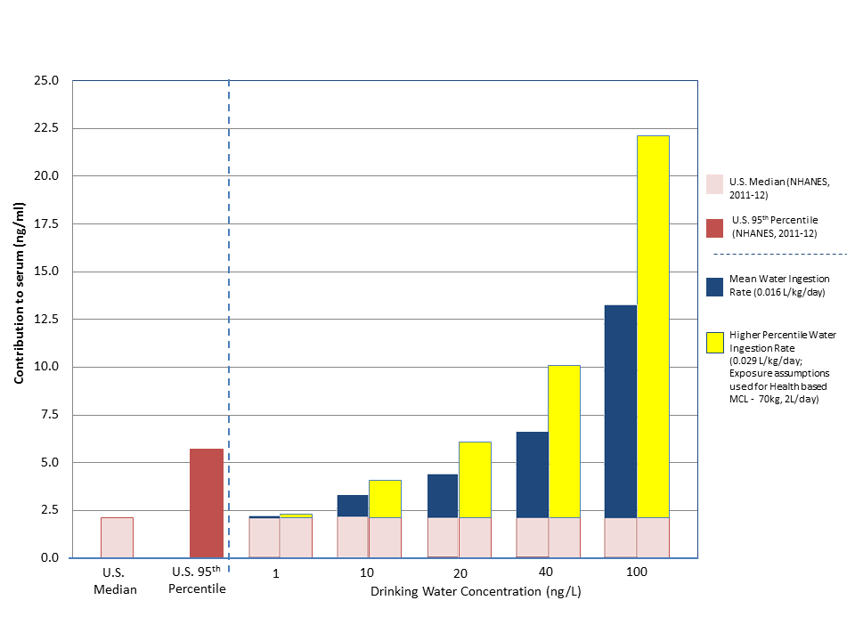
Relatively Low Concentrations of PFOA in Drinking Water Substantially Increase PFOA in Blood Serum

Slide 8
Increases in Blood Serum PFOA are Greater in Infants Considered as a Sensitive Stage of Human Development
Verner et al., 2016
Notes:
Black Line 50th percentile, Red is 95%, Blue is 5%, Dotted lines Maximum and Minimum

Slide 9
Next Steps for the DWQI for 1,2,3-Trichloropropane & PFASs
The 1,2,3-Trichloropropane Public Review Draft will be posted for comment in the next few weeks based on the reports from each of the committees and public comment along with any presentations.
At the next meeting the DWQI will discuss all of the comments and submit a revised document based on consideration of the submitted comments to Commissioner Martin for further policy and cost review for promulgating an MCL.

Slide 10
Next Steps for the DWQI for 1,2,3-Trichloropropane & PFASs
PFOS is likely to be the next compound to be evaluated based on Commissioner Martin’s March 2014 letter request.
The DWQI will convene into a closed session where each of the Chairs of the committees will present their individual committee conclusions concerning PFOA to the full DWQI members and a discussion on the committee findings as they relate to the final recommendations and posting of the Public Review Draft.

Slide 11
SCIENCE DRIVEN EVALUATION BY DWQI ADVISORY TO NJDEP
1,2,3-TCP
PFOA
PFOS

