Slide 1


SGO 2.1
On the Road to Ownership
Office of Evaluation: Summer 2015

Slide 2
Today’s Session Objectives
Apply concepts from today’s presentation to help plan concrete next steps towards:
Improving assessments.
Using more flexible, innovative approaches to increase the value of SGOs for teachers and students.
Integrating SGOs into the typical cycle of teaching and learning.
Utilizing collaboration to improve the SGO process.
SGO 2.0 "From Compliance to Quality"
Notes:
There is a great deal of information in this presentation, some aspects of which might appear to be very challenging to implement. Recognizing competing priorities, even within AchieveNJ, districts should carefully consider which components of the workshop they can realistically and effectively implement this year. Even if a district adopts just one recommendation, such as ensuring its assessments are aligned to critical standards, it has made a step in the right direction. A district can take more steps, as capacity allows, in continuously improving its educator effectiveness system.
The guidance provided in this presentation is a continuation of the information provided during “SGO 2.0: From Compliance to Quality.” If your district feels it still has work to do building on the information provided in 2.0, by all means review and please do so. Following the continuum presented ensures the greatest chance of success in implementing SGOs of the highest value to educators and the students they teach.

Slide 3
Norms and Materials
Norms
Be engaged, attentive, and respectful
Focus on being solution-oriented
Ask questions
Materials
Keep the supporting materials handy during the presentation
Electronic versions of all materials will be available on the AchieveNJ website

Slide 4
SGOs
SGOs are long-term academic goals for groups of students set by teachers in consultation with their supervisors.
When functioning at the highest level, SGOs promote:
Reflective and collaborative teaching practices;
Alignment among standards, instruction, and assessment; and
Improvements in student learning.
Notes:
The Department’s guidance on SGOs have been provided to help educators develop high quality SGOs that have value beyond their use as an accountability measure. The highlighted terms on this statement reinforce the idea that when developed thoughtfully and implemented well, SGOs provide benefit to teachers, their evaluators and, most importantly, their students.

Slide 5
SGO Implementation Challenges and Evolution of Guidance
Year One
Compliance
Meet regulatory requirements
Learn the process
Year Two
Quality
Improve assessments
Increase collaboration
Diversify starting point data
Differentiate targets
Year Three
Ownership
Improve assessments
Increase collaboration
Increase integration
Increase innovation
Using quality assessments
Fostering true collaboration
Setting appropriate targets using better data
Using quality assessments
Enhancing collaborative opportunities
Moving beyond compliance
Notes:
The first two years of SGO implementation proved to be a sometimes difficult but many times rewarding process for educators. The Department’s guidance has reflected the needs as expressed by educators we have talked to throughout the state. This graphic represents the implementation challenges and evolution of the guidance as a result of it. The boxes represent the challenges educators across the state have experienced, while the circles above represent the evolution of the guidance in response to those challenges.
Please note the importance of the growth the Department has experienced along with educators throughout NJ. And that the themes of “SGO 2.1: On the Road to Ownership” are largely a continuation of the work of previous year’s messages.

Slide 6
SGO 2.1: On the Road to Ownership
SGO 2.1
Assessment Design
Collaboration
Integration
Innovation
Promote accurate, useful measures of student learning.
Collaborate with colleagues to increase value for teachers and students.
Use SGOs to enhance and inform teaching and learning.
Increase SGO quality and value for teachers and students.
Notes:
The above four themes of SGO 2.1 are as follows:
Assessment Design: In order to address learning gaps, you need the proper data. With improperly aligned assessments we essentially do not get the necessary data we need to help students succeed.
Innovation: To increase the value of SGOs, what we consider in assessments need to change into what makes the most sense for each teacher. For example, literacy specialists need a different assessment focus than the culinary arts teachers or the biology teachers. Consider both traditional and nontraditional assessment measures for SGOs, depending on which is best to meet the needs of your students. This could be one summative assessment, as well as a combination of three or four; it could also be a portfolio or a performance task.
Integration: This is step four (tracking progress and refining instruction). One of the major build outs in both the guidebook and this presentation is taking SGOs from a series of due dates to a part of the everyday classroom. Teachers assess students all the time. They do this in order to see how well their students are doing as they progress towards mastery of certain standards. This monitoring of data to refine instruction is critical in helping students achieve the greatest success.
Collaboration: This is the glue, the key to everything. While SGOs can be completed individually by each teacher, both the quality and richness of the SGO process is better suited in a collaborative structure.

Slide 7
SGO Process
Choose or develop a quality assessment aligned to the standards.
Determine students’ starting points.
With supervisor input and approval, set ambitious yet achievable student learning goals.
Track progress and refine instruction accordingly.
Review results and discuss score with supervisor.
Collaboration
Collaboration
Integration
Step 2
Step 4
September By Oct. 31 By Feb. 15 By end of school year
Step 1
Step 3
Step 5
Optional mid-year check-in
Adjustments to SGOs can be made
with approval
Assessment Design
Innovation
Collaboration
Collaboration
Collaboration
Notes:
Today’s presentation largely focuses on Steps 1 and 4 of the SGO process.
Step 1 highlights the themes of Assessment Design and Innovation.
Step 4 highlights the theme of integration.
We will also briefly touch in steps 2, 3, and 5 while following the year of a fictional teacher (Mr. Roosevelt) and his SGO. As we move through all five steps we will also see the importance of collaboration throughout the entire SGO process.

Slide 8
Improving Assessments
  The assessment design modules
  The elements of assessment design
  The importance of prioritizing standards
  Innovations in assessment design:
        Portfolios
        Performance-based assessments
SGO 2.1
Assessment Design
Collaboration
Integration
Innovation
Notes:
The first objective for the day is “Improving assessments.”
During this part of the presentation we will investigate the following four areas, highlighting the themes of assessment design and innovation in assessments.

Slide 9
Improving Assessments
Activity: Turn and Talk
Why are quality assessments critical?
  Discuss with a neighbor.
  Write down two reasons why.
Quality assessments are critical because they:
  Accurately measure student knowledge and learning.
  Yield accurate AND meaningful results.
  Promote good instruction and improve student learning.
  Assist schools in curriculum alignment and locating instructional gaps.
  Aid in evaluating programs in schools.
Notes:
Activities such as this turn and talk are embedded throughout the workshop and can be removed or supplemented as time allows.
After a brief discussion, the presenter can reveal these five reasons. In summation, low quality, unaligned assessments are of little use in doing any of the above or in helping students in any meaningful way.

Slide 10

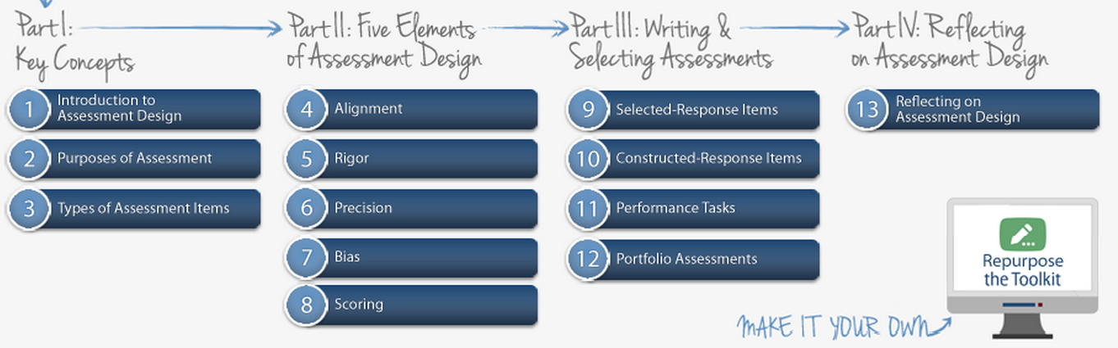
Assessment Design Modules
4 parts
  Part I: Key Concepts
  Part II: Five Elements of Assessment Design
  Part III: Writing & Selecting Assessments
  Part IV: Reflecting on Assessment Design
13 modules
4 parts
  Part I: Key Concepts
  Part II: Five Elements of Assessment Design
  Part III: Writing & Selecting Assessments
  Part IV: Reflecting on Assessment Design
13 modules
Notes:
This slide introduces participants to the Department’s Assessment Design modules. The module meant to be shown during this part is the first 4:30 of assessment design. You can get to the link by clicking on the diagram. The link is also here. http://csai-online.org/spotlight/assessment-design-toolkit
The Assessment Design Modules includes v​ideos and supplemental materials to help teachers write and select well-designed assessments. The modules are constructed with teachers in mind.
The Toolkit includes 13 “modules” divided into four parts: (1) key concepts, (2) five elements of assessment design, (3) writing and selecting assessments and (4) reflecting on assessment design. The modules address how to plan, write and select well-designed assessments.
We will revisit the modules during the presentation focusing on those areas that you can take to your practice and your SGOs.

Slide 11






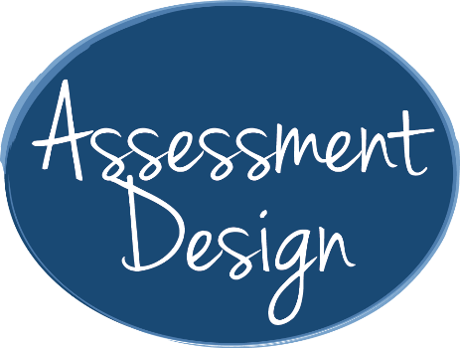


Five Elements of Assessment Design
Notes:
There are five elements of assessment design. Today we will be focusing on alignment and rigor.

Slide 12








Assessment Design: Alignment

Slide 13







Assessment Design: Alignment
Alignment: The degree to which the content of an assessment is aligned with the content of the standards you intend to measure and what you plan to teach in the classroom.
Notes:
Alignment is critical.
With alignment think of assessments as being in the middle of the continuum. They originate from the standard (what we want our students need to go), driving our instruction. This is referred to as backwards design.

Slide 14
Alignment: Unpacking the Standard
Does each assessment item align with the standard you intend to teach and measure?
Read the Standard.
RH.9-10.9: Compare and contrast treatments of the same topic in several primary and secondary sources.
Identify and clarify meanings of terminology used within the standard.
RH.9-10.9: Compare and contrast treatments of the same topic in several primary and secondary sources.
Nouns = content necessary, while verbs = what students need to do.
  Verbs = compare, contrast
  Nouns = treatments, “same topic,” “several sources” primary and “secondary”
Notes:
In order to see if an assessment is properly aligned we first need to unpack it.
Following the steps of unpacking a standard, we see that an understanding of both the nouns and verbs is critical.
How would you go about assessing this standard?

Slide 15
Alignment: Unpacking the Standard
Does each assessment item align with the standard you intend to teach and measure?
Standard
RH.9-10.9: Compare and contrast treatments of the same topic in several primary and secondary sources.
Instruction
Topic: Impeachment of Andrew Johnson
Utilize primary and secondary sources to teach students.
Assessment
“Was Andrew Johnson’s impeachment justified?” Venn Diagram and a Writing Response: Students responded which side had a more compelling argument supported by evidence from the documents.
Notes:
Point out that this sample reinforces comparison and contrast with the Venn Diagram portion as well as comparing treatments by having students write about their analysis.

Slide 16
Alignment: Unpacking the Standard
Activity: Turn and Talk
Work with a neighbor to unpack the standard below keeping in mind the following question:
Does the assessment item align with the standard you intend to teach and measure?
Part One:
Read the Standard.
CCSS. ELA-LITERACY RI.2.1: Ask and answer such questions as who, what, where, when, why, and how to demonstrate understanding of key details in a text.
Identify and clarify meanings of terminology used within the standard.
Nouns = content necessary
Verbs = what students need to do
Part Two:
Suggest an accurate method of assessment for this standard.

Slide 17
Alignment: Unpacking the Standard
CCSS. ELA-LITERACY RI.2.1: Ask and answer such questions as who, what, where, when, why, and how to demonstrate understanding of key details in a text.
Notes:
This slide makes the standard larger if showing to a large group.

Slide 18









Assessment Design: Rigor
Notes:
Here rigor is introduced.

Slide 19
Assessment Design: Rigor
Rigor: the cognitive complexity of a skill within a standard, assessment or assessment item.
An assessment has “an appropriate level of rigor” if…
  It includes items that match the level of rigor of the skill or skills you intend to measure.
  It measures a range of student thinking and understanding so that it can determine what all students know and can do.
Notes:
When defining rigor, remind participants rigor does not always equate to “cognitively complex.” Items do not have to be consistently cognitively complex to meet the rigor of a particular standard, it is that the assessment is aligned to the rigor of the standard. Rigor does not have always have to be high levels, just match what is being asked.

Slide 20
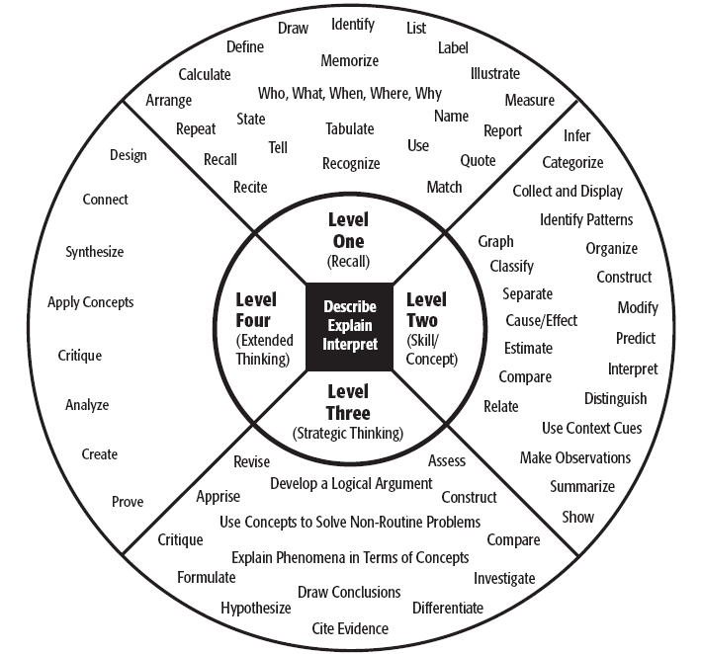








Understanding Rigor
Depth of Knowledge Wheel (DOK)
Bloom’s Taxonomy
Notes:
DOK: Depth of Knowledge represents the comparison of the cognitive demand of Standards and the cognitive demand of the Assessments given to determine their mastery.
Bloom’s Taxonomy is a classification system used to define and distinguish different levels of human cognition—i.e., thinking, learning, and understanding. Educators have typically used Bloom’s taxonomy to inform or guide the development of assessments (tests and other evaluations of student learning), curriculum (units, lessons, projects, and other learning activities), and instructional methods such as questioning strategies.
Today we will be focusing more on DOK.

Slide 21
Understanding Rigor (cont’d)
Understanding Levels of Thinking
Activity: Turn and Talk
Work with a neighbor to explain which level of the DOK wheel each activity represents and why it fits that level.
Choose two insects that you have observed and compare them.
Name a food group.
Create an in-depth character analysis, including textual and historical support for choices and perform said character.
Identify two examples when a fork would not be the right utensil to use and explain why.

Slide 22
Understanding Rigor (cont’d)
Understanding Levels of Thinking
Which level of the DOK wheel each activity represents and why it fits that level.
Choose two insects that you have observed and compare them.
Name a food group.
Create an in-depth character analysis, including textual and historical support for choices and perform said character.
Identify two examples when a fork would not be the right utensil to use and explain why.
Level 2: Basic Skills and Concepts
Level 1: Recall and Reproduction
Level 4: Extend Thinking
Level 3: Strategic Thinking and Reasoning

Slide 23
Understanding Rigor (cont’d)
Activity: Turn and Talk
Work with a neighbor.
  Determine the DOK level of rigor of these standards.
RH.9-10.9: Compare and contrast treatments of the same topic in several primary and secondary sources.
RI.2.1: Ask and answer such questions as who, what, where, when, why, and how to demonstrate understanding of key details in a text.

Slide 24
Prioritization of Standards
Determine the relative importance of the standard using the following criteria
How much time is spent teaching the standard?
Does the standard have value beyond the current course in:
  the next level of the subject,
  other academic disciplines, or
  life/college/career?
Notes:
Determining the importance of standards is critical in the SGO process. This is because you are not measuring every single standard. You are looking at measuring those key, most important standards. To do that you need to consider the following questions.
This will help you with curriculum writing, understanding what they should know coming in to be on the right path, and where they should be going for the next level of instruction. Prioritizing the standards you teach is important.
This activity can include all standards taught during the year or simplified by identifying only those standards likely to be taught during the SGO period. In some cases, educators may want to ensure that particularly critical standards are included within the SGO period enabling extra focus through the SGO process.

Slide 25
Determine Relative Importance of Standard for SGO Period*
Standard Name
CCSS.ELA-LITERACY.RL.5.4 Determine the meaning of words and phrases as they are used in a text
CCSS.ELA-LITERACY.RL.5.6 Describe how a narrator's or speaker's point of view influences how events are described
CCSS.ELA-LITERACY.RL.5.9 Compare and contrast stories in the same genre
CCSS.ELA-LITERACY.RL.5.2 Determine a theme of a story, drama, or poem from details in the text
Rank*
Rationale for Rank*
* Answers will vary based on many factors.
Notes:
There will be differences in opinion in this activity and variation will be based on the type of course you consider when teaching these standards, the starting points of students, priorities of the district, etc.
The point here is to have the conversation and work towards a shared understanding of teaching priorities that can then be reflected appropriately in the assessment.
In the end you need to have a common understanding of where you want to your students to go, because even though its your classroom, they will go to another teacher afterwards and will have come from someone else.
Remember, the standards exist beyond the individual teacher. That’s why it is critical for these things to be developed collectively.

Slide 26
Assessment Checklist
Notes:
Here are the five elements of assessment design. Take a look at the Assessment Checklist.
A good exercise to do would be to get together with colleagues, take a look at an assessment you have created or use, and consult this checklist to see how well it is constructed.

Slide 27
Innovative Approaches that Increase the Value of SGOs
SGO 2.1
Assessment Design
Collaboration
Integration
Innovation
Notes:
The second objective of today’s presentation is “Using more flexible, innovative approaches to increase the value of SGOs for teachers and students.”
This section discusses the innovative end of assessment design.

Slide 28
Use Assessment Approaches that Make Sense
Traditional Assessments | Portfolio Assessments | Performance Assessment
National/State tests (e.g., Advanced Placement, DIBELS, EOC Biology) District, school and departmental tests (e.g., final exams, modified as necessary) | Teaching Strategies Gold® (pre-K, K) Writing and reflection samples (LAL) Laboratory research notebook (sciences) Portfolio of student work (visual and performing arts, etc.) Student project-based assessments (all subjects) | Lab Practicum (sciences) Sight reading (music) Dramatic performance (drama) Skills demonstration (physical education) Persuasive speech (public speaking)
Notes:
When considering assessments for SGOs, teachers need to use the assessment approach that makes the most sense.

Slide 29
Performance Tasks and Portfolios
Performance tasks ask students to create products or perform tasks to show their mastery of particular skills.
Portfolios are a compilation of student work asking students or teachers to collect work products showing growth over a period of time.
Both use the “What-Who-How” Framework
What is the task? (written, physical, verbal, etc.)
Will students work individually or in groups?
How will you prescribe parameters of the task?
How will you time it?
How will you communicate precise directions?
What pieces will be included to demonstrate mastery of standards?
Who makes decisions about the work going in the portfolio?
How might you use things like project logs to stay organized?
How will you score individual components of the portfolio?
How will you score the portfolio as a whole?

Slide 30






Portfolio Assessments
Students or teachers collect student work products
Notes:
There is a module which goes deeper into portfolios.

Slide 31

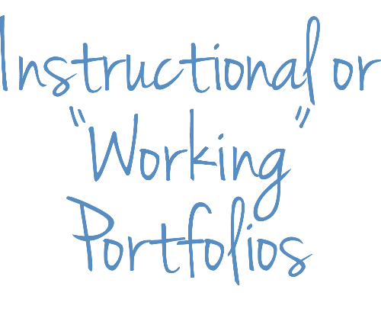


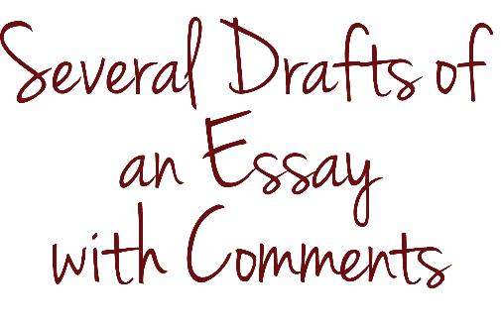




Types of Portfolio Assessments

Slide 32







Performance Tasks
Students create products or perform tasks to show their mastery of a particular skill
Notes:
There is a module that goes deeper into performance tasks.

Slide 33








Mr. Roosevelt’s Performance Task
Designing Performance Tasks
Written
Group
Parameters
Physical
Individual
Timing
Verbal
Communication
Visual

Slide 34
Collaborate to Improve Assessments
One or more educators (teachers and/or administrators) together can do the following:
  Unpack and prioritize standards
  Choose or develop an assessment (traditional, performance-based, or portfolio)
  Developed standards-aligned assessment items across disciplines
Notes:
The third objective of this presentation is that utilizing collaboration can improve the SGO process. The collaborative piece will be revisited during each step.

Slide 35
Suggested Next Steps and Self reflection in
Assessment Design
Review the Assessment Design modules.
Use the assessment checklist for existing assessments.
Build time into teacher’s schedule prior to 10/31 for assessment design.
Use a collaborative team structure to improve the process.
Keeping this in mind:
  What immediate improvements could be made to your (or the teachers you supervise) SGO summative assessment?

Slide 36
One Teacher’s SGO
Introducing Mr. Roosevelt
SGO:
  The assessment is a performance task in the form of a research paper analyzing the emergence of the modern welfare state and its influence on American society.
  Time period of the SGO takes the class from Reconstruction to the end of the Great Depression era.
We will follow Mr. Roosevelt through five steps of the SGO process.
Notes:
Throughout the presentation you will see Mr. Roosevelt. He is a fictional teacher, who teaches United States History 1. We will follow Mr. Roosevelt’s year.
This SGO follows a non-tested subject and grade level teacher. One who is traditionally a in a content driven subject, delivering an innovative SGO in the form of a performance-based assessment.

Slide 37
Mr. Roosevelt’s SGO: The First Three Steps
Step 1
Choose or develop a standards-aligned assessment
Step 2
Determine student starting points
Step 3
Set ambitious and achievable goals
Performance-based assessment
Collaborated
Notes:
We have already seen the type of assessment Mr. Roosevelt is giving; we will NOW LOOK AT Steps 2 and 3 of the SGO process and Mr. Roosevelt’s SGO.

Slide 38
  Step 2: Determining Student Starting Points
Teacher must determine what the most useful data is and how to use it for determining the starting points of his or her students.
  This is can be improved through collaboration.
Choose appropriate sources of information to gauge student preparedness:
  Current grades
  Recent test performance
  Previous year’s scores
  High quality diagnostic pre-assessment
  Important markers of future success

Slide 39
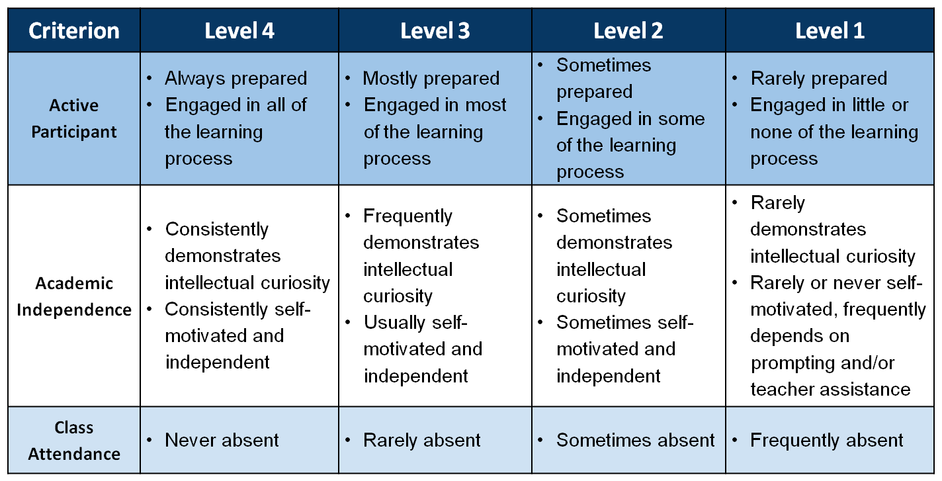
  Sample Rubric for Important Markers of Future Success
Notes:
Here is a selection of potential sources of data.
Markers of future success can be used as one measure of starting points. This can be modified by districts as needed.
See Resource Packet - Sample Rubric for Important Markers of Success http://www.state.nj.us/education/AchieveNJ/teacher/SGOQualityRatingRubric.pdf

Slide 40
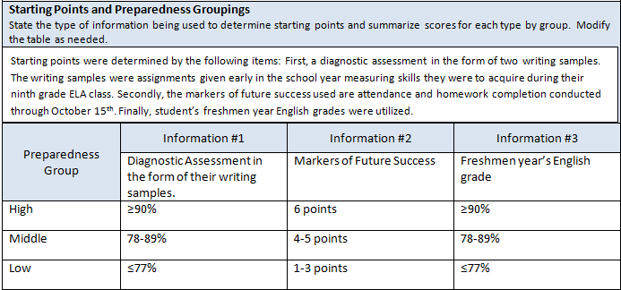
Step 2: Determine Student Starting Points
Notes:
Here is what Mr. Roosevelt used.
Ultimately, along with his team, collectively they determined “what the most useful data was and how to use it for determining the starting points of his students.”

Slide 41
Collaborate to Improve the Determining of Starting Points
One or more educators (teachers and/or administrators) together can do the following:
  Share information about students from previous year in determining starting points.
  Collect and compile relevant data points.
  Once set, discuss student starting points for feedback.

Slide 42
Step 3: Set Ambitious and Achievable SGOs
Best Practices:
Collaborate with your peers and supervisor to enhance SGO value to teachers and students.
Use knowledge of the students, standards, and SGO assessment to develop a vision for student mastery of the standards.
When setting goals, differentiate targets for students based on their relative starting points.

Slide 43
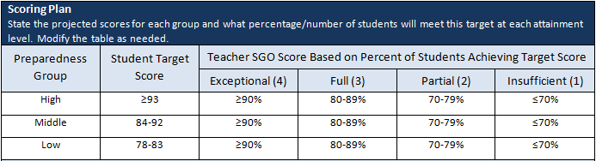
Step 3: Mr. Roosevelt’s Scoring Plan
Using knowledge of the students, standards, and SGO assessment, agree upon a vision for student mastery of the standards you have selected for your SGO.
Notes:
Here is what Mr. Roosevelt used.

Slide 44
Collaborate to Set Improved Scoring Plans
One or more educators (teachers and/or administrators) together can do the following:
  Discuss goal setting (between teacher and co-teacher, mentor, instructional coaches, team members, or administrator).
  Share SGOs for feedback and review.

Slide 45
Mr. Roosevelt’s SGO: Moving into Step Four
Step 1
Choose or develop a standards-aligned assessment
Step 2
Use multiple measures to determine starting points
Step 3
Set learning targets
Step 4
Track progress and refine instruction
Used writing samples, markers of future success and grades
Collaborated
Set differentiated learning targets
Collaborated
Performance-based assessment
Collaborated

Slide 46
Integrating SGOs into the Typical Cycle of
Teaching and Learning
In what ways can student learning be improved by using SGOs as a tool to enhance and inform teaching?
SGO 2.1
Assessment Design
Collaboration
Integration
Innovation
The importance of monitoring cycles
The four purposes of assessment
Using assessment data to inform instruction
The importance of step four
Notes:
This is the fourth objective of today’s training. In this part of the training we will go through the following four items. The supporting theme here is integration.

Slide 47
The Typical School Year
Unit
Lessons
Unit
Lessons
Assessments
Unit
Lessons
Assessments
Assessments
Step 2
Step 4
September November April June
Step 1
Step 3
Step 5
Notes:
Here is the typical school year a teacher engages in.
Units are made up of lessons and assessments. These units fall within the SGO time frame making them an integral part of the entire SGO process.

Slide 48
Monitoring Cycles
A process by which teachers…
Plan – Develop curriculum, instruction, and assessments
Implement – Teach
Collect – Gather indicators of student progress
Analyze – Identify trends, patterns, and misconceptions; decide what needs more reinforcement or re-teaching
Plan – Refine the plan based on analysis of the data
Plan
Implement
Analyze
Collect
Notes:
Discuss through this process what teachers typically do.
Plan: Teachers plan for the academic year so that their students will be able to learn all the required standards. They plan what each instructional unit will look like as well as those for the week and each day. In addition, they plan what types of assessments they should give and when they should give them. The plans that teachers develop are informed by what they have learned from their work in previous years as well as what happened that day in class.
Implement the Plan: In the teacher’s world, implementation is teaching. Teachers follow their short and long-term plans throughout the year, adjusting as needed based on their students’ needs.
Collect Data: To evaluate how their students are progressing, teachers assess their students continually. They collect information from question and answer sessions, during cooperative group work, through exit tickets, in analyzing homework, on unit tests and quizzes, and in many other ways. These forms of assessment all provide evidence that lets a teacher know whether her plans are resulting in the desired outcomes for her students.
Analyze Data: Teachers analyze the data they collect from their students to find patterns that can help inform and improve their instruction and various supports they provide their students. When appropriate, this analysis may lead to changes in the plan of how and what the teacher teaches, completing the cycle. This data leads to a refining of the plan moving forward.

Slide 49
What Do Monitoring Cycles Look Like?
Plan – Develop curriculum, instruction, and assessments
Impeachment of Andrew Johnson
Implement – Teach
Utilize primary and secondary sources
Collect – Gather indicators of student progress
Venn Diagram and writing
Analyze – Identify trends, patterns, and misconceptions; decide what needs more reinforcement or re-teaching
Students struggled to compare treatments of the same topic
Plan – Incorporate into future lesson plans the revisiting of the skill where it makes sense
Provide more practice on comparing treatments of the same topic
Plan
Implement
Analyze
Collect
Notes:
This is a reference to one of Mr. Roosevelt’s monitoring cycles. This is in reference to the alignment example on slide 15.

Slide 50
Short-Cycle Monitoring
  Plan - Align instruction and assessments into short-cycle assessments.
  Implement - Use teaching strategies and assessments to monitor along the way.
  Collect - Use a variety of techniques to frequently collect data.
  Analyze – Analyze the data.
  Plan - Adjust instruction based on the needs shown in the data.
Plan
Implement
Analyze
Collect
Group work, class work and homework, question and answer sessions, weekly spelling quiz, science lab, etc.
Notes:
When these monitoring cycles happen during daily lessons, they can be referred to as short cycle assessments.

Slide 51
Mr. Roosevelt’s Short–Cycle Monitoring Example
Standard
RH.9-10.9: Compare and contrast treatments of the same topic in several primary and secondary sources.
Instruction
Topic: Impeachment of Andrew Johnson
Utilize primary and secondary sources to teach students.
Assessment
“Was Andrew Johnson’s impeachment justified?” Venn Diagram and a Writing Response: Students responded which side had a more compelling argument supported by evidence from the documents.
Notes:
Mr. Roosevelt’s short cycle assessment.

Slide 52
Developing Monitoring Cycles
Short-Cycle Monitoring:
Measure in smaller chunks of time how well students are progressing towards growth on the overall set of standards.
Occur within longer cycles using a wider variety of formative assessment techniques.
Long-Cycle Monitoring
Are longer periods of instruction covering larger sets of standards.
Plan
Plan
Implement
Implement
Plan
Implement
Analyze
Analyze
Analyze
Collect
Collect
Collect
Notes:
These short cycle assessments (daily lessons, Q&A sessions, etc.) are part of longer groups of standards being taught. These checkpoints are part of a longer cycle of monitoring.
While short-cycle assessments occur within longer cycles using a wider variety of formative assessment techniques, long-cycle checkpoints are longer periods of instruction covering larger sets of standards,
Think of these as unit tests for example.
What are chapter tests or unit tests? They are an assessment of a lot standards that go together.

Slide 53
Long-Cycle Monitoring
  Plan - Identify groups of standards students need to learn. Develop an assessment.
  Implement - Teach the standards.
  Collect - Administer the assessment to check understanding of these standards.
  Analyze - Identify which standards are mastered and which may need more practice.
  Plan – Incorporate into future lesson plans skills/content needing more practice where it makes sense.
Plan
Implement
Analyze
Collect
Unit test, project
Notes:
Think of this monitoring cycle like a test or longer project.

Slide 54
Mr. Roosevelt’s Long-Cycle Monitoring Example
Standards
6.1.12.A.5.b; RH.9-10.6; RH 9-10.1; RH.9-10.8; WHST.9-10.9
Instruction
Unit: The Industrial Era
Utilized various teaching strategies and assessments throughout the unit
Assessment
The Industrial Era Unit Test
Notes:
Here is one of Mr. Roosevelt’s long-cycle checkpoints.

Slide 55
Long and Short Cycles
Plan
Plan
Implement
Implement
Long-Cycle: Reconstruction Era Unit
Short- Cycle:
Impeachment
Lesson
Analyze
Analyze
Collect
Collect
Notes:
This slide shows the relationship between the two.

Slide 56
Step 4: Monitoring Performance and Adjusting Instruction
Step Four
Long-Cycles
Short-Cycles
Short-Cycle Monitoring
End of Year Assessment (or assessment period)
Long-Cycle Monitoring
Step One: Choose or develop an assessment based on standards.
Step Two: Determine student starting points.
Step Three: Set an ambitious but achievable SGO.
Step Five: Review results and score.
Notes:
1. These cycles, occurring within the SGO time period, are what constitute step 4.

Slide 57
The Purposes of Assessment
Diagnostic Assessment
Formative Assessment
Interim Assessment
Summative Assessment
The Purposes of Assessment
Notes:
All assessments serve a specific purpose.
Show the *Purposes of Assessment” module (Video number 3) clip. Show the first 2:30 of the video.

Slide 58
The Purposes of Assessment
Diagnostic Assessment: Used to determine students’ knowledge and skills before a unit of instruction.
Formative Assessment: Used to monitor student learning and adjust ongoing instruction.
Interim Assessment: Measure students’ knowledge and skills on a specific set of academic goals, typically within a particular time frame.
Summative Assessment: Measure student mastery of standards at the end of a unit of instruction.
What place might each purpose of assessment have in the SGO process?

Slide 59
Assessments in the SGO Process
Step Four
Long-Cycles
Short-Cycles
Short-Cycle Assessment
Formative Assessments
End of Year Assessment (or assessment period)
Summative Assessment
Step One: Choose or develop an assessment based on standards.
Step Two: Determine student starting points. Diagnostic Assessment
Step Three: Set an ambitious but achievable SGO.
Long-Cycle Checkpoint
Interim Assessments
Step Five: Review results and score.
Notes:
Here we see the different purposes assessments can serve during the SGO process.

Slide 60
A Selection of Assessments Mr. Roosevelt Used in Monitoring Student Growth During His SGO
Diagnostic
Writing assignments to help determine starting points
Formative
Exit tickets
Writing samples
Primary source analysis
Interim
Unit tests
Summative
Research paper
Notes:
“Let’s see what types of assessments Mr. R. is using.”
Here I will show Mr. Roosevelt’s tie ins briefly describing how each type of assessment fits what he needs it to do.
I will emphasize the fact that everything is being done with purpose.
Reiterate here multiple measures: Diagnostic is one measure. The carpenter adage fits here, “measure twice, cut once…”

Slide 61








Using Assessment Data to Inform Instruction
Notes:
Restart the “The Purposes of Assessment” module at 2:30. Here they reiterate how the different purposes of assessment can be used in different ways. Play until 3:15.

Slide 62
Using Short-Cycle Data to Inform Instruction
Plan
Implement
Short- Cycle
Analyze
Collect
Standards
RH.9-10.9: Compare and contrast treatments of the same topic in several primary and secondary sources.
Assessment and Analysis
Venn Diagram and writing: “Was Andrew Johnson’s impeachment justified?”
Upon analysis many students were not using relevant information from multiple sources to support their view.
Plan and Implement
Mr. Roosevelt adjusted his planning moving forward implementing a greater focus on this standard towards the end of this unit and subsequent ones.
Notes:
Here is that alignment example. Again. Slightly different flavor (point out different categories and go over it).
Look what he does at the end; here is that extra planning step. It’s formative. Informing him moving forward. If the kids aced it across the board, he might still provide extra practice, but if not and it went the other way, instruction will look very different.
Standards:
RH.9-10.9: Compare and contrast treatments of the same topic in several primary and secondary sources.
Assessment and Analysis
Warm up: “Was Andrew Johnson’s impeachment justified?”
Upon analysis many students were not using relevant information from multiple sources to support their view.
Plan and Implement
Mr. Roosevelt adjusted his planning moving forward implementing a greater focus on this standard towards the end of this unit and subsequent ones, as the comparison of the treatments of historical events is something which can occur often in a secondary history class.

Slide 63
Using Long–Cycle Data to Inform Instruction
Plan
Implement
Long-Cycle
Analyze
Collect
Standards
6.1.12.A.5.b; RH.9-10.6; RH 9-10.1; RH.9-10.8; WHST.9-10.9
Assessment and Analysis
The Industrial Era Unit Test
WHST.9-10.9 and RH 9-10.1 showed students of all ability levels needed more support in.
Plan and Implement
Short-cycle assessments for the upcoming unit were refined to incorporate more practice on these key standards.
Notes:
Here is a long-cycle one. Just because it’s a unit test does not mean we close the book and move on to completely fresh and new material.

Slide 64
Mr. Roosevelt’s Assessments
Step Four
Long-Cycles
Short-Cycles
Short-Cycle Monitoring
Andrew Johnson Impeachment Venn Diagram and Writing Assignment
End of Year Collected research
papers
Long-Cycle Monitoring: The Industrial Era Unit Test
Step One: Choose or develop an assessment based on standards.
Step Two: Determine student starting points. (Gathered writing samples)
Step Three: Set an ambitious but achievable SGO.
Step Five: Review results and score.
Long-Cycle Monitoring: Progressivism Unit Test
Long-Cycle Monitoring:
The Era of Reconstruction Unit Test
Notes:
I will discuss this slide the data Mr. R. uses to inform instruction along the way
Once again, here is our chart with assessment examples. Take a moment, take it in.
Take to minutes to discuss your understanding of this with a neighbor.
Any further clarifying questions need answering?

Slide 65
Collaborate to Improve SGO Integration
One or more educators (teachers and/or administrators) together can do the following:
  Weigh in on strategies to support SGO attainment
    Include instruction, differentiation, assessment, and enrichment.
  Use team meetings to seek help with particular challenges and difficult cases, such as students performing way below grade level, or new strategies for teaching complex content.
  Analyze class assessment data, sharing refined instructional plans with teams for feedback.

Slide 66
Next Steps and Self Reflection on the Integration of Step 4
“Beginning with the end in mind” ask the following question:
  “What should my students learn by when?”
Choose or develop a quality assessment
Develop a series of long-cycle checkpoints
Develop a series of short-cycle assessments within those long-cycle checkpoints
Use a collaborative team structure to help improve the process.
Keeping this in mind:
  What immediate improvements could be made toward a greater integration of this step in the process?

Slide 67
Mr. Roosevelt’s SGO: the Final Step
Step 1
Choose or develop a standards-aligned assessment
Step 2
Use multiple measures to determine starting points
Step 3
Set learning targets
Step 4
Track progress and refine instruction
Step 5
Review results and score the SGO
Performance-based assessment
Collaborated
Used writing samples, markers of future success and grades
Collaborated
Set differentiated learning targets
Collaborated
Used monitoring cycle data to inform instruction
Collaborated

Slide 68
Step 5: Review Results and Score
Mr. Roosevelt collected information about student learning from the SGO assessment and calculate his SGO score according to the scoring plan.
He consulted with his supervisor to share his information, discussing his final score.
Together, they discussed lessons learned from the year and possible steps for setting SGOs moving forward.

Slide 69
Step 5: Review Results and Score (cont’d)
Review SGO at Annual Conference Describe successes and challenges, lessons learned from SGO about teaching and student learning, and steps to improve SGOs for next year.
The greatest success from this year’s SGO occurred while I was tracking progress. During the unit on Progressivism, assessment data showed many of my students having trouble grasping the concepts of laws and their relationship to the benefit of the social welfare of the people. In addition, from the first writing sample throughout much of the year this group struggled with the causational relationship of some laws and events to others (CCSS.ELA-LITERACY.RH.9-10.3). Because of the data revealing this, I was able to adjust my instruction and content analysis accordingly.
Notes:
Mr. Roosevelt’s reflection on his SGO.

Slide 70
Step 5: Review Results and Score (cont’d)
Results of Student Growth Objective Summarize results using weighted average as appropriate. Delete and add columns and rows as needed.
Prepared-ness Group | Students at Target Score | Teacher SGO Score | Weight (based on students per group) | Weighted Score | Total Teacher SGO Score
High | 6/7 | 3 | .15 | .45 | 3.13
Middle | 20/22 | 4 | .49 | 1.96
Low | 12/16 | 2 | .36 | .72
Notes:
How Mr. Roosevelt scored his SGO.

Slide 71
Mr. Roosevelt’s SGO
Step Four: Tracked progress and refined instruction along the way
Long-Cycles
Short-Cycles
Short-Cycle Monitoring
End of Year Collected research
papers
Step One: With colleagues developed items and scoring rubric for research paper
Step Two: Gathered writing samples, previous year’s ELA grades, etc. to determine starting points
Step Three: Collaborated in setting SGO goal
Long-Cycle Monitoring: The Industrial Era Unit Test
Step Five: Review results and score
Long-Cycle Monitoring: Progressivism Unit Test
Long-Cycle Monitoring:
The Era of Reconstruction Unit Test
Notes:
1. One final, final look at the SGO, highlighting each step we have gone through.

Slide 72
Collaboration and Student Achievement
“The powerful collaboration that characterizes professional learning communities is a systematic process in which teachers work together to analyze and improve their classroom practice. Teachers work in teams, engaging in an ongoing cycle of questions that promote deep team learning. This process, in turn, leads to higher levels of student achievement.”
Richard DuFour , 2004

Slide 73
Collaboration and Student Achievement
SGO 2.1
Assessment Design
Collaboration
Integration
Innovation
Professional Learning : A comprehensive, sustained, intensive, and collaborative approach to improving teachers’ and principals’ effectiveness in raising student achievement.
Notes:
The connection between collaboration and student achievement highlights the importance of professional learning throughout the process.

Slide 74
SGOs and Collaboration
Step One
Unpack & prioritize standards
Step Two
Review results with supervisor
Step Three
Step Four
Weigh in on strategies to support SGO attainment
Step Five
Choose or develop an assessment
Develop assessment items across disciplines
Share information vertically in determining starting points.
Goal setting can be discussed between teacher and co-teacher, mentor, instructional coaches, team members, or administrator.
SGOs, once developed, can be shared within teams for feedback and review.
Teachers and co-teachers can collect and compile data together.
Once set, discuss student starting points with other team members.
Use team meetings to seek help with challenges and difficult cases
Analyze class assessment data, sharing refined instructional plans with teams for feedback.
Consider results in planning the SGO for next year with colleagues

Slide 75
Self-Reflection: Collaborative Teams
Keeping in mind that collaboration with colleagues is a critical component in helping the SGO process, consider the following questions:
  For you (or the teachers you supervise), which of the five steps of the SGO process has collaboration been a regular part of?
  Which of the five steps could you immediately see embedding a collaborative structure right away?
  Which of the five steps would embedding a collaborative structure be more difficult to accomplish?

Slide 76
Possible Next Steps
Take your own self-evaluation back to your district, analyze it, and develop a plan of action based on where your district currently is and where you could feasibly be for the next year and beyond.
Share information from this workshop with all members of your DEAC and develop a strategy for developing higher quality assessments and SGOs throughout the district.
Review the materials from this workshop and plan the time and method for delivering to staff in a PD session.
Watch the Assessment Design modules and plan the time to rollout to your staff to assist with assessment development.
Build in time during collaborative team time for assessment development.
Activity Handout

Slide 77
Thank You
Questions or Feedback?
  Office of Evaluation
educatorevaluation@doe.state.nj.us
(609) 777-3788

