Slide 1
Essex County College EOF
Career Clinic
Report Summary

Slide 2
Summary
The EOF Career Clinic (CC) was a six week program funded by a special program grant from OSHE/EOF in response to an RFP in early spring, 2017 semester. The CC provided Essex EOF students with the opportunity to delve into future careers options.
Career Day Site Visit

Slide 3
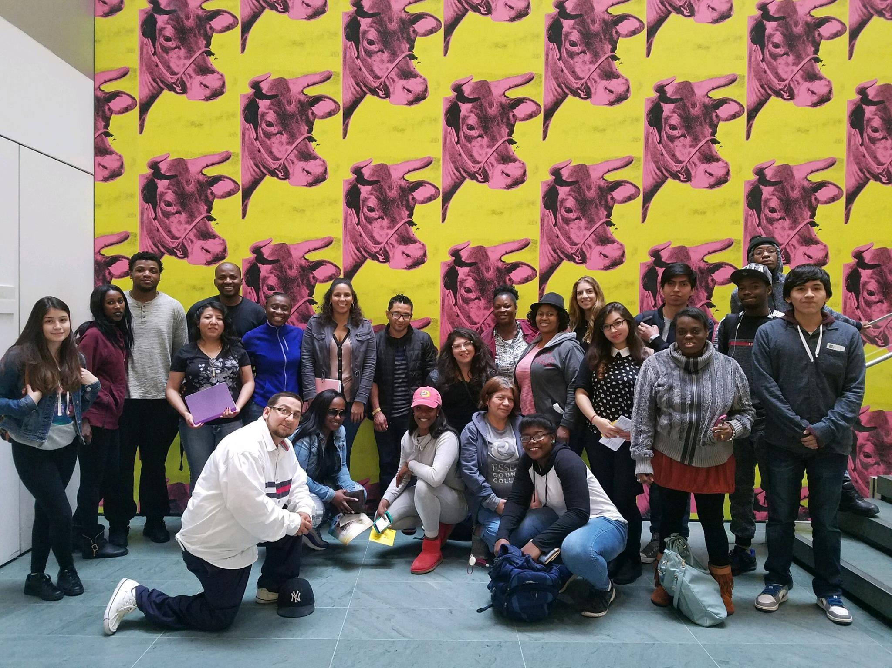
Mission
The Career Clinic‘s mission is to instruct EOF students in the skills critical to making career and educational decisions. The aim is to help them meet personal goals and to lift them out of poverty.
Career Day Site Visit

Slide 4
Target Population / Institutional Context
Essex had recently dissolved the office that offered specialized career services.
Large program – approx. 1,200 EOF students.
While open to all EOF students, we created specialized communication blasts for liberal arts and undeclared majors for ‚‘‘super sophomores‘‘ (those who stay an extra semester/year), sophomores, and freshman students.

Slide 5
Overview & Engagement
One on One Sessions.
Career Corner - Printed articles, job industry forecast reports, career assessments.
Workshops and experiential learning activities.
Online demos of resources and tools via email and social.
Individual sessions: 87 students
Group sessions: 250 students (workshops & community meeetings)

Slide 6
Survey Results
QUESTION 1
I gained a better understanding of self in regard to identifying career options.
4.71 / 5
QUESTION 2
I was able to identify specific careers that match my personality and interest.
4.62 / 5
Question 3
I was able to discover effective strategies to obtain internships and employment.
4.38 / 5
Question 4
I was assisted with learning how to effectively write a resume and/ or cover letter
3.62 / 5
Question 5
I was assisted with learning how to effectively interview
3.79 / 5
Question 6
Overall I am very satisfied with the help I received today.
4.94 / 5

Slide 7
Recommendations
Forms/surveys should be drafted carefully to collect data for other pertinent EOF data we might find important (e.g. How often do you see your EOF counselor?)
Better planning / time management of workshops for more evaluations of workshops to be collected.
Better design of table space for “grab and go” resources for students who are passing through but elect not to get one on one services.
Evening events and student outreach via email, phone calls and class visits
Rotate workshops between morning/afternoon and evenings
Video recording of presentations to share with all students via email and social media.

Slide 8
Misc.
Survey questions slightly adapted from The National Association of Colleges and Employers Sample Student Survey (www.naceweb.org).

