Slide 1


2026 USDA Specialty Crop Block Grant (SCBG)
Tuesday, April 28th, 2026 – Program Info-Session
Hosted by: Billy Conners, NJDA

Slide 2
Agenda
Introduction Video
Program Overview
Eligibility Requirements
Project Types and Examples
Application Process
Q&A

Slide 3
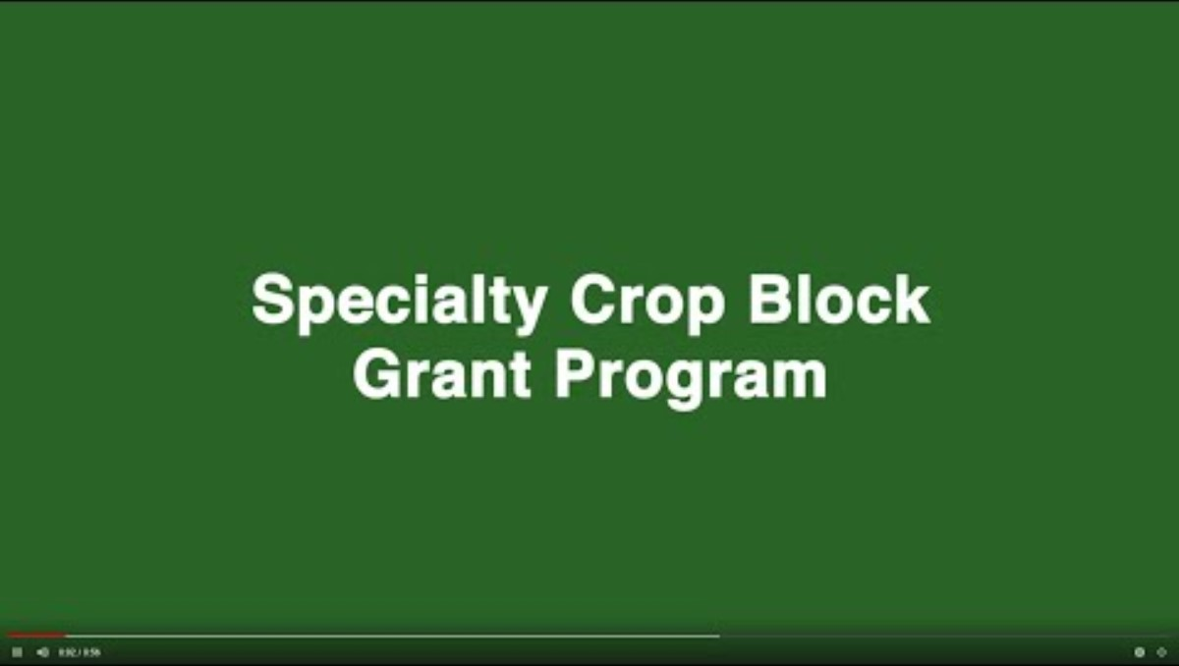
USDA Introduction

Slide 4
Program Overview
The purpose of the Specialty Crop Block Grant Program (SCBGP) is to fund projects that enhance the competitiveness of specialty crops.
Projects can request up to $40,000 for grant expenditures on personnel and fringe benefits, travel, equipment, supplies, contractual and other SCBG-allowable costs.

Slide 5
SCBG Eligibility

Slide 6
Eligibility – Applicant Organizations
Producer Groups or Collectives
Trade Associations
Non-Profits
Universities or Colleges

Slide 7
Eligibility – Agricultural Products
For the purposes of this grant, USDA defines “Specialty Crops” as:
  Fruits and vegetables, tree nuts, dried fruits, horticulture, and nursery crops (including floriculture).
  Eligible plants must be cultivated or managed and used by people for food, medicinal purposes, and/or aesthetic gratification to be considered specialty crops.
  Processed products shall consist of greater than 50% of the specialty crop by weight, exclusive of added water.

Slide 8
Eligibility – Project Types
Education, Marketing and Promotion: Leveraging efforts to market and promote specialty crops;
Research and Development: Assisting producers with research and development relevant to specialty crops;
Expanding availability and access to specialty crops.
Addressing local, regional, and national challenges confronting specialty crop producers; and/or
For such other purposes determined to be appropriate by the Secretary of Agriculture, in consultation with specialty crop stakeholders and relevant State departments of agriculture.

Slide 9
Eligibility – Project Examples
Enhancing food safety
Improving the capacity of all entities in the specialty crop distribution chain to comply with the requirements of the Food Safety Modernization Act (21 U.S.C. Chapter 27)
Investing in specialty crop research, including research to focus on conservation and environmental outcomes;
Developing new and improved seed varieties and specialty crops;
Pest and disease control;
Increasing child and adult nutrition knowledge and consumption of specialty crops;
Improving efficiency and reducing costs of distribution systems

Slide 10
Eligibility – Project Examples
Examples of Acceptable Projects:
  A non-profit organization requests funds to demonstrate the viability of organic small fruit production and partners with Cooperative Extension to publicize the working model of diversification to other regional growers.
  A producer collective or group implements food safety practices or models on the farm to meet food safety requirements and conducts a field day and training services to encourage other small family farmers to adopt the methods.
Examples of Unacceptable Projects:
  A farm requests grant funds to purchase starter plants or equipment used to plant, cultivate, and grow a specialty crop to make a profit or to expand production of a single business or organization.
  A single specialty crop organization requests grant funds to market its organization so that it can increase its membership.

Slide 11
SCBG Application Form + Submission

Slide 12
Application Materials
Specialty Crop Block Grant - Request for Proposals (RFP) - NJDA
Specialty Crop Block Grant - Notice of Funding Opportunity (NOFO) - USDA-AMS
USDA Agricultural Marketing Service General Terms and Conditions
SimpliGov Application Link – Online Application Form
SCBG Guide to Performance Measures – A “How-To” for Outcomes/Indicators

Slide 13
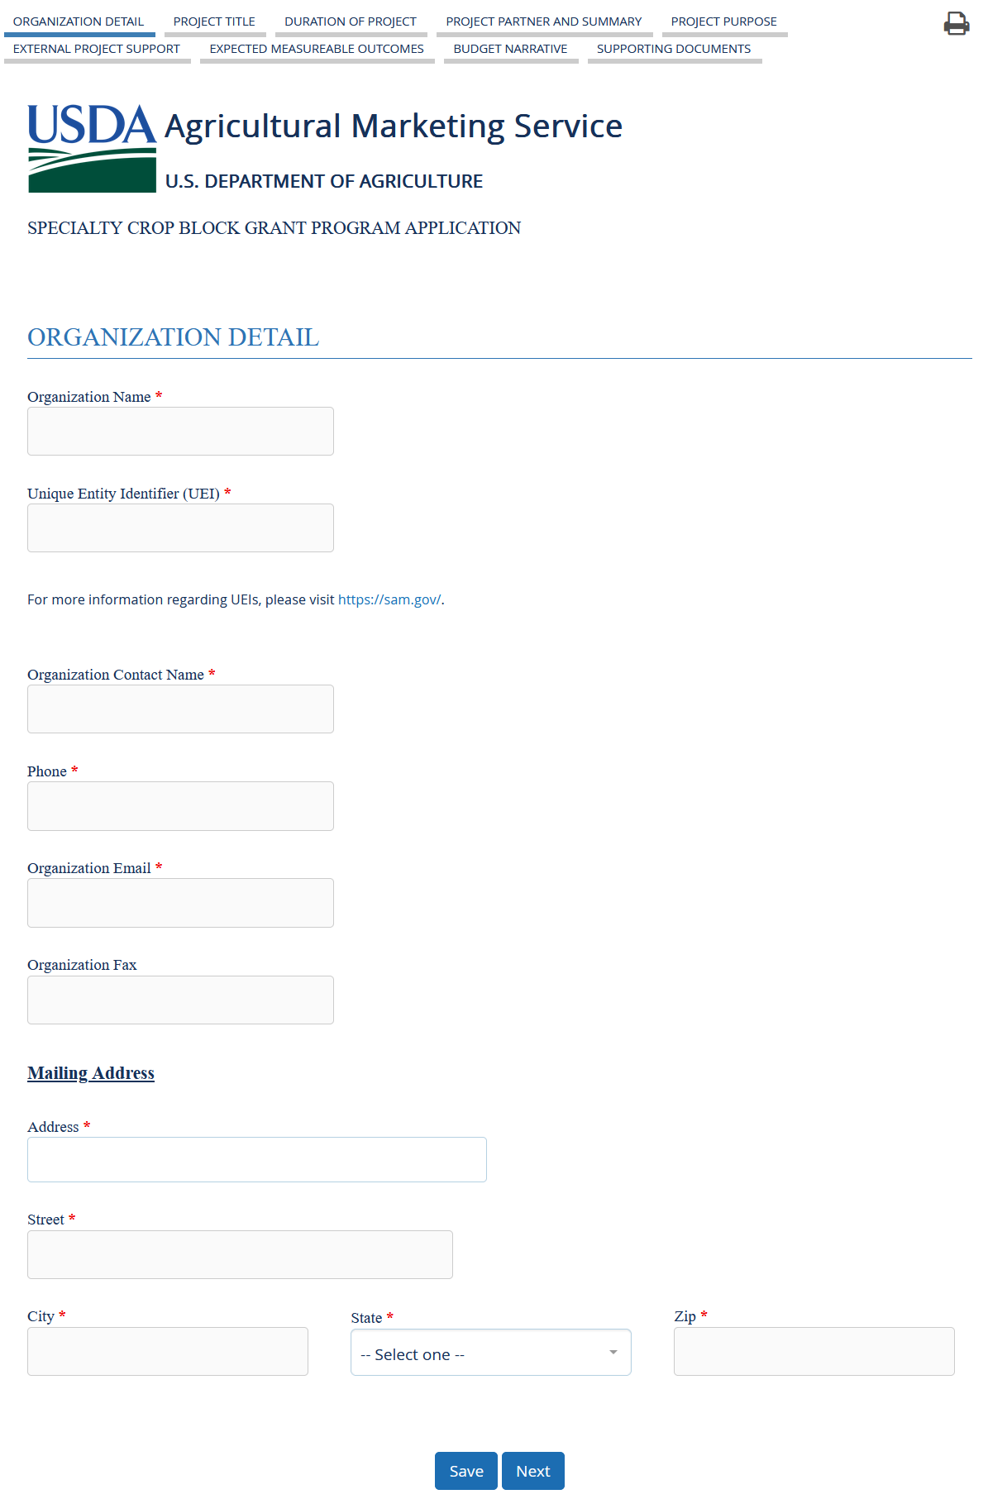
SimpliGov Application - Overview
Application Section Tabs (clickable)
Form Sections (fillable)
Navigation Buttons

Slide 14
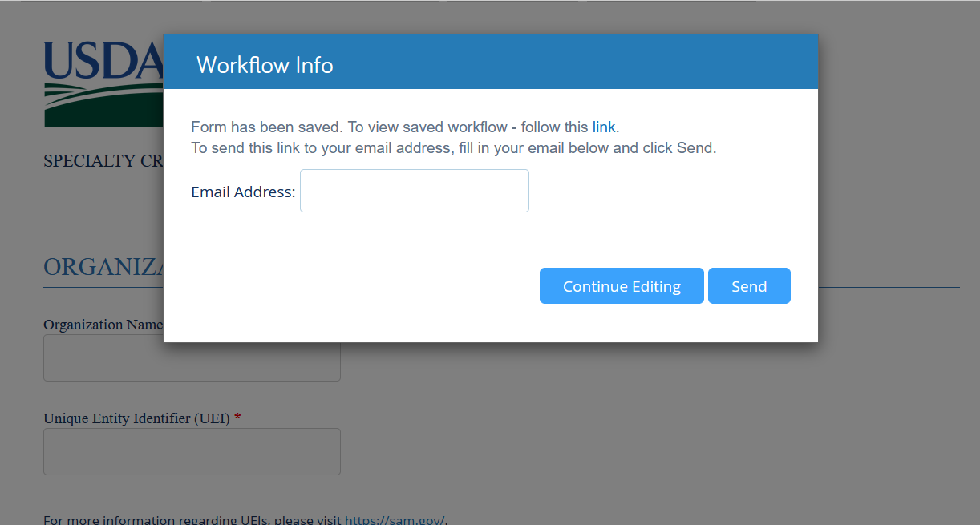
How to: Save your Application
Click “Save”.
Enter your email address in the prompt box.
Click “Send”
An email with a link to your saved application will be sent to the provided address. From there, you can reopen your application and continue work.

Slide 15
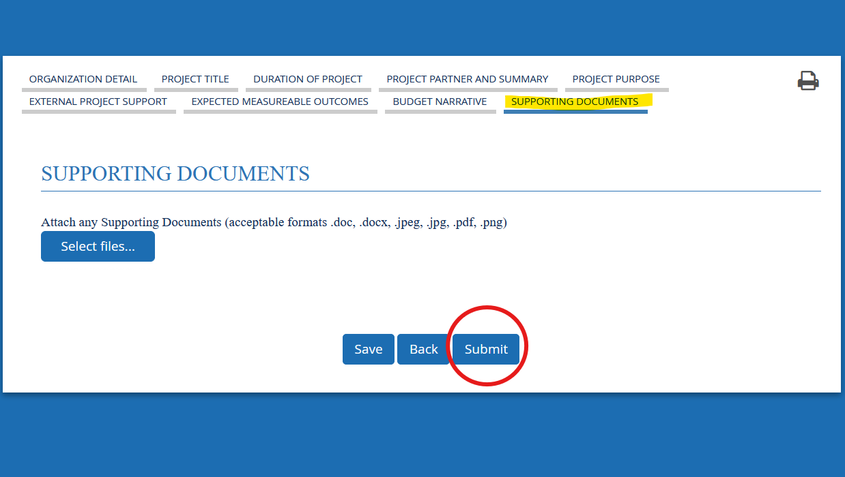
How to: Submit your Application
Go to: Supporting Documents tab
Click “Submit”
You should receive an email confirmation from SimpliGov within 24 hours. If you do not receive an email, please let me know!

Slide 16
Application Deadline
All applications are due through SimpliGov no later than May 14th, 2026 at 5:00pm.
Confirmation of receipt of your submission will be returned to you within 24 hours.
If you do not receive confirmation, please reach out to william.conners@ag.nj.gov to ensure proper submission.

Slide 17
Questions?
Please use the Q&A function to ask your question or type it in the Teams Chat.

