Slide 1



NJ Farm to School Procurement Initiative
​​Funding Overview + Office Hours

Slide 2
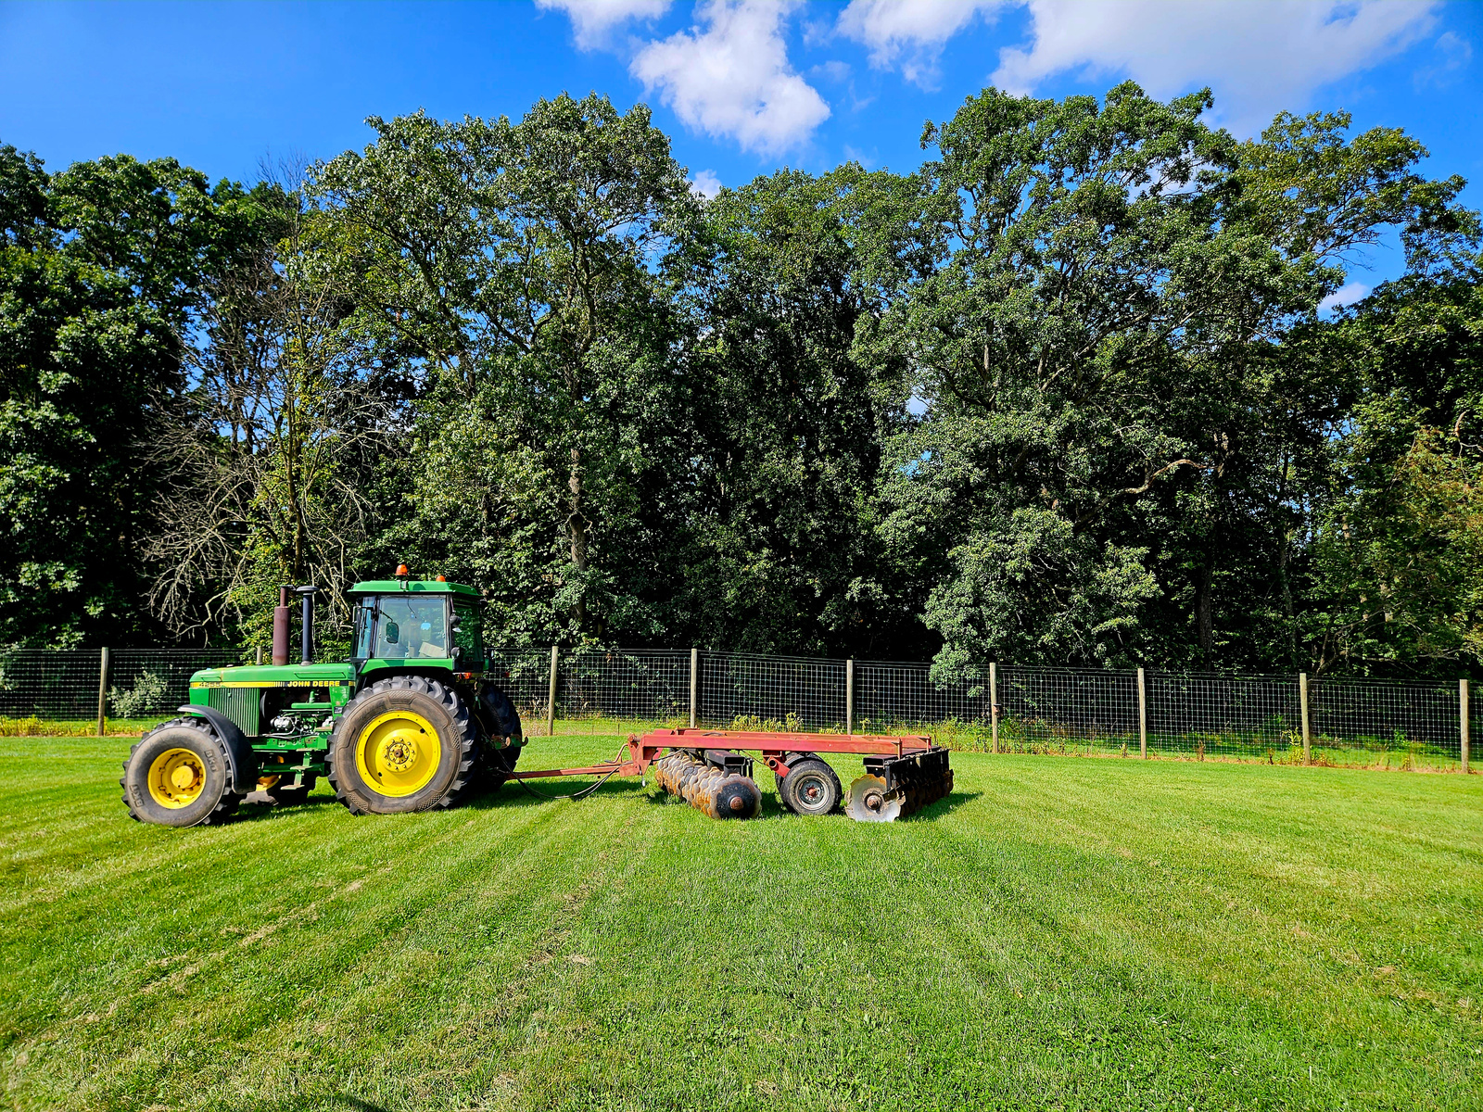
PURPOSE OF TODAY
Review NJF2SPI
Clarify eligible purchases
Walk through documentation expectations
Share optional resources to support purchasing
Open Q&A
Please put questions in the chat!
We’ll answer during the Q&A Portion

Slide 3
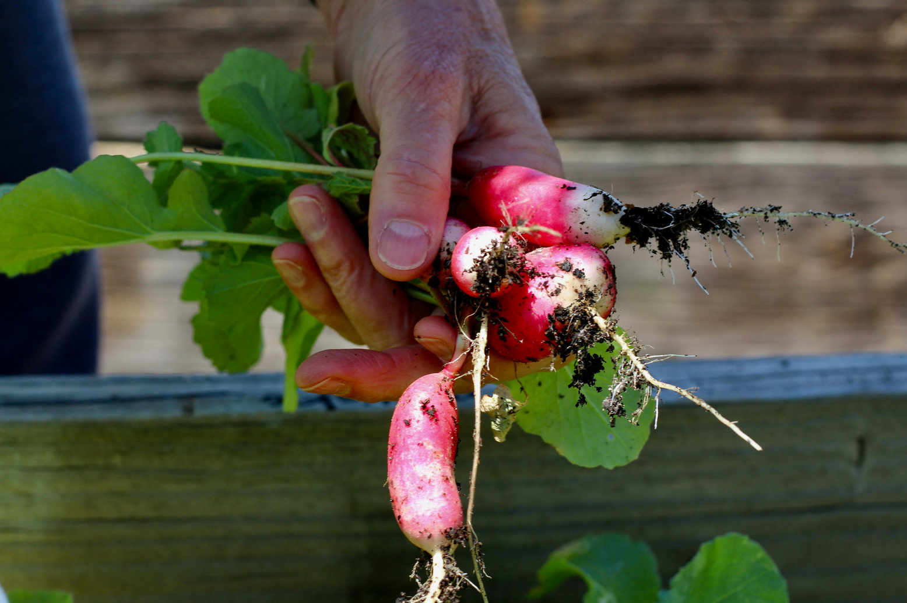
WHAT IS NJ FARM TO SCHOOL
PROCUREMENT INIATIVE?
State-funded reimbursement program
Supports schools purchasing NJ grown foods
Goals:
  Increase local procurement
  Support NJ farmers
  Improve access to local foods in school

Slide 4

RECIPIENT ELIGIBILTY
Participate in NSLP Food Distribution
Must:
  Submit the “Guidelines and Attestation for Participation” form to
    NJDAF2SPI@ag.nj.gov
  Deadline for submission - April 1, 2026

Slide 5

WHAT IS ELIGIBLE FOR FUNDING?
Foods must be:
NJ-grown or raised
Unprocessed or minimally processed
Used in:
School meal programs
Notes:
Slide 4 – What is Eligible for Funding
Foods must be:
NJ-grown or produced
Unprocessed or minimally processed
Used in:
School meal programs

Slide 6
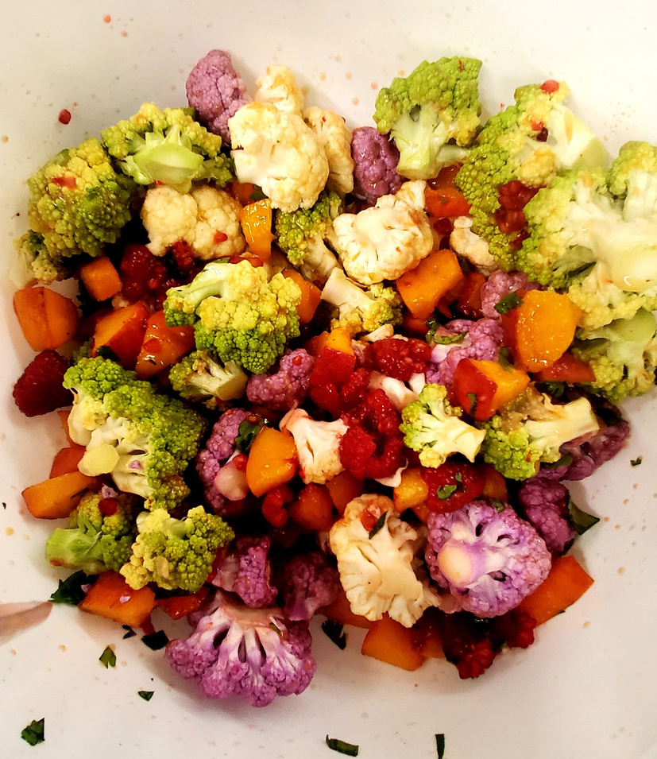
CORE REQUIREMENT
Schools must purchase:
  Unprocessed/minimally processed foods
From:
  A farmer/producer (direct purchase)
OR
  A food distributor/vendor
Both options are allowable and can be used together
Notes:
Slide 5 – Core Requirement (Key Takeaway)
Schools must purchase:
Unprocessed/minimally processed foods
From:
A farmer/producer (direct purchase)
OR
A food distributor/vendor
👉 This determines reimbursement eligibility

Slide 7




What is NOT eligible:
  Processed or heavily processed foods
  Products without clear NJ origin
  Purchases that cannot be verified
  Products of mixed origin
Notes:
Slide 6 – What is NOT Eligible
Processed or heavily processed foods
Products without clear NJ origin
Purchases that cannot be verified

Slide 8

DOCUMENTATION REQUIREMENTS:
  To receive reimbursement:
    Itemized invoices required
  Must include:
    Product details
    Farm/source identified
  Records must be maintained for review
Notes:
Slide 7 – Documentation Requirements
To receive reimbursement:
Itemized invoices required
Must include:
Product details
Farm/source identified
Records must be maintained for review

Slide 9
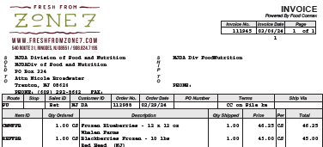


Slide 10


CRITICAL COMPLIANCE REMINDER
All purchases are reviewed
Invoices must clearly show:
  NJ product
  Farm/source
Missing information may result in denied reimbursement
Notes:
Slide 8 – Critical Compliance Reminder
All purchases are reviewed
Invoices must clearly show:
NJ product
Farm/source
👉 Missing information may result in denied reimbursement

Slide 11
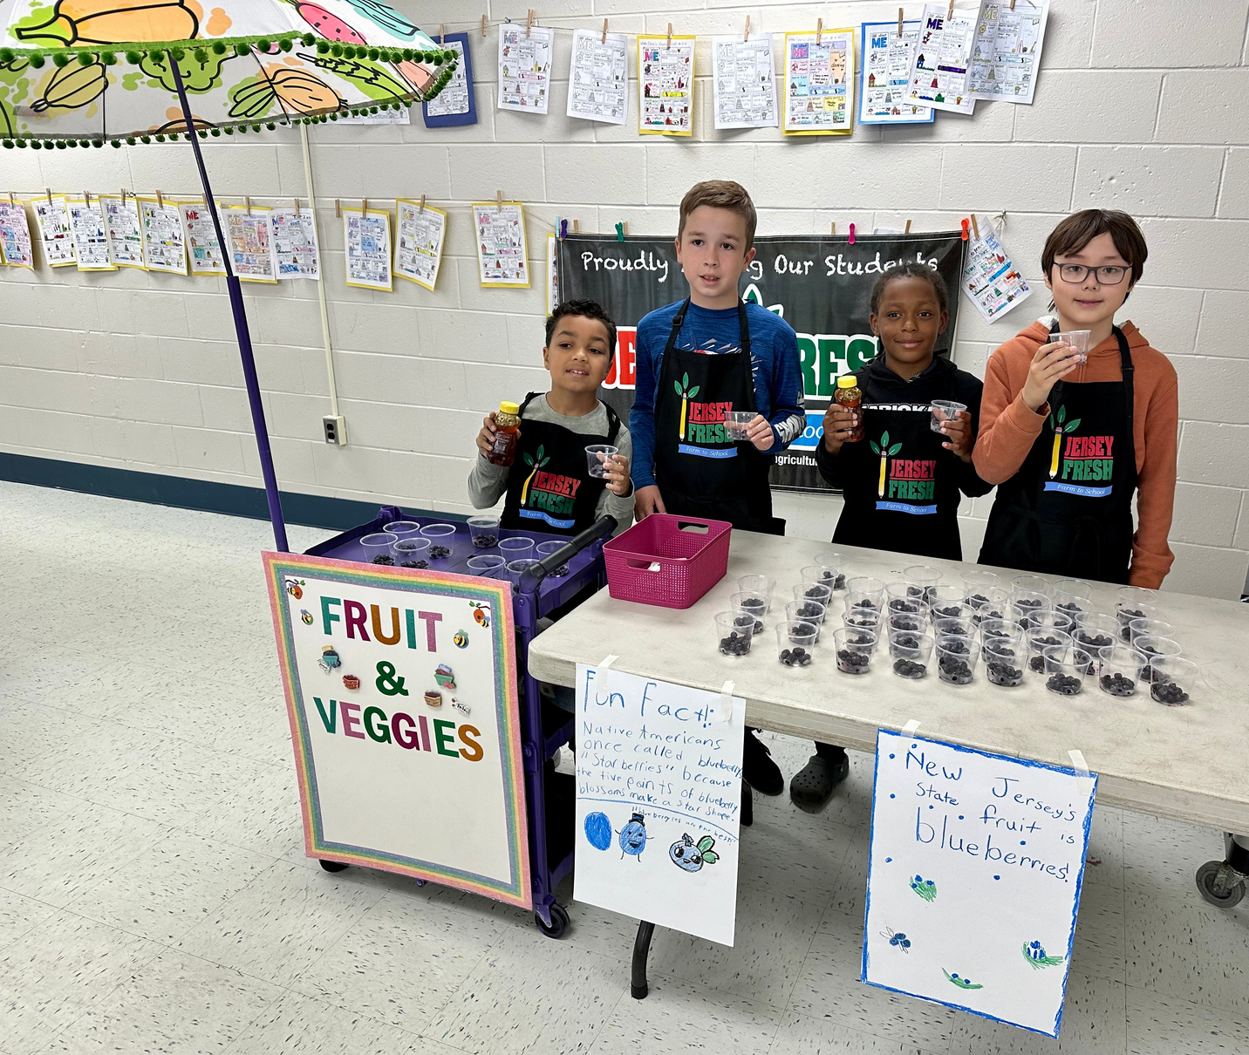

WORKING WITH VENDORS
Ask:
Is this product NJ-grown?
Can the farm be listed on invoices?
What products are available and when?
What are delivery options and minimums?
Notes:
Slide 11 – Working with Vendors
Ask:
Is the product NJ-grown?
Can the farm be listed on invoices?
What products are available and when?
What are delivery options?

Slide 12
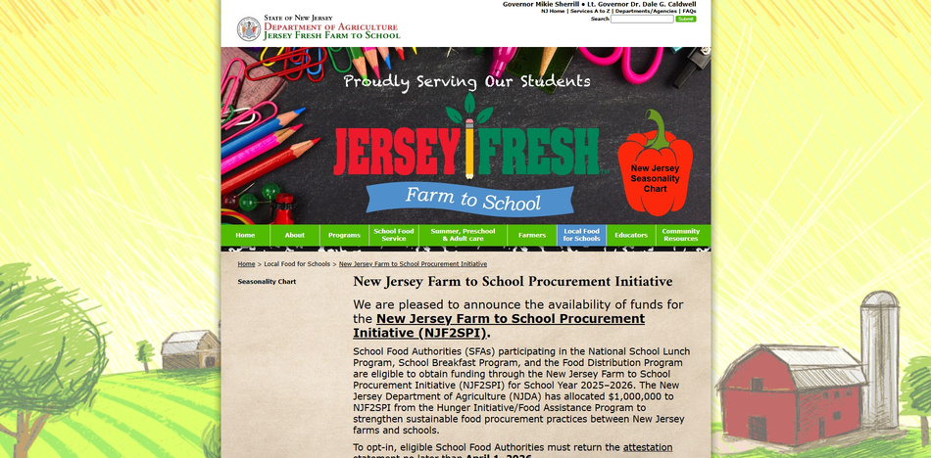


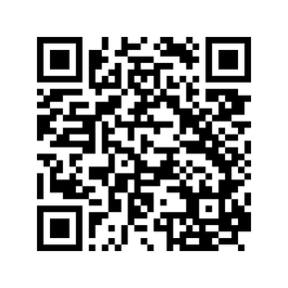
SUPPORTING RESOURCES (Optional Tools)
To help identify vendors and farms:
Food Distributor Resource List
  vendors familar with the NJF2SPI
  offer delivery
Local Farm Directory
  farms organized by county
  farms have requested to be listed and are interested in selling to schools
These resources are optional tools and not required
Notes:
Slide 12 – Supporting Resources (Optional Tools)
To help identify vendors and farms:
Food Distributor Resource List
Vendors familiar with NJF2SPI requirements
Local Farm Directory
Farms organized by county
Farms have requested to be listed and are interested in selling to schools
👉 These are optional tools to support compliant purchasing

Slide 13

COMMON ERRORS
Missing farm name on invoice
Purchasing non-compliant foods such as co-mingled products
Not confirming NJ sourcing
Delaying ordering
Notes:
Slide 13 – Common Pitfalls
Missing farm name on invoice
Purchasing non-compliant foods
Not confirming NJ sourcing
Waiting too long to plan

Slide 14

KEY TAKEWAYS
Must be:
  NJ-grown
  Unprocessed/minimally processed
  Farm/source
Must document:
  Farm/source on invoice
  Documentation = reimbursement
Notes:
Slide 14 – Key Takeaways
Must be:
NJ-grown
Unprocessed/minimally processed
Must document:
Farm/source on invoice
👉 Documentation = reimbursement

Slide 15

ASK A QUESTION
Please write in the chat or raise your hand!
Notes:
Slide 15 – Open Q&A

Slide 16
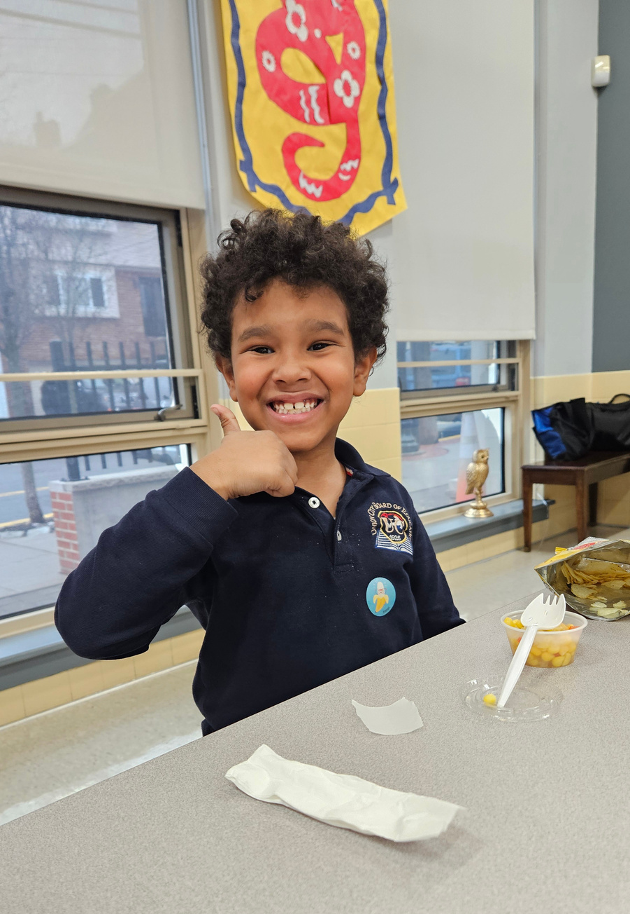

THANK YOU!
CONTACT:
Denise Liptak
NJDAF2SPI@ag.nj.gov
Nicole Broadwater
Nicole.Broadwater@ag.nj.gov

