Slide 1

Bayside State Prison and Southern State Correctional Facility
Air Permitting
Public Information Session – July 12, 2022

Slide 2
On September 22, 2021 NJDEP Commissioner Shawn LaTourette issued Administrative Order AO-2021-25 which allows overburdened communities to participate in open discussion and comment on proposed projects within their community at qualifying facilities within the community.
Maurice River Township in Cumberland County, New Jersey has been classified as an “overburdened community” where the community is either 40 percent lower economic level, 35 percent minority population and/or 35 percent limited English Proficiency.

Slide 3
The qualifying facility under AO-2021-25 is the Bayside State Prison and Southern State Correctional Facility which operate under the New Jersey Department of Corrections and are located in Maurice River Township.
The prisons which are neighboring properties fits the category that they operate under a Title V Operating Permit which is a major source for Air Pollutants.

Slide 4
Bayside State Prison which opened in 1970 which contains prison cells and operational areas including license plate production and making bakery goods.
Southern State Correctional Facility which neighbors Bayside State Prison opened in 1983 with dormitory style cells and has farming areas where inmates work.

Slide 5
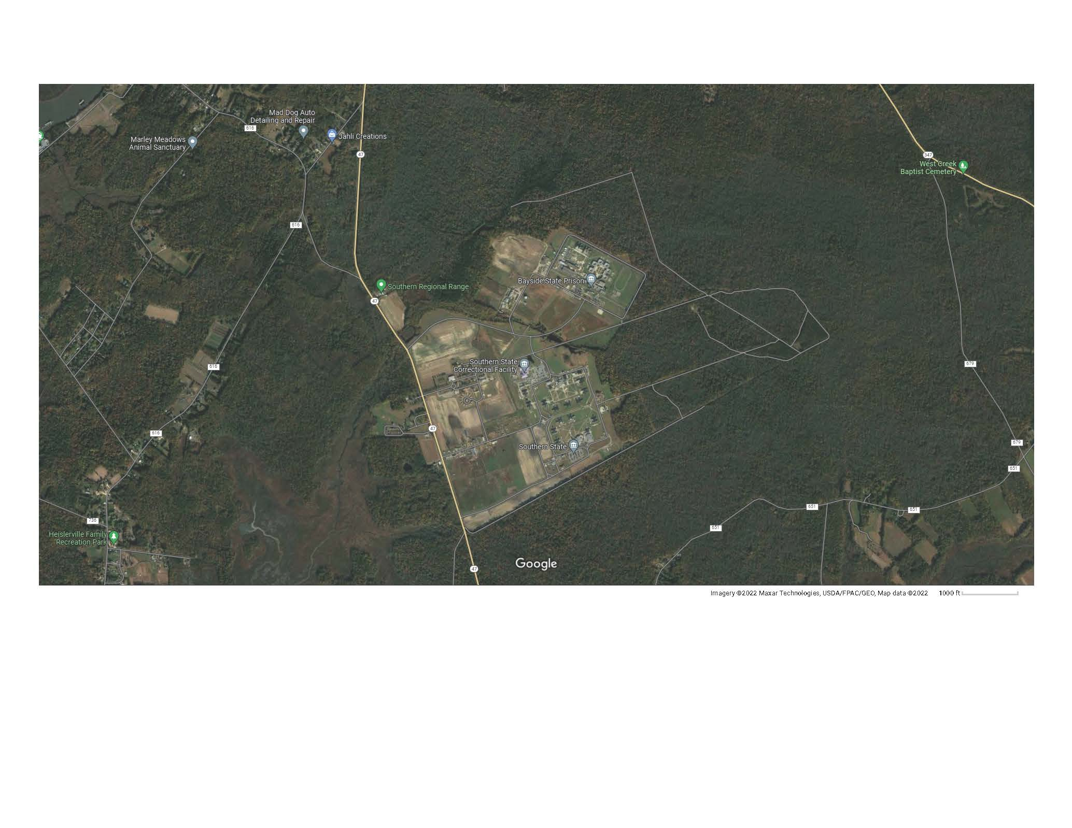

Slide 6
Bayside State Prison and Southern State Correctional facility currently has a Title V Operating Permit which is a facility wide permit due to the potential to emit of Oxides of Nitrogen (NOx) exceeding the annual threshold level of 25 tons per year from all sources from the facilities.
The Title V Operating Permit is currently being renewed and a Draft Permit for the renewal is

Slide 7
Administrative Order AO-2021-25 requires that any proposed permit along with facility upgrade projects requires a 60 day public comment period for approval which includes a Public Information session given to the overburdened community.
The public notice for the Title V Operating Permit renewal has been issued on June 13, 2022 with the Public Information Session being on July 12, 2022.
The Public Comment period will conclude on August 12, 2022 and all comments and responses will made of public record.

Slide 8
Bayside State Prison and Southern State Correctional Facility currently operates under a Title V Operating Permit which is a facility wide permit monitoring air emissions.
The Title V Operating Permit monitors all emission sources at the site which are designated as significant and insignificant sources.
Significant sources are the following:
Two main boilers at the Power Plant at Bayside burning natural gas and No. 2 Fuel Oil.
Five additional boilers servicing buildings throughout both campuses.
Eleven emergency generators servicing both campuses.
Bakery area with bread mixers, cake mixers, proof boxes and three ovens.

Slide 9
A 2,000 gallon and a 6,000 gallon gasoline storage tank located at each campus.
A license plate processing facility the provides a press, 4 ink lines and a dryer.
The permit also covers insignificant sources including diesel fuel storage, small boilers, gas ovens and grills and a wastewater treatment facility.

Slide 10
Also the Title V Operating Permit is being renewed. The renewal application was submitted on July 24, 2020.
After the Public Comment Period based upon AO-2021-25, if no changes result in the permit renewal, the permit will be finalized around November.
The renewed Title V permit will be for 5 years.

Slide 11
Annual Compliance Measures for Title V Operating Permit include:
Annual Emission Statement
Semi-Annual Compliance Reports
Combustion Adjustment Reports for Boilers greater than 5 Million BTU/hour.
Semi-annual sulfur content reporting for fuel oil and diesel used.

