Slide 1
National Emergency Response Information System
February 2025

Slide 2
Legacy System NFIRS
1985
2025
NFIRS Begins
NFIRS 5.0
America Burning released in 1973 lead to the establishments of USFA in 1974 with the Federal Fire Prevention and Control Act in 1974. NFIRS launches in 1975.
NFIRS becomes an “all-hazard” data collection system with the addition of EMS data, wildfire data, and juvenile firesetter module.
NFIRS 4.0
Sunsetting NFIRS
First public release of NFIRS collected data.
Driven by security concerns, outdated data models, and costs in maintaining code base, at the start of calendar year 2026, NFIRS will sunset, and decommissioning will begin.
1975
1999

Slide 3
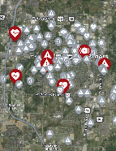
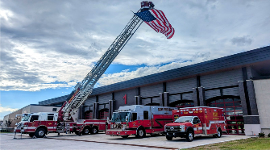
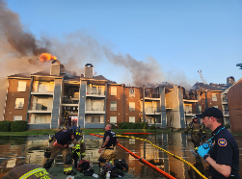
The Road Here
Things that haven’t changed in the fire service over the past 25 years:
  Our legacy Incident Reporting System, NFIRS
Things that have changed in the fire service over the past 25 years:
  Bunker Gear & PPE
  Mission / Incident Types
  Apparatus and Equipment
  Communications
  Tactics and Strategies
  The workforce
  Training
  Available Technology

Slide 4

The goal of NERIS is to empower the local fire and emergency services community by equipping them with near real-time information and analytic tools that support data informed decision-making for enhanced preparedness and response to incidents involving all hazards.

Slide 5

Core Functionality
Secure, highly scalable, cloud-hosted open solutions architecture.
Interoperable, standards-based data model and data governance.
Built on location-services, harnessing the power of geospatial science.
Public, open-sourced data schemas and API infrastructure for maximum, appropriate data sharing.
Publicly available NERIS data dictionary.
Integration of best available, relevant external data for enhanced intelligence.
Achieves operational efficiencies by reducing data
entry burdens on firefighters via integration of data from:
  Computer-aided dispatch systems (CAD)
  Records Management Systems (RMS)

Slide 6
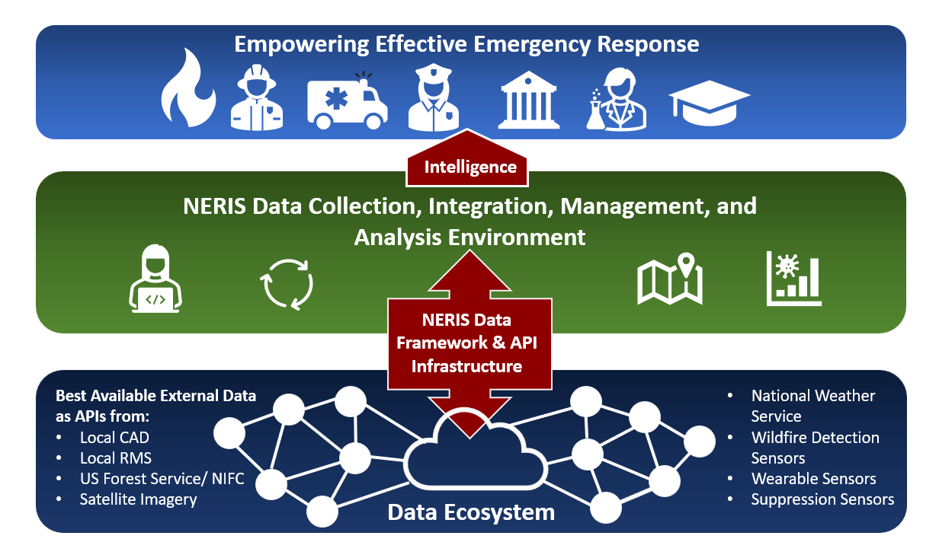
Interconnected Intelligence
Powered by the National Emergency Response Information System (NERIS)

Slide 7
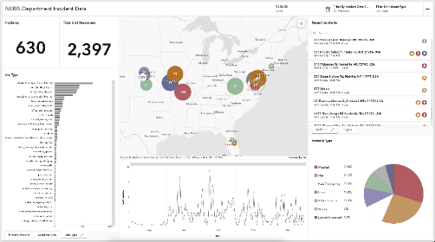
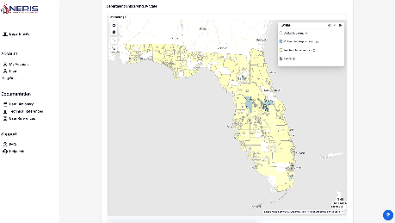
NERIS Fast Facts
Firefighter-first design
Improved data quality, reliability, and accuracy
Near real time, fully geospatial data
Highly flexible, relying on data integration from best available sources for better intelligence
All-hazards: All incidents local fire & EMS responds to
Streamlined and efficient data collection, data sharing, and analytics
Insights on emerging threats and hazards
Agile, development keeping pace with evolving needs, science, and technology advancements

Slide 8
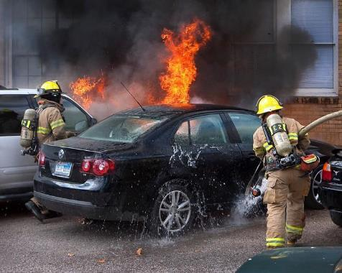
What Improvements will NERIS Offer?
Enhanced Flexibility with Multi-Hazard Incident Reporting
Comprehensive Reporting: Move from a single-category system to a model supporting up to three incident types. This reflects the complexity often faced by fire services in real-world scenarios.
For Firefighters: Simplify reporting by selecting incident types that accurately depict the scene, eliminating the guesswork of single-category constraints.
For Chiefs/Data Analysts: Reduce reliance on interpreting free-text narratives, streamlining data analysis.
NFIRS historically limited incident type selection to only one incident type,
whereas NERIS allows multiple types per incident.

Slide 9
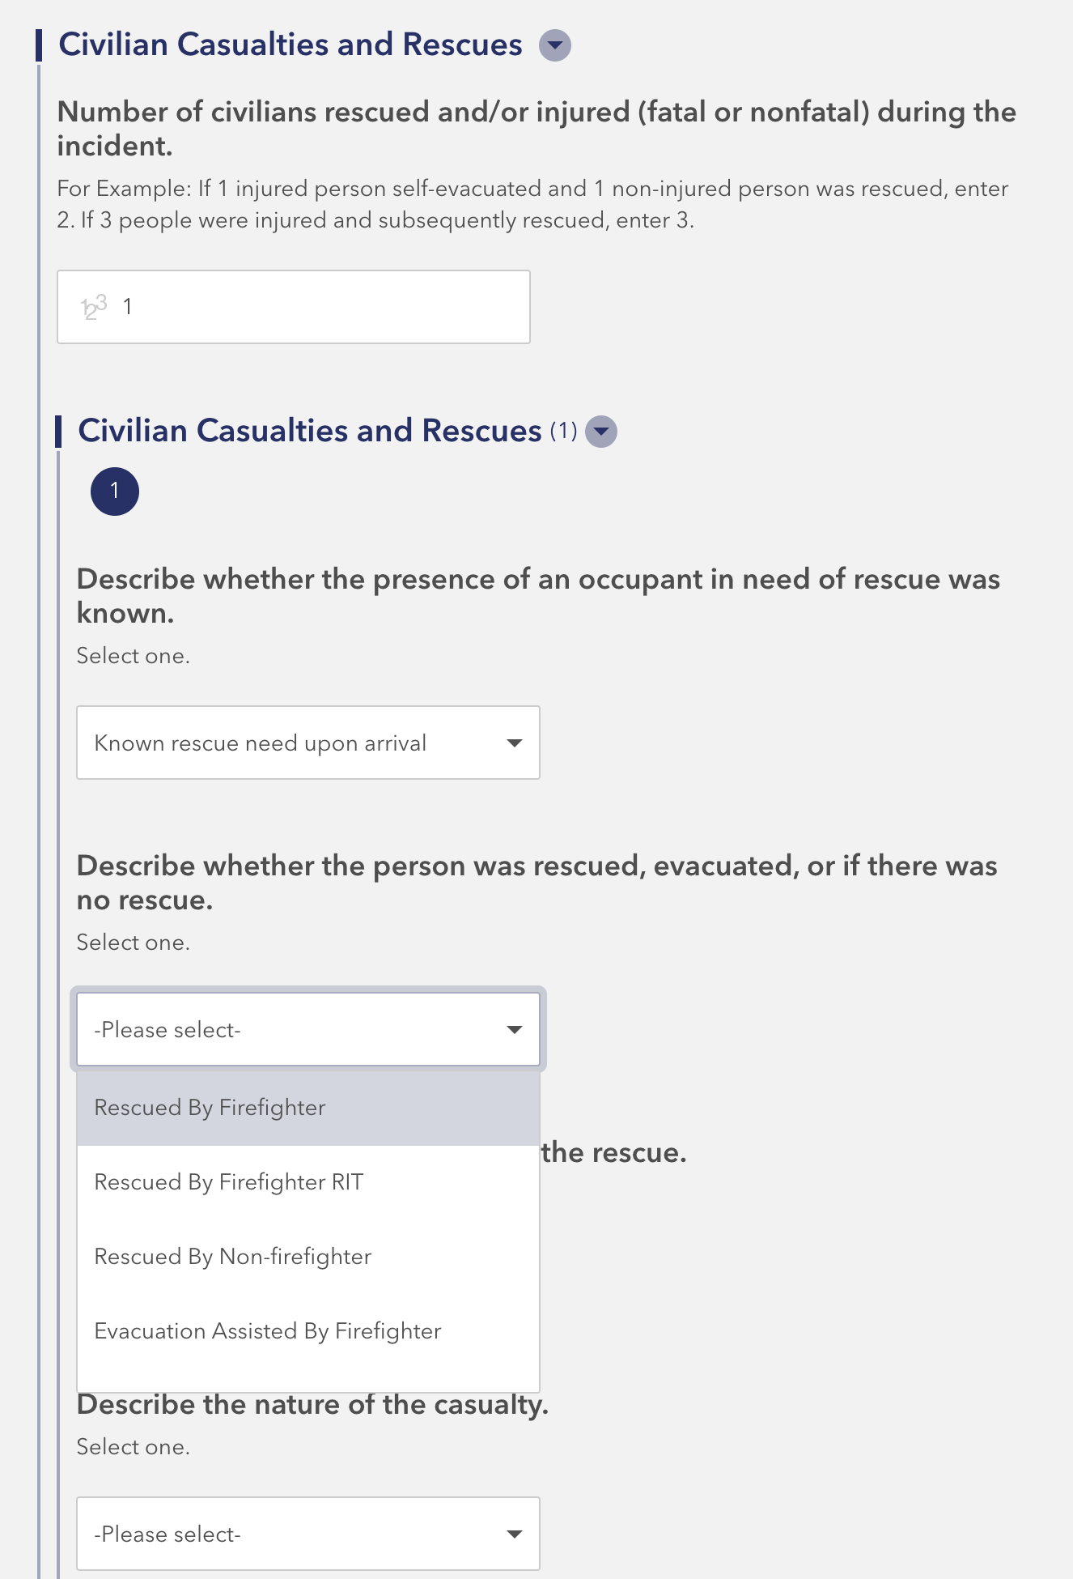
What Improvements
will NERIS Offer?
Enhanced Reporting for Actions, Tactics, and Incident Outcomes
Actions and Tactics: Modernized to capture comprehensive operational data including suppression techniques, ventilation efforts, and on-scene contamination reduction tactics.
Metrics on Rescues, Casualties, and Maydays: Detailed tracking of key metrics reflecting the vital efforts of firefighters during emergency responses.

Slide 10
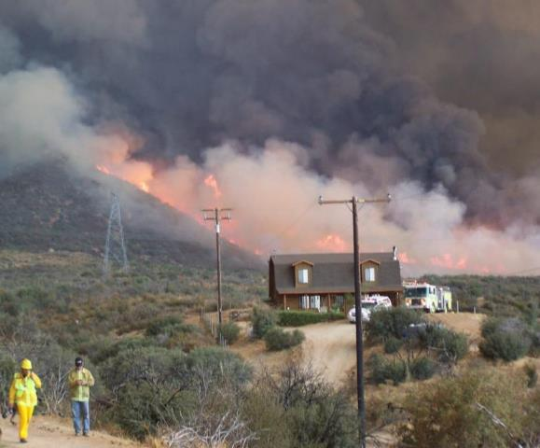
What Improvements
will NERIS Offer?
Enhanced Emerging Hazards and Structure Exposures:
Emerging Hazards: This module will enable the system to evolve to the dynamic environments we operate in, enabling data collection of evolving threats.
Structure Exposures: Entered as a straightforward addition to the original incident report, streamlining entry even in complex scenarios like urban conflagrations and the wildland-urban interface. This will reduce report completion time and improve accuracy on complex fire incidents.

Slide 11




The Focus of NERIS
- Social Vulnerability
- Structures in First Due
- Code Adoption
- Evolving & emerging hazards
- Resource Allocation
- Monitor Staffing Levels
- Station & Unit Capacity
- Geographic areas of concern
- Response Time
- Effective Crew Size & Response Force
- Inform Training Needs
RISK
DEPLOYMENT
PERFORMANCE

Slide 12
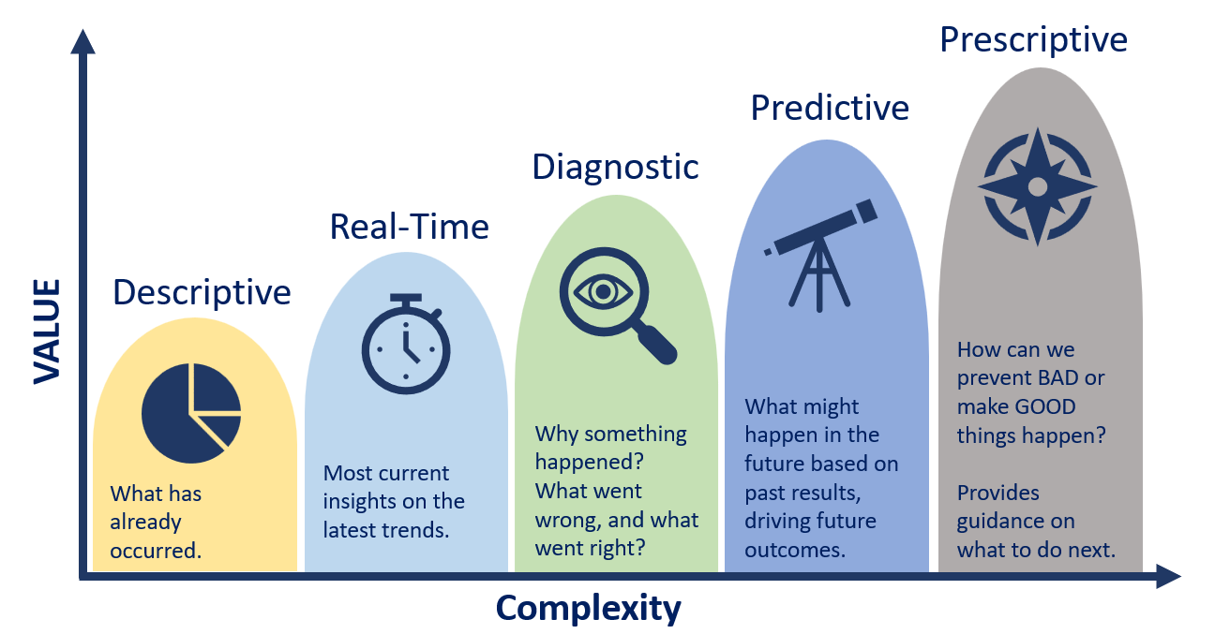
Data Intelligence Powered by NERIS

Slide 13
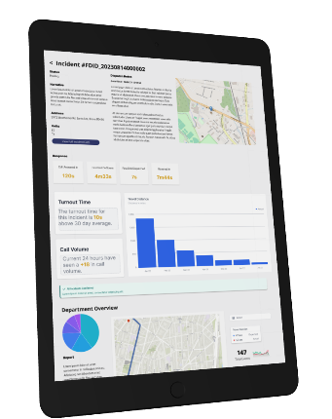
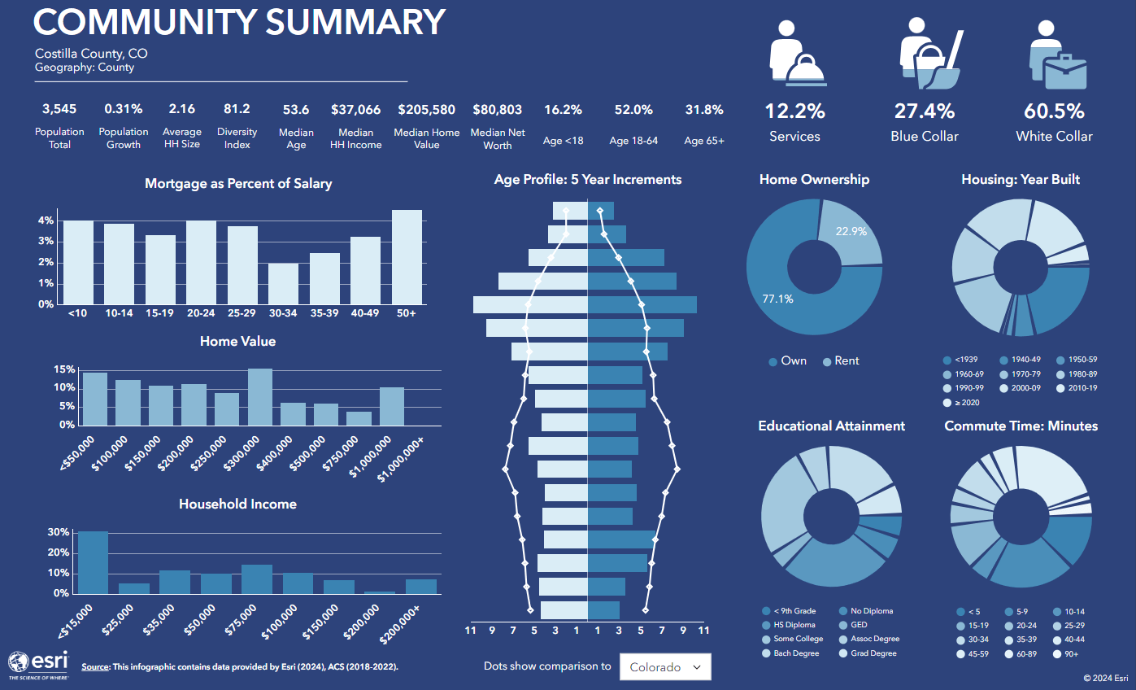

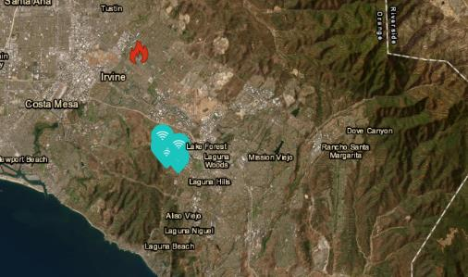
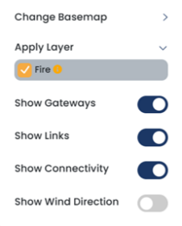
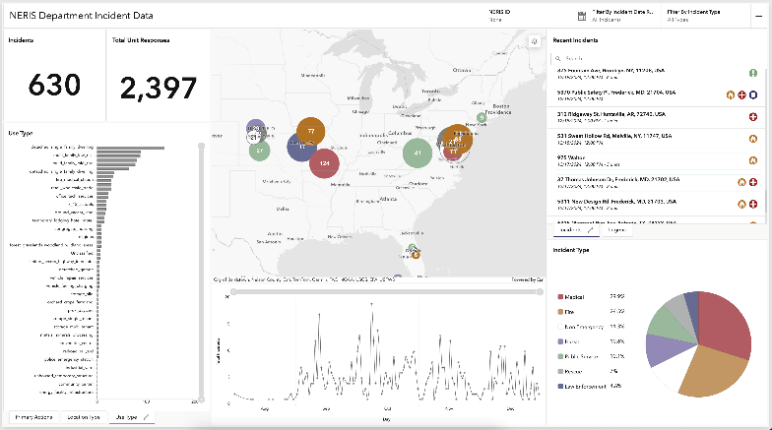
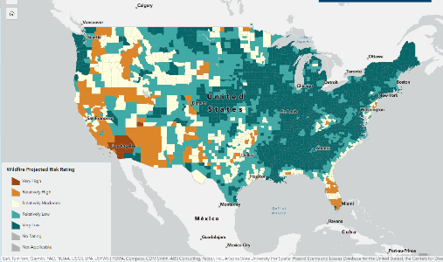
Future
Fire Department
Fingerprint with NERIS
NERIS Fire
Department
Profile
Community Demographics
NERIS Intelligence: Community Risk, Performance, Actions & Tactics
Early Detection Sensor Data
Current & Future
Fire Risk

Slide 14




12-month Outlook
January 2025
May 2025
January 1, 2026
State Fire Marshal Office Onboarding
Broader Adoption
Full Transition to NERIS
Fire departments onboard in phases and start reporting incident data to NERIS based on the onboarding ramp-up plan.
SFM Training and NERIS Onboarding at National Fire Academy and develop partnership with SFM for NFIRS transition with local departments.
All fire incident reporting is conducted using NERIS exclusively. Legacy NFIRS application is sunset, and decommissioning begins.
Targeted Roll Out
National Deployment and ATO
Onboarding ~500 remaining early adopter fire departments and all 50 State Fire Marshals.
Fire departments onboard in phases and start reporting incident data to NERIS. Increased number of API connections established from local CAD & RMS.
July 2025 is the target for ATO.
February 2025
July-December 2025
*Dates and timeline are subject to change.
Notes:
Our Goal – by end of CY2026
24,000+ fire departments onboarded onto NERIS
Local fire departments onboarded onto NERIS

Slide 15
NERIS Onboarding Ramp Up 2025
FEMA Region Focus
FDs < 5000 Pop.
RMS Partners
FDs / Early Adopters
No. Of Fire Departments
State Fire Marshals
Metro FDs
Platform Launch
Targeted Rollout
Broader Adoption
National Deployment
Widespread Availability

Slide 16
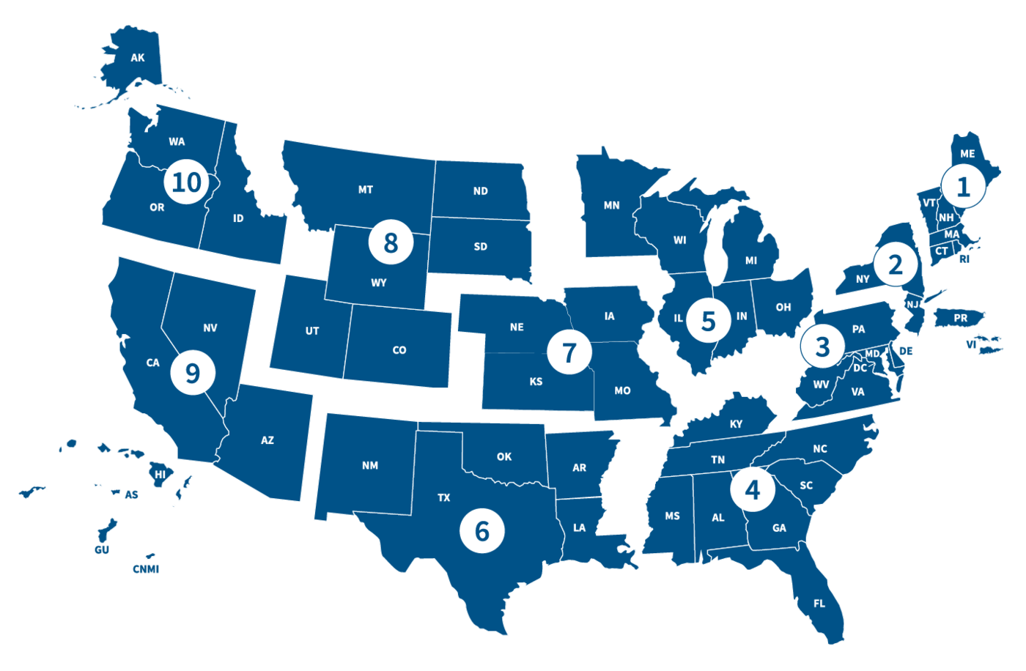
Regional Roll-Out Schedule
Month in 2025 | # of Fire Departments
May
FEMA Region 2 |  | 2,385
June
FEMA Region 4 |  | 5,009
July
FEMA Region 6 |  | 3,632
August
FEMA Region 7 |  | 2,400
September
FEMA Region 3 |  | 3,080
October
FEMA Regions 1 & 10 |  | 2,496
November
FEMA Regions 8 & 9 |  | 2,701
December
FEMA Region 5 |  | 5,460
*Dates and timeline are subject to change.

Slide 17

Vendor Readiness
The NERIS-compatible badge signifies that a vendor’s software
is capable of data exchange with the NERIS platform.
To earn a NERIS compatibility badge, a vendor must:
Create an integration between their software and NERIS
Submit a new incident in the test environment to the FSRI Fire Department
Capture the unique incident number and submit an update to the incident that was created
Establish a station and add a unit to the FSRI Fire Department

Slide 18
NERIS Data Framework
NERIS’ semantic layer
Common data definitions and descriptions – web-based data dictionary publicly available
Data relationships mapping – ontology and metadata
NERIS data model – Cross-walks with applicable standards & National systems
NERIS’ data policy and governance framework
ANSI-approved NENA Standards: NG911 Data Model and Emergency Incident Data Object
Local departments retain ownership over their data
Appropriate data sharing by default within the NERIS platform, stipulated in Terms of Use
National EMS Information System (NEMSIS)
DOI’s IRWIN and InFORM
National Information Exchange Model (NIEM)
DOI Interagency Data Management Environment
ATF’s Bomb Arson Tracking System
Fire Department Registry and FEMA GO
Notes:
RH

Slide 19






NERIS API Integration
An Application Programming Interface (API) acts as the connection between software or systems that allows them to communicate with each other.
Why is this so important?
  Allows connection between third-party RMS and CAD into NERIS.
  Will set the stage for future integrations from NERIS into other systems.
  Eliminates the need for emailing and uploading of files for incident reporting.
  Sets hard parameters on what data elements and information enter NERIS.
Get, Put,
Post, Delete
HTTP Request
CLIENT
NERIS API Gateway
HTTP Response
Incident Payload
SERVER
JSON

Slide 20
Core Entity Data Specification
NERIS Data Schemas
CAD Interface / Dispatch Schema
Community Risk Reduction Schema
Health and Safety Data Schema
Incident Data Schema
Incident Analysis Data Schema
Core
Secondary

Slide 21

CRR Vision
Jurisdictionally in-sync
Multi-hazard driven
Complimenting available resources
Changing culture to embrace prevention and mitigation

Slide 22

Fire/CRR Data-Driven Decisions
The future of Fire based CRR (and fire departments in general) will be shaped by our ability to align with information to inform us about all types of risk, especially the complex interplay related to the public we serve.
Many of the people at risk for fire-related emergencies are also heavy users of the EMS system.
Future leaders will have to hone skills in understanding data from a variety of sources to gain a clearer understanding of a community’s public safety ecosystem.

Slide 23
The “Triple Aim” with NERIS & CRR
Document
Document CRR Activities
Connect
Connect Incident Response with CRR (when appropriate)
Provide
Provide analytics related to risk

Slide 24
CRR Structure
State of the home assessment.
Occupants
Alarms
Hoarding
Etc.
Virtual and in-person events.
Campaigns
Training
Prevention
MIH
Land and structure inspections
Codes and Permits
Maintenance
Zoning
Assessments
Location
Functionality
Flow Rates

Slide 25




CRR Data Hub
State-Level CRR Programs
State-Level Inspections
States can log CRR programs and community events directly into the application. The data is geospatial and will be tagged to the state’s NERIS ID. This data will also be linked with incidents that occur in the areas where the programs occur.
States can log inspections on parcels and structures to be able to goespatially and temporally tag this information. These inspections can be tagged to the incident response data from the local departments.
Local-Level Incidents
Local-Level CRR
Department level data is all geocoded and time stamped. This component tells us the current and legacy hazards a department responds too and the capcity to respond. All CRR data can be geospatially linked to incident data.
Departments can log home visits (e.g., MIH), parcel and property inspections, hydrant inspections, and community events/programs which can be linked back to the historical incident in the geospatial area.

Slide 26
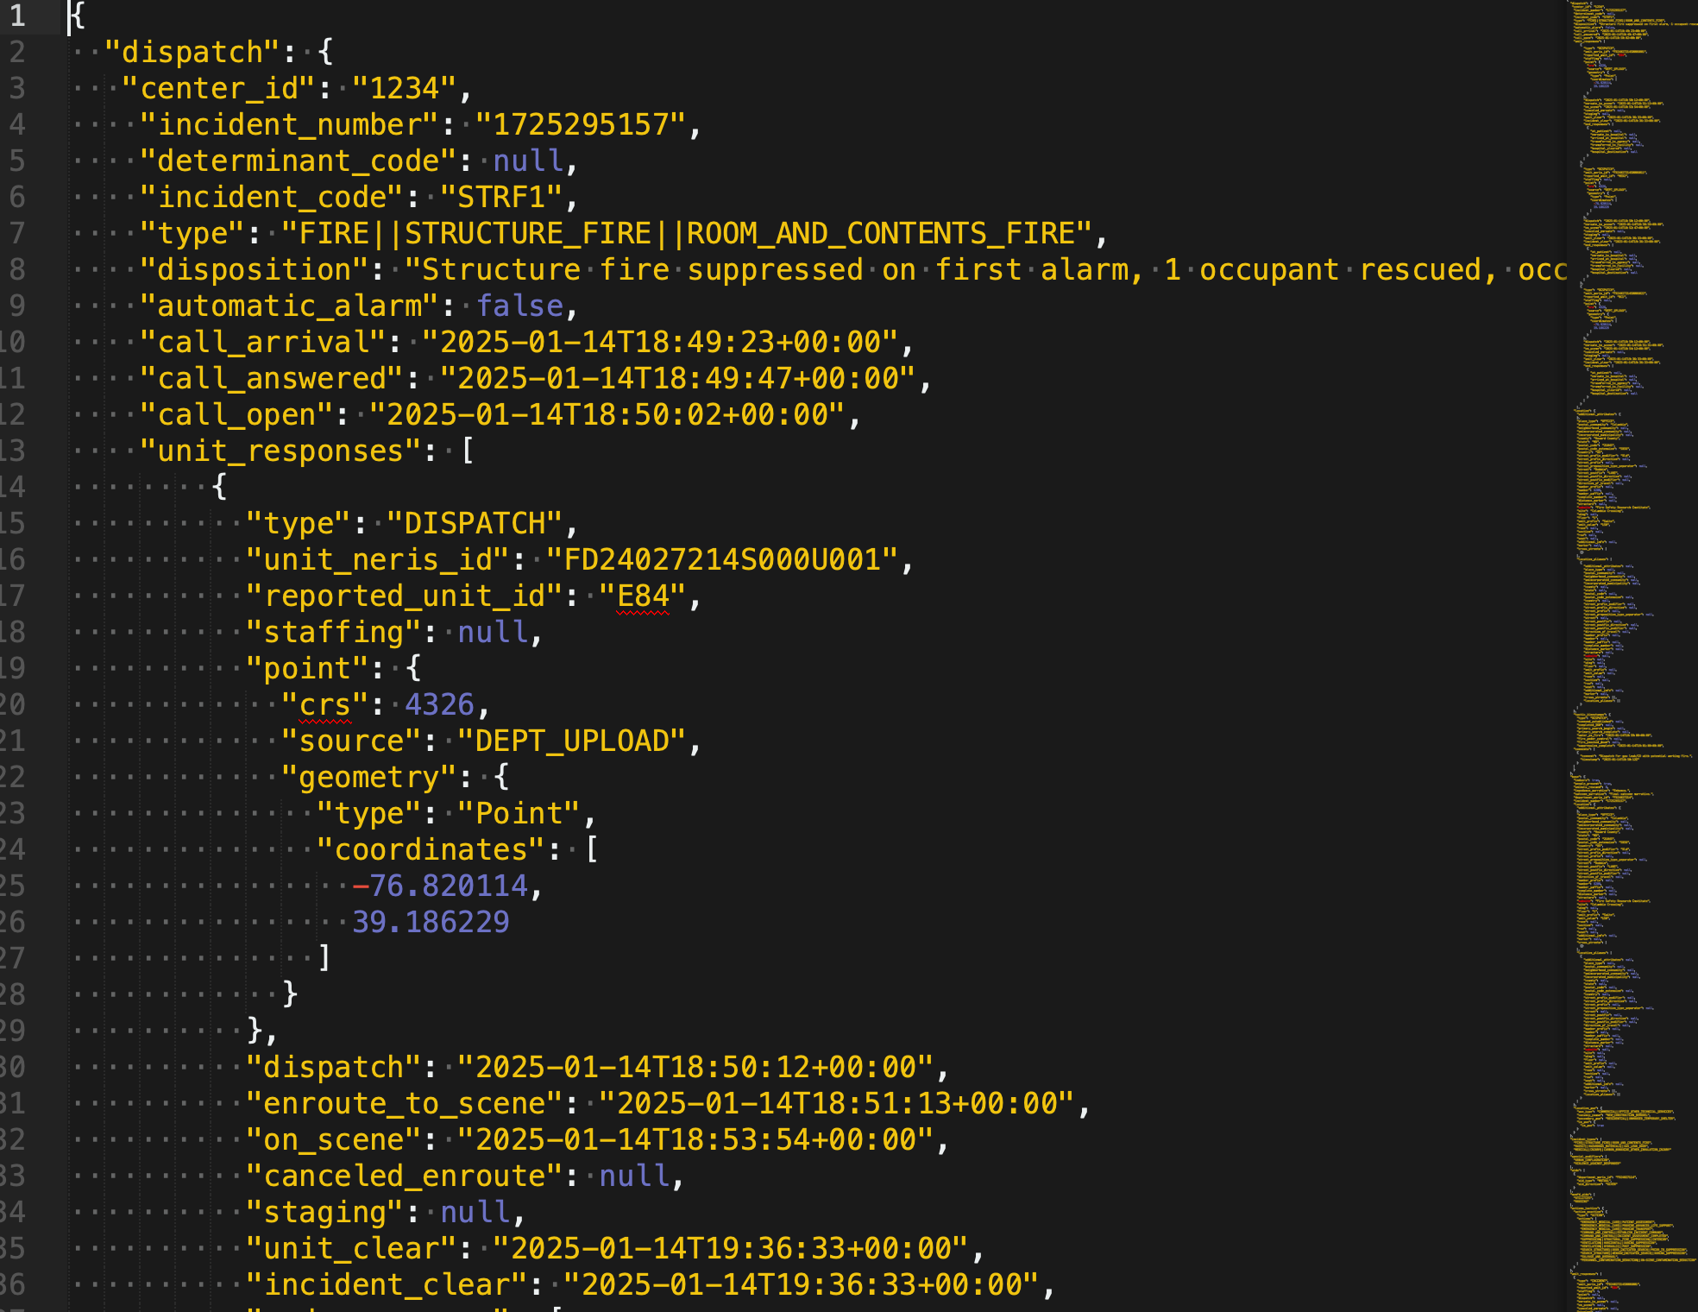
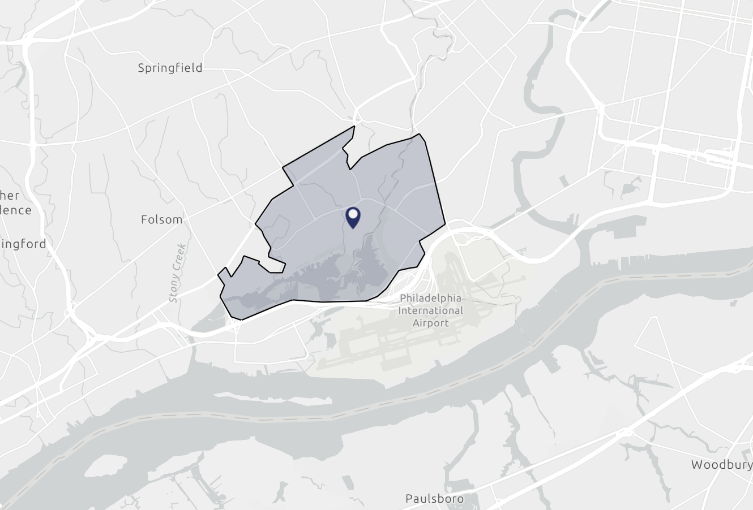
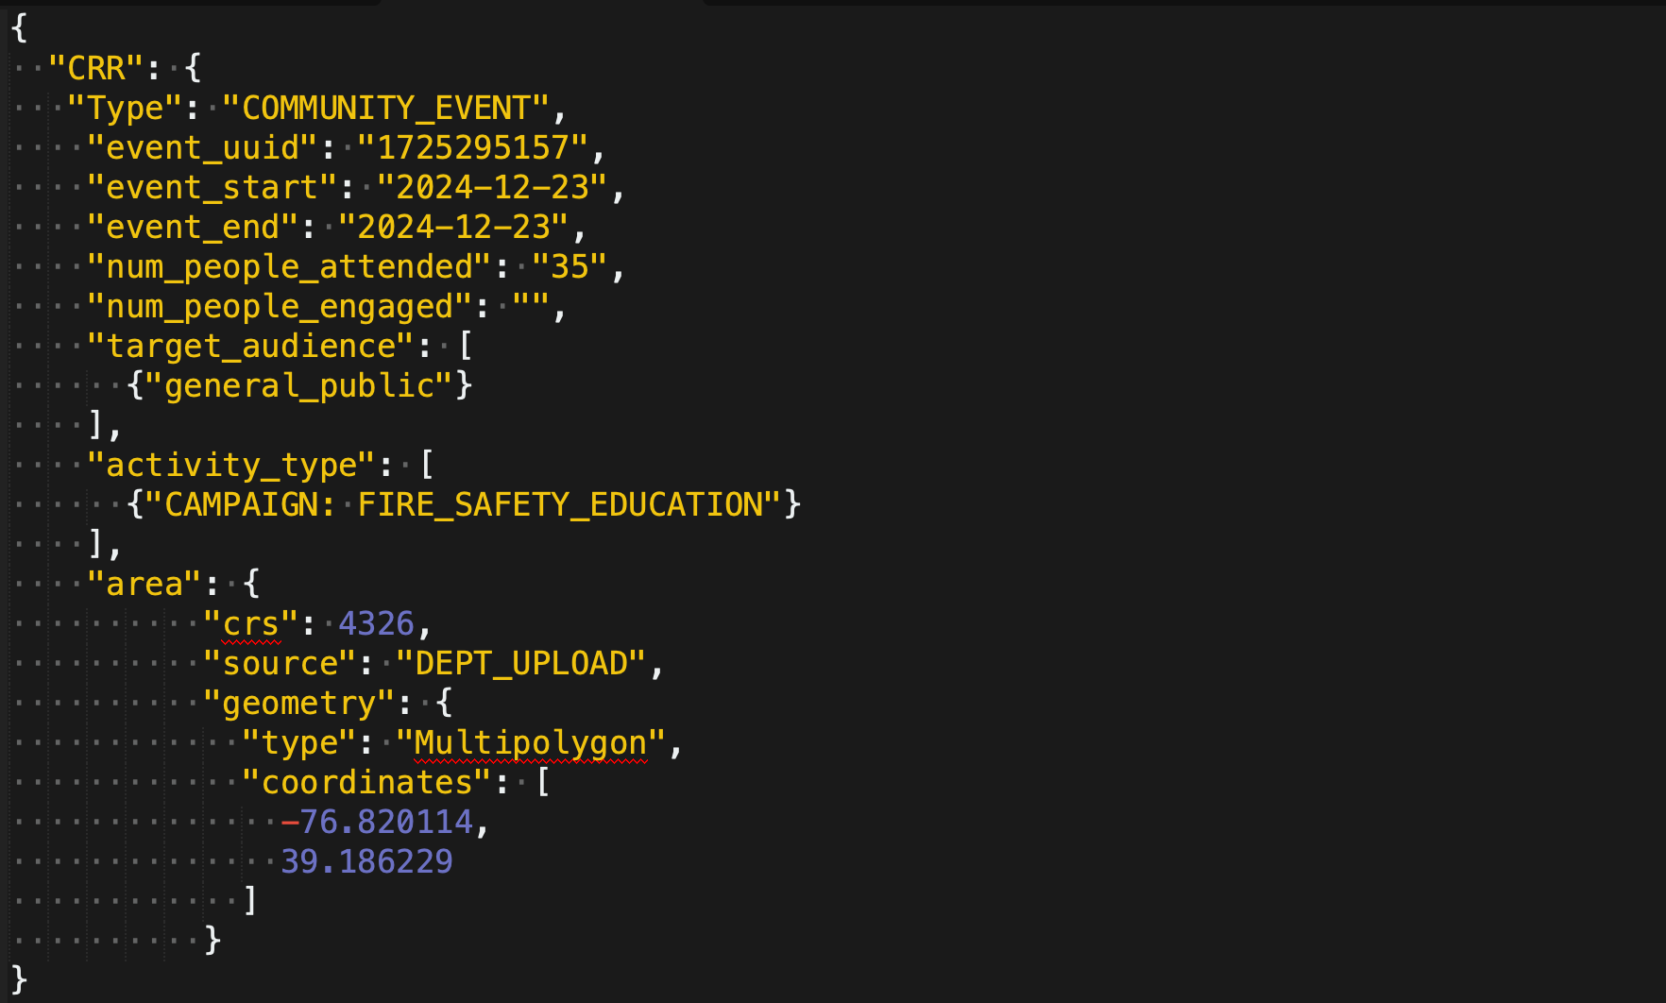
Example of Hub
Incident Payload: 1/14/25
Room and Contents Fire
Fire Safety Education Community Event
12-23-24

Slide 27


NERIS Data Governance
Goal:
Develop basic knowledge on data governance, security, and privacy as it pertains to NERIS
Objectives:
Introduce Data Governance
NERIS Governance Model
NERIS Security and Data Privacy Approach

Slide 28
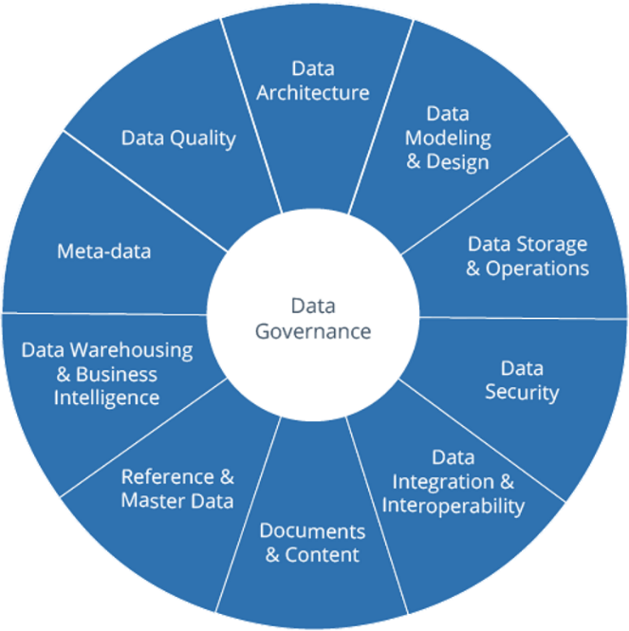
Data Governance – What is it?
A structured framework of policies, procedures, and standards that define how a fire department collects, stores, manages, accesses, and uses its data to ensure accuracy, consistency, security, and compliance with regulations, ultimately enabling better decision-making and operational efficiency within the organization.
Policies
Definitions
Metrics
Lifecycle
Active and Ongoing Initiative
Graphic Credit: Dama International
Notes:
I think the only thing missing from this is the idea of data having business value, or maybe it's implied by "Business Intelligence." Data without value is a sign of poor data governance. Compare one "pocket of excellence" that keeps its data-informed insights all to itself. That's less valuable than if it were shared with the enterprise.
I would also overemphasize right up front that data governance is all about human behavior.

Slide 29
Tenants of “Good” Data Governance
Data Governance Principals
Integrity
Transparency
Auditability
Accountability
Stewardship
Checks-and-Balances
Standardization
Change Management
Goals
Enable better decision-making
Reduce operational friction
Protect the needs of data stakeholders
Train management and staff to adopt common approaches
Build standard, repeatable processes
Reduce costs and increase effectiveness through coordination of efforts
Ensure transparency of processes
Notes:
Since data governance is all about human behaviors, one of the easiest ways for people to begin is to learn to recognize the bad behaviors. For example, using Excel as a database invites so many disasters. Sharing your data on public platforms is a good way to lose control of the data, and we all know how easy it is to remove things from the internet.

Slide 30
NERIS Data Ownership & Management
Entities contributing data to NERIS retain ownership of their data.
Data management within NERIS adheres to the following principles:
Contributed data will be preserved in its original form.
All external data sources used for augmentation will be documented.
Algorithms applied to data, whether at the entity or aggregate level, will be detailed in NERIS technical documentation.

Slide 31
NERIS Data Sharing Policy
Entities onboarded into NERIS agree to share data with their respective State Fire Marshal’s office and the United States Fire Administration’s (USFA) node within the system.
Shared data will be used to assess aggregate emergency responses at state and federal levels.
Note: While entities may opt out of data-sharing agreements, they should be aware that participation in certain state or federal programs may mandate data sharing within NERIS.

Slide 32
NERIS Data Retention Policy
NERIS is not authorized to serve as an entity’s system of record in fulfilling their local jurisdiction’s records retention or storage solution.
Retention of Raw Incident Data:
  All raw incident data collected by NERIS will be retained for a period of seven (7) years from the date of collection, as required by FEMA.
  After the initial seven years, raw data will be moved to long-term archival storage using solutions designed for infrequent access, using a service optimized for SQL-based data. This ensures data integrity while reducing storage costs.
Retention of Transformed Incident Data:
  All transformed (processed and cleansed) incident data derived from raw data (e.g., aggregated datasets, normalized datasets, or trend analyses) will be retained and accessible to users indefinitely.
  Supports long-term historical and trend analysis to inform public safety initiatives, emergency response planning, and federal reporting requirements.

Slide 33
NERIS User Privacy
Required fields for account:
E-mail Address
First Name, Last Name
NERIS Policies:
Terms of Use
  https://neris.fsri.org/terms-of-use
Privacy Policy
  https://neris.fsri.org/privacy-policy
NERIS Compliance:
NERIS intends to be fully complaint with states privacy rights regulations including but not limited to: CCPA/ CPRA (CA), CDPA (VA), CPA (CO)

Slide 34
NERIS Data Privacy
Incident Data Privacy
NERIS Incident Data has undergone a privacy threshold assessment and has been determined not to contain SPII.
What is PII?
Personally Identifiable Information; Information that can be used to distinguish or trace an individual’s identity, either alone or when combined with other information that is linked or linkable to a specific individual.
What is SPII?
Sensitive Personally Identifiable Information; like Social Security, Credit Card, Medical Records, etc. that could cause serious harm if disclosed without authorization.
Fire Department - Data Entry Responsibility:
Free text fields in incidents should not have SPII or PII information entered.
If PII or SPII is entered into an open text field, NERIS automatically scans, identifies, and redacts such data/information.

Slide 35
NERIS Secure By Design
Authorization - Access Control
Each entity (or fire department) is responsible for managing access to its data within NERIS.
A single User may be affiliated with multiple entities and therefore provided access and assigned roles in multiple entities/departments within NERIS.
An initial entity admin will be verified by the NERIS team during onboarding.
The entity admin can invite users, assign roles, and manage permissions as described below:
Entity User: Submits and views incident data, modifies personal attributes, and interacts with system features.
Entity Superuser: Everything a user can do plus can edit/approve incident data.
Entity Admin: Everything a superuser can do PLUS responsible for approving user roles, managing entity attributes, approving 3rd party software integrations, and ensuring secure data handling.

Slide 36
NFIRS to NERIS
Transition

Slide 37
NFIRS Transition Basics
NFIRS
  Planned for sunset and decommissioning in early 2026.
NFIRS Public Data Release (PDR) on OpenFEMA
  Cleaned and processed annual, national data set made publicly available.
  Not full, raw data.
  Data currently available for 1980-2023.
  Data for 2024 and 2025 will be packaged and released on OpenFEMA
  Link: https://www.fema.gov/about/openfema/data-sets/fema-usfa-nfirs-annual-data
NERIS will not consume or connect with historical NFIRS data

Slide 38
Tentative NFIRS Sunset Timeline
CY2025 will be a hybrid reporting year.
  Once a fire department onboards onto NERIS and starts reporting incidents, they do not also have to submit to NFIRS in CY2025.
CY2025 incidents can be submitted to either NFIRS or NERIS depending when a department onboards.
  January 15, 2026 – End date for CY25 Incidents to be submitted into NFIRS
  January 31, 2026 – End date for edits/modifications for CY25 incident records in NFIRS
CY2026 incident reporting.
  Starting January 1, 2026 incident data submission exclusively in NERIS
  No CY2026 incidents will be submitted into NFIRS
*Dates and timeline are subject to change.

Slide 39
NFIRS Data Ownership
Entities contributing data to NFIRS retain ownership of their data.
NFIRS is not authorized to serve as an entity’s system of record in fulfilling their local jurisdiction’s records retention or storage solution.
“The data collected and input into NFIRS by the local fire departments and states belongs the specific users; FEMA/USFA does not have access to this information other than those staff who maintain the system. Therefore, historical data including PII are kept indefinitely for use in longitudinal analyses by those fire departments that own the data.”
Privacy Impact Assessment for the National Fire Incident Reporting System (NFIRS)
DHS/FEMA/PIA-044

Slide 40
Records Retention Guidance for
Local Fire Department
Agency maintains their incident records via their local Records Management System (RMS) or other storage as their system of record and complies with their local records retention policy
GOOD – No further action needed
Scenario A
Agency enters incident reports directly into NFIRS and does not have their own RMS or other storage for the incident records serving as their system of record
ALERT – Agency needs to establish a system of record, retrieve, and store historical incident records in compliance with their local records retention policy.
Scenario B

Slide 41
Guidance for Scenario B:
Performing Historical NFIRS Records Retrieval
Conduct a NFIRS Bulk data export for all years required to comply with your local records retention policy:
  Maximum one-year increments
  Maximum ~750,000 records
  One export at a time
Access the NFIRS Data Warehouse to complete records retrieval:
  Excel Export
  Max ~200,000 rows
  Limited data fields
    Basic Fire, Structure Fire, Wildland modules
Be sure to complete retrieval of your Historical NFIRS records well in advance of the NFIRS sunset date.
  Recommend completing all prior years needed before Nov. 2025, except for your 2025 records.

Slide 42
Call for Action: Records Retrieval
Ensure fire departments understand their local records retention policies and confirm how they are implementing and complying with those policies for fire incident reports/records.
Communicate with your local fire departments
  Determine which agencies are “at risk” and may need to download their historical incident records
Evaluate your state database to determine if there are any data gaps
Establish a download schedule to meet your local or state records retention requirements and policy

Slide 43
Review
Local fire departments retain the ownership and responsibility to maintain their incident records in accordance with their local, and/or state retention policies.
If a state maintains a state-wide incident database, the state is responsible to maintain records in accordance with the state records retention schedule.
As agencies migrate to NERIS, ensure timely closure of NFIRS data*
  Jan 15, 2026 – End of new Incidents in NFIRS
  Jan 31, 2026 – End of incident updates in NFIRS
  February 2026 - NFIRS will sunset
    User access to the NFIRS Enterprise Data Warehouse will also no longer be available.
NFIRS Public Data Release (PDR) will remain and stay publicly available on OpenFEMA
*Dates and timeline are subject to change.

Slide 44
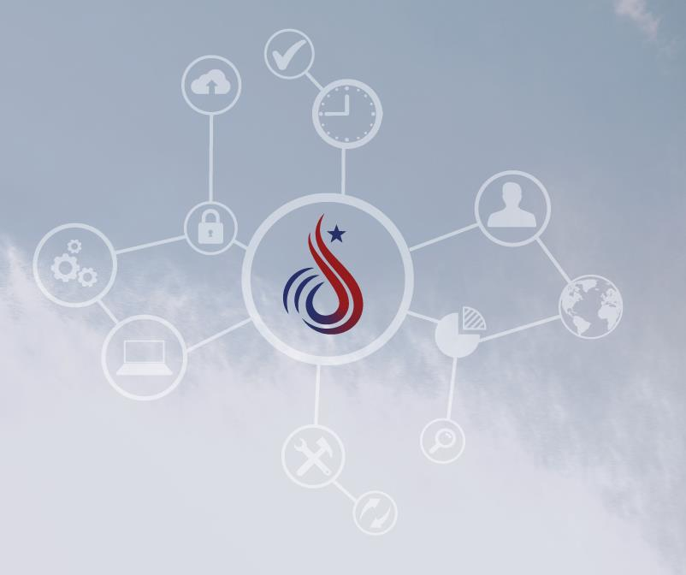
Questions & Answers

Slide 45

More Information:
Website: https://tinyurl.com/494xjnxe
Contact the team: NERIS@ul.org
Notes:
Total presentation is appx 75m

