Slide 1

UEZ Certification System Overview – Business Information Listings

Slide 2
Agenda
How This Will Help You
Accessing the UEZ Certification System
Information Available on Business Information Listings
Setting Up Optimized Report
Utilizing the Search, Sort & Filter
Interpreting the UEZ File

Slide 3

How This Helps You
Allows you to keep up with businesses in your zone
Gather information necessary for local UEZ benefits
Learn more about size of your zone & goal setting

Slide 4
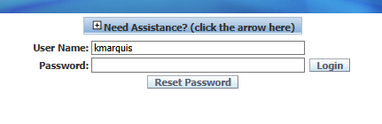
How to Access UEZ Certification System
Log into your myNJ account
Once you’re logged on, there is a DCA Applications section and a box with the link UEZ Certifications.
If you do not have that box, please send an email to UEZInfo@dca.nj.gov so we can arrange for an authorization code to be sent to you.
Select the link and it will bring you to the login page.

Slide 5
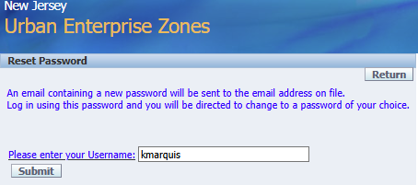
How to Access UEZ Certification System
Your Username should be the first initial of your first name and full last name.
Forgot Password/Trouble Logging On
Select the Reset Password button and follow the prompt.
A new password will be sent to you and once you log in you will be directed to change it.

Slide 6
Transition to UEZ Certification System Module

Slide 7
What Information is Available?
The Business Information Listing (BIL) holds all the information gathered from UEZ Applications.
It is a user-friendly way to sort through information, compared to exporting it all through Excel.
Most Important Information on BIL:
Legal Company Name
NJ Tax ID
UEZ File #
Status
Location Address
Certification, Annual & Recert Dates

Slide 8
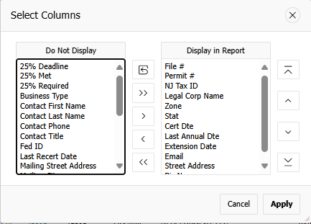
How to Set Up a Report
Select Business Information Listings
Go to Actions then Select Columns
Transfer data titles between Do Not Display and Display in Report usings horizontal arrows between them.
Determine order you want the data titles shown by using vertical arrows on far left
Select Actions then Save Report
Name your report

Slide 9

Using the Search Function
Now that you set up your report, you’ll be able to better utilize the search function.
You can most accurately pull up a single business’ file by searching the NJ Tax ID or File #.
NOTE: The search function is character sensitive. You must spell proper names correctly and use the dashes and slashes for NJ Tax IDs or no results will be found.

Slide 10
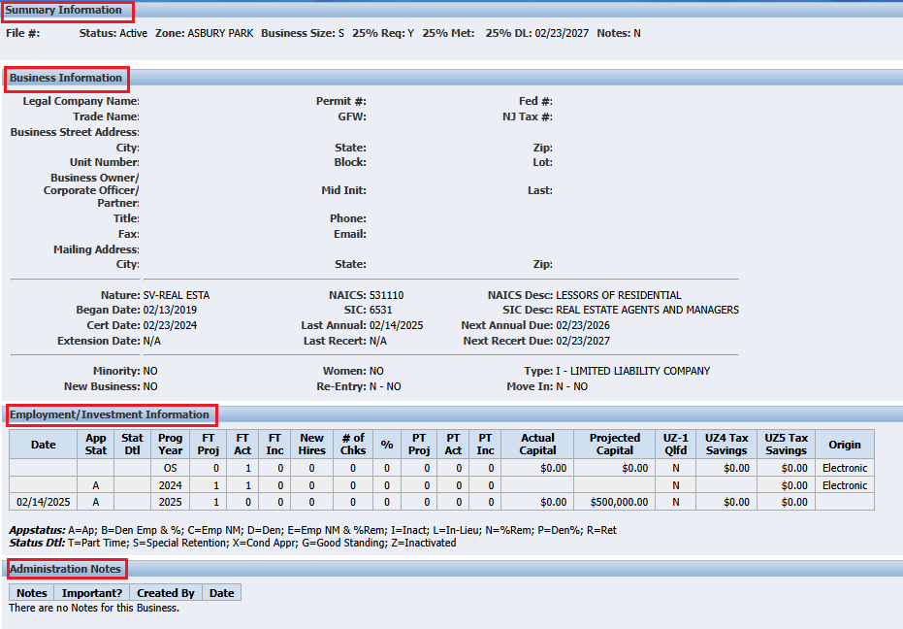
The UEZ File Structure
It is organized into 4 sections:
Summary Information
Business Information
Employment/Investment Information
Administration Notes

Slide 11
Employment/Investment Information
Column | Description
Date | Generally, the date a change was made. This is usually the Friday of the week an application was approved.
App stat | The status of the application, always either an A for Active or I for Inactive.
STAT DTL | More Information about the Status. Letters used here are: C, E, G, N, O, Q, X, Y, Z.
Prog year | Stands for Program Year. OS stands for Original Start (Date)
FT PROJ | # of Projected Full Time Employees
ft act | # of Actual Full Time Employees
ft inc | # Full Time Employees have increased by (negative if decreased)
NEW HIRES | Only updated for First Recertification
# of chks | Number of Employees who meets the 25% Factor Requirements
% | # of Chks/New Hires (25% Factor formula)
PT PROJ | # of Projected Part Time Employees
PT ACT | # of Actual Part Time Employees
PT INC | # Part Time Employees have increased by (negative if decreased)
ACTUAL CAPITAL | Figure listed for Actual Capital Investments for the program year
PROJECTED CAPITAL | Figure listed for Projected Capital Investments for the program year
UZ-1 QLFD | Whether they are eligible for Reduced Sales Tax based on answers to application (may not be accurate in practice) Y for Eligible or N for Not Eligible
UZ4 TAX SAVINGS | How much the business saved with the UZ-4 Contractor’s Exempt Purchase Certificate
UZ5 TAX SAVINGS | How much the business saved with UZ-5 Urban Enterprise Zone Purchase Certificate
ORIGIN | How the application was submitted, almost always Electronic

Slide 12
Status Detail Codes
CODE |  | MEANING | SOLUTION, IF APPLICABLE
APP STAT | STAT DTL
A | - | Active, no issues
A | E | Active, approved for an extension to meet program requirements
A | G | Had Tax issues, currently in good standing
A | X | Active with tax issues (180-Day Conditional Approval) | Refer applicant to UEZTax.Clearances@treas.nj.gov to prevent inactivation.
A | Y | Was inactive, but reinstated during program year
I | C | Inactivated because the business changed ownership and is now active under a different File
I | N | Inactivated because they never submitted their renewal application | If within 6 months from due date, they can submit their missing application to be reactivated.
I | O | Inactivated because the business closed/out of business
I | Q | Inactivated because the program requirements were not met or they opted out
I | Z | Inactivated because the tax issues were not resolved within the 180-day conditional period | Refer applicant to UEZTax.Clearances@treas.nj.gov for reactivation.

Slide 13
Notes about the File Information
The UEZ runs on a Friday date system.
For businesses that were inactivated because of tax issues (I/Z), the date displayed will still be the application approval date. In reality, the business was inactivated six months later.
Actual figures correspond to the Program Year. Projected figures correspond with Date.
For example, if you want to figure out how many actual full-time employees an applicant put on their 2025 application, you have to refer to the 2024 program year line. REMEMBER: Applicants are reporting information for the past program year.

Slide 14
Final Takeaways
Any Questions?
Hopefully, you found this training helpful, and you’ve learned how to:
Access the UEZ Certification System
Set up your Business Information Listing Report
Search, Sort and Filter Business Data
Interpret and Read a UEZ File
Did anyone learn anything new?

Slide 15
Thank you, Coordinators!
Kija Marquis
Certification Representative
877-913-6837
UEZInfo@dca.nj.gov
https://nj.gov/dca/uez/

