Slide 1
Bidder’s Conference
REQUEST FOR PROPOSAL
Pilot of Supportive Visitation Services (SVS)
in Atlantic County
December 20, 2017

Slide 2
Bidder’s Conference
Welcome/Introductions
Purpose
Background
Services to be Funded
County Placement Data
Questions and Answers
2

Slide 3
Purpose
Goal: Increase availability of high quality supportive visitation services
Expand SVS Pilot into Atlantic County (One provider)
Note: Providers with existing contracts to provide visitation services to CP&P in Atlantic County MUST apply and be selected for this opportunity in order to continue providing visitation services.
3

Slide 4
DCF’s Operating Areas
New Jersey Department of Children & Families
Children’s System of Care
Child Protection & Permanency
Clinical Services
Adolescent Services
Family & Community Partnerships
Division on Women
4
Notes:
4

Slide 5
How CP&P Serves Children and Families
Internal Case Practice Model
External Purchased Services
5

Slide 6
CP&P External Purchased Services
New Jersey Department of Children & Families
Children’s System of Care
Child Protection & Permanency
Clinical Services
Adolescent Services
Family & Community Partnerships
Division on Women
Office of Strategic Development
6
Notes:
6

Slide 7
Federal and State Convergence
Field and funding is moving towards the integration of evidence-based models
DCF Strategic Plan Priority - continue to transition service array to research and evidence-supported service models using an implementation science framework approach
DCF’s Office of Strategic Development is charged with modernizing the service array by applying the best available evidence and developing solutions to address the needs of children, youth and families.
7

Slide 8
CP&P External Purchased Services
864 providers in the community that we purchase services from
Core Services Purchased:
Supportive Visitation Services
Family Preservation Services
Mental Health Treatment
Assessment and Evaluation
Supportive Housing
Substance Use Disorder Treatment
8

Slide 9
What does DCF contract for? Types of CP&P Visitation Providers
Therapeutic Visitation
Supervised Visitation
“An intensive program which combines family therapy and parent training within a consultative model of service delivery that is both educationally and therapeutically based. Includes parenting instructing pre- and post-visitation”
(Anne Henley, Director, Family Solutions, VA)
Contact between parents and their children in out-of-home care while in the presence of a specially trained professional who is actively involved in promoting change in parent/child relationships.
9

Slide 10
Why look at visitation?
CP&P core service
Challenges
Opportunity to move towards evidence
What does the literature, policy and practice say?
10

Slide 11
Literature Review Why is family time important?
Child Welfare Outcomes:
Increase the likelihood for reunification
Reduce placement lengths of stay
Decrease chance of re-entry
Child Well-Being Outcomes:
Lower levels of anxiety & depression
Exhibit fewer behavioral problems
High well-being ratings & adjust well to placement
The visit environment plays a crucial role in supporting positive family interactions.
Home-like and other supportive settings are preferable.
11

Slide 12
Weekly visits are the target. But bonding is still challenging even if targets are achieved.
Once a week is
standard practice in
most places.
But it’s difficult to bond in only one hour a week.
12

Slide 13
CP&P Policy: Visitation - NJAC 10:122D-1.1
(a) “each child…shall have the opportunity to visit with parents, siblings and interested relatives.
(b) “Visits that are frequent and of long duration are beneficial…and facilitate movement toward achieving…permanency.”
“…the goal is to hold a visit every week for a period as long in duration as possible.”
13

Slide 14
Policy meets Practice Recommendations for visitation from area/local CP&P.
Safety
Transportation
Cancellation/
Rescheduling Policy
Documentation/
Communication
Program Hours
Case Goal
Restrictions
14

Slide 15
What we learned from the literature and existing practice.
Family time is critical
No “off-the-shelf” evidence-based or evidence-supported visitation model available
CP&P contracts separately for therapeutic and supervised visitation
Type of visitation a family receives is based on CP&P and court order or service availability
How can we make it better?
15

Slide 16
A Visitation CONTINUUM Includes assessment that drives visitation level(s) to meet family needs.
Supervised Visitation: Relatives/Community Partners
Supervised Visitation: Contracted Providers/CP&P
Child is Reunified/
Discharged from Placement
No Visitation/ Unsafe
Unsupervised Visitation
Therapeutic Visitation: Clinical

Slide 17
DCF’s Vision for Original Pilot (2015) Restructured Supportive Visitation Services
Collaborative Assessment, Planning and Re-assessment Processes
Visitation Continuum & Post-Reunification Supports Under One Program
In-Home/In-Community Visits
Flexible hours (evenings, weekends and holidays)
Transportation
NJS Documentation
17

Slide 18
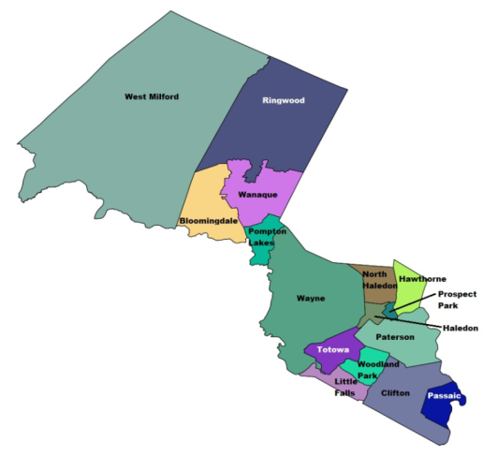
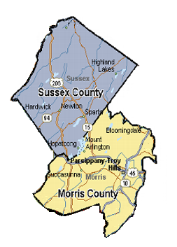
Restructured Supportive Visitation Services Implementation - Phase 1
Original SVS Pilot - 2015/2016
Two Catchment Areas:
Morris and Sussex Counties
Passaic County
One grantee for both areas
Principles of Active Implementation
18

Slide 19
Active Implementation Formula for Success
Effective Practices
Effective Implementation
Enabling
Context
Improved Outcomes
Phase 1
Logic Model
Teams
Practice Profile
19

Slide 20
SVS Pilot Teaming Structure
Enabling
Context
Visitation Implementation Team
Visitation
Model Design
Team
Visitation
Evaluation
Team
Visitation
Operations/Systems
Team
Develops visitation practice model
Identifies and secures supports for the model
Provides input on process and outcome evaluation
Develops reporting structure
Communication and feedback loops between CP&P and implementing agency
Define referral and billing processes
20

Slide 21
SVS Pilot Program Model Components
Effective Practices
Visitation Planning Process
Initial Intake Assessment
Visitation Planning Meeting
Supportive Visitation Services along Continuum
Ongoing Family Reassessments
Post-Reunification Services (Aftercare)
Systems Collaboration and Coordination
21

Slide 22
SVS Pilot Practice Profile Components
Effective Practices
Guiding Principles
Collaborative
Supportive
Flexible
Family-driven
Community-based, least restrictive
Promotes well being
Trauma-informed
Essential Functions
Engaging
Assessing
Active listening
Teaming
Therapeutic intervening
Coaching
22

Slide 23
Active Implementation Moving into the Next Phase
Effective Practices
Effective Implementation
Enabling
Context
Improved Outcomes
Phase 2
Competency Drivers
Data
23

Slide 24
SVS Pilot Implementation Supports
Effective Implementation
Enabling
Context
Capacity to implement SVS program model:
Staffing Model
Training Plan
Coaching/Supervision
Evaluation, Data Collection and Reporting
Quality Improvement Practices
24

Slide 25
SVS Pilot Funding Fee-for-service model
Enabling
Context
$146.10 for each hour in-person time
Includes initial intake assessment, visit planning meetings, supportive visitation services, pre-visit meetings and post-visit debriefs, and aftercare services.
Paid via K-100
5% of program director and senior leader salary for agency staff to actively participate in teaming activities
Advance funds to cover gradual startup of services/initial billing delays
25

Slide 26
CP&P Placement Data Atlantic County
26

Slide 27
CP&P Placement Demographics Atlantic County
27

Slide 28
CP&P Placement Demographics Atlantic County
28

Slide 29
CP&P Placement Data Atlantic County
29

Slide 30
CP&P Placement Data Atlantic County
30

Slide 31
SVS Atlantic RFP Questions and Answers
1st – Answer submitted questions
2nd – Answer questions from attendees
Have technical inquires about forms
and other documents?
Email DCFASKRFP@dcf.state.nj.us anytime.
31

Slide 32
Proposal Deadline Reminder
Bids are due on
January 17, 2018
at 12:00 P.M.
32

