Slide 1
NEW JERSEY DEPARTMENT OF CHILDREN AND FAMILIES
RESPITE PROVIDERS
INFORMATION SESSION
DCF Children’s System of Care
October 17, 2024
Notes:
Intro Static Page

Slide 2
Agenda & Objectives
Welcome & Introductions
Children’s System of Care (CSOC)
Respite Services
RFQ Requirements
Organizing the RFQ Application
Q & A
Notes:
Melissa

Slide 3
Children’s System of Care (CSOC)
Serves youth under 21 with emotional and behavioral health care challenges, intellectual/developmental disabilities including autism, and/or substance use challenges.
Objective is to help youth thrive at home, in school, and in the community; successfully living with their families and becoming independent, productive and law-abiding citizens.
PerformCare, the Contracted Systems Administrator for CSOC, is the single point of access for children, youth, and young adults up to the age of 21
CSOC structure and foundational values ensure that services provided are based on the needs of the youth and family; are family-centered, culturally competent, and community-based.
Notes:
Alex
The NJ Department of Children and Families is devoted exclusively to serving and supporting at-risk children and families. The Children’s System of Care, or CSOC, is the state’s public behavioral health system that serves youth under 21 with emotional and behavioral health care challenges, substance use challenges, and intellectual/developmental disabilities including autism.
The system of care is a coordinated network of services and supports that relies on youth and families being at the center of their own care and aims to support youth and families within the community and with an approach that is mindful of cultural context, the social determinants of health, and how these impact families.
CSOC’s Objective is to Help Youth Succeed:
-At Home-successfully living with their families and reducing the need for OOH treatment settings
-In School-successfully attending the least restrictive and most appropriate school setting close to home
-and In the Community-Successfully participating in the community and becoming independent, productive and law-abiding citizens.
Our contracted system administrator, PerformCare, provides member services, medical necessity determinations, initial and continuing prior authorization of services, quality management functions, as well as development and maintenance of CYBER, which is the electronic behavioral health information record used across CSOC.
PerformCare is also the single point of access to CSOC’s wide array of behavioral health, substance use, and intellectual/developmental disability services for youth and families in New Jersey.
Lastly, CSOC’s values ensure that the supports and services provided are based on the needs of the youth and family, are family centered, culturally competent and community-based.

Slide 4
Family Support Services
Family Support Services (FSS) are:
A coordinated system of supports
Designed to maintain and enhance quality of life
Designed to strengthen families who provide care at home
Notes:
Alex
Family Support Services or FSS were the first programs developed by CSOC to meet the needs of the I/DD youth population that transitioned from DDD to CSOC in 2013.
Family Support Services (FSS) are a coordinated system of on-going public and private supports, services, resources, and other assistance, which are designed to maintain and enhance the quality of life of a youth with an intellectual/developmental disability (I/DD) and their family. FSS are designed to strengthen and promote families that provide care at home for a child or young adult.
FSS is really an umbrella term. The services range from Educational Advocacy, Summer Camp, Assistive Technology, and Respite, which will be the focus on this presentation.
Respite was a huge need (still remains so to this day). Families need to have supports and many times a "break" to help manage the needs and every day stressors associated with having a youth with an IDD challenge.

Slide 5
Family Support Services
Family Support Services do not include:
Daycare/Childcare
Services available through other resources
Funding for the cost of a service animal
ABA Services
Notes:
Alex
FSS **Does not include:
Daycare/Childcare
Services available through other resources
Funding for the cost of a service animal
ABA Services

Slide 6
Family Support Services Eligibility
The youth must be:
Determined eligible for Developmental Disability (DD) services and under the age of 21
Living in the community with a biological/adoptive parent, legal guardian, resource family (foster, adoption, and kinship), or uncompensated caregiver
Unable to obtain the service through any other funding mechanism, including but not limited to:
Private insurance
Medicaid
Local educational authority
*Availability may be limited in certain areas of the state
*FSS are not an entitlement and are based on available funding
Notes:
Alex
Eligibility:
-Youth must be determined eligible for Intellectual/Developmental Disability services through the New Jersey Children’s System of Care or DDD.
Meaning the youth must have a developmental disability diagnosis from a licensed clinician through an evaluation process, and
Must complete the DD eligibility application through PerformCare, if under 18 yrs old, or DDD if they are between the ages of 18-21 yrs old.
-The youth must reside in their own home with a caregiver. A youth in a residential treatment program or congregate care setting is not eligible to receive FSS services.
-READ slide for 3rd bullet
A few additional items:
-Availability may be limited in certain areas of the state, as availability of the service is depended on the providers availability
-FSS are not an entitlement and are based on available funding
And
-A youth must be under the age of 21 and will not turn 21 within the next 90 days. If a youth is turning 21 within the next 90 days of seeking services and is not currently receiving any FSS respite service, a new FSS application will not be completed. If a youth is currently receiving a FSS respite service and will turn 21 within 90 days of submitting a renewal application, a renewal application will be completed and the provider can provide service up until the day before the youth’s 21st birthday.

Slide 7
Accessing Family Support Services
Contact PerformCare at 1-877-652-7624 (24/7) and request to complete a FSS application by phone
PerformCare matches eligible youth to respite providers and authorizes respite services.
Application remains active for one year
Authorizations are given in 3-month increments
Reauthorizations within a 12-month period are based on utilization and benefit to the youth and family
Youth may receive FSS until the day before their 21st birthday
Requests for a different/additional FSS require a new FSS request
Notes:
Alex
Families may access CSOC respite services by contacting PerformCare, CSOC’s Contracted System Administrator (CSA).
To apply for and request Family Support Services (aside from camp) the youth’s legal guardian/parent will call PerformCare to complete a FSS application over the phone.
The application process takes approximately 20 minutes to complete, A Care Connector at PerformCare will work with the caregiver to determine which services they are interested in, and which are appropriate. The FSS application gathers information pertaining to demographics, individual needs/functioning, caregiver needs/functioning; family dynamics, financial information, and any additional services being received by the youth/family. Perform Care does not require financial verification documents for the FSS application.
Once the FSS application is complete, Perform Care evaluates FSS eligibility based on individual needs, caregiver needs, the current services utilized by the family, and the availability of resources.
PerformCare matches eligible youth to respite providers that can meet their needs and authorizes respite services.
The FSS application is valid for 1 year. Families must reapply each year to continue receiving these services. Authorizations are given in 3-month increments.
Reauthorizations within a 12 month period are based on utilization and benefit to the youth and family.
When it is time for renewal, families will receive a letter from Perform Care approximately 90 days before the current FSS application expires. Parents should call Perform Care before the application expires and request to renew their FSS application. The process is the same as the initial application.
Again, No new services will be authorized within 90 days prior to youth’s 21st birthday
Requests for a different or additional FSS require a new FSS request

Slide 8
Types of Respite
Respite Care
Agency Afterschool Respite Care (AASR)
Agency Hired Respite (AHR)
Agency Weekend Recreation (AWR)
Self-Hired Respite (SHR)
Overnight Respite (OVR)
Notes:
Alex
Respite means “break” or “relief.” Respite services are intended to provide temporary relief for the primary caregiver from the demands of caring for an individual with disabilities during the times when the caregiver would normally be available to provide care. The service relieves family members from care on a temporary basis for short periods of time.
There are 5 types of Respite..... from in-home service, like self-hired or agency hired, to facility-based, like an agency after-school program or weekend respite, where the youth would go to a provider site for a few hours..... Or, even overnight respite, where a youth would spend the night.

Slide 9
Agency Afterschool Respite (AASR)
AASR provides youth with group-based social and recreational experiences, rather than educational programming, at the end of the school day.
AASR may be held in a public school or at a provider’s site. Services may not take place in the youth’s home.
Preschool-aged youth enrolled in public school Pre-K programs and youth attending Extended School Year (ESY) programs are eligible for AASR.
Families are responsible for providing and arranging transportation. If a provider chooses to offer transportation, the cost must be included in the posted rate.
Notes:
Alex
Agency After School Care:
Provided by community-based agencies at an agency’s site or a local school (not in the child’s home). After school care programs provide social and recreational experiences rather than educational programming in a group setting.
This service can be provided for up to 240 hours over a 90-day period.
Preschool-aged youth enrolled in public school Pre-K programs and youth attending Extended School Year (ESY) programs are eligible for AASR.
Families are responsible for providing and arranging transportation. If a provider chooses to offer transportation, the cost must be included in the posted rate.

Slide 10
Agency-Hired Respite (AHR)
AHR provides individual social and recreational experiences to youth in or outside of their homes in the community.
AHR offers families a respite worker who is recruited, trained, and employed by a contracted provider.
AHR is offered as an individual service and is not offered in a group setting.
Families are responsible for providing and arranging transportation. If a provider chooses to offer transportation, the cost must be included in the posted rate.
AHR providers must comply with Electronic Visit Verification (EVV) requirements.
Families can utilize time as needed within the 90-day authorization.
Notes:
Alex
Agency Hired Respite:
AHR provides individual social and recreational experiences to youth in or outside of their homes in the community.
A respite worker is recruited, trained and employed by the qualified agency to provide individual social and recreational experiences to children in or out of their homes. This service is provided on a 1:1 basis.
The caregiver and respite provider can work out a schedule that works out best for the youth and her/his family.
Again, families are responsible for providing and arranging transportation. If a provider chooses to offer transportation, the cost must be included in the posted rate.
Of note, AHR providers must comply with Electronic Visit Verification (EVV) requirements, which is a requirement of Medicaid and involves documenting daily interactions with youth through a separate, database/portal. This can be explained further, at a later date, to those that are looking to provide the AHR service.
And, lastly families can utilize time as needed within the 90-day authorization. Meaning, the authorization grants a set number of hours over a 90 day period; however, how those hours are used in the 90 days, is between the provider and family.

Slide 11
Agency Weekend Recreation (AWR)
AWR offers social and recreational activities in a group setting outside of the youth’s home.
AWR services may include a community outing component that is arranged by the provider.
AWR services may be offered on Friday night, Saturday, and/or Sunday. Overnight hours are not permitted.
Families are responsible for providing and arranging transportation. If a provider chooses to offer transportation, the cost must be included in the posted rate.
Notes:
Alex -
This service provides social and recreational experiences to youth outside of their homes in a group setting, sometimes including a community outing component. AWR community outing could be going to a movie, sporting event, community event, etc.
Services may be offered on a Friday night, Saturday, and/or Sunday. But, no overnight hours. Meaning, the youth could participate in a community event or sporting event for a few hours on a Saturday or the youth could participate in a trip to the movies on a Friday night. But, the youth would not be staying overnight in either scenario. (Overnight being anything after 12am.) The provider would have the youth participate in the event and then either the parent would pick the youth back up, or the provider would return the youth to their home, if the provider provides transportation. I stress this, just because this service can sometimes get confused with overnight respite, as AWR is offered during the weekend and some individuals take it to mean that the youth is dropped off Friday and picked back up Sunday. That's definitely not it. It just that the family and provider can utilize the hours over the weekend, but strictly for time-limited events, nothing overnight.
And, again, transportation is the families responsibility, unless the provider chooses to offer transportation. But, again, the family cannot incur any additional costs for transportation, the provider must cover the transportation costs in the posted rated. Otherwise, the expectation is that the family provide transportation for the youth.

Slide 12
Self-Hired Respite (SHR)
SHR provides individual social and recreational experiences to youth in or outside of their homes in the community. SHR is not offered in a group setting.
SHR is offered to families who want to recruit and hire their own SHR worker of their choice.
SHR worker must be at least 18 years old and may be a member of the youth’s household, but not the youth’s immediate caregiver.
Families pay the SHR worker directly and submit paperwork, in support of reimbursement to the provider on a monthly basis.
Families can utilize time as needed within the 90-day authorization.
Notes:
Alex -
.
SHR provides individual social and recreational experiences to youth in or outside of their homes in the community. SHR is not offered in a group setting. This service is provided on a 1:1 basis
Families recruit their respite worker of choice. As of August 2024, the SHR worker may be a household member (not a parent, legal guardian or immediate caregiver). An Immediate caregiver includes, but is not limited to, a youth’s parent (or resource parent), guardian or other legally responsible relative.
The family pays the worker directly and sends the paperwork in support of reimbursement to the provider agency on a monthly basis.
Authorizations are in 90 day increments
One thing to note, families must ensure that their employment of the SHR worker is consistent with all State/Federal requirements

Slide 13
Overnight Respite (OVR)
OVR allows youth to stay overnight in a safe, short-term alternate living arrangement.
OVR must be provided in a licensed facility with round-the-clock supervision and care.
OVR services may not take place in a hotel, or any unlicensed facility.
Families are responsible for providing and arranging transportation. If a provider chooses to offer transportation, the cost must be included in the posted rate.
Families can utilize time as needed within the 90-day authorization.
Notes:
Alex
Overnight Respite allows youth to stay overnight in a safe, short-term alternate living arrangement. Each youth may attend up to 14 days in a rolling 365-day period, based on availability. Services must be provided in a licensed facility with round-the-clock supervision and care; they cannot be provided in, for example, a hotel.
OVR is a group respite program. And, the facility must be licensed by a New Jersey state department: DCF, DHS, or DOH
-Transportation is the same. Providers may not bill families directly for transportation costs.

Slide 14
Funding Information
Providers will be reimbursed according to the maximum rates below:
Program | Symbol | Unit | Rate
Agency After School Respite | AAS | 960 units (240 hours) per 90 days | $7.40 per unit $29.60 per hour
Agency-Hired Respite | AHR | 360 units (90 hours) per 90 days | $10.69 per unit $42.76 per hour
Agency Weekend Recreation | AWR | 300 units (75 hours) per 90 days | $7.08 per unit $28.32 per hour
Self-Hired Respite | SHR | 360 units (90 hours) per 90 days | $7.06 per unit* $28.24 per hour
Overnight Respite | OVR | 1 overnight (maximum 14 overnights in a rolling 365-day period, based on availability) | $155 per night
*Note: NJ State minimum wage must be paid for a SHR worker.
Notes:
Alex
Here you will find a snapshot of the respite service array.
**Read the unit and rate column
As far as Billing and Authorization- Authorizations are generated by Perform Care upon admission to a respite program and at the time of reauthorization. Providers must submit a reauthorization form documenting the youth/family need for respite services and the current utilization rate. So, when a provider admits a youth, a 90 day authorization is generated, and every 90 days, the provider must submit a reauthorization form showing the need for continued service. This form is located in Cyber and is generally just 3-4 questions. Once the provider answers, and there is a continued need shown, a reauthorization will be generated.
Also, respite providers will receive access to PerformCare’s Management Information System (MIS), CYBER. Providers will be able to admit youth and manage their census through their FSS Link in CYBER.
And, now, to speak about the RFQ and logistics, I will hand the presentation over to Lourdes Torres, FSS Supervisor

Slide 15
RFQ
DCF will send an official decision letter to all respondents once a final qualification decision is made.
If qualified, post-award documentation will be collected from the provider by the DCF Office of Contract Administration.
Providers will need to complete a FSS Medicaid application before their contract can be executed.
Once the contract is executed, DCF/CSOC will send a welcome email including information on trainings, billing, referrals, and background check requirements to newly contracted providers.
Notes:
Lourdes
Now, we would like to provide some information about the RFQ process, provider requirements, and deadlines:
After the RFQ Deadline on 11/06/2024 , DCF will conduct a preliminary review of each response to determine where it is eligible for evaluation or immediate rejection based on the criteria stated in the RFQ. Responses meeting the initial screening requirements of the RFQ will be distributed to the Evaluation Committee for its review and recommendations. The voting members of the Evaluation Committee will review responses, deliberate as a group, and recommend final funding decisions.
DCF will send an official decision letter to all respondents once a final qualification decision is made.
If qualified, post-award documentation will be collected from the provider by the DCF Office of Contract Administration. The CSOC respite contract administrator will reach out to the agency via email to begin the process.
CSOC’s Medicaid unit will send qualified respondents a NJ FamilyCare/Medicaid Provider Application via email. Applications must be completed and submitted directly to CSOC’s Medicaid unit.
Once the contract is executed, the CSOC Respite program team will send a welcome email including information on trainings, billing, referrals, and background check requirements to newly contracted providers.

Slide 16
Key Components
Background Checks
Compliance with Reporting:
-NJ Abuse/Adult Protective Services
-Danielle’s Law
-Unusual Incident Reporting (UIR)
Program Description Form
Documentation Requirements
Training Plan
Notes:
Lourdes
Background Checks:
-Providers will ensure all employees rendering services to youth receiving CSOC funding will receive fingerprint background checks that include state and federal Criminal History Record Information (CHRI) during the hiring process and every two years thereafter.
-Once a provider is qualified, CSOC will provide an information packet via email describing the steps for the fingerprinting background process.
-The cost of the fingerprinting background check will be paid for by DCF. The Provider agency will be responsible for ensuring background check clearance for all staff providing CSOC-funded services to youth. This does not include administrative staff if they have no contact with the youth in the program.
-Fingerprinting/background check results are obtained by accessing the DHS records database as described in the information packet provided by CSOC. The provider must maintain a record of the background check results on file and available upon CSOC’s request.
-In addition, qualified providers must ensure that the names of all agency employees, volunteers, and consultants that provide services to youth with I/DD shall be checked against the names found in the Central Registry of Offenders Against Individuals with Developmental Disabilities. If a qualified provider does not have access to the system, DCF CSOC should be notified so access can be granted.
Additional information about the Central Registry of Offenders can be found on the NJ Department of Human Services website found in the chat.
Another Key Component is Compliance with Reporting as there are different situations that must be reported.
-NJ Abuse- As mandated reporters, providers must comply with the requirement to report suspected abuse and neglect against a child under 18 yo to the NJ Division of Child Protection and Permanency through the State Central Registry hotline. In addition, any suspected abuse and neglect against a vulnerable youth 18 years of age or older must be reported to Adult Protective Services (APS). You can find more information about reporting abuse by visiting the websites found in the chat.
-Danielle’s Law- Providers are required to adhere to Danielle's Law which requires staff working in facilities that provide services to individuals with intellectual/developmental or traumatic brain injury to call 911 when there is a life-threatening emergency.
-UIR (Unusual Incident Reporting)-Pursuant to Administrative Order 2:05, providers are required to report all related accidents, incidents, or unusual occurrences involving staff, youth, and/or families by notifying CSOC’s Family Support Services Program Lead and submitting an Unusual Incident Report (UIR) through the Universal Incident Management Reporting System (UIRMS). You can obtain more information about the UIR reporting process at the NJ Dept of Human Services website found in the chat.
In addition, CSOC offers virtual UIR training at no cost to providers. A copy of the Provider UIR training PowerPoint presentation will be sent to Qualified Providers in a CSOC welcome email.
HIPAA- In addition, Qualified providers are required to adhere to the requirements of HIPAA. As DCF is considered a “covered entity” as defined by HIPAA, any agency contracted with DCF to provide services is responsible for adhering to HIPAA requirements. You can learn more about HIPAA requirements via the link in the chat.
Program Description Form: Providers are required to complete a program description form as part of the RFQ response. This will be discussed in further detail later in the presentation.
-#1-providers must complete one form for each respite program they plan to offer
-#2 ages can include any age range that CSOC serves (0-20yo)
#5- hours for AWR, AASR, and OVR should match the program type (e.g. AWR during Friday nights and weekends, but no overnight hours)
-#6 on the form: types of activities offered, how it will be delivered and level of participation from youth
-#7 on the form should include information about the staffing ratio
Documentation Requirements: Qualified Providers must maintain Respite Service Plans (CSOC template or agency plan) and Progress Notes
Service Plans must include:
-reasons for services, goals to be achieved through services, dates of services and number of service hours received, type of services provided and results of quarterly review of each respite service plan.
Progress notes must include:
-number or service hours provided and amount of any SHR stipend to be reimbursed, brief description of service visit, worker’s daily log of youth’s behaviors and activities and any concerns or successes, how the defined goals stipulated in the respite service plan were addressed.
Qualified providers must Maintain progress notes with a brief description of each service visit including dates/times.
Training Plan-trainings required
Lastly, respondents must agree to promote the improvement of the quality of services provided by training EVERY worker who provides direct services to youth. The format used for training is left to the provider’s discretion but needs to include the agency polices and additional trainings listed in the Respite RFQ:
Providers may access the DCF CSOC training site (the link is provided in the chat) for a list of virtual trainings that staff can attend free of charge. Staff may also receive training in the required topics from any other appropriate source. Many agencies have their own curriculums and train their staff in-house.
Providers must maintain on file a record of each employee’s completed trainings which should be available upon CSOC’s request.

Slide 17
Qualification Process
All responses must be delivered ONLINE on the due date by 12:00 P.M. Responses received after 12:00 P.M. on November 06, 2024, will not be considered.
To submit online, respondent must complete an Authorized Organization Representative (AOR) form. The completed AOR form must be signed and dated by the Chief Executive Officer or designated alternate and sent to DCF.ASKRFP@dcf.nj.gov
Registered AOR forms must be received no less than five (5) business days prior to the date the response is due.
Upon receipt of the completed AOR, DCF will grant the Respondent permission to proceed and provide instructions for the submission of the response.
Notes:
Lourdes
All responses must be delivered ONLINE on the due date by 12:00 P.M. Responses received after 12:00 P.M. on November 06, 2024, will not be considered.
To submit the RFQ response online, the respondent must FIRST complete an Authorized Organization Representative (AOR) form. The completed AOR form must be signed and dated by the Chief Executive Officer or designated alternate and sent to the DCF Ask RFP email DCF.ASKRFP@dcf.nj.gov
Registered AOR forms must be received no less than five (5) business days prior to the date the response is due. AOR forms are due on 10/30/2024.
Upon receipt of the completed AOR, DCF will grant the Respondent permission to proceed and provide instructions for the submission of the RFQ response. The RFQ submission instructions are provided after the AOR deadline. Once Providers are granted access to the FTP Server to enter their RFQ response, providers can make changes, including uploading and deleting files, in their response folders up until the RFQ submission deadline.

Slide 18
Timeframes
Notice of Request for Qualification posted September 23, 2024
Email Question and Answer Period up until October 24, 2024
Informational Session on October 17, 2024
Authorized Organization Representative (AOR) submitted no later than October 30, 2024
Completed response submitted no later than November 6, 2024
DCF recommends not waiting until the due date to submit your response in case there are technical difficulties during your submission.
Notes:
Lourdes
These are some important time frames to keep in mind.
The Notice of Request for Qualification for Respite Services was posted on September 23, 2024
The RFQ Email Question and Answer Period was open until October 24, 2024.
The Informational Session was held today October 17, 2024
The Authorized Organization Representative (AOR) form must be submitted no later than October 30, 2024
A Completed RFQ response must be submitted no later than November 6, 2024, at 12:00 p.m.
DCF recommends not waiting until the due date to submit your response in case there are technical difficulties during your submission.

Slide 19
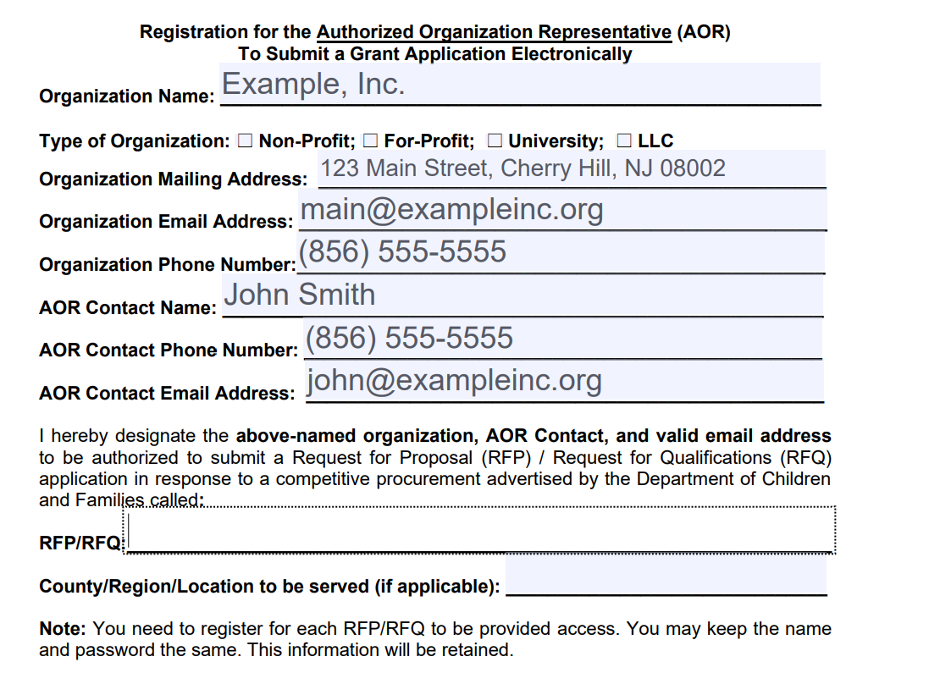
Organizing Your Application
Submit a complete AOR form to DCF.ASKRFP@dcf.nj.gov
Ensure the form is completely filled and signed.
ENTER RFP/RFQ NAME HERE

Slide 20
Organizing Your Application
Applications must be submitted as three separate PDFs.
Providers will be given access and instructions to a secure FTP site to upload.
Refer to RFQ Pgs. 28-32

Slide 21
Organizing Your Application
PDF 1: Section II – Required Performance and Staffing Deliverables
Complete and sign Signature Statement of Acceptance (Found in RFQ p.27)
Only required to submit this signature page (not the whole RFQ)
Your signature certifies that you have read, understood, accepted and, if awarded a contract, will comply with all the deliverables, terms and conditions included in the RFQ.

Slide 22
Organizing Your Application
PDF 2: Section III - Documents Requested to be Submitted with This Response, Subsection A. Organizational Documents Prerequisite to a DCF Contract Award Requested to be Submitted with the Response
There are 25 documents that should be combined into this second PDF. Please complete and, if applicable, sign and date each document.
If any document is not applicable to your agency, please submit a brief statement of non-applicability.

Slide 23
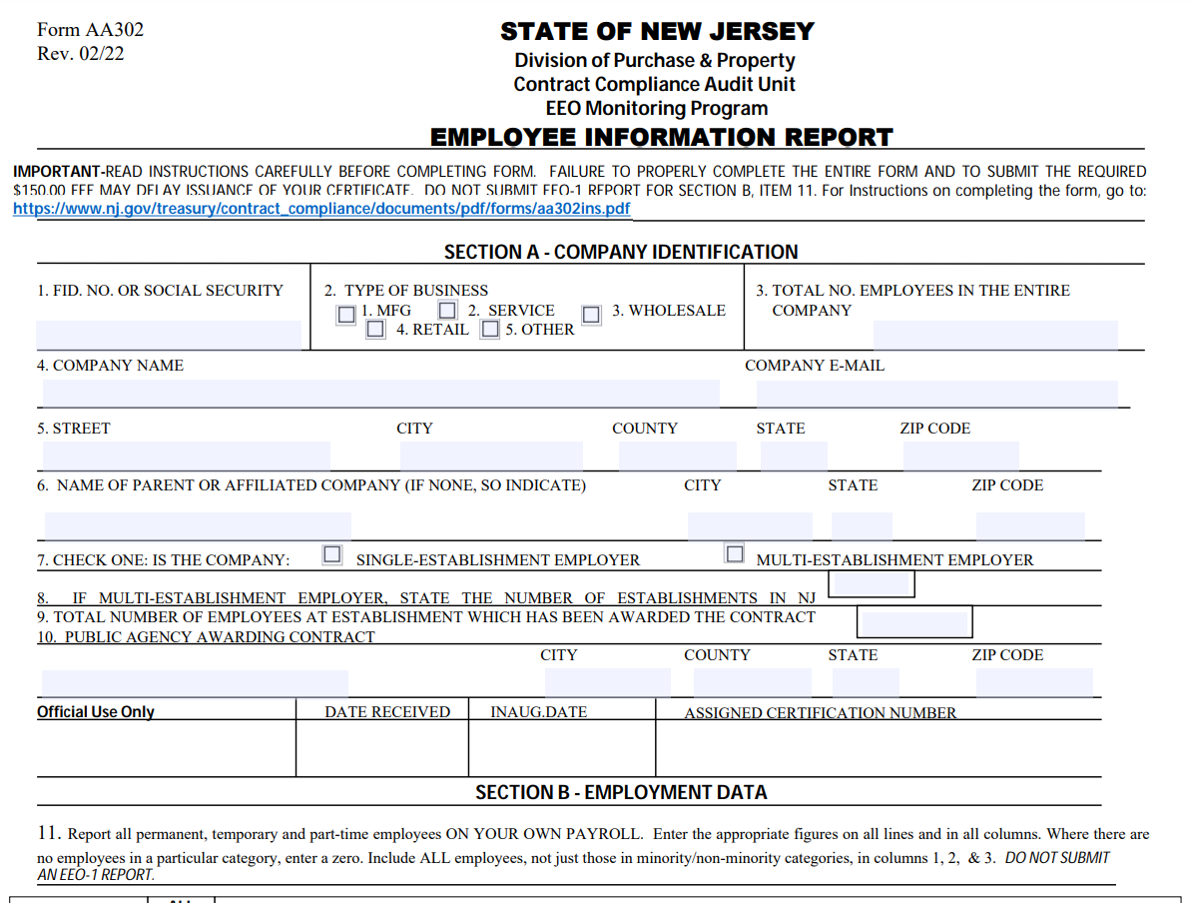
PDF 2 Common Mistakes
2. Affirmative Action Certificate
If you are a startup, you can submit the completed AA302 (left) and the receipt of payment from the Treasury ($150.00).

Slide 24
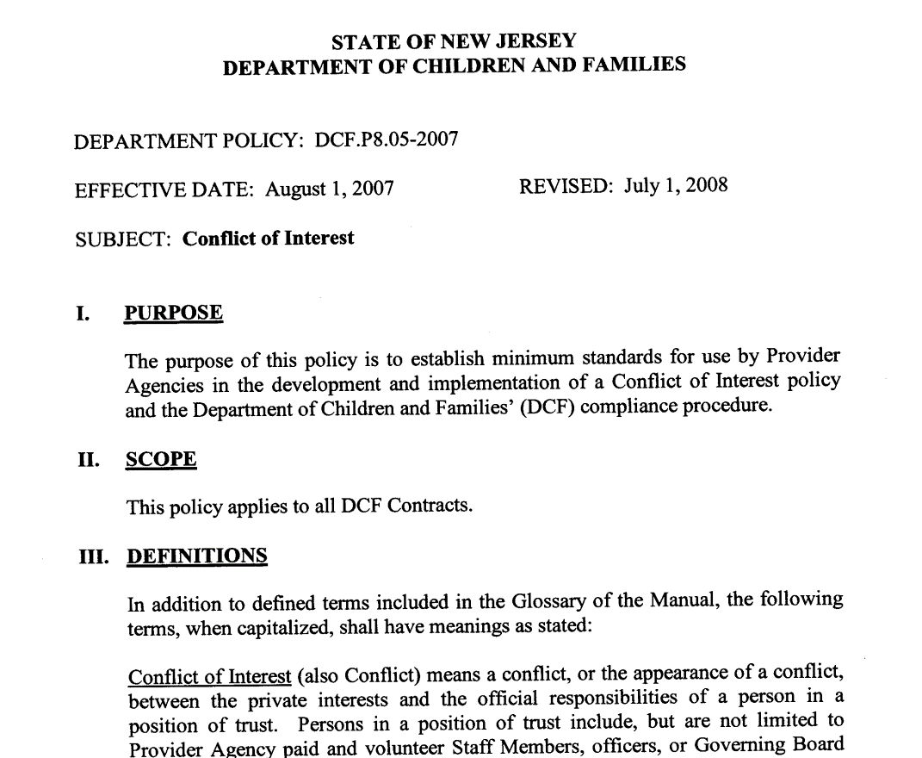
PDF 2 Common Mistakes
8. Your Organization’s Conflict of Interest Policy
Do not submit the DCF Conflict of Interest Policy.

Slide 25
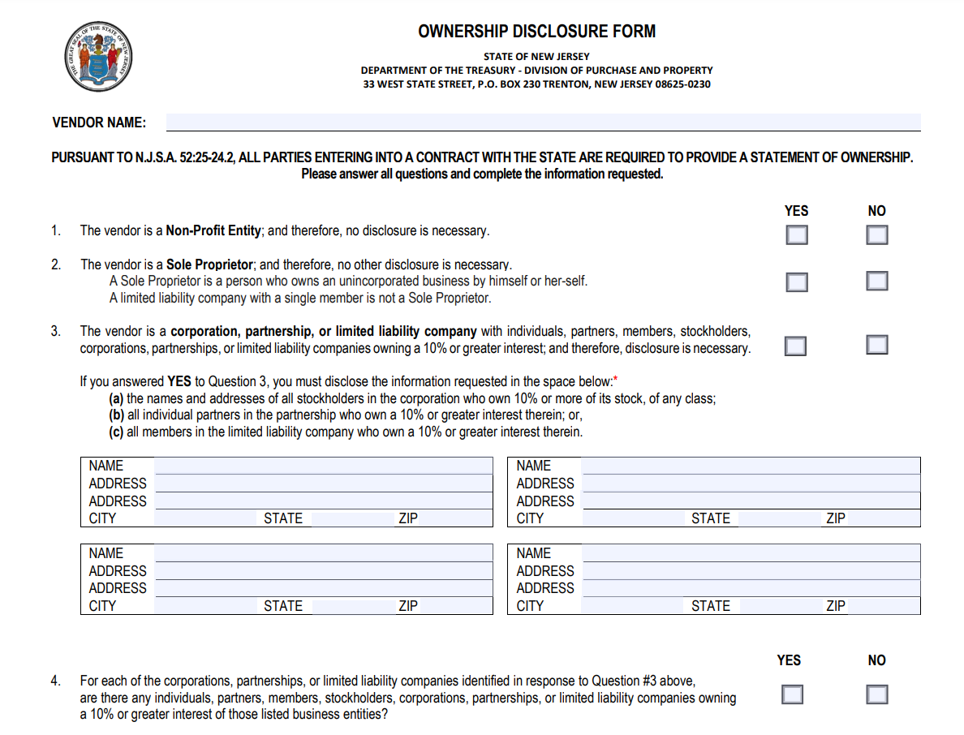
PDF 2 Common Mistakes
13. Ownership Disclosure Form
You must submit this with your response or it will not be considered.
Read each statement carefully.
YOUR AGENCY NAME HERE

Slide 26
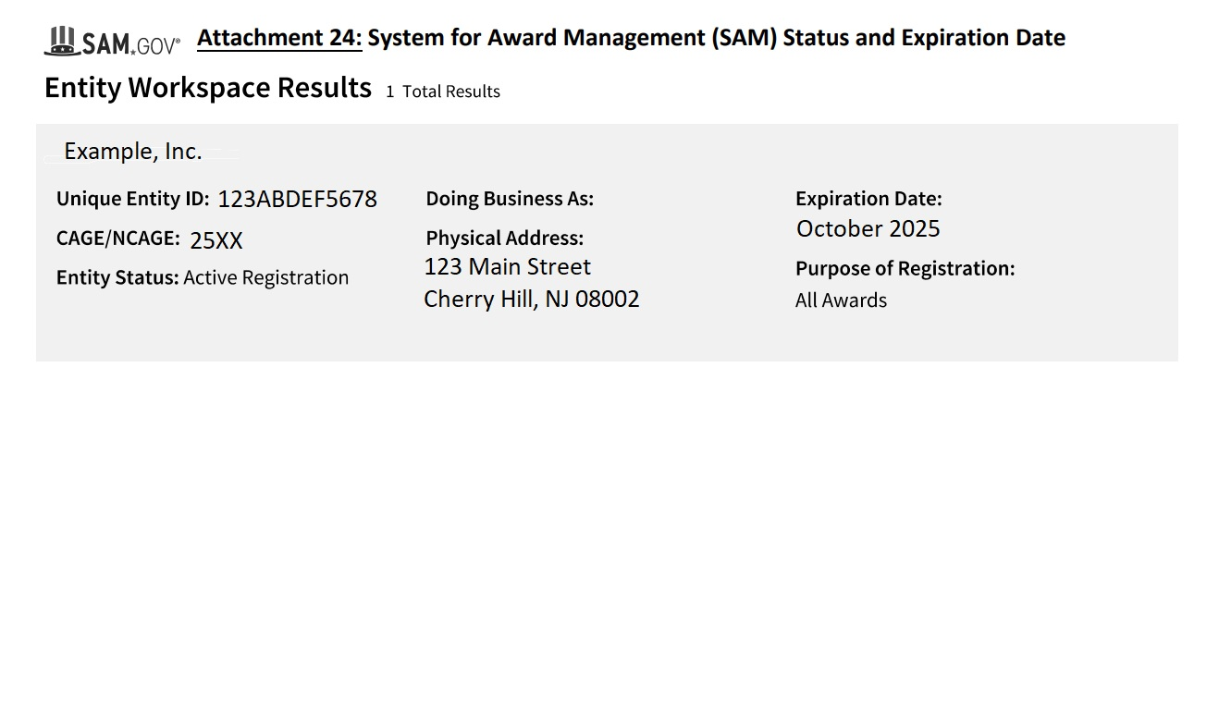
PDF 2 Common Mistakes
16. System of Award Management (SAM)
Submit a printout showing your UEID, Active Status, and Expiration Date.

Slide 27
Organizing Your Application
PDF 3: Section III – Documents Requested to Submitted with This Response, Subsection B. Additional Documents Requested to be Submitted in Support of This Response
There are 4 documents that should be combined into this third PDF:
Program Description Form
Three (3) Letter(s) of Support
Summary of Reduction and Seclusion
Training Curricula Table of Contents
Notes:
Three (3) Letter(s) of Support from community organizations with which you already partner. Letters from any New Jersey State employees are prohibited. They must be signed, dated, and include the contact information (email or phone number) of the signee.
Summary of Reduction of Seclusion and Restraint Use (maximum 3 pages) describing policies adopted and the practices implemented to achieve this goal.
A Training Curricula Table of Contents for the current and proposed workers consistent with the requirements described and certified to in the Activities Requirements of the Required Performance and Staffing Deliverables of this RFQ.

Slide 28
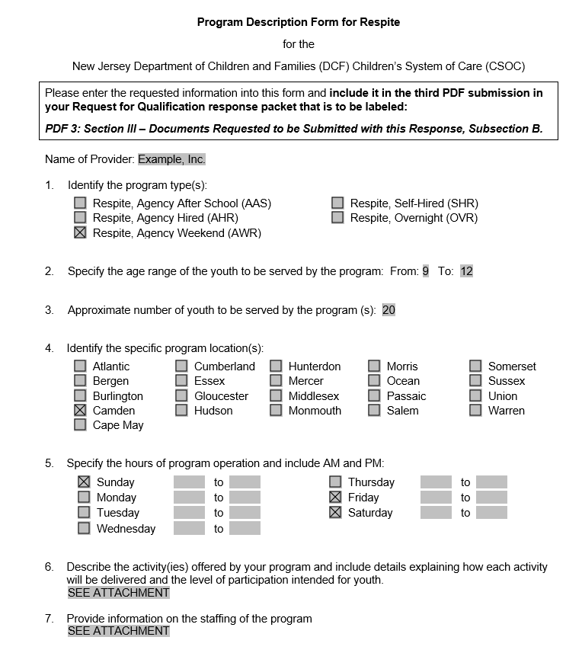
Organizing your Application
Program Description Form
Submit a complete form for each program.
Ensure all questions are complete.
Notes:
6. Youth will participate in recreational activities including board games, sports games, and community outings to local events. Youths will be grouped together based on age, abilities, and interest for specific activities. The youths’ participation levels will be based on their individual capabilities.
7. The program staff ratio will be 5 to 1. Staff members will be available to supervise youth and provide coaching and support during activities.

Slide 29
Questions & Answers
Respondents may not contact the Department directly, in person, or by telephone, concerning this RFP. Questions may be sent in advance of the response deadline via email to DCF.ASKRFP@dcf.nj.gov
Technical inquiries about forms, documents, and format may be requested at any time prior to the response deadline, but questions about the content of the response must be submitted by 12 PM on October 24, 2024.
Responses to content questions will be posted to the Department website at DCF | Requests for Proposals, Qualifications/or Information and Funding Opportunities (nj.gov)
Notes:
Example of a Technical Inquiry:
Do I have to submit the SLD, Individual Provider Agreement, and the State Entity agreement all together? (No. Only one.)
What if I don’t have a SAM? (Please apply for one at the Sam.gov website. It’s free)

Slide 30
Questions
Notes:
This concludes our presentation. At this time, we will answer some previously submitted question and take any questions you may have.
The previously submitted question we received was as follows:
Q. I was wondering if we are eligible to apply since we already have a contract in place as an existing provider. If you can assist with your guidance, it would be greatly appreciated.
Providers who are currently contracted with CSOC to provide respite services do not need to reapply. This RFQ is only for providers who do not currently have a CSOC Respite contract. If you are a current CSOC contracted respite provider and you wish to add a respite program, please contact your CSOC contract administrator.
Q. Do we need an additional NPI number for this service?
The previously submitted Q&A will be posted on the DCF RFQ webpage after this presentation.
If you have any additional questions after the presentation, please email DCF.ASKRFP@dcf.nj.gov.
Thank you!

