Slide 1
New Jersey Department of Environmental Protection Office of Pollution Prevention and Right to Know Community Right to Know Webinar for Report Year 2015

Slide 2
Purpose of Community Right to Know (CRTK)
Increase community awareness of chemical hazards
Support and focus state/local planning activities
Support chemical accident and pollution prevention initiatives

Slide 3
SURVEYS DUE MARCH 1
ALL CRTK SURVEYS
MUST BE SUBMITTED
ELECTRONICALLY
@ www.njdeponline.com

Slide 4
Who Must Complete a CRTK Survey
New Jersey Regulations
Employer as defined by the New Jersey Worker and Community Right to Know Act
Based on the North American Industry Classification System (NAICS) Codes
Access the NAICS Codes at: http://www.nj.gov/dep/opppc/figdoc.htm

Slide 5
Who Must Complete a CRTK Survey (continued)
Federal Regulations
Emergency Planning and Community Right
to Know Act of 1986 (EPCRA)
Any facility, regardless of industry sector, if hazardous
substances are present above reporting thresholds

Slide 6
What Must Be Reported
New Jersey
Hazardous substances on the NJ CRTK Environmental Hazardous Substance (EHS) List
typically, 500 pound reporting threshold
Access the NJ List at: http://www.nj.gov/dep/opppc/figdoc.htm
Federal
Any hazardous substance or product for which a Safety Data Sheet (SDS) is required per the OSHA Hazard Communication Standard
typically 10,000 pound reporting threshold

Slide 7
What Must Be Reported (continued)
New Jersey and Federal
Extremely Hazardous Substances
(EPCRA Section 302)
Contained in the NJ EHS List – designated with an asterisk (*) or asterisk & plus sign (* +)
Reporting Quantity (RQ)

Slide 8
CRTK Facility Reporting Exemptions
Facilities that previously reported as a Non-User or User Below Threshold of NJ CRTK Environmental Hazardous Substances (EHS’s)
Employers within a NAICS Exempt Subcategory
487110 Scenic and Sightseeing Transportation Land - Limited to facilities engaged in horse-drawn cabs and carriages services
488119 Other Airport Operations - Except facilities engaged in flying fields operated by aviation clubs
Complete list of NAICS Codes can be found at:
http://www.nj.gov/dep/opppc/figdoc.htm

Slide 9
CRTK Facility Reporting Exemptions
(continued)
Unstaffed Sites (cell towers, well stations, switching boxes, etc.) unless EPCRA reporting thresholds are met or exceeded
Employers if all locations in NJ perform Administrative functions only
Can only be Exempt after notification to NJDEP!

Slide 10
CRTK Facility Reporting Exemptions
(continued)
If you believe you fit into one of these Reporting Exemptions, and you have not received prior confirmation from NJDEP that you are Exempt, you can go to: http://www.nj.gov/dep/opppc and complete and submit a CRTK Reporting Exemption Form.
You do not have to set up an online account or complete a CRTK Survey.

Slide 11
CRTK Facility Reporting Exemptions
(continued)
Must notify NJDEP if change in status
NJDEP conducts periodic, random inspections to verify status
For Non-Users, Users Below Threshold, and Unstaffed Sites, notification must have been made on or after January 1, 2005
First reporting period after the CRTK Rules were revised to expand the exemption list.

Slide 12
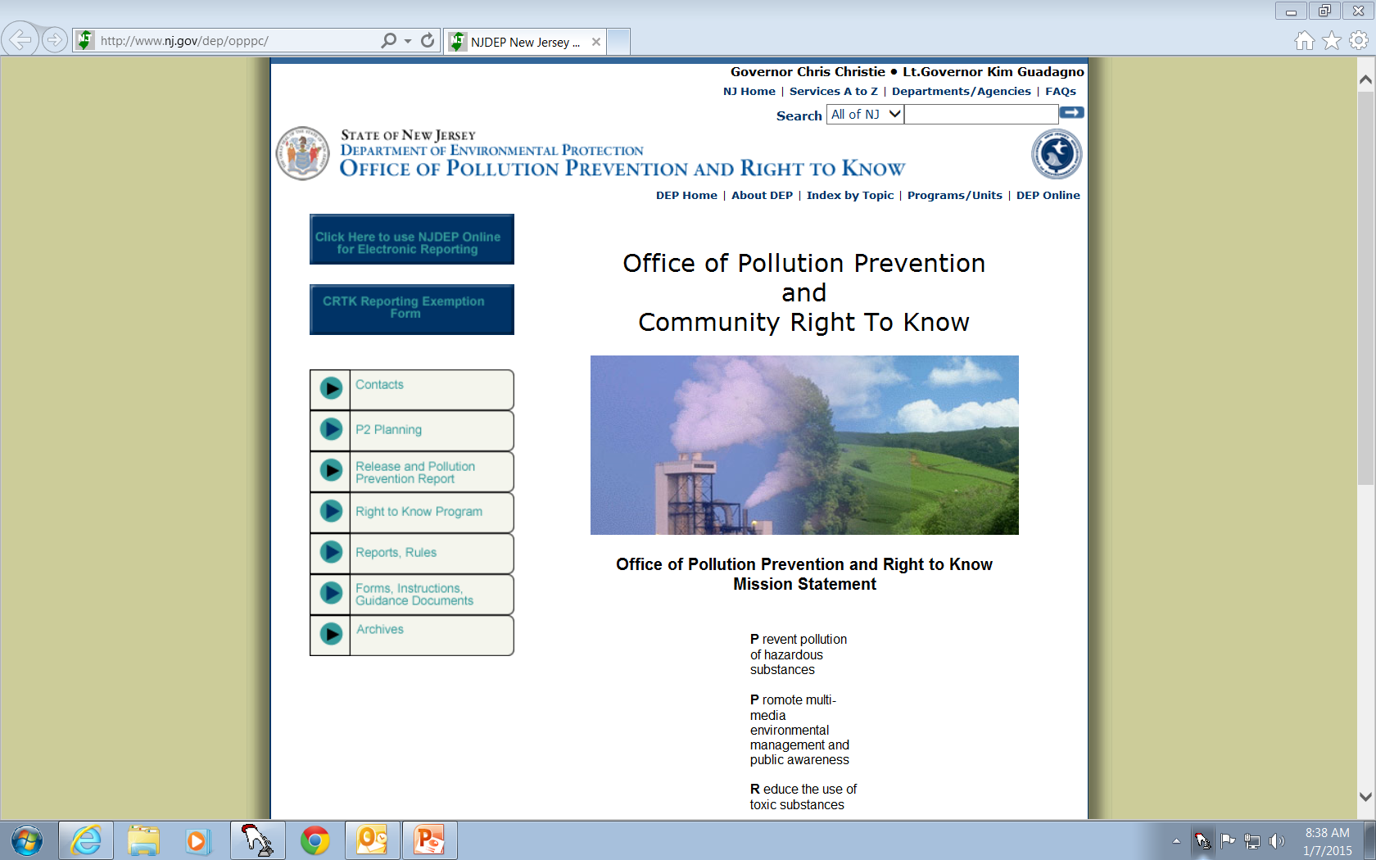
Click on this Blue Box to access the Exemption Form

Slide 13
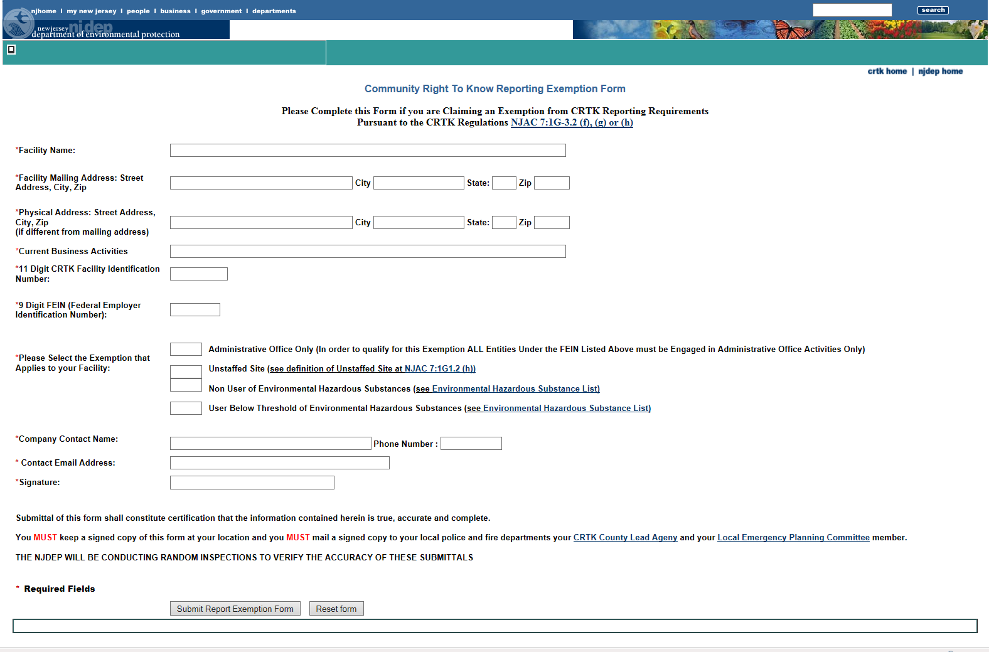
You Must complete all fields and you Must indicate which exemption applies or the form will not be accepted.

Slide 14
CRTK Environmental Hazardous Substance (EHS) Reporting Exemptions
EHS’s present, in aggregate, below reporting thresholds
EHS’s at facilities, or portions of facilities, used primarily for research and development (R&D)
Must obtain a CRTK R&D Laboratory Exemption from NJDEP
http://www.nj.gov/dep/opppc/crtk/rdexap.pdf

Slide 15
CRTK EHS Reporting Exemptions (continued)
EHS’s that are an integral part of the facility structure or furnishings
EHS’s that are, or are contained, in personal property for the personal use of employees
EHS’s present as a solid in any manufactured item formed into a specific shape or design during manufacture to the extent that exposure to any EHS does not occur under normal conditions of use.
Does not include Saran, PVC and Lopac

Slide 16
CRTK EHS Reporting Exemptions (continued)
EHS’s comprising 1% or less of a mixture, or 0.1% if the EHS is carcinogenic as defined at 29 CFR 1910.1200 (d)4 of the OSHA Hazard Communications Regulation
EHS’s contained in ammunition on the person of security personnel

Slide 17
Threshold Determinations
It is necessary to determine if EHS’s were present at any time during the reporting year
All occurrences of an EHS must be aggregated to determine if a threshold has been exceeded

Slide 18
Threshold Determinations (continued)
If threshold was met or exceeded, all occurrences of EHS must be reported
Solids
Only the quantity of an EHS in fume or dust from a solid piece of material being modified needs to be calculated for threshold determinations
Do not include the weight of the entire material being modified

Slide 19
Threshold Determinations (example)
Trenton Manufacturing Company
401 East State Street
Trenton, NJ 08625
CRTK Facility ID 00000057927
NAICS Code 325212 - Synthetic Rubber Manufacturing

Slide 20
Threshold Determinations (continued)
Facility has 200 gallons of degreasing solvent contained in a plastic drum. The Safety Data Sheet (SDS) shows it contains 40% benzene, 20% toluene and 10% xylene
Convert gallons to pounds using density of solvent from SDS (if you cannot find the density use 8 pounds/gallon)
200 gal X 8lbs/gal = 1,600 pounds of solvent
1,600 X 0.40 = 640 pounds of benzene
1,600 X 0.20 = 320 pounds of toluene
1,600 X 0.10 = 160 pounds of xylene

Slide 21
Threshold Determinations (continued)
Facility has 100 gallons of paint contained in a plastic drum and 150 gallons of solvent also in a plastic drum. The SDS shows the paint contains 15% toluene and the solvent 20% toluene
Convert gallons to pounds using density of solvent
from SDS (or 8 lbs/gallon)
100 gal X 8lbs/gal = 800 pounds of paint
800 pounds X 0.15 = 120 pounds of toluene in the paint
150 gals X 8 lbs/gal = 1200 pounds of solvent
1200 X 0.20 = 240 pounds of toluene in the solvent
Aggregate the quantities of toluene
120 pounds + 240 pounds = 360 pounds of toluene

Slide 22
Threshold Determinations (continued)
Facility has 2,000 cubic feet of methane in liquid form and 1,000 cubic feet of chlorine as a gas.
Convert cubic feet to pounds*
Methane
2000 ft3 X 26.3 pounds/ft3 = 52,000 pounds of methane
Chlorine
1,000 ft3 X 0.200 pounds/ft3 = 200 pounds of chlorine
* Conversion table found in CRTK Guidance Document
http://www.nj.gov/dep/opppc/crtk/figdoc.htm

Slide 23
Threshold Determinations (continued)
Facility is cutting a 5,000 pound piece of steel
that contains 20% chromium. They estimate that
approximately 30% of the steel is being generated
as dust from the cutting operation.
5,000 pounds X 0.20 = 1,000 pounds of chromium
1,000 pounds X 0.30 = 300 pounds of chromium in the dust

Slide 24
Threshold Determinations (continued)
Facility has 20,000 pounds of a product called TRXYZ
It is required to have a SDS per the OSHA Hazard Communication Standard
Per the SDS, this product contains 30% acrolein, 40% tire rubber and 30% banana oil
20,000 pounds x 0.30 = 6,000 pounds acrolein
20,000 pounds x 0.40 = 8,000 pounds tire rubber
20,000 pounds x 0.30 = 6,000 pounds banana oil

Slide 25
Threshold Determinations (continued)
In Summary:
Benzene = 640 Pounds
Toluene = 320 pounds (degreasing solvent) + 360 pounds (paint and solvent) = 680 pounds toluene
Xylene = 160 pounds
Methane = 52,000 pounds
Chlorine = 200 pounds
Chromium = 300 pounds
Product TRXYZ = 20,000 pounds
6,000 pounds acrolein
8,000 pounds tire rubber
6,000 pounds banana oil

Slide 26
Threshold Determinations (continued)
Benzene, toluene, xylene, methane, chlorine and acrolein are all NJ EHS’s.
Benzene, toluene and methane exceed the 500 pound reporting threshold and chlorine exceeds the 100 pound reporting threshold
Xylene is below the 500 pound reporting threshold
Product TRXYZ is an EPCRA Only substance and exceeds the EPCRA 10,000 pound reporting threshold (continued) …

Slide 27
Threshold Determinations (continued)
It also contains acrolein, an EPCRA Section 302 substance above the reporting threshold of 500 pounds
Benzene, toluene, methane, chlorine and Product TRXYZ must be reported
Acrolein must be reported as a Section 302 component

Slide 28
Special Reporting Requirements
Multiple Occurrences of EHS
May be grouped as one entry if:
Same container type
Same storage conditions
Solid/liquid/gas
If any of the above criteria differ, EHS must be listed separately
All hazards must be listed
Trenton Manufacturing
Toluene present in paint and solvent
Both contained in plastic drums, both present as a liquid
May be grouped as one entry

Slide 29
Special Reporting Requirements (continued)
Diesel Fuel or #2 Heating Oil, Gasoline, Kerosene, Petroleum Oil and Waste Oil
Reportable if present in quantities of 10,000 pounds or greater
Can use 7 pounds/gallon to convert from gallons to pounds
A quantity of 1,429 gallons or greater would exceed the 10,000 pound threshold
Do not need to identify EHS constituents
Alternative Fuel
Reportable if contains more than 10% ethanol and present in quantities of 10,000 pounds or greater

Slide 30
Special Reporting Requirements (continued)
Wastes
Reportable if the EHS is present elsewhere at the facility at or above the reporting threshold
Do not include quantities of waste in threshold determinations
Combine reporting of EHS in wastes and non-wastes to determine inventory if stored in the same container type
If the waste contains a mixture of EHS’s report it as “Haz Waste, N.O.S. (only if EHS reported)”

Slide 31
Special Reporting Requirements (continued)
Quality Assurance Labs
Small samples of EHS’s that are present elsewhere at or above reporting threshold
Group and report as one entry …
“Substance Samples (only if EHS is reported)”
If stored in same container, enter container code
If stored in multiple containers, select “Other” from dropdown menu and enter “OT” in Container Description box
Use substance number 3628

Slide 32
EPCRA Reporting Requirements
USEPA finalized changes to the federal Emergency Planning and Community Right to Know Act (EPCRA) in July 2012.
Changes effective January 1, 2014
Changes have been incorporated into the electronic reporting forms
Applicable to any facility that is subject to federal EPCRA reporting requirements only, or any facility that reported as least one “EPCRA Only” substance at or above the reporting threshold. Also, applicable to any facility that reported an EPCRA Section 302 substance at or above a reporting threshold.

Slide 33
EPCRA Reporting Requirements (continued)
“EPCRA Only substance” means the substance is not on the NJ EHS List
Additional fields
Latitude and longitude
Maximum number of occupants at any one time
Manned or unmanned
TRI Facility ID (this field may be prepopulated for you)
RMP Facility ID (this field may be prepopulated for you)
Facility Section 302 Emergency Coordinator
(Required if subject to emergency planning
under Section 302 of EPCRA = “Yes”)

Slide 34
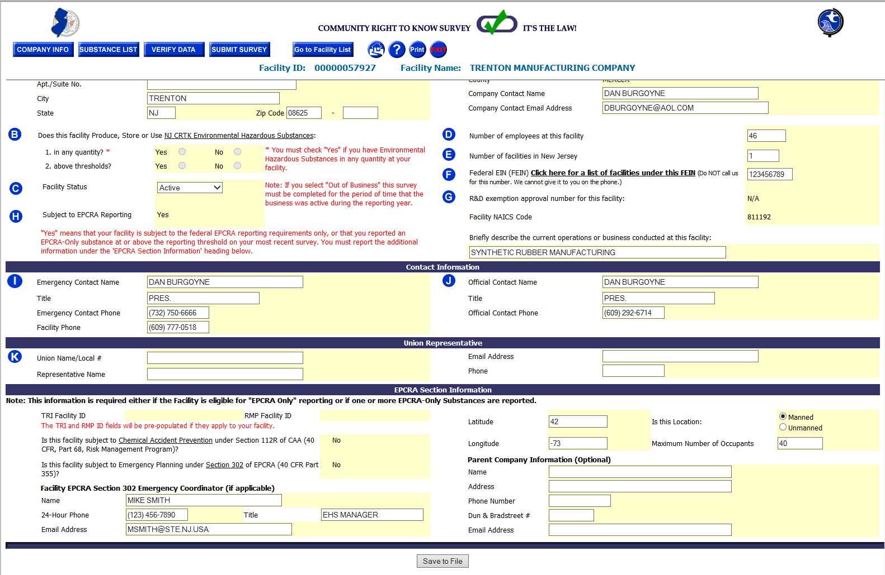

Slide 35
EPCRA Reporting Requirements (continued)
Additional “Yes/No” Questions
Subject to emergency planning under Section 302 of EPCRA?
Subject to chemical accident prevention under Section 112r of the Clean Air Act (40 CFR Part 68, Risk Management Program)?
Pressure and temperature description instead of the codes will appear on the printed survey
Optional Information
Parent Company Name, Address, and
Dun and Bradstreet Number

Slide 36
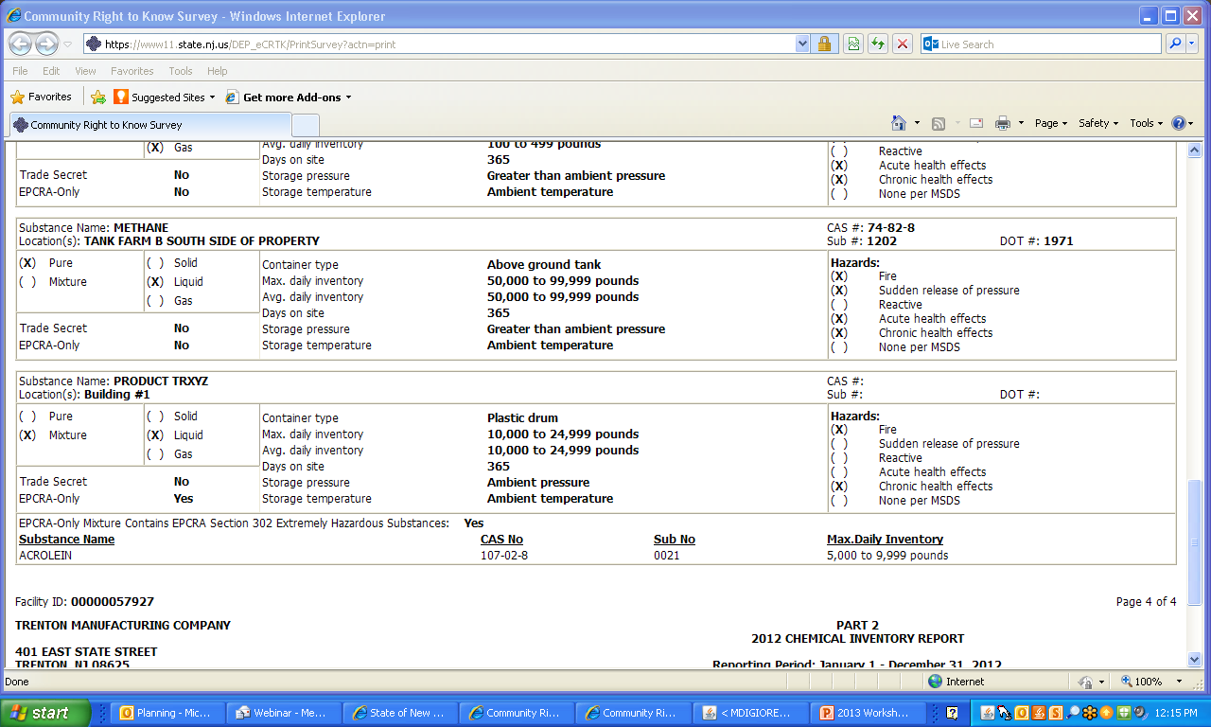
Typed out descriptions for Pressure & Temperature

Slide 37
EPCRA Reporting Requirements (continued)
Additional inventory info
If reporting an EPCRA Only substance as a mixture, must indicate/report any EPCRA Section 302 Extremely Hazardous Substance components present in the mixture above the reporting threshold
Substance name
Chemical Abstract Service (CAS) number
Maximum daily inventory quantity
If this is the only instance of the EPCRA Section 302 substances, it does not have to be reported separately on the Survey

Slide 38
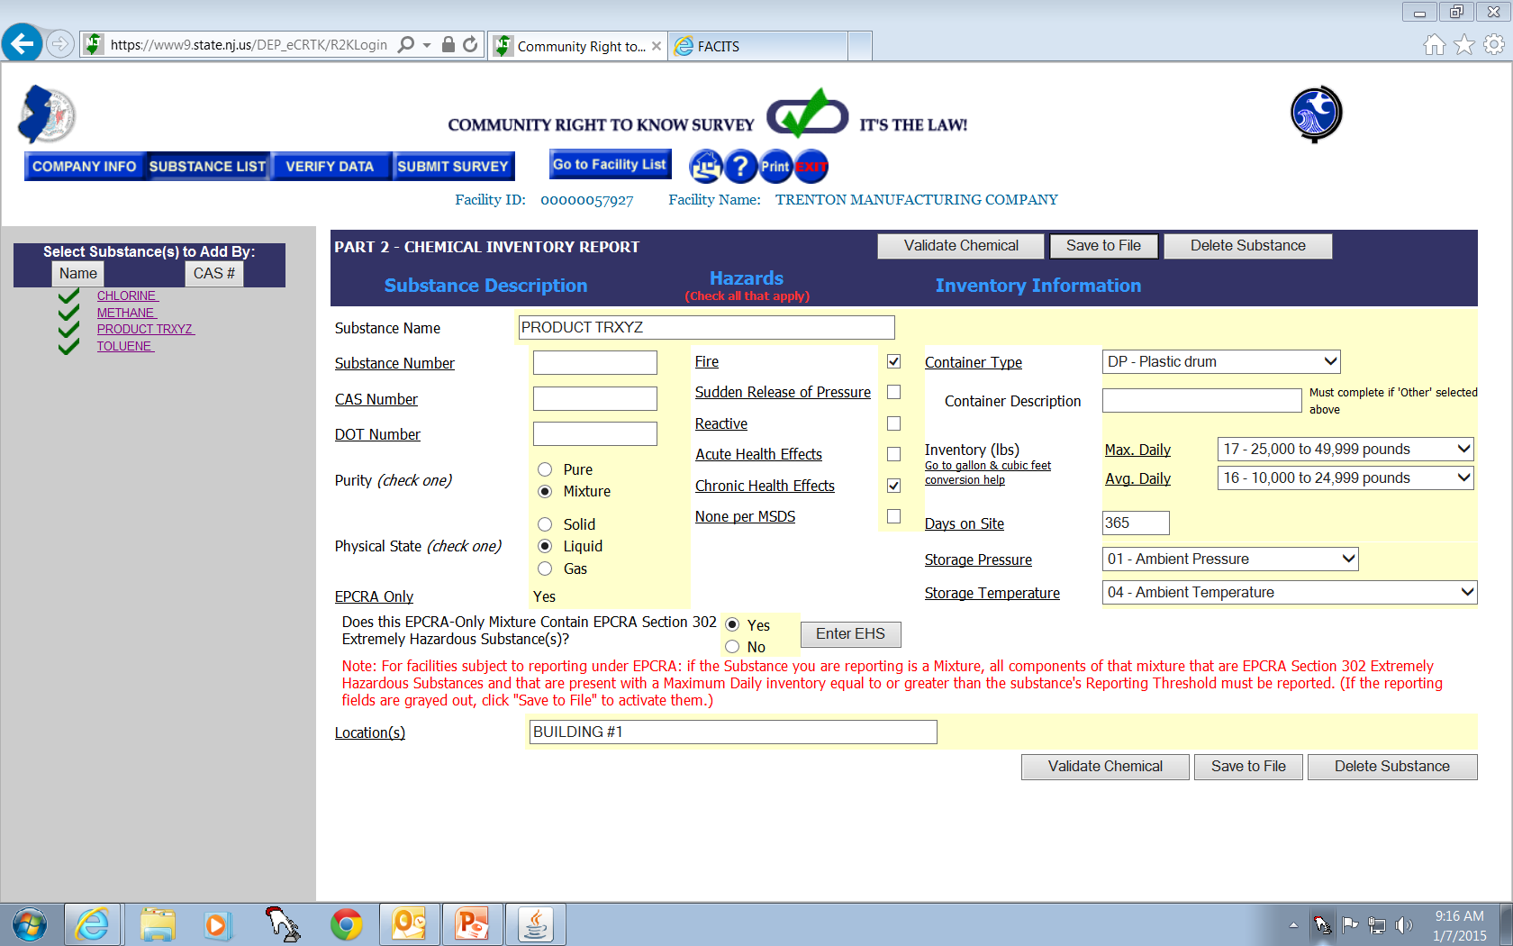
Over 10,000 lbs.
This is your reportable substance under EPCRA
Click here to enter your 302 Chemical(s)

Slide 39
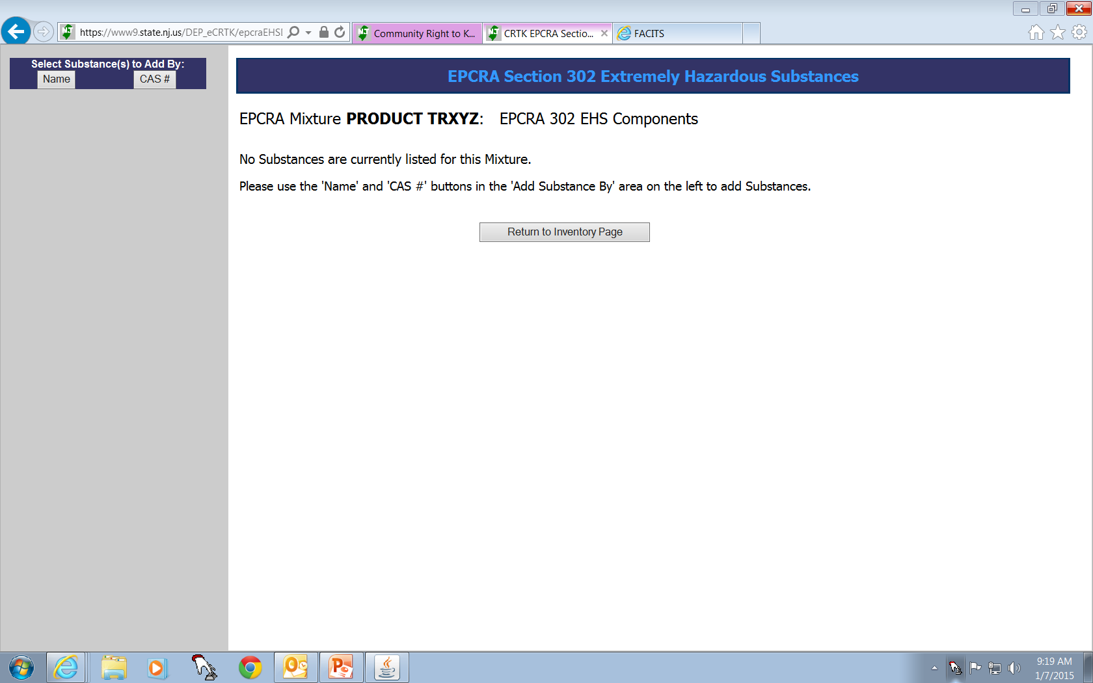
Click on either Name or CAS# to search for your 302 Chemical(s)

Slide 40
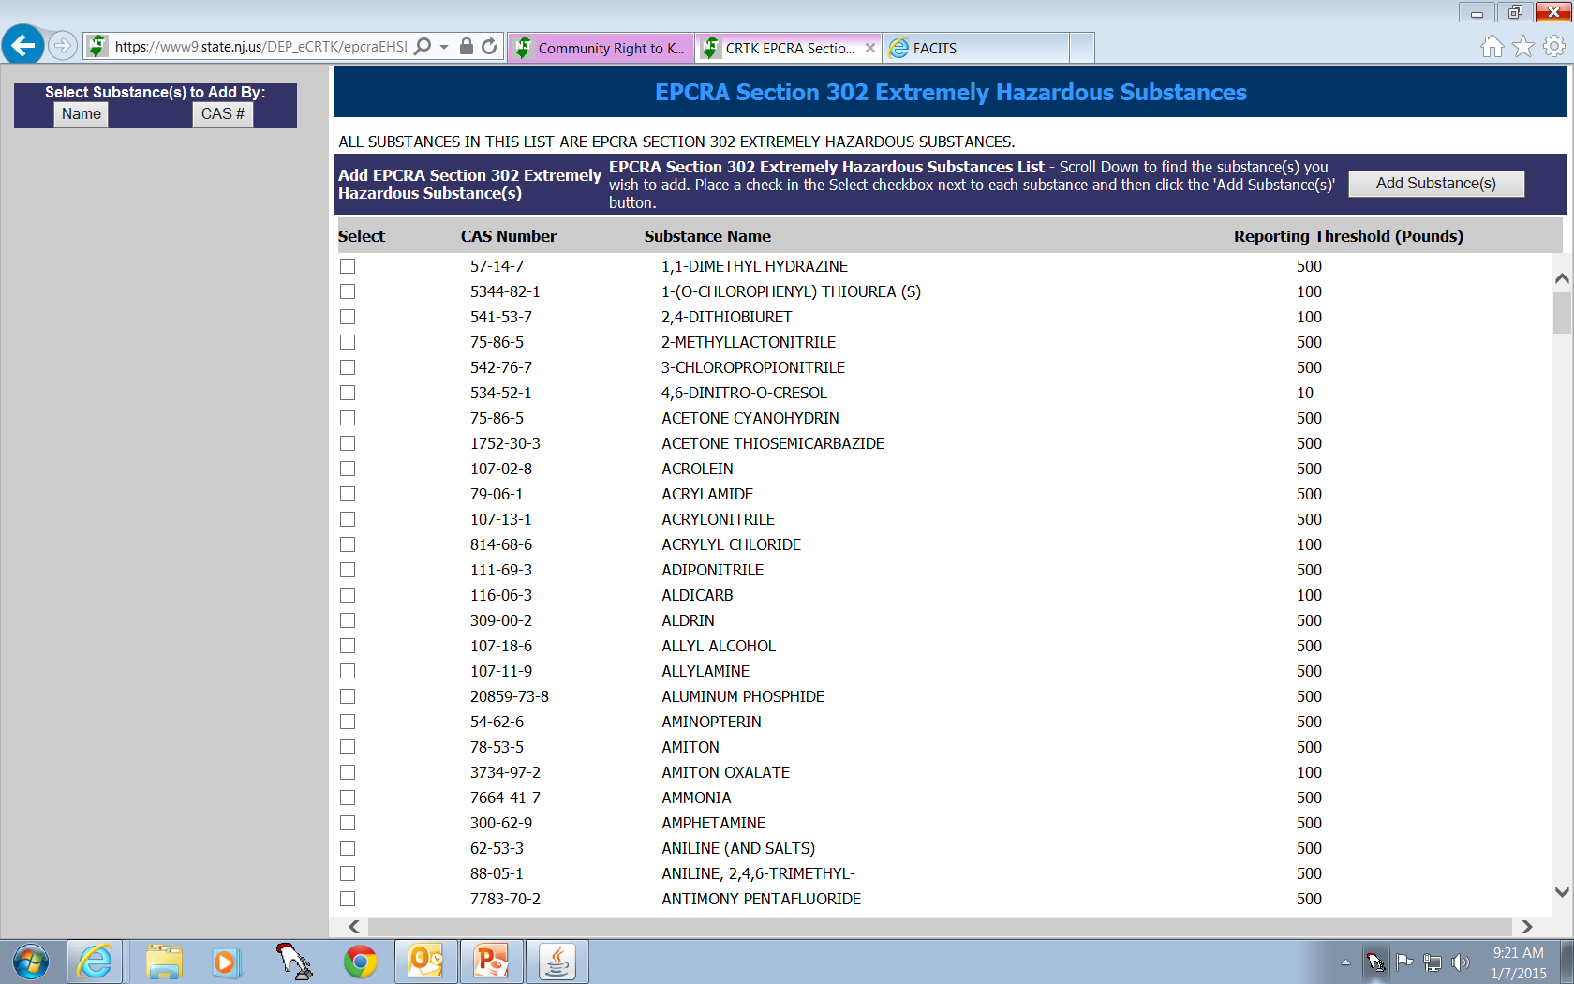
Click here to import your chosen chemical(s)
Click inside the box(es) for the chemical(s) you wish to add

Slide 41
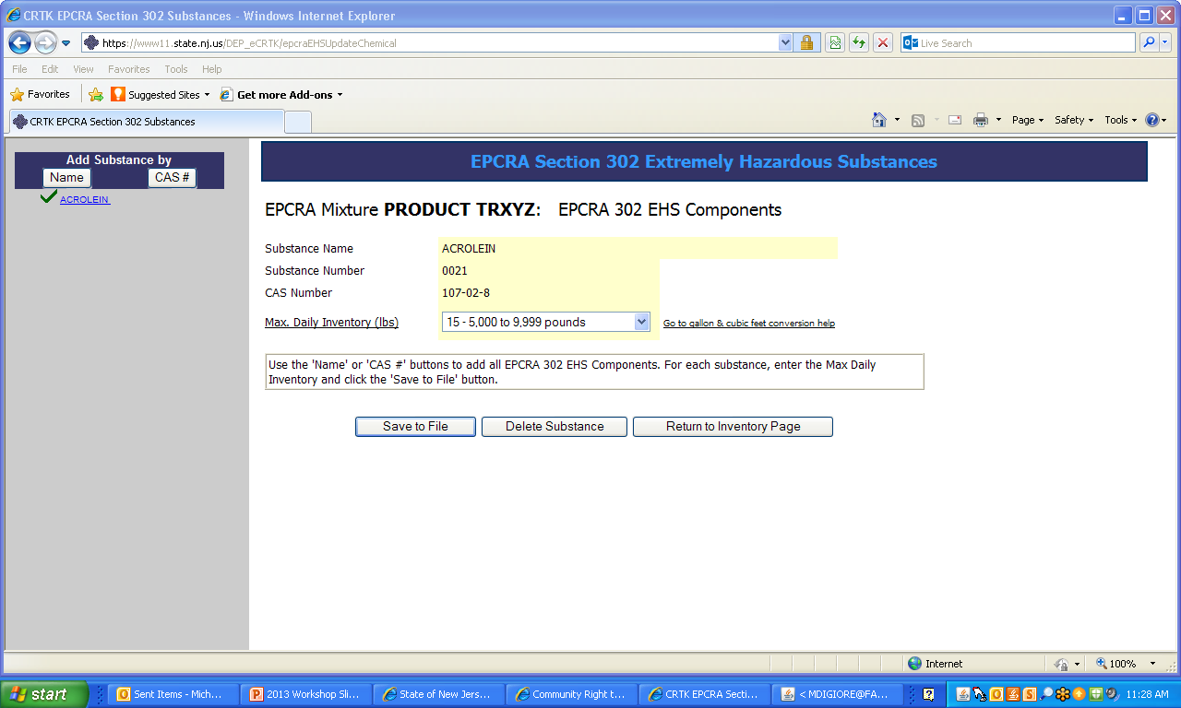
Choose the appropriate Max. Inventory for your 302 Chemical.
Click here before returning to main inventory page.
Takes you back to the main inventory page.

Slide 42
Changes to the Environmental Hazardous Substance List
A separate listing has been added for ammonia (aqueous concentrations of 20% or greater). Only the quantities for concentrations of 20% or greater will be reportable. The CAS # will be the same but a different DOT Number will be used, 2672.

Slide 43
Changes to the Environmental Hazardous Substance List
(continued)
2461 Haz Waste, N.O.S. (only if EHS reported) DOT # 9189
… has been broken into two …
2461 Haz Waste, N.O.S. (only if EHS reported) liquid DOT # 3082, and
2461 Haz Waste, N.O.S. (only if EHS reported) solid DOT # 3077

Slide 44
Changes to the Environmental Hazardous Substance List
(continued)
4204 Nonylphenol N530
Category added, includes only
the following substances:
Isononylphenol 11066-49-2
4-Isononylphenol 26543-97-5
Nonylphenol 25154-52-3
4-Nonylphenol 104-40-5
Nonylphenol, branched 90481-04-2
4-Nonylphenol, branched 84852-15-3

Slide 45
Changes to the Environmental Hazardous Substance List
(continued)
Deleted
Heating Oil 68476-34-6 1993
Should be reported as Diesel Fuel or #2 Heating Oil (containing EHSs)

Slide 46
Changes to the Environmental Hazardous Substance List(continued)
Deleted the following individually listed substances as they are in the “Polycyclic aromatic compounds” category:
4103 1,6-Dintropyrene 42397-64-8
4019 1,8-Dintropyrene 42397-65-4
4108 6-Nitrochrysene 7496-02-8
4017 4-Nitropyrene 57835-92-4

Slide 47
Changes to the Environmental Hazardous Substance List
(continued)
Also Deleted:
1762 Oleum [Sulfuric acid (fuming)] (S) 8014-95-7 1831
1762 Sulfuric acid (fuming) 8014-95-7 1831
2851 Used Petroleum Oil (containing EHSs) 1270
(report as “Waste Oil”)

Slide 48
Other Reporting Changes
Section B on the CRTK Survey will only be applicable for facilities covered by the NJ CRTK rules. Facilities covered under Federal EPCRA will not need to answer these questions
Inventory page will refresh to the first incomplete chemical on the list

Slide 49
Distribution of the CRTK Survey
Original to NJDEP (Electronically)
Local Fire Department (Printed Copy)
Local Police Department (Printed Copy)
County Lead Agency (Printed Copy)
Local Emergency Planning Committee
(Printed Copy)
Employer’s file copy (Printed Copy)

Slide 50
Contact:
Office of Pollution Prevention and Right to Know
609-777-0518
609-292-6714
http://www.nj.gov/dep/opppc

Slide 51
Questions?

