Slide 1
New Jersey Department of Education
Office of Fiscal Policy and Planning
2025 – 2026
Budget Software Training
Software: https://homeroom.state.nj.us/
Guidance: https://www.nj.gov/education/budget/

Slide 2
References
Budget Guidelines and Electronic Data Collection (EDC) Manual
  Contains overview of information necessary to utilize the web-based program, and detailed budget preparation information.
  County review checklist is Appendix D of this document.
  New in 2025-26, Appendix D-4 to review separate proposals for subsequent budget to be presented to voters at special elections.

Slide 3
Other Budget References
2025-26 Budget Statement - Other Items Posted on Website
  Sample Statement of Priorities
  Tuition Revenue and Appropriation Worksheets (Excel)
  Election Calendar
  Clarification for Board Reorganization Meetings
  Budget Q&A
  Worksheet for Changes Made at Public Hearing

Slide 4
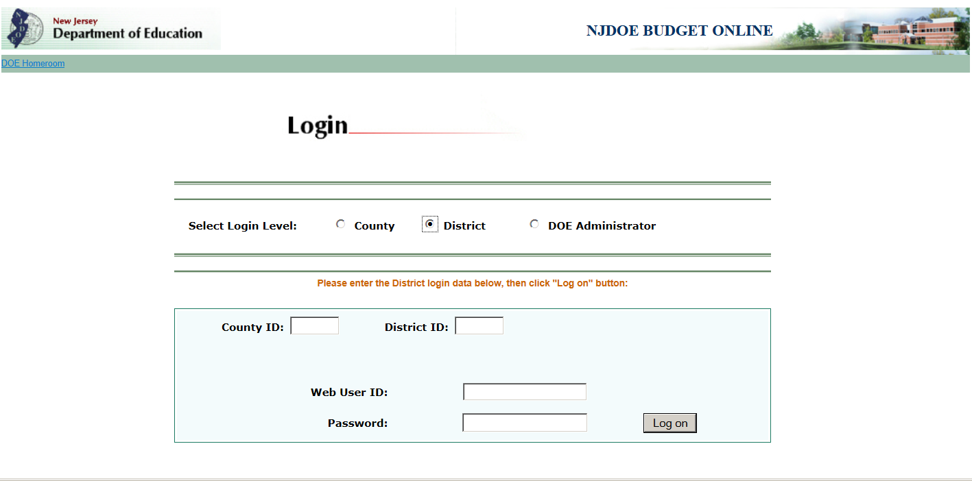
Software Login
District sign-on is controlled by the district’s Homeroom Administrator.
Multiple users may be logged in at the same time, including the county office.

Slide 5
Save Data
You must use the Save Data button on each screen to save your input to the database.
If an on-screen edit message appears (in red text, at the top or bottom of the screen) then the data on that screen is not saved. The user must make changes to clear the edit and select the Save Data button again.

Slide 6
Review of the Budget Software
General Comments - Entry in the System
Entering The District Budget
  General Overview
  Completing the “Budget” Tab
  Completing the “Calculations” Tab
  Completing the “Supporting Documentation” Tab
  Completing the “Enrollment” Tab
  Completing the “Tax Levy Certification” Tab
  Completing the “Edit Report”
  Completing the “County Review and Approval” Tab
User-Friendly Budget/Advertised Budget

Slide 7
General Comments - Entry in the System
Follow specific order of completing screens to allow for correct processing of data. Some screens are dependent on data entry completed in other screens for the calculations to be final.
Refer to manual section II for details.
System automatically logs user off if no activity for two hours.
Users should make sure their Internet settings do not block pop-ups while accessing the budget software.

Slide 8
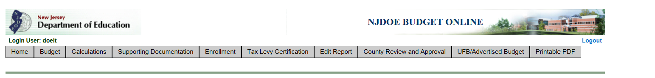
Home Page – Menu Selections
Software is formatted as a series of tabs to access the various screens.
Notices regarding updates to the software will be included on the “Home” screen.

Slide 9
Entering the District Budget - General
2023-24 actual amounts in the revenues and appropriations sections are drawn from the district-certified Audsum submission for that year. Any issues must be addressed in Audsum. Once Audsum is certified, the changes will automatically flow to budget the next time the budget system is accessed.
2024-25 revised revenues and appropriations figures represent the current year budget with revisions as of February 1, 2025.
Budget program preloads the 2024-25 data from certified budget including any adjustments for unliquidated PO’s that were open at the end of the prior audited year.

Slide 10
Entering the District Budget - General (Continued)
Preloaded 2024-25 data must be updated to reflect the appropriations for June 30, 2024 year-end encumbrances and any other revisions made between 7/1/24 and 2/1/25.
  June 30, 2024 Reserve for Encumbrances total from the Audsum (line 90010) is preloaded in the 2024-25 column on revenue line 710 the first time the budget is accessed, and line 710 is open for data entry in case Audsum was not complete when budget is first opened.
  Adjust the individual 2024-25 appropriation lines for the roll-over of the 6/30/24 encumbrances.
Refer to manual section III-A

Slide 11
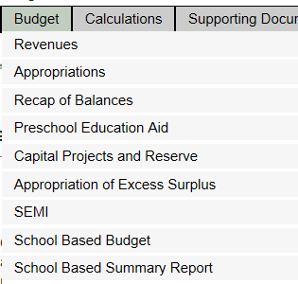
Completing the “Budget” Tab

Slide 12
Completing the “Budget” Tab – Revenues
Data entry for some revenue lines will be performed on other screens and will flow to the revenues screen (Recapitulation of Balances, Preschool Education Aid, SEMI, and Separate Proposals passed at a prior special election).
When data entry is performed on another screen, the “Subtitle” column on the revenue screen notes the screen where data entry is performed.
On a “Total” line or when data for the entire line is pulled from another screen, the line is highlighted in green, and no data entry is allowed.
For miscellaneous revenues, descriptions must be included in the “Explanation” column on the revenue screen (lines 300, 350, 500, 740, 765, and 825). Edits 80 through 85 test for completion.
Refer to manual section III-C-i.

Slide 13
Completing the “Budget” Tab – Revenue Line Updates
New revenue lines were added to the budget software in 2025-26:
  Line 111, account 10-1211 “Local Tax Levy-Separate Proposal for School Election”
  Line 112, account 10-1212, “Local Tax Levy-25-26 Separate Proposal Passed at Prior Special Election”
  Line 114, account 10-121x, “Total General Fund Tax Levy”, a subtotal of the general fund tax levy lines
  Line 802, account 20-4548, “ARP State Fiscal Recovery Funds”
Line descriptions updated in the 2025-26 budget software are:
  Line 111, account 10-1210, line name is updated to “Local Tax Levy-Base Budget”
  Line 110, account 10-1210, line name is updated to “County Tax Levy – Base Budget”
Revenue lines for federal grants no longer funded have been blocked in 2025-26. See the full list of blocked lines in the budget guidelines “changes for 2025-26” section.

Slide 14
Completing the “Budget” Tab – Appropriations
Data entry for some appropriations lines are entered on other screens and flow to the appropriations screen (Recapitulation of Balances, Capital Projects, and Preschool Education Aid).
When data entry is performed on another screen, the “Subtitle” column on the appropriations screen notes the screen where data entry is performed.
On a “Total” line or when data for the entire line is pulled from another screen, the line is highlighted in green, and no data entry is allowed.
The “Explanation” column is only applicable to advertised lines.

Slide 15
Completing the “Budget” Tab – Appropriations (Continued)
The account list has been divided with page-breaks.
  Screen will originally load the first 200 lines applicable to the district operating type.
  Use the page number links at the bottom of the screen to move between screens.
  Save your data before moving to the next page.
Refer to manual section III-C-ii.

Slide 16
Completing the “Budget” Tab –Appropriations Line Updates
One new appropriation line added to the 2025-26 budget software is:
  Line 88722, account 20-498-xxx-xxx, “ARP – State Fiscal Recovery Funds Program”
No new lines were added for School-Based Budgeting in 2025-26
Appropriation lines for federal grants no longer funded have been blocked in 2025-26. See the full list of blocked lines in the budget guidelines “changes for 2025-26” section

Slide 17
Completing the “Budget” Tab – Recapitulation of Balances
All districts must complete the Recapitulation of Balances.
Data entered on this screen will automatically create the Advertised Recapitulation of Balances report incorporated in the newspaper file and User-Friendly Budget file.
2023-24 column is preloaded with the information certified by the district in the 2023-24 Audsum.
Amounts entered into Recapitulation of Balances will flow to the revenues and appropriations screens.
Amounts in middle column flow to the “Appropriation of Excess Surplus” calculation under the Budget tab.
Amount of additional excess surplus calculated on the “Appropriations of Excess Surplus” screen flows to line 4 in the budget year column.
Specific instructions in manual section III-C-iii.
State Impact Aid Reserve added in 2024-25 has been removed in 2025-26, as no eligible districts deposited into the reserve, and ability to deposit has now expired.

Slide 18
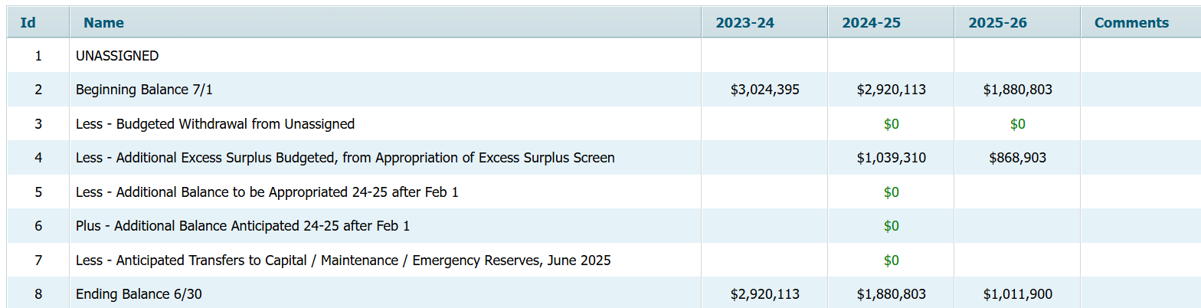
Completing the “Budget” Tab – Recapitulation of Balances (Continued)
All entries will be positive numbers and totals will carry from column to column.
Amounts from 2024-25 original budget will preload into middle column.
Review preloaded amounts in middle column against prior year original budget. If numbers don’t agree, check that all fund balances are recorded on the proper lines in Audsum.

Slide 19
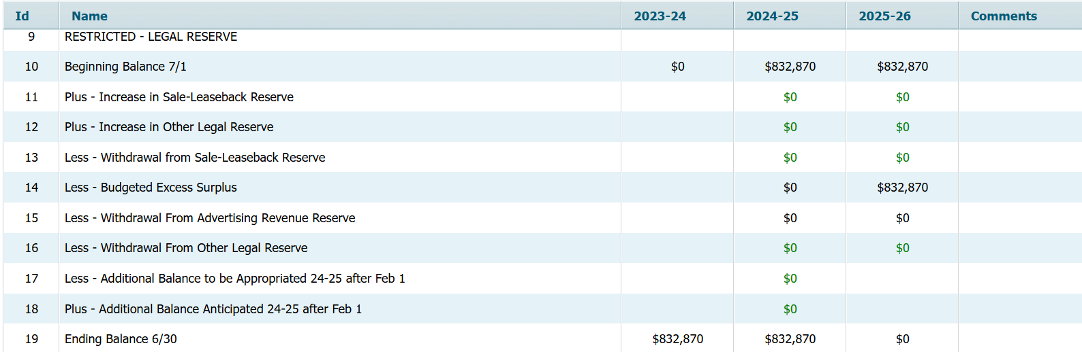
Recapitulation of Balances –
Legal Reserve
Excess surplus from Audsum loads into line 14. If amounts are in the wrong column, then they are on the wrong lines in Audsum.
Withdrawal from advertising revenue reserve, for amounts of bus advertising revenue not spent on fuel in 2023-24, loads into line 15.
Very few circumstances allow a legal reserve. County office will review ending balance on line 19 in the 2025-26 column.

Slide 20
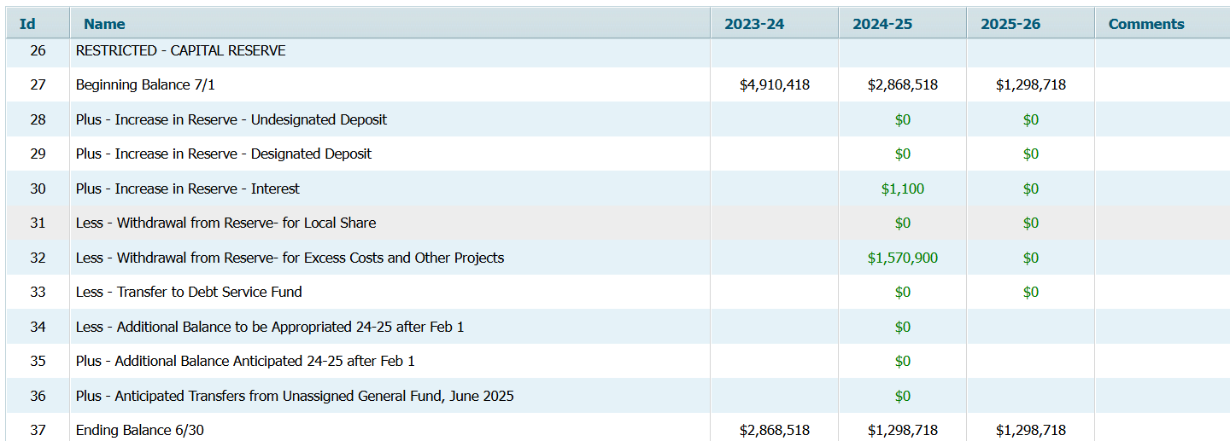
Recapitulation of Balances –
Capital Reserve
Line 29 for designated deposit requires entry in the “Comments” column for description of the designation.
Line 33 reflects change in fund balance for transfer to Debt Service Fund.
Max amount of local share must be entered on line 38.

Slide 21
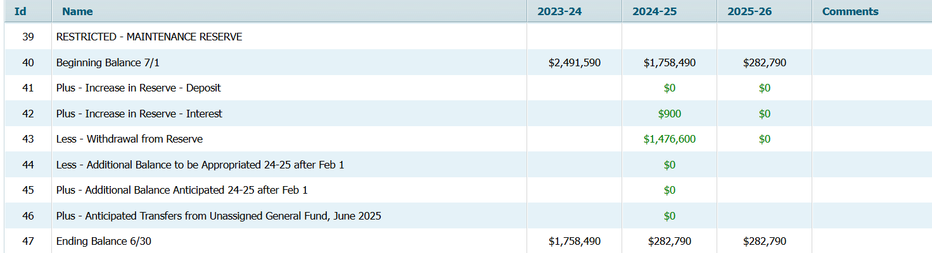
Recapitulation of Balances –
Maintenance Reserve
Withdrawals from maintenance reserve may not be greater than the amount of Required Maintenance costs in function 261. (Edits 168 and 169)

Slide 22
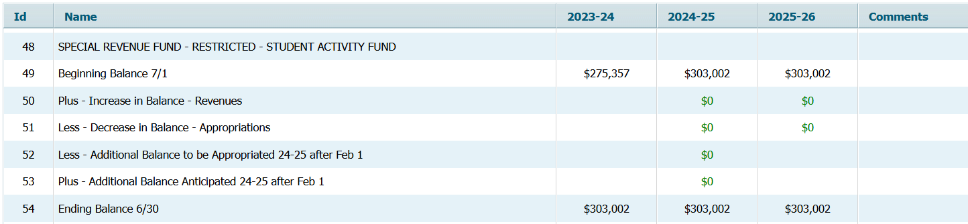
Recapitulation of Balances –
Student Activity Fund
Activity entered on the recap screen will flow to revenue lines 737 and 837, and appropriation line 84200.

Slide 23
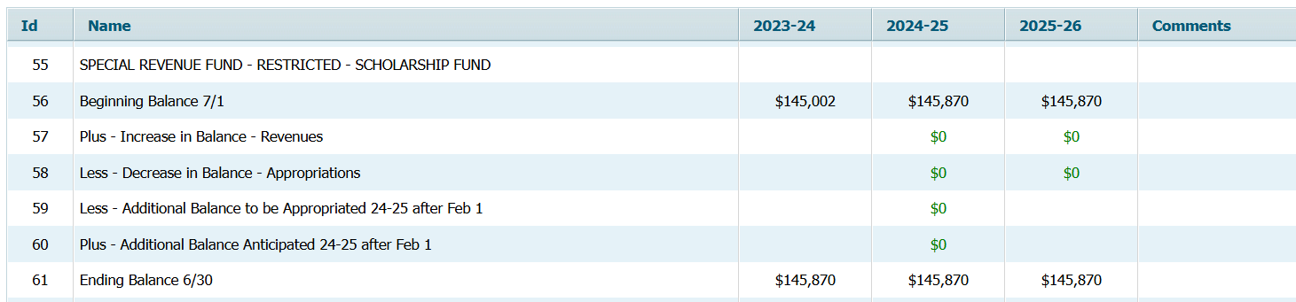
Recapitulation of Balances –
Scholarship Fund
Activity entered on the recap screen will flow to revenue lines 738 and 838, and appropriation line 84220.

Slide 24
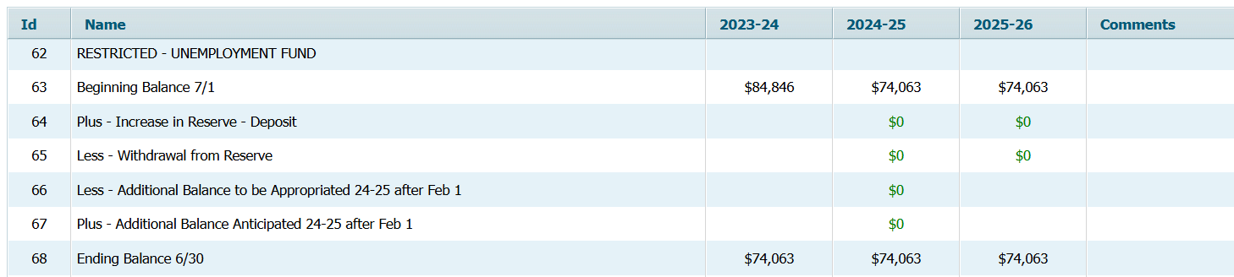
Recapitulation of Balances –
Unemployment Trust Fund
Activity entered on the recap screen will flow to revenue line 678.

Slide 25
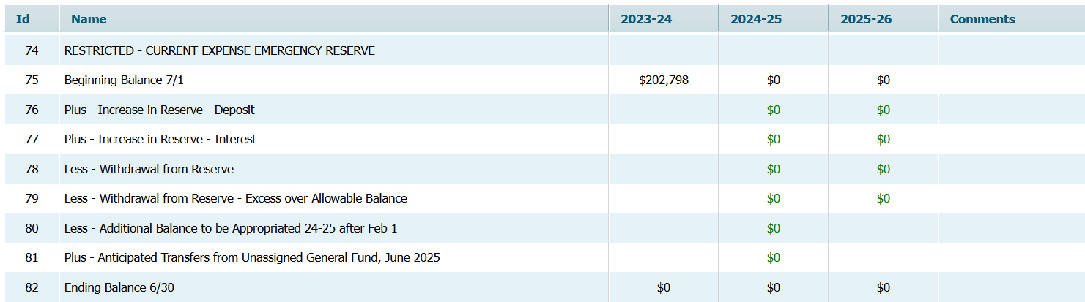
Recapitulation of Balances –
Emergency Reserve
N.J.S.A. 18A:7F-41 allows use of emergency reserve to finance school security improvements. Withdrawals for school security improvements that are included in the original budget do not need Commissioner approval during the year. If an unbudgeted withdrawal is to be made for school security, then Commissioner approval is needed.
Withdrawals are also permitted to fund an increase in total health care costs in excess of four percent.
Any withdrawals for other than school security improvements or health care cost increases over 4% require Commissioner approval and therefore are not eligible to be included in the original 2025-26 budget.

Slide 26
Completing the “Budget” Tab – PEA and Capital Projects
Preschool Education Aid (manual section III-C-iv)
  This screen is only to be completed by districts that receive Preschool Education Aid.
  Amounts to be entered are from the budgets approved by Division of Early Childhood Services (if approved in time for budget submission, submitted version if still in process).
  Entry on this screen flows to 2025-26 revenue and appropriations.
Capital Projects and Reserve (manual section III-C-v)
  Capital Projects List - Advertised report with summary level data.
  Capital Project Detailed Budget – detail report by function/object code, for each project budgeted. Entry on this screen flows to appropriations.
  Detail of Capital Project Fund Balance – detail of amount reported in Audsum as the fund 30 fund balance and encumbrances as of 6/30/24. County office will review balances for completed projects. Refer to budget guidelines for statute and code references for completed projects.

Slide 27
Completing the “Budget” Tab – Excess Surplus
Appropriation of Excess Surplus (manual section III-C-vi)
  Screen is used to calculate the amount of excess general fund surplus that must be appropriated in the 2025-26 budget.
  Calculation is automatic except for lines A1, A2, A3 and A4.
  Additional excess flows to Recapitulation of Balances line 4.
  Line A4 will have no entry in the 2025-26 budget. (Edit 198 ensures this)
  A new version of the calculation has been added to the 2025-26 software, for districts that are repaying outstanding state aid advances. Pursuant to N.J.S.A. 18A:7A-56, the amount of fund balance in general fund cannot exceed 1.5% of general fund appropriations for districts with outstanding state aid advances.

Slide 28
Completing the “Budget” Tab – SEMI, SBB
SEMI (manual section III-C-vii)
  Screen used to calculate the amount of Medicaid reimbursement revenue that must be budgeted under the Special Education Medicaid Initiative (SEMI).
  Separate lines show estimated number of students and county office approval of waiver/alternate projections.
  Screen annually will not be released until the SEMI broadcast memo and district projections are released. 2025-26 screen was released on February 4, 2025.
School Based Budget & School Based Summary Report (III-C-viii)
  Only applicable to those schools required to submit SBB.

Slide 29
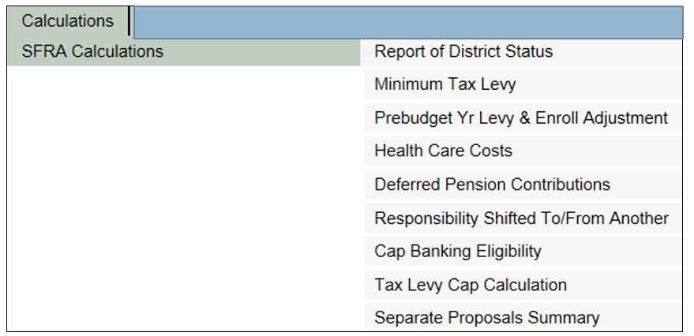
Completing The “Calculations” Tab – SFRA Calculations (1 of 7)

Slide 30
Completing The “Calculations” Tab – SFRA Calculations (2 of 7)
Report of District Status
  Calculation is not available until the release of State Aid.
  Narrative is required if levy exceeds expected local levy. Number of characters allowed is 1,500. Note the issue with special characters.
Minimum Tax Levy
  Calculation is not available until the release of State Aid. No data entry is required.
  GF Tax Levy-Base Budget (Rev. line 100) must be at least the amount on line D.
  Line C5 has been renamed, due to expiration of the prior adjustment for increases in local share for districts with reductions in state aid that were spending below adequacy pursuant to N.J.S.A. 18A:7F-5d. There will be no adjustments this year on this line.
  Calculation of adjustment for P.L.2020, c44 health care cost savings on line C4 will be available from a link on this screen when state aid is released. The amount is calculated from district entries in the Chapter 44 software on Homeroom.
PreBudget Year Levy and Enrollment Adjustment
  No data entry required. All amounts are preloaded.
  This is the calculation of Line A of the Tax Levy Cap screen. Screen must be opened to flow the amount to the Tax Levy Cap screen.
  Line B will contain an adjustment for P.L.2020, c44 adjustment for health care cost savings achieved – this amount will be released with state aid. Calculation of the adjustment for P.L.2020, c44 will be available from a link on this screen when state aid is released.

Slide 31
Completing The “Calculations” Tab – SFRA Calculations (3 of 7)
Adjustment for Increases in Health Care Costs
  Allowable adjustment cannot exceed the average percentage increase in SHBP as determined annually by the Division of Pensions and Benefits percentage shown on line E. Average increase in 2025-26 is 14.0 percent.
  Health benefits are defined as group health and prescription for this adjustment. If dental and vision are included in object 270, these amounts must be entered on the Health Care Cost calculation screen (lines A2 and B2).
  Support for increases in health care costs must be submitted to the county office for review. See manual section III-D-i-4 for support to be submitted (N.J.A.C. 6A:23A-11.3(c))
  Withdrawals from Emergency Reserve to cover increases of health care costs above 4% must be entered in lines A3 and B3.

Slide 32
Completing The “Calculations” Tab – SFRA Calculations (4 of 7)
Deferred Pension Contributions
  Adjustment applies only to those districts which deferred payment on the 2008-09 PERS pension liability.
  No data entry is required on this screen. Amounts draw from entry in Appropriations screen, object 248 lines.
Adjustment for Responsibility Shifted From/To Another District or Entity
  Allows adjustment of tax levy to be increased or decreased accordingly whenever the responsibility and associated cost of a school district activity is transferred to another school district or government entity.
  District must enter all data on these screens and submit supporting information to the ECS.

Slide 33
Completing The “Calculations” Tab – SFRA Calculations (5 of 7)
Cap Banking Eligibility
  A district may request use of “banked cap” only after fully exhausting all eligible statutory spending authority in the budget year.
  Districts must use the oldest year of bank first.
  Entry on Line J to request use of banked cap is performed in the column of the year(s) where cap was generated. The sum of line J from all columns flows to the Tax Levy Cap worksheet.
  If using banked cap, general fund base levy on revenue line 100 must equal tax levy cap in the budget year.
  Line K reflects expiration of 2022-23 bank if not used in 2025-26.
  Adjustment amounts under P.L. 2024, c12 and 13 from 2024-25 will not be used to calculate banked cap, as explained in the prior guidance. The cap adjustment from the 2024-25 budget will not show in the 2024-25 column of the banked cap report.
  2024-25 adjustments for districts below local fair share pursuant to N.J.S.A. 18A:7f-5d which expired in 2024-25 will show in the 2024-25 column, and flow out of banked cap over three years.

Slide 34
Completing The “Calculations” Tab – SFRA Calculations (6 of 7)
Tax Levy Cap Calculation
  No data entry required on this screen.
  Amounts are drawn from other SFRA Calculation screens.
  GF Base Tax Levy on revenue line 100 cannot exceed cap calculated on line I of this report.
  Line G from 2024-25, preload for adjustment increases to levy for SDA districts that are raising levy below required local share, expired in 2024-25. Line G has been renamed to “Reserved”.

Slide 35
Completing The “Calculations” Tab – SFRA Calculations (7 of 7)
Separate Proposal Summary has been updated to include two separate screens:
  Separate Proposals Passed at Special Election (new screen)
    P.L. 2024, c.60 changed the rules for separate proposals to allow for questions for the next year’s budget to be presented to voters at a special election.
    A new screen has been added to collect information regarding 2025-26 separate proposals passed at the March 2025 special election, to allow for certification of the taxes related to the passed question.
    Amounts on this screen will flow to new revenue line 112, and to the A4F on a new separate line for certification and raising of the taxes.
    Districts must include the related appropriations in the detailed appropriation lines, and submit a summary of the detail lines to the county office.
  Separate Proposals to be Presented at the School Election (same as prior budget screen)
    Separate Proposals to be presented to voters in April or November (the district’s school election) must be included on this screen, the same as in prior budgets.
    District must submit detailed appropriation lines for the separate proposal to the county office. These lines must agree to the description in the question.
    Prior to the budget election, the only entry for these questions is on this screen. After the election, if the question passes, the amount is entered by the user on new revenue line 111, and in the detailed appropriations lines related to the passed question. New line 111 will flow to the A4F on a new separate line, for certification and raising of the taxes.

Slide 36
Completing The “Calculations” Tab - Estimated Tuition Calculations
Calculation of estimated tuition rates for both regular and special education students.
The calculated rate for each program is the maximum rate that may be charged for that program by the receiving district.
Middle column of appropriations must be completed before this screen.
Two selections under the Estimated Tuition Calculations menu:
  Formulas for Selected Appropriations – calculates amounts used on two lines of Rate for All Programs screen:
    Building Use Charge
    Allocated Costs
  Rate for All Programs
    Provides the calculation of the estimated tuition rates.
    Budget software automatically calculates the estimated costs per pupil using the Average Daily Enrollment (ADE) from the School Register Summary as specified in N.J.A.C. 6A:23A-17.1.
    If a district enters alternate enrollments, entry must be approved by the county office.

Slide 37
Completing The “Calculations” Tab - CSSD Maximum Permitted Net Budget
Applicable to County Special Services districts only.
Not available until the release of state aid.
Calculates the maximum permitted net budget for the CSSD pursuant to N.J.S.A. 18A:46-31.
Edit #100 checks to make sure the district budget does not exceed the maximum.

Slide 38
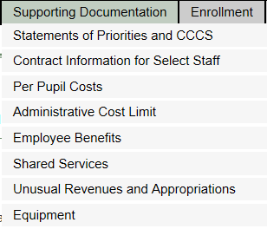
Supporting Documentation Menu

Slide 39
Completing the “Supporting Documentation” Tab
Statement of Priorities - All Districts
New Jersey Student Learning Standards - All Districts except CSSD
Contract Information for Select Staff - All Districts
Per Pupil Costs - Regular, Vocational and CSSD Districts
Administrative Cost Limit - Regular Districts
Employee Benefits - All Districts
Shared Services - All Districts
Unusual Revenues and Appropriations - All Districts
Equipment - All districts except ESC

Slide 40
Statement of Priorities/ New Jersey Student Learning Standards (1 of 2)
District’s Initiatives and Priorities:
Use five categories of budget areas of focus:
  Maintaining Our School System
  Raising Standards and Expanding Opportunities
  Building Professionalism
  Protecting Our Investment (Capital & Maintenance Projects/Capital Reserve)
  Planning for the Future
See sample posted on NJDOE website at https://www.nj.gov/education/budget/docs/Budget_Areas_of_Focus_Sample.pdf
4,000 characters per area. Include line numbers in the entered descriptions.

Slide 41
Statement of Priorities/New Jersey Student Learning Standards (2 of 2)
New Jersey Student Learning Standards:
Provide narrative information regarding new programs or enhancements to existing programs that will ensure the implementation of the nine New Jersey Student Learning Standards in the budget year.
All areas are required to be completed.
In the descriptions, include account numbers increased to address the new programs.

Slide 42
Contract Information for Select Staff
Salary and benefit information is required for the following: Superintendent; Assistant Superintendent(s); School Business Administrator; and any employee with an annual salary that exceeds $75,000 and is not in a collective bargaining unit.
Three screens for completion. All three must be completed, in order:
  Teacher Contract Screen,
  Employee List Screen, and
  Employee Benefit Detail Screen.
Do not use the browser “Back Arrow” on these screens, or the data will not refresh properly.
Enter contract end date before contract begin date for each employee.
Post-employment benefits must have an explanation entered (even if amount is zero).
Refer to manual section III-E-ii.
Required for the User-Friendly Budget.

Slide 43
Per Pupil Cost Calculations
Data entry for the 2024-25 and 2025-26 appropriations, and for the enrollment screen should be completed before running this report.
Advertised Per Pupil Cost Calculations report is generated automatically by the budget program.
Software includes a warning edit (#308) if the district’s 2024-25 budgeted per pupil legal costs, revised as of February 1, 2025, exceeds 130 percent of the state average legal costs per pupil. (Edit is released with state aid.)

Slide 44
Administrative Cost Limit
Advertised per pupil administrative cost cannot exceed the lower of:
  the district’s adjusted, as of February 1, per pupil administrative cost for 2024-25 or;
  the 2025-26 per pupil administrative cost limit for the district’s region, inflated (regional limit).
Per pupil administrative regional limits for 2025-26 are $2,875 for the Northern region, $2,677 for the Central region, and $2,667 for the Southern region.
The enrollment screen must be completed for the details of the regional limit to be calculated in this screen.
The appropriations for 2024-25 and 2025-26 must be completed, and the per pupil costs report calculated, for all amounts to calculate on this screen.

Slide 45
Other Supporting Documentation
Shared Services
  Enter any information relating to a shared service agreement on this data entry screen.
  Separate lines should be used for each service/agreement.
  The same category may be selected multiple times.
  Required for User-Friendly Budget.
Unusual Revenues and Appropriations
  Summarize unusual revenues and appropriations and provide a description of the circumstances.
  Required for User-Friendly Budget.
Equipment
  Appropriations for 2025-26 equipment must be entered in the appropriations screen before completing this screen.

Slide 46
Completing the “Enrollment” Tab
No changes from prior year.
If an amount entered causes the resident enrollment calculation in column H to be less than zero, the cell will not accept the data entry and will revert back to the last saved item in that cell.

Slide 47
Completing the “Tax Levy Certification” Tab
Tab is not available until after the release of State Aid.
Refer to manual section III-G for specific instructions for completion.
Two selections on this tab:
  A4F
    Data entry on this screen must be completed before the Estimated Tax Rate Information report.
    Form has been revised in 2025-26 to include separate proposals on two individual lines of the form, instead of in a separate column.
    Districts with deferred taxes must work with the municipality and the tax assessor regarding the numbers recorded as deferrals before finalizing the budget for review and before finalizing the A4F.
  Estimated Tax Rate Information
    Report is required for the User-Friendly Budget.
    Preloaded valuations are amounts received from Division of Treasury.

Slide 48
Completing the “Edit Report” Tab
Runs edit tests on the data entry in the budget software.
All fatal edits (labeled as “fatal” in the Type column of the report) must be cleared before a district will be able to submit the budget to the county office.
Edits labeled as “warning” will not prevent a district from submitting a budget to the county office.
A complete list of edits is included in the manual at Appendix B. The appendix will be posted at the same time the edits are released in the software.

Slide 49
Completing the “County Review and Approval” Tab (1 of 3)
This tab contains boxes for different stages of the budget review. The boxes are spread across 3 screens:
  For Advertising or Board of School Estimate (for all districts)
  After BSE (for districts with BSE)
  Results of Public Hearing (for all districts with Public Hearings)
  For April Election Districts – Changes for Separate Proposals at the Budget Election
  For November Election Districts – Changes for Separate Proposals at the Budget Election
The screens will display only the sections that apply to the selected election type. For example, if a district selects “Type II April election” on page 1 of the county review screen, then on page 3 of the county review screen only the April Election Results section will display.

Slide 50
Completing the “County Review and Approval” Tab (2 of 3)
All districts must complete section 1, “For Advertising or Board of School Estimate”.
  For initial review, after fatal edits are cleared, district will check the box “Ready for Review” on the “District” line in the “For Advertising or BSE” section.
  All districts will select the 2025 election type. Entry in this box will save when the “ready for review” box is checked.
Districts may use the “Comments” box to provide any additional information they wish to communicate to the county office.
The district “Ready for Review” box blocks data entry ability in all other screens. County review lines block entry on the District “Ready for Review” line. If changes are needed during the review process prior to advertising, the district must un-check the “ready for review” line to open data entry. See the budget guidelines for full description of the entry flow.

Slide 51
Completing the “County Review and Approval” Tab (3 of 3)
When the “For Advertising or BSE” section is completed with the ECS approval, a link will appear at the bottom of the screen to allow access to the next page.
The history of the changes made on each page of this screen are saved in the “Status History” link in the top right corner of each screen. If documentation is needed of the date the budget was submitted, it can be obtained in this link.
Each line of entry is made available when the line above is completed. (For example, the ECBO review line is not available until district clicks “ready for review”. The ECS review line is not available until the ECBO line has status “approved”).
ECS or ECBO may use the “changes needed” boxes to open data entry for changes in each subsequent section.

Slide 52
User-Friendly Budget
Not available until after the release of State Aid.
UFB must be posted on the district website within 48 hours after the public hearing.
Posting on district website must be updated for any changes made for municipal certification of the budget, or for any passed separate proposals.
Posting must be kept on the district website the entire year, until the next budget cycle.
User-friendly budget file contains the following reports:
  Advertised Enrollments Advertised Revenues
  Advertised Appropriations Advertised Recap of Balances
  Per Pupil Costs Unusual Revenues and Approps
  Shared Services Estimated Tax Rate Information
  Contract Information for Select Staff
  Advertised Blended Resource Statement (SBB districts only)

Slide 53
Advertised Budget for Newspapers
Not available until after the release of State Aid.
District must have ECS budget approval before advertising the budget.
Advertised file for newspapers contains the following reports:
  Advertised Enrollments
  Advertised Revenues
  Advertised Appropriations
  Advertised Recapitulation of Balances
  Per Pupil Costs
  Capital Projects Summary
  Advertised Blended Resource Statement (SBB only)
  Separate Proposals Summary

Slide 54
State Aid
Once state aid is released, the software will make available the user-friendly budget, certification of taxes, remaining SFRA calcs, and the option to prepare the advertised budget for newspapers.
The update will change the program without overwriting any data that was previously keyed using the initial program.
State aid revenue lines will be blocked from data entry at this time.
Preschool Education Aid is entered on the PEA screen by the district into the various age-group programs, it is not loaded with the state aid. Edits ensure the amounts entered do not exceed the aid amount.

Slide 55
Other Budget Information
Governor’s Address – State Aid is released within 48 hours after the budget address.
See the election calendar posted at https://www.nj.gov/education/budget/docs/2526/2025_DOE_ElectionCalendar.pdf for the due date of budget for the district’s election type.

Slide 56
Additional Documentation to be Submitted with Budget
Position Control Roster (reconciled to budget accounts). If a 2025-26 separate proposal contains staff positions, then these positions are noted in the PCR submission.
Tuition Revenue/Appropriation Worksheets
Board Resolution for Approval of Budget Submission
Travel Expenditures Maximum
If Requesting any Cap Adjustments (Enrollment, Health Care Costs, Use of Banked Cap, Responsibility Shift) must provide required documentation
  See guidelines manual for detail of what is needed.
Worksheet for Budget Changes Made at Public Hearing
See Appendix D series for items to be submitted.

Slide 57
Questions?
Questions regarding the budget process should first be directed to the county office of education, then to budget@doe.nj.gov.

