Slide 1
Provisional Educator Process:
Virtual Training
Office of Recruitment, Preparation and Certification
Division of Field Support and Services
April 2, 2025

Slide 2
Welcome and Introductions
Vickie Sikorski, Provisional Teacher Process, Coordinator
Mike O’Neill, Provisional Teacher Process, Planning Associate
Jennifer Kern, Provisional Teacher Process, Technical Assistant
Taya Womack, Provisional Teacher Process, Examiner 3

Slide 3
Virtual Training Agenda
Provisional Teacher Process Overview
Provisional Educational Services and Administrative Endorsements Overview
Process for Submitting a Provisional Registration Case
Process for Submitting a Renewal Case
Process for Submitting a Termination Date
Process for Submitting a Conversion to Standard Case
New Jersey Department of Education (NJDOE) Contact Information

Slide 4
Overview of Certification for Teachers (Three-Tiered System)
Type of Certificate | What is it? | When is it issued?
Certificate of Eligibility with Advanced Standing (CEAS) or Certificate of Eligibility (CE) | A license to seek employment as a teacher | Is issued before a candidate seeks employment as a teacher.
Provisional Certification | A temporary license to teach | Is issued once a candidate is hired as a teacher and registered in the provisional process.
Standard Certification | A permanent license to teach | Is issued once a teacher meets all the requirements.
More resources on the certification website

Slide 5
Provisional Process:
Teachers

Slide 6
Provisional Process for Teachers (1 of 4)
Once employment is secured, it is the responsibility of the hiring school district to register the teacher into the Provisional Teacher Process via NJEdCert. A provisional certificate is then issued, which is valid for a period of up to two school years. Please note: The teacher cannot apply for the provisional certificate. This certificate must be requested by the school district.
If the teacher has a CE, the school district must verify completion of the required 50 hours of preservice and must choose the CE Educator Preparation Program (CE-EPP) where formal instruction is being completed in the drop-down menu under "program enrollment.”

Slide 7
Provisional Process for Teachers (2 of 4)
In accordance with N.J.A.C. 6A:9B-8.4(b), ”the employing school district shall register the provisional teacher within 60 days of the date the CE or CEAS holder begins employment.” As of September 1, 2024, a provisional teacher registration, submitted after the 60th day, will be marked as out of regulation and denied.

Slide 8
Provisional Process for Teachers (3 of 4)
The following must be completed while employed under the provisional certification to obtain a standard license:
Mentoring and Induction:
Provisional teachers must complete a school mentoring program.
  The mentoring fee charged by the school district is $550 for CEAS teachers and $1000 for CE teachers.
  The Office of Professional Development has information about developing a mentoring plan. Please contact TeachPD@doe.nj.gov for any questions you may have about developing a mentoring plan.

Slide 9
Provisional Process for Teachers (4 of 4)
The following must be completed while the teacher is employed under the provisional certification to obtain a standard license:
Supervision and Evaluation:
Provisional teachers must obtain at least two years of effective or highly effective final summative evaluations.
  The Office of Educator Evaluation has information regarding AchieveNJ. Please contact edueval@doe.nj.gov for any questions regarding AchieveNJ/summative ratings.
Alternate Route Formal Instruction for CE teachers:
At least 400 hours or the credit equivalent of instruction through an approved CE-EPP.

Slide 10
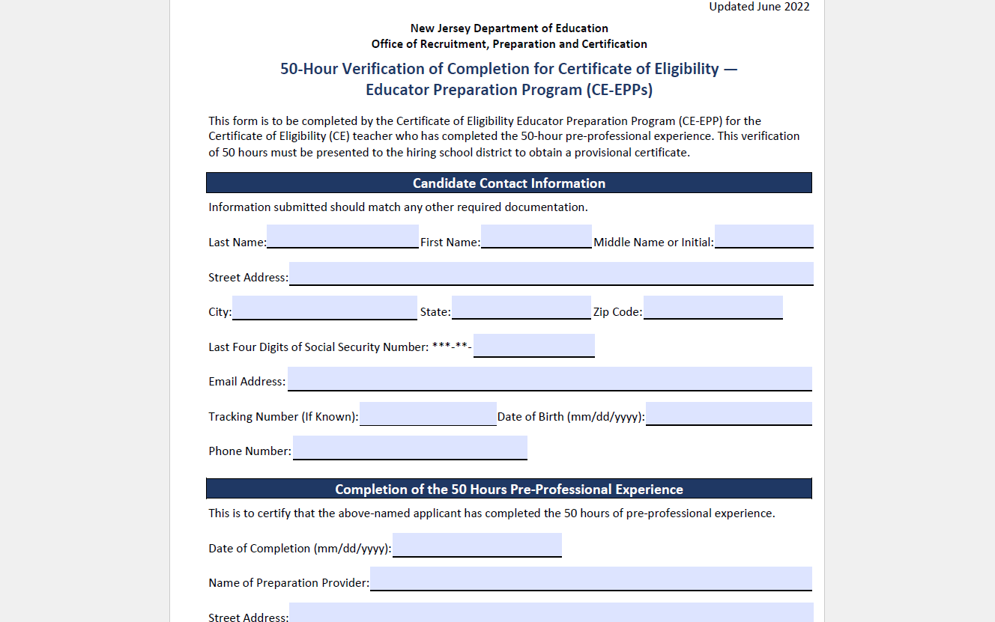
50-Hour Verification of
Program Completion (CE-EPPs)

Slide 11
Instruction for CE Holders (1 of 2)
There are six categories of CE programs:
  Department approved CE-EPP for P–12 Subject Area and K–6 Elementary Teachers;
  Career and Technical Education (CTE);
  Preschool through Grade 3 (P–3 );
  Teacher of Students with Disabilities (TOSD);
  English as a Second Language (ESL); and,
  Bilingual/Bicultural
To see a list of all approved CE programs , please visit the NJDOE website.

Slide 12
Instruction for CE Holders (2 of 2)
Program enrollment requirements for each of the following:
  ESL candidates:
    400 hours or the credit equivalent of instruction through an approved CE-EPP; and,
    15–21 credits in an ESL program.
  Bilingual candidates with content area CE:
    400 hours or the credit equivalent of instruction through an approved CE-EPP; and,
    12 credits in a Bilingual program.
  TOSD candidates with content area CE:
    400 hours or the credit equivalent of instruction through an approved CE-EPP; and,
    21–27 credits in a TOSD program.

Slide 13
Provisional Process:
Educational Services and Administrative Endorsements

Slide 14
School Library Media Specialists (1 of 2)
The school district will register the candidate through NJEdCert.
  If the candidate has a CE, the school district must select the college where the School Library Media Specialists (SLMS) courses will be taken in the NJEdCert drop-down menu under “program enrollment.”
A one-year residency and mentoring is required under the provisional certificate.
  Mentoring must be completed by an experienced school library media specialist. If there is not an experienced SLMS available within the school district to mentor the candidate, an experienced SLMS mentor can be provided through the New Jersey Association of School Librarians (NJASL). The NJASL can be reached at mentoring@njasl.org.

Slide 15
School Library Media Specialists (2 of 2)
A candidate’s standard certificate determination will be based on completion of the residency and the final summative rating.
The final summative rating is entered by the school district in NJEdCert.
A CE candidate must also have the VOPC submitted by the EPP provider.
Please note: The same requirements apply for candidates seeking an Associate School Library Media Specialists (ASLMS) endorsement.

Slide 16
Student Assistance Coordinators (SAC)
The school district registers the candidate through NJEdCert.
  If the candidate has a CE, they must choose the college where courses will be taken in the drop-down menu under "program enrollment.“
A six-month residency is required under the provisional certificate.
A candidate’s standard certificate determination will be based on completion of the residency and the final summative rating.
The final summative rating is entered by the district in NJEdCert.
A CE candidate must also have the VOPC submitted by the EPP provider.

Slide 17
Administrators
The school district registers the administrator through NJEdCert.
Administrators must also be registered in the appropriate residency program:
  Principals will register with Leader to Leader/ NJPSA for the two-year residency.
  School Administrators will register with NJASA for the one-year residency.
  School Business Administrators will register with NJASBO for the one-year residency.
A one-to-two-year residency is required under the provisional certificate.
A candidate’s standard certificate determination will be based on successful completion of the residency.

Slide 18
New Provisional Registration

Slide 19
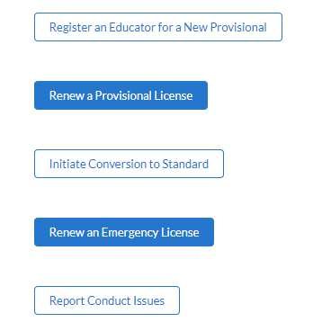
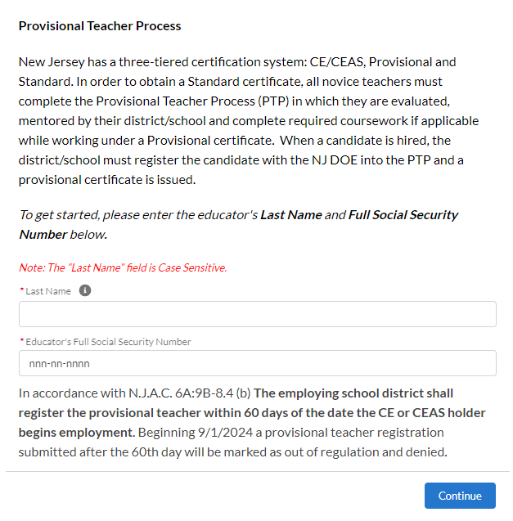
Registering New Provisional Licenses

Slide 20
New Provisional Educator Information
Steps to register an educator for the provisional process:
Complete the fields for last name and social security number.
Verify the email address on file. If the email is incorrect, the applicant will need to login to their NJEdCert account and update their email address.
Complete the fields for job type, employment status, and start date.
Select the license that matches the position for which the school district hired the educator.
Select the CE-EPP information, if applicable, and provide the mentor information.

Slide 21
New Provisional License
After completing the registration, the following will occur:
A case is created and assigned to the provisional program.
An application record is created within the case.
A new provisional teacher process (PTP) record is created for the educator. Please note: This record is created for all educators (i.e., teachers, administrators, and educational service specialists).

Slide 22
Provisional Renewal Process

Slide 23
Renewal of a Provisional (1 of 2)
Candidates who are working under a provisional certificate set to expire on July 31, and who have not yet met the requirements for a standard certificate, will need to be issued a provisional renewal to continue employment in their current role while working towards a standard certificate. The school district can initiate the renewal process in NJEdCert in June of the expiring year.
Candidates may be eligible for one provisional renewal. CE teachers must provide the school district with documentation of progress made towards alternate route program completion.

Slide 24
Renewal of a Provisional (2 of 2)
CE teachers in the following endorsement areas may be eligible for a second renewal of their provisional if they have not completed their coursework:
  Students with Disabilities CE and a CE with an endorsement appropriate to the subject to be taught;
  Bilingual/Bicultural CE, and a CE with an endorsement appropriate to the subject or grade level to be taught; or,
  Teachers who hold a CE in English as Second Language.
These CE teachers must provide documentation to the school district of progress made towards program completion.

Slide 25
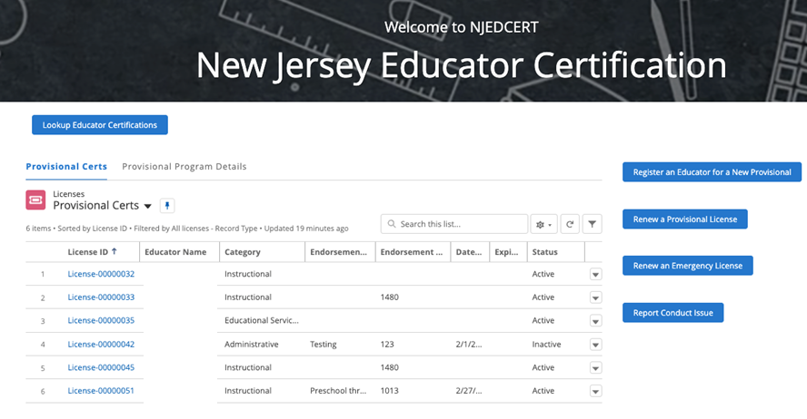
Initiating Provisional Renewal (1 of 3)
To initiate a provisional renewal, the school district will complete the following:
Step 1: From the homepage, click “Renew a Provisional License.”

Slide 26
Initiating Provisional Renewal (2 of 3)
Step 2: There will be a list of provisional licenses that are eligible to be renewed. The school district will select the appropriate educator.
Step 3: Follow the screen prompts.

Slide 27
Initiating Provisional Renewal (3 of 3)
After creating the renewal case, the following will occur:
A case is created with the status “pending payment.”
An application is created and associated to the case.
A new PTP ID record is created and associated to the educator and application.
The educator will receive an email with subject “Your Provisional Renewal Application.” This will allow the educator to complete the application and payment.
Once the payment and Oath of Allegiance are completed, the status will change to “pending review.”

Slide 28
Entering a Termination Date
When an educator leaves a school district, the last date of employment, known as the termination date, must be entered in NJEdCert.
A PTP record is created for each endorsement the educator is registered for in NJEdCert.
  To enter a termination date, visit the “district educator” list in your district NJEdCert account and select the educators hyperlinked name to pull up the account records. Locate the educator’s PTP ID records for your school district and enter the termination date. If the educator has multiple PTP ID records for your district, a termination date must be entered for each PTP ID record

Slide 29
Conversion to Standard Process

Slide 30
Conversion to Standard
School districts must initiate the conversion to a standard for all educators through NJEdCert. Before initiating a conversion to standard, the school district must confirm the following has been completed:
  Teachers have completed 30 weeks of mentoring, received two years of effective or highly effective final summative ratings, and completed required coursework, if applicable.
  Administrators have completed one-to-two-year residency.
  SAC have completed a 6-month residency, received an effective or highly effective rating, and completed the coursework, if applicable.
  SLMS/ASLMS have completed a one-year residency, mentoring, received an effective or highly effective rating, and completed the coursework, if applicable.

Slide 31
Conversion to Standard Checklist
Activity | Teachers | SLMS/ASLMS | SAC | Administrator
Mentoring | Completed 30 weeks of mentoring | Completed one year of mentoring | N/A | N/A
Residency | N/A | Completed one year residency | Completed six-month residency | Completed one-to-two-year residency
Evaluation | Two years of effective or highly effective final summative ratings | An effective or highly effective final summative rating | An effective or highly effective final summative rating | N/A
Coursework | CE teachers completed 400 hours/ credit coursework | CE SLMS/ASLMS completed required coursework | CE SACS completed required coursework | N/A

Slide 32
Final Summative Evaluation
Ratings and Mentorship
The final summative evaluation rating and mentoring weeks completed are entered by the school district into NJEdCert.
To enter a final summative rating and mentoring weeks visit the “district educator” list in your district NJEdCert account and select the educators hyperlinked name to pull up the account records. This will open a page that has the option to choose “Enter Final Summative Ratings and Mentorship.”
Mentoring time must be tracked by each employer. If a provisional teacher leaves employment from the school district and begins to work in a new school district, the initial district will need to complete the Mentoring Transfer Template to document the amount of mentoring time completed.

Slide 33
NJDOE Contact Information

Slide 34
NJDOE Contact Information (1 of 4)
School districts and educators may reach the NJDOE Call Center at (609) 292-2070, Monday through Friday, from 8:00 a.m. to 7:00 p.m.
Educators may create a NJEdCert account to submit inquiries and communicate directly with customer service.
School districts can submit questions by creating a web to case/service case through their NJEdCert account.

Slide 35
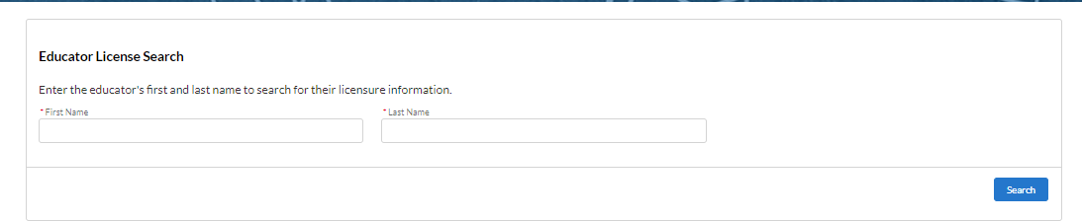
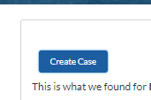
Contact Information: Web to Case (2 of 4)
District Process To Submit a Customer Service Question / Case
Step 1: Look up an educator using the Educator License Search.
Step 2: Click on the “Create Case” button.

Slide 36
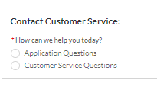
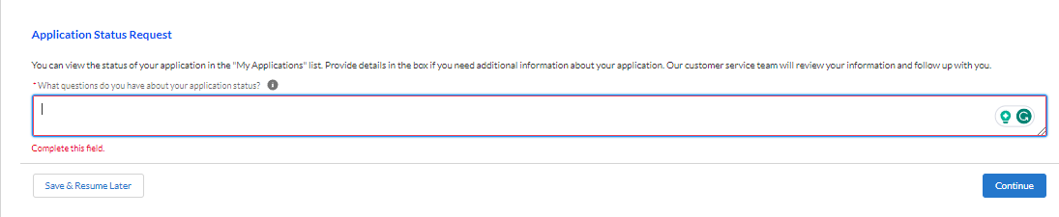
Contact Information: Web to Case (3 of 4)
Step 3: Select the type of question.
Step 4: Type the question and click “continue.”

Slide 37
Contacting Information (4 of 4)
NJDOE County and District Information
nj.gov/education/certification/ctydistinfo/
NJDOE
nj.gov/education
Office of Educator Evaluation
edueval@doe.nj.gov
nj.gov/education/edueval/
Office of Professional Development
TeachPD@doe.nj.gov

Slide 38
Follow Us on Social Media
Facebook:
@njdeptofed
Instagram:
@newjerseydoe
LinkedIn:
New Jersey Department of Education
Threads:
@NewJerseyDOE
X: @NewJerseyDOE
YouTube: @newjerseydepartmentofeduca6565

