Slide 1
New Jersey Department of Education
District Certification Training Summer 2026
District Certification Training
Office of Recruitment, Preparation and Certification
Division of Teaching and Learning Services
July and August 2026
nj.gov/education

Slide 2
General Information
Housekeeping
The PowerPoint Slides will be posted online after all training sessions have occurred.
All questions must be posted into the Q&A panel on the right side of your screen.
All responses to Q&A will be made during the presentation. Submit topic relevant questions into the Q&A while the related content is being discussed.
We are unable to answer any questions that are specific to a district or educator. Please use the web to case for specific questions on candidates.

Slide 3
Agenda
Introductions, Updates, and Contact Information
Welcome
and Introductions
NJEdCert Updates
Educator Conduct
Educator Preparation
Certification Requirement and Process
Provisional Process
Contact Information

Slide 4
NJEdCert
District Experience Updates

Slide 5
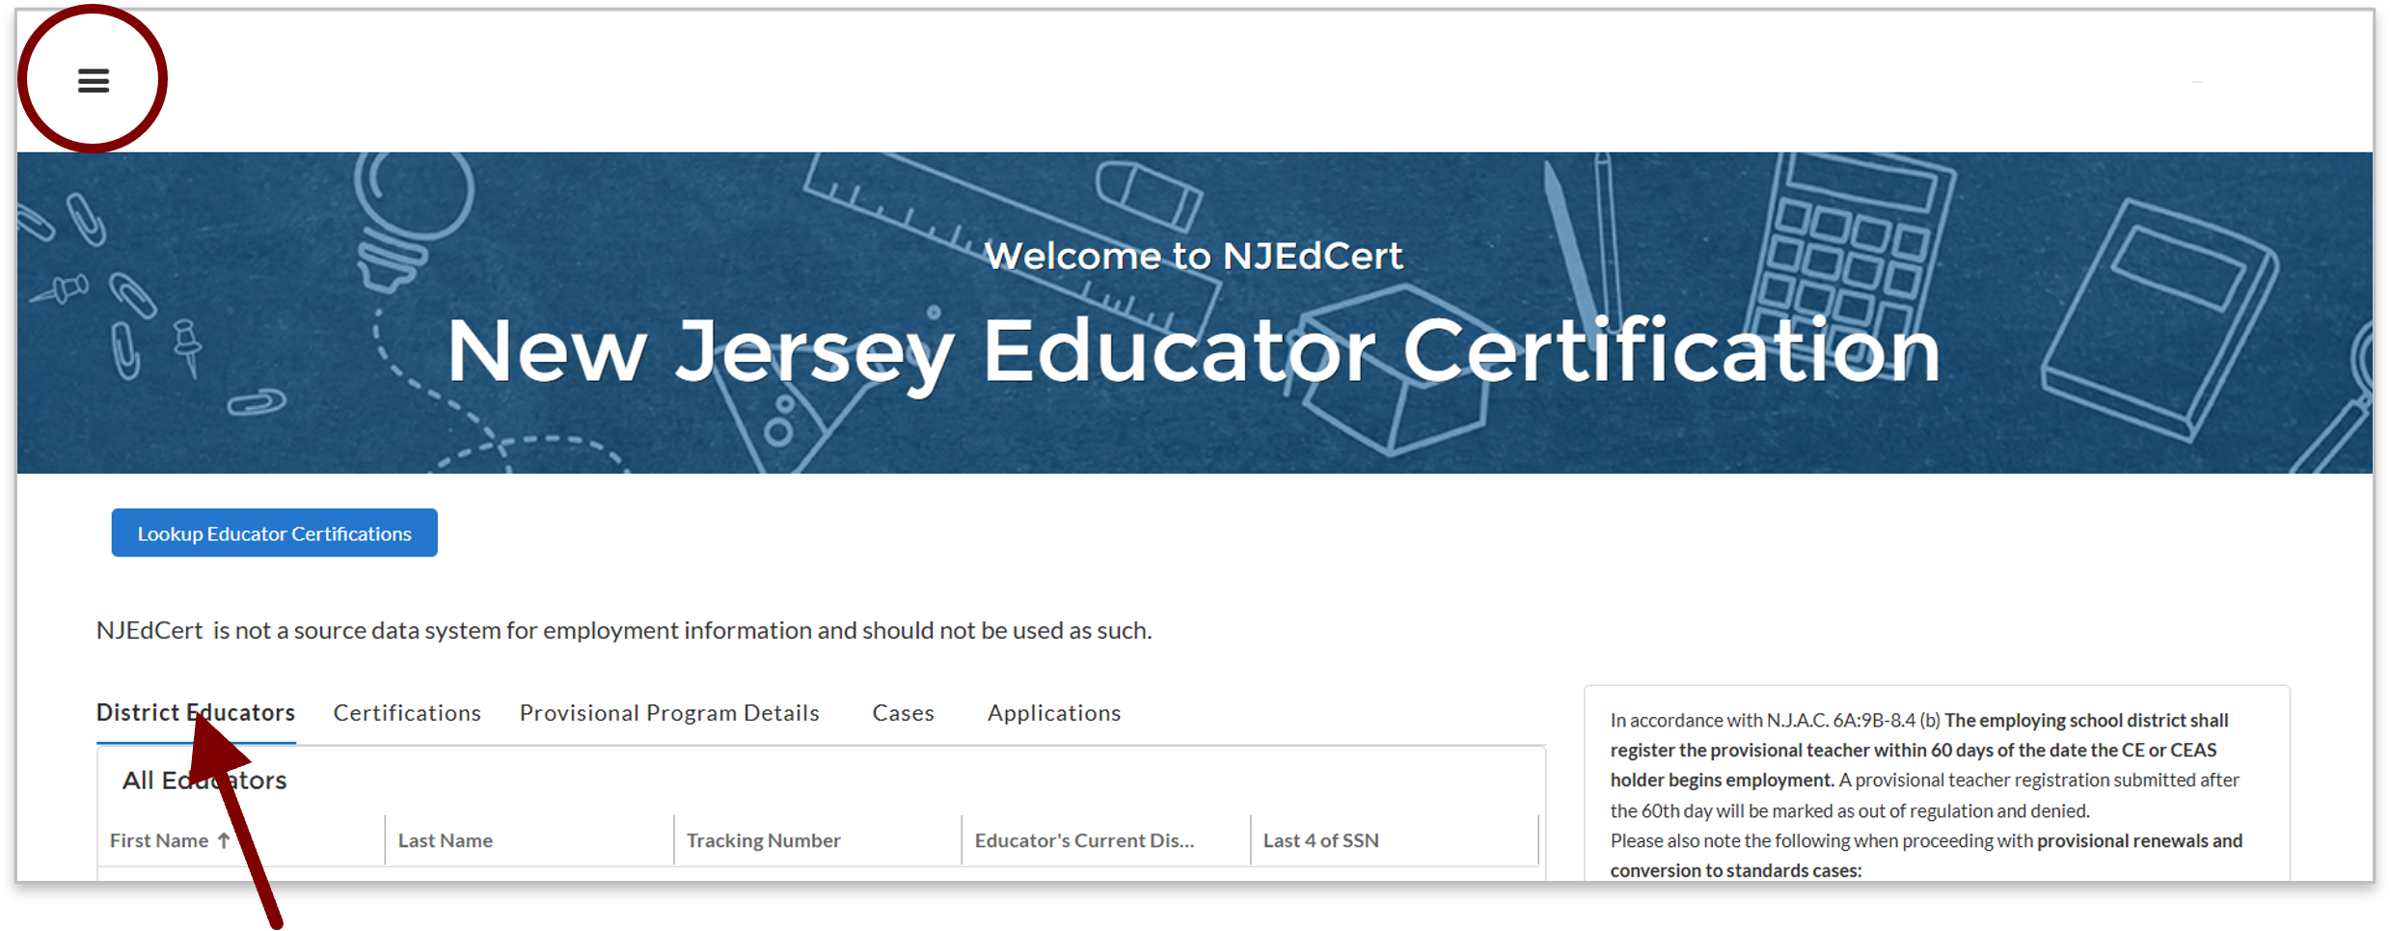
NJEdCert Enhancements
Updated district user homepage
The District Educators table now includes only those educators who are associated with the district in NJEdCert. All columns can be sorted.
The hamburger menu (top-left) is no longer needed - all information is available on the home screen.
The options for district-initiated processes remain the same.
Register an Educator for a New Provisional
Renew a Provisional License
Initiate Conversion to Standard
Renew an Emergency License
Report Conduct Issues
Register an Educator for Limited Non Citizen Standard

Slide 6
NJEdCert Enhancements (1 of 5)
Easier educator lookup and identification for district users
Login and password reset functionality is working. Directions on related screens, including account creation, login, and password reset, have been updated to be more explicit.
Emergency renewal processes have been updated. Educators will be tied to the district associated with their initial emergency licenses. Districts will not need to contact the Department when initiating the emergency renewal process.
Customer service has customizable templates, which improve efficiency while providing individual support.

Slide 7
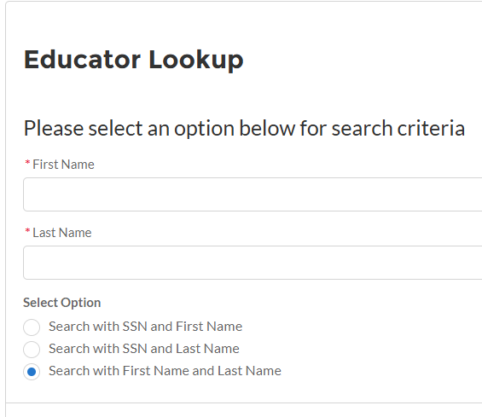
NJEdCert Enhancements (2 of 5)
Improved processes
More flexibility is now available on the educator lookup screen.
Search using First & Last Name (SSN is no longer required)
SSN + First Name
SSN + Last Name

Slide 8
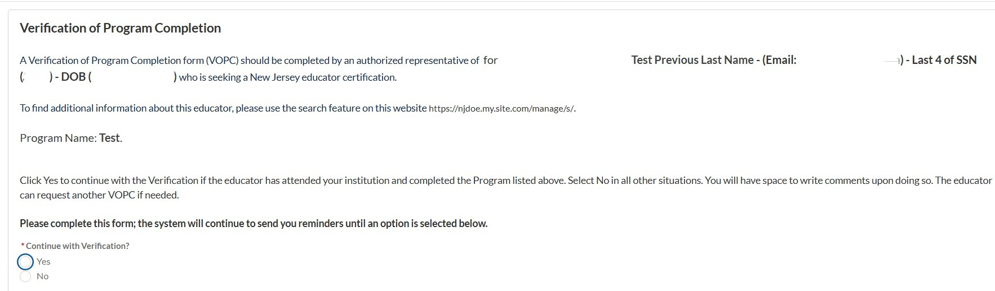
NJEdCert Enhancements (3 of 5)
Improved processes
VOPCs and SOPEs now display previous last names.
Improves educator identification
Reduces verification errors

Slide 9
NJEdCert Enhancements (4 of 5)
Enhanced documentation submission
Process | Processing Time
VOPCs, ROPEs & SOPEs | VOPCs, SOPEs, and ROPEs are linked to existing applications in real time. VOPCs, SOPEs, and ROPEs are linked to applications submitted after the documentation is received within one business day.
Transcript Ingestion | Transcripts received from the Clearinghouse are uploaded to NJEdCert within one hour of receipt. Transcripts received from all other sources are uploaded to NJEdCert within one business day.
Transcript Matching | Transcripts are automatically linked to the appropriate educator record if all identifying information matches. The remaining transcripts are matched within one business day. Transcripts are linked to existing applications in real time. Transcripts are linked to applications submitted after the transcript is received in NJEdCert within one business day.

Slide 10
NJEdCert Enhancements (5 of 5)
Educators now receive explicit instructions regarding the application process when clicking “Apply Now”.
Before You Begin
Determine what credential or certification you would like to apply for by reviewing eligibility requirements here: nj.gov/education/certification. Once you have determined your application type, click Continue to begin.
Entering Employment and Education Information
Provide your education and employment history accurately and completely. If a section does not apply to you, you may skip it.
Educator Preparation Program Applicants
If you completed an educator preparation program, confirm whether your program will nominate you for certification. If so, do not submit a separate application—you will receive an email with instructions to claim the nomination. Separate applications are nonrefundable per regulations.
Provisional Teacher Process (PTP) Applicants
Do not apply for the Standard certificate. Your employing district will initiate the conversion when you are eligible. You will receive an email when the process begins. Contact your district with questions.

Slide 11
Educator Conduct

Slide 12
1. Educator Conduct (1 of 3)
Reporting Educator Conduct
Reporting Requirement
Who it Applies To
What Counts as Conduct
Chief School Administrators must report allegations of unbecoming conduct that result in:
Termination
Resignation
Retirement
Suspension
N.J.A.C. 6A:9B-4.3(a)
Certified staff
Teaching staff members/Substitute teachers
Third-party vendor employees
Broad definition including:
Inappropriate student interactions
Criminal conduct
Improper behavior (in/outside school)

Slide 13
2. Educator Conduct (2 of 3)
Reporting Educator Conduct
How to Report
Submit email: Stateboardofexaminers@doe.nj.gov
Include:
Educator Name
Tracking Number
Brief Description of Conduct
What Happens Next?
Board Coordinator may request additional information
Districts must cooperate with documentation requests including:
  Emails
  Videos
  Investigative notes
N.J.A.C. 6A:9B-4.3(b)

Slide 14
3. Educator Conduct (3 of 3)
Revocation/Suspension
Access to Information
Educator Responsibility
Public Transparency
List sent monthly to County Offices
Districts must use NJEdCert to verify licensure status
Revoked/Suspended educators must report license status to employing district(s)
N.J.A.C. 6A:9B-4.3(c)3
All decisions publicly available
View State Board of Examiners Legal Decisions (nj.gov/education/legal/examiners)

Slide 15
Educator Preparation Programs (EPPs)

Slide 16
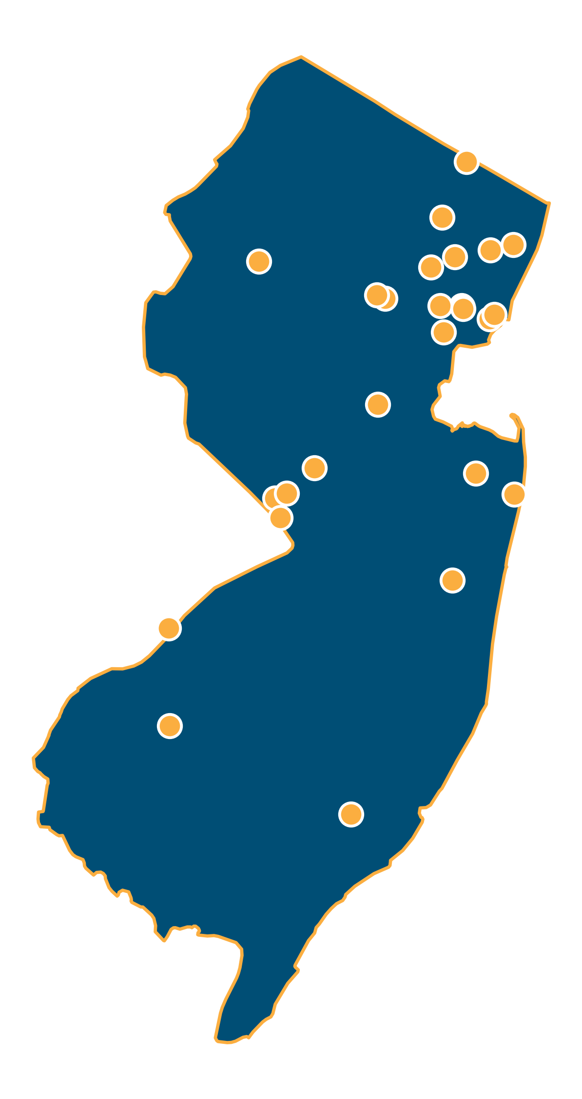
EPP Approved Program Providers
Brookdale Community College
Caldwell University
Centenary University
The College of New Jersey
Drew University
Essex County College
Fairleigh Dickinson University
Felician University
Georgian Court University
Idioma Education & Consulting, LLC
iTeach
Kean University (including New Jersey City University)
Monmouth University
Montclair State University
New Jersey Center for Teaching and Learning
NJEA
NJPSA/FEA
NJASA
NJASBO
Princeton University
Ramapo College of New Jersey
Relay Graduate School of Education
Rider University
Rowan University
Rutgers University – Camden
Rutgers University Graduate School of Education
Rutgers University – Newark
Rutgers School of Nursing
Saint Elizabeth University
Saint Peter’s University
Seton Hall University
Stockton University
Thomas Edison State University
William Paterson University

Slide 17
EPP Approval
Step 1: Application
Step 2: Review
Step 3: Approval
Step 4: Accreditation
Step 5:
Ongoing Approval
Providers submit applications
Credit-bearing programs require OSHE authorization
Applications reviewed by Department
State Program Approval Council (SPAC)
Must meet Professional Standards
Receive approval to operate as an EPP
Required through approved accrediting agency;
New providers - 5 years to achieve
Continued approval required every 7 years

Slide 18
Pathways to Teaching
Type | Commonly Known As | Description
Certificate of Eligibility with Advanced Standing (CEAS) | Traditional Route | A formal teacher preparation program at an accredited college or university.
Certificate of Eligibility (CE) | Alternate Route | A non-traditional teacher preparation program designed for those individuals who have not completed a formal teacher preparation program at an accredited college or university
Standard Certificate | N/A | A permanent certificate issued to a teacher who has met all requirements for state certification. The district will request the issuance of a standard teaching certificate upon completion of the Provisional Teacher Process (PTP).

Slide 19
Career and Technical Education (CTE) Educator Preparation
Regulatory Change
    If the candidate can demonstrate proficiency in the use of English language and mathematics through an alternate measure, CE and CEAS candidates are not required to complete a Commissioner-approved test of basic reading, writing, and mathematics to obtain a standard certificate;
    The State Board of Education shall not require a candidate for a certification of eligibility in CTE to complete an educator preparation program that exceeds 200 hours of instruction (does not include 50 preservice hours); and
    CE CTE programs of study must include six hours of special education and a course or training in culturally responsive teaching.

Slide 20
Paraprofessional Expedited Pathway
The Paraprofessional Expedited Pathways supports the teacher certification of persons who are currently employed to work in a school district as a paraprofessional or an instructional assistant pursuing a CEAS in a specific endorsement area.
The law authorizes a candidate's direct classroom service can count towards clinical practice requirements, provided that the candidate is currently employed by a school district and is providing direct classroom service, including tutoring.
The paraprofessional's direct classroom service can count towards clinical practice requirements if it is under the supervision of a mentor cooperating teacher who is teaching in the endorsement area being sought by the paraprofessional.

Slide 21
Teacher Workforce Initiatives (1 of 4)
Certification Paths
AR Interstate Reciprocity Pilot Program
Accept out-of-state candidates who meet the CE requirements.
Participating EPPs: Rowan University, Rutgers University, Newark.
Limited CE/CEAS Pilot Program
School districts and EPPs must be approved to participate.
Pilot program ends on September 1, 2027.
All limited CEs and CEASs expire on November 1, 2027.
VETeach
  4-year pilot program to facilitate certification of veterans in a 36-month program.
  Available to Veterans of the United States Armed Forces who served on or after September 11, 2001.
  Participating EPP Providers: Ramapo College

Slide 22
Teacher Workforce Initiatives (2 of 4)
Grant Programs
Teacher Quality and Retention: Program to establish a sustainable program of instructional coaching for teachers in high poverty school districts.
  Grant Recipient: Rowan University
  Grant Period: June 1, 2025 – September 30, 2026
Teacher Development: Program to provide support to teacher candidates with clinical placement in high poverty school districts.
  Grant Recipient: Kean University
  Grant Period: June 1, 2026 – May 31, 2027

Slide 23
Teacher Workforce Initiatives (3 of 4)
Grant Programs
New Jersey Registered Teacher Apprenticeship Program Grant: To establish new United States Department of Labor approved registered teacher apprenticeship programs while offsetting the costs associated with tuition assistance and/or on-the-job training.
  Grant Recipients: Rutgers University and Ramapo College
  Grant Period: November 1, 2024 – December 31, 2026

Slide 24
Teacher Workforce Initiatives (4 of 4)
Grant Programs
Paraprofessional Grant: To assist eligible institutions of higher education (IHEs) to recruit and train paraprofessionals with a bachelor’s degree pursuing teacher certification through the alternate route pathway.
  Grant Recipients: Fairleigh Dickinson University, Kean University, Rowan University, and William Paterson University
  Grant Period: June 1, 2026 – August 31, 2027

Slide 25
Certification

Slide 26
Expedited Review of Credentials
Step 1: Application Complete
Step 2:
Case Status
Step 3:
Request Expedited Processing
Step 4:
County Office Action
Step 5:
Final Outcome
A complete application packet has been submitted in NJEdCert.
All required supporting documents, including official transcripts, test scores(s), forms, and letters, have been received in NJEdCert.
NJEdCert case status is in “Pending Review”.
School districts must submit the following to the County Office of Education:
  Expedite Request Form
  Board Resolution or Letter of Hire
Upon receipt, the county office will expedite the application and upload both documents into the educator’s NJEdCert account.
The application is designated as “High Priority” and typically reviewed within one week.
Notes:
Busy season
If there is an educator that you need hired, then you can request that an expedite be placed on their application.

Slide 27
Emergency Certificate Renewal
All emergency certificates expire July 31st of each year. Emergency renewals are for candidates who are renewing their emergency certificate and remaining with the same employer.
School district notifies candidate of emergency certificate renewal.
School district initiates the renewal process via district portal access.
Candidate receives an email from NJEdCert with a link and authorization code to claim and pay for the emergency certificate renewal application.
Once claimed, the case is assigned to the county office of education.
County office of education reviews transcripts and/or documentation and notes whether there has been progress towards standard certification such that renewal is appropriate pursuant to regulations.
If progress towards completion is noted, then the case will be reviewed and if eligible, emergency certificate is renewed and viewable in NJEdCert.
Notes:
An initial “Emergency certificate” is issued for educational services candidates who meet certain requirements for each endorsement and work towards full certification while working.
Renewed twice for a total of 3 years except for the Ed. Interpreter endorsements which can be renewed 3 times for a total of 4 years.

Slide 28
Early Literacy Specialist
The new early literacy specialist endorsement is available at the start of the 2026-2027 school year if the educator is employed under the following authorization:
The early literacy specialist endorsement authorizes the holder to serve as a reading specialist in preschool through grade three. They conduct in-service training of teachers and administrators; coordinate instruction for students or groups of students having difficulty learning to read; diagnose the nature and cause of a student’s difficulty in learning to read; plan developmental programs in reading for all students; recommend methods and materials to be used in the school district reading program; and contributes to the collection of standardized data as a means of determining and monitoring the reading achievement of students. Additionally, the early literacy specialist may serve as the primary general education interventionist for any student in preschool through grade three with a reading or literacy difficulty that is the result of dyslexia or dysgraphia.

Slide 29
Teacher of Computer Science
Amended Regulations
On or before July 1, 2027:
Holders of other instructional endorsements may teach computer science until July 1, 2027.
July 2, 2027 and after:
After July 1, 2027, a teacher of computer science in grades nine through 12 only must hold a computer science endorsement.
Notes:
Test test

Slide 30
New Praxis Subject Matter Test
MS Social Studies
Current Test Expires 8/31/26 | Replacement Test Effective 9/1/26
Middle School with Subject-Matter Specialization: Social Studies in Grades 5–8 Code: 5089 Passing Score: 158 | Middle School with Subject-Matter Specialization: Social Studies in Grades 5–8 Code: 5589 Passing Score: 149

Slide 31
Multistate Registered Professional Nurse License
School Nurse, Non-Instructional School Nurse, and Substitute School Nurse
Along with the NJ registered professional nurse license, the Department can now accept a valid multistate registered professional nurse license issued by the licensing board of a state that is a member of the Nurse Licensure Compact (NLC).
Allows nurses with a multistate RN license to practice in other participating states without needing a separate license in each state.
The Department will verify a candidate's multistate license via the public national nurse licensure verification system nursys.com

Slide 32
Military Science
New requirements were adopted on August 5, 2026 for the military science instructional certificate:
Removal of the 20-year service requirement.
Candidates must hold a currently valid certificate or letter of eligibility issued by the appropriate branch of the United States military (Army, Navy, Marine Corps, Air Force, Space Force, and Coast Guard) authorizing the individual to serve as a Junior Reserve Officers’ Training Corps (JROTC) instructor for that branch.

Slide 33
Provisional Teacher Process: Teachers

Slide 34
Overview of Certification for Teachers
A Three-Tiered System
Certificate | Type | Description
Certificate of Eligibility with Advanced Standing (CEAS) or Certificate of Eligibility (CE) | A license to seek employment as a teacher | Issued before a candidate seeks employment as a teacher.
Provisional Certification | A temporary license to teach | Issued once a candidate is hired as a teacher and registered in the provisional process.
Standard Certification | A permanent license to teach | Issued once a teacher meets all the requirements

Slide 35
Provisional Process for Teachers (1 of 3)
The Basics
Once employment is secured, it is the responsibility of the hiring school district to register the teacher into the Provisional Teacher Process via NJEdCert. The teacher cannot apply for this; the district must request this.
    A provisional certificate is then issued;
    The provisional is valid for a period of up to two school years.
  If the provisional candidate holds a CE, the district must verify completion of the required 50 hours of pre-professional experience and must choose in the CE Educator Preparation Program (CE-EPP) where formal instruction is being completed in drop down menu under “program enrollment.”
N.J.A.C. 6A:9B-8.4 (b), "the employing school district shall register the provisional teacher within 60 days of the date the CE or CEAS holder begins employment.” A provisional registration submitted after the 60th day will be marked as out of regulation and denied.

Slide 36
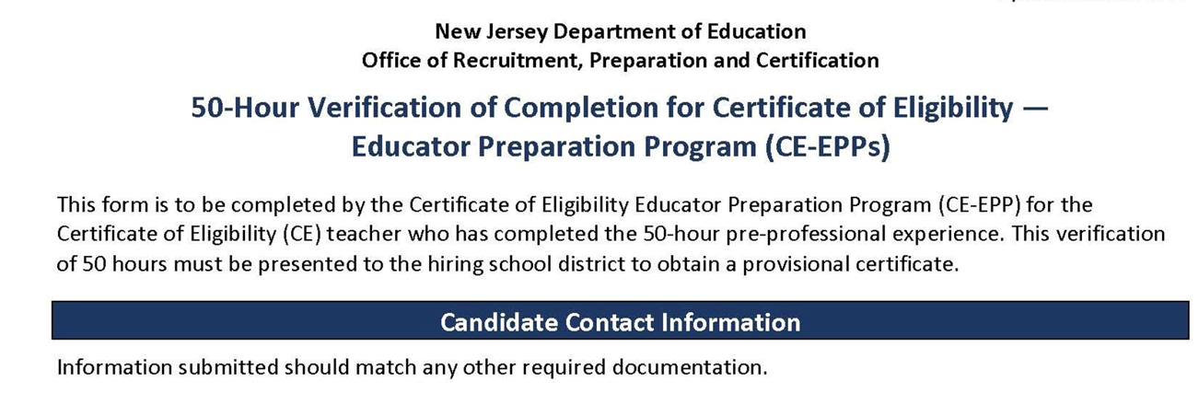
50-Hour CE-EPP Verification of Program Completion (VOPC)
Form

Slide 37
Provisional Process for Teachers (2 of 3)
Requirements to Obtain Standard Certification
The following must be completed while employed under a provisional certification to obtain a standard license:
(1) Mentoring and Induction
Provisional teachers must complete a school mentoring program.
The mentoring fee charged by the district is $550 for CEAS teachers and $1000 for CE teachers.
The Educator Mentoring and Induction Support webpage has information about developing a mentoring plan. Please contact TeachPD@doe.nj.gov for any questions you may have about developing a mentoring plan.

Slide 38
Provisional Process for Teachers (3 of 3)
Requirements to Obtain Standard Certification
(2) Supervision and Evaluation
Provisional teachers must obtain at least two years of effective or highly effective final summative evaluations.
The Office of Educator Evaluation has information regarding AchieveNJ. Please contact edueval@doe.nj.gov for any questions regarding AchieveNJ/summative ratings.
(3) Alternate Route Formal Instruction for CE teachers
At least 400 hours, or the credit equivalent of instruction, through an approved CE-EPP.

Slide 39
Instruction for CE Holders (1 of 2)
Categories of CE programs:
Department-approved CE EPP for P–12 Subject Area Teachers;
Career and Technical Educators (CTE);
Elementary K–6
Preschool through Grade 3 (P–3 );
Teacher of Students with Disabilities (TOSD);
English as a Second Language (ESL); and,
Bilingual/Bicultural.
To see a list of all approved CE programs , please visit the NJDOE website

Slide 40
Instruction for CE Holders (2 of 2)
“Program Enrollment” requirements for each of the following:
(1) English as a Second Language (ESL) candidates:
  400-hours or the credit equivalent through an approved CE-EPP; and 15 credits in an ESL program.
(2) Bilingual candidates with a content area CE:
  400-hours or the credit equivalent through an approved CE-EPP; and 12 credits in a Bilingual program.
(3) TOSD candidates with a content area CE:
  400-hours or the credit equivalent through an approved CE-EPP program; and 21 credits in a TOSD program.

Slide 41
Provisional Process: Educational Services and Administrative Endorsements

Slide 42
School Library Media Specialists (SLMS) 1 of 2
The school district will register the candidate through NJEdCert.
If the candidate has a CE, the school district must select the EPP where the School Library Media Specialists (SLMS)courses will be taken in the NJEdCert drop-down menu under "program enrollment".
A one-year residency and mentoring is required under the provisional certificate.
    Mentoring must be completed by an experienced school library media specialist. If there is not an experienced SLMS available within the school district to mentor the candidate, an experienced SLMS mentor can be provided through the New Jersey Association of School Librarians (NJASL). NJASL can be reached at mentoring@njasl.org.

Slide 43
School Library Media Specialists (SLMS) 2 of 2
A candidate’s standard certificate determination will be based on completion of the residency and the final summative rating.
The final summative rating is entered by the district in NJEdCert.
A CE candidate must have the VOPC submitted by the EPP provider.
Note: The same requirements apply for candidates seeking an Associate Library Media Specialist (ASLMS) endorsement.

Slide 44
Student Assistance Coordinators (SAC)
The school district registers the candidate through NJEdCert.
If the candidate has a CE, they must choose the EPP where the courses will be taken in the drop-down menu under "program enrollment”.
A six-month residency is required under the provisional certificate.
A candidate’s standard certificate determination will be based on completion of the residency and the final summative rating.
The final summative rating is entered by the school district in NJEdCert.
A CE candidate must have the VOPC submitted by the EPP provider.

Slide 45
Provisional Process for Administrators
The school district registers the administrator through NJEdCert.
Administrators must be registered in the appropriate program:
    Principals will register with Leader to Leader/ NJPSA for the two-year residency.
    School Administrators will register with NJASA for the one-year residency.
    School Business Administrators will register with NJASBO for the one-year residency.
A one-to-two-year residency is required under the provisional certificate.
A candidate’s standard certificate determination will be based on successful completion of the residency.

Slide 46
New Provisional Registration

Slide 47
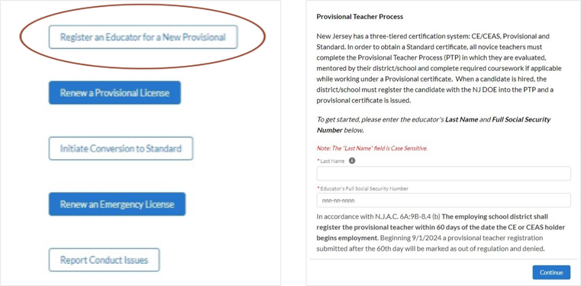
Register Educator for New Provisional License (1 of 2)

Slide 48
2. Register Educator for New Provisional License (2 of 2)
Entering Educator Information in NJEdCert
Steps to register an educator for the provisional teacher process:
Complete the fields for last name and social security number.
Verify email address on file. If email is incorrect, the applicant will need to login to their NJEdCert account and update their email address.
Complete fields for job type, employment status, and start date.
Select the license that matches the position for which the district hired the educator.
Select the CE EPP information, if applicable, and provide the mentor information.

Slide 49
Post Registration Submission
Register Educator for New Provisional License
After completing the registration, the following will occur:
    A case is created and assigned to the provisional program.
    An application record is created within the case.
    A new provisional teacher process (PTP) record is created for that educator.
Note: This record is created for all educators (i.e. teachers, administrators, and educational service specialists).

Slide 50
Provisional Renewal Process

Slide 51
Renewal of Provisional (1 of 2)
What is Renewal and When is it Required
Expiring Initial Provisionals: Candidates who have not met the requirements for a standard certificate while working under a provisional certificate set to expire on July 31, will need to be issued a provisional renewal to continue employment in their current district.
    The school district can initiate the renewal process in NJEdCert in June of the expiring year.
How Frequently Can it Be Renewed: Candidates may be eligible for one provisional renewal. CE teachers must provide the school district with documentation of progress made towards alternate route program completion.

Slide 52
Renewal of Provisional (2 of 2)
Special Endorsements
CE teachers in the following endorsement areas may be eligible for a second renewal of their provisional if they have not completed coursework:
    Teacher of Students with Disabilities CE, and a CE with an endorsement appropriate to the subject to be taught; Student with Disabilities CE holders must demonstrate successful completion of at least two courses per provisional period to the school district.
    Bilingual/Bicultural CE, and a CE with an endorsement appropriate to the subject or grade level to be taught; or
    Teachers who hold a CE in English as a Second Language
CE teachers must provide the school district with documentation of progress made towards program completion.

Slide 53
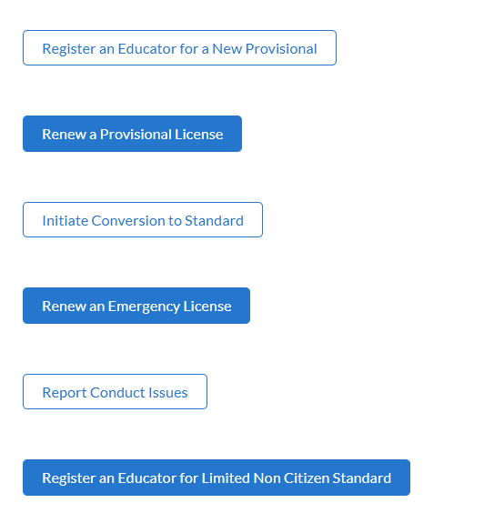
Initiating Provisional License Renewal (1 of 2)
To initiate a provisional renewal, the school district must complete the following:
Step 1: From the homepage, click “Renew a Provisional License.”
Step 2: Once the district has selected the provisional licenses eligible to be renewed, choose the appropriate educator.
Step 3: Follow the screen prompts.

Slide 54
Initiating Provisional License Renewal (2 of 2)
After creating the renewal case, the following will occur:
A case is created with the status “pending payment.”
An application is created and associated to the case.
A new PTP record is created and associated to the educator and the application.
The educator will receive an email with the subject line, “Your Provisional Renewal Application.” This will allow the educator to complete the application and payment.
Once the payment and Oath of Allegiance are completed, the status will change to “pending review.”

Slide 55
Entering a Termination Date
When an educator leaves a school district, the last date of employment, known as the termination date, must be entered in NJEdCert.
A PTP record is created for each endorsement the educator is registered for in NJEdCert.
To enter a termination date, visit the "district educator" list in your district NJEdCert account and select click educators hyperlinked name to pull up the account records. Locate the educator’s PTP ID records for your school district and enter a termination date for each. If the educator has multiple PTP ID records for your district, a termination date must be entered for each PTP ID record.

Slide 56
Conversion to Standard Process

Slide 57
Conversion to Standard
School districts must initiate a conversion to standard for all educators through NJEdCert. Before initiating a conversion to standard, the school district must confirm the following has been completed:
    Teachers have completed 30 weeks of mentoring, received two years of effective or highly effective final summative ratings and completed required coursework, if applicable.
    Administrators have completed one-to-two-year residency.
    SAC have completed a 6-month residency, received an effective or highly effective rating, and completed coursework, if applicable.
    SLMS/ALMS have completed a one-year residency, mentoring, received an effective or highly effective rating, and completed coursework, if applicable.

Slide 58
Conversion to Standard Checklist
Activity | Teachers | SLMS/ASLMS | SAC | Administrator
Mentoring | Completed 30 weeks of mentoring | Completed one year of mentoring | N/A | N/A
Residency | N/A | Completed one year residency | Completed six-month residency | Completed one-to-two-year residency
Evaluation | Two years of effective or highly effective final summative ratings | An effective or highly effective final summative rating | An effective or highly effective final summative rating | N/A
Coursework | CE teachers completed 400 hours or semester-hour credits. | CE SLMS/ASLMS completed required coursework | CE SACS completed required coursework | N/A

Slide 59
Final Summative Evaluation Ratings and Mentorship
The final summative evaluation rating and mentoring weeks completed are entered by the school district into NJEdCert.
    To enter a final summative rating and mentoring weeks visit the "district’s educator" list in your district NJEdCert account and select the educator's hyperlinked name to pull up the account records. This will open a page that has the option to choose “Enter Final Summative Ratings and Mentorship.”
    Mentoring time must be tracked by each employer. If a provisional teacher leaves a school district and is employed in a new school district, the initial district will need to complete the Mentoring Transfer Template to document the amount of mentoring time the educator completed. (Educator Mentoring and Induction Support)

Slide 60
NJEdCert Instructional Videos
Video 1: NJEdCert video on provisional registration, final summative rating, and termination.
Video 2 :How to submit provisional renewal case in NJEdCert YouTube video
Video 3: How to submit a CEAS conversion to standard case in NJEdCert YouTube video
Video 4: How to submit a CE conversion to standard case in NJEdCert YouTube video
Video 5: How to submit a Customer Service Web to Case in NJEdCert YouTube video

Slide 61
Contact Information

Slide 62
Contact Customer Service
Call Center (Monday-Friday 8 am to 7 pm): (609) 292-2070
Educators can create an NJEdCert account to submit questions and communicate directly with customer service staff. Case inquiries include:
    Name update
    DOB update
    Social Security Number update
    Citizenship Status update
    Test Score Records
    Application Questions
    Customer Service Questions
School districts can create a case through their NJEdCert school district account to submit questions. Information on how to do this can be found here: How to submit a customer service web to case in NJEdCert.

Slide 63
Additional Contact Information/Resources
Office of Educator Evaluation email address: edueval@doe.nj.gov
Educator Evaluation website: nj.gov/education/edueval
Educator Mentoring and Induction Support: nj.gov/education/profdev/mentor/
Office of Professional Development email address: TeachPD@doe.nj.gov
NJDOE County and District Information: nj.gov/education/certification/ctydistinfo/
EPP Training: EPP Training Using the NJEdCert Portal
NJDOE Apply for Certification: nj.gov/education/certification/apply/
New Jersey Department of Education: nj.gov/education

Slide 64
Q&A
We are working to respond to your remaining Q&A questions. Please remain with us as we work to ensure your questions are answered.

Slide 65
Follow Us
Facebook
@njdeptofed
X
@newjerseydoe
Instagram
@newjerseydoe
LinkedIn
New Jersey Department of Education
nj.gov/education
Threads
@newjerseydoe
YouTube
@newjerseydepartmentofeduca6565

Slide 66
Thank You
Office of Certification, Recruitment and Preparation

