Slide 1
Session 3: Play and Kindergarten Centers
Divisions of Early Childhood Services
Office of Kindergarten to Third Grade Education

Slide 2
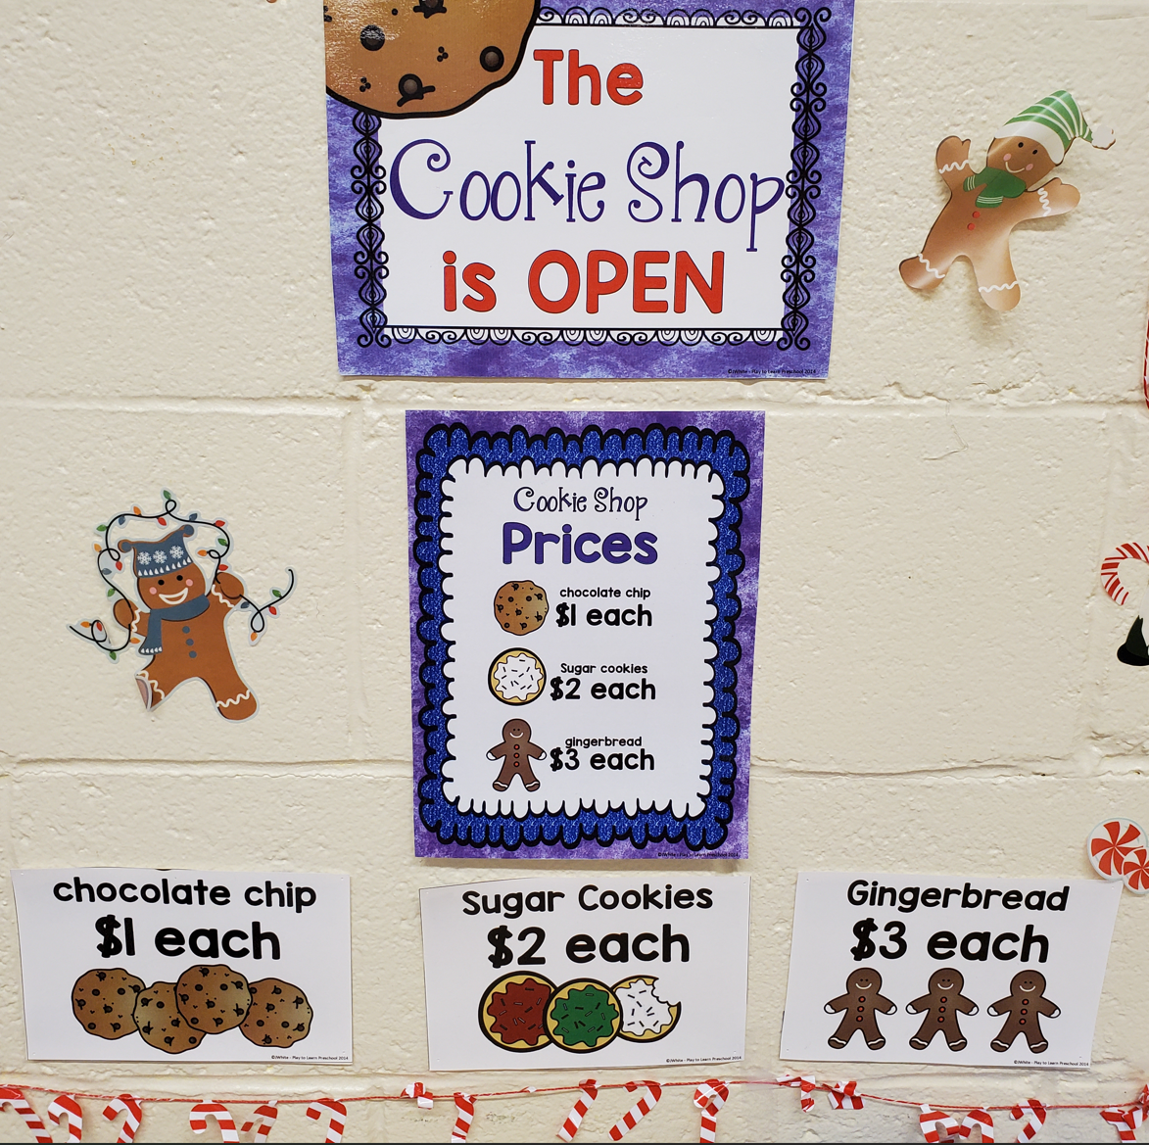
Intentional Play (1 of4)
Intentional play is a learning approach.
Children can learn though an active process when they engage in meaningful, socially interactive, iterative, and joyful play.
Children become agents of their learning.

Slide 3
Intentional Play (2 of 4)
Play provides children the opportunity to practice what they have learned, build, negotiate relationships, communicate, listen, and develop ideas.
Learning occurs best when children are mentally active, engaged, socially interactive, and building meaningful connections to their lives, all components found during play (Hassinger-Das et al., 2017).
Play is also intrinsically motivating for children.
WHY PLAY?

Slide 4
Intentional Play (3 of 4)
Elements of play and joy can be infused into the entire kindergarten day so that learning is engaging, fun, and effective.
Play should be immersed in all curricular areas.
When teachers create specific opportunities for children to engage in authentic and joyful play, it can indeed help students meet academic standards while also promoting holistic development.
Meeting the NJSLS via Play Video

Slide 5
Intentional Play (4 of 4)
Within the kindergarten day, teachers should provide time for balanced play.
The benefits of play are strengthened when all kinds of play are offered daily.
Different kinds of play give children the opportunities to develop their social, emotional, and cognitive development.
Approaches to Learning: How Young Children Learn
Share thoughts

Slide 6
Choice Time Centers (1 of 2)
Choice time is a dedicated part of the day when children can engage in play-based learning through centers.
Children can freely choose an available center of their choice based on the teacher’s center-management system.
Movement from one center to another will be based upon student interest, engagement, and availability of space in the desired location.

Slide 7
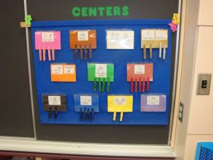
Choice Time Centers (2 of 2)
Choice time centers allow students to express themselves through play-critical part of the kindergarten day.
Setting up the choice time centers, supply each area with ample materials for multiple students to play with during the entire time.

Slide 8
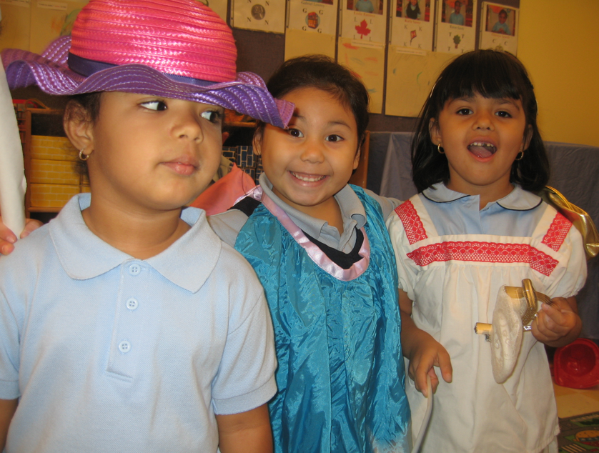
Fantasy/Imaginative Play
One type of play is known as fantasy/imaginative play.
In this type of play, children choose an imaginary scenario in which they take on roles and act them out and then determine a set of rules to go along with the roles.
Self-regulation increases as children develop and adhere to a set of rules that define the roles.

Slide 9
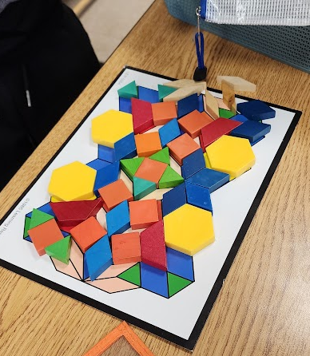
Constructive Play
Constructive play is another type of play.
It is an organized form of play that can be goal and product oriented.
In this type of play, children use materials, such as blocks, playdough, art, and recycled materials to construct something
An activity that increases in complexity as they mature.

Slide 10
Play Involving Games
Play involving games with an external set of rules helps children develop a different set of skills and strategies than in fantasy play.
In this form of play, children must follow the rules.
This allows children to develop important social skills such as cooperation, negotiation, and healthy competition.

Slide 11
Outdoor Play
Outdoor play provides the opportunity to improve sensory integration skills (Yogman et al., 2018).
These activities involve the child as an active participant and address motor, cognitive, social, and linguistic domains.

Slide 12
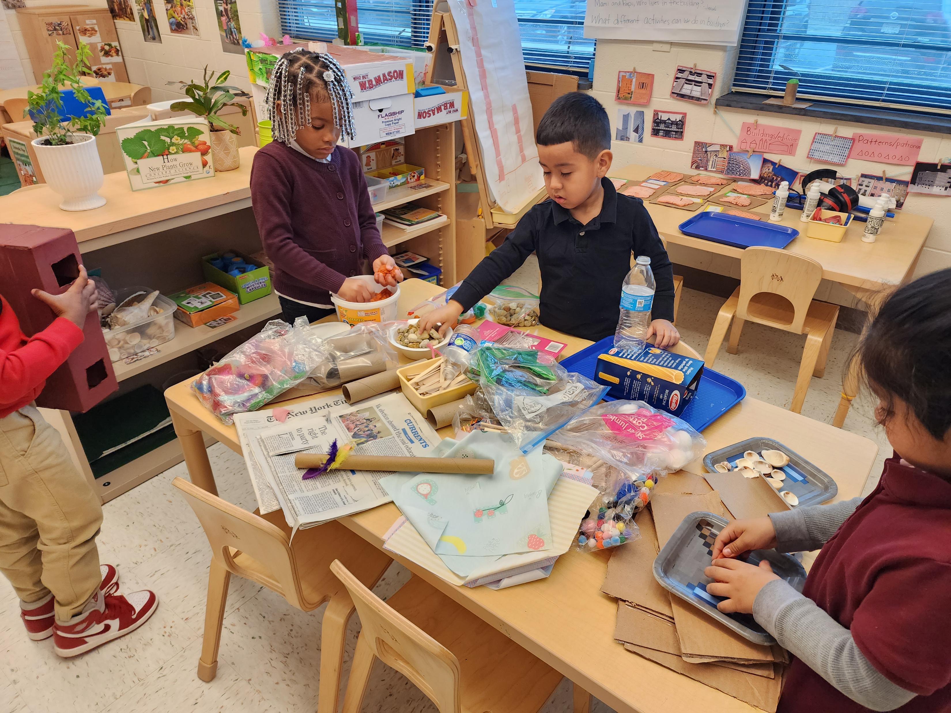
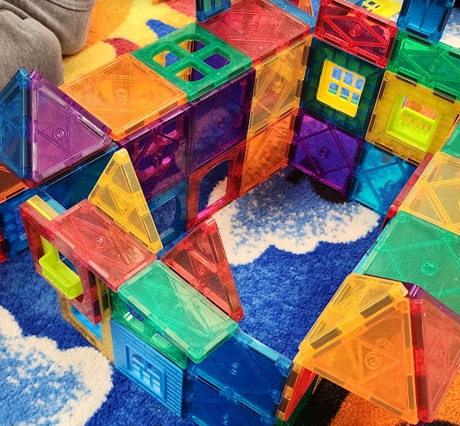
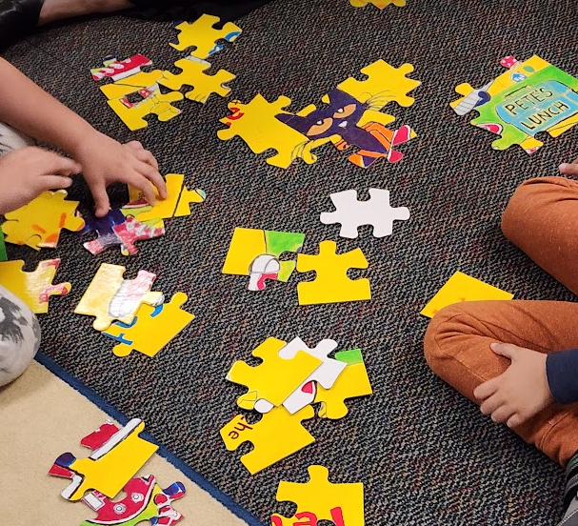
Why Playful Centers?

Slide 13
Centers (1 of 2)
The NJDOE has adopted New Jersey Student Learning Standards (NJSLS) for all content based academic instruction.
Many of these standards can also be incorporated into intentional play-based learning opportunities for our youngest learners.
Educators who design curricula and teach kindergarten are encouraged to use play in addition to teacher-led instruction to incorporate the NJSLS to meet the needs of all learners in their classroom.

Slide 14
Centers (2 of 2)
The idea of balancing student-led independence and teacher-led direction in learning centers reflects a pedagogical approach that recognizes the importance of both autonomy and guidance in the learning process.
Research in education has emphasized the value of finding a balance between these two instructional modes, “negotiate a balance between academic learning (e.g., literacy skills) and the use of developmentally appropriate practices (e.g., play-based learning)” (Danniels & Pyle, 2018, p. 4).

Slide 15
Content Specific Learning Centers (1 of 2)
Differing from choice centers, learning centers in the kindergarten classroom are used to help further content instruction.
There are many different types of learning centers and occur during English Language Arts, Mathematics, and/or Science/Social Studies.
It is important to plan learning centers intentionally, making sure the materials in the center are necessary for the task at hand.
High-quality learning centers are designed to offer students a variety of learning alternatives as a follow-up to whole-class and small group instruction discussions.

Slide 16
Content Specific Learning Centers (2 of 2)
Learning centers:
Typically used after the modeling of important materials or concepts.
Designed to provide students with opportunities to enrich and enhance their appreciation and understanding of the topics through individual experiences in the center.
Filled with manipulatives, art materials, books, and other instructional tools.

Slide 17
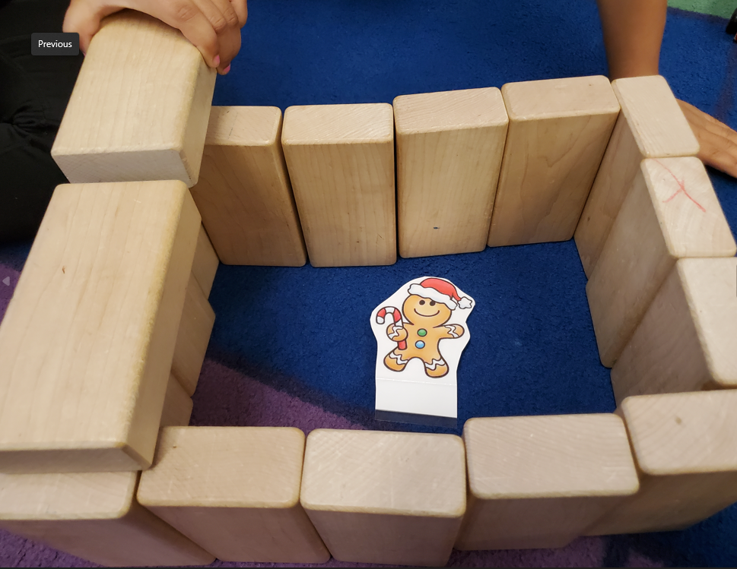
Block Center
Playing in the block center provides students with opportunities to problem solve, imagine, create, and build their social-emotional competencies as they work with others and persevere in a task.
Developmentally Appropriate Practices: Joyful Learning & Instruction Across the P-3 Classroom
Share thoughts

Slide 18
Literacy Center
Children will have the opportunity to strengthen their skills in many of the NJSLS-ELA such as developing foundational reading skills, reading books of different genres, writing for real purposes, and building speaking, listening, and language skills.

Slide 19
Math Center
The goal of mathematics centers in kindergarten is for students to build mathematical proficiency through purposeful practice in playful, standards-based, hands-on, academically challenging ways that help students gain confidence in mathematics (Newton, 2022).
Math Centers
Share thoughts

Slide 20
Dramatic Play Center
Arreguin-Anderson et al., (2018) note that pretend play is an integral part of a child’s social, emotional, and cognitive development.
In the dramatic play center, children can act out real world situations and play the role of different characters with their peers.

Slide 21
Science/Discovery Center
The science/discovery center promotes learning and development in different ways than direct instruction and media.
Through exploration, learners construct knowledge about the world (Gallo-Fox & Stegeman, 2018).

Slide 22
Art and/ or Makerspace Center
Numerous materials and supplies should be provided for children to use in this space, such as easels and paints, a variety of crayons, markers, pencils, assorted types of paper, non-toxic clay/dough, various collage materials, and any other materials that might spark imagination in children (Bongiorno, 2014).

Slide 23
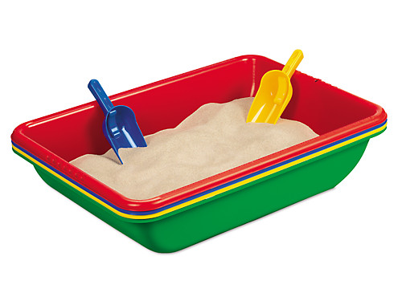
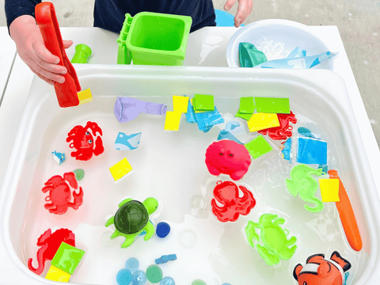
Sensory Exploration Sand and Water Center
Concepts set forth in the NJSLS-M and NJSLS-S such as volume, weight, measurement, water flow, and motion can be explored through effective teacher prompting during play (Vanover, 2018).

Slide 24
Technology Center
Access to technology provides equitable and expanded access to high-quality, standard-based computer science and technological design education.
Teachers plan lessons intentionally, and teachers are informed about the types of technology tools and interactive media that are developmentally appropriate for students.

Slide 25
Reflection Questions
How did you/can you turn-key the big ideas from Session 2: P-3 Continuum and Transitions?​?
What are any take aways you have from the session today and how does it connect to your work?
How will you turn-key information from Session 3: Play & Kindergarten Centers?
Session 4 (May 16, 2025) Standards Based Kindergarten Instruction & Parent and Family Engagement
Complete survey in chat.

Slide 26
References (1 of 4)
Arreguin-Anderson, M.G, Salinas-Gonzalez, I., & Alanis, I. (2018) Translingual play that promotes cultural connections, invention, and regulation: A latcrit perspective. International Multilingual Research Journal, 12(4), 273-287. DOI: 10.1080/19313152.2018.1470434
Bongiorno, L. (2014). How process-focused art experiences support preschoolers. National Association of the Education of Young Children.

Slide 27
References (2 of 4)
Danniels, E., & Pyle, A. (2018). Defining play-based learning. Encyclopedia on Early Childhood Development. https://www.child-encyclopedia.com/play-based-learning/according-experts/defining-play-based-learning.
Gallo-Fox, J., & Stegeman, L. (2018). Explore early: Support scientific development among young children with learning centers. Science and Children, 55(9).
Hassinger-Das, B., Hirsh-Pasek, K., & Golinkoff, R. M. (2017). The case of brain science and guided play: A developing story. Young Children, 72(2).

Slide 28
References (3 of 4)
Murray, R., & Ramstetter, C. (2017). Recognizing the benefits of recess. American Educator, 41(1).
Mraz, K., Porcelli, A., & Tyler, C (2016). Purposeful play: A teacher's guide to igniting deep and joyful learning across the day. Heinemann.
National Association for the Education of Young Children and the Fred Rogers Center for Early Learning and Children’s Media. (2012). Selected examples of effective classroom practice involving technology tools and interactive media. Saint Vincent College.
Newton, N. (2022). Guided math lessons in kindergarten: Getting started. Eye on Education.

Slide 29
References (4 of 4)
Vanover, S. T. (2018). The importance of sand and water play. National Association for the Education of Young Children. https://www.naeyc.org/resources/blog/importance-sand-and-water-play.
Yogman, M., Garner, A., Hutchinson, J., Hirsh-Pasek, K., & Golinkoff, R., Committee on Psychosocial Aspects of Child and Family Health, and Council on Communications and Media. (2018). The power of play: A pediatric role in enhancing development in young Children. Pediatrics, 142(3).

Slide 30
Follow Us on Social Media
Facebook: @njdeptofed
Instagram: @newjerseydoe
LinkedIn: New Jersey Department of Education
Threads: @NewJerseyDOE
X: @NewJerseyDOE
YouTube: @newjerseydepartmentofeduca6565

Slide 31
Thank You!
New Jersey Department of Education: nj.gov/education
https://www.nj.gov/education/earlychildhood/
https://www.nj.gov/education/earlychildhood/p3alignment/
Beth.Wharton@doe.gov

