Slide 1
Session 4: Standards Based Kindergarten Instruction & Parent and Family Engagement
Division of Early Childhood Services
Office of Kindergarten to Third Grade Education

Slide 2
NJDOE Disclaimer
Please be advised that neither the New Jersey Department of Education, nor its employees, specifically promotes, endorses, recommends, or favors any of the entities or resources listed herein. Instead, this list of entities and resources is provided for informational purposes only. School districts must always evaluate and determine, based on the individualized needs of its student population, whether to utilize and/or expend its resources on the entities or resources herein.

Slide 3
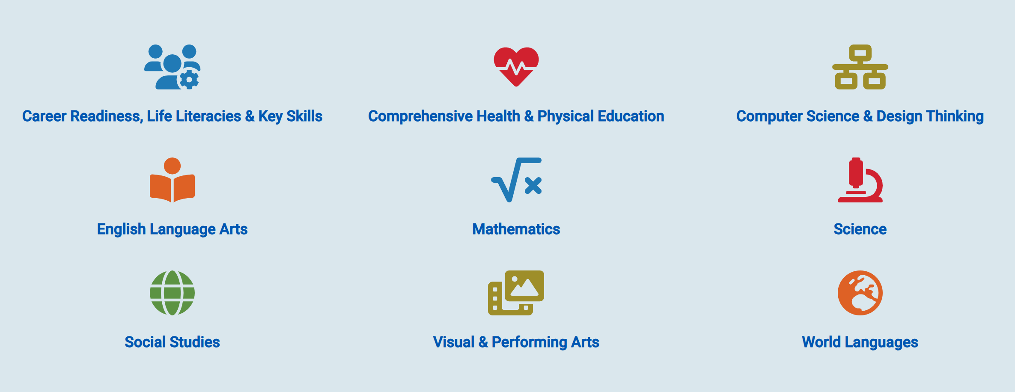
K-12 New Jersey Student Learning Standards

Slide 4
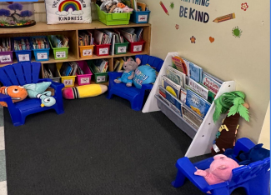
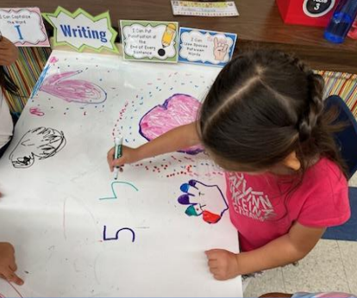
English Language Arts Overview
Standards based best practices
Reading Foundational Skills
Reading Comprehension
Modeling Writing and Mini-lessons
  NJSLS-ELA

Slide 5
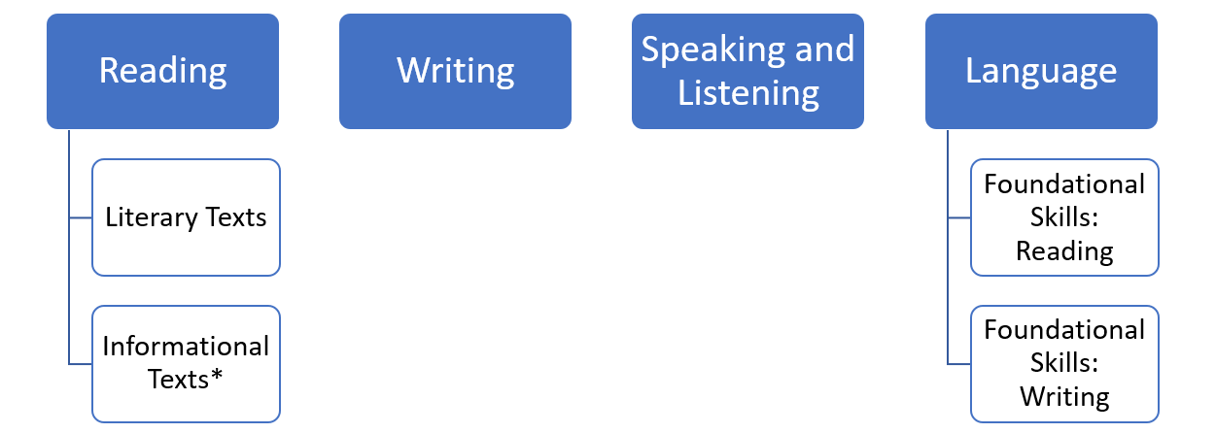
NJSLS- ELA (2023)

Slide 6
Text Version of NJSLS-ELA(2023)
The diagram shows the four domains of literacy. The domains of reading and language are each connected to two further concepts.
The four domains are:
Reading
Writing
Speaking and Listening
Language
The Reading domain connects to:
Literary texts
Informational Texts
The Language domain connects to:
Foundation skills: reading
Foundational skills: writing

Slide 7
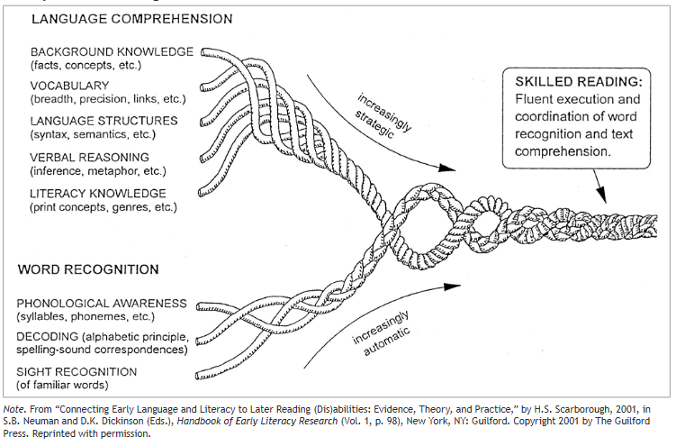
Scarborough’s Rope

Slide 8
Text version of Scarborough’s Rope
The many strands that are woven into skilled reading.
The Reading Rope consists of lower and upper strands. The word-recognition strands (phonological awareness, decoding, and sight recognition of familiar words) work together as the reader becomes accurate, fluent, and increasingly automatic with repetition and practice.
Language Comprehension (Upper Strands):
Strands include:
Background knowledge (facts, concepts, etc.)
Vocabulary (breadth, precision, links, etc.)
Language structures (syntax, semantics, etc.)
Verbal reasoning (inference, metaphor, etc.)
Literacy knowledge (print concepts, genres, etc.)
Word Recognition (Lower Strands)
Strands include:
Phonological awareness (syllable, phonemes, etc.).
Decoding (alphabetic principle, spelling-sound correspondences
Sight recognition (of familiar words).
Skilled Reading:
Language comprehension becomes increasingly strategic and word recognition becomes increasingly automatic in the progression to becoming a skilled reader. A skilled reader displays fluent execution
and coordination of word recognition and text comprehension.

Slide 9
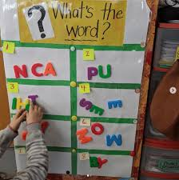
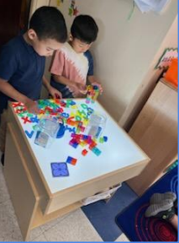
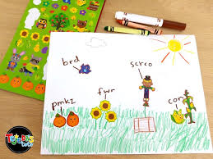
English Language Arts (1 of 3)
Reading:
Phonemic Awareness
Phonics/ Word Recognition
Fluency
Vocabulary Acquisition
Building Reading Comprehension

Slide 10
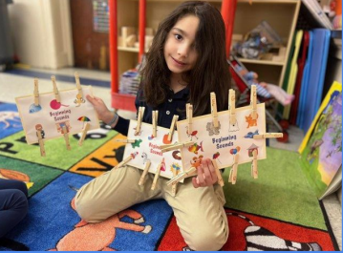
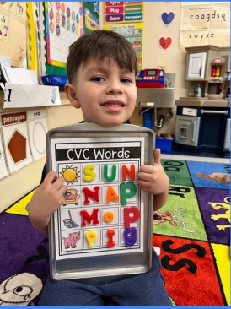
English Language Arts (2 of 3)
Developmentally
Appropriate Practices (DAP)
Intentional play
Interest
Small groups
Oral language

Slide 11
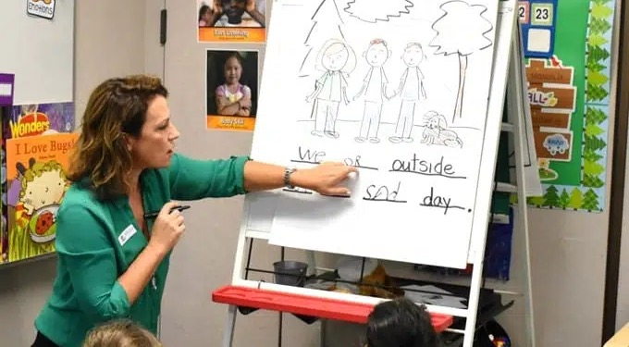
English Language Arts (3 of 3)
Modeling Writing and Mini-lessons:
  Print conventions
  Interactive writing
  Shared writing
  Handwriting
  Guided Writing group
  Conferences

Slide 12
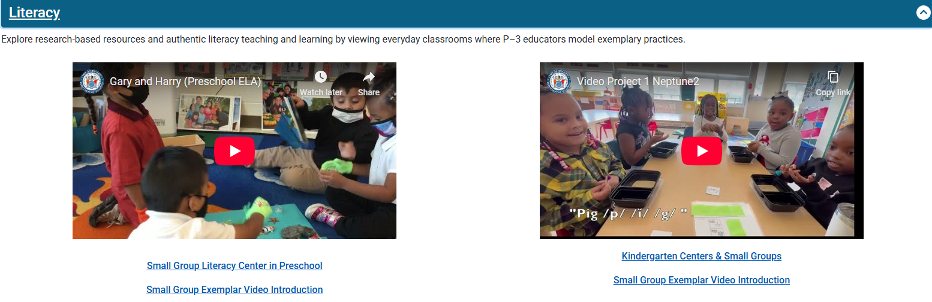
Additional Resources (1 of 2)
P–3 Educator Exemplars and Early Learning Experts Video Library

Slide 13
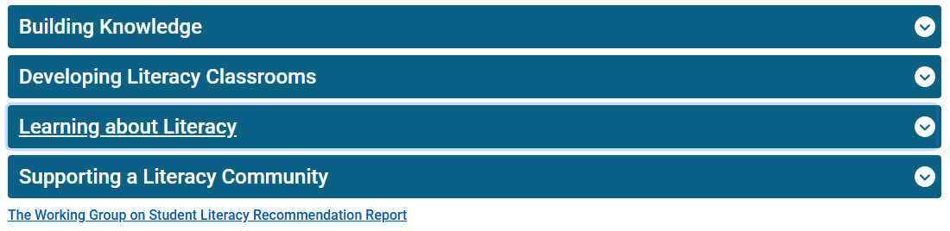
Additional Resources (2 of 2)
Learning Equity and Academic Recovery (LEAR)

Slide 14
Mathematics Overview
The importance of early knowledge of mathematics
Developmental learning trajectories
Problem solving
Mathematical discourse
Small group instruction
Centers

Slide 15
Mathematics in Early Years
Mathematics has predictive power.
All children have the potential to learn difficult mathematics.
We know a lot about how children learn mathematics!
Math in the Early Years

Slide 16

Mathematics: Learning Trajectories
Developmental Learning Trajectories:
Learning Trajectories are descriptions of children’s thinking and learning in a specific domain and a route through a set of developmental levels using instructional tasks designed to move students through a developmental progression.
learningtrajectories.org
Using Developmental Learning Trajectories (presentation)

Slide 17

Mathematics: Problem Solving (1 of 5)
Problem Solving is…
Standards-aligned
Daily!
Low floor, high ceiling tasks
Engaging, relevant, real-world
Using templates and work mats (scaffolds).
Problem Solving (presentation)
K.O.A.A.2
Solve addition and subtraction word problems, and add and subtract within 10, e.g., by using objects or drawings to represent the problem.
NJSLSM
Addition and Subtraction Subtypes

Slide 18

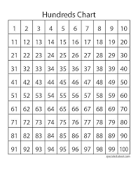

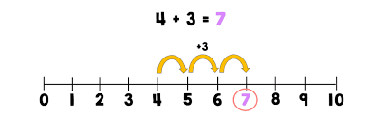
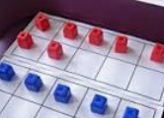



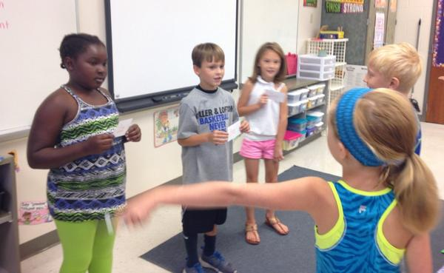
Mathematics: Problem Solving (2 of 5)
Tools and Manipulatives
Visuals

Slide 19
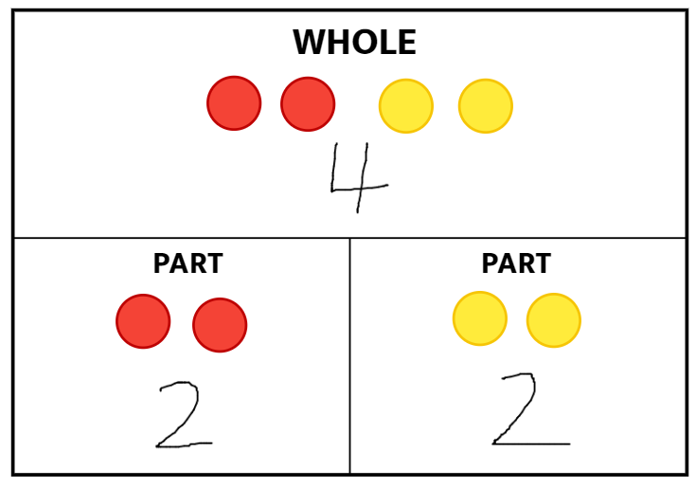

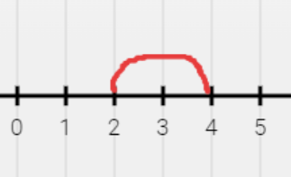
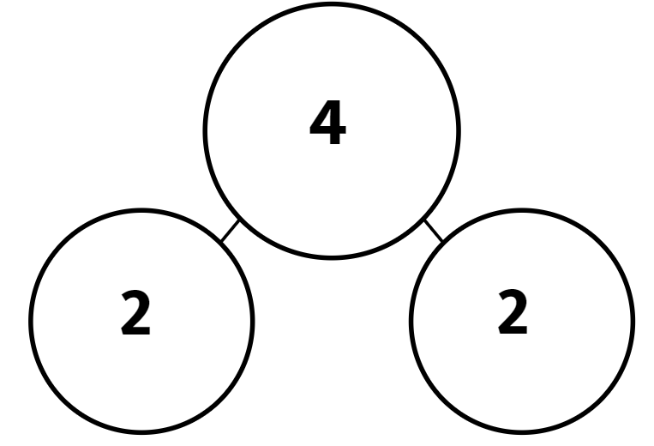

Mathematics: Problem Solving (3 of 5)
Lisa had 2 red marbles and 2 yellow marbles. How many did she have altogether?

Slide 20
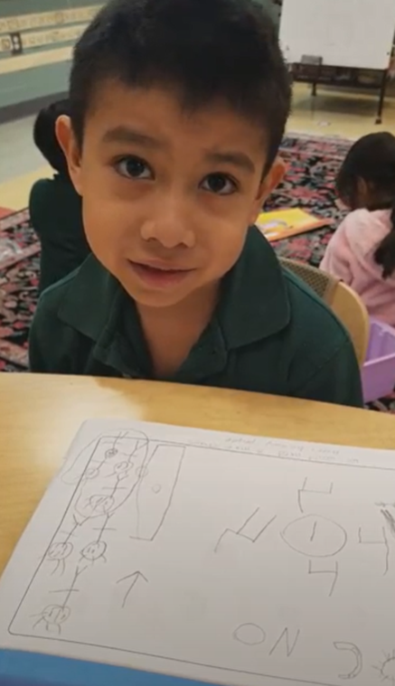
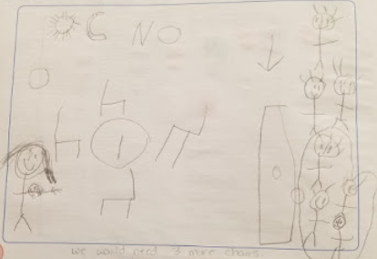
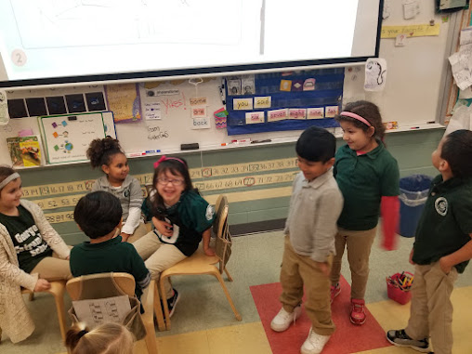
Mathematics: Problem Solving (4 of 5)
Present rich, real-world tasks:
I am having a party. I set up 4 chairs at the table. The doorbell rings, and there are 7 friends at the door. Do I have enough chairs?

Slide 21
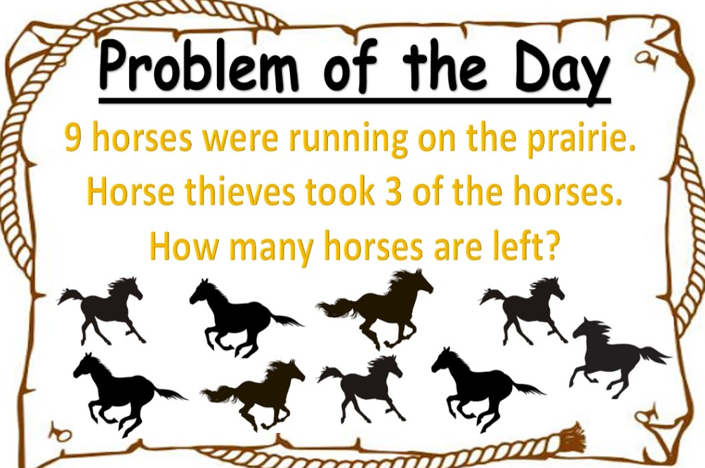
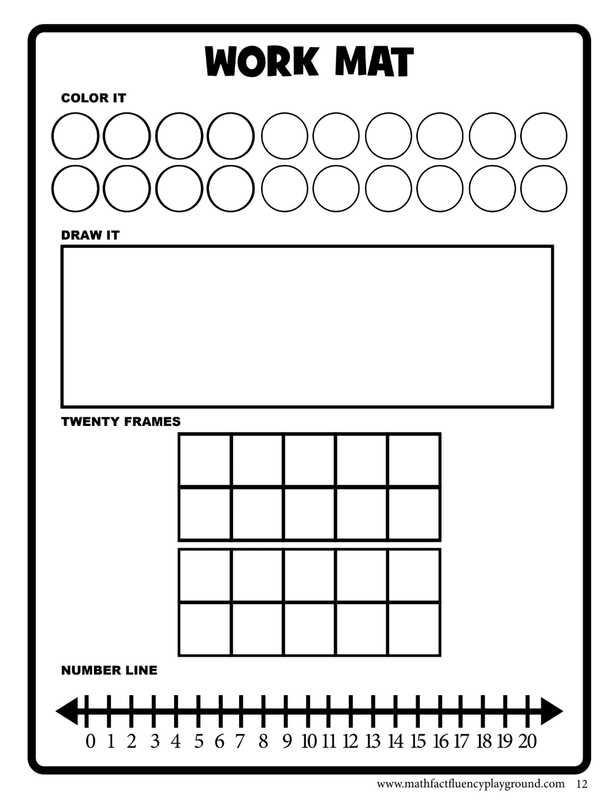
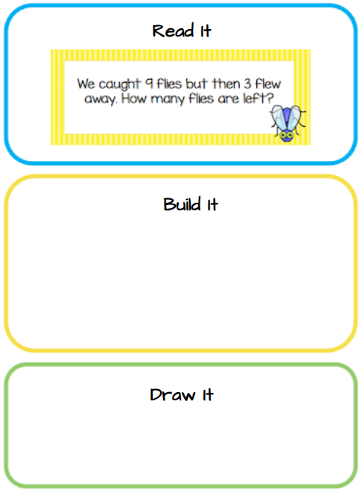
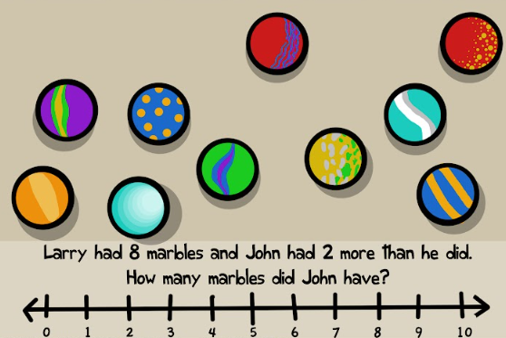
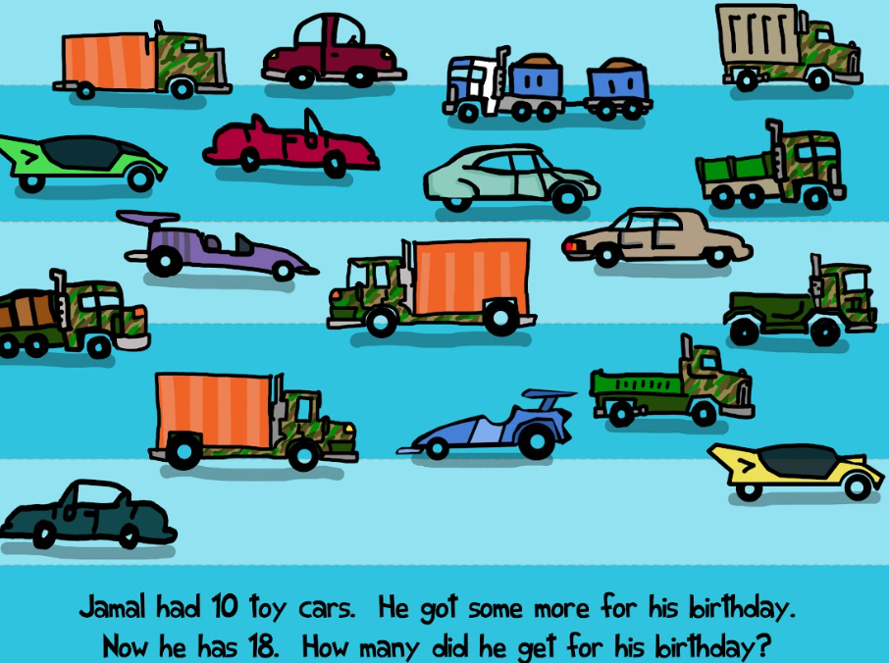
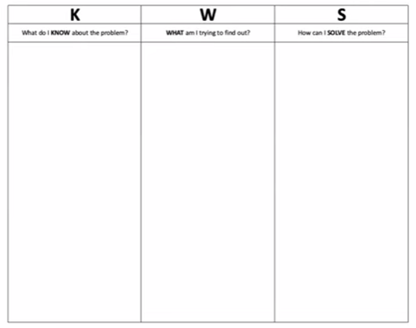
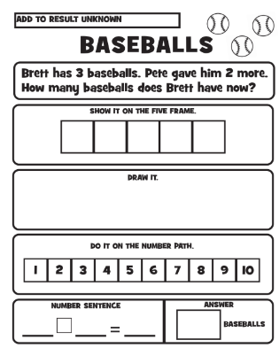
Mathematics: Problem Solving (5 of 5)
Work mats
Planning Templates
Scaffolds

Slide 22
Mathematics: Discourse (1 of 2)
Questioning
Model and Promote Expected Behaviors
Strengthen Math Vocabulary
Select Rich Tasks

Slide 23
Mathematics: Discourse (2 of 2)
How can teachers elicit children’s solution methods?
Encourage active listening to evaluate others’ thinking.
Ask children to share, clarify, and/or justify their ideas
Facilitate children’s responding
Use a wide range of question types to probe and challenge children’s thinking. Pose meaningful questions!
Encourage children to explain their thinking. Ask “Why?”, “How did you…?”, “Could you…?” type questions.
Elicit many solution methods for one problem
Wait patiently and listen attentively to children
Actively elicit communication between children. Use conversation cards, question stems, etc.
Reinforce the expectation that children listen to one another respectfully.
Encourage children to elaborate their response
Respond to errors as learning opportunities questions!
Levels of Classroom Discourse (Hufford-Ackles, et al., 2014)

Slide 24
Mathematics: Small Group Instruction (1 of 2)
Flexible Small Group Instruction is small, intentional lessons with 3-4 students in their zone of proximal development, around a major standard. They follow a framework… just like a lesson!
Flexible Small Group at a Glance
Priority Goals
Steps | Timing | Teacher’s role
1. Mini-Lesson | 2 - 3 minutes | Teacher presents a brief mini lesson based on a concept, strategy, or skill highlighted in the data gathered about the students.
2. Focus & Learning Expectations | 2 - 3 minutes | Teacher presents a focus for the meeting “Today we will…” teacher outlines learning expectations. “You will learn how to…” or “You will be practicing…”
3. Model | 3 - 5 minutes | Teacher models or demonstrates the math concept, strategy, or skill.
4. Discuss & Do Math | 3 - 5 minutes | Teacher gives the children opportunities to discuss and ‘practice the math’ (in a group, with a partner, or alone).
5. Monitors Student Work (formative assessment) | 3 - 5 minutes | Teacher listens to students’ conversations and watches their work to guide instruction.
6. Debrief & Future Plans | 2 minutes | Teacher summarizes major takeaways, highlights main points, makes any necessary clarification, and solicits further questions/comments. Teacher discusses homework and center work.

Slide 25
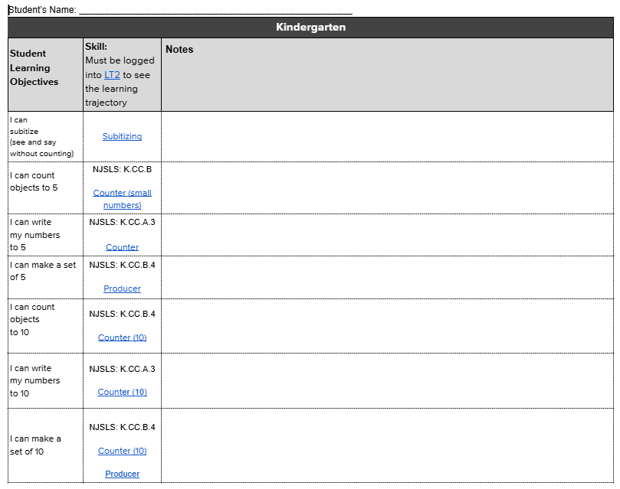
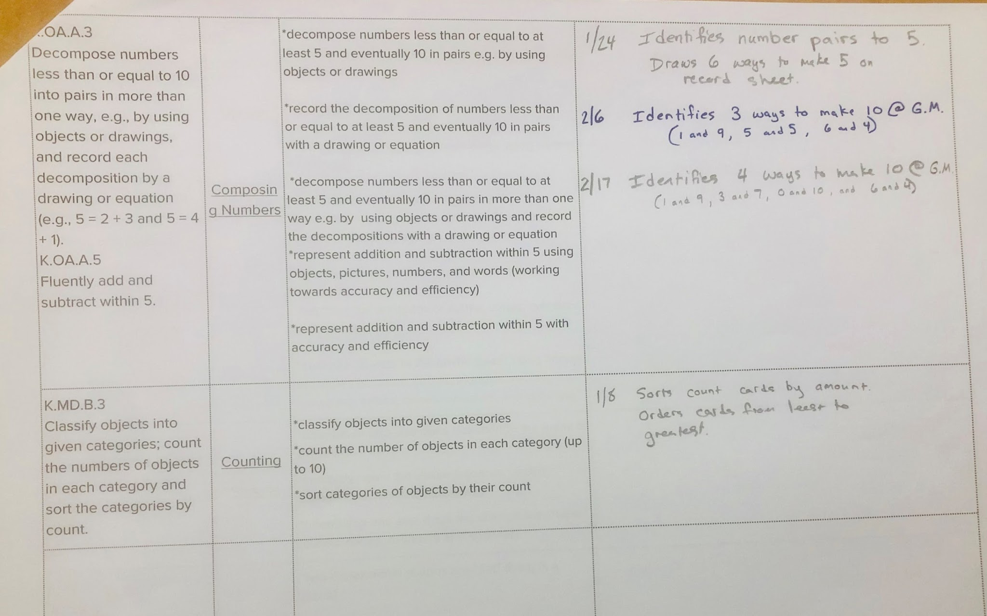
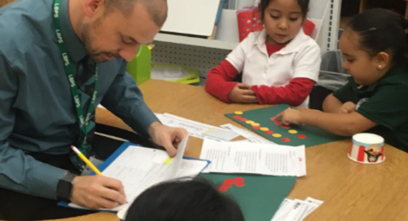
Mathematics: Small Group Instruction (2 of 2)
Formative Assessment
Teachers monitor student work.
Teachers listen to students’ conversations.
Teachers question students to gauge understanding and guide the learning.
Teachers record anecdotal data!
Anecdotal Note Catcher

Slide 26
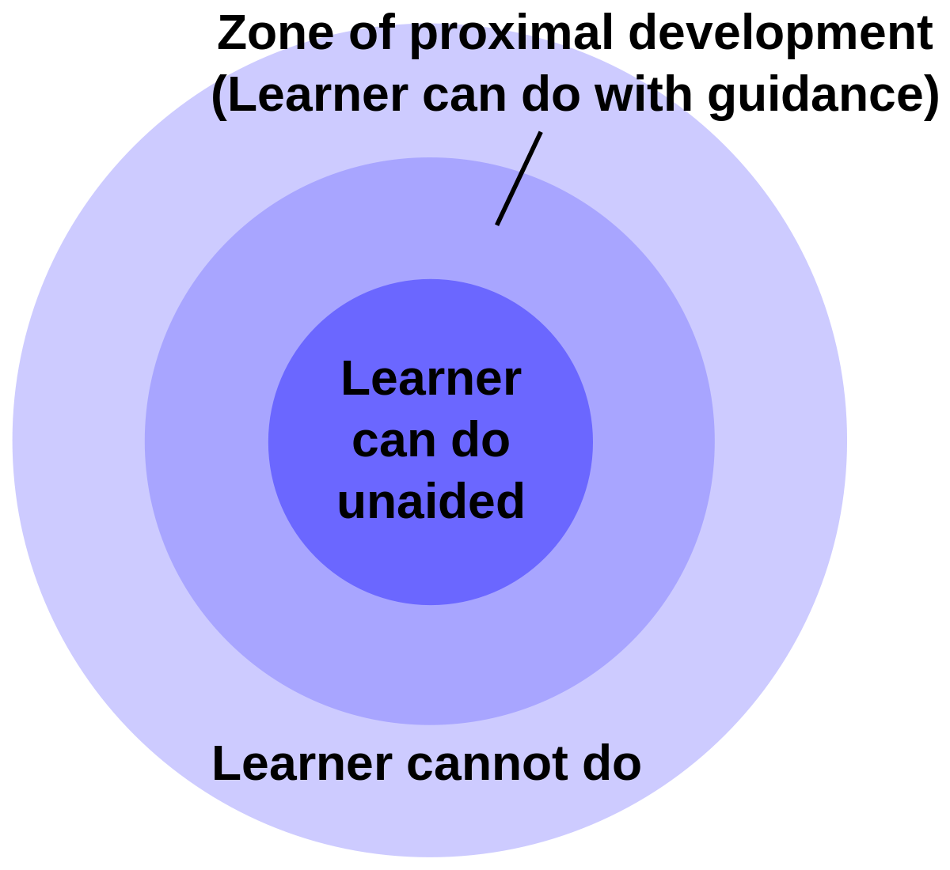
Mathematics: Centers (1 of 3)
Differentiating/Leveling Centers
Levels are based on the understanding that students learn at their own pace.
Students working in their zone of proximal development (ZPD).
Students engage in productive struggle.
Math Centers part 1 Presentation
Math Centers part 2 Presentation

Slide 27
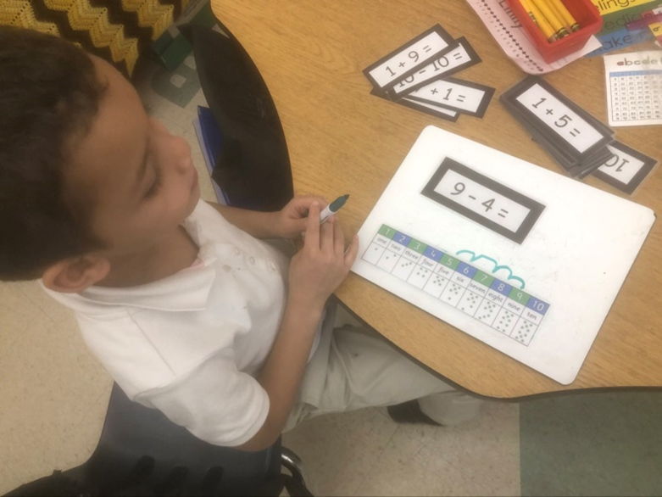
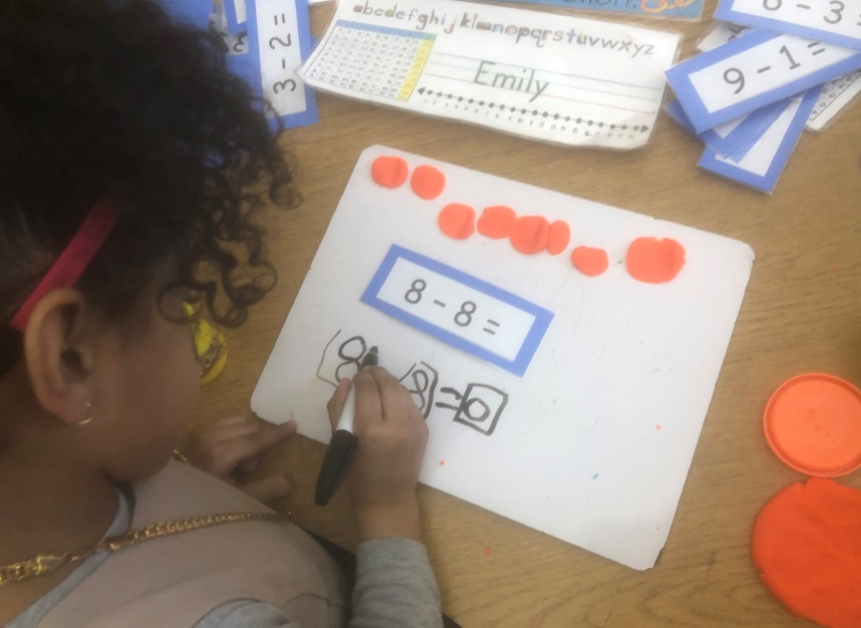

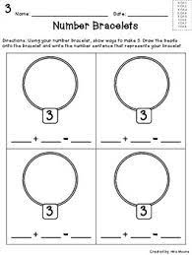
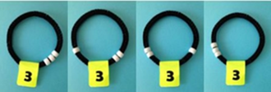
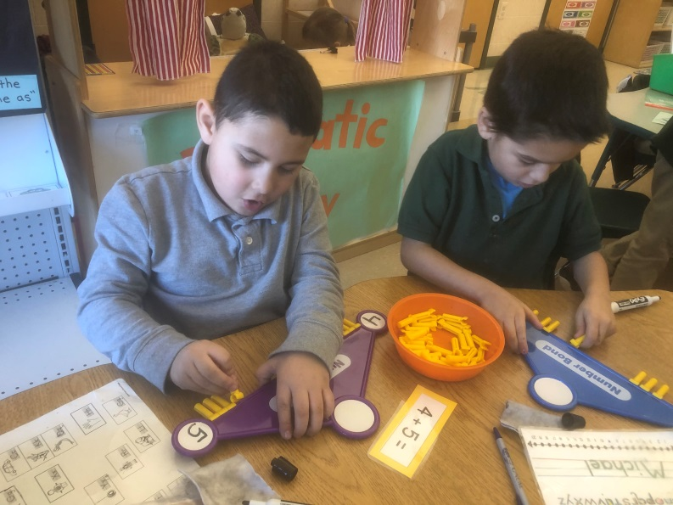
Mathematics: Centers (2 of 3)
Differentiate/ Level Centers using the Cycle of Engagement:
Concrete
Pictorial
Abstract
Concrete Activity | Representational/Pictorial Activity | Abstract Activity
Show different ways to make the number shown on the number bracelet. | Use the number bracelet to show many ways to make the number shown. Draw it. | Use the number bracelet. Find many ways to make the number 5. Record the number sentence.

Slide 28
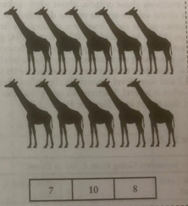
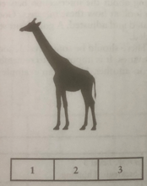
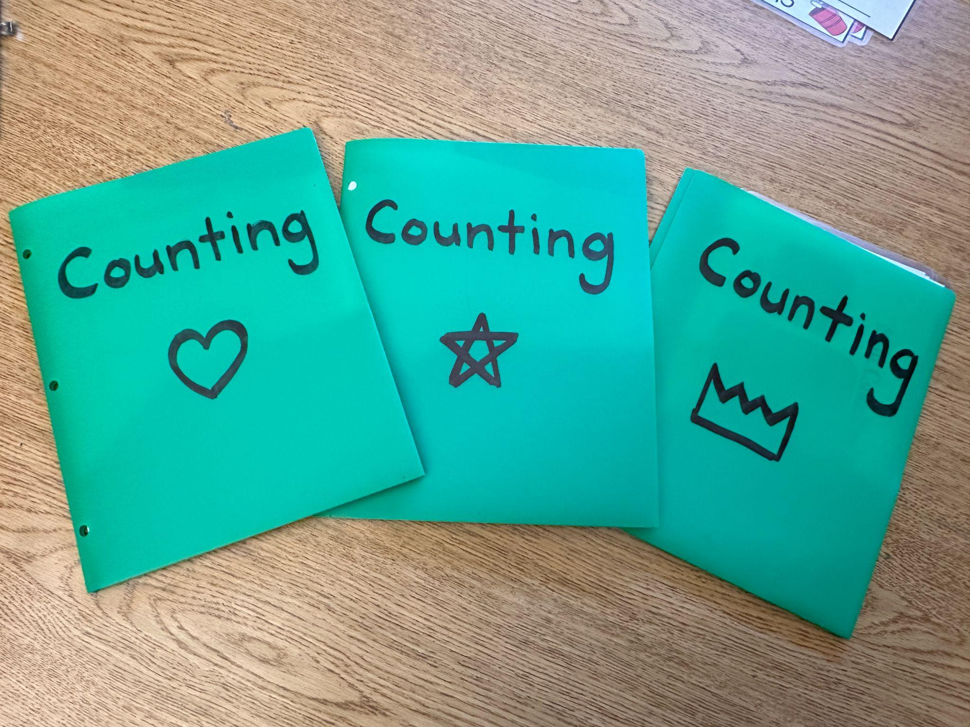
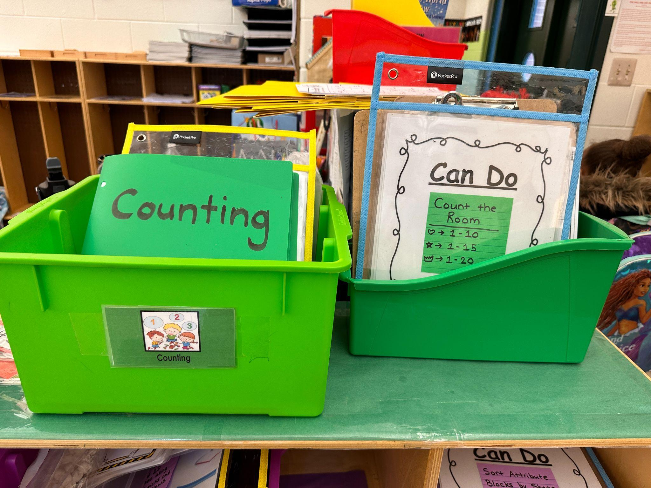
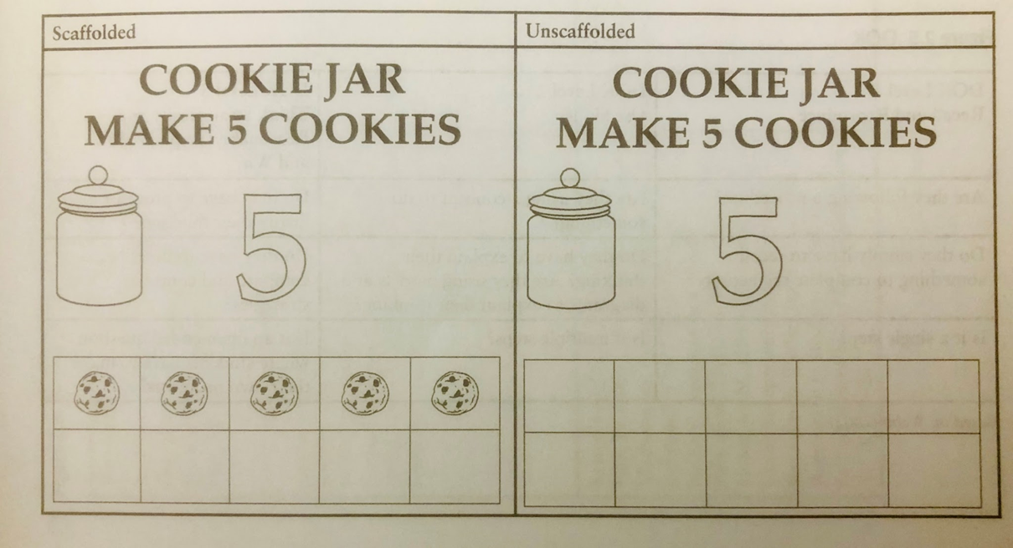
Mathematics: Centers (3 of 3)
Leveling Centers

Slide 29
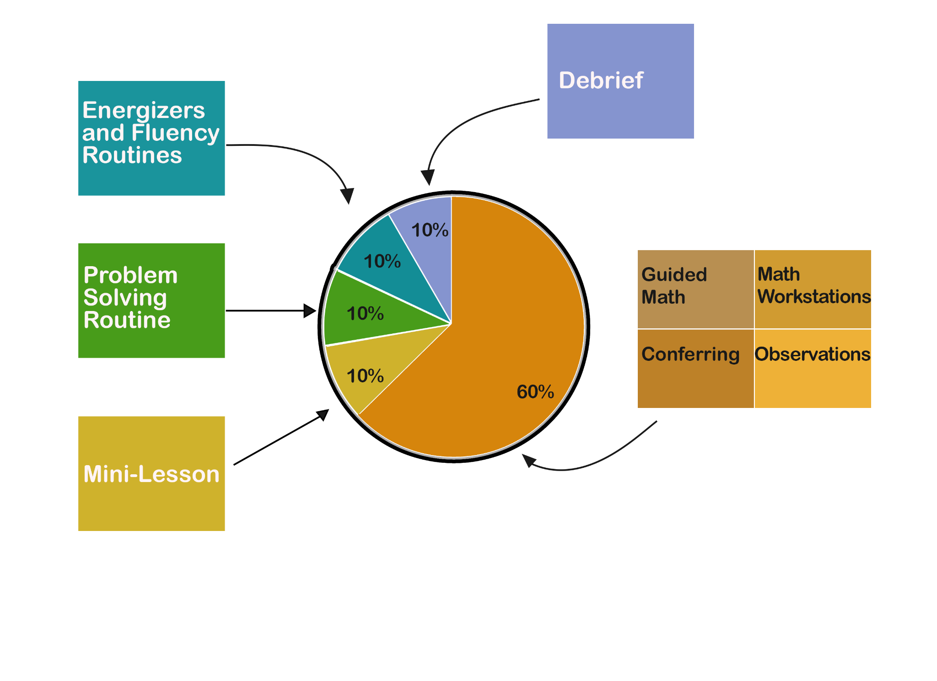
Mathematics: Teaching Block
Math Block
60-75 minutes!

Slide 30
Text Version: Mathematics Teaching Block Diagram
Activity | Percentage of Time
Energizers and Routines | 10%
Problem Solving | 10%
Mini lesson | 10%
Student Activities: Small Groups, Centers, Observation, Conferencing | 60%
Debrief | 10%

Slide 31
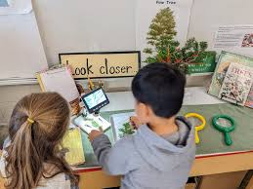
Science
Students in kindergarten develop an understanding of the three science domains:
physical sciences (K-PS)
life sciences (K-LS)
Earth systems and space sciences (K-ESS)
The foundation of the NJSLS-S reflects three dimensions
  science and engineering practices
  disciplinary core ideas
  crosscutting concepts.

Slide 32
Science: Understanding Standards
K-LS1-1 Use observations to describe patterns of what plants and animals (including humans) need to survive.
Science And Engineering Practices
Analyzing And Interpreting Data
Analyzing data in K–2 builds on prior experiences and progresses to collecting, recording, and sharing observations.
Use observations first hand or from media to describe patterns in the natural world in order to answer scientific questions. (K-LS1-1).
Disciplinary Core Ideas
LS1.C: Organization for Matter and Energy Flow in Organisms
All animals need food in order to live and grow. They obtain their food from plants or from other animals. Plants need water and light to live and grow. (K-LS1-1)
Crosscutting concepts
Patterns
Patterns in the natural and human designed world can be observed and used as evidence. (K-LS1-1)
Connections to Nature of Science
Scientific Knowledge Is Based On Empirical Evidence
Scientists look for patterns and order when making observations about the world. (K-LS1-1)

Slide 33
Science: Interdisciplinary Connections
K-LS1-1 Use observations to describe patterns of what plants and animals (including humans) need to survive.
English Language Arts: W.K.7 Participate in shared research and writing projects (e.g., explore a number of books by a favorite author and express opinions about them). (K-LS-1)
Mathematics: K.MD.A.2 Directly compare two objects with a measurable attribute in common, to see which object has “more of/less of” the attribute and describe the difference.

Slide 34
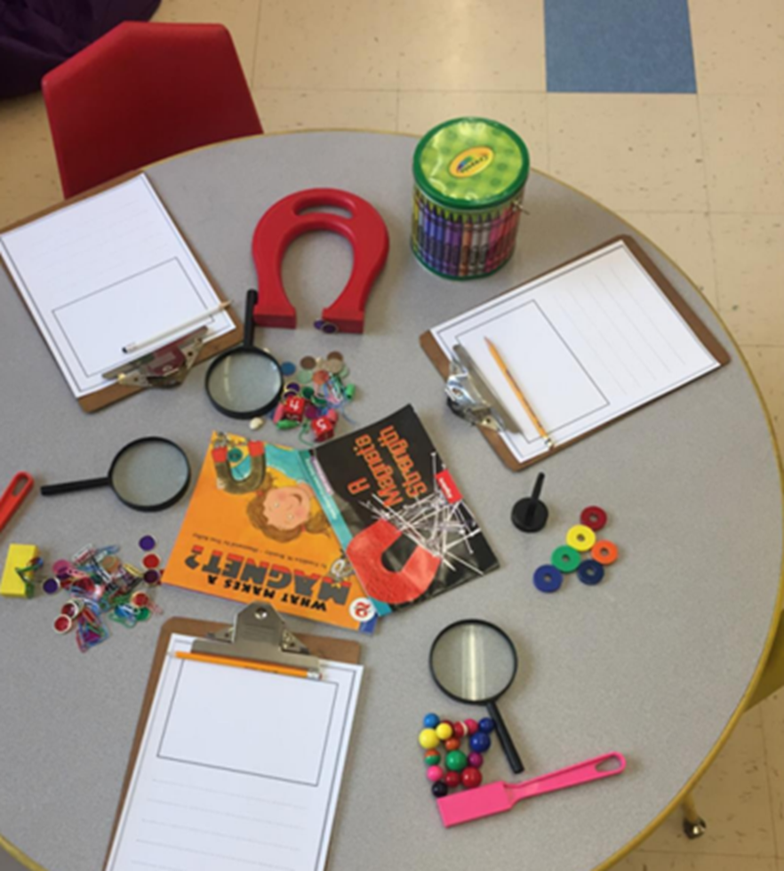
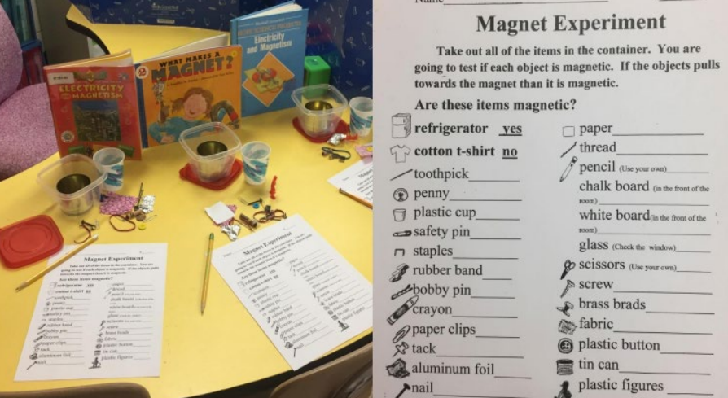
Science: Centers
What do you Notice?

Slide 35

Social Studies (1 of 5)
Social studies provide teachers with a platform to design activities that cultivate and extend “young children’s diverse skills and abilities to form and voice opinions, identify and solve problems, negotiate roles, perceive diversity and inequality, and recognize the consequences of their decisions and behaviors on others” (National Council for the Social Studies, 2019, para. 1).
NJSLS-SS

Slide 36
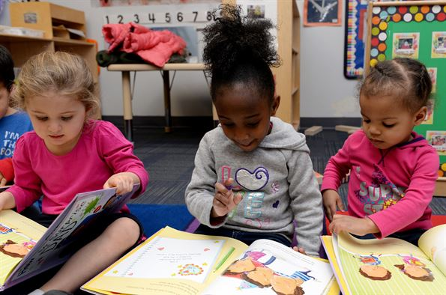
Social Studies (2 of 5)
The research strongly supports the integration of ELA and social studies. Utilizing high-quality social studies text in ELA can increase literacy as well as engagement (Tyner & Kabourek, 2021). The NJSLS-SS aligned curriculum can be presented through activities building upon collaboration and partnership, as well as independent discovery via centers.

Slide 37
Social Studies (3 of 5)
NJSLS Social Studies include specific practices or skills such as:
developing questions and planning inquiry (asking appropriate questions);
gathering and evaluating sources (understanding documents, visuals, songs, etc.);
seeking diverse perspectives (appreciating oneself and others’ differences);
developing claims and using evidence (drawing conclusions based on evidence);
presenting arguments and explanations (articulating ideas and opinions);
engaging in civil discourse (listening and understanding others’ opinions); and
taking informed action (positively contributing to one’s family and community).

Slide 38
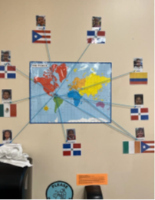
Social Studies (4 of 5)
Social Studies gives students opportunities to collaborate, discuss, build consensus, and explore their role and responsibilities as members of the classroom community. This leads to greater self-awareness, self-management, social awareness, dialogue and perspective-taking, responsible decision-making, and civic action.

Slide 39

Social Studies (5 of 5)
These skills are developed through the implementation of four social studies disciplinary concepts:
1. Civics
2. History and Culture
3. Geography
4. Economics
Essential Questions

Slide 40
Parent and Family Engagement (1 of 25)
Partnerships in Student Learning and Development
Why is this topic included with professional guidelines?

Slide 41

Parent and Family Engagement (2 of 25)
A shared language means a shared understanding
The Story that shaped NJ’s Model for Effective Partnerships
Once upon a time……

Slide 42





Parent and Family Engagement (3 of 25)
The Honor of Parenting
For many years educators used the term “parent.” Then, across the nation, some folks felt that the term “parent” might be restrictive, so the field shifted to using the term “family.”
As we worked with NJ parents, families, and educators, some parents expressed their preference to be recognized and respected as their child’s main or sole provider and champion. They asked us to use the term “parent.”
No doubt, diverse family structures have expanded the circle of individuals who care for the health, education, and wellbeing of our children; however, a parent’s relationship should never be diminished by the symbolism of words. And they should never feel that it is. We want to honor all those in the parenting role. In NJ, we use the terms “parent” and “family” together and interchangeably.
As caring partners, an educator’s priority is to focus on understanding our student’s support system outside of the classroom and forming relationships that enable every child to reach their highest potential.

Slide 43
Parent and Family Engagement (4 of 25)
Shared Language
  More terms that shape NJ’s model of effective parent and family engagement
        Learning Partnerships
        Involvement and/or Engagement
        Compliance and Contingency
        2-Gen Support

Slide 44

Parent and Family Engagement (5 of 25)
Benefits and Outcomes
      Students
      Educators
      Parents and families

Slide 45
Parent and Family Engagement (6 of 25)
Benefits and outcomes for students
  Achieving higher grades and test scores
  Being more likely to be promoted with strong skills
  Having better attendance and homework completion
  Developing a more positive attitude toward school
  Improved social emotional skills and behavior

Slide 46
Parent and Family Engagement (7 of 25)
Benefits and outcomes for educators
  Ease teachers’ challenge of generalizing and applying learning
  Increased relationships of mutual respect with teachers and leaders
  Increasing teachers’ and administrators’ morale and job satisfaction
  Improved communication about student learning
  Enhanced communities’ opinions of schools with involved parents
  Improving the performance and quality of school programs

Slide 47
Parent and Family Engagement (8 of 25)
Benefits and outcomes for parents and families
  Gaining confidence and becoming more capable of helping their child learn
  Understanding what is taught in school
  Becoming clear on the expectations for learning outcomes
  Developing a better understanding of their child’s emotional and intellectual needs
  Improving communication with their child’s teachers, making it easier to meaningfully communicate about learning and behavior
  Engaging positively in policymaking at school and in the community

Slide 48
Parent and Family Engagement (9 of 25)
Learning and Development
Every example in the K-Guidelines can be adapted to support children through home and school partnerships!

Slide 49
Parent and Family Engagement (10 of 25)
Develop and Foster Partnerships with Parents and Families
Model of Learning Partnerships
4-Categories of effective practices
6-Types of activities shaped to meet a school’s unique needs

Slide 50

Parent and Family Engagement (11 of 25)

Slide 51
Parent and Family Engagement (12 of 25)
4-Fundamental Categories of Effective Partnerships
Parent and Family Involvement – Passive participation in activities related to school life (Slide 52)
Parent and Family Engagement – Extending student learning beyond the classroom by creating partnerships that have an interactive learning component and building family capacity to help their children learn. (Slide 53)
Compliance and Contingency Partnerships – Requirements that focus on including families in processes or procedures of school operations and accountability as a condition for the receipt of funds or support. It includes partnerships required in ESSA and NJ statutes. There are also contingencies which are most often tasks attached to requirements necessary to receive grants, awards, program benefits, etc. (Slide 54)
2-Gen Supports - Build and support the well-being of families to help their child learn and develop in safe and healthy ways that enable them to reach their full potential. 2-Gen support serves both generations simultaneously. (Slide 55)

Slide 52
Parent and Family Engagement (13 of 25)
1. Parent involvement is the traditional term generally used to describe an opportunity created by educators for families. Parents who are involved usually focus on the school’s scheduled activities – often held at school – and the expectations educators have of them.
Partnership:
Educators
Involvement
Examples of involvement include sending home school notices and announcements, attending children’s performances; returning school-required paperwork; attending parent/teacher conferences; volunteering; providing school supplies; school fundraisers; planning and participating in classroom events; chaperoning activities; etc.

Slide 53
Parent and Family Engagement (14 of 25)
2. Parent engagement in student learning is the most powerful, yet least common type of home/school relationship. Parent engagement in learning means a two-way partnership that has an instructional support component for parents to support in-class teaching and learning and extend their child’s learning and development outside of school. It occurs when educators facilitate learning partnerships with families and help support their capacity to work directly with their child. Engaging parents and families in student learning shows students their family prioritizes education.
Partnership:
Educators, Parents and Students
Engagement
Examples of engagement in student learning occur when educators provide parents with information on “what, why, and how” their child is learning at school; share guidance and insight on adapted classroom teaching and learning strategies that can be done at home; send home examples of support strategies to help parents prompt their child’s critical thinking skills; provide “Look-Fors,” and a dependable way parents can share their observations with their child’s teacher, etc. Families are considered valuable thought partners in providing feedback used to evaluate and support students.

Slide 54
Parent and Family Engagement (15 of 25)
3. Compliance activities are based on the school’s accountability requirements. Relationships with families are part of those responsibilities. All schools must comply with state and federal obligations, and some have additional requirements, such as those associated with a grant, financial contingencies, or ESSA funding. It is beneficial for parents to know accountability information to help connect to the school. Compliance activities must be in place whether parents participate at school, in learning support at home, or not at all.
Partnerships:
Not required
Compliance and Contingency
Examples range from written school policies, home/school compacts, meeting attendance numbers and sign-in sheets, the type and number of notifications sent to parents, programs and services for specific student populations, signed and submitted paperwork, employment of specific support staff, identified timelines and schedules for tasks, and representation on committees, etc.

Slide 55
Parent and Family Engagement (16 of 25)
4. 2-Generation Support (2-Gen Support) means educator-led access to a network of services and opportunities that support and champion family well-being by simultaneously working with children and the adults in their lives. 2-Gen partnerships can close opportunity gaps and enable families to gain access to resources, connections, and opportunities to ensure their child is healthy, safe, and prepared for successful learning. Educators can facilitate 2-Gen partnerships by increasing their own knowledge about the community and providing all families with access to information and equitable supports that can help children learn at their best.
Partnership:
Educators, Families, Students, and Communities
2 Gen Support
Examples of 2 Gen supports include a variety of opportunities for families seeking a network of services such as school breakfast and lunch programs, housing security, language supports; community health centers, academic enrichment activities; libraries (with technology); tutoring, reciprocal social networks for new and hard-to-reach families, before and after care programs, summer camp, etc.

Slide 56

Parent and Family Engagement (17 of 25)

Slide 57
Text Version of Parent and Family Engagement (17 of 25) Diagram
The chart is a circle split into 4 sections:
Involvement
Engagement
Compliance & Contingency
2-Gen Support
Each section contains a list of 6 words:
Parenting
Communication
Volunteering
Learning at home
Decision-making
Collaborating with the community

Slide 58
Parent and Family Engagement (18 of 25)
6 Types of Family Involvement
Parenting: Supporting families in creating positive home environments for their child
Communication: Establishing two-way communication between school and home
Volunteering: Encouraging parents to volunteer in school activities
Learning at home: Promoting learning activities at home
Decision making: Involving parents in school decisions
Collaborating with the community: Engaging parents in community activities

Slide 59






Parent and Family Engagement (19 of 25)
2022-2023 K-3 Resources Packet
NJ K-3 Self-Assessment Validation System
NJ_Chronic_Absenteeism_Toolkit_Revised.docx
P-3 Approaches to Learning: How Young Children Learn
Guide to Effective P-3 Transition (2025-26)
State Partnership with Johns Hopkins University (2025-26)

Slide 60
Parent and Family Engagement (20 of 25)
Packet Cover
What, Why, and Who Should Use the Fall 2022 Packet of K-3 Resources
Family 5 - A Five Point Home-School Communication about Student Learning
Developmentally Appropriate Practices for Learning Outside of the Classroom
How the Education Communication System Works for Parents and Families
Young Math Masterminds - Mathematics is Everywhere
Young Math Masterminds - Mathematics in Kindergarten
Young Math Masterminds - Thoughts on Math Anxiety
Young Readers - Building Comprehension in Kindergarten
Young Readers - Building Comprehension in First through Third Grade
Young Readers and Writers - Three Tips for Supporting Writing Skills at Home
The Basics - Engaging Families Fact Sheet for Educators
The Basics - Lets Work Together to Support Your Childs Success (English)
The Basics - Lets Work Together to Support Your Childs Success (Spanish)
Quality - What Does a High-Quality Kindergarten Program Look Like
Quality - First Through Third Grade Quality Checklist

Slide 61

Parent and Family Engagement (21 of 25)
The Family 5
A Five-Point Home and School Communication about Student Learning
This is a simple, easy-to-use document that models high-quality home/school communications about support for teaching and learning.
The purpose is to support both families and teachers.
It includes 5 reflective questions for teachers on one side and 5 informative statements for parents to support student learning on the other side.

Slide 62
Parent and Family Engagement (22 of 25)
5 Points for families to support learning:
What –This is what your child is learning in class. It aligns with the NJ Student Learning Standards. You can learn more about the standards here (Student Learning Standards).
Why – This is why your child is learning it and how it will be used in the real world.
How – This is how you can help your child learn it outside of school.
Show – These are some “Look-Fors” or behaviors your child is likely to show while learning new skills.
Know - Communicating as Learning Partners allows us both to know if your child is learning new information. This is how to tell me about what your child knows.
The Family 5
A Five-Point Home-School Communication about Student Learning

Slide 63



Parent and Family Engagement (23 of 25)
Young Math Masterminds
Mathematics in Kindergarten
This is another fun, standards-based learning document that helps families support their child’s learning.

Slide 64


Parent and Family Engagement (24 of 25)
Young Readers
Building Reading Comprehension in Kindergarten
This is a glimpse of a fun, simple learning-based communication that helps families support what happens in a kindergarten classroom. It models points from the Family-5.
It is a fun and informal way to share information that strengthens learning partnerships. It includes a brief explanation about ELA learning, pointers to build capacity outside of the classroom, sample guiding question that families can use to help their child improve critical thinking skills, ways to check for understanding, and a few resources to learn more. Teachers can share communications like every weeks, few weeks, instructional unit, marking period, or even for the grade-level standards. (Although NJ DOE recommends a frequently as possible.)
These skills are transferable for learning “any time and any where!”

Slide 65


Parent and Family Engagement (25 of 25)
Use all tools! Take all opportunities!
Build good practices on all possible strategies to support children’s learning!
Protocol Sample Practices Of High-Quality Indicators Of Family And Community Engagement.docx

Slide 66
References (1 of 2)
Bauml, M. (2016). Is it cute or does it count? Learning to teach for meaningful social studies in elementary grades. The Journal of Social Studies Research, 40(1), 55–69.
Carpenter, T. P., Fennema, E., Franke, M. L., Levi, L., & Empson, S. B. (2015). Children's mathematics: Cognitively guided instruction (Second Edition). Portsmouth, NH: Heinemann.
Duke, N. K., & Cartwright, K. B. (2021). The science of reading progresses: Communicating advances beyond the simple view of reading. Reading Research Quarterly, 56(Suppl 1), S25–S44
Duke, N. K., Ward, A. E., & Pearson, P. D. (2021). The Science of reading comprehension instruction. Reading Teacher, 74(6), 663–672.
Foorman, B., Beyler, N., Borradaile, K., Coyne, M., Denton, C. A., Dimino, J., Furgeson, J., Hayes, L., Henke, J., Justice, L., Keating, B., Lewis, W., Sattar, S., Streke, A., Wagner, R., & Wissel, S. (2019). Foundational skills to support reading for understanding in kindergarten through 3rd grade (NCEE2016-4008). Washington, DC: National Center for Education Evaluation and Regional Assistance (NCEE), Institute of Education Sciences, U.S. Department of Education. http://whatworks.ed.gov.

Slide 67
References (2 of 2)
Hufford-Ackles, K., Fuson, K., & Sherin, M. G. (2014). Describing levels and components of a math-talk learning community. In E. A. Silver & P. A. Kenney (Eds.), More lessons learned from research: Useful and usable research related to core mathematical practices (Volume 1) (pp. 125–134). Reston, wVA: NCTM
National Council for the Social Studies. (2019). Early childhood in the social studies context. https://www.socialstudies.org/position-statements/early-childhood-social-studies context
Scarborough, H. S. (2001). Connecting early language and literacy to later reading (dis)abilities: Evidence, theory, and practice. In S. B. Neuman & D. K. Dickinson (Eds.), Handbook of early literacy research (Vol. 1, pp. 97–110). New York, NY: Guilford Press.
Tyner, A., & Kabourek, S. (2021). How social studies improves elementary literacy. Social Education, 85(1), 32-39. https://www.socialstudies.org/sites/default/files/view-article-2021-02/se-85012132.pdf

Slide 68
Follow Us on Social Media
Facebook:
@njdeptofed
Instagram:
@newjerseydoe
LinkedIn:
New Jersey Department of Education
Threads:
@NewJerseyDOE
X: @NewJerseyDOE
YouTube: @newjerseydepartmentofeduca6565

Slide 69
Thank You!
New Jersey Department of Education: nj.gov/education
https://www.nj.gov/education/earlychildhood/
https://www.nj.gov/education/earlychildhood/p3alignment/
Beth.Wharton@doe.gov

