Slide 1
Kindergarten Consortium Session 2:
P-3 Continuum & Transitions
Division of Early Childhood Services
Office of Kindergarten to Third Grade Education

Slide 2

P-3 Continuum & Transitions

Slide 3
P-3 Continuum (1 of 4)
“P–3 is the term used to define approaches that are intentionally designed to align children’s learning experiences before formal school entry (Preschool) with those in the primary grades of elementary school (K–3).
(Kristie Kauerz, National P-3 Center)

Slide 4
P-3 Continuum (2 of 4)
“The vision for P–3 approaches is to improve the quality and coherence of children’s learning opportunities, from the experiences children have before they enter the K–12 system and extending through elementary school. Ultimately, comprehensive P–3 approaches hold the potential to improve child outcomes and to prevent or close achievement gaps.”
(Kristie Kauerz, National P-3 Center)

Slide 5
P-3 Continuum (3 of 4)
To ensure the success of every student and close the achievement gap, it is imperative that all children have access to high-quality, aligned programs from P–3.
Effective instruction, instructional consistency and meaningful learning opportunities grounded in developmentally appropriate practices are central to a P–3 approach.
(Freschi, 2023)

Slide 6
P-3 Continuum (4 of 4)
Additional research shows that each grade level should incorporate all elements of high-quality education, as well as promote children’s development and support higher-order thinking skills in literacy and mathematics while growing their social-emotional skills.
(Ewen & Herzfeldt-Kamprath, 2016)
Having a kindergarten program that focuses on developmentally appropriate differentiated instruction is key to maintaining their learning trajectory throughout kindergarten and beyond.
(Drummond et al, 2016)

Slide 7
Vertical Alignment
Vertical alignment ensures that what a student learns in one grade becomes the foundation for the grades that follow.
Preschool to third grade alignment helps students have a strong academic foundation and experience smoother transitions from one grade or specialized program to the next.
Thinking about and co-planning for transitions can make a significant difference in the success of every child throughout the entire school year.

Slide 8
Self-Reflection
Does your district need more in-depth evaluation to either demonstrate the effectiveness of your P-3 efforts or to diagnose potential problems?
If so, where is implementation not meeting expectations and why?
How are you supporting the P-3 alignment within your school or district in your current role? Is there an opportunity for improvement?

Slide 9
P-3 Transitions
The New Jersey Department of Education (NJDOE), Division of Early Childhood Service (DECS), depicts student transitions in the early grades as a multiyear, interconnected, aligned process and a critical component of a high-quality education program.

Slide 10
Framework for Transitions (1 of 2)
There are eight categories:
Cross-Sector Work
Administrator Effectiveness
Teacher Effectiveness
Instructional Tools
(Kauerz & Coffman, 2019)

Slide 11
Framework for Transitions (2 of 2)
5. Learning Environment
6. Data-Driven Improvement
7. Engaged Families
8. Continuity and Pathways
(Kauerz & Coffman, 2019)

Slide 12
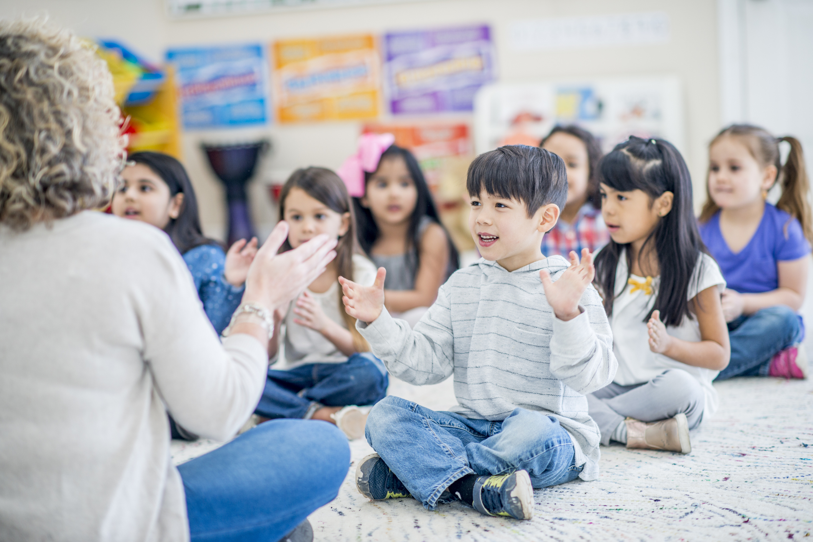
Kindergarten

Slide 13
Transition to Kindergarten (1 of 5)
The transition to kindergarten is one of the most critical moments in a child’s life as they enter the formalized K–12 education system.
Successful transitions to kindergarten can result in reduced stress and improved social-emotional well-being at the onset of kindergarten, improved academic growth, and increased family engagement throughout the course of the school year.

Slide 14
Transition to Kindergarten (2 of 5)
As preschool age children move into kindergarten classrooms, children will continue to learn by experiencing the world around them. It is important to think about the transition into kindergarten as a partnership between children, early child teachers and providers, kindergarten teachers, and families.

Slide 15
Transition to Kindergarten (3 of 5)
School districts can work towards creating a high-quality kindergarten program.
The team can establish goals to ensure seamless support for all children, preschool through grade three, and create transition activities based on those goals.
Provide an opportunity for children to take a kindergarten screening and/or a Home Language Survey.
Allow opportunities for kindergarten teachers to visit preschool classrooms.

Slide 16
Transition to Kindergarten (4 of 5)
Provide professional development opportunities that combine both preschool and kindergarten teachers to ensure continuity from one setting to another.
Provide common planning time for preschool and kindergarten teachers as well as with administration to ensure alignment from one year to the next.
Engage children in small group activities to discuss the similarities and differences between preschool and kindergarten.

Slide 17
Transition to Kindergarten (5 of 5)
Schedule opportunities for children to spend time in kindergarten classrooms and the cafeteria as well as engage in joint activities with the kindergarten students.
Create a kindergarten transition team composed of both kindergarten and preschool teachers to facilitate the activities.

Slide 18

School Transition Team

Slide 19
Creating a Transition Team (1 of 3)
School District Administrators can:
create a transition team;
identify a transition team facilitator;
identify children at risk for learning;
plan systems for data collection, analysis, and accountability; and
create common planning time for teachers within and across grade levels and with specialists.
(Adapted from Kauerz & Schaper, 2021)

Slide 20
Creating a Transition Team (2 of 3)
Survey families and the community.
Include a process for collaborating with families, early learning providers, and local public and private agencies.
Establish goals to ensure seamless support for all children.
Provide information to families on the transition to and from each grade level from preschool through third grade.
Create transition activities based on the goals created.
Generate a timeline and revisit and update the transition plan.
(Adapted from Kauerz & Schaper, 2021)

Slide 21
Creating a Transition Team (3 of 3)
Teachers can:
participate on the transition team;
meet with other teachers and specialists within and across grades;
prepare and disseminate developmentally appropriate home learning activities;
get to know each child and family; and
welcome new children and their families.
(Adapted from Kauerz & Schaper, 2021)

Slide 22

Attendance

Slide 23
The Importance of Attendance
As children transition from grade to grade each year, attendance is crucial. Attending school every day helps children build a foundation for learning. Missing school in the early grades can lead to future struggles with meeting important reading milestones, challenges with social skills, and repeating grades. Routines start early for students and their families. Getting into the habit of regularly going to school in pre-kindergarten and kindergarten can help with attendance in higher grades.

Slide 24

Families

Slide 25
Working with Families (1 of 2)
Provide families with information.
Encourage families to visit future kindergarten classrooms.
Share reading lists, materials, and activities for families to use.
Hold kindergarten information sessions where families can ask questions.
Offer meetings with the appropriate staff members.

Slide 26
Working with Families (2 of 2)
Families provide the best support to help their child prepare for new experiences and confidently approach challenges of all forms. However, without guidance and high-quality information from educators at the child’s school, family support during transitions is not as effective as it can be.

Slide 27
Additional Considerations for Transition
A supportive learning environment promotes the development of children’s critical thinking skills;
Highly effective teachers gather data that is needed to guide instruction, ensuring that all children grow and learn at the appropriate pace.
High-quality P-3 classrooms need to be developmentally appropriate to support all learners in the classroom.

Slide 28
Reflection Questions
How did you turn-key the big ideas from Session One?
What are any take aways you have from the session today and how does it connect to your work?
How will you turn-key information from Session 2: P-3 Continuum and Transitions?
Session 3 (April 8, 2025): Play & Kindergarten Centers.
Complete survey in chat.

Slide 29
References (1 of 2)
Ewan, D., & Herzfeldt-Kamprath, R. (2016). Examining quality across the preschool-to-third-grade continuum. Center for American Progress.
Freschi, E. (2023). Developmentally appropriate practice in kindergarten: Observation guide. Center to Improve Social and Emotional Learning and School Safety at WestEd.
Kauerz, K., & Coffman, J. (2019). Framework for planning, implementing, and evaluating p–3 approaches. National P–3 Center. https://nationalp-3center.org/resources/framework-for-planning-implementing-and-evaluating-p-3-approaches/

Slide 30
References (2 of 2)
Kauerz, K., & Schaper, A. (2021) Transition to kindergarten: Findings from recent research. Education Commission of the States, National P – 3 Center. https://nationalp-3center.org/wp-content/uploads/2021/06/Transition-to-K_Recent-Research_2021.pdf
Schilder, D. (2019). Prekindergarten to grade three tool. New York State Education Department and the Northeast Regional Comprehensive Center. Center for Enhancing Early Learning Outcomes. https://www.nysed.gov/sites/default/files/programs/early-learning/p-3-tool-fillable.pdf

Slide 31
Follow Us on Social Media
Facebook:
@njdeptofed
Instagram:
@newjerseydoe
LinkedIn:
New Jersey Department of Education
Threads:
@NewJerseyDOE
X: @NewJerseyDOE
YouTube: @newjerseydepartmentofeduca6565

Slide 32
Thank You!
New Jersey Department of Education: nj.gov/education
https://www.nj.gov/education/earlychildhood/
https://www.nj.gov/education/earlychildhood/p3alignment/
Beth.Wharton@doe.gov

