Slide 1
Reflections from Session One
Considering yesterday's session what is one:
idea/concept you feel you could immediately incorporate into your planning?
idea/concept still circling your mind that you feel you need to dig deeper into?

Slide 2
Developing Effective Collaboration with Colleagues Through School Improvement Panels (ScIPs) Session 2
Office of Educator Effectiveness
October 2022

Slide 3
Session Objective
Participants will apply a data inquiry cycle process to support equitable outcomes in their local context.
This step-by-step process will help participants shape conditions for data-driven decision making and dialogue in their School Improvement Panels.

Slide 4
Norms
Students should be at the center of our work
Be open, kind, and collaborative
Interact early and often
Take a “humbition” orientation

Slide 5
Agenda
The Process of Data Inquiry in ScIPs
The Process of Data Inquiry in Supporting
Mentoring Program Conversations
Evaluation Implementation
Professional Development
Leveraging the Work of ScIPs to Ensure Equitable Outcomes

Slide 6
The Process of Data Inquiry in ScIPs

Slide 7
Key Tasks of the ScIP: A Review
Venn Diagram
Mentoring
Professional Development
Evaluation Implementation

Slide 8
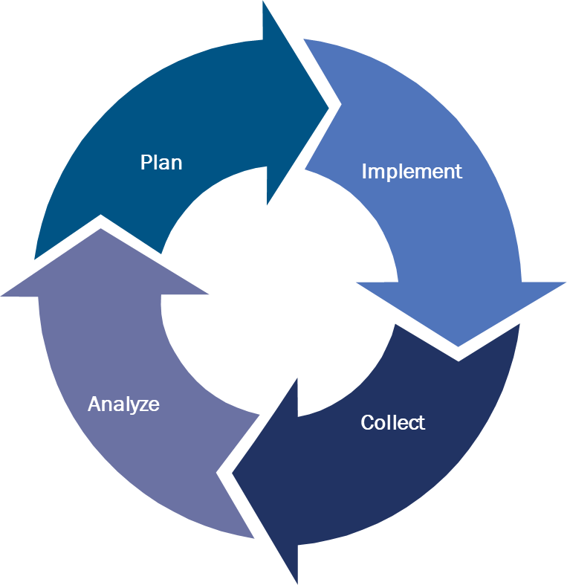
The Process of Data Inquiry in School Improvement Panels
Participants will apply a data inquiry cycle process to support equitable outcomes in their local context.
Plan utilizing available data points to formulate.
Implement the plan throughout the school.
Collect data to evaluate how the plan is working.
Analyze the data, potentially tweaking the plan moving forward.

Slide 9
Distributed Leadership and Data Inquiry in ScIPs
A team of educators from different levels of leadership, grades, and/or subject areas who work collaboratively to create positive, schoolwide change.
Actively engage teachers
Routinely evaluate student data
Make content-focused decisions
Commit to continuous improvement
Notes:
Actively engage teachers by regularly soliciting teacher feedback, observing teachers in the classroom, and guiding teachers to reflect upon their practice;
Routinely evaluate student data to track progress in meeting student achievement goals;
Make content-focused decisions about professional development and instructional strategies; and
Commit to continuous improvement by implementing the above with fidelity.

Slide 10
Turn and Talk Warm Up
How can you utilize a data inquiry cycle and distributed leadership simultaneously to optimize your ScIP?

Slide 11
The Process of Data Inquiry in Supporting Mentoring Program Conversations

Slide 12
Mentorship: Key Tasks
01
Identify critical needs of new educators
02
Establish support structures for new educators
03
Support mentors with capacity, resources, and guidance

Slide 13
Mentorship Survey Data Activity
The next slide’s sample data set was collected from a fictional end of the year survey.
Analyze the data regarding the success of the mentorship program in this school.
Suggest tweaks to the plan to assist in implementation for the following year.

Slide 14
Mentorship Survey Data
Mentees were asked to rate the following components on a scale of 1 to 5 with 5 being the best rating. These are the cohort averages.
Component | Rating
Quality of mentor | 4
Frequent support | 3
The program was organized | 4
The program was relevant | 3
The program supported pedagogical needs | 2
The program assisted in building and district protocols | 3
Communication of program was clear | 2

Slide 15
Mentorship Survey Data Discussion
Distributed Leadership Discussion:
Analyze: What does the data suggest about the effectiveness of the mentoring program in this school?
Planning: How could you leverage a ScIP's distributed leadership model and calendar to plan for mentorship changes and additional data collection?
Implementation: How will you involve and inform stakeholders as you implement mentorship changes and additional data collection?
Collect: How will you make sure that a comprehensive data set is collected in the future to determine the effectiveness of your implementation?

Slide 16
The Process of Data Inquiry in Supporting Evaluation Implementation

Slide 17
Evaluation Implementation: Key Tasks
01
Organize and plan trainings, observations, and other activities pertinent to evaluation.
02
Analyze aggregate evaluation data to make recommendations for further support.
03
Attend informational sessions and trainings to keep current.

Slide 18
Evaluation Implementation Aggregate Data Activity
The next slide’s sample data set was collected from select observation indicator scores in this middle school.
Analyze the aggregate observation indicator data. What does it tell you?
What action step(s) might you suggest based on these numbers?

Slide 19
Evaluation Implementation Aggregate Data Discussion
Observation Indicator Data by Grade Level
Grade | Questioning & Discussion Mean | Student Engagement Mean | Knowledge of Resources Mean | Knowledge of Students Mean
6 | 2.95 | 2.53 | 3.11 | 3.22
7 | 2.48 | 3.50 | 3.00 | 2.93
8 | 3.45 | 2.99 | 3.25 | 2.45
Using the steps of the data inquiry cycle, work with your team to develop a plan to utilize this information to support evaluation implementation at this school.

Slide 20
The Process of Data Inquiry in Supporting Professional Development

Slide 21
Professional Development: Key Tasks
01
Analyze aggregate evaluation data according to observation instrument
02
Identify professional learning needs and plan to implement support
03
Review “Standards for Professional Learning” to ensure activities align and to assess success

Slide 22
Professional Development Needs Activity
The next slide’s schoolwide sample data set was collected from aggregate elementary school observation data.
What professional learning needs might be warranted based on what is seen here?

Slide 23
Professional Development Needs Data Set
Highest Observation Instrument Elements
Analyze the data regarding aggregate observation data collected in this elementary school.
What professional learning needs might be warranted based on what is seen here?
What action step(s) would you suggest based on these numbers?
Professional Responsibilities (Domain Mean) | 3.30
Demonstrating Flexibility and Responsiveness | 3.26
Organizing Physical Space | 3.24
Managing Classroom Procedures | 3.15
Lowest Observation Instrument Elements
Questioning and Discussion Techniques | 2.68
Engaging Students in Learning | 2.53
Knowledge of Resources | 2.24

Slide 24
Leveraging the Work of ScIPs to Ensure Equitable Outcomes

Slide 25
Ensuring Equitable Outcomes
“…establish expectations for equity, create structures to ensure equitable access to learning, and sustain a culture of support for all staff." -Learning Forward 2022
ScIPs recognize in promoting the growth of educators that culture in schools is critical in creating conditions for learning.
ScIPs are transparent bodies who make decisions focused on leveraging evaluation systems as a vehicle for professional learning.
ScIPs prioritize trust with an understanding that a supportive professional culture improves teacher satisfaction and retention.

Slide 26
Ensuring Equitable Outcomes Through ScIPs: A Discussion
“…establish expectations for equity, create structures to ensure equitable access to learning, and sustain a culture of support for all staff." -Learning Forward 2022
In your groups:
Pick any one of the three areas you just engaged in (mentoring, evaluation and implementation, professional development) and discuss the ways your suggestions may support equitable outcomes.
What data will inform your success for this initiative?

Slide 27
Request
Between now and our final session we would ask you to track one concept you have implemented this year.
As part of that tracking, we would love to learn from your experiences:
Optional DOE follow up support with your school.
Panel session celebrating successes in session three.

Slide 28
Reflection Activity
One thing learned today that you could immediately implement?
Are there any topics discussed today that you would like us to consider exploring further in our next session?
Are there any topics not yet explored that you would like us to consider exploring further in our final session?

Slide 29
Thank You!
New Jersey Department of Education: nj.gov/education
Follow Us!
Facebook: @njdeptofed
Twitter: @NewJerseyDOE
Instagram: @NewJerseyDoe

