Slide 1
Building School Cultures that Facilitate Teacher Leadership
Linda Mayger
The College of New Jersey
July 2025

Slide 2
Session Objectives
We will:
Describe teacher leadership.
Identify reasons teacher leadership efforts fail.
Develop a list of strategies that systematically support the development of collaborative school cultures.

Slide 3
Overview
What teacher leadership is
Why teacher leadership efforts fail
Building a culture that supports teacher leadership

Slide 4
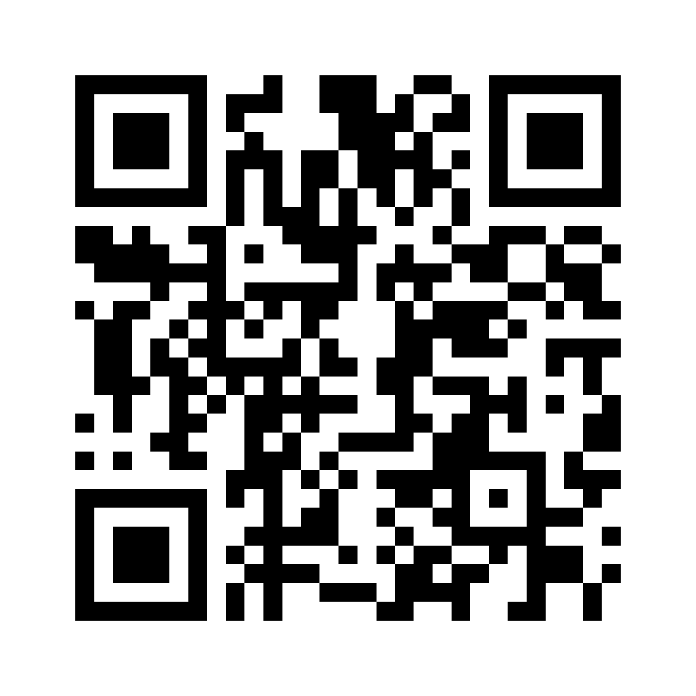
Word Cloud
Teacher leadership in my school is _______.
  Join at menti.com
  Code: 53741135
Notes:
https://www.menti.com/alcqjryq6q7w

Slide 5
Small Group Discussion
What is teacher leadership in your school?
How does your school benefit from teachers being willing to take on leadership responsibilities?
Why do teachers want to lead?

Slide 6
Defining Teacher Leadership

Slide 7

Definition
Leadership is set of practices.
Without positional authority, teachers influence their peers by sharing respected expertise, modeling effective practices, and supporting teamwork within their schools.

Slide 8

Seven Domains of Teacher Leadership
1: Fostering a Collaborative Culture
2: Accessing and Using Research
3: Facilitating Professional Learning
4: Improving Education
5: Effective Uses of Assessments and Data
6. Family & Community Engagement
7. Advocating for Student Learning and the Profession

Slide 9
Small Group Discussion
Why do teacher leadership efforts fail?

Slide 10

Leadership Killer: Unsupportive Administrators
Only 1/3 of surveyed NJ teachers felt appreciated for their contributions.
(Hauser & Mayger, 2025)
Negative experiences such as administrator micromanagement, perceived favoritism, and disregard for teachers’ expertise are demotivating. (Ghamrawi et al., 2025)

Slide 11

Leadership Killer: Lack of Impact
Perceptions that their efforts make no difference and change resistance among colleagues inhibit teacher leadership.
(Wenner & Campbell, 2017)

Slide 12

Leadership Killer: Teacher Overload
In a teacher leadership survey of NJ teachers :
Only 13% were provided extra time and 25% were offered extra pay for teacher leadership responsibilities.
Several had extra jobs or coaching responsibilities to supplement their incomes.
(Hauser & Mayger, 2025)

Slide 13

Leadership Killer: Toxic Culture
Chronic complaining among colleagues reduces teachers’ beliefs that engagement in teacher leadership is worthwhile and can make a tangible difference in their schools.
(Hauser & Mayger, 2025)

Slide 14
Building a Collaborative School Culture

Slide 15
Culture Builders
A collaborative school culture is the foundation of teacher leadership.
(Louis et al., 2010; Skaalvik & Skaalvik, 2021)

Slide 16
Culture Builders, cont.
A collaborative school culture:
increases teacher autonomy, belonging, and job satisfaction (Skaalvik & Skaalvik, 2021)
improves student learning (Leithwood et al., 2010; Waters et al., 2008)

Slide 17
Culture Builders
Recognition
Training
Impact
Time
Money
Opportunity

Slide 18

Recognition
Appreciation can be a verbal or tangible.
Notice both formal and informal teacher leadership practices.
Without a culture of valuing teachers as professionals, recognizing extra work could be perceived as manipulative.
Continually recognizing the same people may be perceived as favoritism.

Slide 19

Training
Potential avenues:
Graduate coursework in educational leadership
Professional learning related to curriculum development, group facilitation, or instructional coaching
”Train the trainer” models where teachers become instructional experts who then teach their colleagues new techniques

Slide 20

Impact
Teachers are motivated by opportunities to make a difference in their schools. (Hauser & Mayger, 2025)
Create routines that allow teachers to be listened to and heard.
Provide opportunities for teachers to influence policies and procedures that affect their work.
The most impactful efforts are aligned with school/district goals.

Slide 21

Finding Time for Collaborative Leadership
Repurpose some existing collaborative planning periods or before/after school time.
Replace some staff meetings with teacher-led meetings.
Strategically use co-teaching: While one teacher leads a lesson, the other can focus on leadership or mentoring.
Schedule district committee meetings during the collectively bargained time slot for school staff meetings.

Slide 22

Money
Create formal teacher leadership roles with stipends and clear leadership expectations.
Offer small grants for teacher leaders who propose creative projects that enhance teaching and learning.
Reward teacher who lead PD or pilot new initiatives with extra classroom supplies or technology upgrades

Slide 23

Opportunity
Ensure that all teachers, regardless of their tenure or subject area, have leadership opportunities.
The full array of potential ways to lead should be made available to teachers, allowing each person to share strengths with the community.
Create systems that support teacher leadership:
  Committees and project teams
  Shared leadership structures
  Teacher-led professional learning
  Formal roles

Slide 24
Routines are Key
  You can’t rely individuals to spontaneously do the ‘right things.’
  Strategically create routines to systematically build collaborative cultures.

Slide 25
Design a micro-intervention

Slide 26
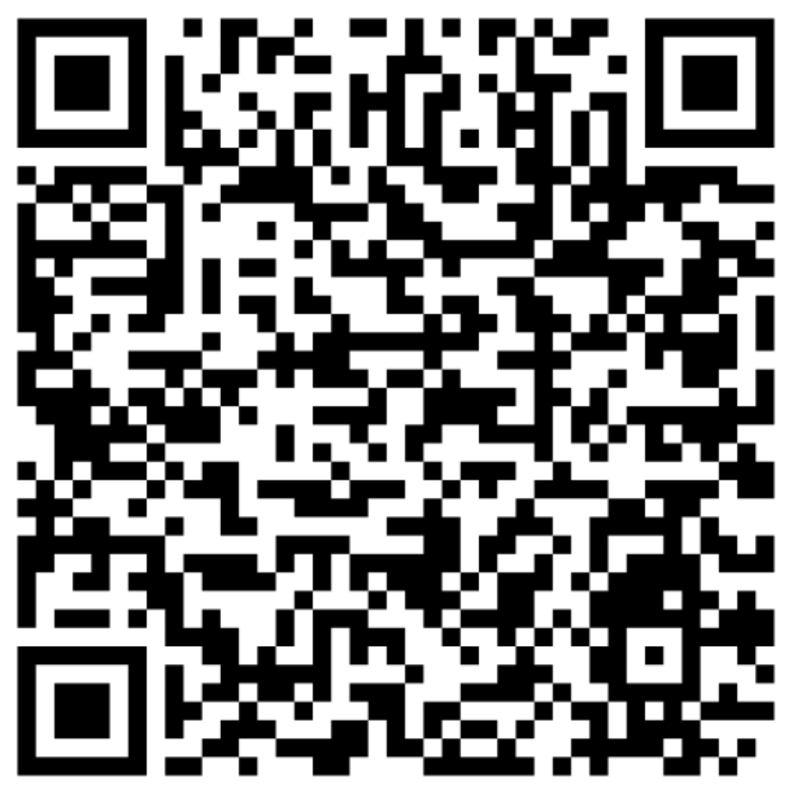
What school routines build collaborative cultures?
Recognition
Training
Impact
https://padlet.com/lndmayg/what-routines-build-a-collaborative-school-cultures-cweadj4afsa6z3ee
Time
Money
Opportunity
Notes:
Padlet URL: https://padlet.com/lndmayg/what-is-a-routine-your-school-could-adopt-to-build-a-collabo-cweadj4afsa6z3ee

Slide 27
Whole Group Discussion
How do we develop systems in our schools that support teacher leadership?

Slide 28
Conclusion
Teachers possess capabilities and knowledge that are critically needed to strengthen their schools.
Effective schools need collaborative structures that promote 'collective intelligence.’
(Teacher Leader Model Standards, p. 12)

Slide 29
Thank You!
New Jersey Department of Education: nj.gov/education
Linda Mayger
maygerL@tcnj.edu

Slide 30
References
Hauser, M. L., & Mayger, L. K. (2025). Teacher leadership: What matters, what works, and how to make it happen. The College of New Jersey. https://www.researchgate.net/publication/389426595_Exploring_Teacher_Leadership_What_Matters_What_Works_and_How_to_Make_it_Happen
Leithwood, K., & Jantzi, D. (2000). Principal and teacher leadership effects: A replication. School Leadership and Management, 20(4), 415–434. https://doi.org/10.1080/713696963
Louis, K. S., Leithwood, K., Wahlstrom, K. L., & Anderson, S. E. (2010). Learning from leadership project: Investigating the links to improved student learning. University of Minnesota, The Wallace Foundation. https://wallacefoundation.org/report/learning-leadership-investigating-links-improved-student-learning-investigating-links
Skaalvik, E. M., & Skaalvik, S. (2021). Collective teacher culture: Exploring an elusive construct and its relations with teacher autonomy, belonging, and job satisfaction. Social Psychology of Education, 24, 1389-1406. https://doi.org/10.1007/s11218-021-09673-4

Slide 31
References, con.
Teacher Leadership Exploratory Consortium (2011). Teacher leader model standards. http://www.teacherleaderstandards.org/downloads/TLS_Brochure.pdf
Waters, T., Marzano, R.J., & McNulty, B. (2008). Balanced Leadership: What 30 years of research tells us about the effect of leadership on student achievement. Denver, CO: Mid-Continent Research for Education and Learning.
Wenner, J. A., & Campbell, T. (2017). The theoretical and empirical basis of teacher leadership: A review of the literature. Review of Educational Research, 87(1), 134-171. https://doi.org/10.3102/0034654316653478
York-Barr, J., & Duke, K. (2004). What do we know about teacher leadership? Findings from two decades of scholarship. Review of Educational Research, 74(3), 255-316. https://doi.org/10.3102/00346543074003255

