Slide 1

Fueling Educator Success: Leveraging Title II, Part A to Foster a Positive School Climate
Office of Supplemental Educational Programs
Division of Educational Services
July 29, 2025
Notes:
(Amy)
Welcome to this presentation on Fueling Educator Success: Leveraging Title II, Part A to Foster a Positive School Climate. These funds play a crucial role in supporting teacher quality and student success.
"We're thrilled to be here from the NJ Department of Education to talk about something critical to all of us: the success of our educators and, ultimately, our students.“ My name is Amy Gallagher and I’m the Manager in the Office of Supplemental Educational Programs. I am joined today by our Title II and IVA State Coordinator, Ms. Antoinette Caldwell-Wong and our ESEA Project Research Specialist, Dr. Peter Frank.
"Today, we're diving into a powerful resource – Title II, Part A – and exploring how we can strategically use it to fuel positive school climates, support our teachers, and drive student achievement.“
Before I turn it over to my esteemed colleagues, I would like to get a sense of who is joining us today. By show of hands….

Slide 2
Housekeeping
Blended Format: Presentation + Action Planning Workshop
All participants will receive a copy of the presentation
The use of AI bots or automated systems for notetaking in NJDOE meetings is strictly prohibited
Notes:
(Antoinette)
A few housekeeping points for our time today:
The NJDOE does not allow third-party AI notetaking bots in meetings. If you have one accompanying you today, please disable it.
We want our presentation to be interactive with you and to support your action planning as you explore and learn about a broad range of innovative and evidence-based practices at the institute today.
Finally, this presentation will be posted to the conference’s website.

Slide 3



Agenda
Our Fuel: Title II, Part A
Our Destination: Thriving Educators, Thriving Students
Our Engine: Five Phases Of Continuous Improvement
Notes:
(Peter) "Before we jump in, let's outline what we hope to achieve together today. We want you to leave with a clearer understanding of Title II-A, its potential, and practical ways to leverage it, especially for enhancing school climate and culture." Our shared mission focuses on educator retention, professional growth, and positive school climate. Title II-A serves as the fuel, while the Continuous Improvement Cycle functions as the engine driving us toward our destination: equitable access to high-quality education and academic excellence for all students. As we progress today, you can use these icons in our slides as we cover these three areas. You are encouraged to use the handouts provided when we explore the continuous improvement Cycle.

Slide 4

Envisioning Your Destination
Two Classrooms, One Student
The Energized Teacher
Jordan walks into a classroom with a supported, connected teacher.
The Struggling Teacher
In another room, Jordan finds an isolated, overwhelmed educator.
Are The Classrooms Different?
Not funding or curriculum, but teacher support and school culture.
Every student deserves the energized classroom. Every educator deserves the support needed to create one.
Our intent is to support you in reaching this destination.
Notes:
(Antoinette)
Let us start with the end goal in mind, with some visioning.
Imagine a student named Jordan walking into two different classrooms. In one, the teacher is energized, supported, and connected, creating an environment where learning thrives. In the other, the teacher is isolated, overwhelmed, and unsupported - struggling to get through the day.
The difference isn't about funding or curriculum. It's about the culture of collaboration and the professional support behind the educator. This stark contrast illustrates a fundamental truth: every student deserves that first classroom, and every educator deserves the support to create it.

Slide 5
Our Fuel: Title II, Part A
Notes:
(Peter) Our Fuel is Title II, Part A

Slide 6
Our Fuel: Title II, Part A: Purpose
  “…is to
  (1) Increase student achievement consistent with the challenging state academic standards;
  (2) Improve the quality and effectiveness of teachers, principals, and other school leaders;
  (3) Increase the number of teachers, principals, and other school leaders who are effective in improving student academic achievement in schools; and
  (4) Provide low-income and minority students greater access to effective teachers, principals, and other school leaders.”
[ESEA §2001: Statement of Purpose]
Notes:
(Peter) "So, what exactly is Title II, Part A designed to do? Let's look at the official purpose directly from the Elementary and Secondary Education Act." (Read or paraphrase points from slide). Title II A funding is intended to support teachers, principals, and other school leaders in their work to increase student achievement, improve the overall quality of instruction, and ensure equity of educational opportunity for all students. "It's ambitious, and it's comprehensive."

Slide 7

Title II, Part A: Scope
Funds are used to support the learning needs of all students, including those with disabilities, multilingual learners, and gifted and talented students.
Participants include teachers, principals, instructional leadership teams, paraprofessionals, and other school leaders.
Notes:
(Antoinette) "And who benefits? The scope is broad. These funds are meant to uplift all students by supporting a wide range of educators in your schools – from teachers and principals to paraprofessionals and leadership teams."
Title II A supports the provision of training in the identification of unique groups of students, such as students with disabilities, multilingual learners, and those who are gifted and talented, in order to develop programs and activities that increase the ability of teachers to teach and support those most in need effectively.
Title IIA also supports school leaders with selecting and implementing formative assessments, designing classroom-based assessments, and using that data to improve instruction and student academic achievement.
(Peter) "The critical takeaway here is that ESSA provides significant flexibility. This isn't just about compliance; it's an invitation to be strategic and tailor these funds to your LEA's unique needs to achieve these vital goals.“ Beyond the legal language, Title II-A represents a powerful commitment: Every student deserves educators who are fully equipped to help them succeed. The scope is universal and inclusive - covering all educators and all students, regardless of background, ability, or circumstance

Slide 8

Levers of Title II, Part A
Professional Learning That Transforms
Moving from "sit and get" to "grow and glow" with sustained, job-embedded development.
Recruitment & Retention That Builds Belonging
Moving from "sit and get" to "grow and glow" with sustained, job-embedded development.
Effective Instructional Climate
Using effective teaching strategies that understand and support the whole child.
Each lever is evidence-based. Each lever is important. All work together to transform schools.
Notes:
(Antoinette) "With that purpose and scope in mind, where can Title II-A make the biggest difference? We see three interconnected missions."
(Peter) "First, High-Quality Professional Learning. And the law is very specific here – we're talking about learning that is sustained, intensive, collaborative, job-embedded, data-driven, and classroom-focused. No more 'one-and-done' workshops!“ "Think deep dives into curriculum, collaborative planning, or effective tech integration.“
(Antoinette) "Second, Recruitment and Retention. This is about attracting great people and, just as importantly, keeping them. Title II-A can support everything from signing bonuses and mentoring programs to developing leadership pathways that make teaching a long-term, rewarding career."
(Peter) "And third, a crucial area: Supporting the Whole Child by fostering a Positive School Climate. This includes training for educators on trauma-informed practices, social-emotional learning, mental health literacy, and robust family engagement. When our school communities are healthy and supportive, everyone benefits.“
(Antoinette) "Underpinning all of this is the requirement for activities to be evidence-based. We'll touch more on that later, but it’s about investing in what works."

Slide 9
Lever 1: Professional Learning That Sticks
From "Sit and Get" to "Grow and Glow"
Professional development must be sustained, intensive, collaborative, job-embedded, data-driven, and classroom-focused to truly transform practice.
Allowable Professional Learning
Collaborative models (PLCs, coaching)
SEL integration and inclusive practices
New teacher support and leadership development
Technology integration and Universal Design for Learning implementation
Considerations For Ensuring Professional Learning Sticks
Title II-A funds can support “sticky” professional learning that is strategically planned, consistently implemented, and thoughtfully evaluated. It must connect directly to the student needs identified in your comprehensive assessment.
Notes:
(Peter) "Let's zoom in on Professional Learning. Title II-A isn't just for any workshop. The law defines effective professional development very clearly. “Professional development must be sustained, intensive, collaborative, job-embedded, data-driven, and classroom-focused to truly transform practice "This means moving away from isolated events towards ongoing, meaningful learning experiences."
(Antoinette) "What does this look like in practice? It could be intensive coaching cycles, well-structured PLCs focused on student data, job-embedded training on new curriculum, or sustained learning on inclusive practices and UDL.“ to create ongoing cycles of learning, application, reflection, and refinement.
(Peter) "The crucial elements are that it's connected to your school or district's strategic goals, it's ongoing, and there's a way to see its impact in the classroom. And remember, this should all be part of a comprehensive PD plan with clear verification of participation."

Slide 10



Lever 2: Recruitment & Retention That Works
Strategic Recruitment
Signing bonuses, alternative pathways, targeted outreach
Meaningful Development
Mentoring, leadership opportunities, growth pathways
Intentional Retention
Instructional supports, recognition, improved conditions
Considerations For Ensuring Recruitment & Retention Works
Title II-A funds can support innovative, evidence-based, thoughtfully and collaboratively applied approaches across the entire educator career pathway, from recruitment to retirement.
Notes:
(Antoinette) "A great school climate relies on great people. Title II-A provides significant leverage for both recruiting new talent and retaining the excellent educators you already have."
(Peter) "On the recruitment side, think creatively: Can you offer signing bonuses for those hard-to-fill science positions? Invest in targeted marketing to attract a diverse pool of candidates? Support paraprofessionals who want to become certified teachers? Title II-A can help."
(Antoinette) "For retention, it's about creating a supportive and growth-oriented environment. This means strong mentoring for new teachers, opportunities for teacher leadership, fair evaluation systems that actually help teachers improve, and critically, supporting staff mental health and wellness." "Even recognition programs can make a difference!"
(Peter) "And if you're considering using Title II-A for class size reduction, remember the focus must be on ensuring those classes are led by certified, licensed, and highly effective teachers."

Slide 11




Lever 3: Effective Instructional Climate
Trauma-Informed Practices
Professional development that equips educators to recognize and respond to student trauma, creating environments where healing and learning can coexist.
Multi-Tiered Support Systems
Implementing the NJ Tiered System of Supports (NJTSS) to ensure appropriate interventions for academic, behavioral, and social-emotional needs.
Family Engagement
Strengthening school-family partnerships to create consistent support systems for student success across all environments.
Considerations For Ensuring Effective Instructional Climates
Title II-A funds can support investments in a positive school climate that creates conditions for educator and student success.
Notes:
The reality is clear: Students struggle to learn, and teachers struggle to thrive. By investing in a positive school climate, we create the conditions for both educators and students to succeed.

Slide 12
Golden Rules: Data-Informed & Evidence-Based
Comprehensive Needs Assessment
Title II-A spending must align with identified needs across multiple data points:
Student achievement patterns
Staff demographics and retention rates
School climate survey results
Professional development feedback
"Don't guess, assess! Your data tells a story; Title II-A helps write the next chapter."
Evidence-Based Supports
ESSA emphasizes strategies proven to be effective, categorized by evidence levels:
Tier 1 - Strong (Experimental studies)
Tier 2 - Moderate (Quasi-experimental studies)
Tier 3 - Promising (Correlational with controls)
Tier 4 - Demonstrates a Rationale (Logic Model)
Prioritizing the highest evidence-based supports maximizes your investment and impact.
Notes:
(Peter) "So, we have all these allowable uses. How do we decide where to focus? Two golden rules: Needs Assessment and Evidence."
"First, every LEA receiving Title II-A funds must conduct a comprehensive needs assessment. As shown on the slide, this involves examining a wide range of data, including academic achievement, staff retention, and school climate surveys. Your Title II-A plan must directly address the needs you identify."
"Second, the law requires us to prioritize evidence-based strategies. This slide outlines the different levels of evidence from Tier 1 to Tier 4. The stronger the evidence, the more confidence we can have in the intervention's potential success. And even if strong empirical evidence isn't yet available for a very new idea, it must at least demonstrate a clear rationale, often through a logic model."

Slide 13



The Supplement Not Supplant Rule
Supplement: Adding To Existing Efforts
Title II-A funds must enhance, expand, or add to activities that would otherwise be funded by state or local sources, creating additional opportunities for growth.
Not Supplant: Never Replacing
These federal funds must never take the place of or replace state/local funds that would have been used for the same purpose.
Key Questions To Ask
Were local funds used for this previously?
Is this required by state/local law?
Would you use state/local funds if federal funds weren't available?
If yes to any, it may be supplanting!
“Funds made available under this title shall be used to supplement, and not supplant, non-Federal funds that would otherwise be used for activities authorized under this title.”
Sec. 2301. Supplement, Not Supplant.
Notes:
(Antoinette) Understanding the supplement, not supplant rule is essential for compliance and effective use of Title II-A funding. This principle ensures that federal resources truly expand opportunities rather than simply maintaining existing ones, creating maximum benefit for educators and students alike.
"A critical fiscal rule for Title II-A is 'supplement, not supplant.' In simple terms, these federal funds are meant to add to what you're already doing or would be doing with state and local money, not replace those funds."
This slide offers some helpful guiding questions. If you were already funding an activity with local money, or if it's required by state law, using Title II-A for it is likely supplanting. The goal is to use these funds for new initiatives or to enhance existing ones beyond what local funds could support."

Slide 14
Our Engine: Five Phases Of Continuous Improvement
Notes:
(Peter) "Alright, let's shift gears into a more interactive segment. We've discussed the many possibilities with Title II-A. But how do you move from ideas to impactful, sustainable programs? We recommend a cycle of continuous improvement.“ For the remainder of our time together, we will use the handout provided at the beginning.

Slide 15
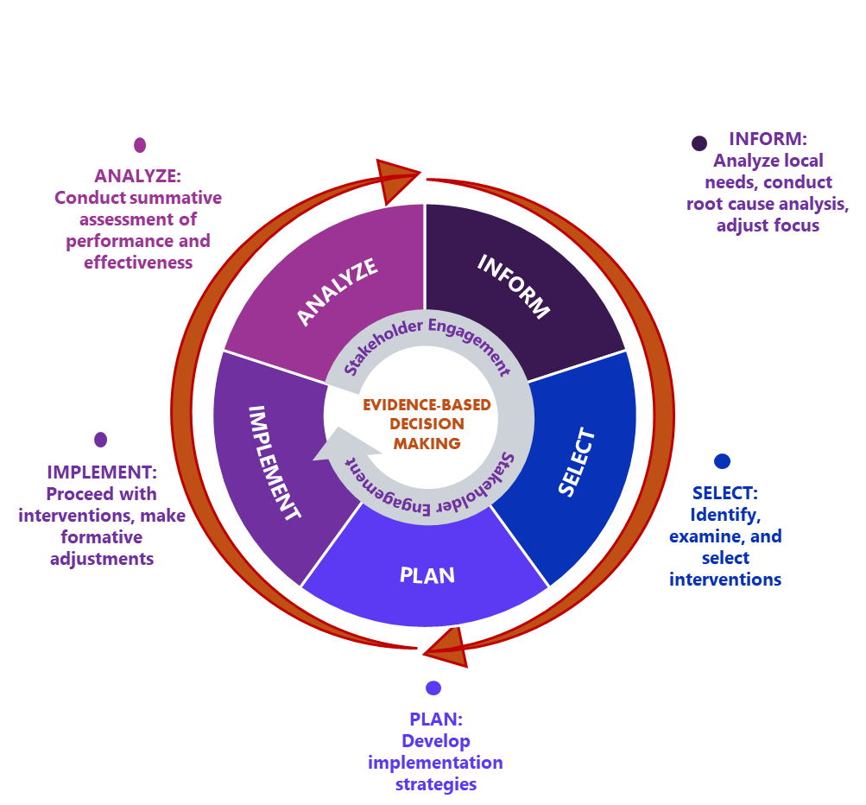
The Continuous Improvement Cycle
This cycle provides a framework for organizing your ESEA planning efforts.
Provides a structured, iterative process for planning and learning.
It is not strictly linear, allowing you to revisit phases as needed.
Stakeholder engagement must occur at every phase.
"We don't just do our best—we do better than our best the next time to be always better."
Notes:
(Antoinette) "This cycle has five key stages: Inform, Select, Plan, Implement, and Analyze. It’s a roadmap to help you make data-driven decisions, choose the right strategies, execute them well, and learn from the results to keep getting better.“
(Peter) "For this activity, we invite you to pick one challenge your district faces – maybe it's retaining new teachers, improving school climate in a specific building, or providing more effective PD in a certain subject. Keep that challenge in mind as we walk through each stage."

Slide 16



INFORM - Knowing Your Starting Point
The Comprehensive Needs Assessment (CNA) forms the core of this stage. By revisiting academic data, staff retention figures, climate surveys, and teacher feedback, you can identify root causes rather than just symptoms. This deeper understanding allows you to prioritize needs effectively, determining which are most critical and which can be realistically addressed through Title II-A resources.
Gather Comprehensive Data
Collect information from performance reports, surveys, retention statistics, and classroom observations to establish a complete picture.
Identify Root Causes
Look beyond symptoms to understand the underlying factors contributing to challenges in your educational environment.
Prioritize Critical Needs
Determine which areas require immediate attention and which can be effectively addressed with available resources.
Notes:
(Antoinette) "The cycle begins with INFORM. This is all about your Comprehensive Needs Assessment. The foundation of improvement begins with accurate information. As we say, "Don't guess. Assess." This stage requires a comprehensive examination of your current reality through multiple data sources like NJ School Performance Reports, surveys, and retention statistics. Don't just look at surface-level problems; dig deep into your data to understand the root causes. What are your staff retention trends? What are your climate surveys really saying? What feedback are you getting from teachers?“ "The goal here is to move beyond assumptions and pinpoint the most pressing needs that Title II-A can help address. This deeper understanding allows you to prioritize needs effectively, determining which are most critical and which can be realistically addressed through Title II-A resources.

Slide 17
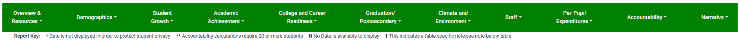
Title IIA: Align Spending to Needs
Student Growth:
  Trends and Progress
  Performance Level
  Growth by Grade
Academic Achievement:
  ELA Assessment- Performance by Grade
  Mathematics Assessment – Performance by Grade
  Graduation Proficiency Assessment
Staff:
Staff Counts
Student and Staff Ratios
Teachers and Administrators – One-Year Retention (District Level)
Notes:
(Peter) Before you decide how to use Title IIA funds, it’s important to ensure that we’re focusing on real, data-driven needs that will benefit teachers and students.
Your Performance Report is a great place to start. This slide lists some key areas to examine.
It helps us ask the right questions:
Where are our students being underserved?
Where do our teachers need more support?
Once you have identified those gaps, it’s time to prioritize— Focus on areas with the greatest potential for impact.
Then, make sure those needs align with your district goals.
Finally, it’s important to connect those needs to Title IIA allowable uses; that way, you stay focused and within guidelines.
Activity Element (Think/Pair/Share - Brief):
"Consider your chosen challenge. What 1-2 key pieces of data would you need to truly understand this need in your district?"
(Allow 1 minute for individual thought, 1 minute for pairs to discuss if feasible, or just ask for a few shout-outs).
So, for that challenge you're thinking about: What specific data would be most crucial for you to examine? (Pause for brief activity). Great insights!"

Slide 18




SELECT – Choosing What Works
Match to Needs
Align strategies directly with identified challenges
Evidence-Based Practices
Prioritize strategies with proven effectiveness
Context Considerations
Evaluate fit with local environment and resources
Title II-A Alignment
Ensure strategies qualify for funding support
Notes:
(Peter) "Once you understand your needs, it's time to SELECT your interventions. This isn't about picking the shiniest new program; it's about choosing strategies that are evidence-based and directly address the needs you've identified.“
(Antoinette) "Think about your district's context. What resources do you have? What's feasible? And, of course, ensure it's an allowable use of Title II-A funds. For the need you're focusing on, what's one evidence-based strategy you might consider? (Pause for activity). Excellent ideas are surfacing!“
Activity Element (Think/Pair/Share - Brief):
"For your chosen need, and based on what we've discussed about Title II-A allowable uses, what's one evidence-based strategy that comes to mind as a potential solution?"
(Allow 1 minute for thought/discussion).

Slide 19




PLAN – Charting Your Course
Effective planning transforms good intentions into actionable steps that result in outcomes. This stage centers on developing a detailed roadmap for implementation, with the logic model serving as your visual guide. A comprehensive logic model connects your resources, activities, outputs, and desired outcomes in a clear, causal chain.
Priorities
Inputs
Resources needed: funding, staff, materials, policies, and practices
Activities
Actions you will take: mentoring programs, surveys, professional development
Outputs
Direct products: feedback collected, teachers trained, mentoring pairs established
Outcomes
Expected changes: improved skills, increased retention, better student outcomes
Internal & External Factors
Notes:
(Antoinette) "With a strategy selected, we move to PLAN. This is where you map out the details. A powerful tool for this is a Logic Model. It helps you articulate the theory of action – how your inputs and activities will lead to desired outcomes.“ Your plan should include specific goals, measurable objectives, realistic timelines, and clearly assigned responsibilities. Remember to align your planning with both district priorities and Title II-A allowable uses to ensure coherence across initiatives and maximize available resources for sustainable impact.
(Peter) “Let’s consider the questions: For input, what resources will you need? For Activities, what specific actions will you take? For Output, what will be the immediate measurable results? And for Outcomes, what changes do you hope to see in teacher practice, school climate, or student achievement?“
Activity Element (Conceptual):
(Antoinette) "For your strategy, try to quickly sketch out one example for each part of a logic model: an input, an activity, an output, and a short-term outcome.
Imagine creating a simple logic model for your chosen strategy. What would be one key INPUT, one ACTIVITY, one OUTPUT, and one desired short-term OUTCOME?” This kind of thinking ensures your plan is coherent and focused.

Slide 20
IMPLEMENT – Bring Your Plan to Life
Implementation transforms planning into action. This stage focuses on executing your strategy while maintaining fidelity to your design. Remember that "no plan survives first contact perfectly," so build in mechanisms for monitoring progress and making necessary adjustments along the way.
Make Real-Time Adjustments
Use the feedback and monitoring data to make necessary refinements to your approach, addressing emerging challenges proactively.
Collect Ongoing Feedback
Establish channels for participants to share their experiences, challenges, and suggestions throughout the implementation process.
Monitor Implementation Fidelity
Regularly assess whether the program is being implemented as designed, identifying deviations that impact effectiveness.
Execute the Plan
Put your carefully designed strategy into action, ensuring all team members understand their roles and responsibilities in the implementation process.
Notes:
(Peter) "Now for the action: IMPLEMENT! This is where your planning meets reality. As you roll out your initiative, it's crucial to monitor how it's going. "Are you implementing with fidelity – meaning, are you doing what your plan said you would do? Are you seeing the early outputs you expected? What are participants saying? Be ready to be flexible and make adjustments. Very few plans unfold exactly as written.“
Tracking outputs and short-term outcomes provides real-time feedback on your implementation effectiveness. Establishing regular feedback loops with participants helps identify challenges early, while coaching supports help educators apply new practices consistently. Stay agile and responsive, using data to refine your approach as you learn what works best in your specific context.
(Antoinette)
Activity Element (Reflection):"Thinking about your strategy, what's one challenge you anticipate during implementation, and how could you prepare for it or keep an eye on it? This proactive thinking is key.“ We will take another 2 minutes for you to take notes and briefly discuss.

Slide 21





Analyze – Data Review and Assessing
The analysis phase completes one cycle and launches the next. Here, you'll evaluate the effectiveness of your implementation by collecting and analyzing outcome data that directly connects to your logic model. Determine whether you achieved your goals and understand the why behind your results.
1. Collect Outcome Data
Gather information aligned with your logic model goals
2. Evaluate Effectiveness
Assess achievement of goals and understand contributing factors
4. Refine for Next Cycle
Apply learnings to strengthen the next improvement iteration
3. Celebrate Successes
Recognize achievements and share wins with stakeholders
Notes:
(Antoinette) "Finally, we ANALYZE. After a set period, it's time to step back and evaluate. Did your initiative achieve its intended outcomes? What does your data show? What lessons did you learn?"
(Peter) "This stage is critical not just for accountability, but for learning and growth. Share your findings, celebrate what worked, and use these insights to refine your approach for the future. This brings us right back to the INFORM stage for the next cycle, making your efforts even stronger."
(Antoinette) "If your strategy worked well, what key outcome would tell you that? And how would that success shape your plans moving forward? This continuous loop is how we build sustainable, impactful programs.“
Activity Element (Forward-Thinking):
"If your strategy is successful, how would you know? What's one key outcome you'd measure to demonstrate impact? And how could this success inform future planning?"
This reflective practice should identify both successes and challenges, extracting valuable lessons from each. Share findings with stakeholders and celebrate wins, however small. Most importantly, use these insights to inform your next improvement cycle, creating an upward spiral of continuous enhancement in educational practices.

Slide 22






Stakeholder Engagement
Collaborating with Stakeholders through all continuous improvement phases offers a multiplier effect because it builds collective capacity to address systemic challenges that no single entity could solve alone.
External Partnerships
Connections with other LEAs, county offices, NJDOE, and higher education facilitate:
Best practice sharing
Joint grant opportunities
Regional solutions
Internal Collaboration
Teachers, administrators, and departments working together within your LEA facilitate:
Shared resources
Cross-departmental innovation
Unified vision
Community Engagement
Involving Families, local businesses,
and organizations facilitate:
Authentic stakeholder voice
Extended resources
Sustainable support
Notes:
(Peter) "As we conclude this activity, let's underscore the power of collaboration. No district is an island. The challenges we face and the solutions we develop, are often shared. No district is an island. No challenge is unsolvable together." Stakeholder engagement creates a powerful multiplier effect, transforming individual efforts into collective impact. This collaborative approach works across both internal partnerships within your LEA and external relationships with other districts, county offices, NJDOE, higher education institutions, and community partners.
(Antoinette) "Think about how you can collaborate more effectively within your district – breaking down silos between schools or departments. And look for opportunities to collaborate externally – with neighboring districts, your county office, or even us at the NJDOE. The NJ Teacher Climate and Culture Innovation Grants, for example, are designed to produce shareable solutions."
(Peter) "By working together, sharing what works, and learning from each other, we can amplify the impact of Title II-A and create a stronger, more supportive educational ecosystem across New Jersey."

Slide 23
Our Destination: Thriving Educators, Thriving Students
Notes:
(Antoinette) Our Fuel and Engine takes us to our destination: a place of thriving education for students.

Slide 24



Our Destination: Where Classrooms Thrive
Engaged Learning
Students thrive in classrooms where teachers feel supported and empowered to innovate, creating dynamic learning experiences that spark curiosity and deep understanding.
Professional Growth
Mentorship and collaborative professional development create a culture where educators continuously refine their practice through structured, meaningful learning opportunities.
Data-Driven Success
When leadership teams use data effectively through the continuous improvement cycle, they can identify successes, address challenges, and systematically enhance educational quality.
Notes:
(Peter) Picture Jordan, the student we met at the beginning. Today, they enter a transformed learning environment where every adult feels supported, valued, and equipped to excel. The hallways buzz with professional conversations, classrooms vibrate with innovative teaching, and a culture of growth permeates every interaction.
This transformation didn't happen by chance. It resulted from deliberate application of the Continuous Improvement Cycle, strategic use of Title II-A resources, and unwavering commitment to educator success. Because when educators thrive, students flourish. As you return to your districts, carry this vision with you – not as a distant aspiration, but as an achievable reality through the framework we've explored together.

Slide 25
Takeaways and Next Steps To Fuel Your Success
Title II-A as Strategic Resource
Leverage the flexibility of Title II-A funding to address your most pressing educator development and school climate needs through targeted, evidence-based approaches.
Evidence-Based Practice Focus
To ensure your investments yield meaningful results, prioritize strategies with proven effectiveness for educator retention, professional growth, and a positive school climate.
Continuous Improvement Framework
Apply the five-phase cycle (Inform, Select, Plan, Implement, Analyze) for systematic educational enhancement, creating an upward spiral of excellence.
Stakeholder Engagement Multiplier
Maximize impact through intentional partnership within and beyond your district, sharing resources and learning from diverse perspectives to address complex challenges.
Notes:
(Antoinette) "We've covered a lot – from the nuts and bolts of Title II-A to a framework for strategic planning. Remember, this is a flexible resource designed to empower you to make real, positive changes.“ As we approach the conclusion of our journey through the Continuous Improvement Cycle, let's consolidate what we've learned. Title II-A offers flexible, strategic resources that can powerfully impact educator development and school climate. By focusing on evidence-based practices for retention, growth, and a positive environment, you can maximize this funding's potential.
(Peter) "Our challenge to you is to take these ideas, particularly the continuous improvement cycle, back to your districts. Start those conversations. Identify those needs. Plan strategically. And collaborate!“ The cycle we've explored provides a comprehensive roadmap for impactful planning and implementation. Remember that collaboration amplifies success, creating opportunities for innovation and shared learning. Now, we challenge you: What will your Title II-A story be? How will you leverage these resources to fuel educator success this year?
(Antoinette) "Together, we can use Title II-A not just to address shortages, but to truly fuel the success of every educator and student in New Jersey.“
Remember the following School Districts’ Requirements When Using Title II-A funding:
Addressing the learning needs of all students;
Making evidence-based decisions;
Prioritizing allocation of funds to high-needs schools;
Consulting a range of stakeholders in planning and implementation; and
Supplementing, not supplanting, non-Federal funds.

Slide 26
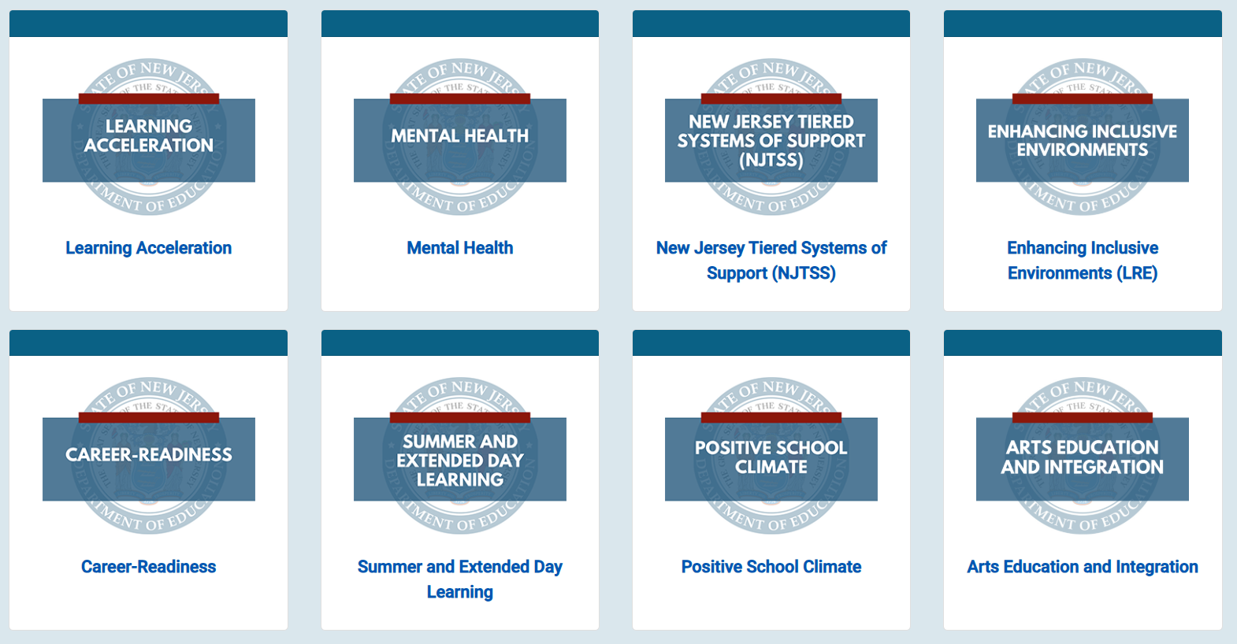

Website Resource
Information available
on the NJDOE
Maximizing Federal Funds webpage
Notes:
(Peter) Maximizing Federal Funds is an NJDOE resource that provides information about different activities that can be supplemented by multiple federal funds to maximize both the use and impact of the funds. You can access the website through the QR code on the slide, the link, or a quick browser search.

Slide 27

References and Contact
Elementary and Secondary Education Act of 1965 – ESSA
Evidence Based Practices - ESSA
Title IIA:
Title II, Part A Allowable and Unallowable Expenditures
Non-Regulatory Guidance for Title II, Part A (September 27, 2016)
TitleIIA@doe.nj.gov
2025 Title II, Part A Non-Regulatory Guidance (United States Department of Education)
Supporting Effective Instruction State Grants (Title II-A, Website, United States Department of Education)
Notes:
(Amy) As an attendee of today’s event, you will have access to a PDF of the slides, which includes linked resources shown to support your planning and use of Title II, Part A funds.

Slide 28

Follow Us on Social Media
@NewJerseyDOE
New Jersey Department of Education
Thank You!
New Jersey Department of Education
@newjerseydoe
New Jersey Department of Education
@newjerseydoe
Notes:
(Amy) "On behalf of Antoinette, Peter, and the entire team at the Department of Education, thank you so much for your time and active participation today. We hope this session has provided you with valuable insights and practical strategies to fuel the success of your educators and students with Title II Part A Funds. Please stay connected with the Department. You can follow us on all major social media platforms to get the latest updates, resources, and information."

