Slide 1
House Pride, School Wide-Together We Rise!
Juan Pablo Duarte-José Julián Marti School No. 28
Elizabeth Public Schools
July 29, 2025
Notes:
Our school is located at 25 First Street in Elizabeth, NJ.
We serve students in PK-8th grade.
Enrollment: 882
•408 GE
•382 ML
•60 SE Only
•32 SE & ML

Slide 2
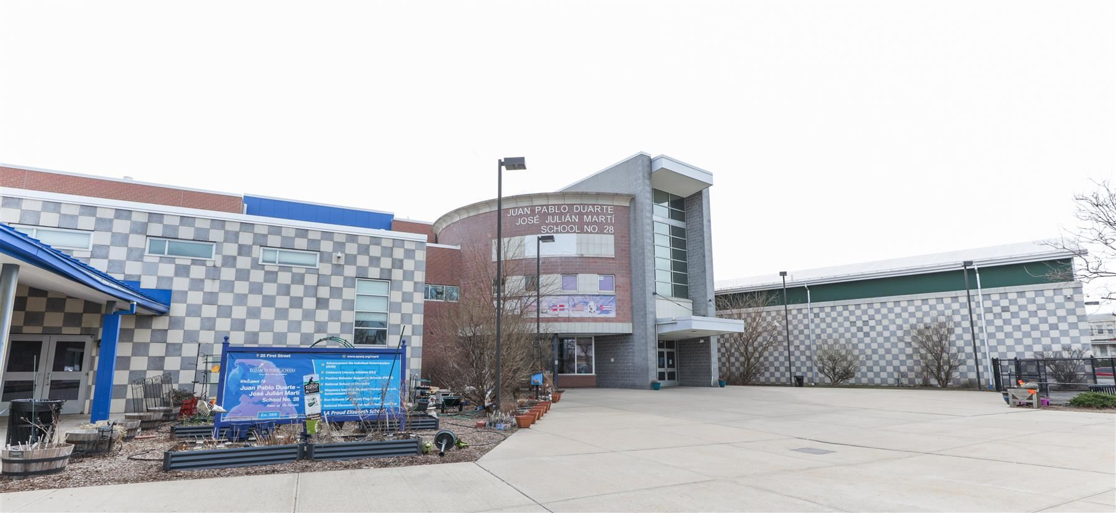


School Mission
Juan Pablo Duarte-José Julián Marti School No. 28 will promote excellence in academics, character development, and environmental education by providing experiences that will inspire all students regardless of race, gender, ethnicity and/or disability to improve the health and wellness of our school, reduce environmental impact and continue their education beyond high school.
2

Slide 3
The RCA House System
What is a House System? (https://youtu.be/WNJqNmP34ao)
3

Slide 4
Spring 2024: SEL - What We Noticed
4

Slide 5
Panorama Family Survey
Total Responses:
2024-2025= 220 responses
2023- 2024= 68 responses
General Observations & Analysis:
Parent survey responses saw a significant increase from 68 in 2023–2024 to 220 in 2024–2025, reflecting a 223% rise in participation. This suggests improved outreach or engagement efforts and provides a more comprehensive view of parent perspectives for the current year.
Family Feedback:
  Strengths/Positives:
    80% responded favorably in school climate
    6% increase for “How well do administrators at your child’s school create a school environment that helps children learn?”
5

Slide 6
Staff Survey (NJ School Climate Improvement – NJSCI)
Total Responses:
  2024-2025= 85 responses
  2023- 2024= 75 responses
General Observations & Analysis:
Staff survey responses for the NJ School Climate Improvement (NJSCI) showed a modest increase from 75 responses in 2023–2024 to 85 responses in 2024–2025. This 13% increase indicates a slight improvement in staff engagement and willingness to provide feedback. Continued efforts to maintain and boost participation will help ensure diverse and representative input from school staff.
Staff Feedback:
Staff feedback highlights a key strength in the school climate: supportive staff and strong interpersonal relationships among colleagues, suggesting a positive and collaborative work environment. However, a notable area of concern is student interpersonal behaviors, indicating a need for targeted interventions to improve student interactions and social-emotional development. Addressing this concern could further enhance the overall school climate and support both staff and student well-being.
6

Slide 7
8 Houses, 1 Family
The Ron Clark Academy House System is a program that divides students, faculty, and staff into different "houses" to foster a positive school culture and community. Each house has unique characteristics, traditions, and values, promoting a sense of belonging and healthy competition. The system aims to build character, empower academic excellence, enhance relationships, and promote school spirit.
7
Notes:
Our school has 8 houses, however we are 1 family.
Each house represents a core value.
Based on the Ron Clarke Academy
Team Altruismo-House of Givers
Team Amistad-House of Friendship
Team Isibindi-House of Courage
Team Reveur-House of Dreamers
Team Nukumori-House of Kindness
Team Onraka-House of Unity
Team Protos-House of Success
Team Sollevare-House of Uplifting
*Click on the picture to get directed to the RCA House System website

Slide 8

Purpose
School Leadership
Celebrate diversity and different cultures
Academic Excellence
Relationship Building
Passionate Climate & Culture
Promote sense of belonging & community for all
8
Notes:
This house system is a dynamic, exciting, and proven way to create a positive climate and culture for both students and staff. All houses come together to celebrate and represent their core value and culture to promote belonging for all. Make this year magical...the Power is within you!

Slide 9
Applying the House System
Step 1: Assign House Leaders
Pick 4-8 house leaders depending on your enrollment and how many houses you will have. House leaders will be responsible for organizing house events and communicating with house members.
Step 2: Students and Staff are initiated into a “house.”
Houses are composed of a mixture of grades and staff members through a random selection process. Faculty meetings are a great opportunity to do this. Students can follow the house that their homeroom teacher is in or select their own.
Step 3: Collect points
Houses compete against one another throughout the year in different areas. Attendance, grades, and positive displays of character are a few ways that students can earn points for their houses.
Step 4: Celebrate
Houses with the highest points at the end of the month or marking period receive a reward.
9

Slide 10
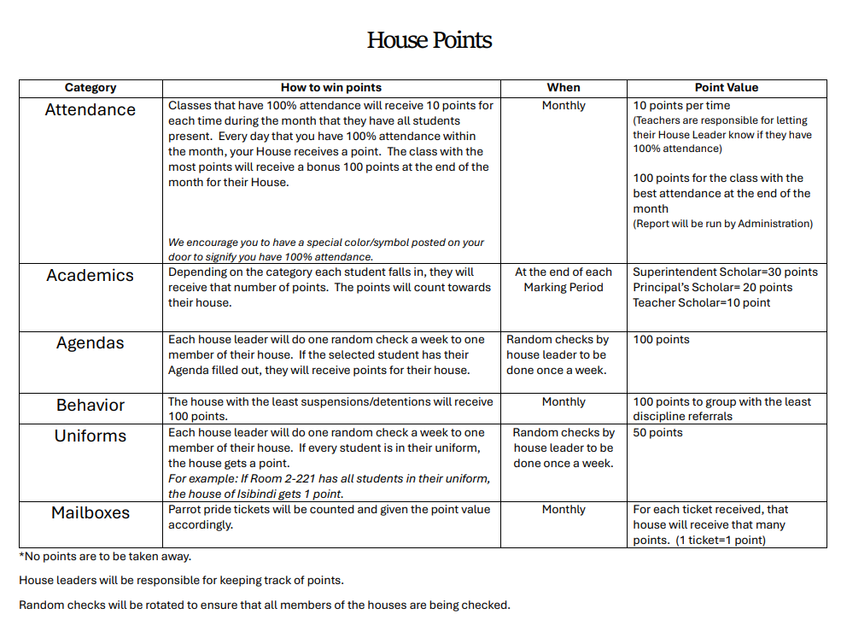
Point System
https://keepthescore.com/board/wsmddmjrhxvqe/
10
Notes:
Click on the House Points rubric to gain access to our live scoring system.
See how our house winner is presented to the school community.

Slide 11

Implementation/Interactivity
Circle Breakouts
  During this activity, each person will be assigned to a “house” and will sit in a circle with their house leader. They will discuss that specific house’s core values.
  House History Reading
  Read all about your house’s history, core values, and designated holidays.
  Activities
  Develop a list of activities that could be incorporated in your school relating to the house.
  Celebrations
  Name ways that house winners will be recognized and rewarded
Rotate
Questions
It is recommended that this circle activity is used when implementing the house system in your school, specifically when introducing it to staff members.
11
Notes:
Circle Breakouts
1 house leader per circle
Each circle represents 1 house
*This will model exactly how it will look when implementing the House System in their school.*

Slide 12

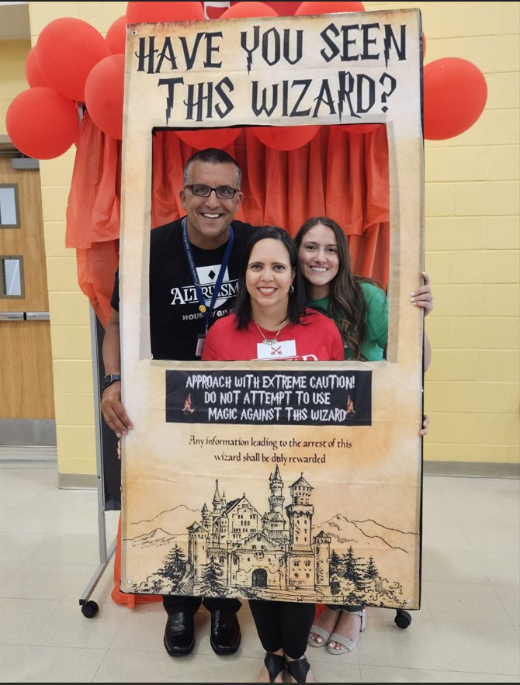



House System In Action
12
Notes:
Please click the Picture Gallery star in the bottom right corner to see our gallery.
https://www.canva.com/design/DAGT351Dpp0/D_-tAMfiFWx8VTD-0dZXJA/view?utm_content=DAGT351Dpp0&utm_campaign=designshare&utm_medium=link2&utm_source=uniquelinks&utlId=hf5447fc8ad

Slide 13
Follow Us on Social Media
Facebook:
@njdeptofed
Instagram:
@newjerseydoe
LinkedIn:
New Jersey Department of Education
Threads:
@NewJerseyDOE
X: @NewJerseyDOE
YouTube: @newjerseydepartmentofeduca6565
13

Slide 14

Thank You!
Mrs. Evelyn Rodriguez-Salcedo, Principal
25 First Street
Elizabeth, NJ 07206
rodrigev@epsnj.org
(908) 436-3950
14

