Slide 1
Igniting the Spark – Cultivating a Positive Culture and Climate for Educators
Thomas Jefferson Intermediate School
Trenton Public Schools
Date: July 29th, 2025

Slide 2



Introduction
Thomas Jefferson Intermediate School | Trenton Public Schools
Robert Porche
12 years in education, 7 years with TPS
Lead PDs and Student Leadership Initiatives
Apple Learning Coach
Committed to shaping the future of education through inclusion and technology
Sara Longo
13 years in education, 9 years with TPS
Master's Degree in Educational Leadership
Passion for using innovation and leadership to spark positive school culture and empower educators
Dr. Nadia Ramcharan
22 years in education TPS
Professor (Rutgers University Graduate School of Education)
Passionate and experienced educator committed to equity, innovation, and student success. Rising from a 1:1 aide to principal, she brings deep insight into all levels of education. With expertise in multilingual learning, technology, and restorative practices, she fosters inclusive, student-centered environments and champions positive school culture.

Slide 3
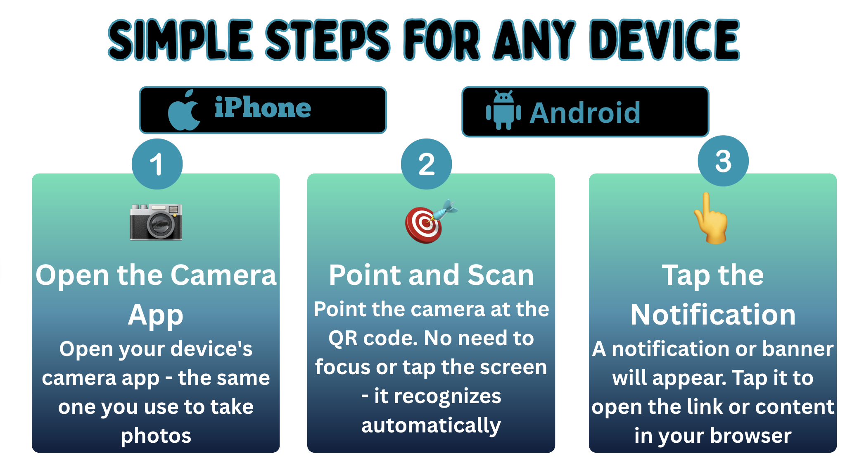
How to Scan QR Codes

Slide 4
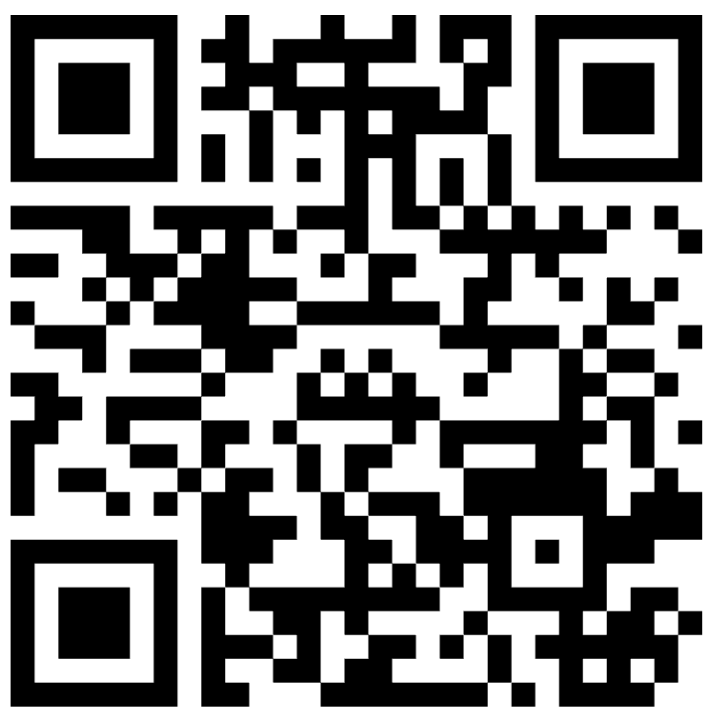
Introduction Question
What does trust, collaboration, and teacher empowerment look like in your schools?
https://www.mentimeter.com/app/presentation/alv1by6habc9ejz3bctkhzidmqw3rcwi/edit?question=3mw6mv4miur9
Notes:
https://www.mentimeter.com/app/presentation/alv1by6habc9ejz3bctkhzidmqw3rcwi/edit?question=3mw6mv4miur9

Slide 5
Workshop Focus
Building
Building intentional trust among educators as
the foundation for school improvement.
Implementing
Implementing effective collaboration structures that maximize collective expertise.
Developing
Developing teacher leadership capacity to drive meaningful, and sustainable change.
Notes:
Do you know your staff?
How many of you know the strengths of each staff in your building?
Are you leveraging that?
Can you list all your staff? Their interests? What classes they taught? --- look at trauma
Do you provide opportunities for shared leadership, staff voice, committees, etc.
Where did your vision come from

Slide 6
Trusting Relationships Amongst Staff (1)
How can trusting relationships be built amongst staff? (Turn and talk)
  Do you know your staff/colleagues and their strengths?
  Are there opportunities for staff voice?
  Does staff feel appreciated?
  Mutual Respect
  Fairness to ALL
  What opportunities are there for staff to build relationships outside the school setting?
Notes:
Turn and talk
Different groups take different questions

Slide 7

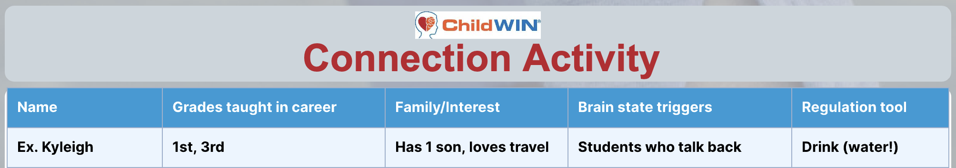
Trusting Relationships Amongst Staff (2)
How well do you know your staff?
Connections Between Us (Adult to Adult)
Activity measures how connected staff feel together
More supportive workplace creates healthier community environment
When adults feel safe children feel safer
Staff examine depth of their collegial relationships
Teachers can turnkey this into their classrooms
Goal: build stronger communities everywhere through connections
Prevent Child Abuse New Jersey. (2022). Trauma sensitive practices in action: Turnkey videos for year-round application. Child Wellness Institute.
Notes:
Do you know your staff?
How many of you know the strengths of each staff in your building?
Are you leveraging that?
Can you list all your staff? Their interests? What classes they taught? --- look at trauma
Do you provide opportunities for shared leadership, staff voice, committees, etc.
Where did your vision come from
Is it important to know the people who are you are spending the most time of your day with?
Show of hands, how well do you know your staff? How where are your holes?

Slide 8
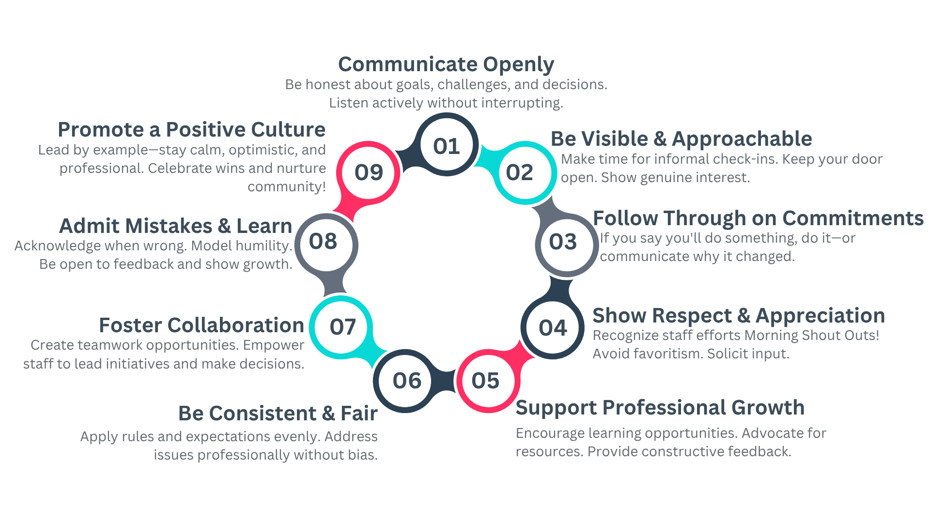
Trusting Relationships Amongst Staff (3)
Notes:
Do you know your staff?
How many of you know the strengths of each staff in your building?
Are you leveraging that?
Can you list all your staff? Their interests? What classes they taught? --- look at trauma
Do you provide opportunities for shared leadership, staff voice, committees, etc.
Where did your vision come from

Slide 9
Trusting Relationships Amongst Staff (4)
Communicate Openly and Transparently
Be honest about goals, challenges, and decisions.
Listen actively without interrupting or dismissing concerns.
Share information consistently and in a timely manner to avoid surprises.
Be Visible and Approachable
Make time for informal check-ins.
Keep your door (literally or figuratively) open.
Show genuine interest in their well-being and ideas.
Follow Through on Commitments
If you say you’ll do something, do it—or communicate why it changed.
Reliability builds credibility.
Notes:
Do you know your staff?
How many of you know the strengths of each staff in your building?
Are you leveraging that?
Can you list all your staff? Their interests? What classes they taught? --- look at trauma
Do you provide opportunities for shared leadership, staff voice, committees, etc.
Where did your vision come from

Slide 10
Trusting Relationships Amongst Staff (5)
Show Respect and Appreciation
          Recognize staff efforts publicly and privately. (Morning Shout Outs)
          Avoid favoritism by celebrating all contributions fairly.
          Solicit input on decisions that affect their work.
Support Professional Growth
      Encourage and provide access to learning opportunities.
      Advocate for their needs when it comes to resources or support.
      Provide constructive feedback with empathy.
Notes:
Show Respect and Appreciation
Ask your self why you’re not able to?

Slide 11
Trusting Relationships Amongst Staff (6)
Be Consistent and Fair
Apply rules and expectations evenly.
Address issues professionally and without bias.
Foster Collaboration
Create opportunities for teamwork and shared leadership.
Empower staff to lead initiatives and make decisions.
Admit Mistakes and Learn from Them
Acknowledge when you’re wrong and model humility.
Be open to feedback and show growth in response.
Promote a Positive Culture
Lead by example—stay calm, optimistic, and professional.
Celebrate wins, encourage laughter, and nurture community.

Slide 12
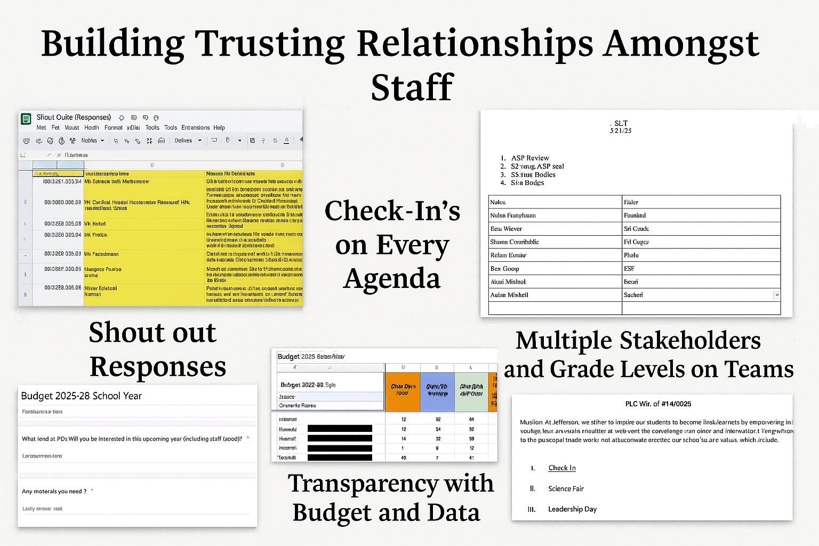
Examples

Slide 13
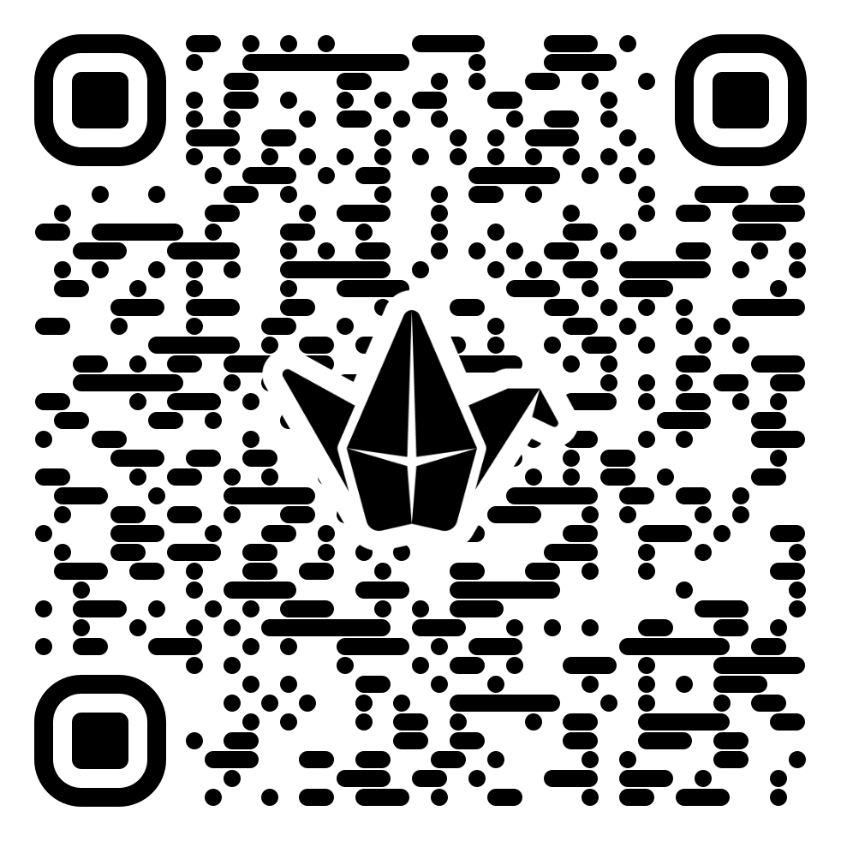
Fostering Collaboration (1)
What meaningful opportunities exist in your school for collaboration—both formal and informal?
How do you and your colleagues collaborate across grade levels, content areas, roles, or even with families and community partners?
https://padlet.com/selongo/bulletin-board-un1gha606tlr4psn
Notes:
https://padlet.com/selongo/bulletin-board-un1gha606tlr4psn

Slide 14

Fostering Collaboration (2)
What would it take for every educator in our building to feel like they’re part of a collaborative team
working toward a shared vision—not just working in the same place?
  Have I intentionally created opportunities for teachers across grades or content areas to collaborate?
  Do all voices feel equally valued in PLC conversations, including quieter or newer staff?
  Have I modeled or encouraged co-teaching and peer observation as tools for learning—not evaluation?
  Am I using collaboration tools myself to model transparent and collaborative planning?
  What barriers (mindset, time, trust, or tools) may be limiting collaboration right now?
  What is one actionable step I can take this month to deepen collaboration across my staff?
Notes:
List teams you have, how are people sharing a voice

Slide 15
Fostering Collaboration (3)
A Clear, Shared Vision
Establish and consistently communicate a shared instructional vision that every staff member understands, believes in, and helps shape.
Schedule Protected Time for Collaboration
Embed collaboration into the master schedule during the school day — not just as an “extra” — and protect it from being overtaken by admin tasks.
Intentional Team Structures
Create cross-grade or interdisciplinary PLCs with rotating leadership to promote equity in voice, foster creativity, and break down silos. (Create protocols) (Planning is essential)
Notes:
List teams you have, how are people sharing a voice

Slide 16
Fostering Collaboration (4)
Psychological Safety
Foster a culture where teachers feel safe to share ideas, make mistakes, ask for help, and give constructive feedback without fear or judgment.
Visible, Active Leadership
Be present in collaborative spaces – not to control them, but to listen, encourage, and celebrate the process and outcomes.
Be willing to do anything you are asking the staff to do
Modeling Collaborative Practices
Use co-leadership in staff meetings, co-create agenda, or facilitate instructional rounds where teachers learn from one another with purpose.
Use of Collaborative Digital Tools
Leverage tools like Google Docs, Shared Drives to support transparent, real-time input and asynchronous collaboration
Notes:
List teams you have, how are people sharing a voice

Slide 17
Fostering Collaboration (5)
Empowerment Through Choice
Allow teachers to choose or co-design collaborative structures and inquiry cycles based on their passions and students needs
Celebration and Visibility
Celebrate collaborative wins regularly – shout-outs, showcases, newsletters – and highlight how teamwork is improving student learning.
Consistent Follow-Through
Ensure collaborative plans lead to action. Revisit decisions made in teams, show progress, and provide the support/resources promised
Notes:
List teams you have, how are people sharing a voice

Slide 18

Everyone Has Genius (1)
Building Teacher Leadership Capacity
How are teachers being empowered to lead beyond the classroom to strengthen school-wide instructional quality and student outcomes?
Empowering Teacher Leadership
Unlocking Superpowers Within
Activating Potential in Every Educator

Slide 19
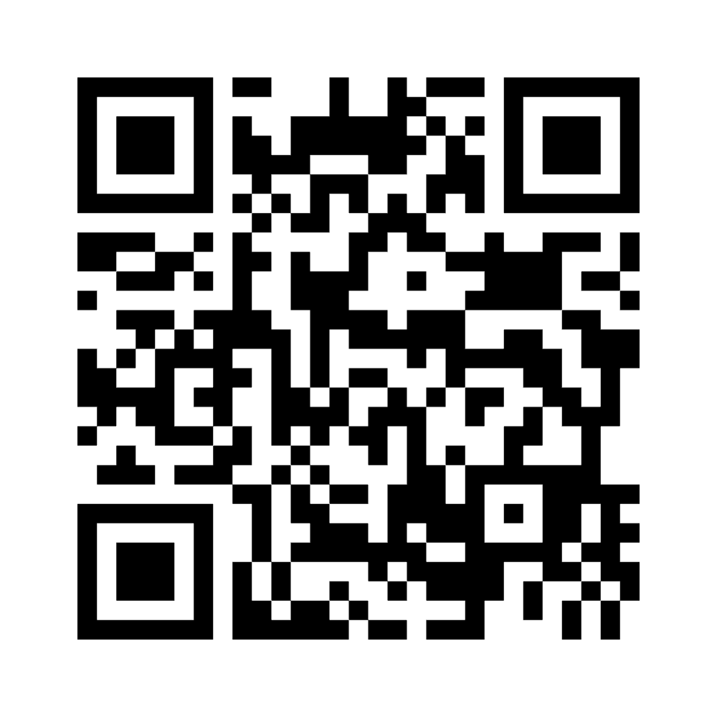
Everyone Has Genius (2)
In one word, what's your educator superpower?
https://www.mentimeter.com/app/presentation/alyzd99nisnyyak5nrhzv1yh84vwpxyu/edit?question=es7p4wfx2emc
Notes:
https://www.mentimeter.com/app/presentation/alyzd99nisnyyak5nrhzv1yh84vwpxyu/edit?question=es7p4wfx2emc

Slide 20
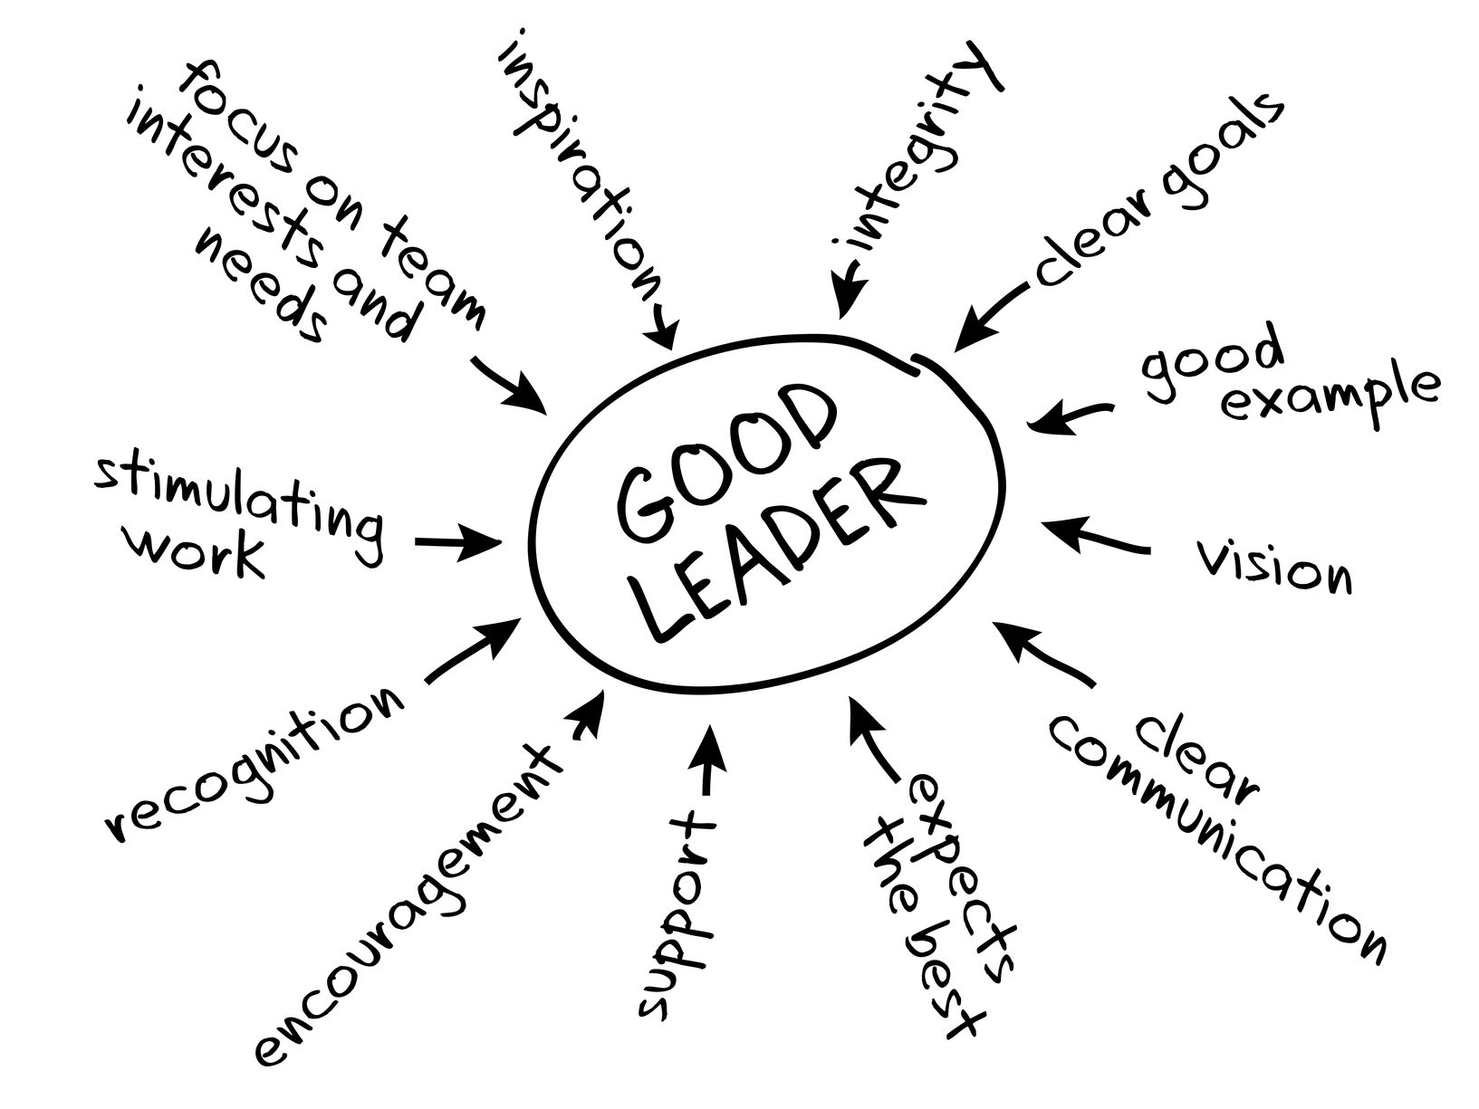
Everyone Has Genius (3)
🔑 Identify and activate leadership potential in all educators
Sometimes teachers don’t realize their own superpowers — it's our role to observe and empower them.
Leadership is not a title — it's a mindset and a set of actions. Every educator has something powerful to offer.
Notes:
Give the real life examples of finding teachers strengths and highlighting them.
Mr. L , Ms. S Viz, Ms. Chak, Mr. Porche

Slide 21
Everyone Has Genius (4)
Practical Teacher Leadership Strategies:
  Distribute leadership opportunities (e.g., tech lead, PD presenter, mentor teacher, student voice coordinator, grade level leader, SLT, Culture and Climate Team, Houses)
  Offer micro-credentials or stipends for leadership in curriculum, equity, or innovation
  Showcase teacher-led success stories within the school and to the broader community
  Invite teacher voice in school-wide decisions via advisory teams or steering committees

Slide 22
Why Teacher Leadership Matters
  Builds capacity within the school
  Increases engagement and morale
  Supports sustainable school improvement
  Elevates teacher voice and innovation

Slide 23
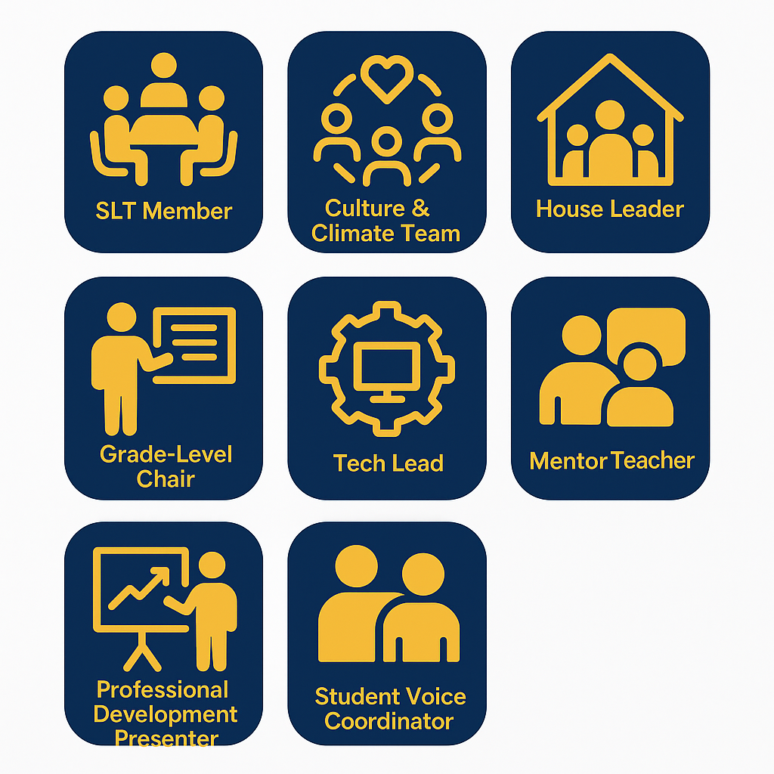
Practical Strategies to Empower Teacher Leadership
Create diverse leadership roles that match strengths and interests:
Teachers rise when their efforts are seen, valued, and invested in.
Rotate roles and invite new leaders annually to build school capacity.​

Slide 24

Showcase Teacher-Led Success Stories
📣 Celebrate and spotlight:
Model classrooms
Peer-led initiatives
Innovations in instruction
Use:
Staff newsletters
Social media
School board meetings
Teacher of the Month with a leadership twist
Notes:
PBSIS raffel just for teachers
Monthly staff get togethers

Slide 25
Invite Teacher Voice into Decision-Making
🤝 Empower teachers to shape the school:
Leadership advisory committees (SLT, IR&S, Etc.)
Task forces for key initiatives (e.g., scheduling, discipline, curriculum, data, culture and climate)
Listen
Surveys with follow-up actions

Slide 26

Reflection/Call to Action
What did you learn today that you could potentially implement locally to empower teacher leadership in your building? Who is a ‘hidden leader’ you’ve observed, and how might you activate their superpower to support your school community?

Slide 27
Questions????

Slide 28
Follow Us on Social Media
Facebook:
@njdeptofed
Instagram:
@newjerseydoe
LinkedIn:
New Jersey Department of Education
Threads:
@NewJerseyDOE
X: @NewJerseyDOE
YouTube: @newjerseydepartmentofeduca6565

Slide 29
Thank You!
New Jersey Department of Education: nj.gov/education
rporche@trenton.k12.nj.us
selongo@trenton.k12.nj.us

