Slide 1
Creating a School Culture of Empowerment
Dr. Tony DeMarco
Vanessa Ahmed
Lori Koehler
Sarah Opdyke
July 29, 2025

Slide 2
The Leadership Belief Spectrum
Instructions:
Read the statement when it is displayed on the screen
Move to the part of the room that matches your belief
Be prepared to share why you chose your position.

Slide 3
Leadership & Decision Making
“The principal should be the final decision-maker on all important school issues.”
“Teachers should have a voice in school-wide decisions, even if they don’t hold formal leadership roles.”
“Shared decision-making slows down progress and leads to inconsistent implementation.”

Slide 4
Trust and Control
“Giving up control as a leader is risky and can lead to mistakes.”
“Trust must be earned before responsibilities can be shared.”
“Micromanagement is sometimes necessary to ensure high standards.”

Slide 5
Empowerment and Growth
“Teachers thrive when they are trusted to lead.”
“Leadership opportunities should be reserved for the most experienced staff.”
“Professional growth happens best when teachers are given autonomy and responsibility.”

Slide 6
Culture and Collaboration
“A strong school culture starts with how leadership is shared.”
“Teachers should be actively involved in shaping the school’s vision and values.”
“When teachers feel valued and heard, student success improves.”

Slide 7
Rethinking School Leadership
Modern-day schools are complex organizations, and a traditional top-down approach is not conducive to achieving measurable student learning outcomes or establishing a positive culture where staff believe they are empowered to effect positive change.

Slide 8
Shared/Distributive Leadership
Sharing or distributing leadership does not diminish or dilute the power or leadership of an individual. To the contrary, it allows leadership to be distributed and shared exponentially through various individuals.

Slide 9
Shared vs. Distributive Leadership
Shared Leadership
Multiple individuals share responsibilities
Collaborative influence across roles
Distributed Leadership
Decision-making is dispersed among the team
Develops leadership capacity in others
By adopting a distributive leadership approach, principals can delegate responsibilities to capable staff members, fostering a culture of trust and shared ownership. When teachers are given a voice in decision-making, it enhances the school climate, strengthens teacher confidence, and positively impacts student outcomes.

Slide 10
Relationships and Collaboration (1 of 2)
Effective distributive leadership requires trust, collaboration, and empowering those with the capacity to engage in the work that is expected of them.

Slide 11
Relationships and Collaboration (2 of 2)
Effective collaboration cannot take place without healthy relationships.
Adopt a mindset of relationship building vs relationship management.

Slide 12
Relationships are the Heartbeat of the School (1 of 2)
A Google AI overview describes a healthy heart as follows:
A healthy heart is characterized by strong function and efficient circulation. Key indicators include a normal heart rate, healthy blood pressure, and the ability to perform moderate-intensity physical activity without discomfort. Other signs of a healthy heart can include a good recovery rate after exercise, strong gums, and a balanced lifestyle with healthy eating, regular exercise, and adequate sleep.
How can this description of a healthy heart be used as a metaphor for a healthy school culture?

Slide 13
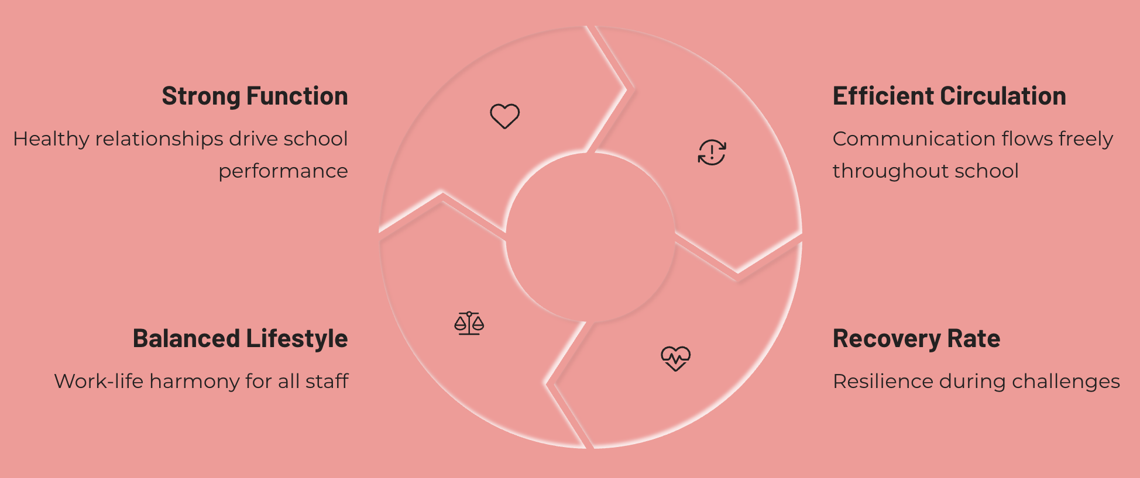
Relationships are the Heartbeat of the School (2 of 2)

Slide 14
Collaboration as a Core Value
If collaboration is a core value, it must be supported and nurtured by the systems in place.

Slide 15
Collaboration Resulting in Student Success (1 of 2)
Leveraging the school schedule to meet academic needs and provide enrichment opportunities:
Collaborative scheduling
Co or collaborative teaching situations
Common planning time

Slide 16
Collaboration Resulting in Student Success (2 of 2)
Proactively identifying students and promoting a flexible, dynamic process:
At-risk students identified through multiple criteria
Not a “one-size-fits-all” approach
Programs that adapt based on student progress

Slide 17
Maintaining a Positive School Culture (1 of 3)
There is always something to celebrate, and there must be joy in our work!
A “Lived Out” Mission Statement
A “lived out” mission statement is something that all stakeholders understand, can internalize, and becomes an authentic part of their everyday work at school

Slide 18

Maintaining a Positive School Culture (2 of 3)
Actively involve staff in significant school events/rituals
Homeroom visits and “counting up” the days
Rocky’s Rockstars
Rocky’s Readers
The RFIS Mascot: Rocky the Husky

Slide 19
Maintaining a Positive School Culture (3 of 3)
Maintaining an authentic coaching approach to staff evaluation
Feedback as Growth
Powerful Questions
Solution-Focused
Recognize Progress

Slide 20
The Next Steps
How can you use the principles of distributive leadership to empower members of your school community?
Discuss with your group and begin to develop an action plan specific to the needs of your school. You can use any of the examples discussed today or create a plan for a situation unique to your school. Click here for more examples of how to empower staff and drive meaningful change in your school.
Here is a link to two possible Action Plan Templates to consider using. Make a copy of the doc and feel free to use it as you see fit.

Slide 21
Thank You!
New Jersey Department of Education: nj.gov/education
Dr. Tony DeMarco –Principal, Reading-Fleming Intermediate School
anthony.demarco@frsd.us
Vanessa Ahmed –Vice Principal, Reading-Fleming Intermediate School
vanessa.ahmed@frsd.us
Lori Koehler –Math Teacher, Reading-Fleming Intermediate School
lori.koehler@frsd.us
Sarah Opdyke –Math Interventionist/Teacher, Reading-Fleming Intermediate School
sarah.opdyke@frsd.us

