Slide 1


Teacher Leadership: Bridging Theory to Practice to Impact School Culture
NJ County Teachers of the Year

Slide 2

Bridging Theory and Practice

Slide 3
"A Leader Is One Who Knows The Way,
Goes The Way, And Shows The Way."
– John C. Maxwell
John C. Maxwell encapsulates the essence of leading by example.
Effective leaders are knowledgeable, proactive, and visible.
This quote serves as a reminder that actions speak
louder than words in inspiring and guiding a team.

Slide 4
Today’s Presentation
Provides actionable strategies for cultivating teacher leadership
Aligns with NJ Professional Standards for Teachers (NJPST) and Teacher Leader Model Standards (TLMS)
Covers research-based theory, practical methods, and collaborative activities
Aims to develop teacher leaders who drive school improvement

Slide 5
Objectives
By the end of this session, participants will:
Understand the core principles of teacher leadership and its impact on school culture.
Identify how the NJ Professional Standards for Teachers (NJPST), particularly Standard Ten: Leadership and Collaboration, and Teacher Leader Model Standards (TLMS) define teacher leadership roles.
Apply strategies to nurture teacher leaders by fostering trust, empowering them, and promoting their professional growth.

Slide 6
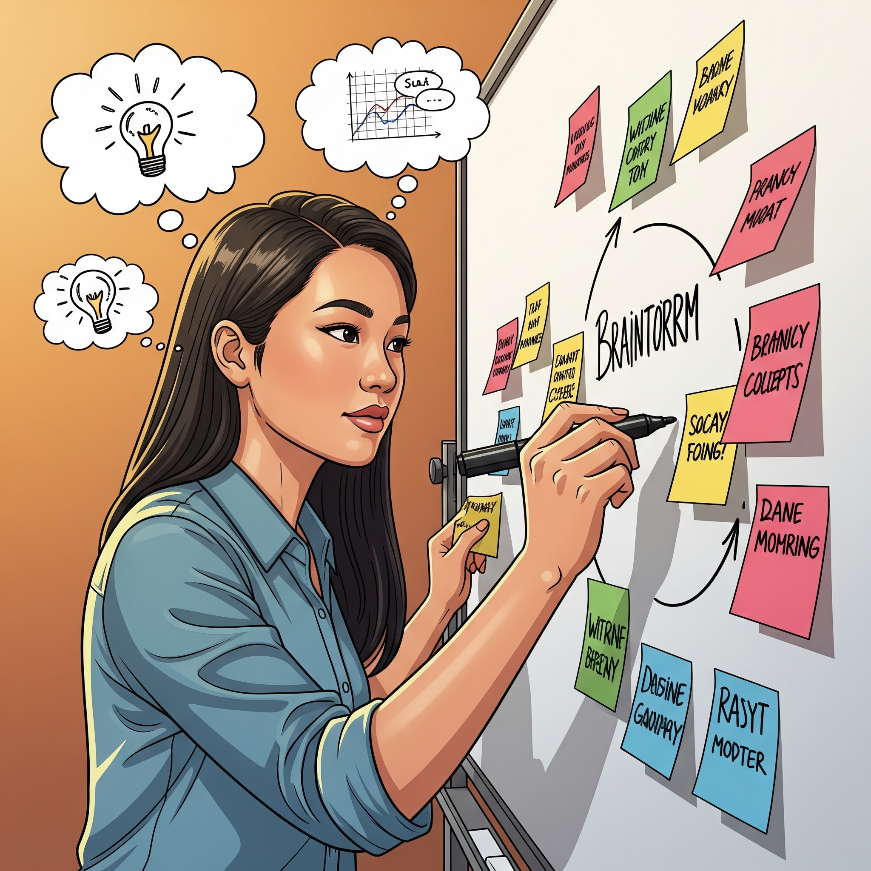
Take a note
After hearing the presentation’s overview and objectives, write down one (or more) things that YOU hope to learn and/or take away with you today.
Then turn and tell your neighbor.

Slide 7

Overview
Teacher leaders drive meaningful change by connecting theory to practice and transforming school culture.
This empowers teachers to shape school
values, norms, and collaboration beyond
classroom instruction.

Slide 8

Theoretical Foundations (1)
Definition: Teacher leadership is:
Influencing peers, administrators, and the school community
Improving teaching, learning, and student achievement
Taking on roles beyond the classroom
Promoting collaboration, shared responsibility, and ongoing professional growth
Fostering a positive, innovative
  school culture

Slide 9
Theoretical Foundations (2)
Key Theories:
  Distributed Leadership: Leadership responsibilities are shared among teachers, not limited to formal administrators.
  Transformational Leadership: Focuses on inspiring and motivating colleagues to achieve collective goals and foster innovation.
  Collaborative Culture: Emphasizes teamwork, open communication, and shared decision-making.

Slide 10

School Culture & Teacher Leadership
https://www.youtube.com/watch?v=lbQIeys5rbw&list=PL2uWqdcaf18-wJJHuArtnPE8iE8udDdpF&index=4
Notes:
https://www.youtube.com/watch?v=lbQIeys5rbw&list=PL2uWqdcaf18-wJJHuArtnPE8iE8udDdpF&index=4

Slide 11
The Teacher Leader Model Standards
The Standards consist of seven domains describing the various attributes of teacher leadership:
Domain I: Fostering a collaborative culture to support educator development and student learning
Domain II: Accessing and using research to improve practice and student learning
Domain III: Promoting professional learning for continuous improvement
Domain IV: Facilitating improvements in instruction and student learning
Domain V: Promoting the use of assessments and data for school and district improvement
Domain VI: Improving outreach and collaboration with families and community
Domain VII: Advocating for student learning and the profession

Slide 12
Standard 10: Leadership and Collaboration
Teachers seek leadership roles and opportunities to take responsibility for student learning and school improvement.
Key performances include:
  Taking active roles on instructional teams, giving and receiving feedback, analyzing learner work and data, and sharing decision-making responsibilities.
  Collaborating with colleagues, families, and community members to meet diverse learner needs and ensure growth.
  Advancing the profession by advocating for best practices and continuous learning.
Critical dispositions emphasize responsibility for student learning, reflective practice, understanding biases, and commitment to ethical standards.

Slide 13
NJPST Standard 10
🧩 NJPST Standard Ten: Leadership and Collaboration
Leadership and Collaboration
The teacher seeks appropriate leadership roles and opportunities to take responsibility for student learning, to collaborate with learners, families, colleagues, other school professionals, and community members to ensure learner growth, and to advance the profession.
Ethical Practice
Teachers shall act in accordance with applicable policies as well as legal and ethical requirements and shall use integrity and fairness to promote the success of all students.
Notes:
https://teacherprep.princeton.edu/tpp-handbook/new-jersey-professional-standards-teachers
https://www.nea.org/resource-library/teacher-leader-model-standards

Slide 14
Impact on School Culture
Teacher leaders shape the norms and values of a school, creating a culture where new ideas are welcomed and all voices are valued.
Schools with strong teacher leadership show higher levels of teacher motivation, retention, engagement, and willingness to implement instructional change.
Impact on school culture includes enhanced collaboration, increased teacher efficacy, and improved student outcomes.

Slide 15
Teacher Leadership in Practice
Modeling Collaboration: Teacher leaders demonstrate effective communication, active listening, and facilitation skills, helping colleagues work together to solve problems and make decisions.
Mentorship and Coaching: Providing guidance and support to new and experienced teachers, promoting ongoing professional growth.
Data-Driven Decision Making: Leading curriculum development and instructional improvement based on student data and evidence-based practices.
Inclusive Practices: Advocating for equity, social justice, and culturally responsive teaching to ensure all students have opportunities to succeed.

Slide 16

Thought Question:
What policies and practices must you change in order to transform your school into an organization that supports teacher leadership?

Slide 17
Strategies to Nurture Teacher Leaders
Fostering Trust
  Create safe, respectful environments where teacher leaders feel valued and heard.
  Encourage open communication and shared decision-making to build confidence and collaboration.
Empowering Teacher Leaders
  Provide formal leadership roles aligned with NJPST Standard Ten, such as instructional coaches, team leaders, or curriculum specialists.
  Allocate time and resources for teacher leaders to engage in leadership activities.
Promoting Professional Growth
  Offer targeted professional development focused on leadership skills, collaboration, and data-driven instruction.
  Encourage reflective practice and continuous learning through peer observations, feedback cycles, and action research.

Slide 18
Strategies for Bridging Theory to Practice
Professional Development/Learning: Provide targeted training in leadership skills, adult learning theory, and facilitation.
Structured Collaboration: Establish regular opportunities for teacher leaders to facilitate peer observations, feedback sessions, and collaborative planning.
Recognition & Support: Administrators should empower teacher leaders with time, resources, and formal recognition of their roles.
Shared Leadership Structures: Implement systems that encourage shared decision-making and distribute leadership responsibilities across staff.
Feedback Loop: Foster a culture where teachers reflect on their practice, learn from each other in a supportive environment, and having admin follow through.

Slide 19
Possible Collaborative Activities
Case Study Analysis: Examine scenarios where teacher leadership transformed school culture.
Role-Playing: Practice leadership conversations and collaborative problem-solving.
Action Planning: Develop individualized plans to implement teacher leadership strategies aligned with TMLS.

Slide 20
Scenarios Where Teacher Leadership
Transformed School Culture (1)
Scenario 1: Shared Leadership Model: Building Community and Engagement: A school implemented a shared leadership model where teachers and students were given significant voice in decision-making. Tenured teachers mentored newer staff, fostering a culture of collaboration and mutual respect. This approach led to increased teacher retention, as all teachers felt valued and heard. The school also saw stronger student engagement, with students empowered to lead community-impact projects such as STEM nights that connected classroom learning to real-world issues. These events became integral to the curriculum, enhancing instruction and building a sense of purpose and community pride.
Notes:
1. EducationNC
ednc.org/perspective-bu…
Transforming school culture with shared leadership - EdNC
"At its heart, a shared leadership model is about giving a voice to students and teachers," says Jackson Park Elementary School's principal, Will Gibson.

Slide 21
Scenarios Where Teacher Leadership
Transformed School Culture (2)
Scenario 2: Instructional Teacher Leadership in High-Need Districts: In the Gadsden Elementary School District in Arizona, formal teacher leadership roles were created, such as master teachers responsible for leading professional learning teams and coaching peers. This distributed leadership structure empowered teachers to innovate and support each other, leading to significant improvements in student achievement—many schools earned their first-ever "A" ratings from the state. The district also developed a sustainable leadership pipeline, with several principals rising from master teacher roles, demonstrating how teacher leadership can drive both cultural and academic transformation.
Notes:
2. Nietteach
niet.org/newsroom/show/…
The One-Two Punch of Teacher Leadership | NIET
Formal pathways that support retention and advancement of top teachers ensure great teaching in every classroom and provide the opportunity, competence, and confidence to pursue other educational leadership positions.

Slide 22
Scenarios Where Teacher Leadership
Transformed School Culture (3)
Scenario 3: Distributed Leadership During Principal Transitions:
Research shows that when schools establish distributed leadership, where teachers share in decision-making and leadership responsibilities, the negative impacts of principal turnover are mitigated. Teacher leaders promote collaboration and inclusion, empowering their peers and sustaining positive school culture even during times of administrative change. This model fosters a sense of ownership and continuity among staff, leading to improved morale and student outcomes.
Notes:
3. kennesaw
digitalcommons.kennesaw.edu/cgi/viewconten…
[PDF] The Role of Teacher Leaders in Sustaining School Culture During ...
2 One way to ensure a school can continue its success in the face of a leadership transition is to establish distributed leadership. In distributed leadership, it is understood that the combined leadership of multiple parties is more effective than an individual leader could be (Leithwood et al., 2007).

Slide 23
Scenarios Where Teacher Leadership
Transformed School Culture (4)
Scenario 4: Collaborative and Supportive Leadership Styles:
Schools where principals and teacher leaders collaboratively shape the culture are marked by open communication, shared purpose, and collective celebration of achievements. In such environments, teachers are more engaged and satisfied, and the school community is strengthened through joint participation in events and rituals. In contrast, schools with authoritarian leadership experience disengagement and dissatisfaction among teachers, highlighting the transformative impact of teacher-led, collaborative cultures.
Notes:
4. Frontiers
frontiersin.org/journals/educa…
The role of leaders in shaping school culture - Frontiers
1Department of Pedagogy, Aleksander Moisiu University, Durrës, Albania 2Department of English, Aleksander Moisiu University, Durrës, Albania Principals plays a decisive role in shaping school culture.

Slide 24
Key Elements Across Scenarios
1: Turn and talk - What do YOU feel were the key elements across the 4 scenarios?
2. Discuss with your table - did everyone come up with the same ideas/elements?
Empowerment and Voice:
Teachers are given real influence over school decisions, leading to higher engagement and satisfaction.
Mentorship and Collaboration:
Experienced teachers mentor new staff, and all teachers collaborate on curricular and community projects.
Sustained Improvement:
Teacher leadership supports continuity and improvement during leadership transitions, reducing disruption and maintaining positive culture.
Student Outcomes:
Schools with strong teacher leadership see measurable gains in student achievement and engagement.
Leadership Pipeline:
Teacher leadership roles provide pathways for professional growth, often leading to future school and district leaders.
Key Elements Review
Notes:
4. Frontiers
frontiersin.org/journals/educa…
The role of leaders in shaping school culture - Frontiers
1Department of Pedagogy, Aleksander Moisiu University, Durrës, Albania 2Department of English, Aleksander Moisiu University, Durrës, Albania Principals plays a decisive role in shaping school culture.

Slide 25
Recommendations for NJ Schools
Create Leadership Pathways: Develop clear roles and advancement opportunities for teacher leaders.
Foster a Collaborative Culture: Prioritize trust, open communication, and shared vision among all staff.
Support Ongoing Learning: Invest in continuous professional development focused on leadership and collaboration.
Encourage Inclusive Practices: Ensure teacher leaders are equipped to promote equity and culturally responsive teaching.
Monitor and Evaluate Impact: Regularly assess the effects of teacher leadership on school culture and student outcomes.

Slide 26
Targeting Strategies for Teacher Leaders (1)
🏬 Instructional Leadership
Interdisciplinary Team Leads: Coordinate cross-subject collaboration for units, projects, and student support.
SEL Integration Coaches: Model and support social-emotional learning within academic content.
Student Data Leads: Lead team data reviews to inform interventions and monitor progress.
Peer Coaching: Pair teacher leaders with colleagues for goal setting, lesson feedback, and modeling best practices.
Model Classrooms: Designate certain classrooms as demonstration spaces where teachers can observe high-impact teaching strategies in action.
Lead PLCs (Professional Learning Communities): Empower teacher leaders to facilitate data-driven discussions, unit planning, and vertical articulation.

Slide 27
Targeting Strategies for Teacher Leaders (2)
👥 Professional Collaboration & Mentorship
Grade-Level Team Facilitators: Run team meetings focused on planning, communication, and student needs.
New Teacher Mentorship: Assign experienced teacher leaders to support onboarding, classroom management, and school culture integration.
PD Facilitators: Encourage teacher leaders to design and deliver professional development that’s relevant and teacher-tested.
Micro-PD Sessions: Host short, focused sessions during prep or lunch led by teachers around bite-sized, actionable topics.
🎯 Student-Focused Roles
Advisory Program Designers: Develop and lead advisory lessons on SEL and character.
Restorative Practice Liaisons: Support behavior interventions and lead restorative circles.
Student Voice Ambassadors: Guide student-led initiatives, forums, or leadership groups.

Slide 28
Targeting Strategies for Teacher Leaders (3)
🌎 Culture, Equity & Family Engagement
Curriculum Reviewers/Panels: Ensure grade-level content is culturally responsive and inclusive and engage teacher leaders in reviewing curriculum for representation, accessibility, and rigor.
Family Engagement Team Members: Plan and host events, workshops, and multilingual outreach.
Celebration Leads: Organize student recognition programs for achievement and growth.
Equity Teams: Involve teacher leaders in facilitating conversations and trainings around cultural responsiveness and inclusive practices.

Slide 29
Targeting Strategies for Teacher Leaders (4)
🌎 Culture, Equity & Family Engagement (continued)
Teacher Voice Committees: Formalize avenues for teacher input on schoolwide decisions, initiatives, and student needs.
Recognition Programs: Have teacher leaders help develop peer-recognition systems to celebrate innovation, collaboration, and student impact.
Family Engagement Liaisons: Teacher leaders can help build partnerships between families and schools through events, communication, or outreach.
Student Leadership Coaches: Guide student council or lead projects that promote student voice and service learning.

Slide 30
Targeting Strategies for Teacher Leaders (5)
💻 Innovation & Enrichment
Tech Integration Mentors: Support digital tools and classroom tech
Enrichment Club Sponsors: Run clubs like STEM, arts, podcasting, or coding.
PBL Coaches: Help teams design engaging, interdisciplinary project-based learning experiences.
Tech Ambassadors: Identify tech-savvy teacher leaders to coach peers on integrating tools like AI, Google Workspace, or adaptive platforms.
Pilot Programs: Let teacher leaders test new curriculum, digital tools, or instructional strategies and report on outcomes.
Teacher Lit Circle: Lead a school wide book study on best practices

Slide 31
Targeting Strategies for Teacher Leaders (6)
⚒️ School Improvement & Teacher Voice
Teacher Advisory Council: Collaborate with admin on policies, scheduling, and school climate.
MTSS Grade-Level Reps: Participate in multi-tiered student support planning.
Peer Observation Pods: Coordinate walk-throughs and reflection cycles to improve instruction.
Data Teams: Engage teacher leaders in interpreting student data and shaping school improvement goals.
Grant Writers/Project Leads: Support teacher leaders in seeking funding for initiatives aligned with school priorities.

Slide 32

Teacher Leadership Action Plan (1)
Step 1: Identify a Climate/Culture Focus
Prompt: "Brainstorm one specific area where teacher leaders could improve school climate (e.g., peer collaboration, student belonging, staff morale).
Action:________________________________________
Role: Teacher leaders will [concrete task]
Support Needed: [Time/tools/training]
Domain I Alignment: [e.g., "Facilitates peer
learning"]

Slide 33
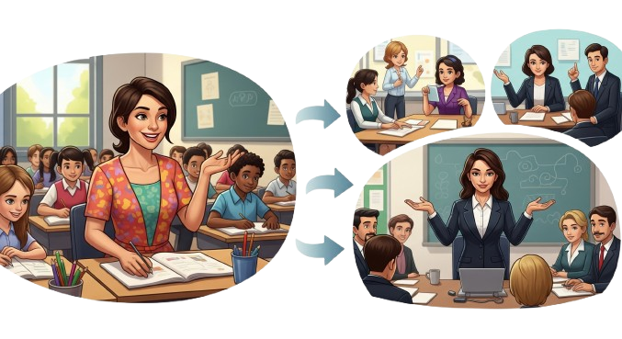
Teacher Leadership Action Plan (2)
Step 2: Design a Teacher Leadership Role
"Using Domain I of the NEA TLMS, draft a micro-action where teacher leaders address your focus area. Specify:
Role: What leadership task will teachers perform?
Support: What resources or training is needed?
Impact: How does this build a collaborative culture?"

Slide 34

Teacher Leadership Action Plan (3)
Create a step-by-step plan outlining how teacher leaders can be supported and empowered in your school community
Share ideas on how to measure the impact of these leadership initiatives on school climate over the next semester
Discuss potential challenges in developing teacher leaders and propose solutions to overcome them

Slide 35
Summary and Call to Action
Teacher leadership is essential for cultivating a collaborative, inclusive, and high-performing school culture.
NJ’s Professional Standards for Teachers and TLMS provide a clear framework for defining and supporting teacher leadership roles.
By fostering trust, empowering teachers, and promoting ongoing professional growth, schools can develop teacher leaders who drive meaningful school improvement.
Thank you for your commitment to advancing teacher leadership in New Jersey schools.

Slide 36
Thank You!
Today’s Presenters were:
Theresa Maughan: njstoy2022@gmail.com ( NJ State Teacher Of The Year 2022)
Leana Malinowsky: lrmalinowsky@gmail.com (Middlesex CTOY 20223)
Jennifer Donnelly: jcd31463@comcast.net ( Hudson CTOY 2024
Kristen Johnson : kjohnson.ctoy25@gmail.com ( Middlesex CTOY 2025)
For for More Information and Support Please Reach To Us At : njctyleads@gmail.com
A Special Thank You To Our NJCTY Planning Committee For Their Work In Putting Together This Presentation
Leigh Cline, Margarita Diakos, Lisa Dolby, Nicola Fischer, Kristen Hickman,
Julie Mercier, Bernadette Orsita, Jaclyn Potachar, Erin Sharpe, Andrea Wendell

Slide 37
Follow Us on Social Media
Facebook:
@njdeptofed
Instagram:
@newjerseydoe
LinkedIn:
New Jersey Department of Education
Threads:
@NewJerseyDOE
X: @NewJerseyDOE
YouTube: @newjerseydepartmentofeduca6565

