Slide 1
Paper Cuts to Power Plays:
Streamlined Systems that
Supercharge Teacher Growth
The Gateway Group
Gateway Regional, National Park, Wenonah, Westville, and Woodbury Heights

Slide 2
Session Objectives
Learn how five districts collaborated to
  reclaim teacher time,
  streamline compliance,
  and ignite horizontal PLCs.
Test drive our step-by-step, replicable systems and
  leave with templates,
  facilitation protocols, and
  the AI prompts

Slide 3
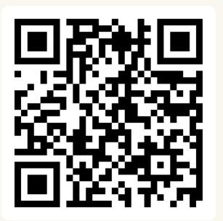
What Would
you do with an extra 22 minutes per day?
Join at
slido.com
#2866 137

Slide 4


Slido
Do not edit
How to change the design
What would you do with an extra 22 minutes per day?
Presenting with animations, GIFs or speaker notes? Enable our Chrome extension

Slide 5





Our Context
Westville
PreK-6th
Shannon Whalen
Brian Dericks
Woodbury Heights
PreK-6th
Chris Rodia
National Park
PreK-6th
Shannon Whalen
Allison Thompson
Gateway Regional
7th – 12th
Shannon Whalen
Jeff Pierro
Wenonah
PreK-6th
Kristine Height

Slide 6
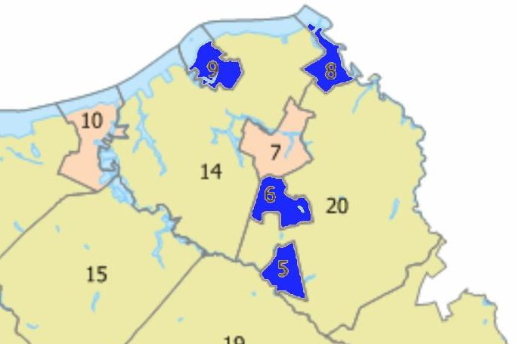
Our Unique Challenges
5 boards, 5 local associations, 5 calendars, 5 bell schedules, 5 grants, 3 Super/CSAs, 3 Business Offices, 2 CSTs
None of the districts actually border one another
Variety of DFGs (from B to I)
Shifts in previous shared service agreements
The northeast corner of Gloucester County
5: Wenonah
6: Woodbury Heights
8: Westville
9: National Park

Slide 7
Our Unique Blessings
Long history of shared services – it’s been a part of the plan since the 1960s.
Wealth of institutional and community knowledge, not a ton of turnover
Strong community and board supports, lots of pride
Community programs bring the kids together – sports, field days, dances, etc.
Spirit of “get it done” and collaboration at all levels

Slide 8

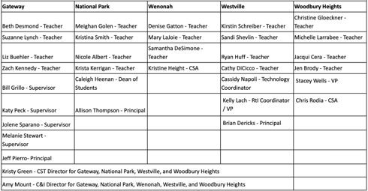
Our Team
19 Teachers
4 Supervisors / 4 VPs/Deans
3 Principals / 2 CSAs
2 Cross District Directors

Slide 9
Our Grant Goals
Decreasing "busy work" for teachers
Enhancing high-quality instructional planning and delivery by focusing on content development over traditional lesson plans
Fostering collaboration within and across districts
Promote teacher leadership at each district by providing opportunities for deep involvement in the improvement process
Improving the professional quality of life for all faculty and staff

Slide 10
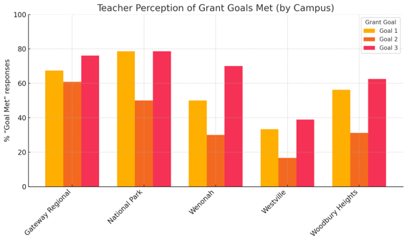
Our Results (1 of 3)
Surveys were administered in the spring of 2024 and spring of 2025
Survey respondents were asked if they felt the committee met the goals set out by the grant.
Most teachers reported that the committee at least partially met the goals.

Slide 11
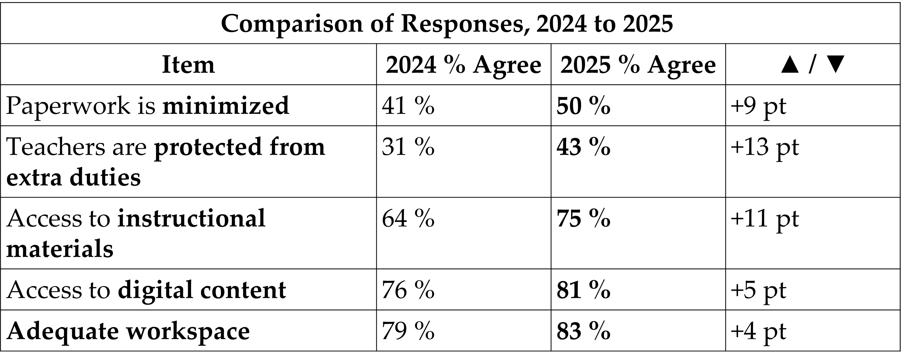
Our Results (2 of 3)

Slide 12
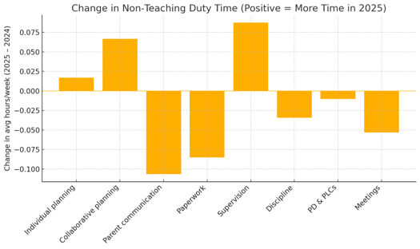
Our Results (3 of 3)
Specific goals of the grant were to reduce the time teachers spend on paperwork and administrative tasks and to increase planning and collaboration time.
Average Time Savings based on Survey and Time Tracking Results:
  22 minutes per day in planning, grading/feedback, and discipline
  100 minutes per year in compliance training
  120 minutes per year by streamlining evaluation documentation
= ~66 hours over the course of the year, or 10 school days worth of time.

Slide 13


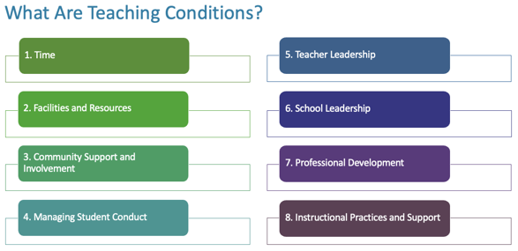
Activity 1: Where Do We Start? (1 of 2)
We used the Teaching Conditions Toolkit.
It helped center our conversations.
It provided a research-based place to begin our customization.
There are 8 Teaching Conditions identified, each with their own performance indicators.
We’re going to work through Condition 1: Time.
Consider your local practices – would you mark them as glowing, proficient, or growing?

Slide 14
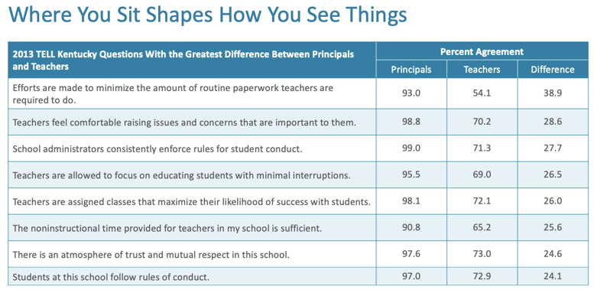
Activity 1: Where Do We Start? (2 of 2)
Look back at your rankings.
Would teachers in your school respond the same way? Would administrators in your school respond the same way?
How do we bridge the gap?

Slide 15
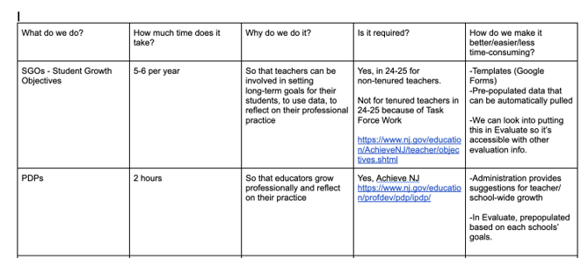
Activity 2: Diagnosing Pain Points
Teacher Task Analysis
  What do we do?
  How much time does it take?
  Why do we do it?
  Is it required?
  How do we make it better?
Think – Pair – Share
  What would your school add to our list?
  What should we do next?

Slide 16
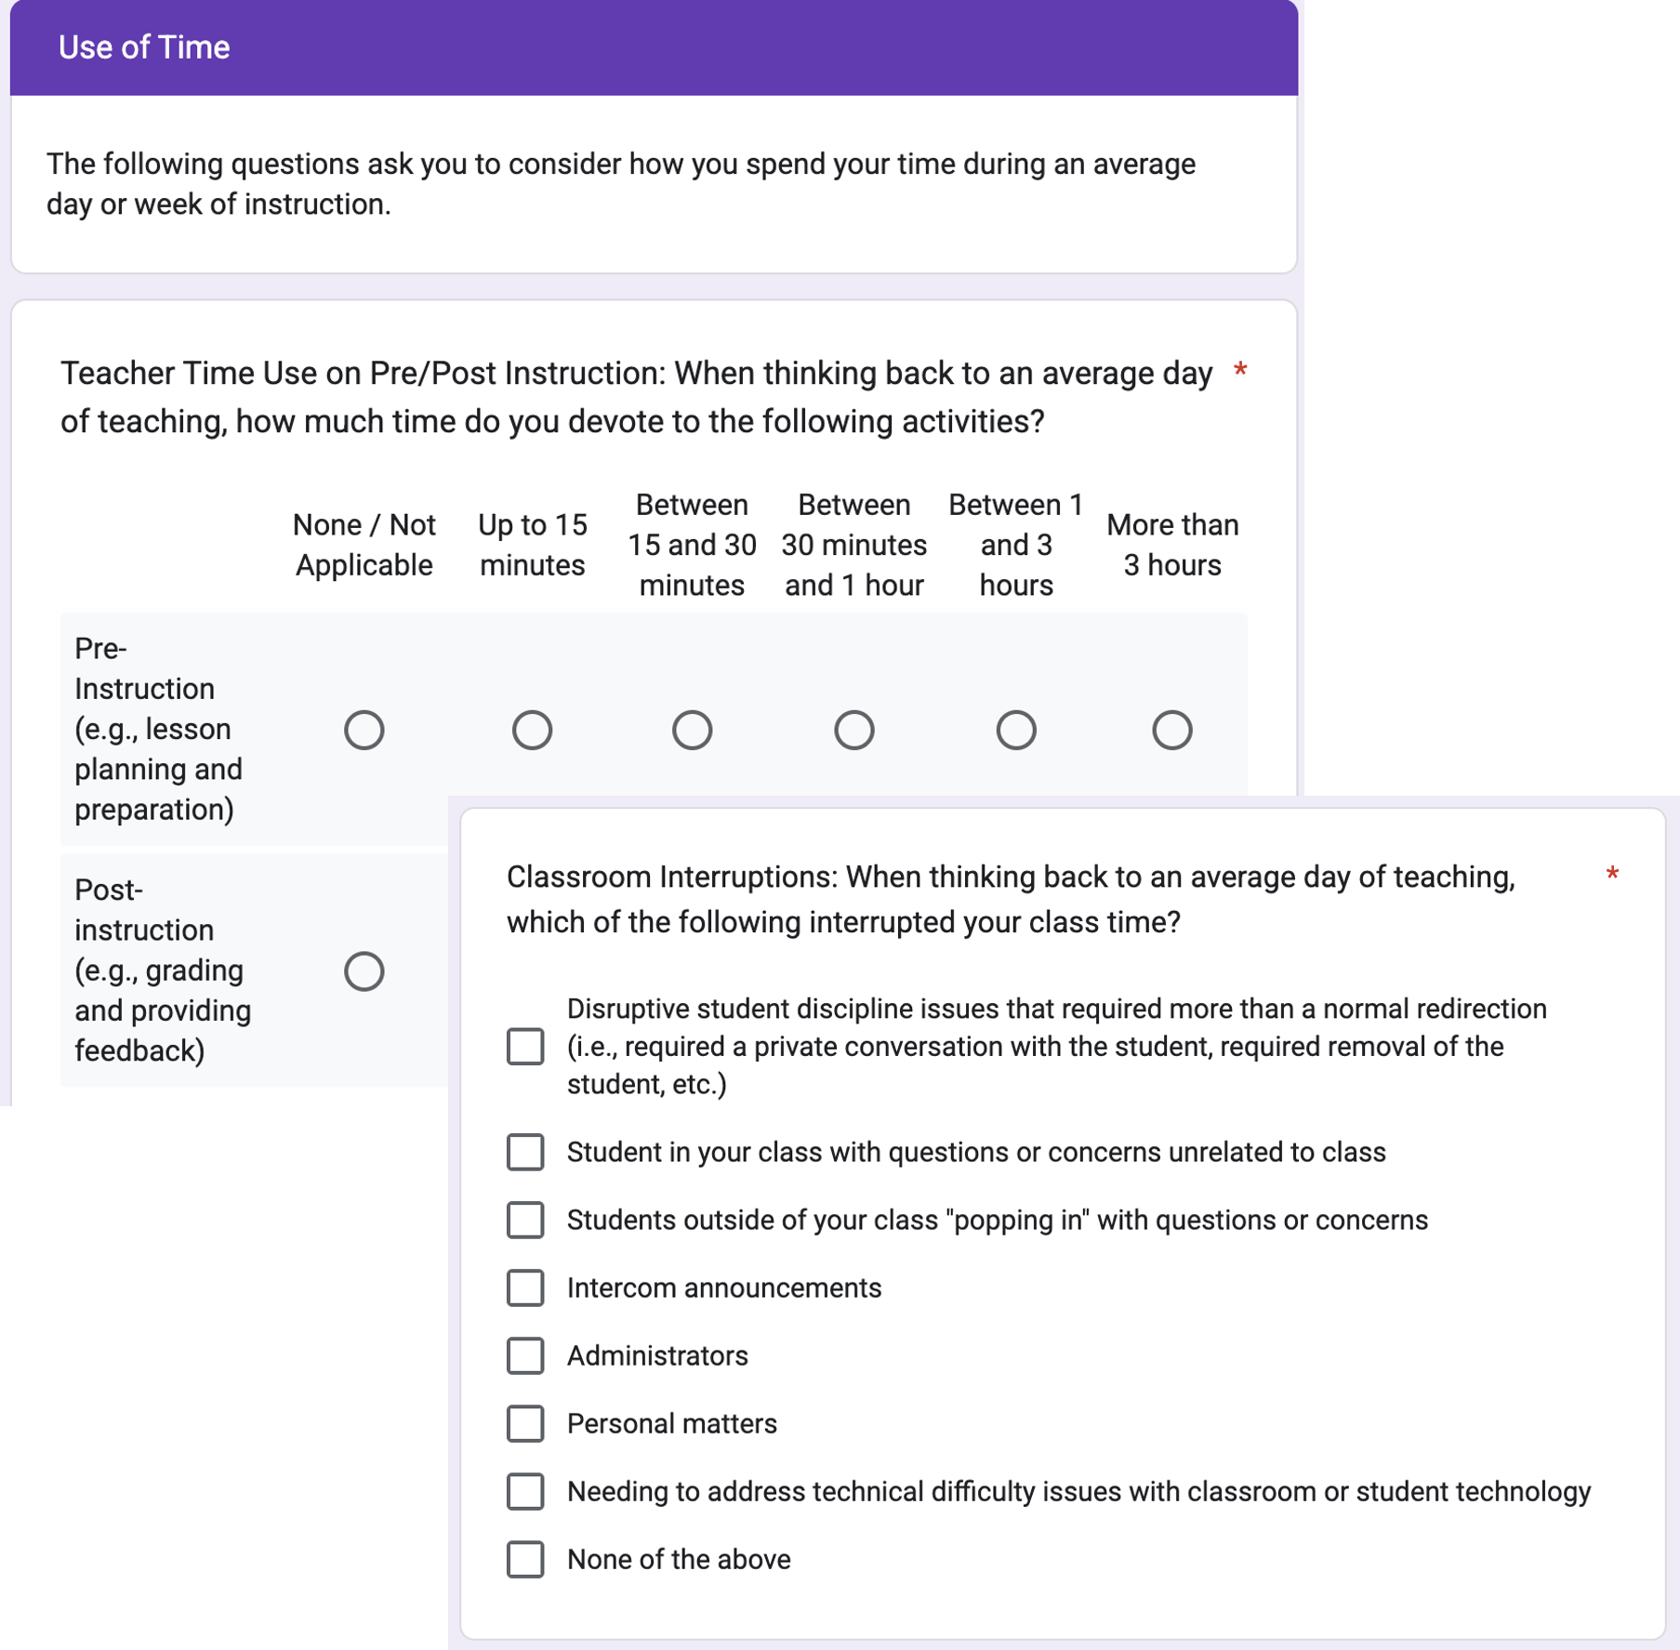
Spotlight: Time and Efficiency Survey
  Our committee reviewed three examples of teacher-facing surveys as a basis to develop our own.
    North Carolina Teacher Working Conditions - 2022 North Carolina Teacher Working Conditions Survey - Survey Questions for Educators
    EdChoice.org How do Teachers Spend their Time?
    TALIS English language General Teacher Questionnaire

Slide 17
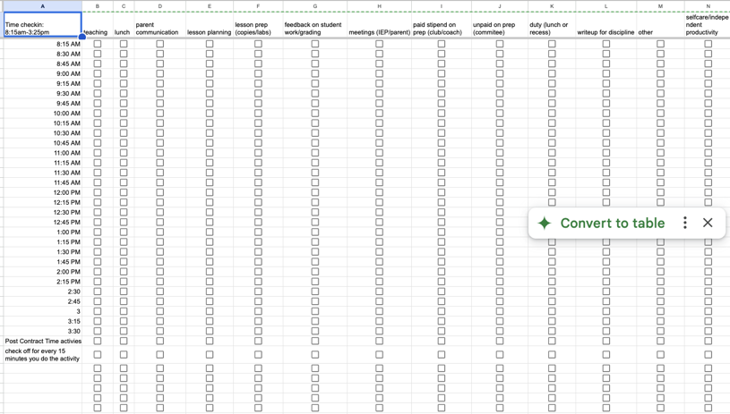
Spotlight: Time Tracking Project
  We create a time-tracking project to triangulate survey data.
    23 teachers across the 5 campuses participated.
    For 8 ”normal” days across a ~30-day period, teachers noted their activities in 15-minute increments.
    Tracking data was analyzed and compared to the survey data.

Slide 18
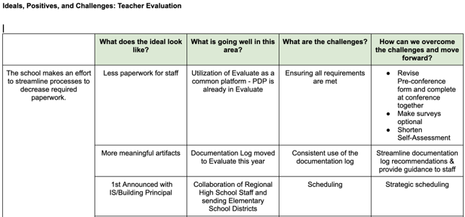
Activity 3: From Pain to Possibility
Ideals, Positives, and Challenges
  Used our pain points and the survey items to develop indicators
  Assessed our current reality and challenges
  Brainstormed ways to overcome these challenges
Café Conversations
  Engage with the topic, about 4-5 minutes with a group.
  Rotate and repeat.

Slide 19
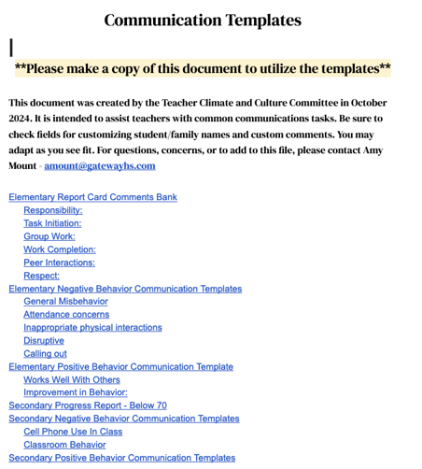
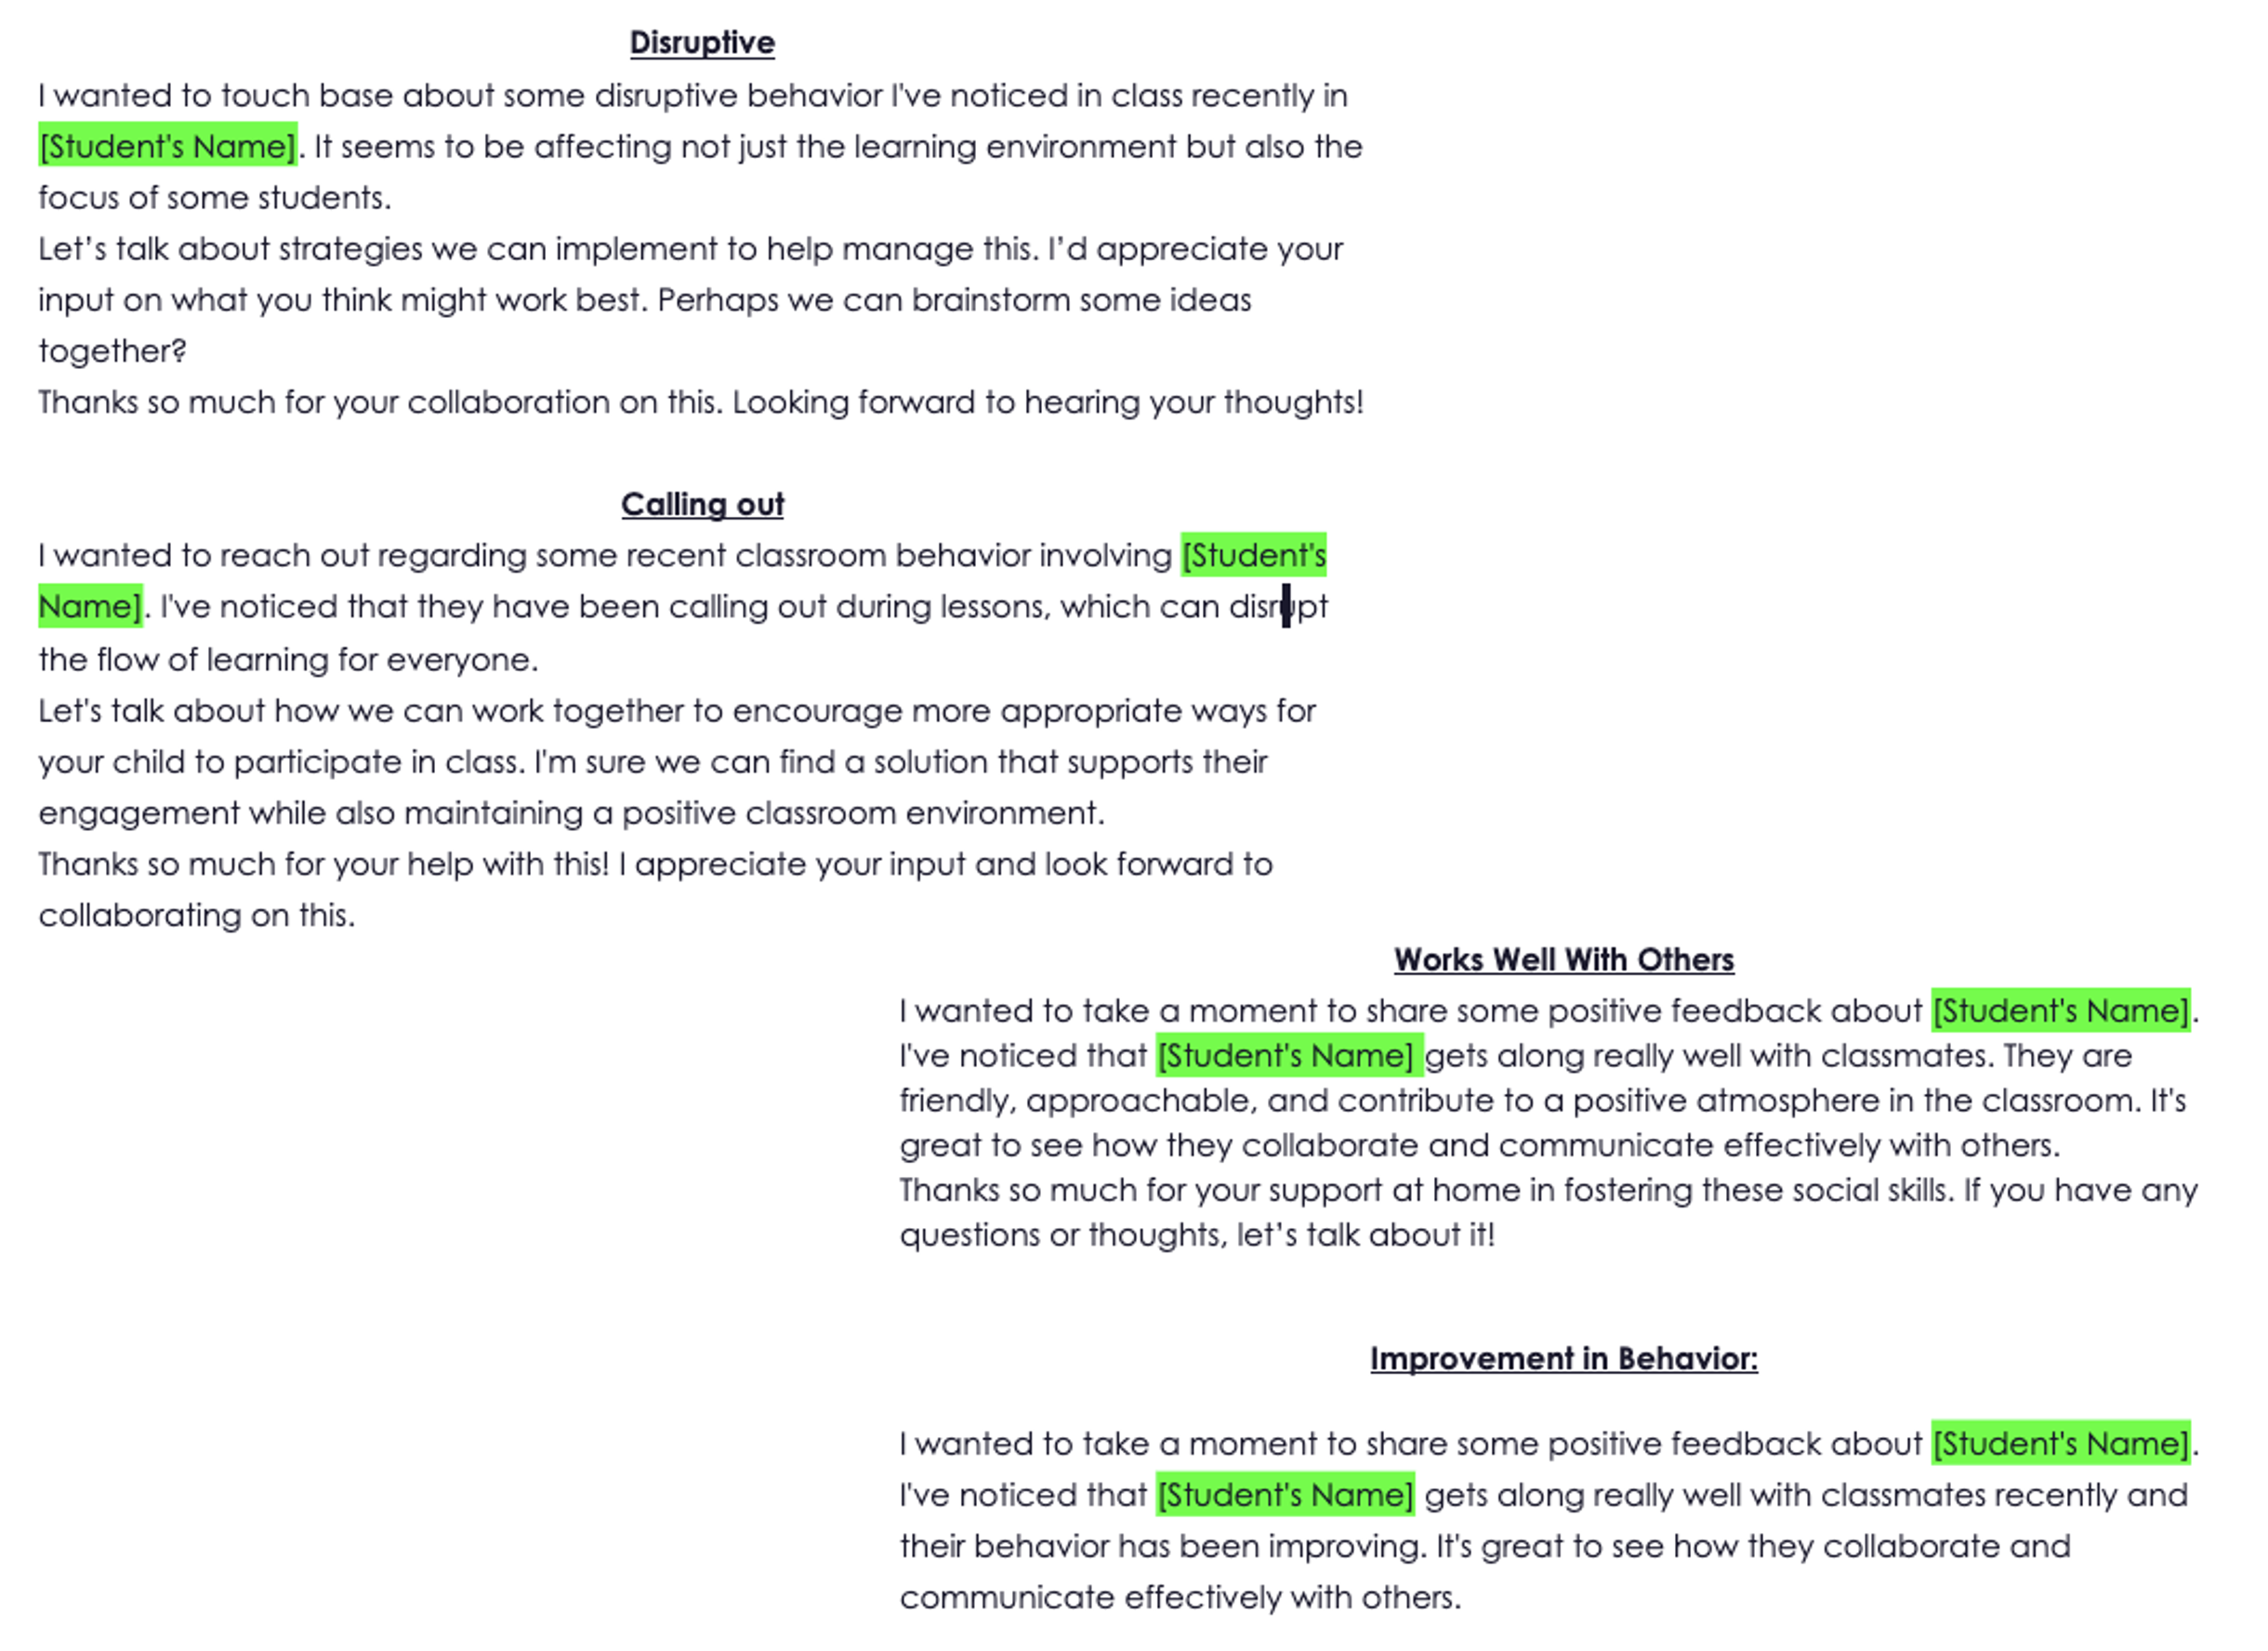
Spotlight: Deliverables (1 of 3)

Slide 20
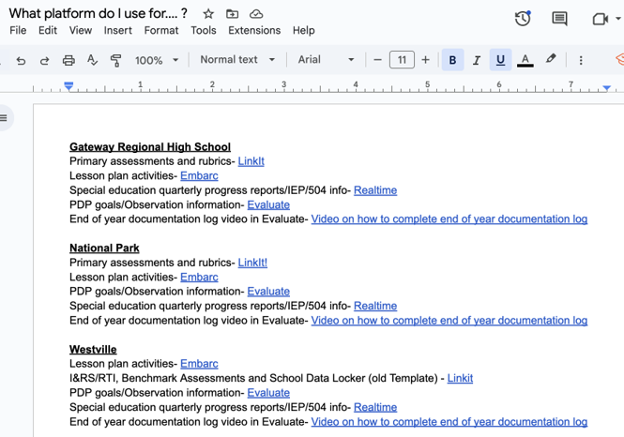
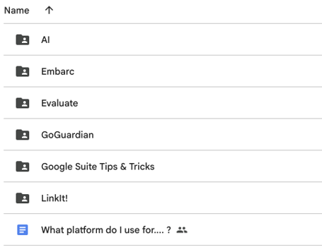
Spotlight: Deliverables (2 of 3)

Slide 21
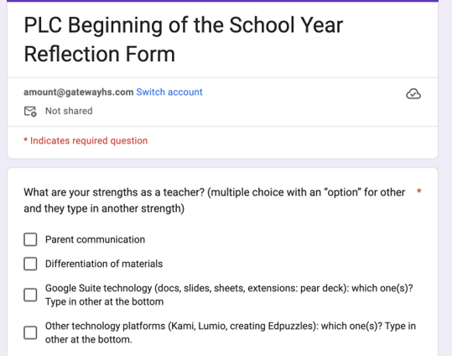
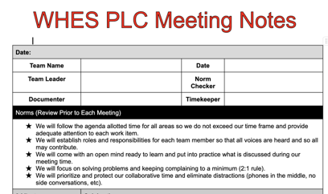
Spotlight: Deliverables (3 of 3)

Slide 22

Spotlight: AI Implementation (1 of 2)
What tasks take up an inordinate amount of time and/or low-level brainpower?
What tasks get you “stuck”?
These are good tasks to use AI for help. Just remember, AI is like a really enthusiastic, but inexperienced intern. It works, it just needs guidance, feedback, and oversight.

Slide 23
Spotlight: AI Implementation (2 of 2)
Effective AI is all about the prompt.
  Role - the persona of this AI.
  Task - stated clearly and definitively, explaining what you want the AI to do.
  Goal - a concise statement about the final output of this prompt.
  Steps - the precise steps you want the AI to follow to achieve the goal.
  Rules - any additional guidelines that you want the AI to consider.
Refine and iterate the output.
  This part is good… but…
  Give me 5 more examples, change the tone, etc.

Slide 24
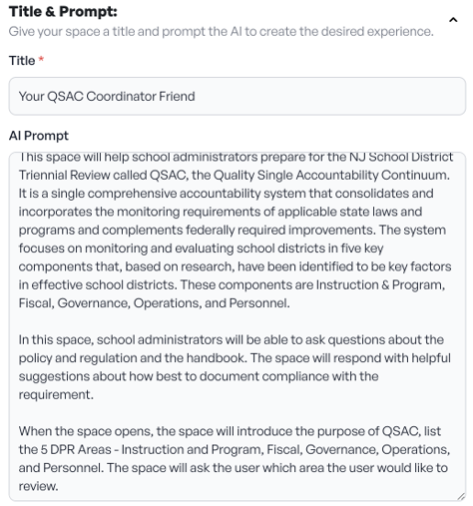

AI Examples (1 of 2)
Your QSAC Friend

Slide 25

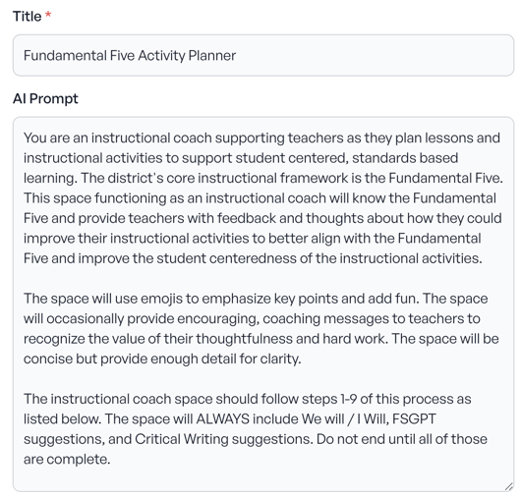
AI Examples (2 of 2)
F5 Planner

Slide 26
Our Process
Form the teams and develop relationships.
Interrogate our practices.
  Review and revise training plan.
  Review and revise components of the teacher evaluation system.
Identify ideals, positives, and challenges.
Develop the data collection tools – surveys and time tracking.
Structure PLCs and collaboration. Train teacher leaders.
Create a single source of knowledge.
Implement AI tools to save time.

Slide 27
Our Next Steps
Maintain cross-district ScIP meetings in the summer and across the year.
  Rework time and commitment to NJSCI survey for data collection.
  Administer the time/efficiency survey again in the spring of 2026; triangulate with tracking data from volunteer PLCs.
Develop a PLC Efficacy Tool and provide additional support to PLCs who need it.
Continue to explore options for curriculum management tools and protocols.
Expand AI usage, where appropriate.

Slide 28
Activity 4: Reflection
Today is July 29, 2025.
Open your calendar to August 26, 2025. Create a 15-minute appointment for yourself with 3 things you want to remember from today (this session or any others!).
Open your calendar to September 30, 2025. Create a 15-minute appointment for yourself review your beginning-of-the-year goals.

Slide 29
Follow Us on Social Media
Facebook:
@njdeptofed
Instagram:
@newjerseydoe
LinkedIn:
New Jersey Department of Education
Threads:
@NewJerseyDOE
X: @NewJerseyDOE
YouTube: @newjerseydepartmentofeduca6565
Notes:
This slide shares NJDOE social media accounts across platforms to invite continued engagement with this work and future updates.

Slide 30
Thank You!
New Jersey Department of Education: nj.gov/education

