Slide 1
Reclaiming Time With AI:
The Tech Tools That Gave Our Teachers Time Back
Northern Valley Regional High School District
July 29, 2025

Slide 2

Introductions
Northern Valley Regional High School District is a comprehensive public school district in northeastern Bergen County, serving students in grades 9–12 from the towns of Closter, Demarest, Harrington Park, Haworth, Northvale, Norwood, and Old Tappan
Notes:
Introduction of NVRHS
Introduction of presenters (Marc, Chrissy, Erica, Tom)

Slide 3
Here Today!
Chrissy Nazarko – Teacher + Instructional Coach
Erica Sposa – Teacher + Technology Mentor
Tom Villa – Teacher + Leader of Data & Digital Assessment
Jenn Mezzina – Assistant Superintendent
Marc Cicchino – Director of Innovation
Notes:
Introduction of NVRHS
Introduction of presenters (Marc, Chrissy, Erica, Tom)

Slide 4
The TCCI Grant (1 of 2)
“The Teacher Climate and Culture Innovation Grant is intended to address one of the key recommendations from the Task Force on Public School Staff Shortages in New Jersey: ‘reclaiming teacher time’ through the investigation and implementation of policies and procedures which reduce administrative paperwork and other tasks that pull teachers away from classroom instruction.”
Notes:
Introducing the TCCI grant as context

Slide 5
The TCCI Grant (2 of 2)
What is something that is particularly time-consuming for your teachers (or for you) that draws from the classroom?
Notes:
Introducing the TCCI grant as context

Slide 6
Our Process
Pre Grant
Core team
Initial pilots
Grant Period
Implement PPGEs:
Post Grant
Evaluate effectiveness of PPGEs
Share and scale
Gathering data (surveys, conversations)
Develop PPGEs
Assessment & AI Tools
Teacher Leads
Professional Development
Expanding Innovations
Notes:
Sharing our process – Outline of subsequent slides.
Note: Marc will deliver the introduction and “pre-grant” slides; Chrissy, Erica, and Tom will deliver the ”grant period” slides; Marc will deliver the “post-grant” slides.

Slide 7
Pre-Grant Process (1 of 2)
Core team
  Highly collaborative process: Local Professional Development Committees, Instructional Coaches, Tech Mentors, Admin Team
Gathering feedback: “What’s your problem?”
  Surveys, Focus Groups, Honest Conversations
Developing PPGEs (policies, programming, guidance, and/or equivalencies)
  What can we fix? (And what can we fix “for free”…?)
  What can we pilot before we adopt / implement at scale?
Notes:
Introduce the core (and “extended core”) team
Our process for gathering feedback, and the importance of asking, “What’s your problem?” (Problems were identified and solved ”for free.”)
Using that feedback to develop PPGEs (“magic button” / “mystical seagull”)

Slide 8
Pre-Grant Process (2 of 2)
What’s Your Problem?
Identify a time-consuming problem that impacts you.
Turn & Talk: Share with a neighbor.
Brainstorm potential solutions.
Notes:
Introduce the core (and “extended core”) team
Our process for gathering feedback, and the importance of asking, “What’s your problem?” (Problems were identified and solved ”for free.”)
Using that feedback to develop PPGEs (“magic button” / “mystical seagull”)

Slide 9
Sample Problems
Transferring Grades from LMS to SIS
Activated “Grade Passback”
Keeping Track Of So Many Tools
Consolidated With ClassLink
Adding PD to Summative Evals
Pre-populated PD options
Notes:
Sample problems that were solved “for free” (speaks to the importance of collecting feedback, looking for problems to solve)

Slide 10
PPGEs
Emerging AI & Related Technologies
Optional Professional Development
Teacher Leadership & Support
Notes:
Introduce the three major categories we targeted with our PPGEs:
Identifying and adopting emerging AI technologies to generate content (time consuming content creation)
Related: MasteryConnect to streamline standards-aligned common assessment administration and analysis
Teacher Leadership to support these newly adopted tools (data leads) AND to alleviate burdens associated with previous initiatives (proctors)
Optional PD offered when school was not in session

Slide 11
Professional Development (1 of 5)
Two-Day Summer PD Opportunity
PD sessions offered to staff
  2-day PD event offered twice throughout the summer
  1-day PD event offered on MLK day (school closed)
Optional and Paid
Facilitated by members of the core team

Slide 12
Professional Development (2 of 5)
Two-Day Summer PD Opportunity
Focus Areas (structured as AM/PM sessions):
  Prompt Engineering
  Meet Your New AI Toolkit
  Streamlining With Technology
  Canvas Unleashed

Slide 13
Professional Development (3 of 5)
Two-Day Summer PD Opportunity
Designed to be sustainable; ongoing support from:
  Teacher Leaders of Data and Digital Assessment
  Technology Mentors
    Available throughout the school year for technology-related learning and support
  Instructional Coaches
    Structured support for new staff in their first three years; available to support veteran staff

Slide 14
Professional Development (4 of 5)
Additional Supports
Professional Learning Communities (PLCs)
In-Services
Mid-Year Optional PD Day
Goal of integrating new skills into practice
  Sharing successes
  Working through challenges

Slide 15
Professional Development (5 of 5)
Two-Day Summer PD Opportunity
Major benefits:
  Time to explore new tools that can reduce paperwork and administrative burdens for teachers
  Time to become fluent with emerging technologies
  Time to learn the shortcuts and efficiencies that keep getting pushed off during the school year
  Time to engage with these new practices with support, before September

Slide 16
Teacher Leadership & Support (1 of 4)
Teacher Leaders of Data & Digital Assessment
&
Assessment Proctors

Slide 17
Teacher Leadership & Support (2 of 4)
Teacher Leaders of Data & Digital Assessment
Created curriculum maps with standards in MasteryConnect
Designed and detailed the procedures for creating, sharing, and administering common assessments in MasteryConnect
Assisted teachers with assessment creation, administration, and analysis

Slide 18
Teacher Leadership & Support (3 of 4)
Assessment Proctors
District Reflection & Revision Policy:
  Allows students to revisit assessments to promote mastery of standards
  Assessments under an 85% can be revisited for a maximum score of 85%
The “re-take” process can be cumbersome
Assessment Proctors facilitated re-takes in dedicated assessment rooms

Slide 19
Teacher Leadership & Support (4 of 4)
Teacher Leadership Roles
Brainstorm: What kind of new teacher leadership roles might benefit your school in the context of supporting climate and culture?
Turn & Talk: Share and discuss your ideas with a neighbor.

Slide 20
Emerging AI & Tech Tools (1 of 4)
MasteryConnect – For streamlining the creation, distribution, administration, and analysis of standards-aligned common assessments.
Nolej – For rapidly generating interactive instructional content.
BriskTeaching – For generating content and streamlining assessment.
GetMarked – For rapidly migrating assessments between platforms
Northern Valley AI – For all other district-specific content-generation.

Slide 21
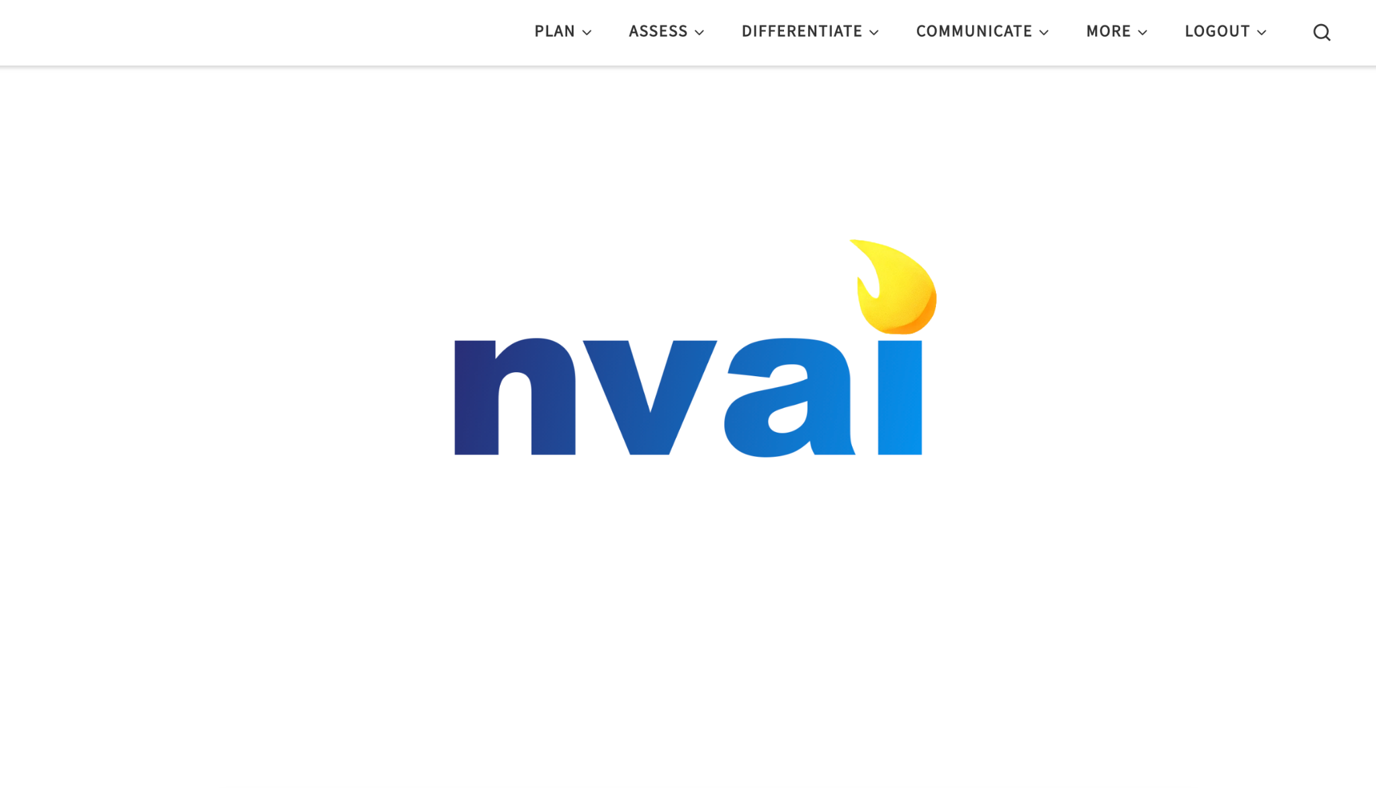
Emerging AI & Tech Tools (2 of 4)

Slide 22
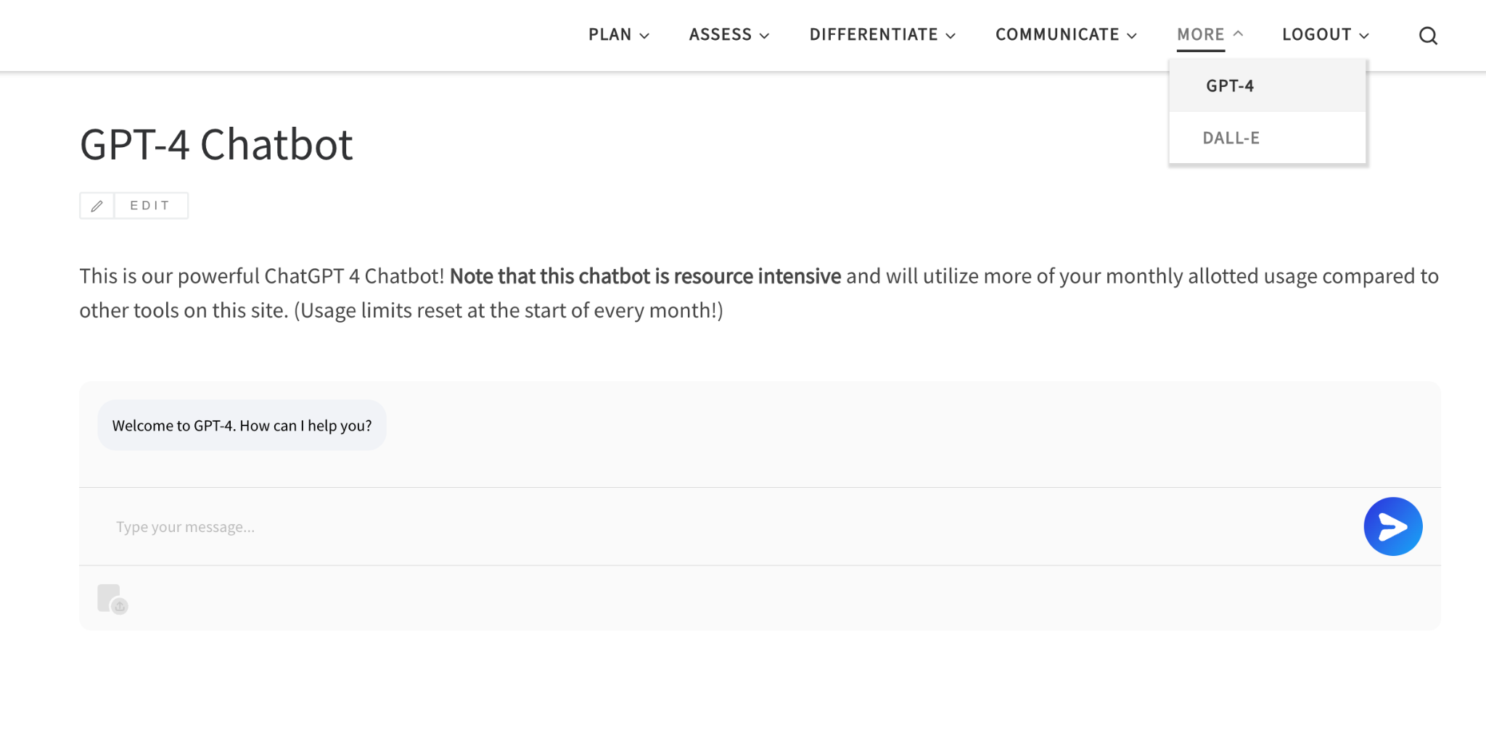
Emerging AI & Tech Tools (3 of 4)

Slide 23
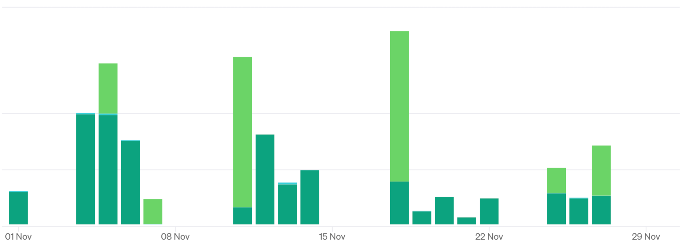
Emerging AI & Tech Tools (4 of 4)
Notes:
Total annual cost: $43.01

Slide 24
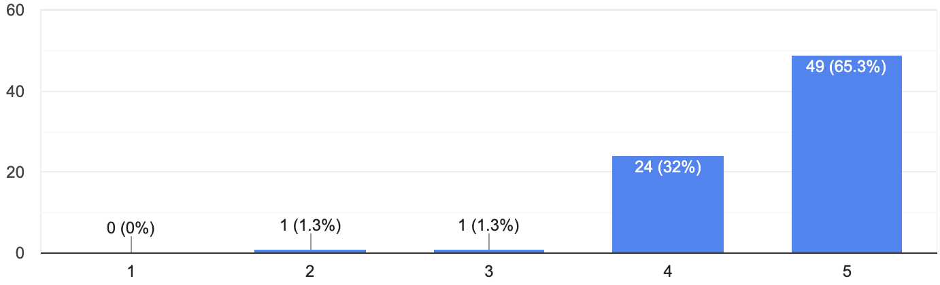
Takeaways (1 of 5)
Evaluating the effectiveness of our PPGEs
“How beneficial did you find the PPGEs…?

Slide 25
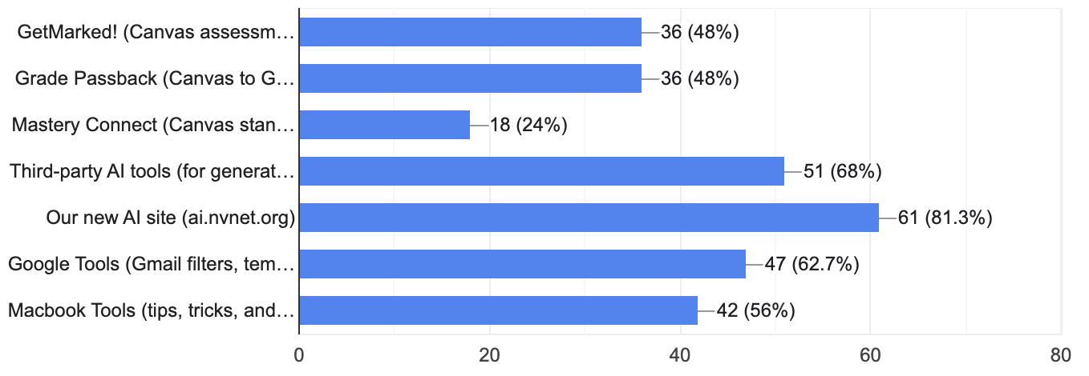
Takeaways (2 of 5)
Evaluating the effectiveness of our PPGEs
Which tools will have the greatest impact?

Slide 26
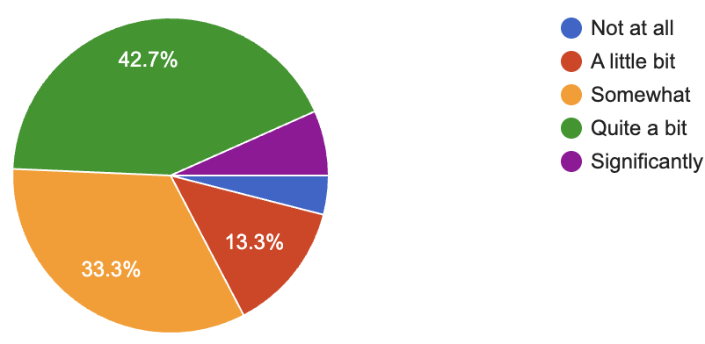
Takeaways (3 of 5)
Evaluating the effectiveness of our PPGEs
To what extend do you believe these practices will reduce administrative burdens?

Slide 27
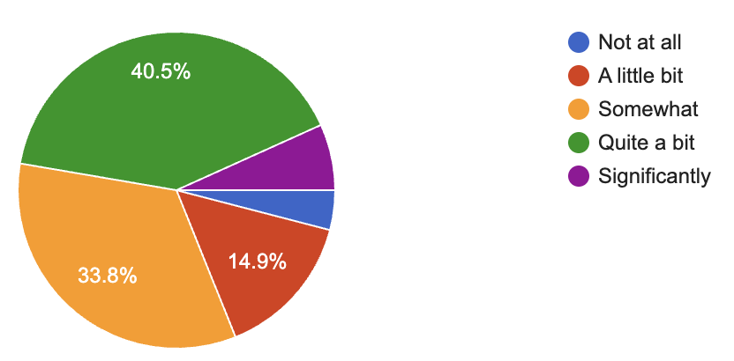
Takeaways (4 of 5)
Evaluating the effectiveness of our PPGEs
To what extend do you believe these practices will reduce time spent working on weekends and staying late after school?

Slide 28
Takeaways (5 of 5)
Reflections and Next Steps
The importance of sharing and replicating PPGEs.
The importance of sustaining PPGEs that were effective.
The importance of having honest conversations about real problems.
How we intend to expand on this work in Year 2 (“Expanding Innovations in Teacher Climate and Culture”)

Slide 29
Thank You!
For additional information, please feel free to reach out to
Marc Cicchino – cicchinom@nvnet.org

