Slide 1

Setting the Anchor:
Securing Dunellen's Future Through Staff Leadership
Dunellen Public Schools
July 29, 2025

Slide 2
Presentation Objectives
Understand how Dunellen Public Schools is creating capacity for professional growth through committee work, professional development, and communication strategies.
Reflect on current practices and identify time-consuming or repetitive tasks that may hinder instructional impact.
Collaboratively generate strategies to increase staff leadership and participation in school improvement efforts.
Identify practical changes that teams can make to advance a unified vision for student growth.

Slide 3
Do Now - Drop the Anchor!
What type of work is very time consuming?
What type of work is necessary but repetitive?
What solutions have you personally implemented that might benefit others?

Slide 4

Vision and Framing

Slide 5
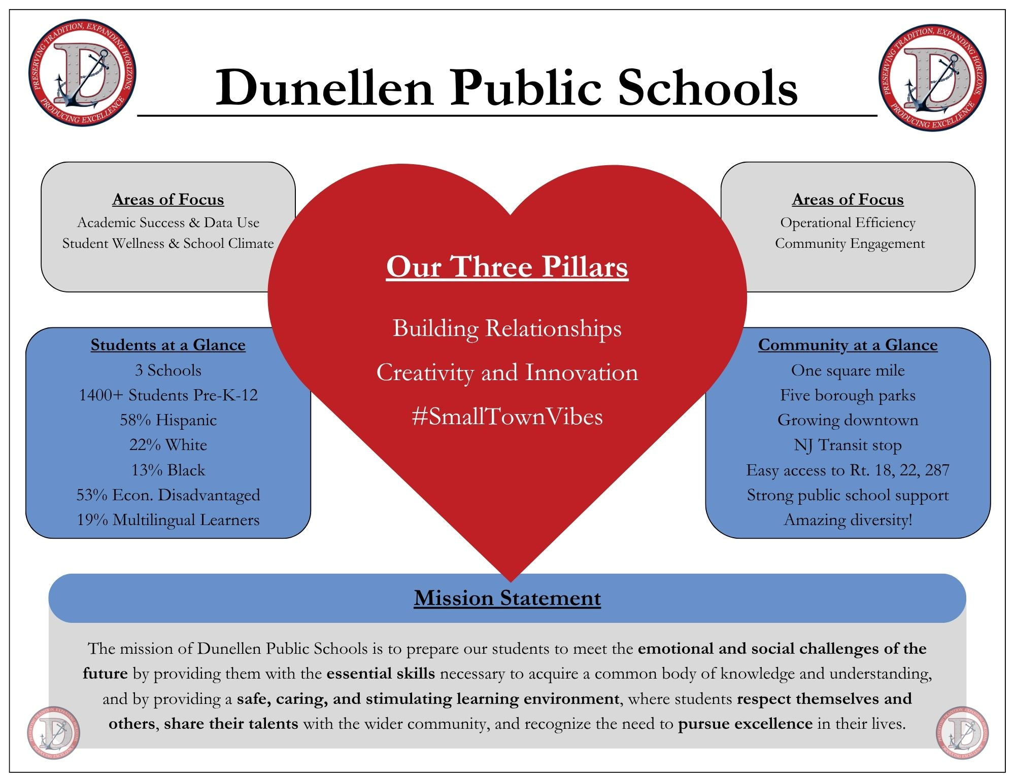
About Us

Slide 6
Securing Dunellen’s Future
What it entails:
  Building collaborative and innovative structures throughout the system to empower stakeholders
Who has to be involved
  The people closest to the work, plus those who can make the work stick
How the work has to progress
  Through patience, dialogue, feedback, and a willingness to change course

Slide 7
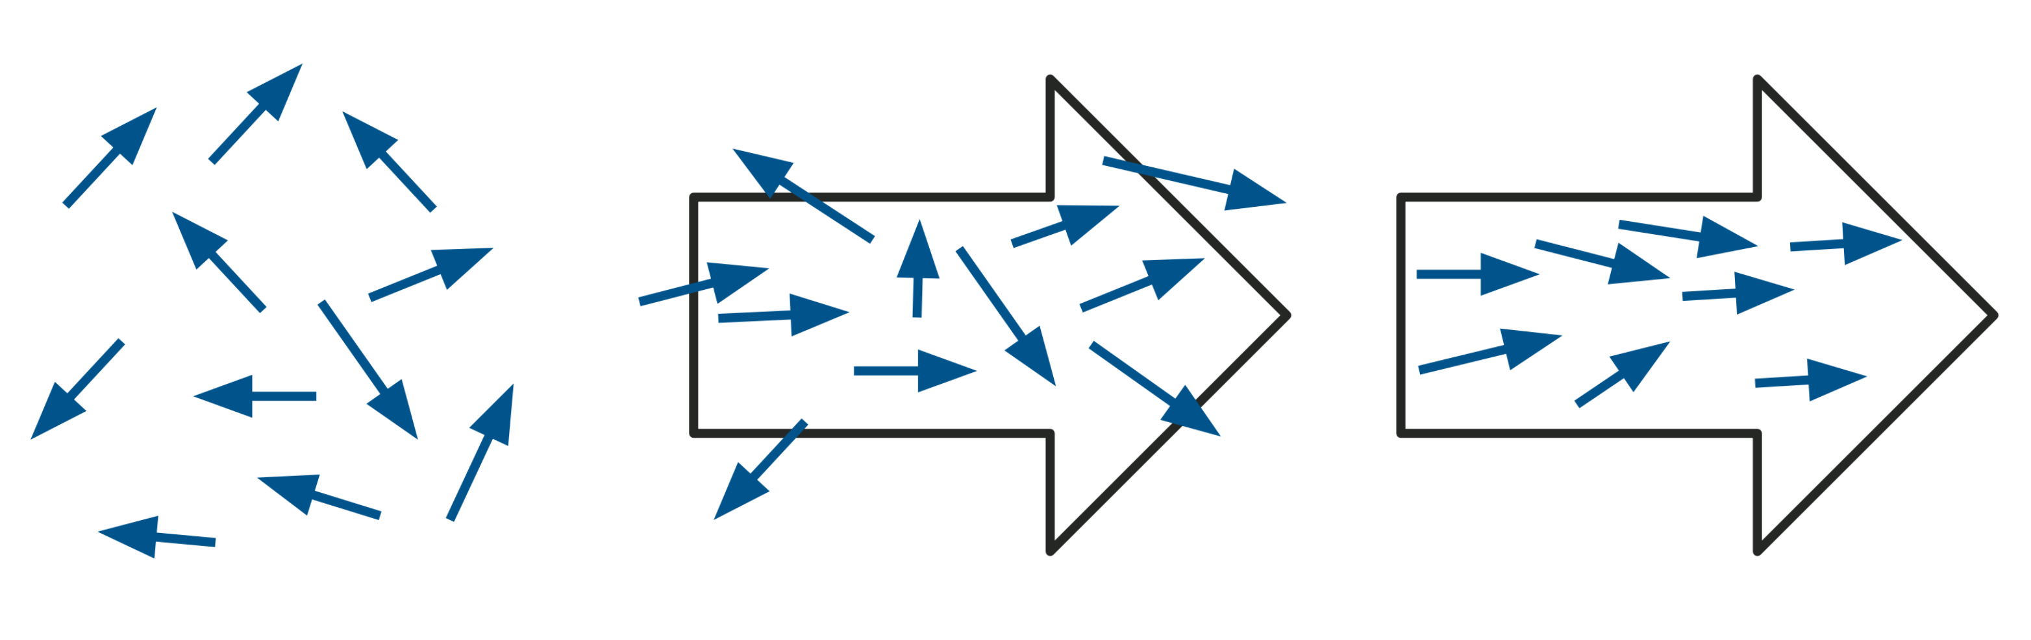
Align Your Efforts
FROM RANDOM ACTS OF IMPROVEMENT
TO ALIGNED ACTS OF IMPROVEMENT
Image © 2025 Studer Education, LLC.

Slide 8
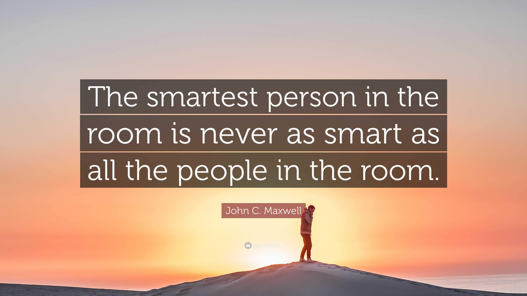
Use Your Resources

Slide 9

Cycle of Work
Identify areas for improvement
Determine leverage points
Find ways to reallocate resources
Assess your progress
Repeat

Slide 10

Design Thinking Sprint

Slide 11
Design Thinking Sprint (1)
Design Your Own Improvement
Identify a challenge
Suggest a leverage point
Propose a small redesign (time, process, communication, or tools)

Slide 12
Design Thinking Sprint (2)
Design Your Own Improvement
Identify a challenge
Suggest a leverage point
Propose a small redesign (time, process, communication, or tools)
Reflection: How did the process feel? What was hard? What was easy? Any key takeaways?

Slide 13
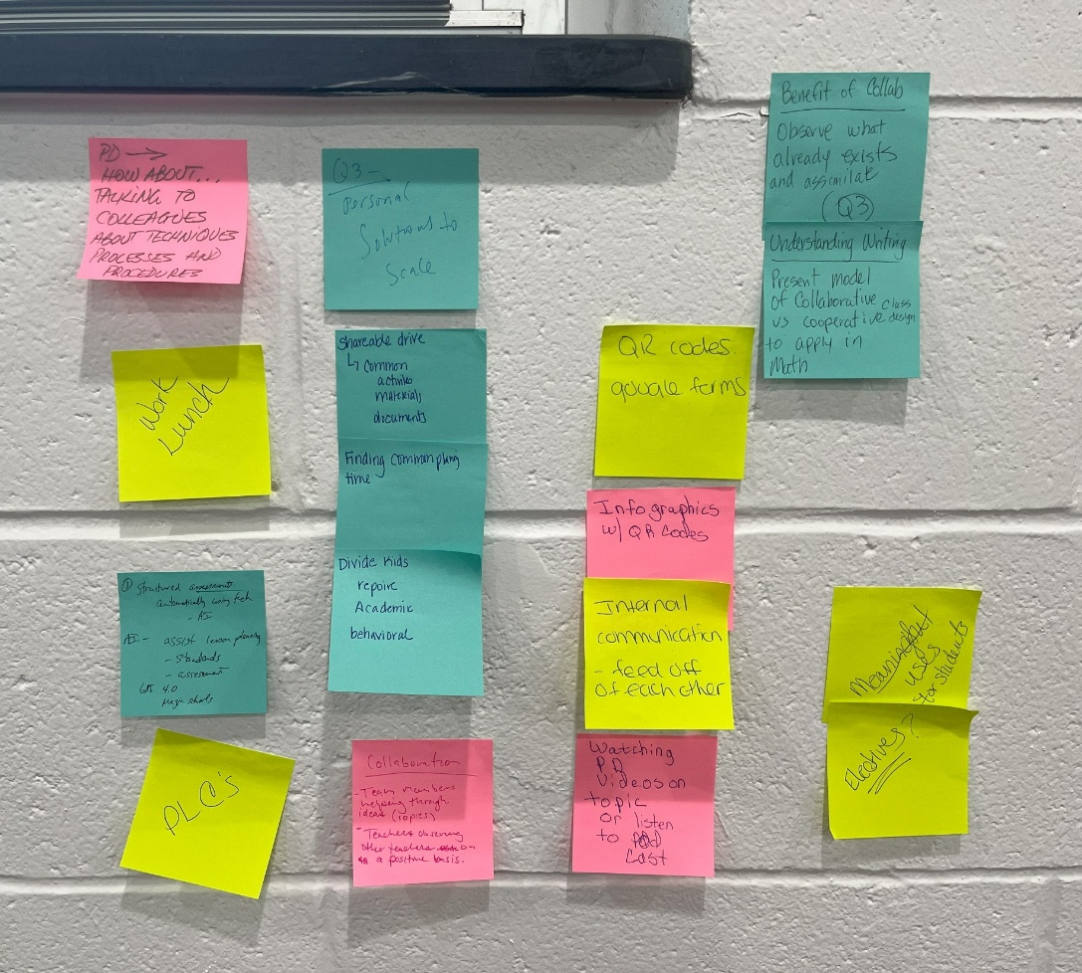
Insight to Impact

Slide 14
Grant-Funded Efforts
Teacher Climate and Culture Committee
“Resilience in Teacher Leadership” PD Session
Tools to Help Reduce Burden
  Atlas Curriculum Management
  AI solutions (SchoolAI, MagicSchool.ai, Diffit)

Slide 15
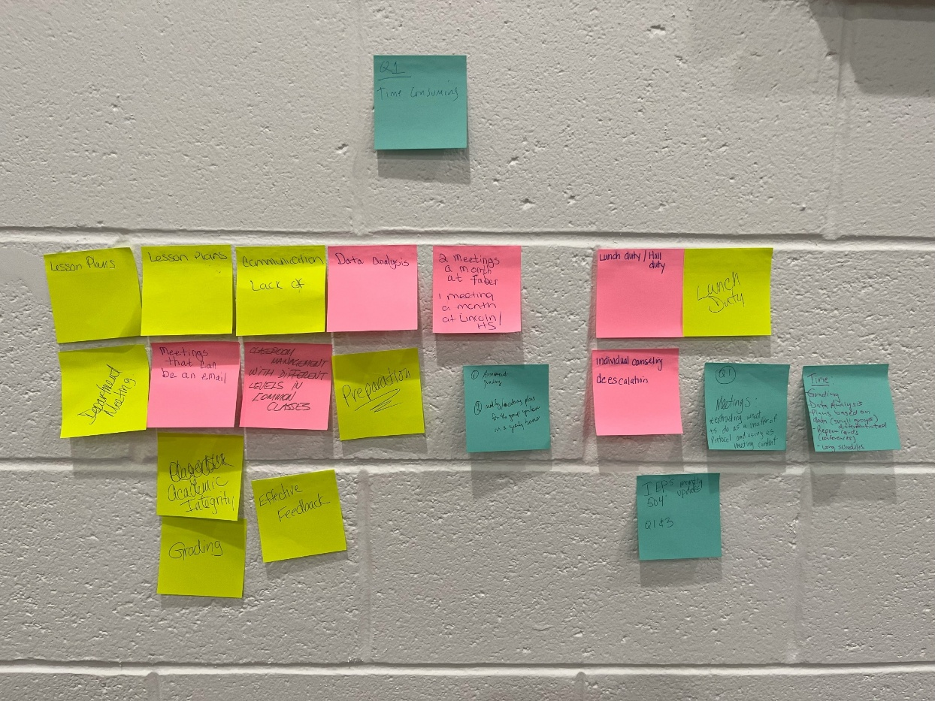
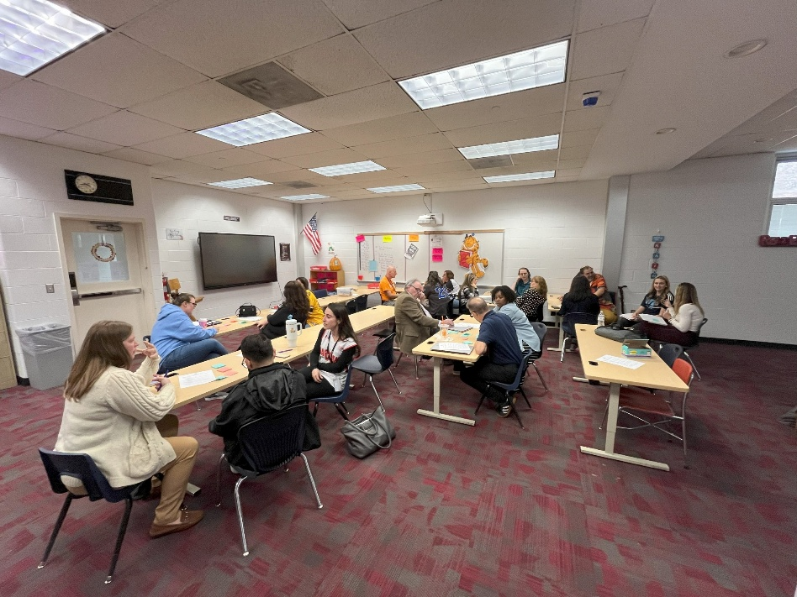
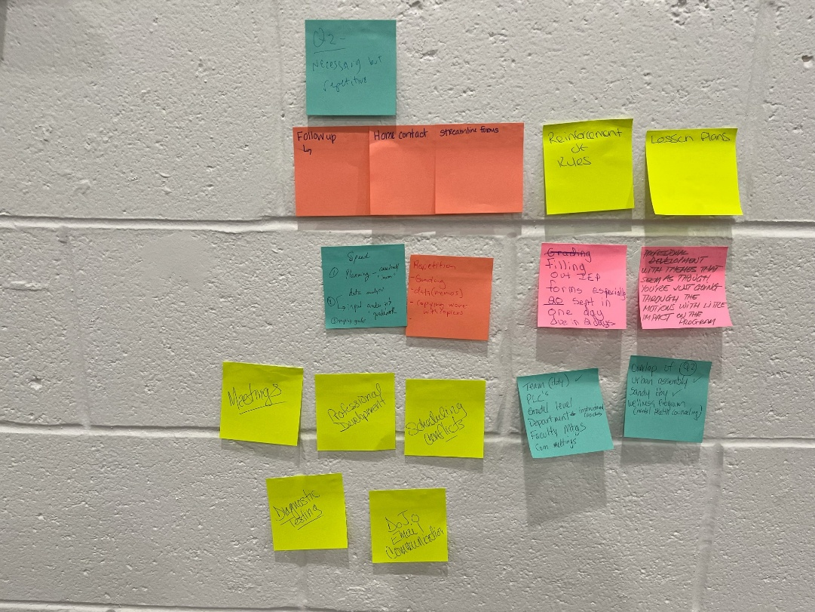
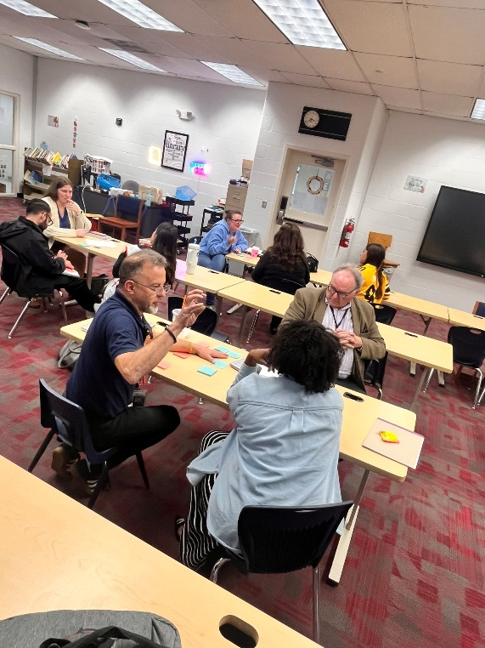
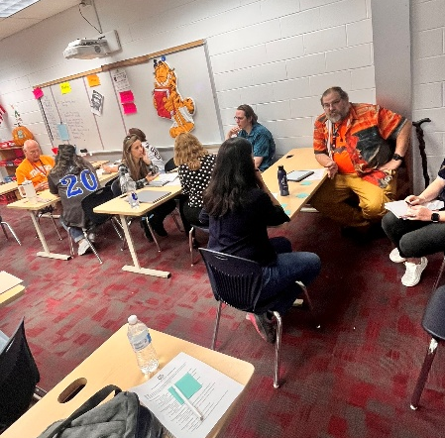
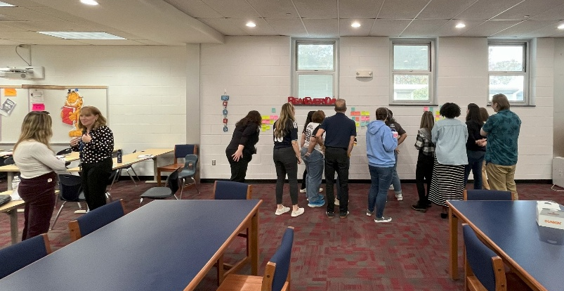
Grant-Funded Efforts (1)
Teacher Climate and Culture Committee
By creating the TC&C Committee, our efforts will be more aligned to staff member needs, because those closest to the work will be providing information regarding the most important opportunities for improvement.

Slide 16
Grant-Funded Efforts (2)
Committee Focus on Evaluation
Walkthroughs
Staff Evaluation
Student Growth Objectives and Professional Growth Objectives
Professional Development Plans

Slide 17
Grant-Funded Efforts (3)
Specific Focus on Walkthroughs
Purpose and trust
  Why are they occurring? Articulate purpose
  Trust that the purpose is not to “catch” people or build a case against them
Effectiveness
  Timeliness of feedback
  Are they tied to actual efforts for systemic improvement?
  Teachers generally believe that walkthroughs are of greater value to administrators rather than to the teachers themselves.
  Walkthroughs can be seen as "drive-bys". The connection to larger improvement efforts is not readily apparent.

Slide 18
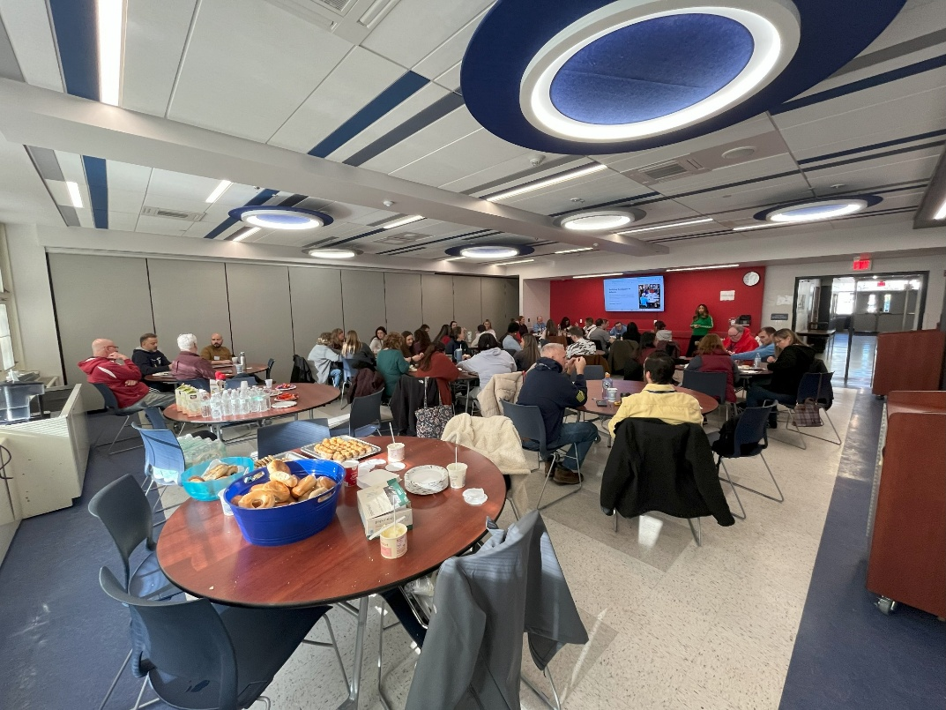
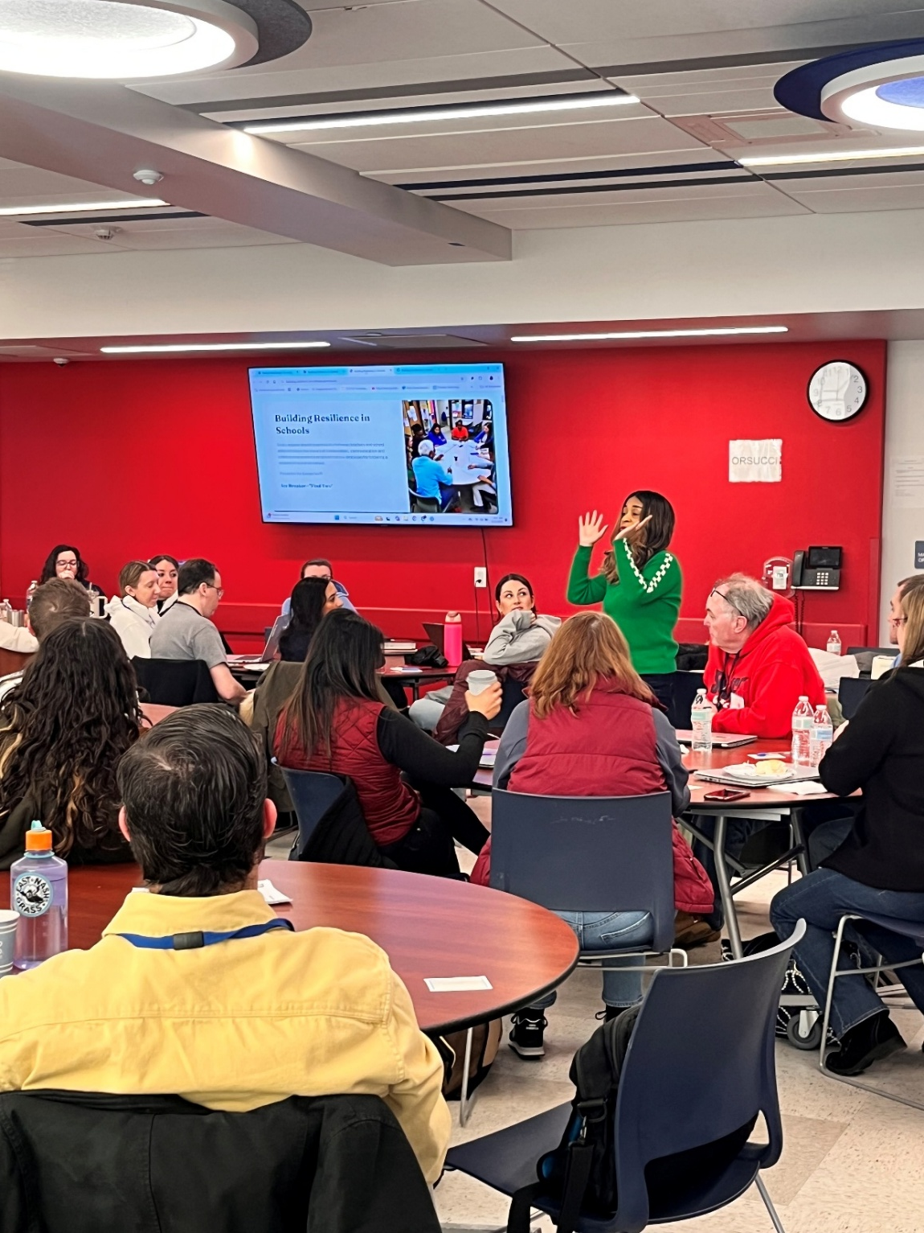
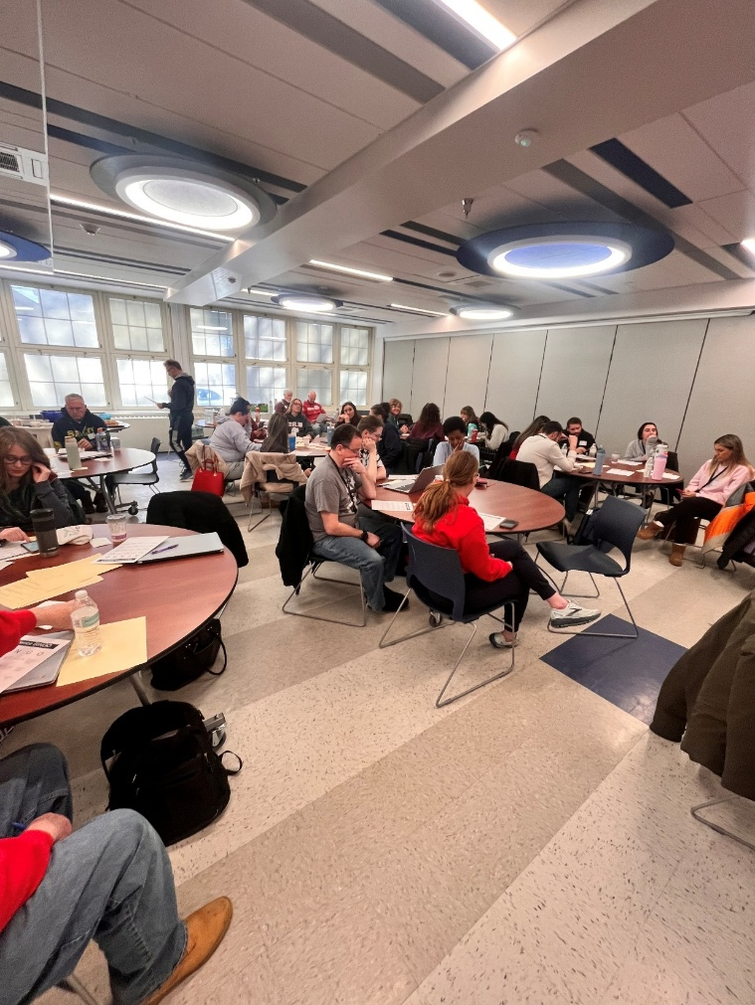
Grant-Funded Efforts (4)
“Resilience in Teacher Leadership” (RiTL) PD Session
By developing the RiTL PD session, we will accelerate and broaden our work sharing the core principles of educational leadership, because the self-selected participants represent a “coalition of the willing” that can help set a foundation for these efforts.

Slide 19
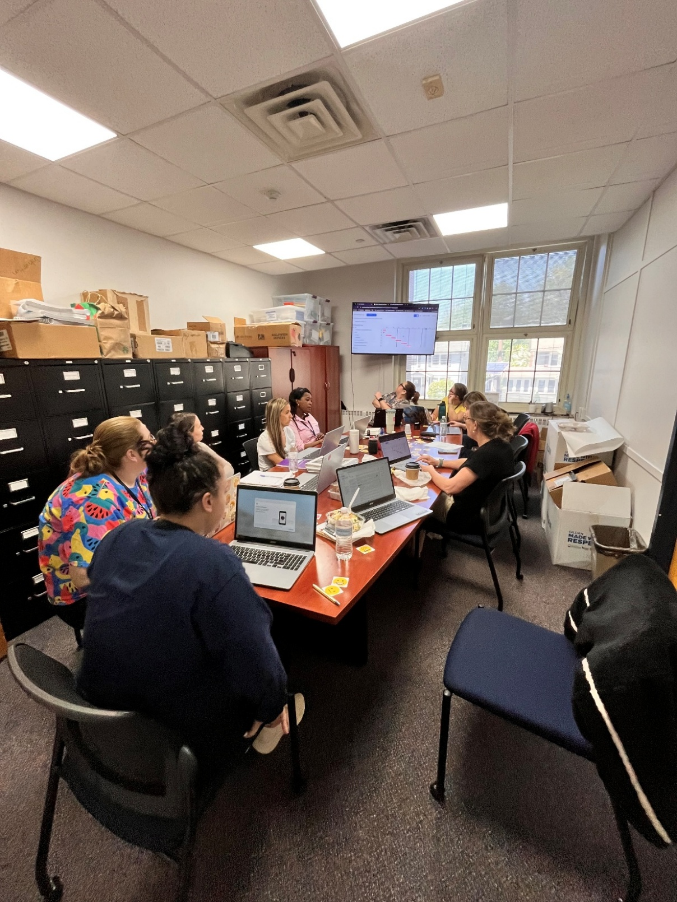
Grant-Funded Efforts (5)
Tools to Help Reduce Burden
By purchasing tools designed to help reduce the burden on educators, our improvement efforts can begin to show a real impact, because the tools are designed to simplify processes that cause ongoing challenges for staff.

Slide 20
Grant-Funded Efforts (Future!)
Teacher Climate and Culture Grant Committee
  Continue work of the on a monthly basis
Learning Experience Leaders (LEL’s)
  Create LEL’s as a formal educator leadership role to help facilitate improvement efforts (AI, Curriculum, PLC’s, MTSS)
Identify New Leverage Points
  Use other structures, such as evaluation waivers and the Labor Management Collaborative, to help inform and guide additional improvements

Slide 21

Vision Mapping

Slide 22
Your Turn
Identify areas for improvement
Determine leverage points
Find ways to reallocate resources
Iterate

Slide 23

Closing

Slide 24
Key Takeaways
This work is hard but valuable
Ask those closest to the work to participate
Use a simple process to identify and address improvements
Some challenges can be overcome easily but others are much harder

Slide 25
Acknowledgments
Thank you to:
The New Jersey Department of Education
The Dunellen Board of Education
The incredible faculty and staff of Dunellen Public Schools
Our amazing students and Families
The wonderful educators and partners we have met along the way!

Slide 26

Contact Us
Please reach out – we love to collaborate and learn from others!
Dunellen Public Schools
www.dunellenschools.org

