Slide 1
The Leader Within: Exploring the Power of Teacher Leadership with Teachers
Dr. Joanne Connor
Dr. David Lindenmuth
Dr. JoAnn Manning
Dr. Magdalena Martin
Dr. Margaret Thornton
Dr. James Coaxum
Dr. Gäetane Jean-Marie
Rowan University
July 29, 2025

Slide 2

Welcome

Slide 3
Our Norms for Today
Be fully present and engaged (as much as can be expected)
Support the learning of your colleagues
Speak your truth and listen to the truths of others
  “Shut Up and Listen”
Lean into Discomfort
Expect and accept non-closure
Give (and Get) Grace

Slide 4
A Great Leader?
Discuss in with your elbow partner
•Think of an influential leader or role model in your life
•Someone in your life that “MADE A DIFFERENCE”
•What makes (made) them “great”?
•Would anyone list you as a leader in their life?

Slide 5
What is Leadership?
How do you define leadership?
Bennis defines leadership as translating vision into reality (Bennis, 2010).
"Leadership is the process of interactive influence that occurs when, in a given context, some people accept someone as their leader to achieve common goals" (Silva, 2016).
Forbes magazine defines leadership as a process of social influence, which maximizes the efforts of others, towards the achievement of a goal. (https://www.forbes.com/sites/kevinkruse/2013/04/09/what-is-leadership/?sh=4edeb8985b90)

Slide 6
“Leaders aren’t born, they are made. And they are made just like anything else, through hard work. And that’s the price we’ll have to pay to achieve that goal, or any goal.
-Vince Lombardi

Slide 7
Types of Leaders
Discuss examples of
Formal Leaders
Informal Leaders

Slide 8
Sources of Power(French and Raven 1959)
Legitimate
  From title/rank in formal hierarchy
  Organizational chart
Reward
  Ability to distribute rewards for desired behaviors
Coercive
  Ability to distribute punishments to deter unwanted behaviors.
Expert
  Demonstrated expertise - “the go to person”
Referent
  Based on the ability to create genuine relationships with followers who admire, respect, or want to emulate you

Slide 9
Why Teacher Leadership?
“Leadership is second only to classroom instruction among all school-related factors that contribute to what students learn at school”
Leithwood, Louis, Anderson, and Wahlstrom (2004)
“Teacher leadership is the lifeboat to a better and stronger school”
Megan M. Allen in Education Week Teacher

Slide 10
Improving Schools Through Teacher Leadership
  Improving School Effectiveness and Improvement
  Improving Teacher Effectiveness
  Improving Student Learning

Slide 11
Benefits and Challenges of Teacher Leadership
Benefits
Professional Confidence
School Improvement
Problem-Solving Skills
Skill Utilization
Challenges
Time Constraints
Recognition
Navigating Change
Balancing Roles

Slide 12
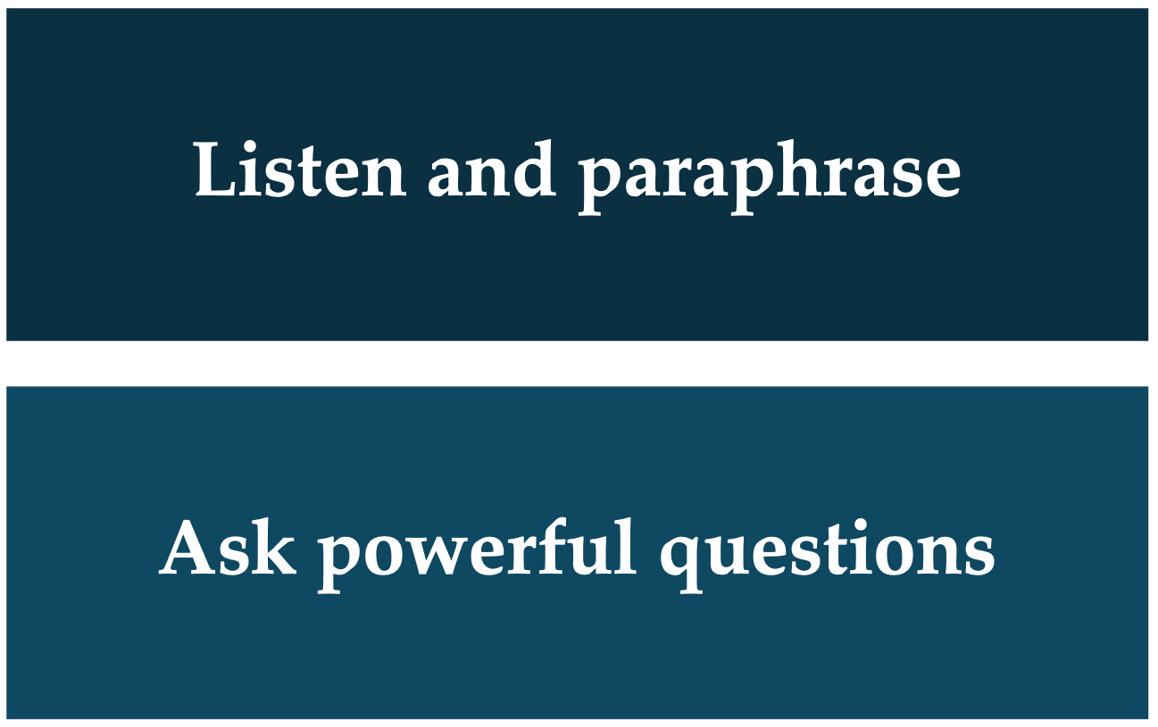
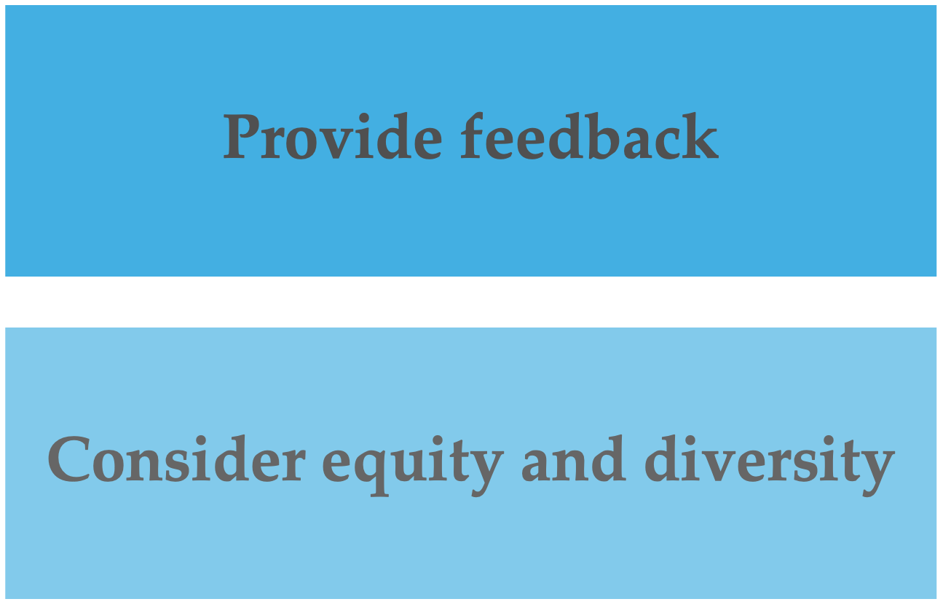
Communication Skills
Be present, listen for the essence, set aside judgment…Acknowledge, clarify, summarize
Ask questions that are open-ended, nonjudgmental, personal, and forward moving
Ask permission, ground in data, keep bite-sized, align with goals and action/competency development
Be aware of disciplinary and cultural contexts, and the roles of teacher leaders in social justice and equity issues
Adapted from Cognitive Coaching, 2015

Slide 13
Coaching and Mentoring
Coaching
Coaching is a process that enables learning and development to occur and thus performance to improve. To be a successful a coach requires a knowledge and understanding of process as well as the variety of styles, skills and techniques that are appropriate to the context in which coaching takes place. Eric Parsloe
Mentoring
Mentoring is a process of guiding, teaching, and supporting a less experienced person by a more experienced person. The goal of mentoring is to help the mentee develop their expertise, build confidence, and become part of the professional culture

Slide 14
Breakout Groups
Discuss which skill(s) - Communication, Collaboration, Coaching, Mentoring - you are “good” at and which skill(s) you may need to “improve” upon?

Slide 15
Enacting Change in Schools Using Kotter’s Change Framework

Slide 16
The Importance of Change
•The pace of change in education is increasing due to evolving technologies, new teaching methods, and shifting student needs.
•Effective change management helps create more engaging, effective, and inclusive learning environments.
•Kotter's 8 Steps provide a proven, systematic approach for leading change in educational settings.

Slide 17
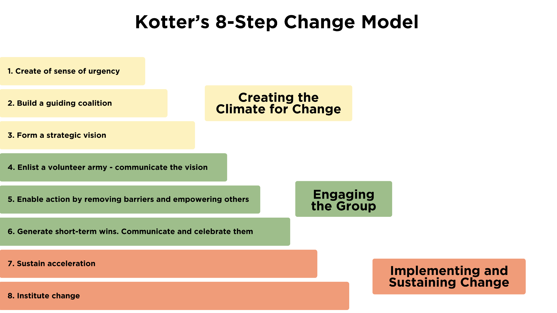
Kotter’s 8 Step Change Model

Slide 18

Creating the Climate for Change
•Create a sense of urgency
•Build a guiding coalition
•Form a strategic vision

Slide 19

Engaging and Empowering the Group
Enlist a volunteer army
Enable action by removing barriers
Generate short-term wins

Slide 20

Implementing and Sustaining Change
•Sustain acceleration
•Institute change

Slide 21
Activity: Scenario 1
You are a math teacher in a high school. There are 7 other teachers in your Department. Because of increasing difficulty in managing schedule conflicts, it is not possible to find a common time to meet as a Department. As a result, each teacher is managing their classrooms differently, and providing instruction as they see best. Disciplinary referrals are rising, and test scores in math are decreasing. The administration is putting a lot of pressure on the Math Department to fix the problem. What could you do?

Slide 22
Activity: Scenario 2
At Oakwood Elementary School, Ms. Thompson, a 4th-grade teacher, is facing increasing disruptive behavior in her classroom. Students are frequently talking out of turn, interrupting each other, and not following instructions during independent work time. Despite Ms. Thompson's best efforts to manage the behavior, she feels overwhelmed and frustrated. The disruptions are affecting her ability to teach, and students are struggling to stay on task, which is impacting their academic progress.
Ms. Thompson brings her concerns to the school leadership team, highlighting that some of the disruptions are beginning to escalate into more significant issues of classroom management. She’s concerned that without a consistent approach to handling disruptions, her students will continue to struggle with focus and productivity. Other teachers in the grade level have expressed similar frustrations, and there’s a growing sense of disconnection between students and their learning.
The Principal has asked Ms. Thompson to work with her colleagues to create a plan to address the problem. What should she do?

Slide 23
The “Job” Isn’t Easy, But …
“Don’t Quit” by Edgar A. Guest -
“When things go wrong, as they sometimes will,
When the road you’re trudging seems all uphill,
When the funds are low and debts are high,
And you want to smile but have to sigh.
When care is pressing you down a bit,
Rest, if you must, but don’t you quit……..”

Slide 24
Thank You!
New Jersey Department of Education: nj.gov/education
Research Team Leader: Margaret Thornton, thorntonm@rowan.edu

