Slide 1
Enhancing Teacher Well-Being: Identifying and Addressing Stressors for Improved Job Satisfaction
Old Bridge Township Public Schools
Dr. Caitlin Colandrea, Mr. James Oliveri, Mr. James Phillips, Mr. Ryan Sobin, Ms. Kathleen Corsentino
Date 7-29-25

Slide 2
Pilot Schools
Madison Park Elementary: 336
Miller Elementary: 317
Jonas Salk Middle School: 889
Carl Sandburg Middle School: 934

Slide 3
Data Sources
The Positive Behavior Intervention and Supports School Climate Survey
Teacher satisfaction surveys including key items about time and workload (paperwork activities, student behavioral and mental health needs, time allocated to various meetings, and level of teacher satisfaction associated with autonomy, support, time, access to materials and work/life balance).
Focus group conversations with task force monthly.
The percentage of actual time on task for lesson planning and other areas.

Slide 4
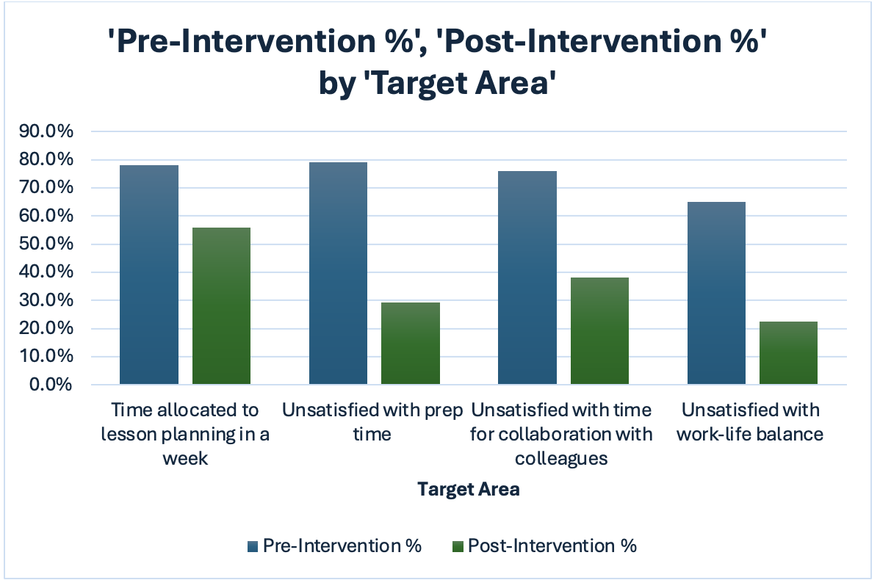
Data Results

Slide 5
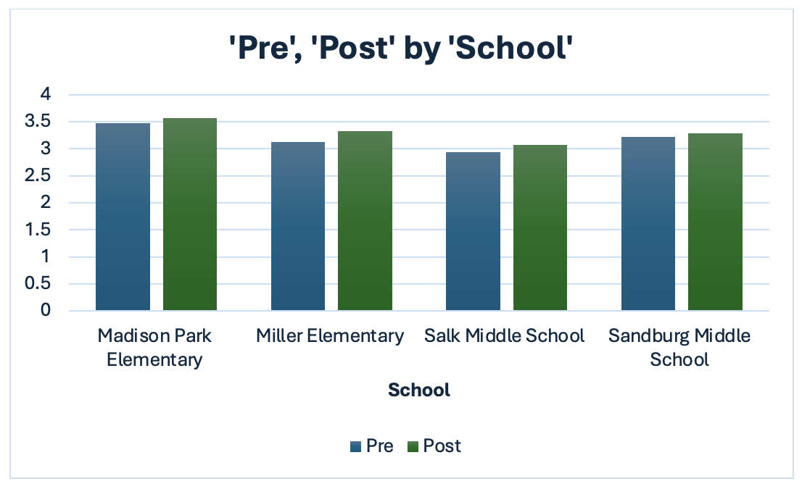
School Climate Surveys

Slide 6
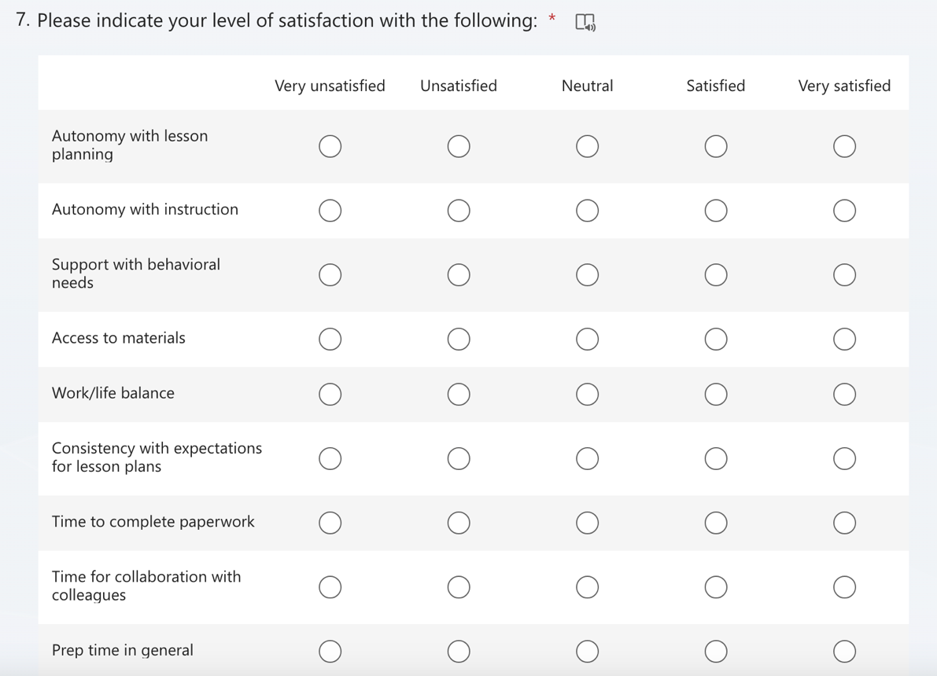
Survey Sample Questions

Slide 7

Activity
Build survey questions from template provided

Slide 8
Target Areas
Reduce time on task for lesson planning
Increase prep time
Improve overall work/life balance

Slide 9
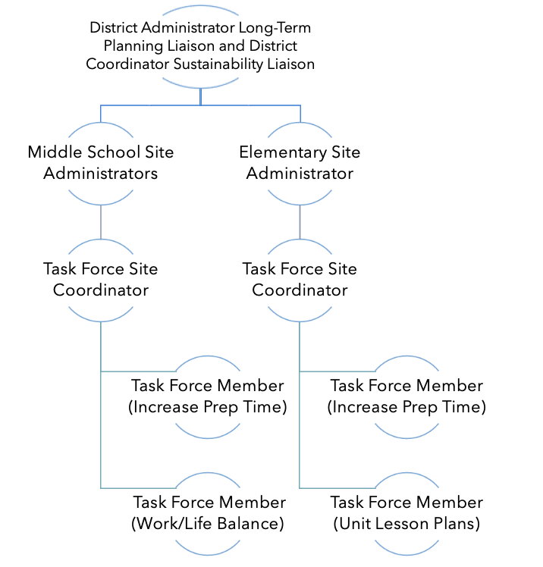
Task Force

Slide 10
Activity- Create Task Force
Create a Task Force and Assign Roles and Responsibilities

Slide 11
Reduce Time on Task: Lesson Planning

Slide 12
Unit Plans
A unit plan is a comprehensive guide for teaching a specific topic or subject over a longer period, often several weeks.
Unit plans outline the overall goals, content, assessments, and pacing for an entire unit.

Slide 13
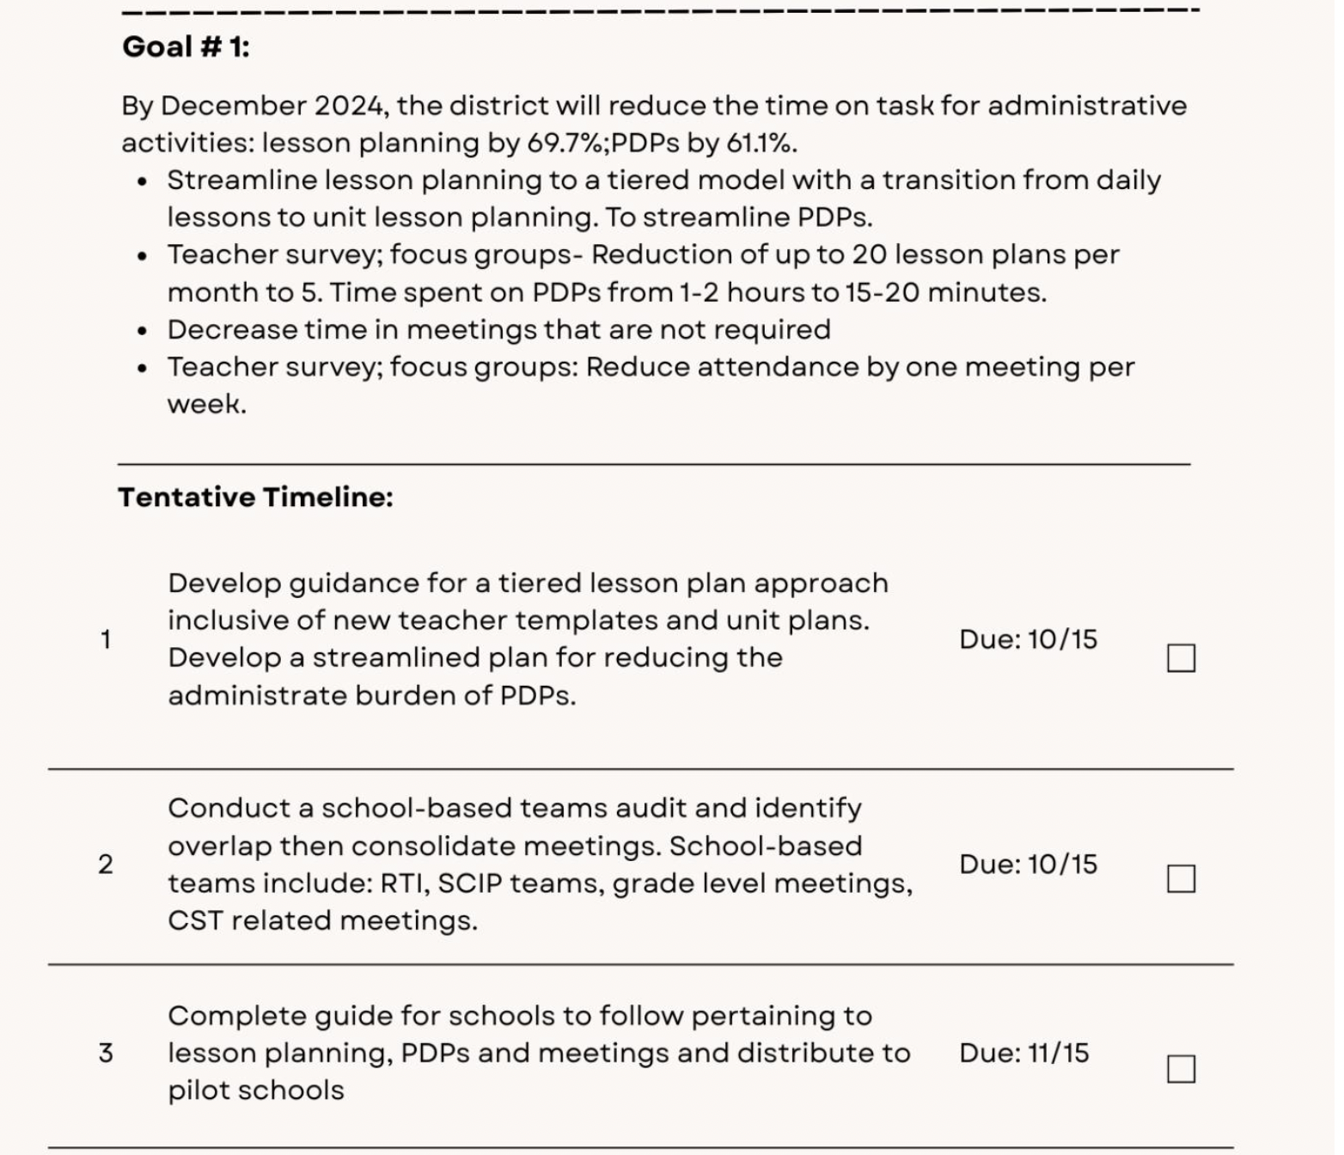
Create a Timeline Activity

Slide 14
Increase Prep Time

Slide 15
Friendly Coverages
Friendly coverage (per half of a block- approximately 34 minutes) was created as a resource for moments when a teacher needs to step out of the classroom (roughly 30 minutes max).
This does not apply to homeroom coverages or paid coverages but for quick personal moments that do not require using half of a personal or sick day. Examples include phone calls, virtual appointments, meetings for family, etc.

Slide 16

Additional Prep Time
At the middle school level, the use of noon-hour supervisors (lunch parents) to instead cover teacher bathroom duty periods allowing for additional time for teachers to have for prep.
Social Emotional Learning (SEL) and STEM activities implemented at the elementary level by the school counselor and related arts teachers who have holes in their schedules due to travel between buildings.
This time allows for teachers to attain additional scheduled prep time.
Another benefit from this model is the impact on student behavior at the tier-1 level, in turn decreasing stress on teachers for behavior concerns among students.

Slide 17

Activity
Brainstorm ways to increase teacher prep time using one of the three models provided

Slide 18
Improve Work/Life Balance

Slide 19
PM PLCs
PM PLCs allow team teachers to gather during PM Homeroom as a team to discuss team matters without taking up individual prep times by utilizing spare hall duty teachers to cover homerooms on a rotating schedule.

Slide 20

Portfolio Observations
New Jersey's TEACHNJ Act offers tenured teachers with a "highly effective" rating more flexibility in how they're observed and evaluated. This could involve in-depth analysis of student work, peer-to-peer observation and feedback, or leading a professional development session for colleagues. This approach empowers teachers to take ownership of their professional growth and ensures the evaluation process is a meaningful tool for continuous improvement.

Slide 21

Lead Teachers
Volunteer District Elementary Task Force Committee known as Lead Teachers.
There will be two volunteers, one K-2 general education teacher and one 3-5 general education teacher from each building for each Lead Teacher Committee.

Slide 22

Activity- Teacher Leaders
Brainstorm ways to increase teacher leader opportunities and autonomy using the examples provided.

Slide 23
Follow Us on Social Media
Facebook: @njdeptofed
Instagram: @newjerseydoe
LinkedIn: New Jersey Department of Education
Threads: @NewJerseyDOE
X: @NewJerseyDOE
YouTube: @newjerseydepartmentofeduca6565

Slide 24
Thank You!
New Jersey Department of Education: nj.gov/education
Dr. Caitlin Colandrea
ccolandrea@obps.org

