Slide 1
Lesson Plan Repository
Hillsborough Public School District
Sari Hussey, Lauryn Peterson, and Dr. Lisa Rebimbas
July 29, 2025

Slide 2
Learning Objectives
Learn about the Lesson Plan Repository that Hillsborough Public School District developed.
How to apply the Lesson Plan Repository to your own district.

Slide 3
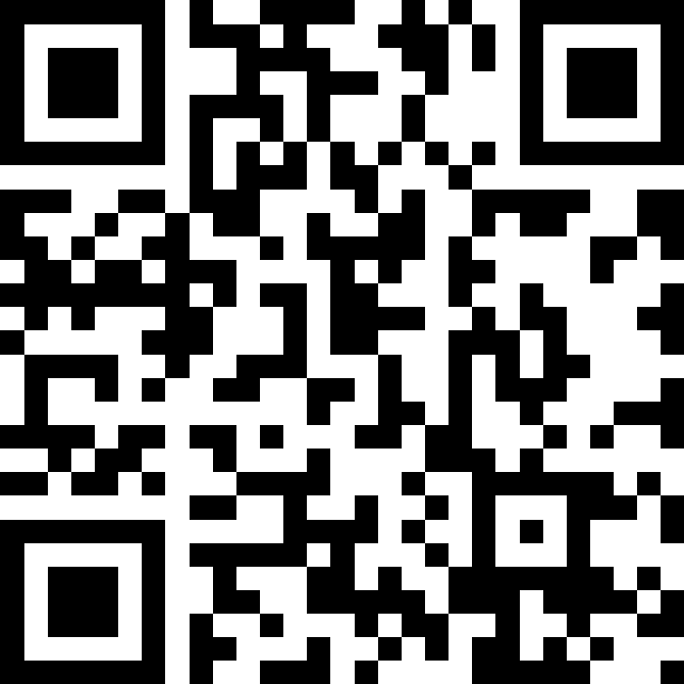
Let’s Paint a Picture…
📱 Scan the QR code or go to slido.com
🔢 Use code: #2413565

Slide 4
Teacher Climate and Culture Innovation Grant
Purpose
Reclaim teacher time
Focus on implementing lessons, activities, creating resources and differentiating instruction
Implementation
Teachers throughout the district created templates of lesson plans.
Public library on Genesis so that all staff members have access to the templates.

Slide 5
Our Process
Assistant Superintendent, President of Hillsborough Teacher’s Union, and other administrators met to discuss the plan for what was needed to reclaim teacher time.
Decided on how to develop Lesson Plan Repository, how many teachers needed and job descriptions
Posted positions and hired staff- tried to fill as many different grade levels and subjects as possible
Assigned roles for lesson planners/core developers
Created login information on Genesis (lesson plan platform used in Hillsborough)
Project manager met with all lesson planners/core developers to assign jobs and plans
Lesson planners worked in teams to split up the workload and tackle as many lesson plans as possible for their content area
Project manager conducted check-ins throughout to gauge how far along teams were in the process

Slide 6
Our Process (continued)...
Lesson planners were given 72 hours to complete as many lesson plans as possible.
Project manager met with lesson planners and core developers for next phase
core developers went back into all the lesson plans that the developers created to cross-check that all important components of the lesson plans were there (i.e. standards, essential questions, procedures, etc.)
Worked with our tech department to figure out how to make this accessible for all teachers once the repositories went live
Project manager and core developers created presentations for their respective schools to introduce the repository at BOE staff meetings.

Slide 7
Question
If you were to incorporate a lesson plan repository in your district what would be your top three areas to focus on? Why?
subjects?
grade levels?
schools?

Slide 8
Staff
Project Manager
Organized and managed each part of the project
Held meetings with Assistant Superintendent, tech department and group members
Created timelines for lesson plans to be completed
Created resource page for entire staff
44 Lesson Planners
Created lesson plans on Genesis for grade level and subjects
Included all components of lesson plans
16 Core Developers
Checked over lesson plans for all components
Helped to create resource page for entire staff and demonstrated to staff at first faculty meeting
Point person for individual schools
Created and analyzed survey for staff

Slide 9
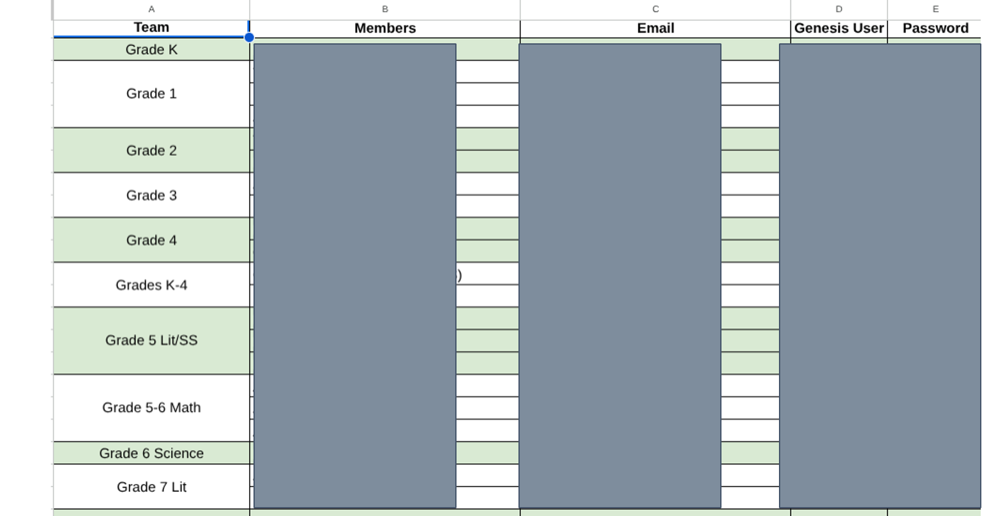
Sample

Slide 10
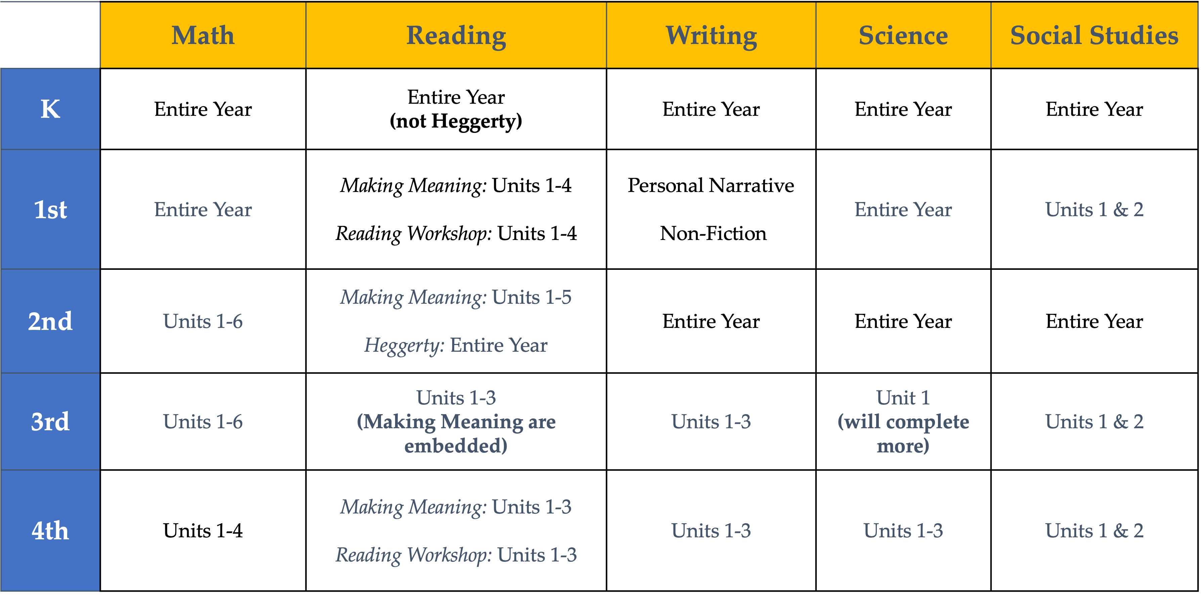
Lesson Plans Created
Notes:
Hide or delete slides for ones you don’t need.

Slide 11
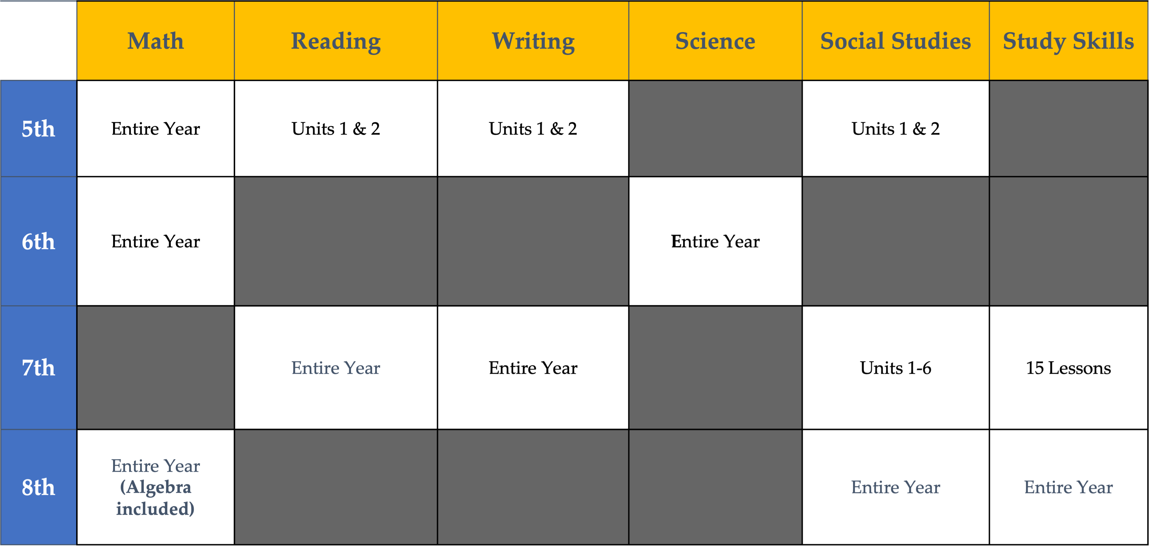
Lesson Plans Created (2)
Notes:
Hide or delete slides for ones you don’t need.

Slide 12
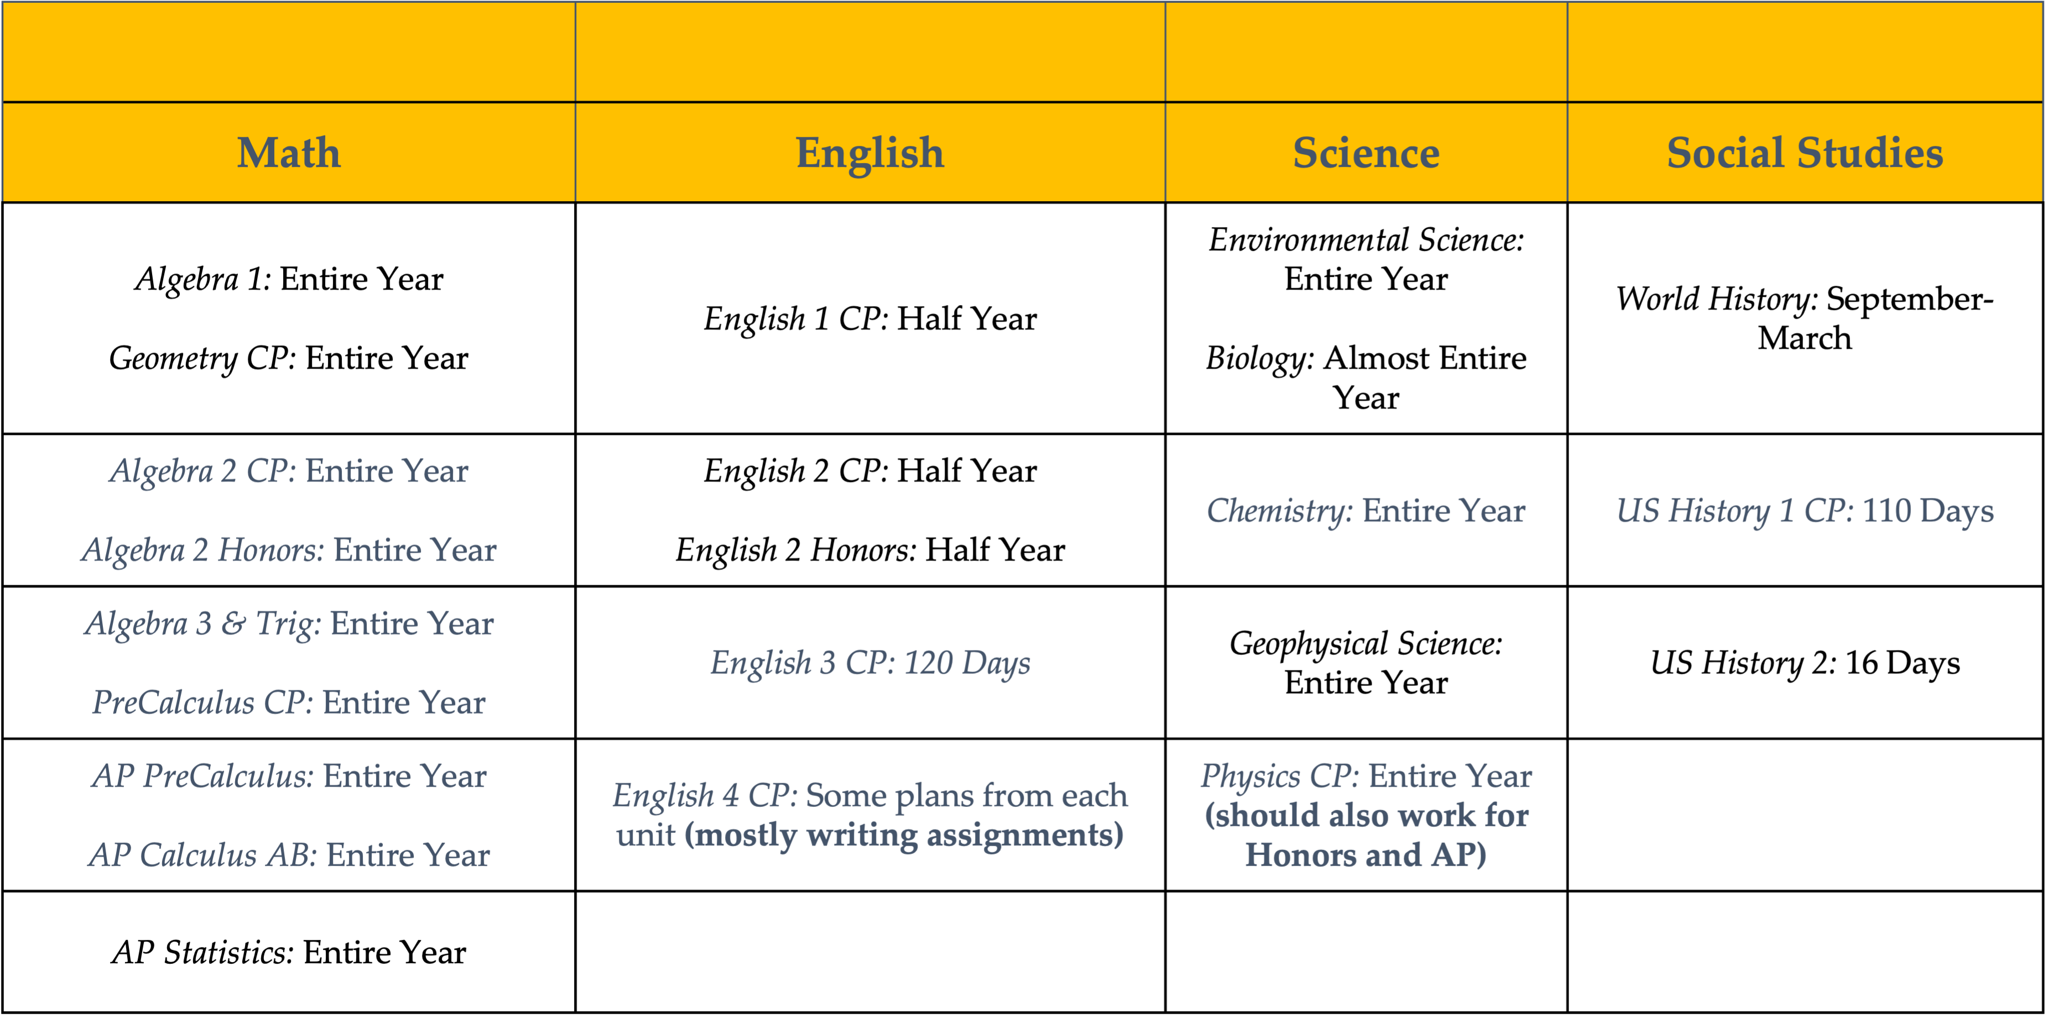
Lesson Plans Created (3)
Notes:
Hide or delete slides for ones you don’t need.

Slide 13
Challenges (1 of 2)
Genesis- looking up plans
Adding lesson plan buddies
Ways to access the repository

Slide 14
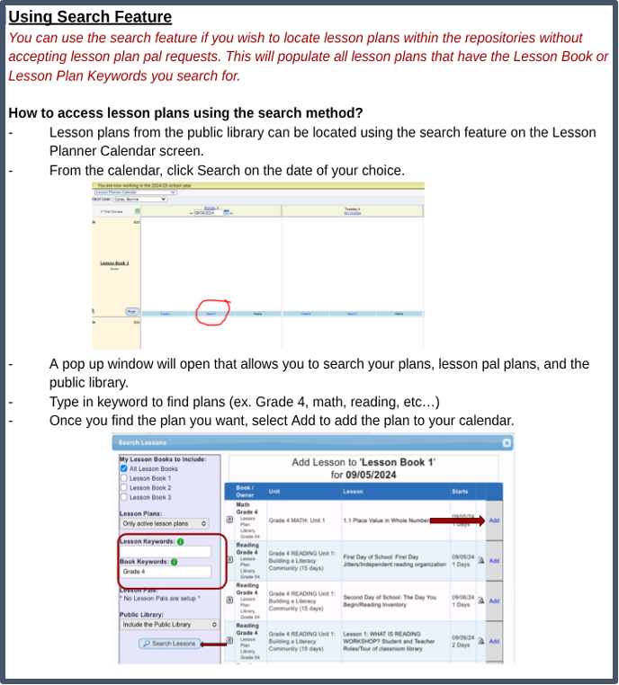
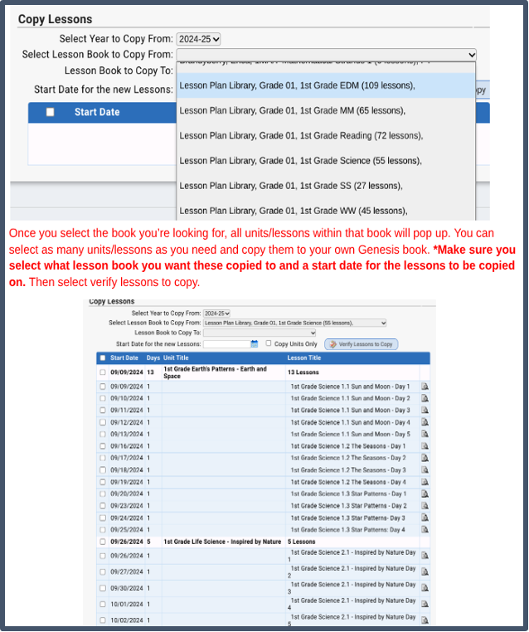
Ways to Access Repository
We advised teachers to put in a ticket on our tech help desk to gain access to specific lesson plan repositories if they needed access.

Slide 15
Challenges (2 of 2)
Labeling lesson plans so they are consistent through district

Slide 16

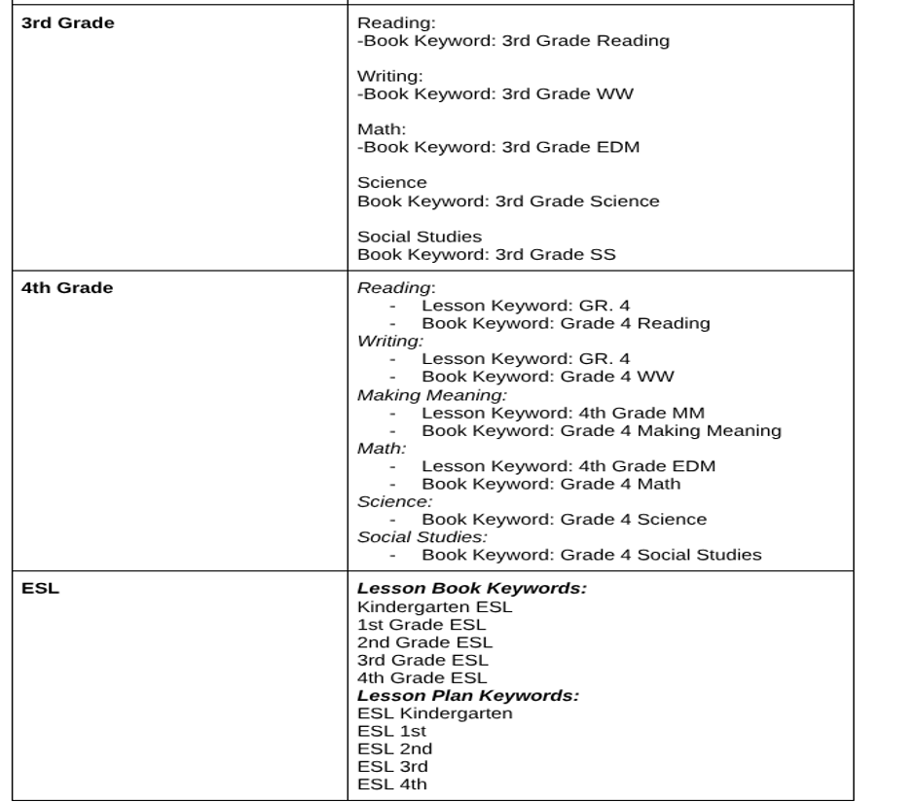
Labels for Consistent Access

Slide 17
Resource Page/Lesson Plans Created
Resource Page
https://drive.google.com/open?id=1-OmBLD-L2XVAcopWLE-1IOqb8YrLR7nM
attached PDF

Slide 18
Data
Once the repositories went live and our staff got the chance to use them, a survey was created and sent out to gather honest feedback about usability, efficiency, and overall impact.

Slide 19
Data
Once the repositories went live and our staff got the chance to use them, a survey was created and sent out to gather honest feedback about usability, efficiency, and overall impact.

Slide 20
Key Findings
Of the 148 participants in the survey, 61.2% reported using the repositories
84% feel confident using the repository
91% find the lesson plans adaptable
71% feel that is has reduced time spent on planning
The 3 biggest reasons for the 38.8% who have not used the repository:
“I’d rather use my own lesson plans.”
“There isn’t content applicable to my teaching assignment.”
“I am not sure how to access the repository.”

Slide 21
Key Findings- Positive Feedback
“I feel confident in my ability to search and locate lesson and unit plans within the lesson plan repositories.”
“Using the lesson plan repository has helped reduce the time I spend on planning and preparation.”
“The lesson plan templates available in the repository align well with the curriculum I teach.”
“The lesson plans in the repository are adaptable and provide flexibility for customization.”

Slide 22
Key Findings- Areas to Improve On
“The repository is built for classroom teachers, not intervention/foundational skills.”
“I use the lesson plan repository frequently to add lesson plans into my Genesis books.” (about a 50/50 split between Strongly Agree and Strongly Disagree)
“Lessons were not written for my grade and subject level unfortunately, so it really is of no use to me at this time.”

Slide 23
Turn and Talk
At this point what are your thoughts on the lesson plan repository?
How can you replicate this project using other platforms such as Atlas, Google, etc. ?

Slide 24
Next Steps…
Create plans for areas that were not covered
When curriculum is being rewritten- have teachers edit and revise plans in repository
Voluntary submission of past lesson plans into the repository

Slide 25
Application
“If we could give teachers back, let’s say - 3 hours a week, what would that mean for morale and retention?”

Slide 26
Thank You!
New Jersey Department of Education: nj.gov/education
Sari Hussey, shussey@htps.us
Lauryn Peterson, lpeterson@htps.us Dr. Lisa Rebimbas, lrebimbas@htps.us

Slide 27
Follow Us on Social Media
Facebook: @njdeptofed
Instagram: @newjerseydoe
LinkedIn: New Jersey Department of Education
Threads: @NewJerseyDOE
X: @NewJerseyDOE
YouTube: @newjerseydepartmentofeduca6565
Notes:
This slide shares NJDOE social media accounts across platforms to invite continued engagement with this work and future updates.

