Slide 1
Let the Glitter Settle: Trauma-Sensitive Mindfulness Beyond the Glitter Jar
2025 New Jersey State Teacher of the Year
July 29, 2025

Slide 2
Welcome
Let’s see who is in the room
Quick share:
  What is a small joy?

Slide 3
Community Agreements
One speaker
Speak from your own experience
Confidentiality
Choice
Be as present as possible

Slide 4
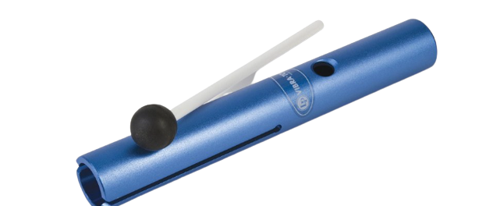
Moment to Arrive

Slide 5

Intention Setting
What brought you here?
What do you hope to learn?

Slide 6
Mindfulness Definition (1of 2)
Mindfulness is awareness that arises through paying attention, on purpose, in the present moment, non-judgmentally
Jon Kabat-Zinn

Slide 7
Mindfulness Definition (2 of 2)
Mindfulness is present moment awareness with kindness and curiosity.

Slide 8

Glitter Jar Analogy

Slide 9
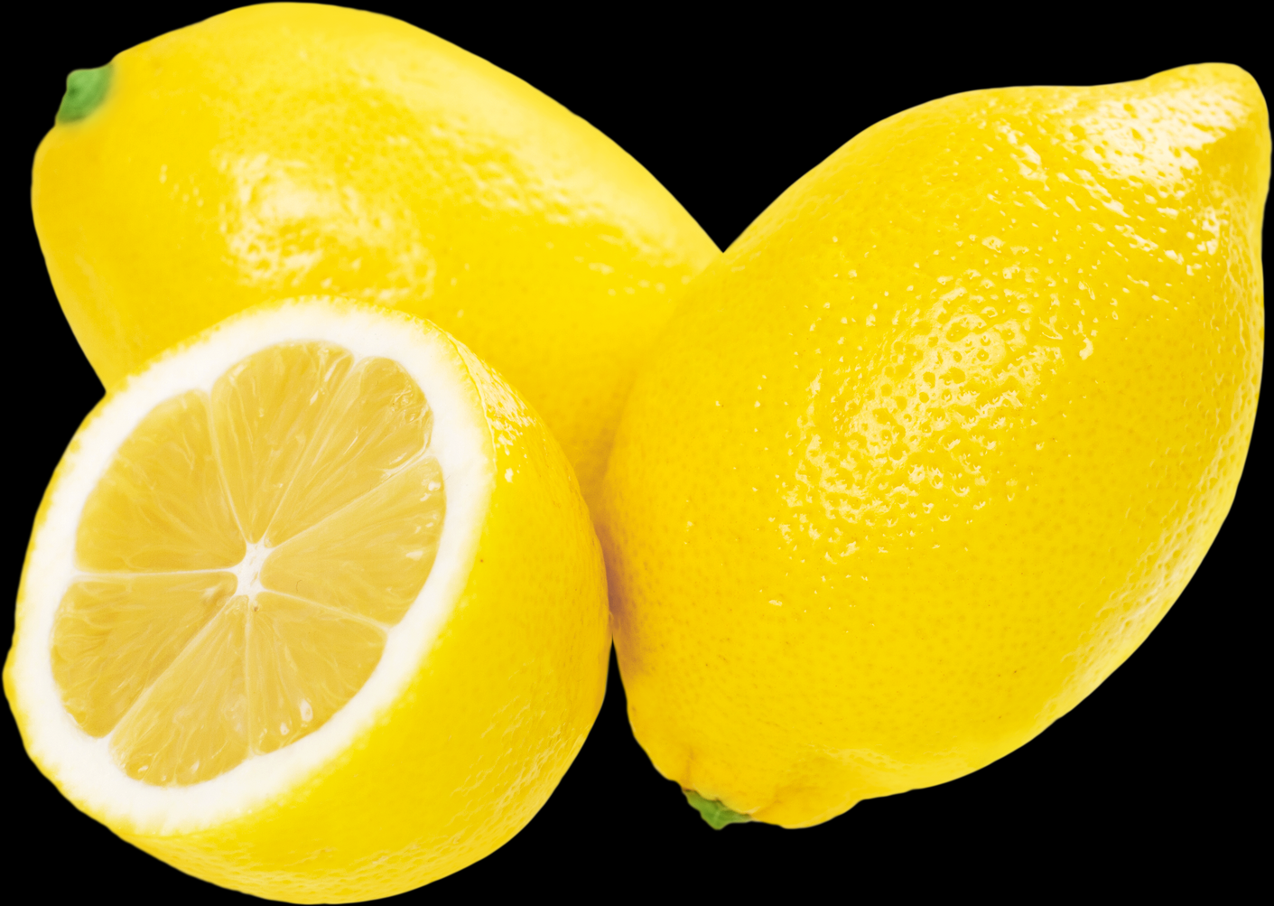
Lemon Experiment

Slide 10
Mirror Neurons (1 of 2)
When we witness someone engaging in something the same neurons fire in our brains!

Slide 11
Mirror Neurons (2 of 2)
How do mirror neurons show up in our learning spaces?

Slide 12
Regulation
Be the thermostat, not the thermometer
In order to help co-regulate, we must be regulated.
Our nervous system support their nervous systems.

Slide 13
Trauma-Sensitive Mindfulness
“Trauma-sensitive, or trauma-informed, practice means that have a basic understanding of trauma in the context of our work.”
“We commit to recognizing trauma, responding to it skillfully, and taking preemptive steps to ensure that people aren’t retraumatizing themselves under our guidance.”
Trauma-Sensitive Mindfulness David A. Treleaven p 7

Slide 14
The 5 Principles of Trauma-Sensitive Mindfulness
Practice in relationship
Stay within the window of tolerance
Shift attention to support stability
Keep the body in mind
Understand social context

Slide 15
Practice in Relationship (1 of 2)
What are some ways that you create a safe school community and develop strong relationships with your students?

Slide 16
Practice in Relationship (2 of 2)
Clear expectations
Agenda/timeline
Invitational language
Choice
Know your students
Know your trauma experts
Connect with adults in the room

Slide 17

Orienting and Attuning Practice

Slide 18
Orienting and Attuning Reflection
What did I notice?
When might I use this?

Slide 19
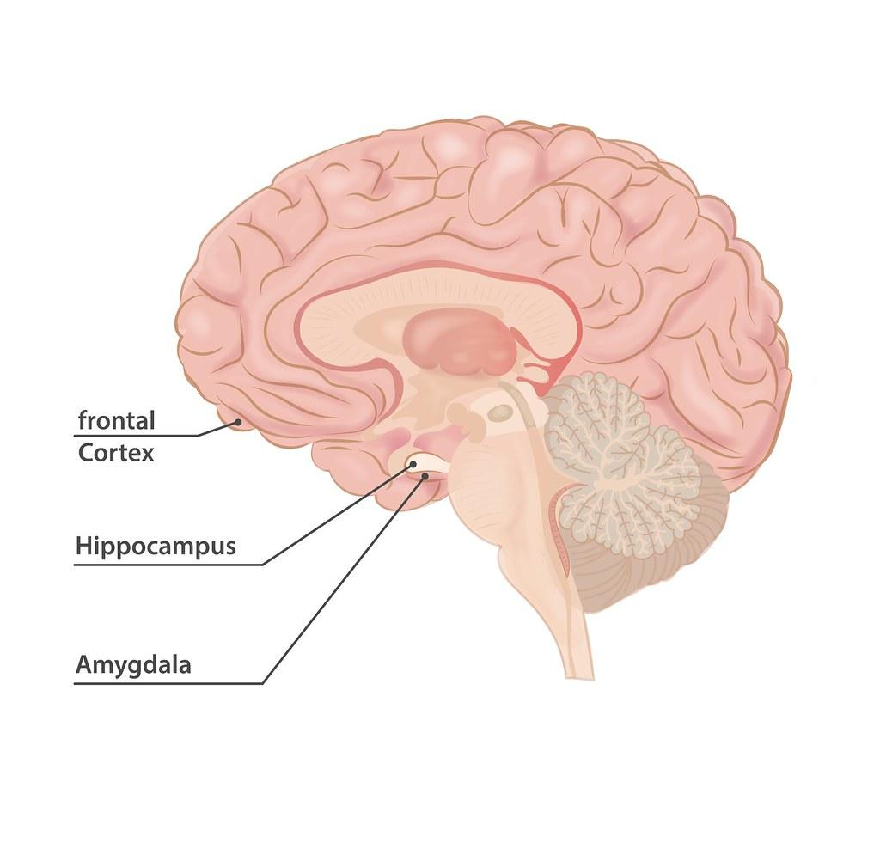
Neuroscience
Amygdala
Prefrontal Cortex
Hippocampus

Slide 20

The Window of Tolerance
Zone that lies between the two extremes of hyperarousal and hypoarousal
Term coined by Daniel Siegel (2010)

Slide 21
Hyperarousal
Increased sensation
Emotional reactivity
Hypervigilance
Intrusive imagery
Disorganized cognitive processing
Trauma-Sensitive Mindfulness by David A Treleaven

Slide 22
Hypoarousal
Relative absence of sensation
Numbing of emotions
Disabled cognitive processing
Reduced physical movement
Trauma-Sensitive Mindfulness by David A Treleaven

Slide 23
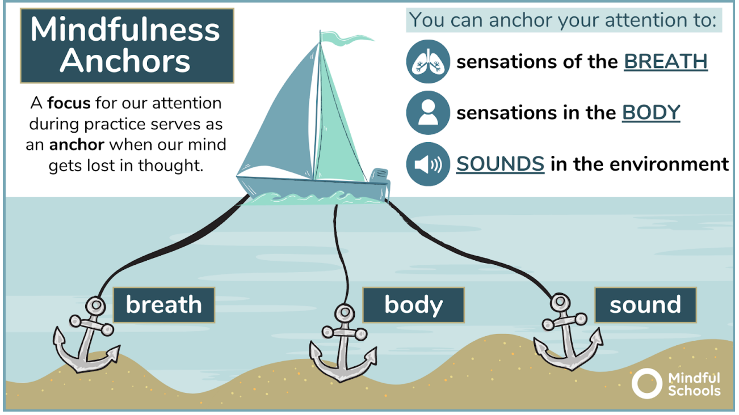
Anchors
From Mindful Schools Curriculum

Slide 24

Anchor Practice

Slide 25
Anchor Reflection
What did I notice?
When might I use this?

Slide 26
Shift Attention to Support Stability
Choose anchors that are stabilizing
Reorient
Focus In, then Widen Out
Focus on Resilience

Slide 27
Keep the Body in Mind
Choice
Incorporate movement
Watch for signs of dissociation
Utilize exteroceptive sensations
Be cautious with body scans
Flexible with posture
Respect physical boundaries
Create safer spaces
Offer a scent-free environment
Offer gender neutral bathrooms

Slide 28


Tense and Release Practice

Slide 29
Tense and Release Reflection (1)
What did I notice?
When might I use this?

Slide 30
Understand Social Context
Understanding social memberships power and privilege
Cultural appropriation
Systems of trauma

Slide 31

Finger Press Practice
Origins are from Kundalini Yoga
Sa Ta Na Ma
Sat Nam- my true identity

Slide 32
Tense and Release Reflection (2)
What did I notice?
When might I use this?

Slide 33
Reflections
What are you taking home with you?
How do you see yourself using this in the future?

Slide 34
Remember
YOU are the most important resource in the room.
Having your own practice has massive benefits on you and your students!

Slide 35
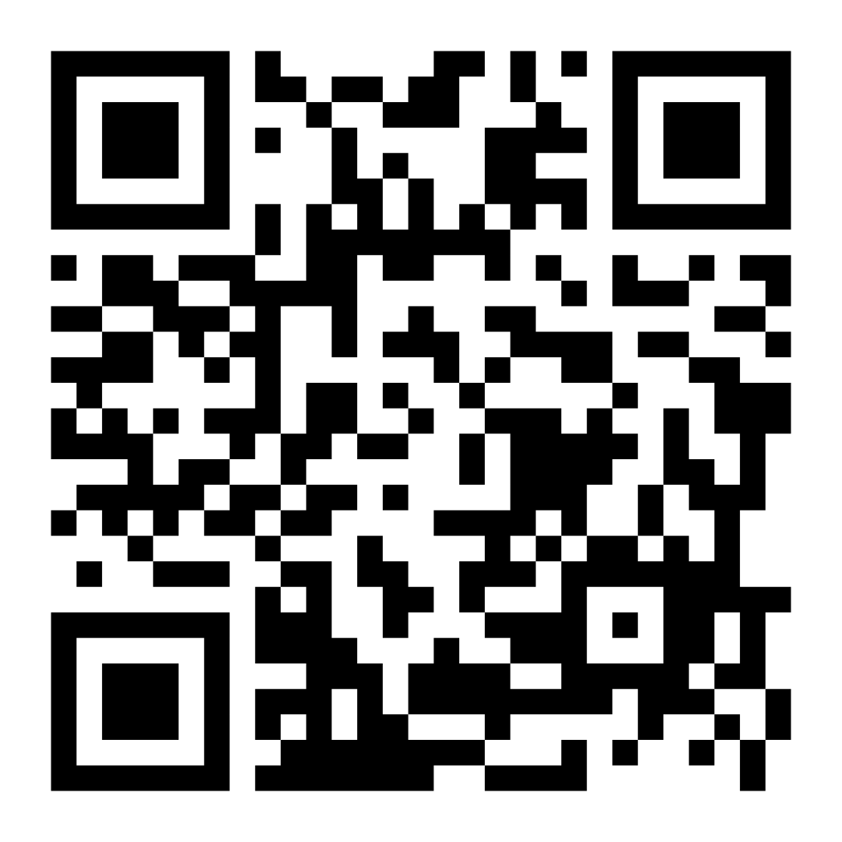
Thank You!
Please complete this quick feedback form
Link to form: https://docs.google.com/forms/d/e/1FAIpQLSeQpmn6ZBPfYXJDKOJQ_DaC5q1yyHb0aBstPY4DzairIB0SQA/viewform

Slide 36
Let’s Stay Connected!
Facebook:
Stefanie Lachenauer, 2025 NJ State Teacher of the Year
Instagram:
@2025NJSTOY
LinkedIn:
Stefanie A Lachenauer
Stefanie Lachenauer
2025NJSTOY@gmail.com

Slide 37
Thank You!
New Jersey Department of Education: nj.gov/education
Stefanie Lachenauer
2025NJSTOY@gmail.com

