Slide 1
New Jersey Tiered Systems of Supports: Setting a Vision and Taking the Journey Together
New Jersey Department of Education
July 29, 2025

Slide 2
Objectives
Explain NJTSS clearly
Highlight the importance of communication, leadership, and data in making NJTSS work.
Leave participants with one or two actionable takeaways they can use in their context—immediately.
Notes:
Join us to kickstart your New Jersey Tiered Systems of Supports (NJTSS) journey! This session will focus on building a shared vision rooted in positive school culture and climate, effective family engagement, and strong leadership. Learn dynamic communication strategies to inspire, connect, and drive lasting commitment to NJTSS in every corner of your school community.

Slide 3
Set the Vision
What does a positive school climate look like?
What does effective family engagement feel like?
What does strong leadership sound like in action?

Slide 4
Set the Vision (2)
In ONE word, how would you describe a school that has it all together?

Slide 5
What do we already know?

Slide 6

Communication
What makes communication effective in your school?
Jot your ideas on sticky notes or discuss with a partner.
We’ll revisit these thoughts later.

Slide 7
New Jersey Tiered System of Supports (NJTSS)
Notes:
The New Jersey Tiered System of Supports is a framework that districts can use to meet student needs and provide interventions in a data-driven way. Now, I recognize that this topic can be very jargony, and I will do my best to present the content in plain language, so I’m conveying the content in a manner that can resonate with everyone in the audience regardless of your level of experience with tiered systems of support.

Slide 8
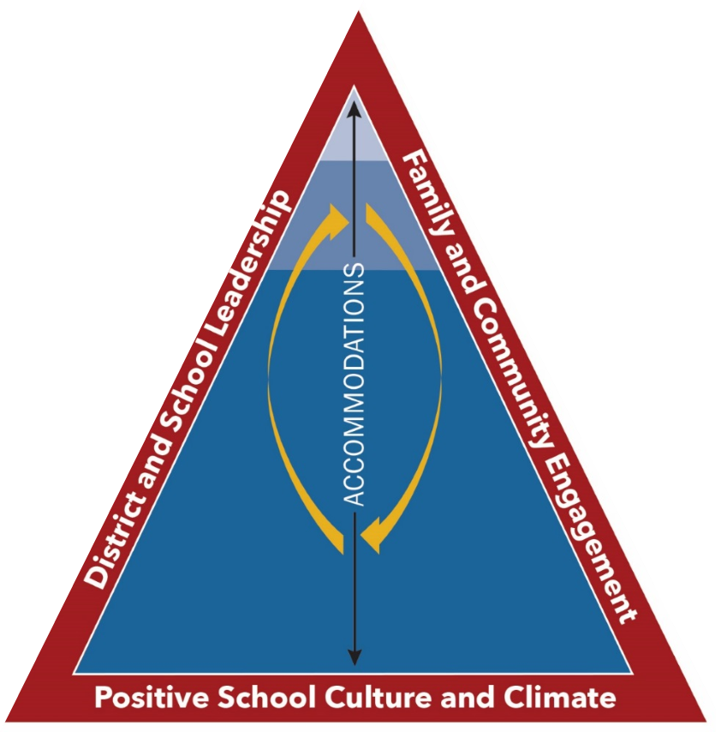
NJTSS: Defined
New Jersey Tiered System of Supports: A framework for supporting the academic, behavioral, social-emotional and health needs of all students through a layered continuum of evidence-based practices, interventions and services.
Notes:
So that we are all on the same page, I just want to briefly talk about the definition of NJTSS.
Student growth and learning are at the heart of NJTSS. The intent of NJTSS is to support the whole child with instructional and behavioral supports that prepare every student for postsecondary education, career, and life in their community. The NJTSS framework aids districts in allocating their resources efficiently and most effectively using data-informed processes to provide strategies and interventions that support all students in achieving success. The NJTSS framework brings together concepts from intervention frameworks like Intervention and Referral Services and Response to Intervention to provide a unique framework for New Jersey. The definition on the slide is a bit academic, but you can consider the New Jersey Tiered System of Supports as a progressive service delivery system, where individuals with the more significant needs are provided with more support all the while reflecting on how to improve the overall system, so there are reduced numbers of individuals requiring that more intensive support.
In alignment with the goal of today’s presentation, when implemented with fidelity, NJTSS provides protections against biases individuals may have because the data are collected using objective instruments that indicate how a student or the system is performing relative to expectations.

Slide 9

The NJTSS Framework Essential Components
Effective district and school leadership
Family and community engagement
Positive school culture and climate
High-quality learning environments, curricula, and instructional practices
Universal screening
Data-based decision making
Collaborative problem-solving teams
Progress monitoring
Staff professional development
Notes:
What makes the NJTSS model unique is its emphasis on strong district and school leadership, a positive school culture and climate, and family and community engagement- the outer red triangle you see here. When these three things come together, we are best able to help all students. The framework acknowledges that instruction and intervention will be most effective if those components are in place, and if a district is exploring where to begin with NJTSS, focusing on these three components is a great start. Overall, the nine components that make up NJTSS are essentially how we ensure we are using this framework with fidelity as well as honoring the various stakeholders involved in making sure every student succeeds.

Slide 10
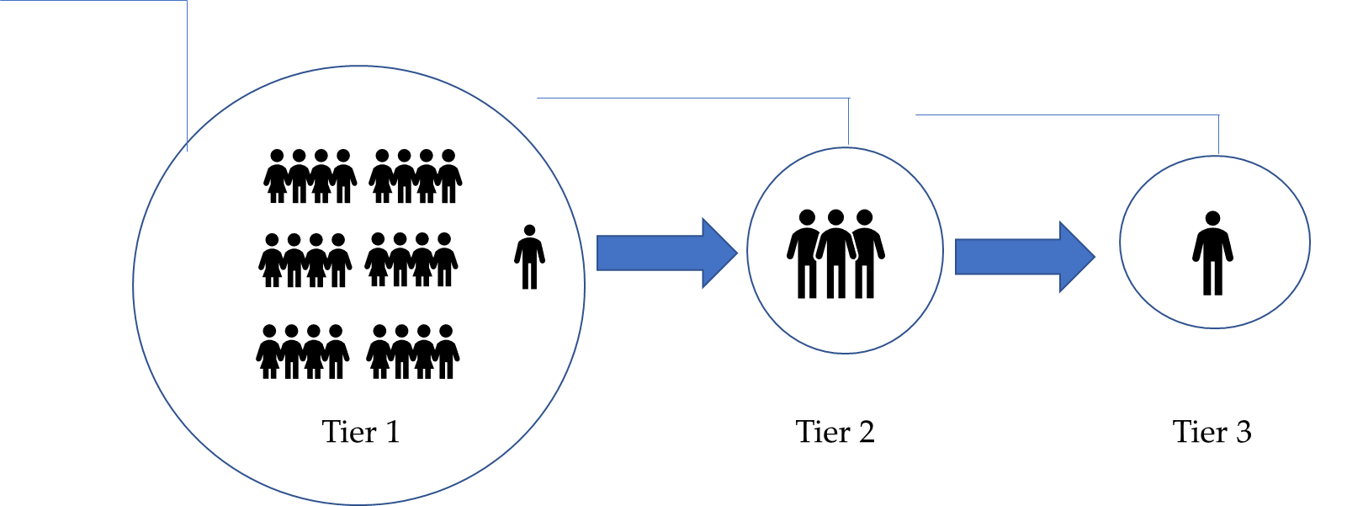
Visualizing the NJTSS Process
Sample School Community
Universal Screening
Diagnostics, Increased Intervention, and Progress Monitoring
Intensive Intervention, and Progress Monitoring
Notes:
In practice the NJTSS functions like this:
Click: All students participate in universal screening using a valid and reliable instrument that was tested to determine whether it will indicate how a student is performing relative to pre-determined benchmarks. For example, a depression screening could be implemented to identify students exhibiting increased signs of depression relative to their peers. If you are interested in learning more about universal screening instruments, what works clearinghouse is a great place to start.
Click: if a student is identified as performing below pre-set benchmarks they are then provided additional diagnostics to narrow in on exactly the level of need they are demonstrating. Diagnostics typically focus on specific skills or concepts that could be preventing a student from successfully progressing while engaging in grade-level content or meeting general developmental benchmarks. Tier 2 interventions are often delivered in small groups with a dosage dependent on the intervention being provided and the student’s level of need. While receiving intervention, students are monitored to evaluate whether the intervention is having the intended impact. If not, a student can be provided another intervention or the student could be provided more intensive intervention.
Click: Tier 3 interventions are reserved for students demonstrating the most significant need. These interventions are often provided to individual students. Tier 3 interventions are the most intensive, typically are the most expensive, and will generally require additional staff with specialized expertise related to the student’s need like a Math or Reading Specialist or an interventionist. Progress monitoring is key in Tier 3 because of the resources required at this level of intervention, it can be expected that measurable progress occurs early on when providing the intervention.
One important point about this process is that students are not fixed into tiers once they receive tiered services. All multi-tiered systems of support systems are intended to be fluid, where once a student demonstrates the ability of finding success with less intense interventions they will no longer be supported with Tier 2 or Tier 3 interventions.

Slide 11
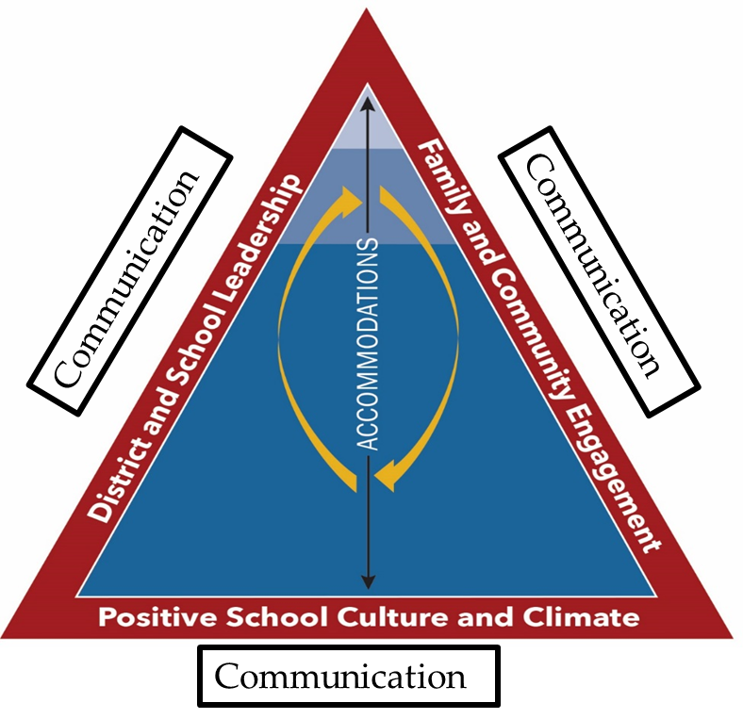
Communication and NJTSS
Notes:
Communication is not listed on the NJTSS graphic or in the essential components, but it is paramount to NJTSS’s success – embedded in all areas of tiered systems. Clear communication is necessary in all areas. We need clear communication from leadership, communication between teams, communication through data, communication with families, communication about school expectations: communication is inherent in the framework.
NJTSS has the same shared vision for everyone: Meeting students’ needs, delivering high-quality instruction, using the resources we have. To do this, we need everyone on board with the same clear messaging.
Fortunately, we have some strategies you can use next week to enhance your district’s internal and external communication.

Slide 12

Communication and Effective Communication
Communication is a process by which information is exchanged between individuals through a common system of symbols, signs, or behavior

Slide 13

Communication and Effective Communication (2)
Effective communication involves applying the skills to exchange information with clarity, empathy, and understanding.

Slide 14
What Does Collaborative Success Look Like?
Student and district success
Data-based decision making.
Problem-solving teams with a variety of staff roles.
Bidirectional, district- and community-wide communication.
Family and community involvement.
Notes:
Communication and data work in tandem to ensure success for all under the NJTSS framework. Grounding communication in data focuses everyone on the district’s goals: adjusting the NJTSS framework to help all students, and making intervention decisions to help individual students.
When a team of various roles comes together to analyze the data in front of them, they use their different perspectives to determine the best strategies for improving Tier 1, or for providing appropriate interventions to students in Tiers 2 and 3.
Families are better able to help their students at home when they know about NJTSS, the tiers, and what that means for their child. We need multiple perspectives for the whole picture.
Furthermore, when we have discussions in both directions it gives us more data to refine the NJTSS framework and help students even more. Families can provide data teams with information that would provide insight into either a global problem or an individual student problem.
Take this example regarding attendance: Families had difficulty understanding the district calendar graphics and therefore did not know when school was closed versus a half day. With the insight from the families, rather than data alone, the district updated the calendar’s graphics and added a text message blast the day before half-days.
Or, consider a student whose academic performance suddenly indicates they are at risk. Family input could reveal that the student’s best friend moved, the parents are getting a divorce, someone lost their job, they are struggling with a new medical diagnosis that the school does not yet know about – context that provides a better picture of the whole student.
Creating a shared vision using our data and intentional communication equips us to address the needs of the whole child, the district, and the system.

Slide 15

Sample Layers of Leadership
District Level
Building Lead
Set district goals and visions.
Set the implementation fidelity plan.
Consists of building lead stakeholders:
Director of Curriculum, Director of Special Education, Supervisor, Principal, Assistant Principal, etc.
Building Level
Drive building level NJTSS.
Use data for curriculum and professional development planning purposes.
Consists of building leadership and content specific coaches:
Principal, Assistant Principal, School Psychologist, Literacy/ Math Coach, etc.
Intervention
Run all data meetings.
Hold student progress monitoring meetings.
Consists of building-level stakeholders:
Literacy/Math Coach, School Counselor, School Psychologist, 504 Coordinator, Teacher representative, etc.
Analyze classroom or grade-specific data.
Create and discuss intervention plans.
Provide direct assistance to teachers.
Consists of:
Literacy/Math Coach, Interventionist, Teacher.
Notes:
When we begin to talk about leadership, we want to outline the various teams that exist within an organization. District level teams are made up of building lead members. Together, they set the vision and goals for the district, they set the guidelines for rollout, and they address implementation fidelity, as they continue to meet and check in with building lead teams.
Building Lead teams are often comprised of building leadership and content specific coaches. They analyze building level data to drive a building-level multi tiered system of supports as well as the professional development and other building specific needs.
The building level teams are often comprised of building-level stakeholder such as academic coaches, interventionists, vice principals. These meetings are often focused on ensuring alignment and roll out is being done with fidelity across a building.
And lastly, intervention teams exist within the structure of the building. These teams meet to create and discuss intervention plans as well as provide direct assistance to teachers.

Slide 16
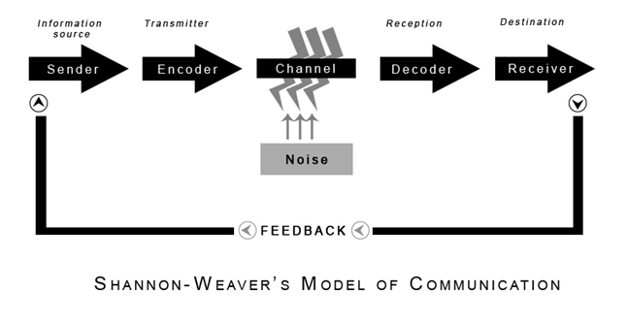
Weaver’s Model of Communication
Notes:
Weaver’s Model of Communication is often something discussed when learning about communication and talking about the concept of "message sent.". How might a leader know if message sent is always message received?
In 1948, Shannon was an American mathematician and electronic engineer. Weaver was an American scientist. Both of them joined together to write an article in “Bell System Technical Journal” called “A Mathematical Theory of Communication” which is typically referred to as the “Shannon-Weaver model of communication”.
This model was specifically designed to develop the effective communication between sender and receiver. At first, the model was developed to improve technical communication but later, it was and has been widely applied in the field of communications.
Weaver's Model of Communication details various concepts like Information source, noise, channel, message, and receiver. Not only do messages need to be encoded by the sender, they need to be decoded by the receiver. The takeaway here is that it is important for leadership to focus on messaging as the message sent is not always message received.

Slide 17
Applying Weaver’s Model of Communication (1 of 2)
Principal – “We need to prioritize Tier 2 interventions for student behavior.”
Principal uses email with formal language and strategic jargon (e.g., “optimize MTSS) deployment”).
Email
Counselor – Experienced with Tier 1 PBIS work, sees Tier 2 as a reactive step backward.
Counselor concludes the principal doesn’t value proactive, schoolwide supports.
Counselor’s inbox is flooded.
She’s multitasking during a chaotic morning.
She interprets “prioritize” as “drop all Tier 1 work.”
Notes:
🎯 Slide Content:
Scenario: Principal to School Counselor
📣 Sender (Information Source): Principal – “We need to prioritize Tier 2 interventions for student behavior.”
🛰️ Transmitter (Encoding): Principal uses email with formal language and strategic jargon (e.g., “optimize MTSS deployment”).
📬 Channel: Email
🔊 Noise:
Counselor’s inbox is flooded.
She’s multitasking during a chaotic morning.
She interprets “prioritize” as “drop all Tier 1 work.”
👂 Receiver (Decoding): Counselor – Experienced with Tier 1 PBIS work, sees Tier 2 as a reactive step backward.
🎯 Destination: Counselor concludes the principal doesn’t value proactive, schoolwide supports.
⚠️ Key Insight:
The intended message ("Let’s strengthen Tier 2 to support Tier 1") was filtered through the counselor’s experiences and context, leading to misalignment in understanding.
🧩 Takeaway Box:
✅ Effective communication in schools requires:
Awareness of the audience's perspective
Use of clear, shared language
Opportunity for feedback and clarification
Would you like this as a visual PowerPoint/Google Slide layout or want to expand the scenario with dialogue?

Slide 18
Miscommunication in Action
Where did the breakdown happen?
How could the message be improved?
What assumptions shaped interpretation?

Slide 19
Applying Weaver’s Model of Communication (2 of 2)
Key Insight:
The intended message ("Let’s strengthen Tier 2 to support Tier 1") was filtered through the counselor’s experiences and context, leading to misalignment in understanding.
Effective communication in schools requires:
Awareness of the audience's perspective
Use of clear, shared language
Opportunity for feedback and clarification

Slide 20
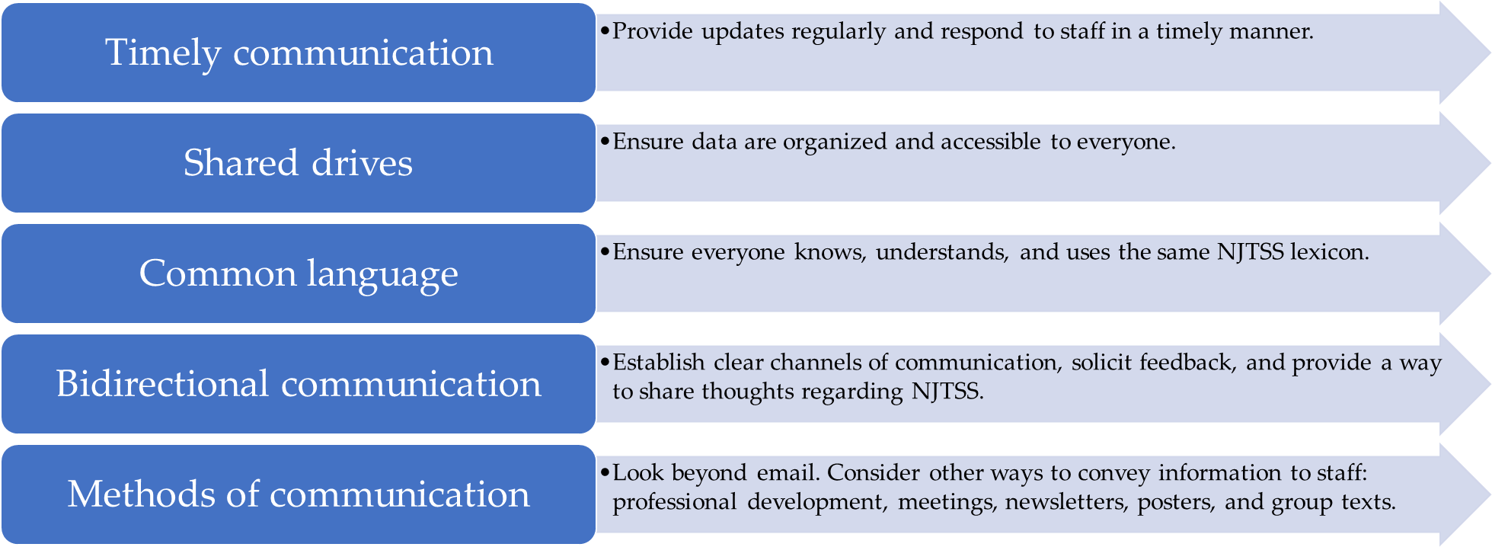
Enhancing Internal Communication
Notes:
Internal communication is communication within the district. It could be from the board of education or central office to building administrators, from administrators to staff, or even from staff to students. Regardless, we want the messaging to be easy, organized, and clear.
Using timely communication, shared drives, common language, bidirectional communication, and other methods of contact besides email will go a long way to extend your internal communication. Make sure staff and students have a way to communicate back to you, including soliciting feedback.

Slide 21
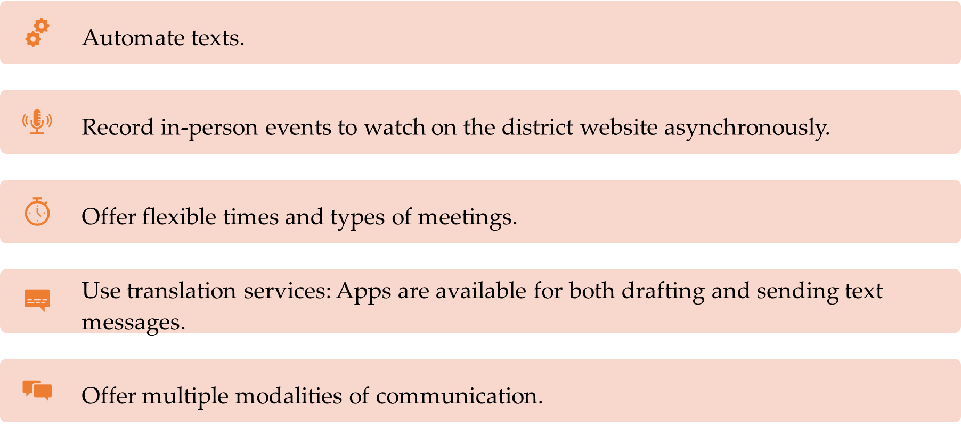
Enhancing External Communication
Notes:
External communication is communication that extends outside the district walls – families and community. With a few tweaks you can get more mileage from your external communication.
When you offer a variety of times and types of communication, you reach more audience members. As a working parent myself, I appreciated when my son’s district offered virtual conferences and recordings of school events to watch at night. A host of families can benefit from you switching up your times and formats for meetings and events.
Translation services go a long way, too. There are a variety of apps that will let you compose a text, translate it, send it, and then translate the texts that you receive back to your language. It’s all contained within the app, protecting your phone number. This is a life-changing upgrade in communication for families and educators.

Slide 22
Utilizing Artificial Intelligence (AI)
The benefits of using Artificial Intelligence (AI) for internal and external communications include:
Customized and/or personalized communication.
Multilingual and accessible communication.
Platform-specific
Communication.
Notes:
The Technical Manual (which, again, is coming soon) has some great suggestions for how to levy Artificial Intelligence, or AI, to help do some of the heavy lifting. You can use AI to generate some of the language you need to create clear, custom communication for whichever audience in the school community. It offers translation services and makes it easy to create a host of formats, like flyers, social media posts, documents for messaging apps, etc.

Slide 23
Sample AI Prompts: Internal
Draft an email for high school teachers explaining updates to NJTSS interventions, emphasizing the role of data in identifying student needs. Keep it professional yet concise.
Develop a checklist for implementing a Tier 3 intervention focused on [specific student need] that includes data collection methods and progress monitoring strategies.
Notes:
I’ve provided some sample prompts for internal and external communication. Some are from the Technical Manual and some I created myself with Google Generative AI. These internal prompts involve crafting an email to high school teachers explaining NJTSS interventions and creating a checklist for creating a Tier 3 intervention.

Slide 24
Sample AI Prompts: External
Create a brief, informative message for families explaining the NJTSS framework and its benefits for their child. Explain the tiered approach and how it supports all students. Provide a link to a relevant resource or website. Use simple language.
Develop a toolkit for families to use at home to support their child's learning in [specific area, e.g., reading, math], including activities and resources.
Notes:
These prompts, focusing on external communication, include creating an informative message to explain NJTSS basics to families as well as a toolkit for families to use at home to help their students.
Keeping your audience in mind when engineering prompts makes a big difference. (The audience is families, the audience is high school math teachers, etc – literally write it in the prompts!) You also don’t need to limit AI use to drafting letters, as demonstrated by the toolkit and checklist prompts.

Slide 25
Using AI Responsibly
Always check your district’s AI policy before using AI tools and disclose the use of AI.
1
Always have a human review anything that AI generates.
2
Consider AI your first draft and refine it to get your final product.
3
Notes:
To use AI responsibility, keep these three considerations in mind. All 3 of these points are imperative. AI is not a replacement for a human, it is a tool to enhance your communication. AI is a really good way to get a first draft and then refine it to get what you need it to be. Just as I’ve modeled, make sure you disclose the use of AI, too.

Slide 26
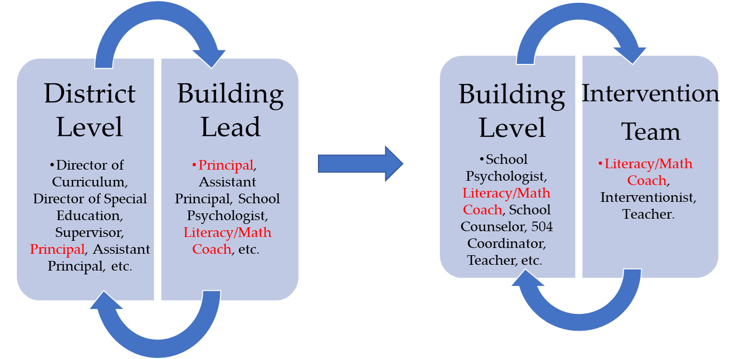
Communication Process
Notes:
Keep in mind, communication must flow between the district level and building lead, as well as building level and intervention teams. A building lead member must be on the district level team as well as on the building level team. This ensures consistent messaging across the district. Here, you can see the principal is on the district level and building lead teams. The literacy or math coach straddles the building lead and building level teams, then participates in both the building level and intervention teams.
As we have experienced, messages can get lost in translation, so it is critical that leaders focus on clear communication when constructing teams and relaying information.

Slide 27
What makes communication effective in your school?

Slide 28
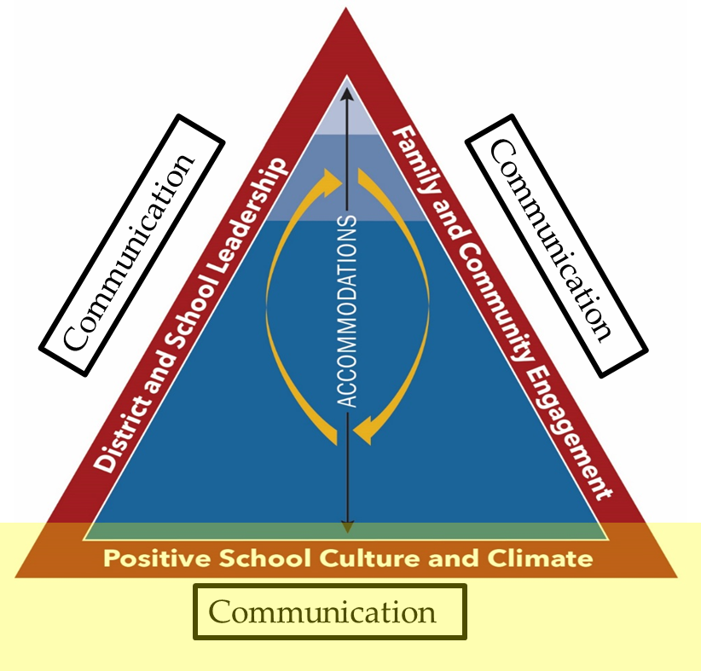
Communication and NJTSS (2)
Notes:
Communication is not listed on the NJTSS graphic or in the essential components, but it is paramount to NJTSS’s success – embedded in all areas of tiered systems. Clear communication is necessary in all areas. We need clear communication from leadership, communication between teams, communication through data, communication with families, communication about school expectations: communication is inherent in the framework.
NJTSS has the same shared vision for everyone: Meeting students’ needs, delivering high-quality instruction, using the resources we have. To do this, we need everyone on board with the same clear messaging.
Fortunately, we have some strategies you can use next week to enhance your district’s internal and external communication.

Slide 29
NJ School Climate Improvement (NJ SCI)
Surveys for student, educators, & families/caregivers.
-Comprehensive information on school climate.
-Includes optional demographic information so data can be disaggregated.
-Available in 33 languages.
Platform provides school teams with tools & support to engage in school climate improvement process.
-Collects survey data.
-Generates comprehensive, interactive data reports.
-Assists with data analysis and decision-making.
-Assists with development, implementation, and progress monitoring of action plans.
-Includes learning resources and tools.

Slide 30

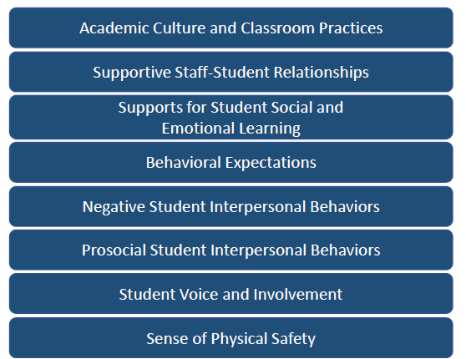
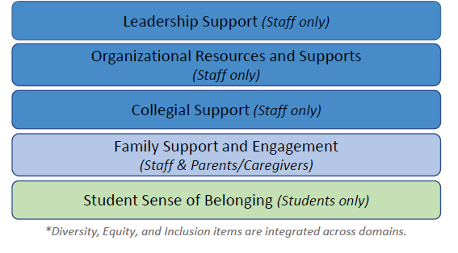
Survey Domains
Notes:
Provide a handout with detailed domain descriptions to participants, and ask them to think about how the strengths and challenges they identified in the warm up connect to these areas.

Slide 31
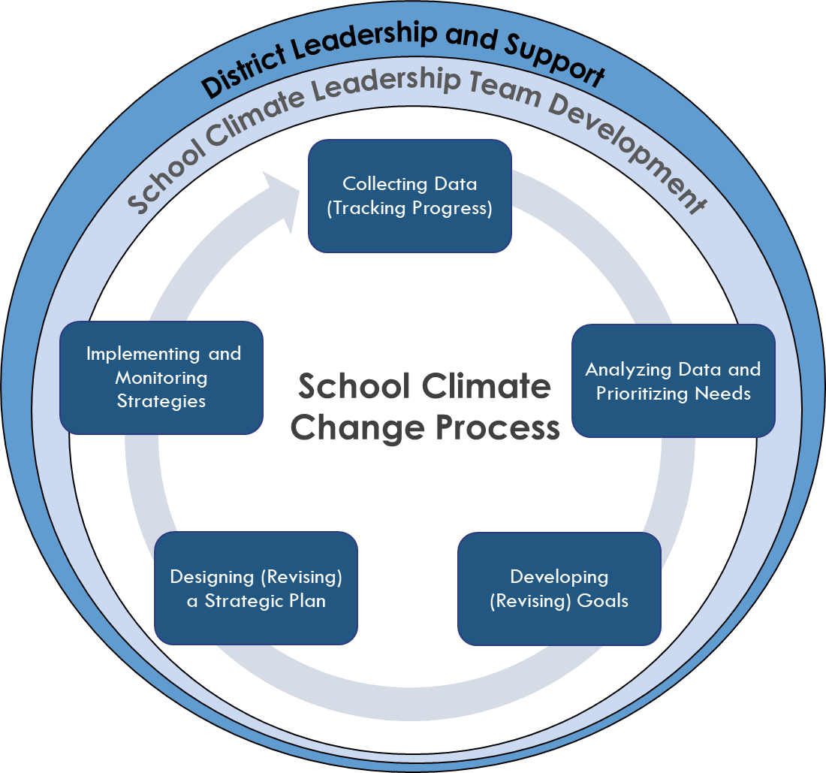
School Climate Change Process
Notes:
Connect to how the data are used to implement a School Climate Change Process

Slide 32
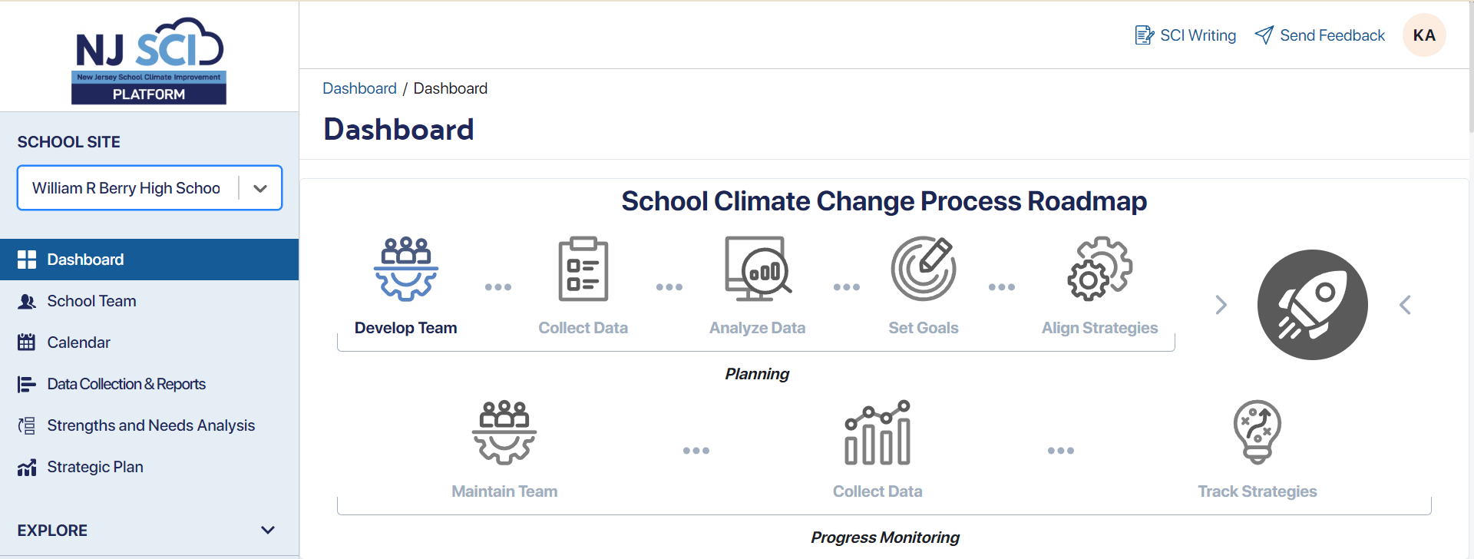
NJ Sci Platform Screenshot
njschoolclimate.org

Slide 33
Comprehensive Data Reports and Insights

Slide 34
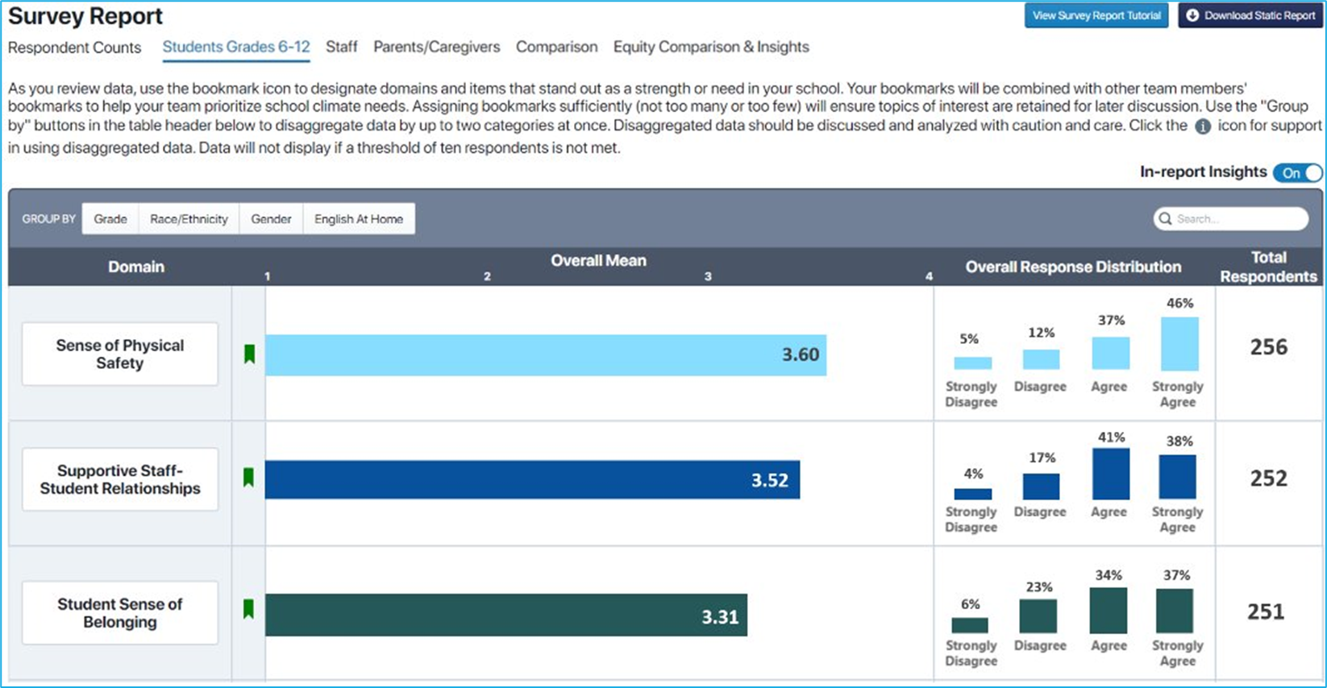
Survey Report Example
Notes:
After collecting data, the platform allows teams to instantaneously view comprehensive data reports and insights, including disaggregated results to support a collaborative data analysis process for prioritizing strengths and needs within and across respondent groups. This step involves extensive team discussions and gathering feedback from the community on results and potential next steps.

Slide 35
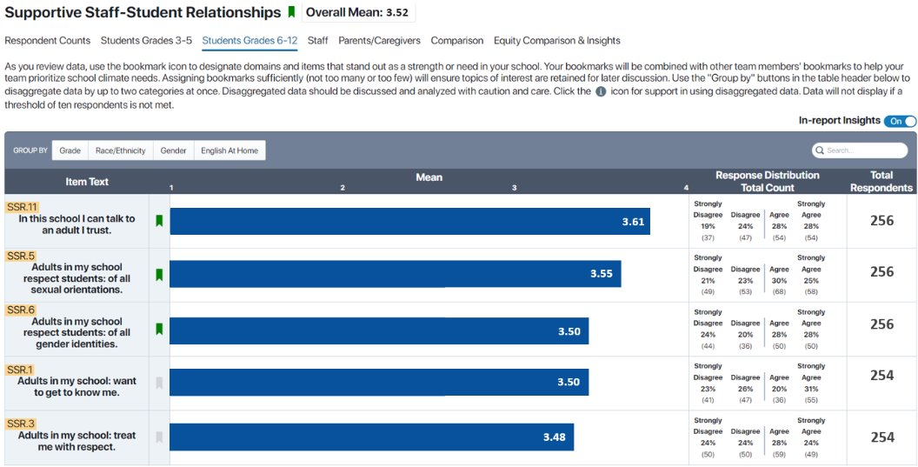
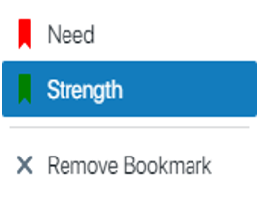
Supportive Staff-Student Relationships Screenshot Example
Notes:
This information can also be viewed at the item level. While reviewing data, individual team members may apply bookmarks to domains or items they perceive as a strength or need along the way. These individual bookmarks get tallied and later appear in the Strengths and Needs Analysis workspace.

Slide 36
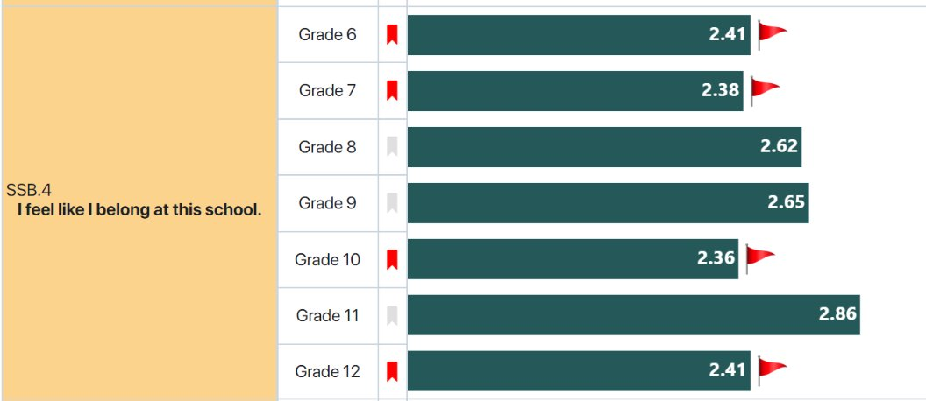
Screenshot of SSB.4 Results

Slide 37
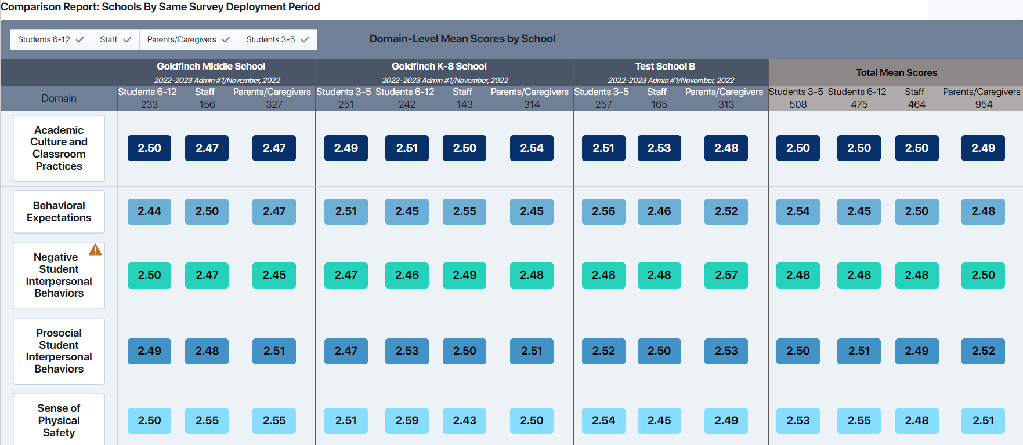
Comparison Report Screenshot

Slide 38
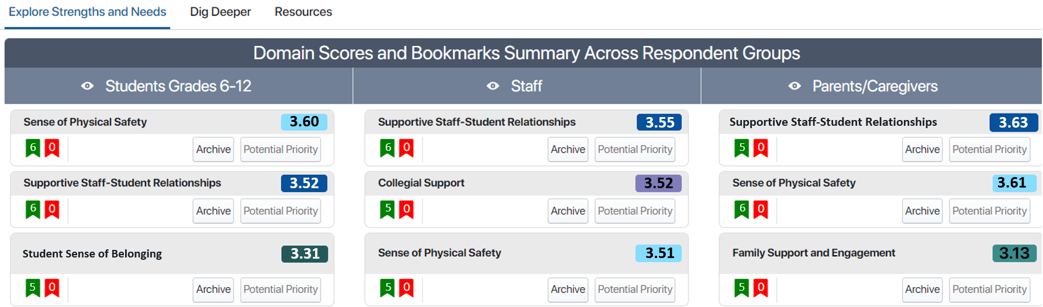
Domain Scores and Bookmarks Summary Screenshot

Slide 39
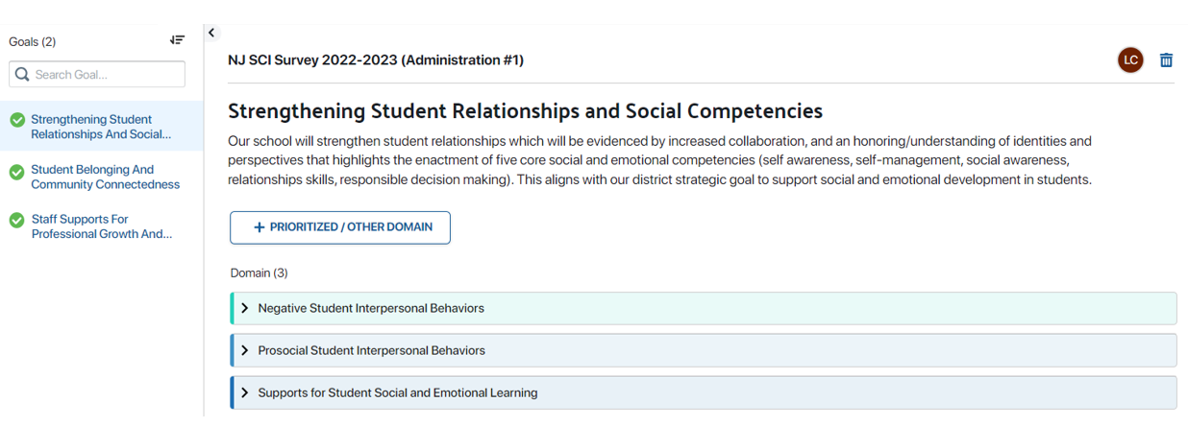
Develop Improvement Plan

Slide 40
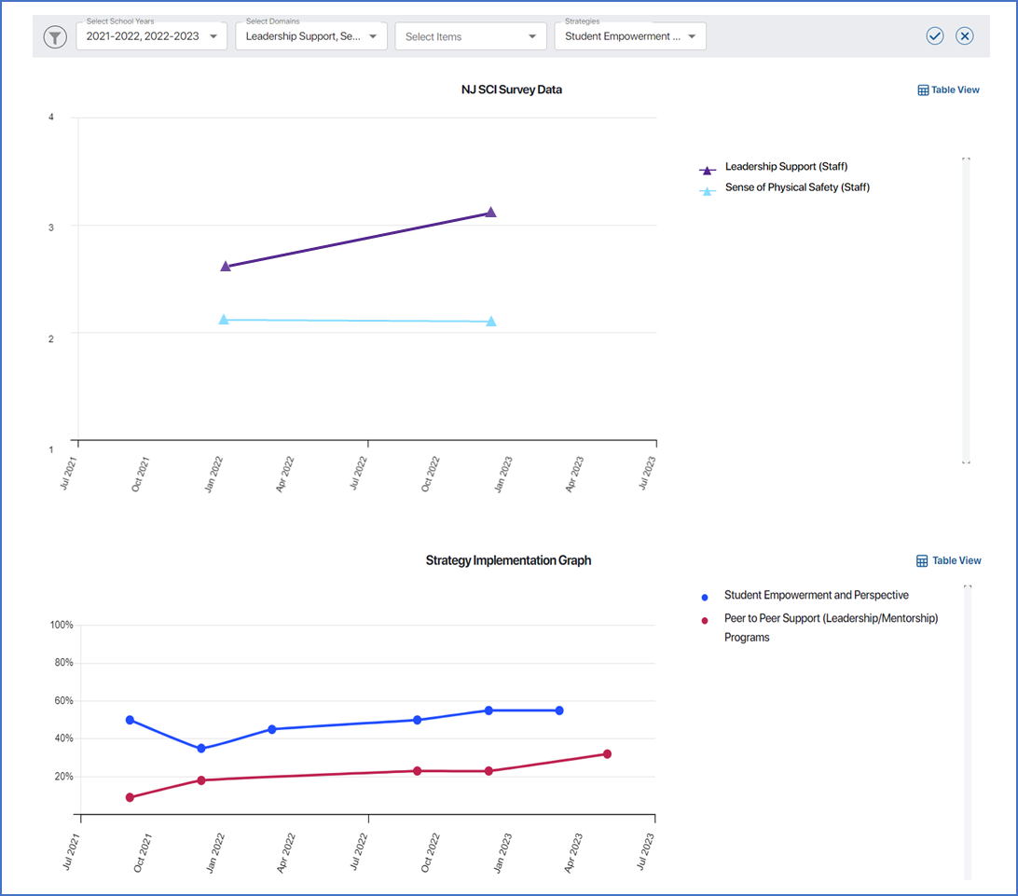
Track Your Progress

Slide 41
Ethos, Pathos, Logos in Communications
Ethos: Appeal to Credibility
Pathos: Appeal to Emotions
Logos: Appeal to Logic
Use sound reasoning, facts, and evidence to build a compelling and rational argument.
Establish your authority, expertise, and trustworthiness to persuade your audience.
Evoke emotions like empathy, concern, or enthusiasm to connect with your audience on a deeper level.
By understanding and effectively applying ethos, pathos, and logos, you can create more impactful and persuasive communications.

Slide 42

Appreciate the Journey….Regardless the Path

Slide 43
Resources You Can Use Today
Resource | Description
Parent and Family Engagement Assessment Tool | NJDOE assessment tool that allows you to survey the scope of your engagement and communication.
Tools for Calculating Chronic Absences | District and School Attendance Tracking Tools to get started with attendance screening.
Data-teaming Tools from the National Center on Intensive Intervention | Meeting guides, sample agendas, tools for analyzing data, and note-taking templates for intervention meetings.
Guide to Starting the Universal Screening Process from MTSS4Success | Worksheet to customize universal screening processes by examining the target population, administration schedule, implementation procedures, and data analysis approaches.
The New Jersey Tiered System of Supports for Early Reading (NJTSS-ER) | A U.S. Department of Education State Personnel Development Grant supports statewide capacity building for NJTSS-ER.
New Jersey School Climate Improvement Platform | The New Jersey School Climate Improvement (NJ SCI) Platform is a free, web-based application designed to increase district and school access to tools and resources for data-driven school climate improvement planning and implementation.
Notes:
Here is a list of other checklists, toolkits, guides, sample agendas, and templates for a variety of NJTSS-related topics, including chronic absenteeism, universal screening, data meetings, and family engagement.
If you’re interested, Rutgers (in conjunction with the NJDOE) developed the NJTSS-ER (Early Reading) program – it has a host of resources specific to early reading and NJTSS.

Slide 44
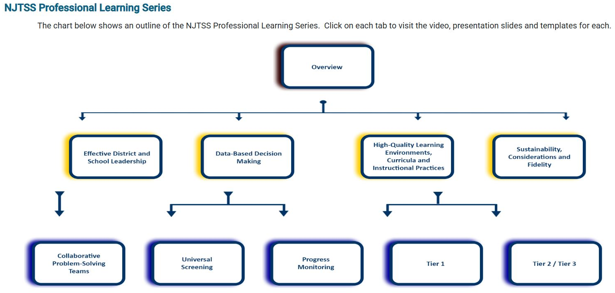

Resource: NJTSS Professional Learning Series
Videos and slides to facilitate your own learning or turnkey in district.
Notes:
Please visit our Professional Learning Series! We have a library of videos to foster your own learning or turnkey concepts in district. They are on the NJTSS website, and we have even more videos coming soon.

Slide 45
Recap

Slide 46



A message to your future self…
Write Yourself a Postcard
Reflection
Identify a Habit
Commit to Change
Take a moment to consider one communication or data habit you can adopt to strengthen NJTSS in your school.
What specific action or behavior can you implement to improve communication or data-driven decision-making for NJTSS?
Address and write down your chosen habit on the postcard provided, and pledge to put it into practice.

Slide 47






Thank You!
New Jersey Department of Education
@NewJerseyDOE
@newjerseydoe
New Jersey Department of Education
New Jersey Department of Education
NJTSS@doe.nj.gov
@newjerseydoe
Notes:
As always, I want to thank you for your time and attention today. If you are interested in learning more about the New Jersey Department of Education, please consider following us on Facebook, Instagram, LinkedIn, Threads, X and/or YouTube. I am available to take any questions today and I have this email address here should you think of questions at a later date.

