Slide 1



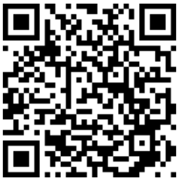

Prevention and Intervention Programs for Children and Youth who are Neglected, Delinquent, or At-Risk
Title I, Part D of the Every Student Succeeds Act (ESSA) offers federal funding to support youth defined as neglected, delinquent, or at-risk. It has two subparts, one providing state-level funding, and the other providing funds to local educational agencies (LEAs).
Title I, Part D Program Requirements
Supporting State Agencies and LEAs
The state agencies (Department of Corrections, Department of Children and Families, and the Juvenile Justice Commission) and LEAs that conduct Title I, Part D programs are required to:
Improve educational services for children and youth in local and state institutions, so the students can meet the challenging State academic standards that all students in the State are expected to meet;
Provide children and youth returning from local and state institutions and correctional facilities with the services needed to make a successful transition back to school or employment; and
Prevent at-risk youth from dropping out of school as well as provide children/youth returning from correctional facilities (or neglected and delinquent facilities) with a support system to ensure their continued education and the involvement of their families and communities.
New Jersey provides resources and opportunities for technical assistance to support state agencies and LEAs in meeting the needs of neglected, delinquent, and at-risk youth on an ongoing basis through direct response to inquiries and with the support of the Neglected and Delinquent Technical Assistance Center, which is supported by the United States Department of Education (USED).
Additionally, the New Jersey Department of Education is poised to assist agencies in improving conditions for learning through school climate initiatives (e.g., social and emotional learning, restorative justice) and the New Jersey Tiered System of Supports (NJTSS).
How Funds are Awarded: New Jersey is awarded funds under Title I, Part D through a formula grant based on the number of children in state-operated institutions and per-pupil educational expenditures.
Read the ESSA State Plan on the NJDOE website.

