Slide 1

School Ethics Commission
Business Administrator/Board Secretary Review and Approval of 2026 Personal/Relative and Financial Disclosure Statements (Disclosure Statements)
January 2, 2026

Slide 2
Populating the list

Slide 3
The log-in page for business administrators/board secretaries (board secretaries) is:
https://homeroom6.doe.state.nj.us/schoolethics/login
As a reminder, the log-in page for school officials is:
https://homeroom6.doe.state.nj.us/schoolethics/login-officials

Slide 4
Once logged in to the system, board secretaries can add school officials to their 2026 “Filing list.”
School officials can be added by either:
“Including” them from a previous list; or
(2) “Adding” a new school official.
When adding a new school official, remember to include the school official’s first name, middle name (if applicable), last name, “role” (e.g., Administrator, Board Member, or Board Secretary), and their email address.

Slide 5
When adding a new school official, please remember to include:
(1) The correct spelling of the school official’s first name;
(2) The correct spelling of the school official’s middle name (if applicable);
(3) The correct spelling of the school official’s last name;
(4) The school official’s “role” (e.g., Administrator, Board Member, or Board Secretary);
(5) A current/valid email address for the school official; and
(6) The start date of the school official’s employment/term.

Slide 6
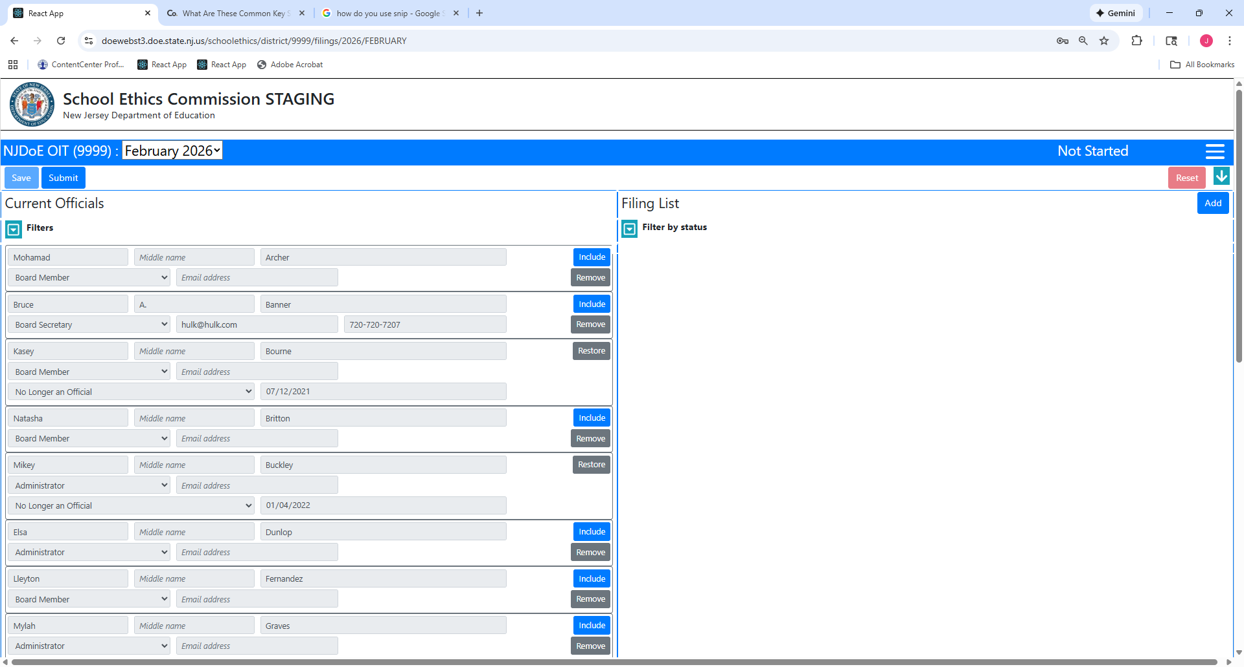

Slide 8
After populating your list, hit “Save.”
“Saving” your list will result in the creation of PINs for each school official on your list, and the status of each school official’s filing will be noted as “Not Started.”

Slide 9
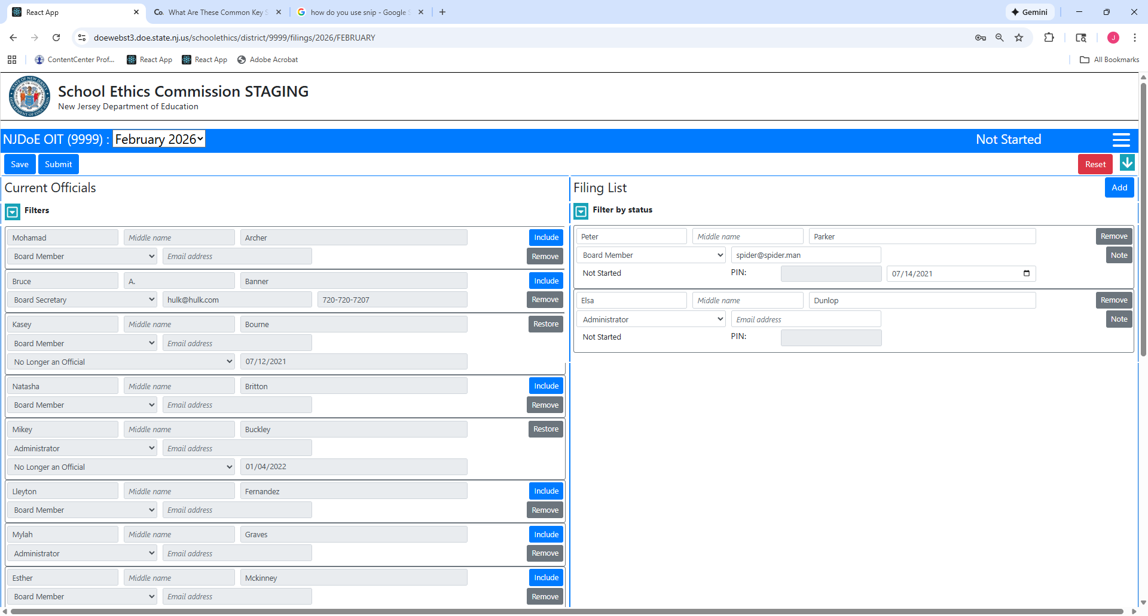

Slide 10
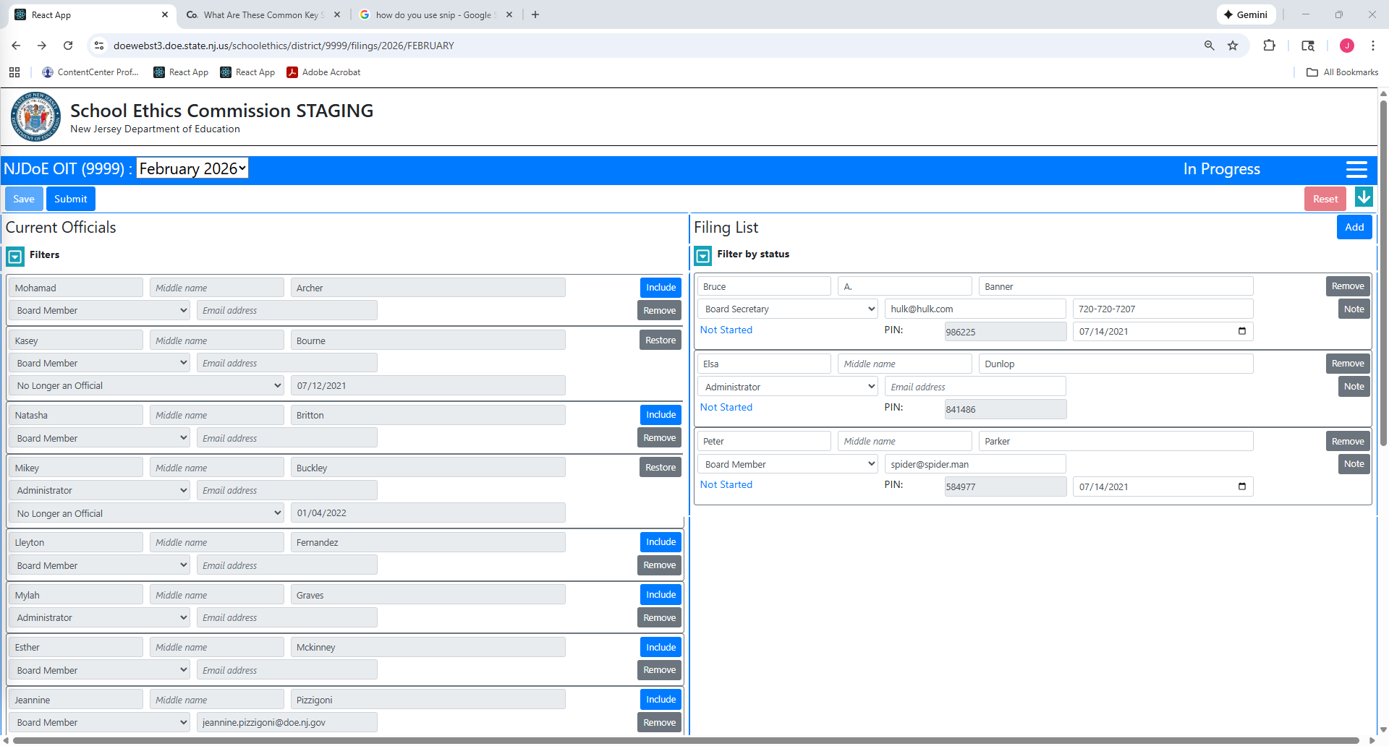

Slide 11
Important Reminder: Once PINs have been generated, it is the responsibility of the board secretary to provide each school official with their PIN.
Sample emails for board secretaries to send to school officials are available on the Commission’s website (“2026 Instructions For Filing Disclosure Statements, Exhibit A”).

Slide 12
Once all school officials have been entered on the list, the board secretary must certify and date the list (at the bottom of the page), and then click “Submit” (at the top of the page).
Important Reminder: Once the list has been submitted, new school officials cannot be added.
If a school official needs to be added after the list has been submitted, please contact school.ethics@doe.nj.gov for assistance.

Slide 13
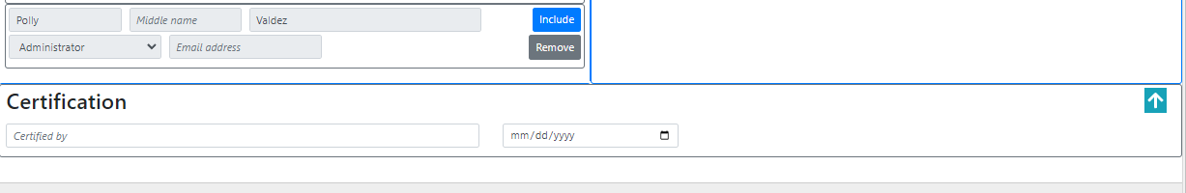

Slide 15
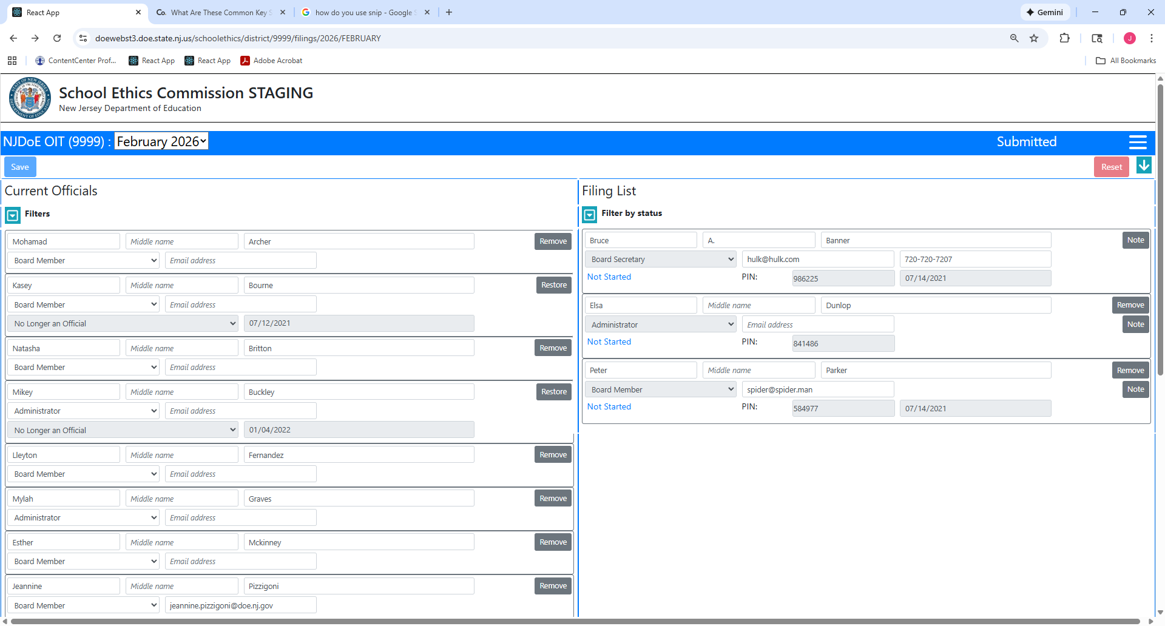

Slide 16
Accessing and viewing Disclosure Statements

Slide 17
After the list has been populated, board secretaries can:
View the status of each school official’s Disclosure Statements;
Approve a school official’s Disclosure Statements; and
Return a school official’s Disclosure Statements.

Slide 18
Definitions for Status of Disclosure Statements
Not Started: The Disclosure Statements have not been started.
In Progress: The Disclosure Statements have been started, but have not been submitted by the school official to the board secretary.
Submitted: The Disclosure Statements have been submitted by the school official, and are pending board secretary review.
Reviewed by Board Secretary: The Disclosure Statements have been reviewed by the board secretary, and are pending County Office/SEC review.
Approved: The Disclosure Statements have been approved by the County Office/SEC.

Slide 19
Approving disclosure statements

Slide 20
After a school official has uploaded and submitted his/her Disclosure Statements, the school official’s status will appear (in the list) as “Submitted.”
In order for the board secretary to approve each filing, please do the following:
Click on the “Submitted” status of a school official.
Users can filter the filing list by checking the “submitted” status.

Slide 21
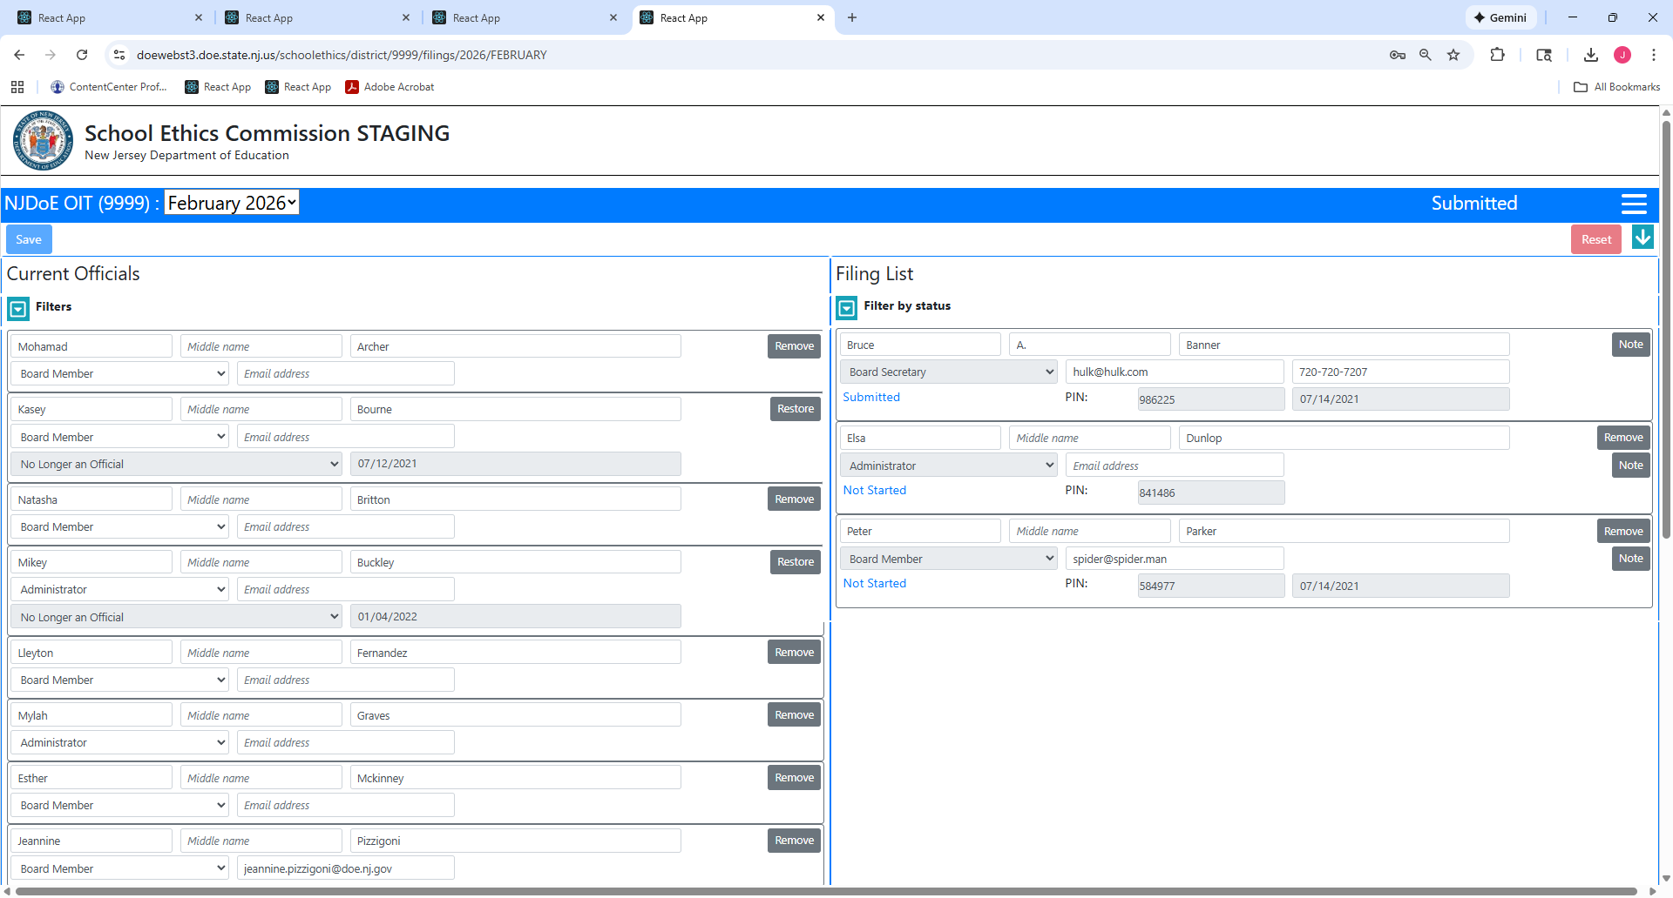

Slide 22
To view a school official’s Disclosure Statements, click “Download Uploaded Disclosure.”

Slide 23
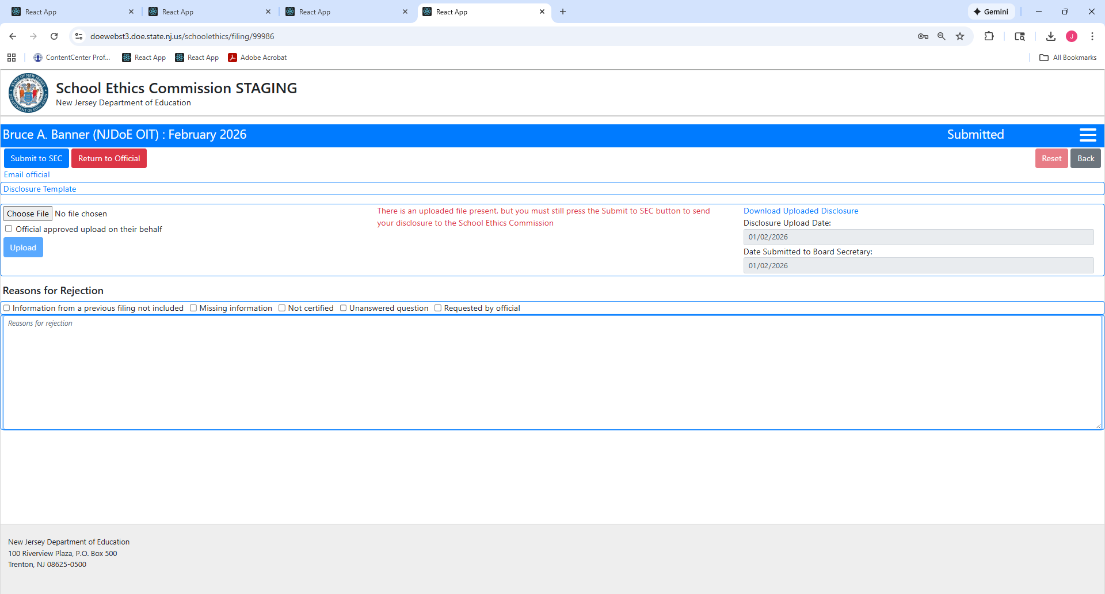

Slide 24
If, after reviewing a school official’s Disclosure Statements, the board secretary determines they are complete, click “Submit to SEC.”

Slide 25
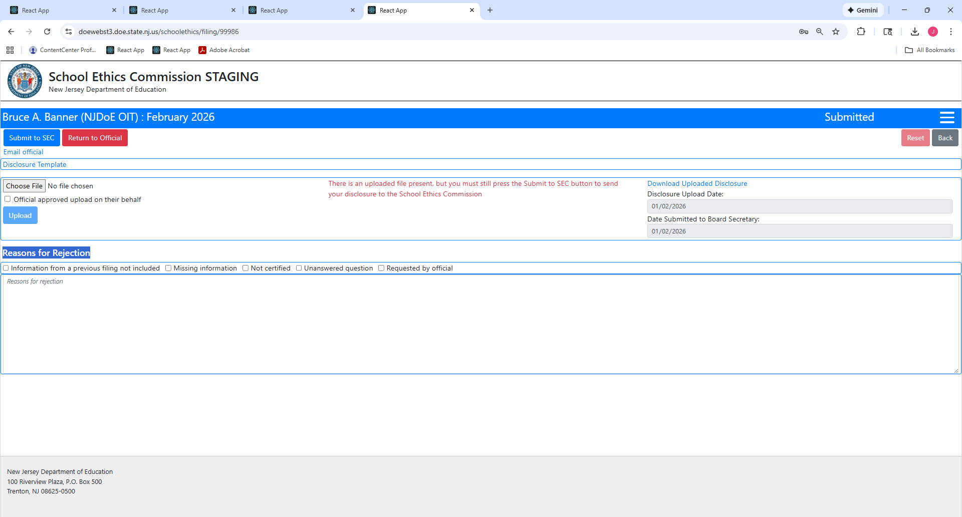

Slide 26
Once the board secretary clicks “Submit to SEC,” there is nothing further for the board secretary to do, and the Disclosure Statements will be pending County Office/SEC review.
Note that, after the board secretary clicks “Submit to SEC,” the filing status of the school official changes to “Reviewed by Board Secretary.”

Slide 27
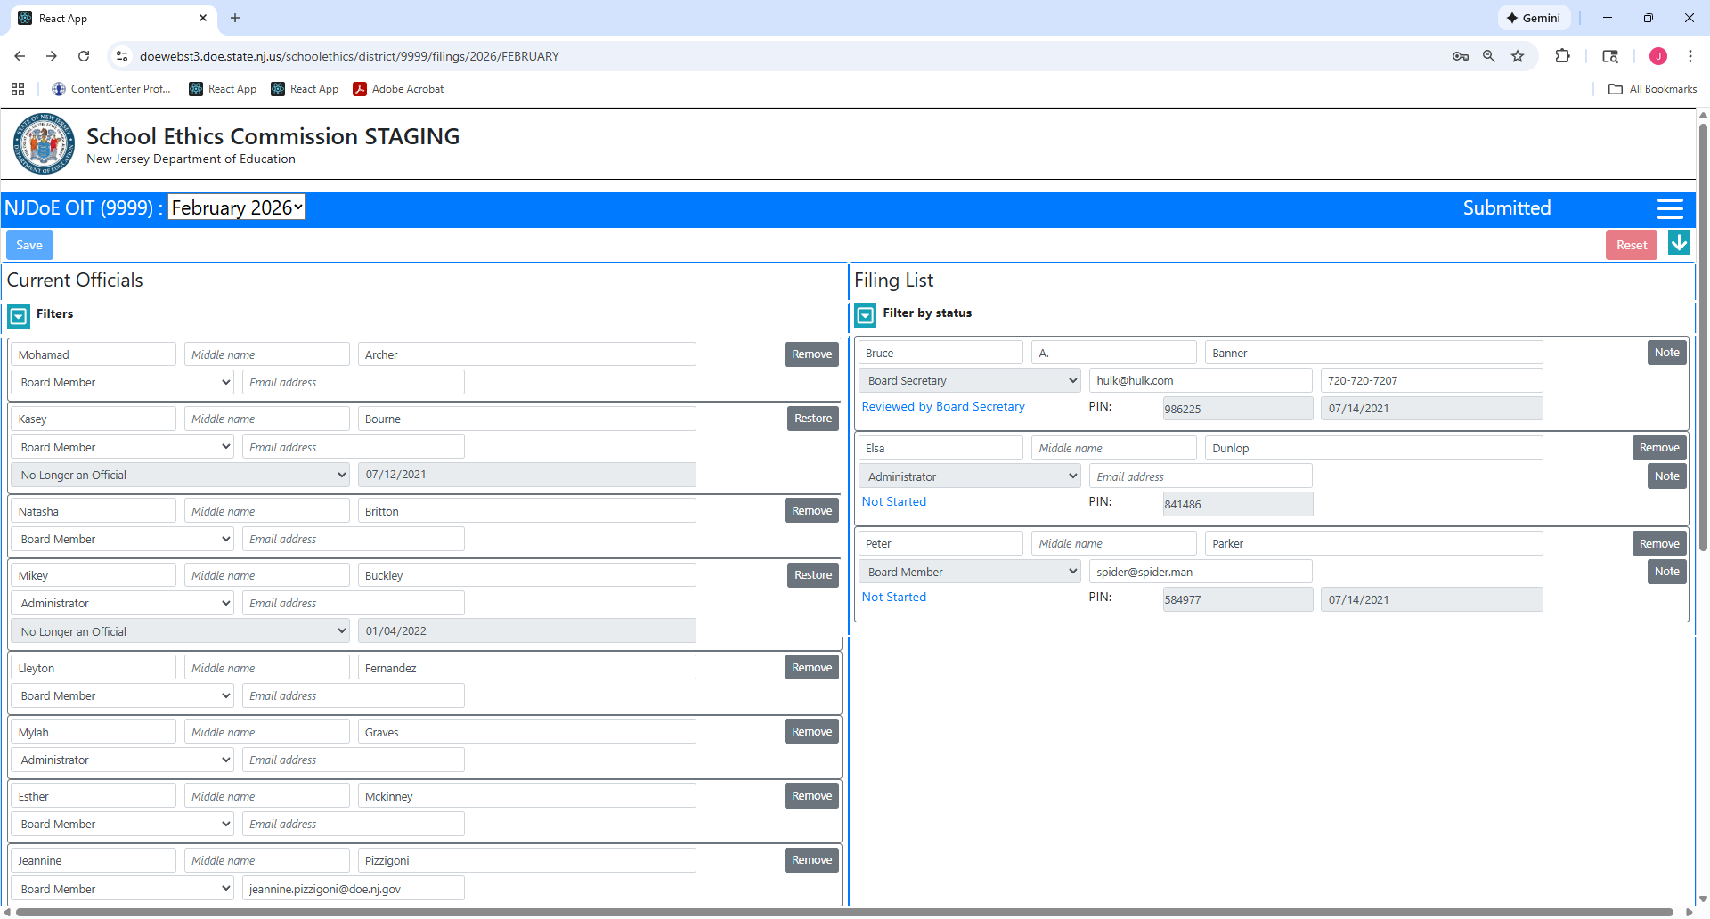

Slide 28
RETURNING DISCLOSURE STATEMENTS

Slide 29
If, after reviewing a school official’s Disclosure Statements, the board secretary determines there are errors requiring the return of the Disclosure Statements to a school official, please do the following:
Select the reason(s) for returning the filing.
  There are five pre-populated reasons for returning the Disclosure Statements: information from a previous filing not included; missing information; not certified; unanswered question; and requested by official.
  To the extent there may be another reason(s) for returning the filing, there is a text box for the board secretary to include a narrative/detailed explanation.
  If the board secretary does not enter a reason(s) for returning the Disclosure Statements, an error message will appear.
Important: Although the school official will be able to view the notes/reasons for return of his/her filing, the school official does not automatically receive a notification that his/her filing has been returned. Therefore, it is recommended that, before the board secretary clicks “Return to Official,” he/she should send an email to the school official advising of the impending return.

Slide 30
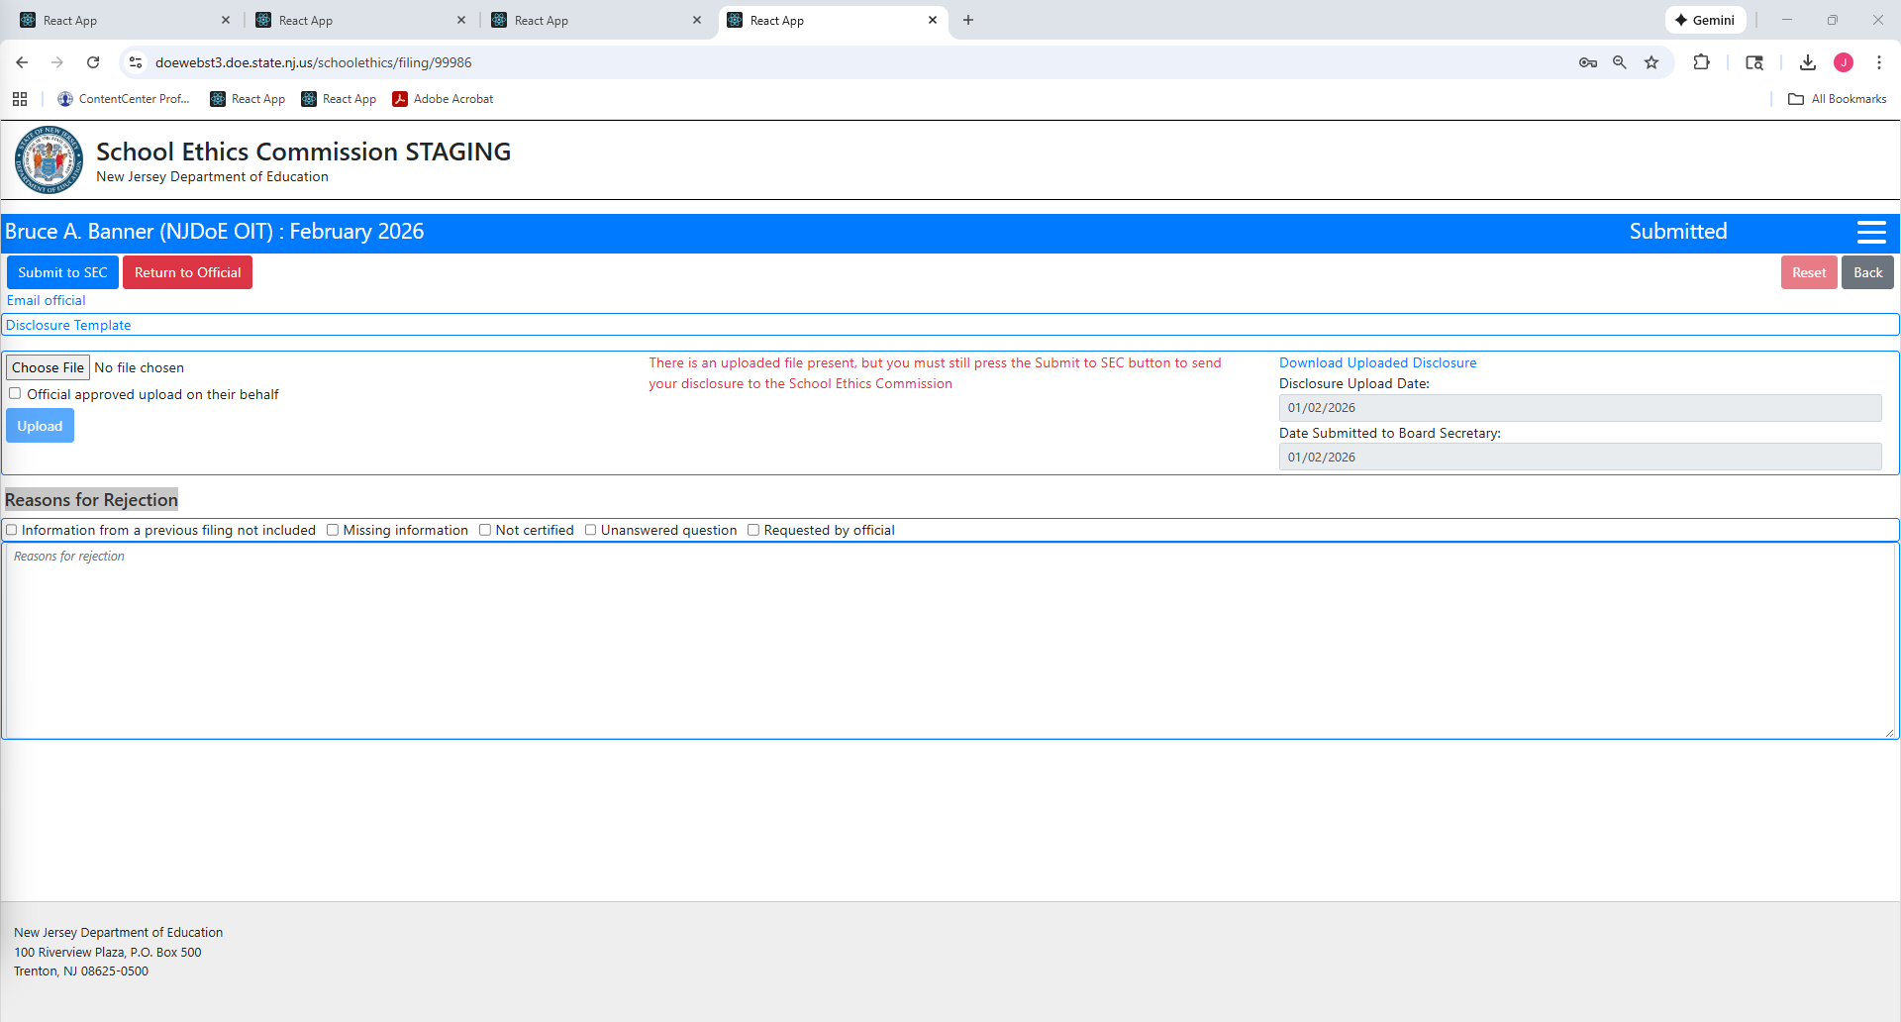

Slide 31
Next, click “Return to Official.”

Slide 33
Once the board secretary clicks “Return to Official,” there is nothing further for the board secretary to do in the system. However, the board secretary should notify the school official that their filing has been returned for correction.
Note that, after the board secretary clicks “Return to Official,” the filing status of the school official (on the list of school officials) changes to “Returned to Official.”

Slide 34
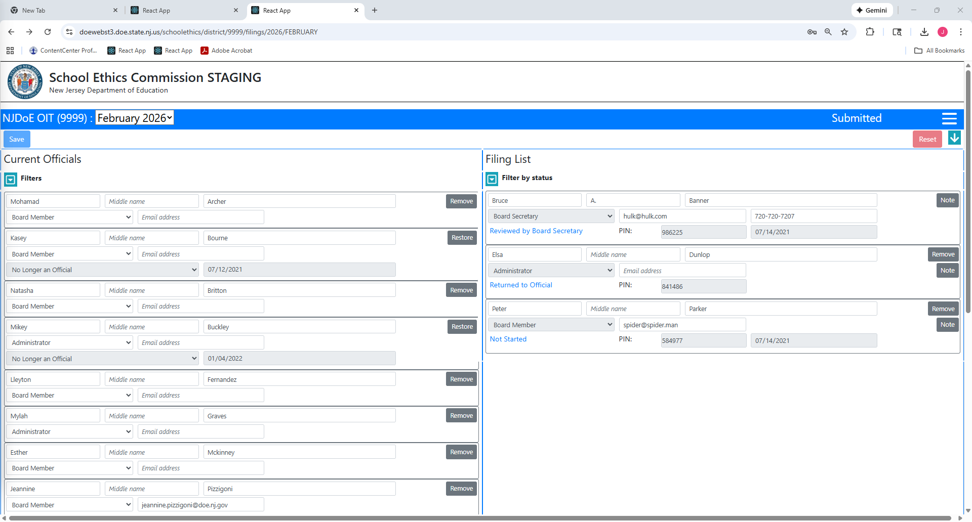

Slide 35
The school official will need to log-in to the electronic filing system to view the errors associated with his/her filing (https://homeroom6.doe.state.nj.us/schoolethics/login-officials).
After the school official logs-in, he/she can download the document that was previously submitted, and make the necessary corrections to the Disclosure Statements.
Once the corrections are made to the Disclosure Statements, the school official must save a new version of the Disclosure Statements.

Slide 36
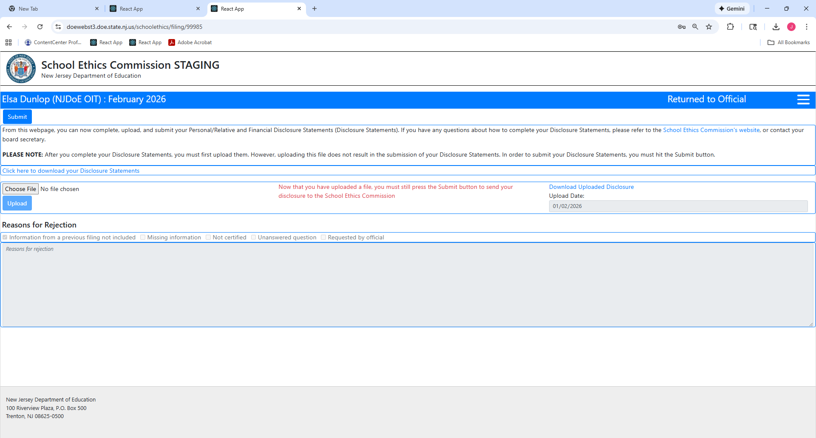
After clicking this link, the school official can view the document submitted previously, and can make the necessary corrections.
NOTE: A new version of the document will need to be saved to the school official’s computer.

Slide 37
After the corrections have been made and the file saved, the school official must click “Choose File.”

Slide 39
After the school official selects a file (the corrected version of his/her completed Disclosure Statements), the school official must click “Open.” The file name will then appear next to “Choose File.”
The school official must click “Upload.”
If the file was uploaded successfully, the screen will indicate, “Upload successful.”

Slide 40
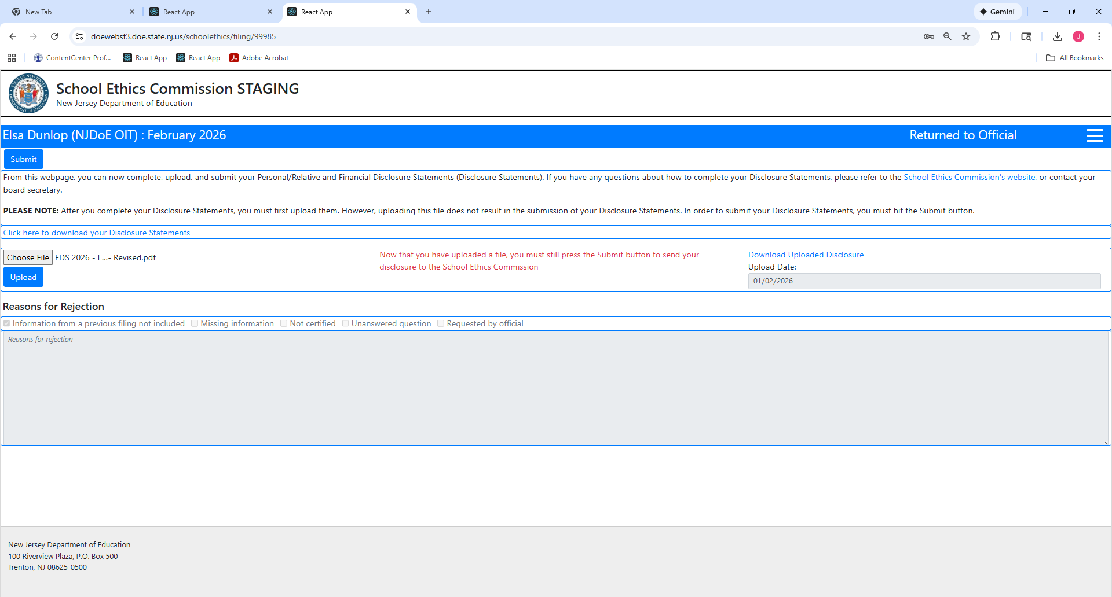
The file name will appear next to “Choose File”

Slide 41
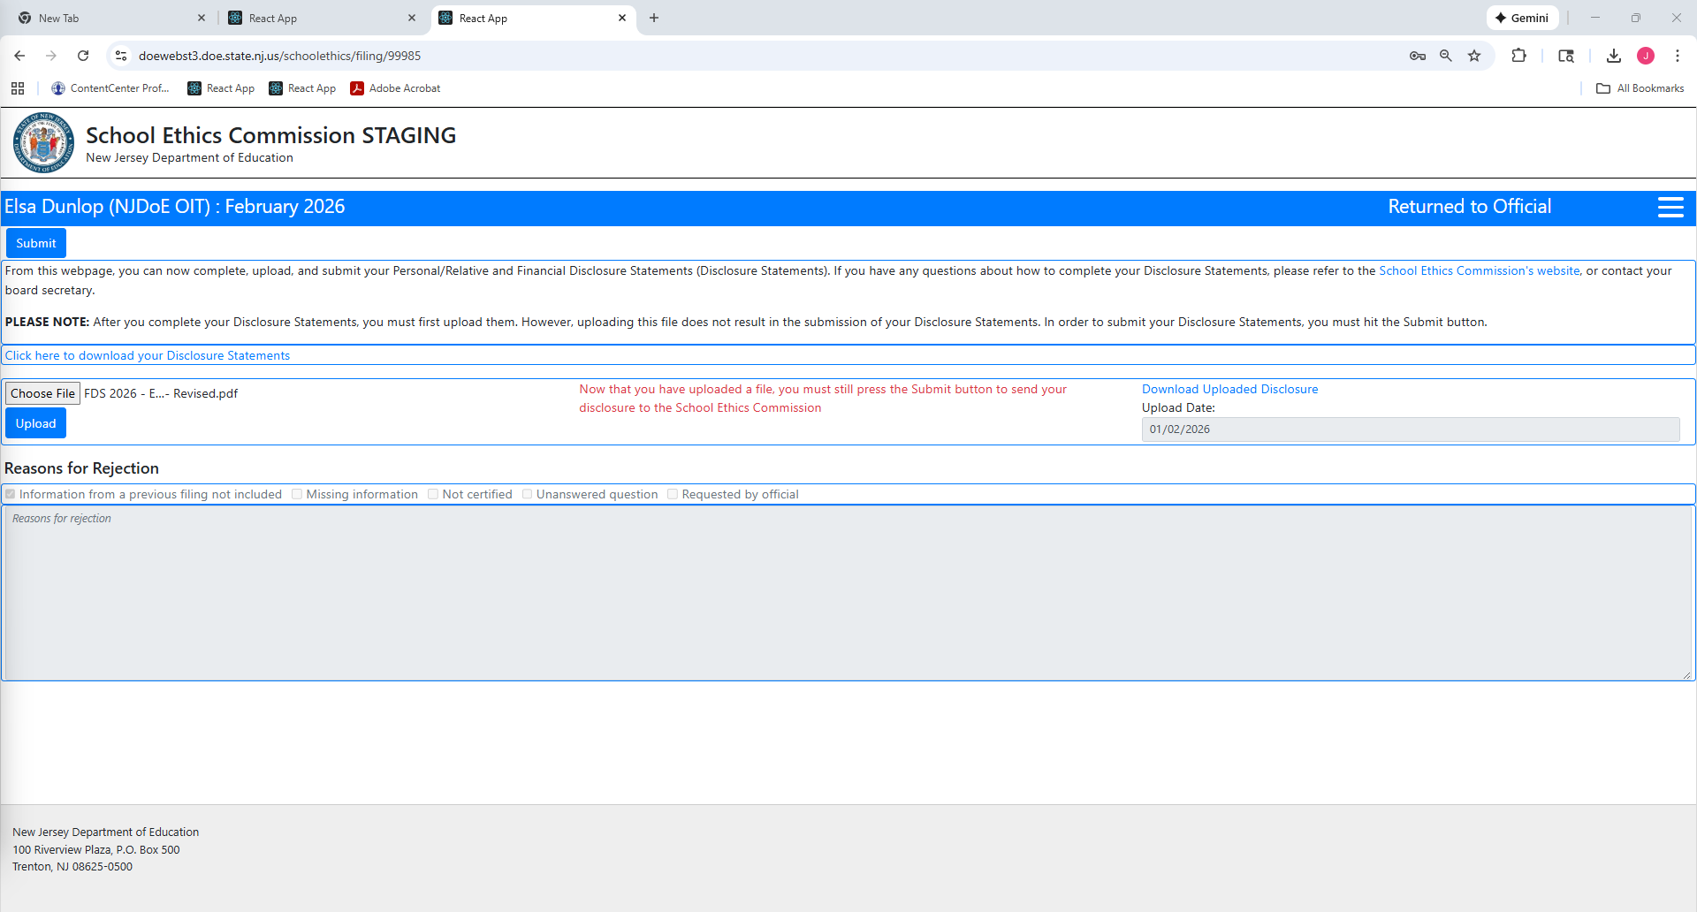
The file must be uploaded

Slide 42
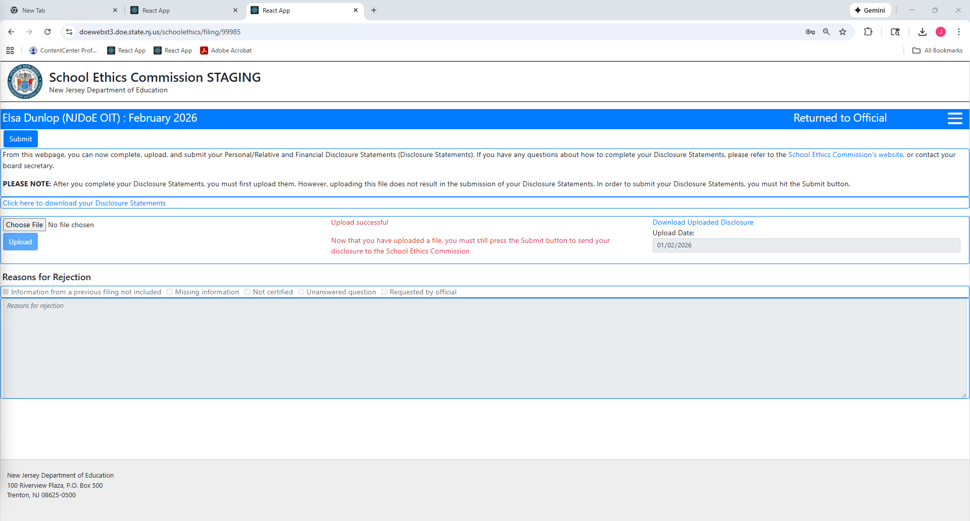

Slide 43
Once uploaded successfully, the school official must click “Submit.”
Note that, once the school official clicks “Submit,” the filing status of the school official (on the list of school officials) changes to “Submitted,” and is again pending board secretary review.

Slide 45
Once the school official resubmits his/her Disclosure Statements, the board secretary must re-review the filing.
If the Disclosure Statements still contain errors, the board secretary should repeat the procedures set forth in this section.
If the Disclosure Statements are complete, the board secretary should approve the filing by following the steps outlined in “Approving Disclosure Statements.”

Slide 46
Submitting disclosure statements ON BEHALF OF a school official

Slide 47
If, for whatever reason, a school official is unable to submit his/her Disclosure Statements through the electronic filing system, the board secretary may, if requested, submit a school official’s completed Disclosure Statements as follows:
From the board secretary’s log-in page (https://homeroom6.doe.state.nj.us/schoolethics/login), click on the “Not Started” or “In Progress” status of the school official’s Disclosure Statements.

Slide 48
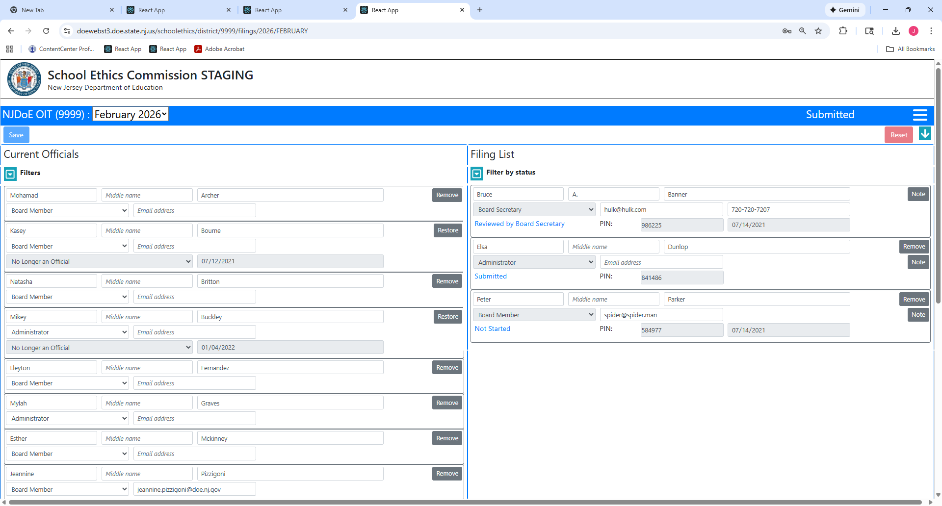

Slide 49
Next, click “Choose File.”
After the board secretary has selected a file (the PDF version of the school official’s completed Disclosure Statements), click “Open.” The file name will then appear next to “Choose File.”
The board secretary must check the box that states, “Official approved upload on their behalf.”
After the box is checked, click “Upload.”
If the file was uploaded successfully, the screen will indicate, “Upload successful.”

Slide 50
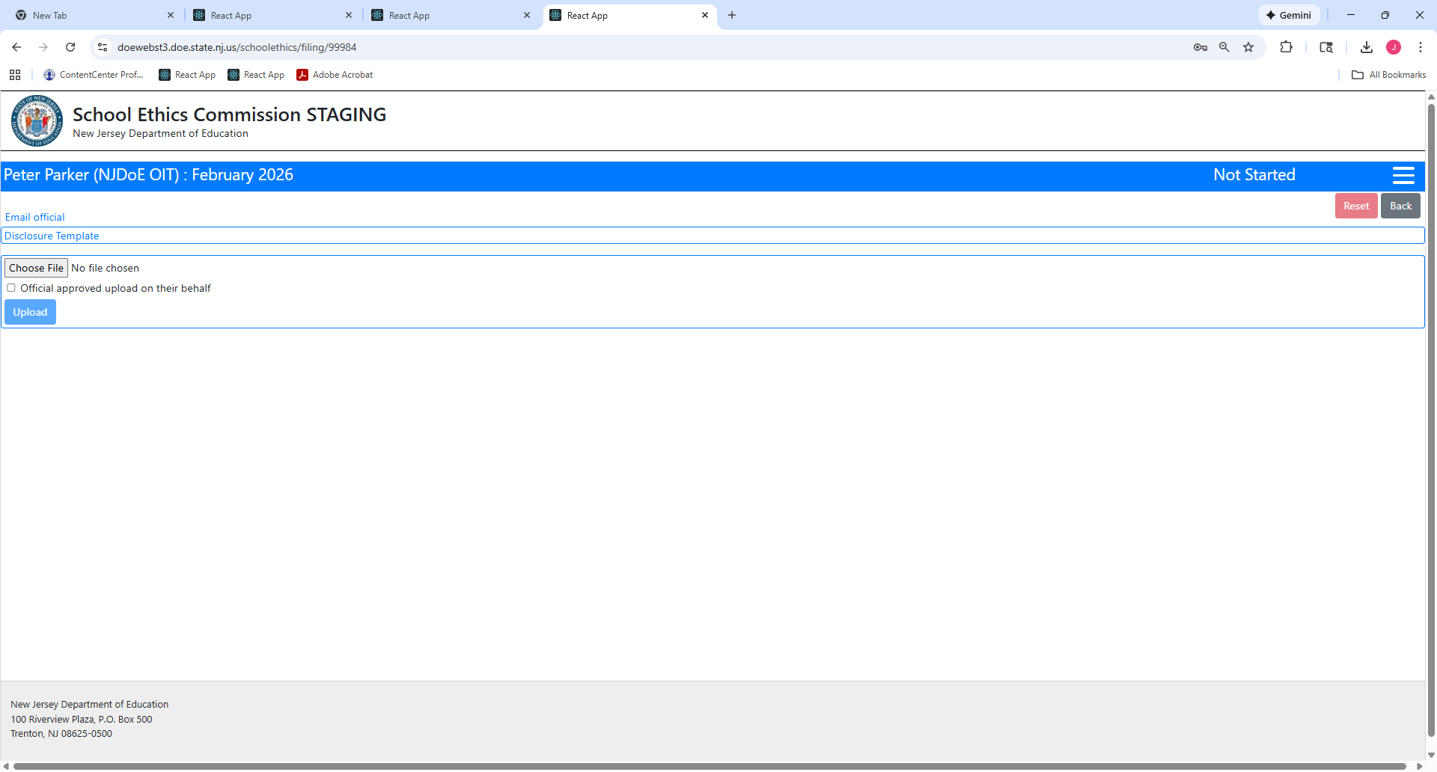

Slide 51


Slide 52
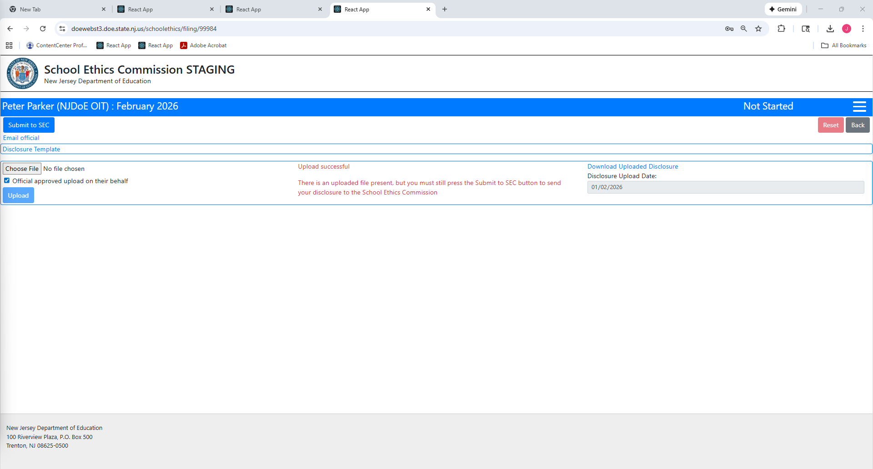

Slide 53
Once uploaded successfully, click “Submit to SEC.”
Once the board secretary clicks “Submit to SEC,” there is nothing further for the board secretary to do, and the Disclosure Statements will be pending County Office/SEC review.
Note that, after the board secretary clicks “Submit to SEC,” the filing status of the school official (on the list of school officials) changes to “Reviewed by Board Secretary.”

Slide 55
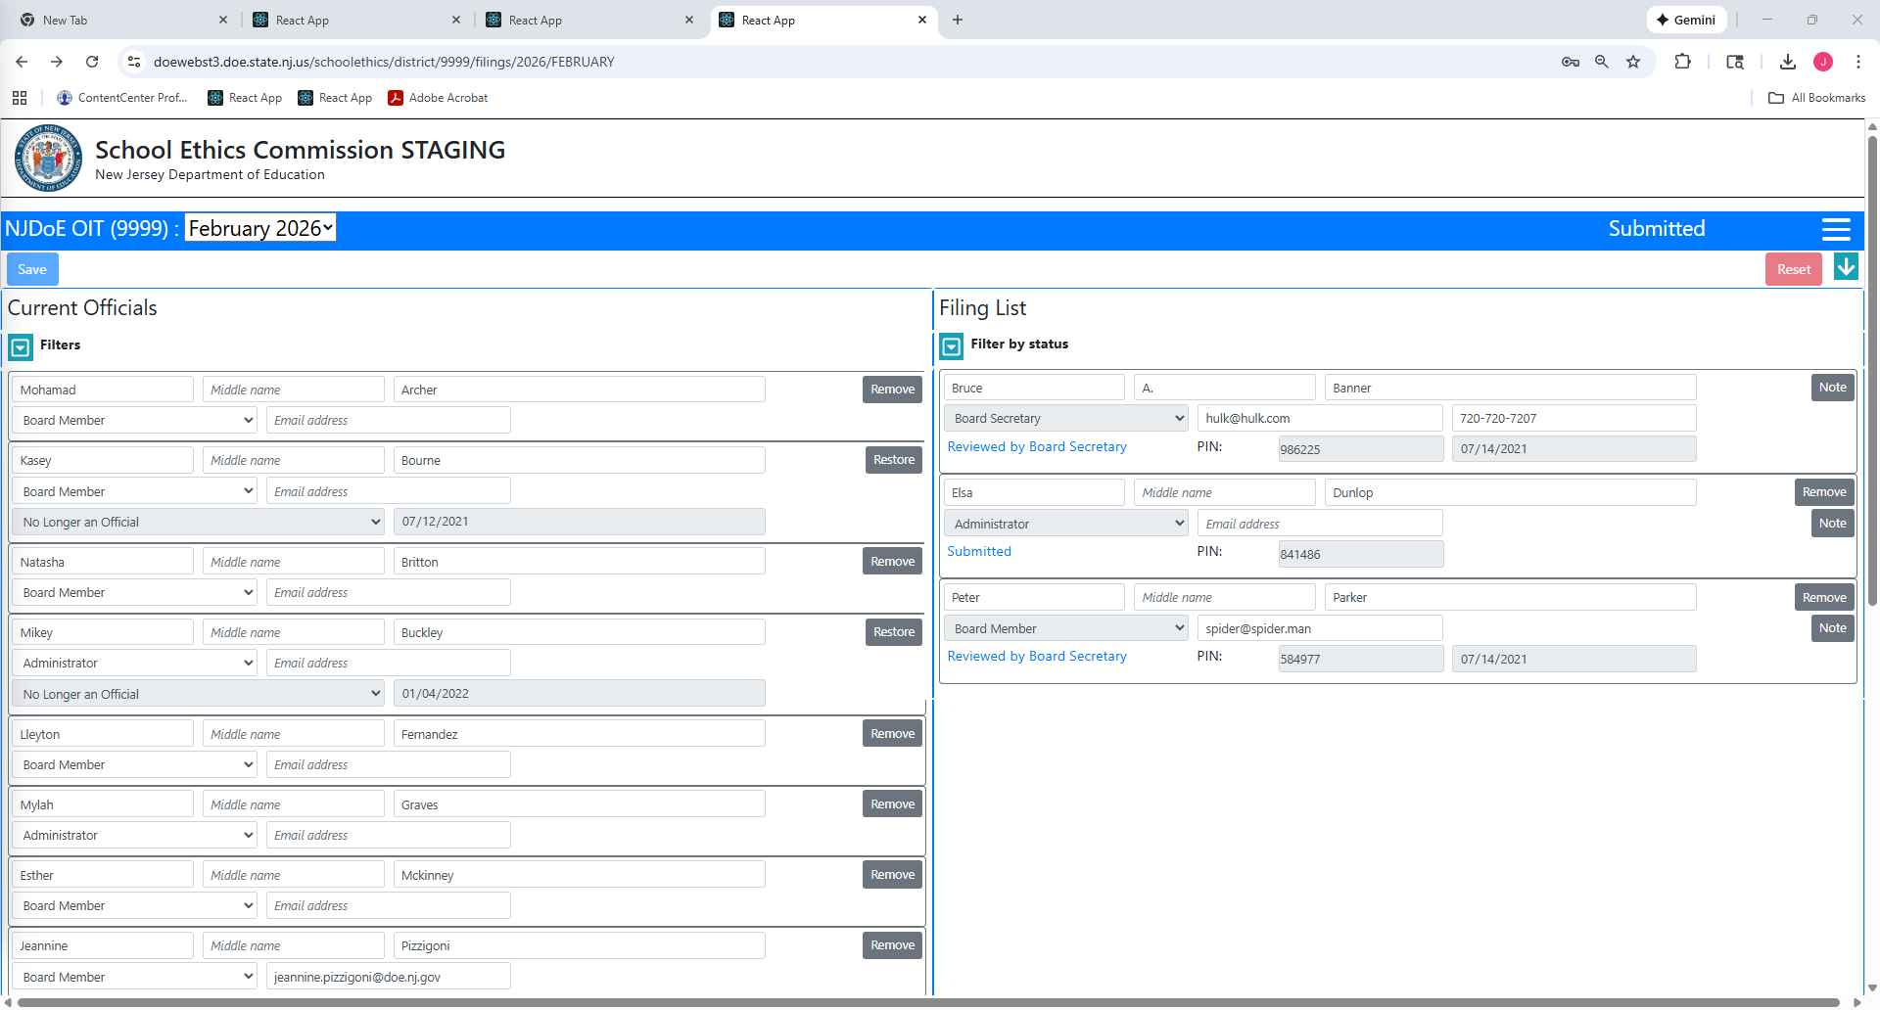

Slide 56
Questions?
Please contact school.ethics@doe.nj.gov or
refer to the School Ethics Commission’s website: https://www.nj.gov/education/ethics/fds/index.shtml
Thank you.

