Slide 1
New Jersey Department of Education
NJGMS Technical Assistance: FY27 ESEA Original Application
Office of Grants Management
May 2026
nj.gov/education

Slide 2

Goals of Today’s Work Session​
How to create the FY27 ESEA Application in NJGMS.​
Steps to complete the application in NJGMS.​
Submit the application to the NJDOE.​
Answer any outstanding general questions and give specific guidance for your district.​

Slide 3

Dates to Remember
Application Opened: 6/23/2026
Application Due By: 7/31/2026
Consortium Due By: 7/8/2026 5:00 pm
Project Period: 7/1/2026 – 9/30/2027
Revision Due By: 5/14/2027

Slide 4
FY27 Improvements
Increased character counts.
Allowable use updates.
Submit button is back!
Separated from the Bd. Authorization page.
Budget changes to group function-object codes.
Commas & Dollar Signs!
Pop-Up confirming your submission.
Email notifications!

Slide 5
NJGMS Getting Started Guide
FY27 ESEA Consolidated

Slide 6

Where is my FY27 ESEA grant?
Most asked question…
I don’t see my FY27 ESEA grant, where is it?
  First, update the Contacts from the Organization Profile.
  Next, agree to Assurances in the Organization Profile.
  Save the Application.
Dashboard - Applications
  Select the ESEA tile.
  Click on Create Application.

Slide 7
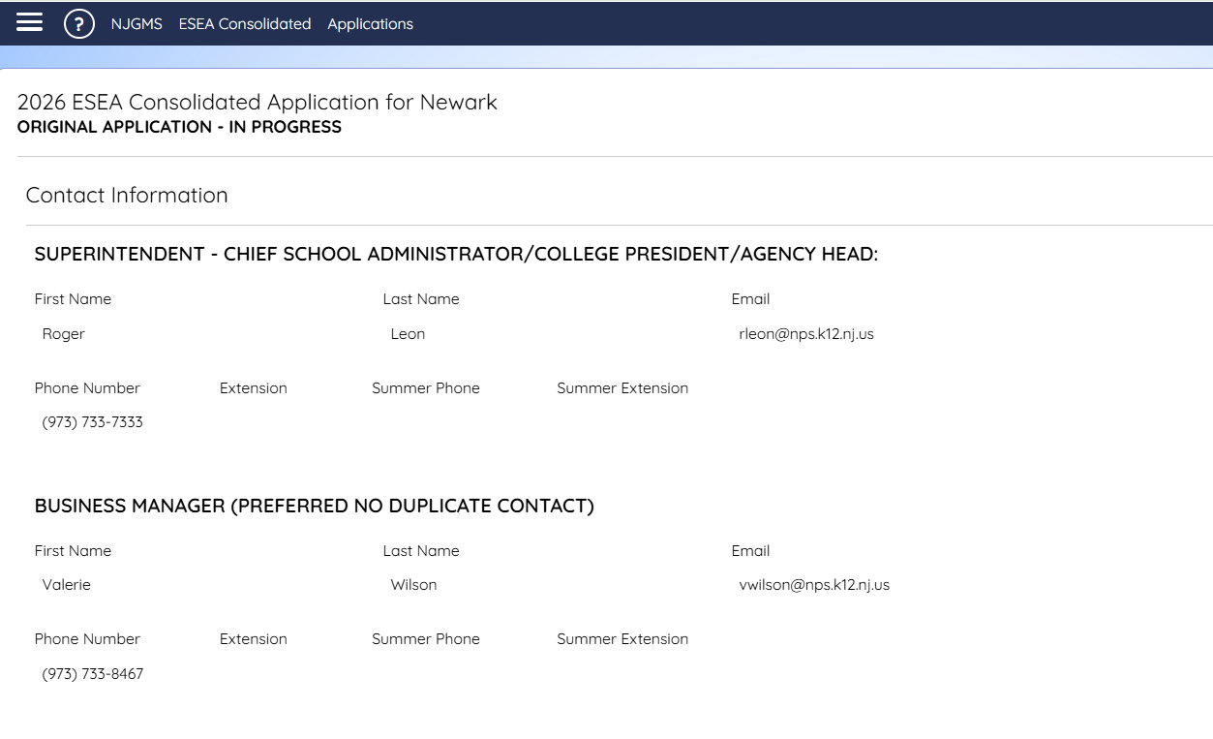
FY27 ESEA Consolidated (1 of 2)
Contact Information
Contact information is imported from the Organization Profile.
If contact information needs to be changed, this must be done in the Organization Profile.

Slide 8
FY27 ESEA Consolidated (2 of 2)
Allocations
All allocations will show in the first table.
Carryover will generate after the FY26 Final Expenditure Report has been approved.
Released funds will generate upon completion of the Refused Funds section.
Title | Title I-A | Title I D LEA | Title I SIA Part A | Title II-A | Title III | Title III Immigrant | Title IV Part A | Title V RLIS
Public Allocation | $2,070,411 | blank | $150,000 | $338,911 | $406,366 | $45,650 | $156,253 | blank
Part A Neglected | $203,183 | blank | blank | blank | blank | blank | blank | blank
ReAllocated Curr Year (+) | blank | blank | blank | blank | blank | blank | blank | blank
ReAllocated Prior Year (+) | blank | blank | blank | blank | blank | blank | blank | blank
Release (−) | blank | blank | blank | blank | blank | blank | blank | blank
Total | $2,476,777 | $0 | $150,000 | $338,911 | $406,366 | $45,650 | $156,253 | $0
Carryover | blank | blank | blank | blank | blank | blank | blank | blank

Slide 9
Consortium Application
Title IIA, Title III, Title III Immigrant & Title IVA
FY27 Consortium Applications are outside of the ESEA Application. Please see the NJGMS Dashboard for instructions on how to apply.
Important Information
Consortium applications are due by 5:00 pm on 7/8/2026. There will be no extensions or exceptions.
Only the Lead Applicant will submit one application identifying all the participants. Multiple applications or changes to the application once it is submitted are not permissible.
The Lead Applicant must maintain all documentation related to the participants agreeing to participation in the consortium.
The Participant does not complete the application.
Once the consortium is approved, funds will be transferred into the lead applicant and display on the Allocations page in the ESEA Application.
Neither the Lead or the Participant should submit the ESEA Application until the transfer of funds is completed.

Slide 10
FY27 ESEA Consolidated (1 of 4)
Allocations- Consortiums
Consortium information will be displayed here when applicable.
For FY27, Consortium Applications will be outside of the application. Please see the Dashboard for instructions for applying.
A list of FY26 Consortia can be found on the OGM ESEA Website.
Consortium | Title I-A | Title I D LEA | Title I SIA Part A | Title II-A | Title III | Title III Immigrant | Title IV Part A | Title V RLIS
Funds Received | blank | blank | blank | blank | blank | blank | blank | blank
Funds Contributed | blank | blank | blank | blank | blank | blank | blank | blank
Applicant LEA / Member | blank | blank | blank | blank | blank | blank | blank | blank
Total Adjusted | $2,476,777 | $0 | $150,000 | $338,911 | $406,366 | $45,650 | $156,253 | $0

Slide 11
FY27 ESEA Consolidated (2 of 4)
Allocations- Transfers
This table allows the transfer of Title II-A and Title IV Part A funds into allowable Titles.
Totals will adjust to reflect transfers after the page is saved.
Transfers are only allowed on the original application and/or when budgeting carryover in a revision.
Transfers | Title I-A | Title I D LEA | Title I SIA Part A | Title II-A | Title III | Title III Immigrant | Title IV Part A | Title V RLIS
Available for Transfer | blank | blank | blank | $338,911 | blank | blank | $156,253 | blank
From Title II-A | 1000 | blank | blank | blank | blank | blank | 10000 | blank
From Title IV Part A | 1000 | blank | blank | 15000 | blank | blank | blank | blank
Total Available | $2,478,777 | $0 | $150,000 | $342,911 | $406,366 | $45,650 | $150,253 | $0

Slide 12
FY27 ESEA Consolidated (3 of 4)
Allocations- Refused Funds
Place a check in the box for the Current Year or Previous Year (carryover*) Funds.
Refused Funds | Title I-A | Title I D LEA | Title I SIA Part A | Title II-A | Title III | Title III Immigrant | Title IV Part A | Title V RLIS
Current Year Funds | ☐ empty checkbox | ☐ empty checkbox | ☐ empty checkbox | ☐ empty checkbox | ☑ Checked box | ☐ empty checkbox | ☐ empty checkbox | ☐ empty checkbox
Previous Year Funds | ☐ empty checkbox | ☐ empty checkbox | ☐ empty checkbox | ☐ empty checkbox | ☐ empty checkbox | ☐ empty checkbox | ☐ empty checkbox | ☐ empty checkbox

Slide 13
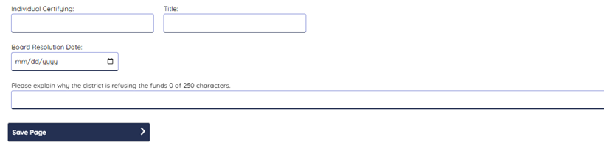
FY27 ESEA Consolidated (4 of 4)
Allocations- Refused Funds
Complete the required fields to confirm the refusal.
Save the Allocations page.
LEAs are required to engage in timely, meaningful consultation with nonpublic schools before transferring funds out of Title II, Part A and/or Title IV, Part A. ESEA §117(b)(1) and ESEA…
Districts receiving a Title IV-A allocation of $30K or more must conduct a comprehensive needs assessment prior to receiving its allocation. A subsequent needs assessment to examine its needs…
✅The school district hereby resolves through a Board resolution not to apply for the fund specified above for the current Fiscal Year. {checkbox is checked}

Slide 14
Non-Public Consultation (1 of 3)
LEAs are required to engage in timely and meaningful consultation with nonpublic school officials to determine their needs and the services the LEA will provide. The nonpublic equitable share is calculated in the ESEA application and varies by title.
For Title I, Part A, LEAs are required to identify the number of students who reside in their district and attend nonpublic schools either inside or outside of their geographic area. The equitable share is calculated in Title I, Part A, Eligibility based on information the LEA enters.
For Title II, Part A; Title III; Title III Immigrant; and Title IV, Part A, the calculation is based on information the nonpublic schools enter on the Nonpublic Enrollment Report and includes only those nonpublic schools located in an LEAs geographic area.

Slide 15
Non-Public Consultation (2 of 3)
To ensure equitable services are provided in a timely manner, pursuant to requirement under ESEA, as amended by Every Student Succeed Act (ESSA), a LEA must obligate all funds allocated for equitable services in the year for which they are appropriated.
LEAs are required to complete and upload the Nonpublic ESEA Consultation forms in NJ Homeroom.

Slide 16
Non-Public Consultation (3 of 3)
For programmatic questions regarding the provision of equitable services please consult the NJDOE Nonpublic Consultation Toolkit or email the ESEA Nonpublic Ombudsman
Ombudsman.NonPublic@doe.nj.gov

Slide 17
NJGMS Getting Started Guide
FY27 Needs Assessment

Slide 18
FY27 Needs Assessment (1 of 3)
Improvements
Several of the text boxes have an increased character count based on feedback from County Reviewers and districts.
The Need Summary page has been moved to last in the sequence.
Error Message will display on the Messages tab if the district did not complete the required fields and/or has at least one identified need.

Slide 19
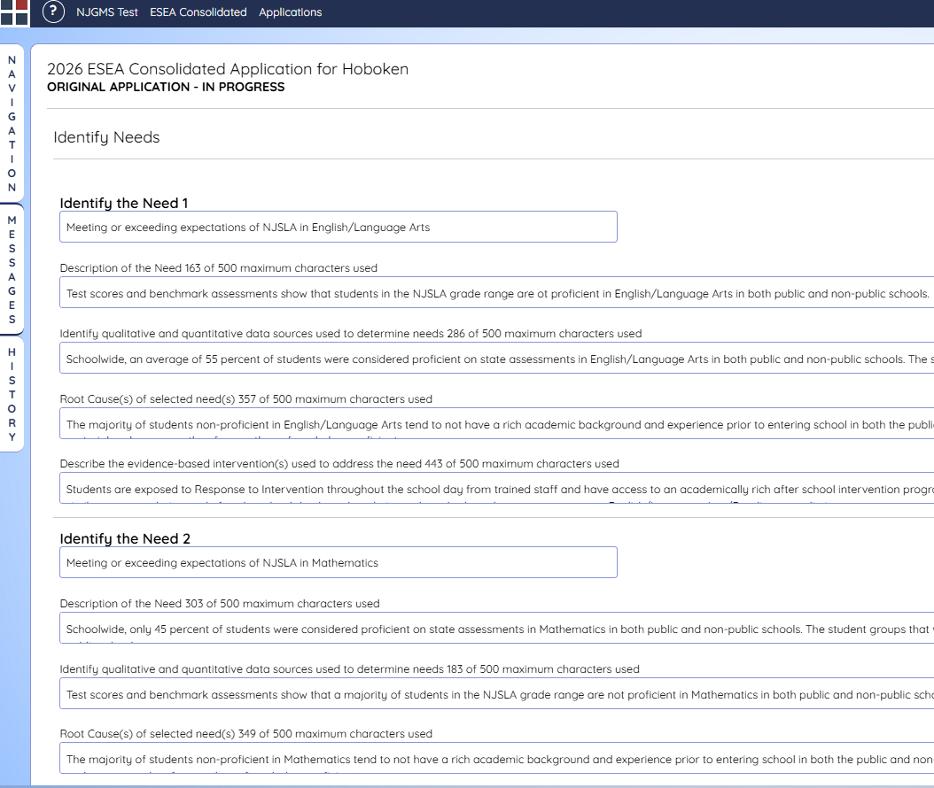
FY27 Needs Assessment (2 of 3)
Identify Needs 1–5/6–10
Input at least one (required) or more needs, up to ten total.
Once you Identify your Need(s), the following fields are required:
  Description of Need
  ESEA Funding Source
  Identify Qualitive and Quantitative data sources.
  Root Causes
Save the page after each Need is Identified and all required fields for that need are completed.

Slide 20
FY27 Needs Assessment (3 of 3)
Needs Summary
The Needs Summary page is generated from the Identify Needs 1–5 and Identify Needs 6–10 pages.
Select the appropriate Title(s) to fund each Need.
Save the page.
Tip: Once saved, the Identified Needs will be brought into the sub-grant applications as funded.
Identify Need | Title I-A | Title I-D | Title I SIA Part A | Title II-A | Title III Part A | Title III Part A Immigrant | Title IV Part A | Title V RLIS
Meeting or exceeding expectations of NJSLA in English/Language Arts | ✅ Checked box | Blank | blank | ✅ Checked box | ✅ Checked box | ✅ Checked box | ✅ Checked box | blank
Meeting or exceeding expectations of NJSLA in Mathematics | ✅ Checked box | Blank | blank | ✅ Checked box | ✅ Checked box | ☐ empty checkbox | ☐ empty checkbox | Blank

Slide 21
NJGMS Getting Started Guide
FY27 Title I-A Eligibility

Slide 22
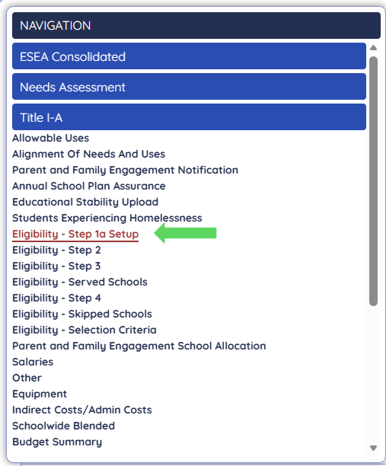
FY27 Title I-A Eligibility (1 of 11)
Getting Started
Eligibility must be completed in order (Step1a – Step 4)
Expand the menu for Title IA and click on Eligibility Step 1a Setup

Slide 23
FY27 Title I-A Eligibility (2 of 11)
Step 1a
Enter your school-based enrollment data for the public and non-public (don't forget to Save the Page)
Select the appropriate Certification(s) for your district.
School Attendance Areas | Category | Grade Span | Feeder Method Used | CEP (Y/N) | Students Experiencing Homelessness | Total Non-public Enrollment | Number Low Income Public | Number Low Income Non-public
0004 – NJ Reg Day School | Secondary | PK–12 | ☐ empty checkbox | ✅ Checked box | 0 | 0 | 0 | 0
0010- Arts | Secondary | 9–12 | ☐ empty checkbox | ☐ empty checkbox | 0 | 0 | 0 | 0

Slide 24
FY27 Title I-A Eligibility (3 of 11)
Step 1a (continued)
Select your Data Source for Title IA Eligibility
If CEP is checked for any attendance centers, the CEP options and certification will be under the enrollment table after you save.
Title I Eligibility – Step 1a Eligibility Setup
Data for non-CEP school attendance centers if not using Direct Certified data (Public data for CEP approved school attendance centers will be pre-entered by the NJDOE)
a. Free and/or reduced lunch
b. Temporary Assistance to Needy Families (TANF)
c. Supplemental Nutrition Assistance Programs (SNAP)
d. National School Lunch Program (NSLP)
e. School Breakfast Program (SBP)
f. Special Milk Program for Children
g. Summer Food Service Program)
h. Seamless Summer Option (NJ Dept of Agriculture)
i. Census poverty data (generally not available at the school level; if an LEA uses this measure, it would likely be part of a composite with one or more of the above measures)
j. Medicaid data
k. Composite of any of the above poverty measures (counted by the LEA)

Slide 25
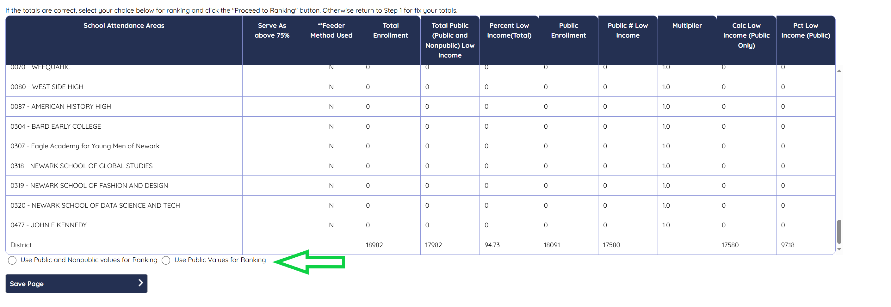
FY27 Title I-A Eligibility (4 of 11)
Step 2
Select your Values for Ranking & Save the Page. (Use public and nonpublic values for ranking or use public values for ranking)

Slide 26
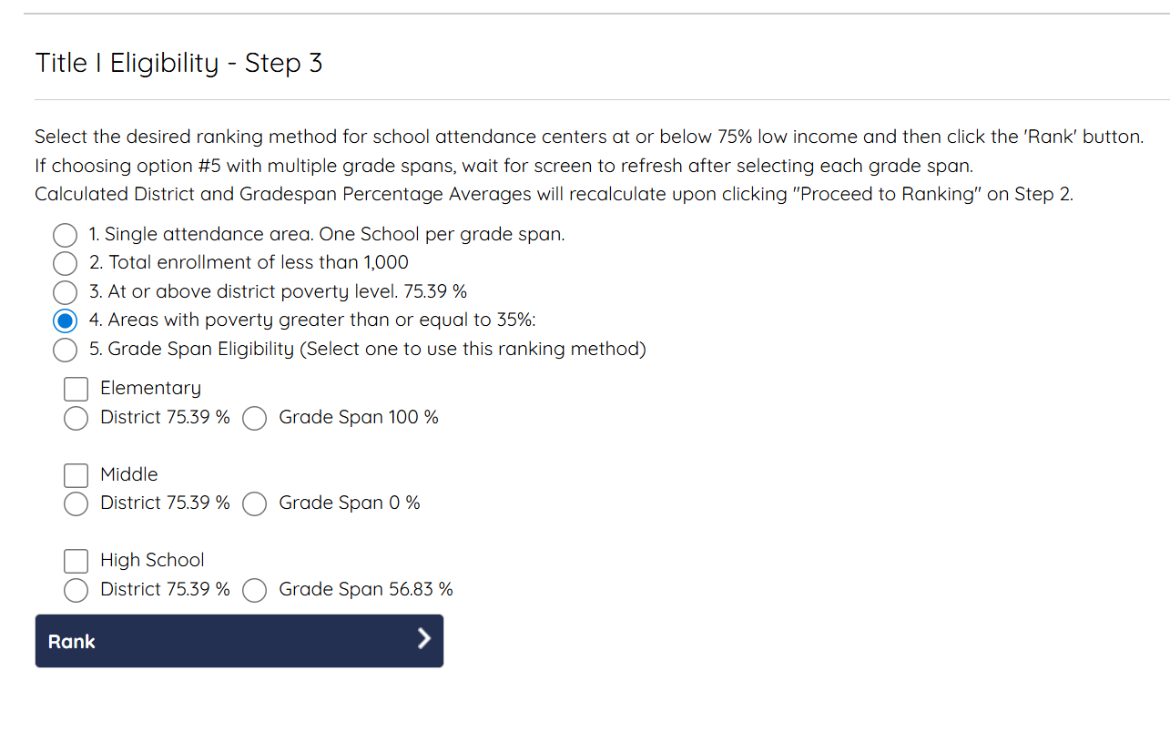
FY27 Title I-A Eligibility (5 of 11)
Step 3
Select your Ranking Method & Save the Page.

Slide 27

FY27 Title I-A Eligibility (6 of 11)
Served Schools
If you want to Skip a school, click the checkbox in the Skip/Do Not Fund column for that school.
If you want use LEA Discretion to fund a school, click the check box in the LEA Discretion column.
Calculate and Save.
Attendance Center | Grade Span | **SW/TA | Skip / Do not Fund | Prior Yr Served Non Discretion | LEA Discretion | School Designation | Ranking Low Income Percent | Public Low Income | NonPublic Low Income
Section 1: Schools Above 75% Low Income (these schools must be served) | blank | blank | blank | blank | blank | blank | blank | blank | blank
0020 - Barringer | 9–12 | SW | blank | blank | blank | Additional Targeted Support and Improvement | 100 | 13456 | 0

Slide 28
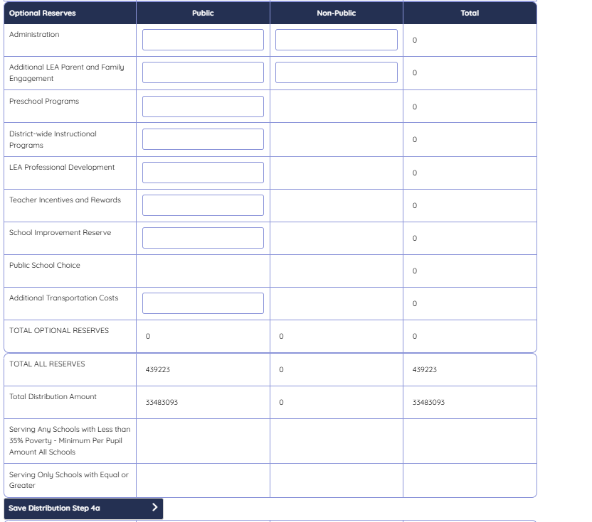
FY27 Title I-A Eligibility (7 of 11)
Step 4a
Enter any Optional Reserves.
Click on Save Distribution.

Slide 29
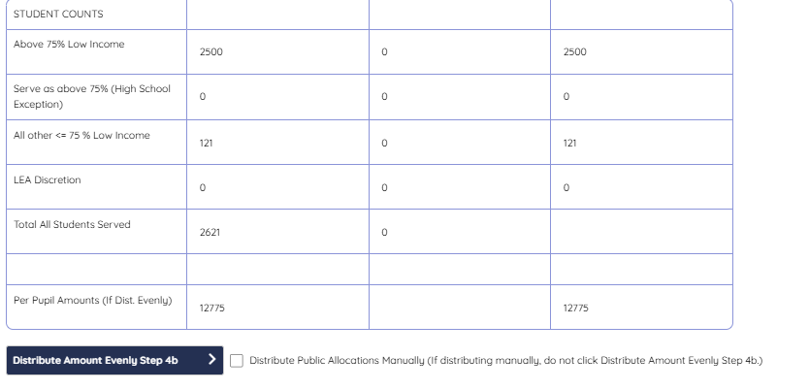
FY27 Title I-A Eligibility (8 of 11)
Step 4b
Select either Distribute Evenly or Distribute Manually. (if distributing manually, do not click Distribute Amount Evenly Step 4b).
Click on Save Step 4b

Slide 30
FY27 Title I-A Eligibility (9 of 11)
Step 4c
Click on the Save button on the bottom of the page.
Attendance Center | **SW/TA | School Designation | Ranking Low Income Percent | Public Low Income | NonPublic Low Income | Total Allocated | Per Pupil Amount | Public Allocation | Nonpublic Per Pupil Amount | Nonpublic Allocation
Section 5: Ineligible Schools – The schools are not eligible based on the ranking method and were either not serve in the previous year or were served with LEA discretion. They cannot be served. | blank | blank | blank | blank | blank | blank | blank | blank | blank | blank
0470 - Hawthorne | SW | blank | 4.33 | 13 | 0 | blank | blank | blank | blank | blank
Save Step 4c >

Slide 31
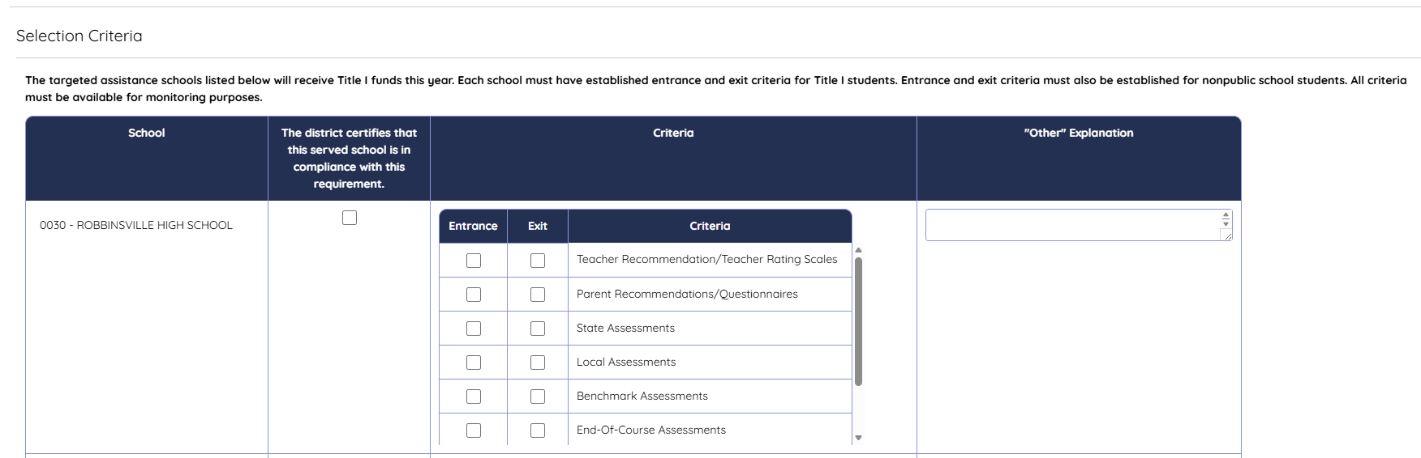
FY27 Title I-A Eligibility (10 of 11)
Selection Criteria
Select the Entrance and Exit Criteria the district will use for the Title IA Program(s).
Click on the Save button on the bottom of the page.

Slide 32
FY27 Title I-A Eligibility (11 of 11)
Tips
Eligibility must be saved in consecutive order. If you make a change in any step, you must go back to Step 1a and re-save each step.
Districts do not have to use the same ranking method as in past years. If the needs of the district have changed, or if there were changes in enrollment, users can select a different ranking method.
Districts are required to enter at least $100 per homeless student in Eligibility Step 4. In the event that the district does not have any reported homeless students, you are still required to reserve Homeless funds. Questions about homeless students, can be sent to TitleI@doe.nj.gov
Questions regarding Non-Public Schools can be sent to Ombudsman.NonPublic@doe.nj.gov

Slide 33
NJGMS Getting Started Guide
Sub-Grants

Slide 34
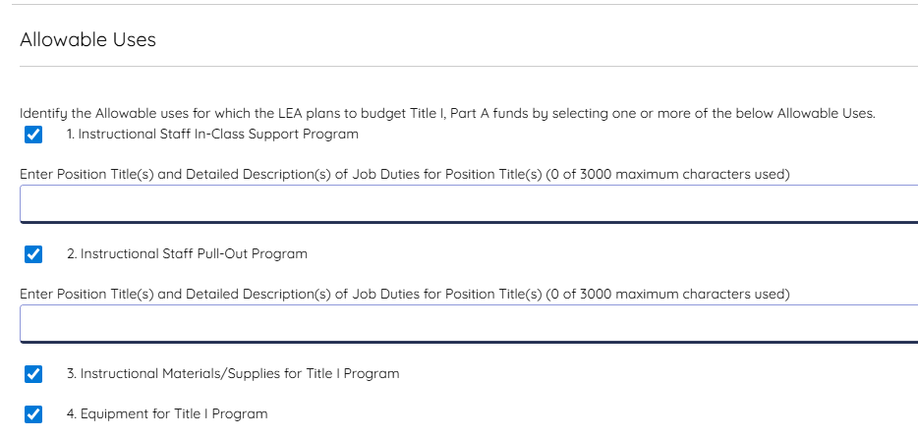
FY27 Title I-A through Title V
Allowable Uses
Select the appropriate uses for the Title.
When checked, some allowable uses will expand to require additional information such as text or checks.

Slide 35
FY27 Allowable Uses Updates
The Allowable Uses for Title IIA have been modified to match recent guidance from USED.
    If selecting Reduction in Class-Size: There will be a portion that opens up for required fields to be completed.
Allowable Uses for Title III have changed to ensure compliance with Federal Regulations (3114(d), 3115(c), and 3201(7) of the Elementary and Secondary Education Act).
Allowable Uses for Title III Immigrant have been updated.

Slide 36
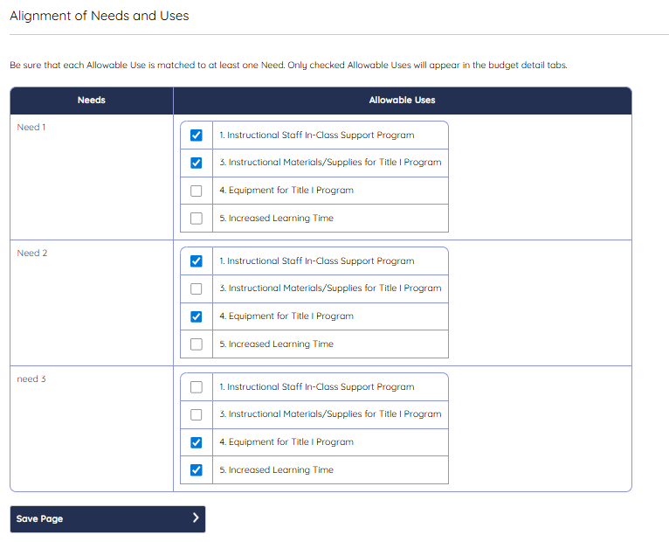
FY27 Title I-A through Title V
Alignment of Needs and Uses
"Needs" are generated from the Needs Assessment Summary page.
Select the Allowable Uses for each Need.
Save the Alignment of Needs and Uses page.
Troubleshoot #1: If there are no Needs listed, go back and complete the Identify Needs pages under Needs Assessment.
Troubleshoot #2: If there are no "Allowable Uses" listed, go back and check Title IV Part A in Needs Assessment, Needs Summary page.
Tip: Saving this page will bring the Allowable Uses into the Budget Pages.

Slide 37
FY27 Improvements
Budget Pages
Commas and dollar signs have been added!
Once you save the page, navigate away and return, the system will group the function-object codes in order.
FTE's can now go out two decimal places.
The default for Title IA Reserves is “Not Applicable.”

Slide 38
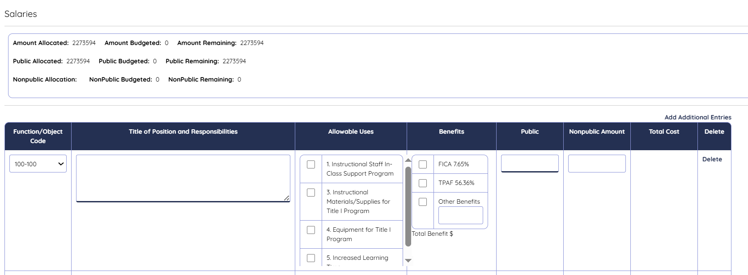
FY27 Title I-A through Title V (1 of 6)
Budget- Salaries
All salaries, Instructional(100) and Non-Instructional(200) will be entered here.
The table at the top will update the amount budgeted/remaining each time the page is saved.
Select Add Additional Entries (above Delete) to open new budget lines.
Tip: Save the page after each entry to prevent loss of data in the event the system times-out.

Slide 39
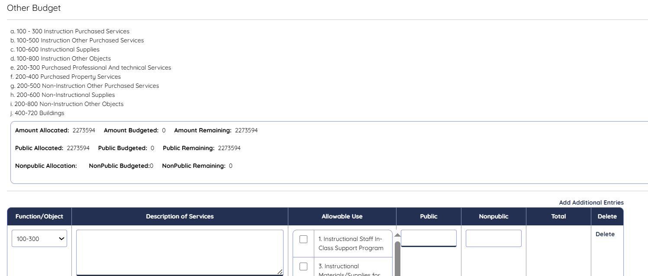
FY27 Title I-A through Title V (2 of 6)
Budget- Other
All Instructional and Non-Instructional Expenditures will be entered on this page.
Function/Object codes are listed at the top.
The table will update the amount budgeted/remaining each time the page is saved.
Select Add Additional Entries (above Delete) to open new budget lines.
Tip: Save the page after each entry to prevent loss of data in the event the system times-out.

Slide 40
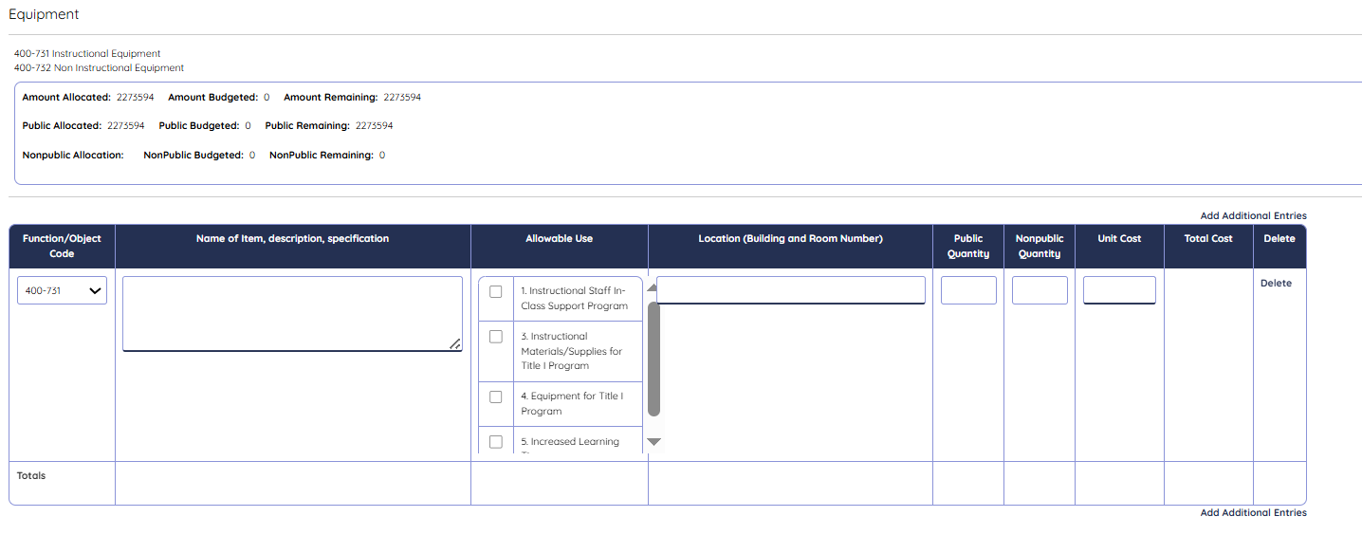
FY27 Title I-A through Title V (3 of 6)
Budget-Equipment
Equipment refers to an item over $2000, that is permanent, and would be repaired rather than replaced.
Complete each section, providing the requested information.
Saving the page will update the table at the top which display amount budgeted/remaining.

Slide 41
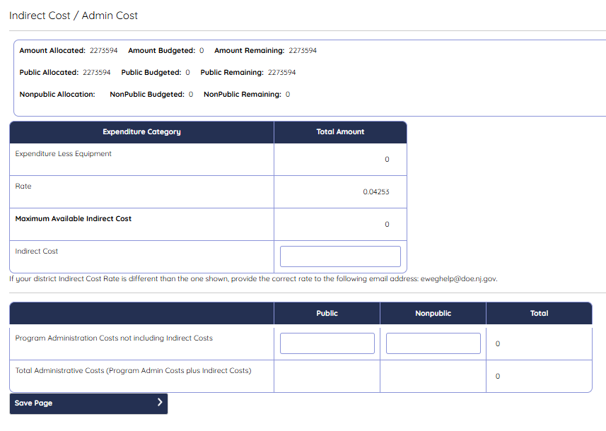
FY27 Title I-A through Title V (4 of 6)
Budget-Indirect Costs/Admin Costs
The total amount budgeted for Indirect Costs plus Program Administration may not exceed the allowable percentage.
Indirect Costs are costs incurred for support services that are not readily identified as program costs.
  Examples of such services are, custodial services, bookkeeping services, utilities, and supervision. Indirect costs are determined by an assigned indirect cost rate.
Save the page.

Slide 42
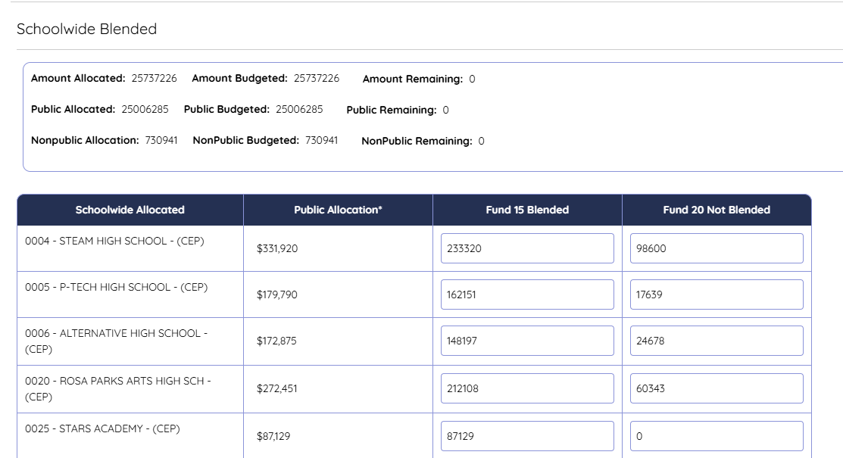
FY27 Title I-A through Title V (4 of 6)
Budget-Schoolwide Blended
Any district using 520-930 must complete this page prior to budgeting funds. The amount remaining must be greater than or equal to Public Allocation Total by School.
Fund 15 shows in the 520-930 section of the budget summary.
Save the page.

Slide 43
FY27 Title I-A through Title V (5 of 6)
Budget Summary
This is a “read only” page that is generated upon saving each page of the budget.
It displays a separate table for 100, 200, 400, 520, and Admin costs.
It also displays a Totals table.
Function / Object | Expenditure Category | Public Amount | NonPublic Amount | Total Amount
100-100 | Personal Services Salaries | $0 | $0 | $0
100-300 | Purchased Prof. & Tech. Services | $0 | $0 | $0
100-500 | Other Purchased Services | $0 | $0 | $0
100-600 | Supplies and Materials | $0 | $0 | $0
100-800 | Other Objects | $0 | $0 | $0
Subtotal Instruction | blank | $0 | $0 | $0

Slide 44
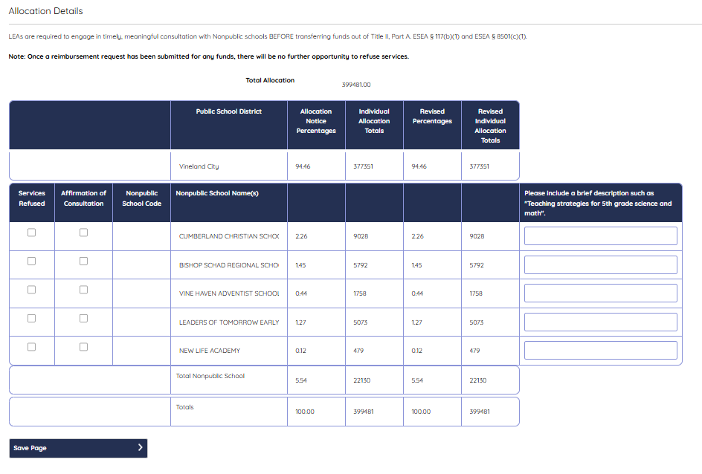
FY27 Title II-A – Title IV (6 of 6)
Allocation Details
Check the box(es) under Affirmation of Consultation to indicate that the LEA consulted with each nonpublic school.
If a nonpublic school(s) refused services, check the appropriate box(es) under Services Refused.
For each participating nonpublic school, enter a very brief description of the services to be provided.
Save the Allocation Details page.

Slide 45
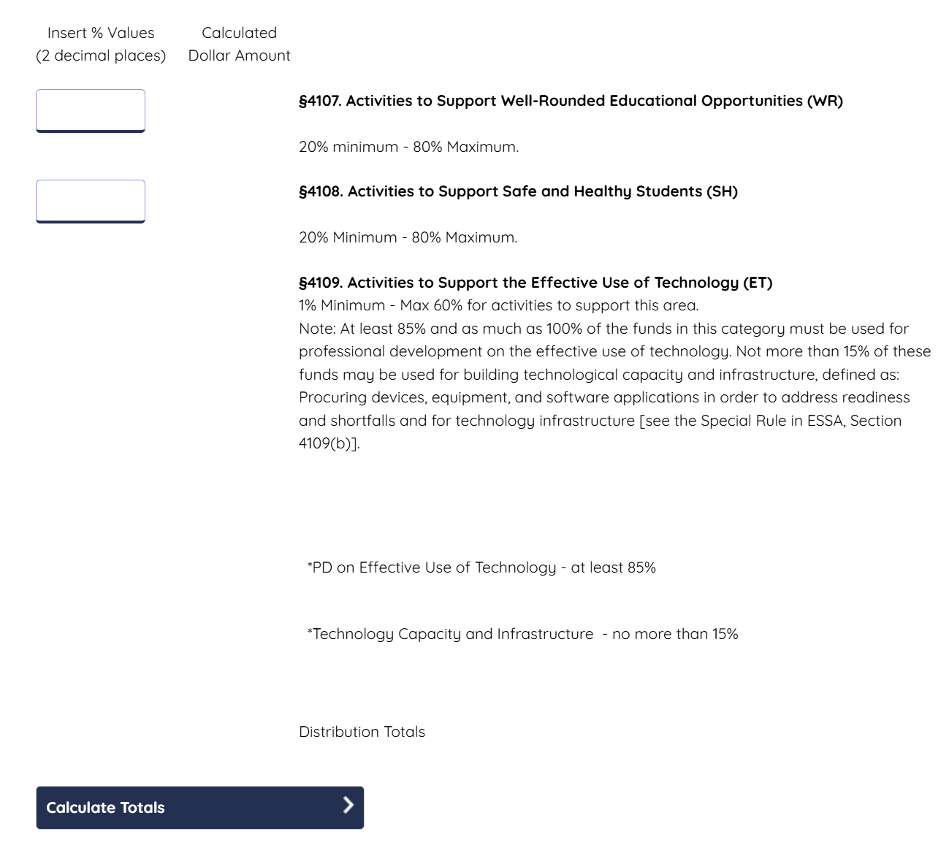
FY27 Title IV Part A (1 of 3)
Allowable Uses
Enter the amount for Indirect Costs (if applicable).
Enter the percentages for the Activities for WR & SH.
If the percentages do not equal 100% the system will calculate the remaining as ET.
Calculate Totals.
Title IV A Part A Total Available Amount | 2138102
Indirect Costs | blank
Total Distribution | blank

Slide 46
FY27 Title IV Part A (2 of 3)
Allowable Uses (continued)
Check (✓) all the appropriate Allowable Uses under each section.
Save the page.
Tip: If you did not include WR, SH, or ET from the top percentage chart, you will get an error message. You will need to adjust your percentages or uncheck the allowable uses for that area.
§4107. Activities to Support Well-Rounded Educational Activities (WR)
Accelerated Learning Programs WR-Accelerated Learning Programs
American History WR-American History
College and Career Guidance and Counseling
Computer Science
Economics
Engineering
Environmental Education
Geography

Slide 47
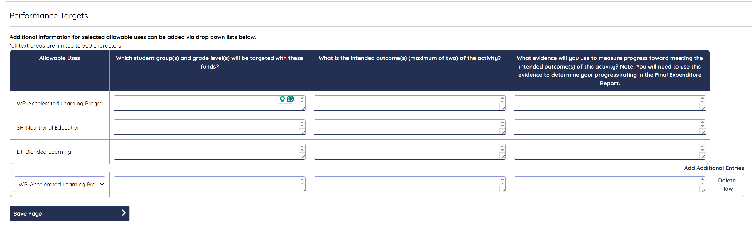
FY27 Title IV Part A (3 of 3)
Performance Targets
Complete the areas required for Performance Targets aligned with the Allowable Uses selected.
Please keep it clear and concise provided only required information.

Slide 48

Bd Authorization Page
Agree to Certifications.
Enter the Board of Education Resolution Date for the acceptance and approval of funds for the ESEA Grant.
Save the Page.

Slide 49
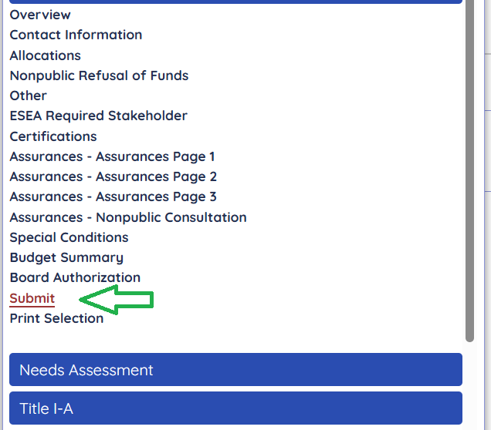
Submit Page
This is the last step!
Once you have cleared all the Messages
and completed the Bd. Authorization.
Submit.
Are you sure you want to submit the application?
  Yes or No
Pop-Up Successful Submission.
Email Notifications are back!

Slide 50
Substantially Approved
  When an LEA successfully submits an application, they receive an automatic email notification through the NJGMS system that the application has been submitted in “substantially approved form.”
  This is only a preliminary approval; the application will be reviewed and given final approval by the NJDOE staff.
  Pursuant to federal guidance, if the LEA submits the application by the due date, they may begin to encumber funds as of the July 1 project start date.
  If the application is submitted after the due date, they may only encumber funds as of the date of submission.
  Applications will be considered on time if they are submitted by Friday, July 31, 2026.

Slide 51
Approval Process
  Submission
  Tier I
    County Level – Program and Fiscal Review
  Tier II
    Office of Grants Management – Fiscal Review
  After Tier II approval, districts must file a revision for any program or fiscal changes.

Slide 52
Thank You
Office of Grants Management
Help Desk
Martin Egan, Director
Jill Dobrowansky, Ed.D., Manager

Slide 53
Follow Us
Facebook
@njdeptofed
X
@newjerseydoe
Instagram
@newjerseydoe
LinkedIn
New Jersey Department of Education
nj.gov/education
Threads
@newjerseydoe
YouTube
@newjerseydepartmentofeduca6565

