Slide 1
LEARning about Literacy:
Professional Learning Community Series
Session 1 - Phonological Awareness
Office of Learning Equity and Academic Recovery (LEAR)
Division of Teaching and Learning
Notes:
Facilitator Narration: Welcome! We’re excited to have you join us for this first session in our Professional Learning Community Series. Today, we’ll be looking to strengthen our instructional practices based on the latest research in phonological awareness.
Note to Facilitator: Turquoise highlights indicate a “click” is needed to advance the slide animation.

Slide 2
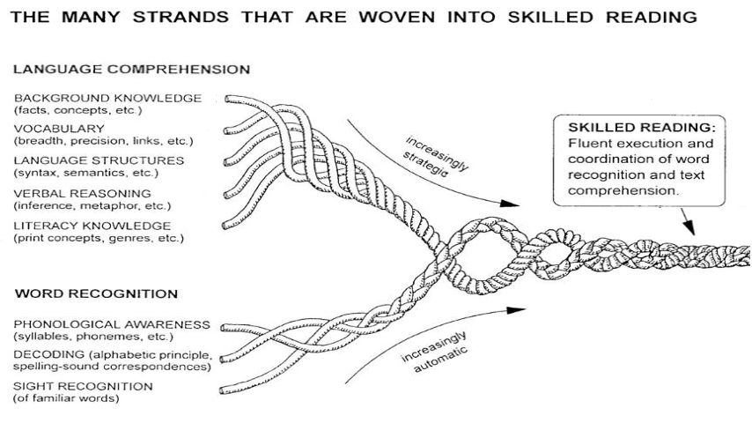
Session 1 - Phonological Awareness
Scarborough, 2001
Notes:
Facilitator Narration: If you took the opportunity to watch the brief video included in the introductory email, you are familiar with Scarborough’s Reading Rope image. In this session we will be exploring an important word recognition skill, Phonological Awareness.
Note to Facilitator: You might also consider watching the introductory video together before launching into the topic for this session.

Slide 3
Text version of Scarborough’s Rope
The many strands that are woven into skilled reading.
The Reading Rope consists of lower and upper strands. The word-recognition strands (phonological awareness, decoding, and sight recognition of familiar words) work together as the reader becomes accurate, fluent, and increasingly automatic with repetition and practice.
Language Comprehension (Upper Strands):
Strands include:
Background knowledge (facts, concepts, etc.)
Vocabulary (breadth, precision, links, etc.)
Language structures (syntax, semantics, etc.)
Verbal reasoning (inference, metaphor, etc.)
Literacy knowledge (print concepts, genres, etc.)
Word Recognition (Lower Strands)
Strands include:
Phonological awareness (syllable, phonemes, etc.).
Decoding (alphabetic principle, spelling-sound correspondences
Sight recognition (of familiar words).
Skilled Reading:
Language comprehension becomes increasingly strategic and word recognition becomes increasingly automatic in the progression to becoming a skilled reader.
A skilled reader displays fluent execution and coordination of word recognition and text comprehension.

Slide 4
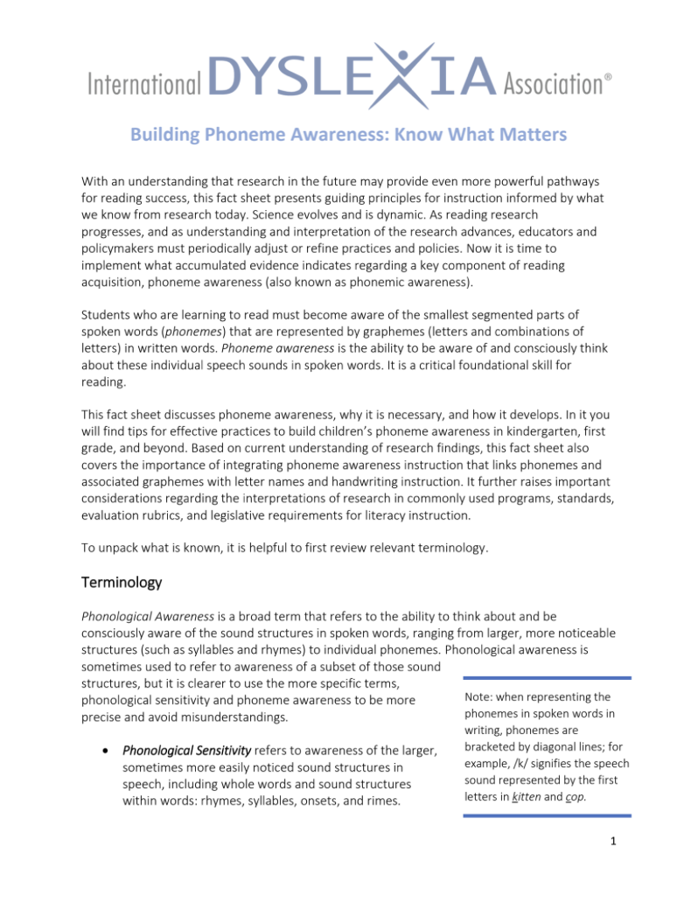
Building Phoneme Awareness: Know What Matters
(1 of 3)
Start phonemic awareness instruction early: Begin with phonemic awareness instruction that focuses on phonemes while reducing time spent on broader phonological sensitivity tasks.
Notes:
Facilitator Narration: As a pre-work activity for this session, we read the International Dyslexia Association’s brief Building Phoneme Awareness: Know What Matters. We are going to discuss the three key implications for instruction identified on page 10 of this brief. Can I get a volunteer to read bullet point #1?
Volunteer Reads: Educators should begin right away with phoneme awareness instruction in kindergarten (and when working with older students with phoneme awareness deficits). The best use of instructional time in kindergarten and beyond is to focus on phonemic awareness while greatly reducing time spent on phonological sensitivity elements. Educators do not need to follow a continuum that requires instruction in each element of phonological sensitivity (counting the words in a sentence, rhyme recognition and production, syllable counting, syllable segmenting/blending, and so on) prior to beginning instruction to develop phoneme awareness.

Slide 5
Start Phonemic Awareness Instruction Early (1 of 2)
Phonological Sensitivity
Phonemic Awareness
[add text]
Notes:
Facilitator Narration: Thank you. Let’s take a moment to discuss the components of phonological awareness described in this brief as phonological sensitivity and phonemic awareness.
Activity (5-10 minutes): Create a space to capture notes on the two components of phonological awareness (if virtual, using this slide and annotating tools; if in-person, using chart paper and markers). Facilitate the discussion to prompt community members for the following points:
Phonological Sensitivity refers to awareness of the larger, sometimes more easily noticed sound structures in speech, including whole words and sound structures within words, such as rhymes, syllables, onsets, and rimes. Research indicates that phonological sensitivity instruction (with larger units such as rhyme, syllables, and onset-rime) is neither a prerequisite nor a causal factor in the development of phonemic awareness. An instructional continuum from phonological sensitivity to phoneme awareness is not necessary and should not delay explicit phonemic awareness instruction. There can be benefits to teaching students about syllable and rhyme structures, but mostly for reasons unrelated to phonemic awareness, such as syllable awareness during spelling or morphology instruction and rhyme structures during read-alouds and poetry writing.
Phonemic Awareness is the ability to be aware of and consciously think about individual speech sounds (phonemes) in spoken words. Phoneme awareness is a necessary component of early reading and spelling development. It goes beyond the hearing or perceiving of the speech sounds in spoken words. Phoneme awareness involves conscious awareness that allows a learner to notice and think about the phonemes in words they hear and pronounce. This skill develops gradually, almost always in the context of learning about phonemes and letters in written words.

Slide 6
Start Phonemic Awareness Instruction Early ( 2 of 2)
Phonological Sensitivity
Whole Words, Rhymes,
Syllables, Onsets, Rimes
Instruction on phonological sensitivity (e.g., rhyme, syllables) is not a prerequisite for phonemic awareness.
Can be beneficial in areas like spelling, morphology, read-alouds, and poetry writing but unrelated to developing phonemic awareness.
Phonemic Awareness
Phonemes
Instruction on phoneme awareness is essential for early reading and spelling development.
Develops gradually, usually alongside learning about phoneme-grapheme correspondences in written words.
Notes:
Facilitator Narration: Great discussion and distinctions noted! It is important to note that it is often common for students, especially young students or those struggling to learn to read, to lack both phonological sensitivity and phoneme awareness. However, research shows that even though phonological sensitivity can be taught, doing so can delay the type of instruction needed to build students’ phonemic awareness and corresponding letter knowledge—the skills that are really most relevant for developing proficient word recognition skills. There can be benefits to teaching students about syllable and rhyme structures, but mostly for reasons unrelated to phonemic awareness, such as syllable awareness during spelling or morphology instruction, rhyme structures during read-alouds and poetry writing, or even onsets.

Slide 7
Building Phoneme Awareness: Know What Matters
(2 of 3)
Start phonemic awareness instruction early: Begin with phonemic awareness instruction that focuses on phonemes while reducing time spent on broader phonological sensitivity tasks.
Coordinate phoneme awareness with grapheme knowledge: Integrate instruction on phoneme awareness with letter knowledge and handwriting to build foundational reading skills quickly and effectively.
Notes:
Facilitator Narration: Now let’s get into deeper discussion about instructional practices. Can I get a volunteer to read bullet point #2 from the International Dyslexia Association’s brief Building Phoneme Awareness: Know What Matters (page 10)?
Volunteer Reads: By focusing immediately on phoneme awareness instruction coordinated with letter/grapheme knowledge and handwriting, teachers can assess and teach the key skills connected to reading success and thus help students build foundational reading skills more effectively and quickly. These activities provide students with direct instruction and insights about how the writing system works, boosting motivation, confidence, and success.

Slide 8
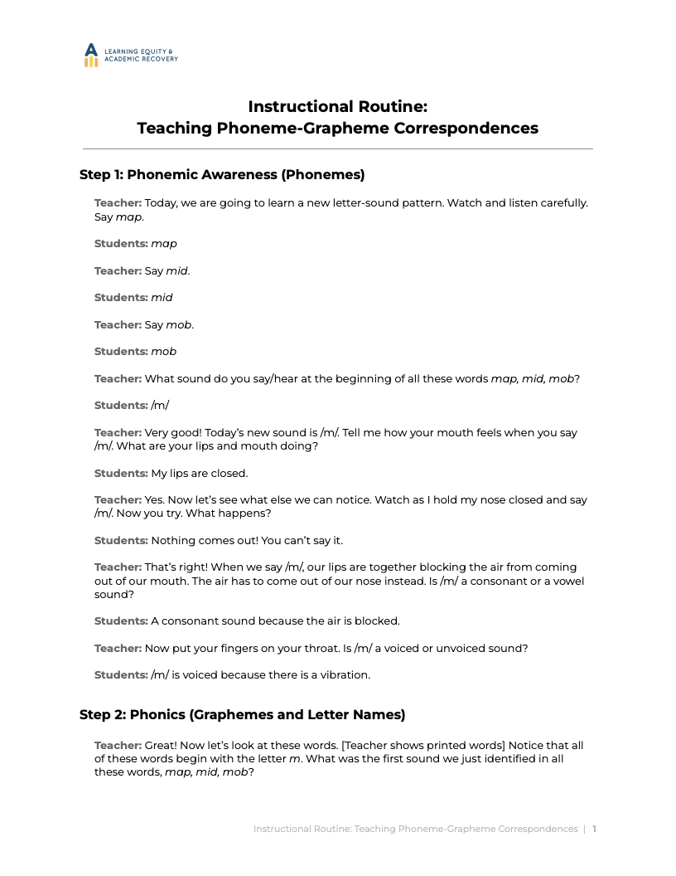
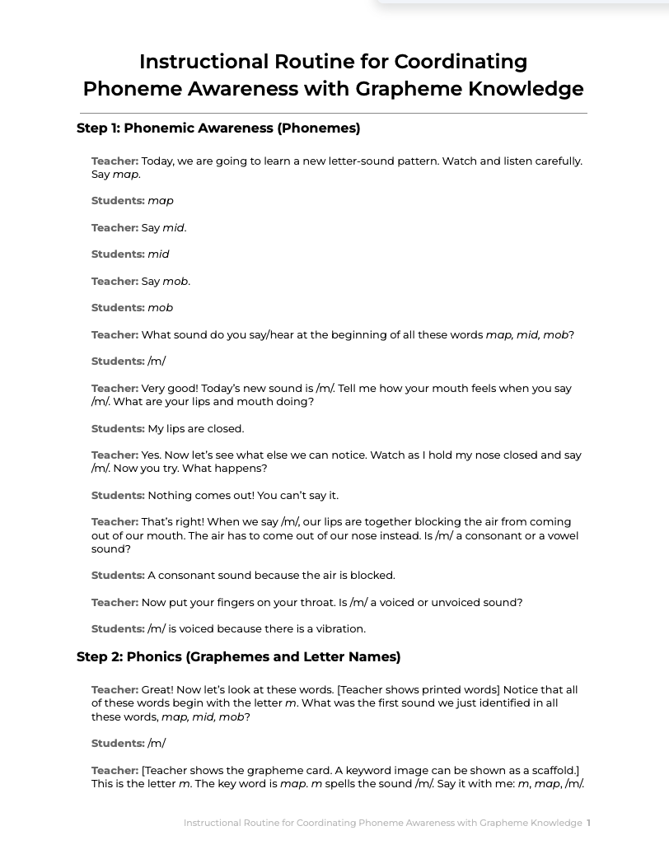
2. Coordinate phoneme awareness with grapheme knowledge
Step 1: Phonemic Awareness (Phonemes)
Step 2: Phonics (Graphemes and Letter Names)
Step 3: Handwriting (Letter Formations)
Notes:
Facilitator Narration: Thank you. This coordination can be accomplished with a simple instructional routine that can be incorporated in our phonics instruction (or more advanced word study for older students). Let’s review the instructional routine with a partner and discuss how this can be implemented in our classrooms.
Activity (5-10 minutes): Distribute copies of the Instructional Routine: Teaching Phoneme-Grapheme Correspondences to all community members. Ask community members to pair off and review the routine. Community members may choose to role play the instructional routine or just review individually in preparation for discussion.
Prompt with questions as needed:
What did you notice about the instructional routine?
Does our current reading program have a similar routine for integrating letter sounds, letter names, and letter forms?
How can this new routine be implemented to improve our current reading program or to help better coordinate existing programs already in use?
For older students, how could a similar type of instructional routine to used to integrate spoken words with their spellings, and meanings during advanced word study or vocabulary instruction?

Slide 9
Building Phoneme Awareness: Know What Matters
(3 of 3)
Start phonemic awareness instruction early: Begin with phonemic awareness instruction that focuses on phonemes while reducing time spent on broader phonological sensitivity tasks.
Coordinate phoneme awareness with grapheme knowledge: Integrate instruction on phoneme awareness with letter knowledge and handwriting to build foundational reading skills quickly and effectively.
Target phoneme awareness at the student’s level: Focus on initial, final, and medial phonemes, progressing from simple syllable words to more complex words as skills develop.
Notes:
Facilitator Narration: Great discussion, now let’s discuss the last implication for instruction identified on page 10 of the brief. Can I get a volunteer to read bullet point #3?
Volunteer Reads: Whenever phoneme awareness instruction is needed, either for beginning readers or for older struggling readers, teachers should focus on phoneme awareness at the level appropriate for the student, keeping these recommendations in mind: Start with initial phonemes, then final phonemes, followed by medial vowel phonemes in words that are simple syllables; after these beginning levels of phoneme awareness are accomplished, next work on awareness of the internal consonants in complex, one-syllable words that include consonant blends.

Slide 10



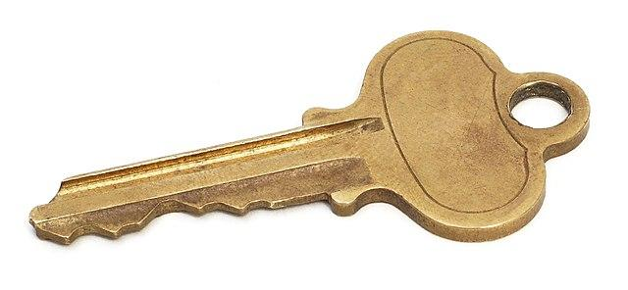
What is a phoneme?
A phoneme is the smallest, individual sound unit in a spoken word. It’s the smallest unit of speech with a phonetic distinction significant enough to make a word distinguishable in meaning from another word in a language.
house versus mouse
key versus ski
Notes:
Facilitator Narration: It’s important to focus our phoneme awareness instruction at the level appropriate for the student. So, let’s warm up our own phoneme awareness before we discuss the simplicity or complexity of different tasks and the phonemic confusions that might arise for our students.
A phoneme is the smallest, individual sound unit in a spoken word. It’s the smallest unit of speech with a phonetic distinction significant enough to make a word distinguishable in meaning from another word in a language. For example, house versus mouse or key versus ski.

Slide 11
How many phonemes are in these words?
3
4
5
comb
fox
shrimp
3
2
4
fence
shoe
queen
Notes:
Facilitator Narration: Next, let’s count the number of phonemes in some words. Can I get a volunteer for the first word?
Activity (3 minutes): Ask volunteers to segment each word into its individual sounds and share how many phonemes are in the word. You might distribute and use the Elkonin boxes provided with manipulatives to demonstrate and practice a phoneme counting activity that could be used with students. Click to reveal each animated answer as you go.
comb = /k/ /ō/ /m/, 3 sounds (4 letters; graphemes c-o-mb)
fox = /f/ /ŏ/ /k/ /s/, 4 sounds (3 letters; graphemes f-o-x)
shrimp = /sh/ /r/ /ĭ/ /m/ /p/, 5 sounds (6 letters; graphemes sh-r-i-m-p)
gate = /g/ /ā/ /t/, 3 sounds (4 letters; graphemes g-a-t[e])
shoe = /sh/ /ü/, 2 sounds (4 letters; graphemes sh-oe)
queen = /k/ /w/ /ē/ /n/, 4 sounds (5 letters; graphemes q-u-ee-n)
Optional activity extension: To stress the importance of coordinating phoneme awareness instruction with letter/grapheme knowledge and handwriting, after counting phonemes in each word have all community members map each phoneme to its corresponding grapheme and notice how the number of phonemes does always match the number of letters in the word’s spelling. You might use chart paper/markers or white boards/dry erase markers.
Note to Facilitator: Notice if any community members are confusing sounds (phonemes) or letters/letter combinations (graphemes) and discuss how important it is to be clear with students about what is being asked for in any given instructional activity. For example, a teacher may need to clarify to a student, “You counted the letters. I am asking you to count the sounds.” or “You provided the letter name. I am asking for the sound.”
Also, this activity may spark a discussion on how specific phoneme-grapheme correspondences should be introduced to students and applied during phoneme-grapheme mapping activities. For example, the grapheme x represents two distinct phonemes /k/ and /s/ and the combined graphemes qu represent two distinct phonemes /k/ and /w/. You can hear/feel these phonetic distinctions by comparing the words sax (4 phonemes) to sack or sass (3 phonemes); and quick (4 phonemes) to kick and wick (3 phonemes). Published reading programs will differ in how they handle these unique correspondences. Some may introduce and apply them as x representing one combined sound /ks/ or qu represents /kw/. Either way, it is most critical that all materials treat the correspondences similarly and that all teachers across grades and classrooms are teaching the concepts in a consistent manner. From a corrective feedback perspective, it is important that teachers understand these phonetic distinctions so they can provide helpful support when needed. For example, if the district’s reading program introduces x representing one combined sound /ks/ and a student is having persistent confusion or difficulty spelling words such as snacks as snax and box as bocks, it may be helpful to explain the two distinct phonemes /k/ and /s/ while prompting the student to think about the target word’s grammatical number and part of speech.

Slide 12



3. Target phoneme awareness at the student’s level
Phonological Sensitivity
/b/ /ă/ /t/
Preschool - Alliteration & Rhyme
Kindergarten - Simple Words
Isolate Phonemes
Identify Phonemes
Categorize Phonemes
Blend Phonemes
Segment Phonemes
Manipulate Phonemes
/p/ /l/ /ă/ /n/ /t/
Phonemic Awareness
Grade 1
Grade 2+ - More Complex Words
/t/ /r/ /ŭ/ /m/ • /p/ /ə/ /t/
Notes:
Facilitator Narration: Now that we’re warmed up, let’s discuss phonemic awareness instruction within a progression from simple to more complex word structures.
In preschool, young children will build their phonological sensitivity by noticing rhyme and alliteration as part of hearing and remembering nursery rhymes and songs. When targeting awareness of an initial phoneme, generating alliterative sequences can help bring that phoneme to children’s attention (for example, the /t/ /t/ /t/ in “Turtle, turtle, turn the tide. Turtle, turtle, take a ride.”), which can foster early phoneme awareness.
Students will typically build awareness of initial phonemes in words [point to /b/ in bat], before they gain awareness of final phonemes [point to /t/ in bat]. Medial vowel phonemes are a bit more challenging for students [point to /ă/ in bat]. While explicit phonemic awareness instruction beginning in kindergarten will focus on tasks such as isolating or identifying phonemes, categorizing phonemes, or most importantly blending, segmenting and manipulating phonemes [point down the list of phonemic awareness tasks from top to bottom], it is vitally important that we are using words in our instruction that match the students level of awareness.
Using simple syllable words will facilitate student’s mastery of beginning phoneme awareness [point to bat] and prepare them for explicit instruction using words that are complex syllables [point to plant] where becoming aware of initial or final external consonants [point to /p/ and /t/ in plant] is easier than becoming aware of the internal consonants in the consonant blends [point to /l/ and /n/ in plant & /r/ in trumpet]. So it is important to note that students may still be developing their automaticity with some of these more complex phonemic awareness skills beyond first grade, even though formal phonemic awareness instruction may have been discontinued in our reading programs.
Optional Question: For students in upper grades who may be struggling in the area of fluent word recognition, in what ways can we begin to target phonemic awareness instruction that meets their needs? Prompt the discussion to points related to first assessing the extent of phoneme awareness in struggling readers in any grade, and if weaknesses in phoneme awareness are evident, calibrating intervention to the student’s level of phoneme awareness development and integrating it with phonics or word analysis instruction/intervention.

Slide 13
Text Version: Target phoneme awareness at the student’s level
Phonological Sensitivity
Preschool: Alliteration and Rhyme
bat: /b/ /ă/ /t/
plant: /p/ /l/ /ă/ /n/ /t/
trumpet: /t/ /r/ /ŭ/ /m/ • /p/ /ə/ /t/
Phonemic Awareness
Kindergarten: Simple Words
Isolate Phonemes
Identify Phonemes
Categorize Phonemes
Grade 1
Blend Phonemes
Segment Phonemes
Manipulate Phones
Grade 2+: More Complex Words

Slide 14
Adapting to Student Needs
Students face extra demands when the English phonology used during reading instruction differs from their own home language/dialect.
Multilingual Learners must develop awareness of English phonemes, including both familiar and unfamiliar sounds.
Dialects are rule-governed and linguistically valid variations of English that require respectful, informed teaching.
Student with disabilities may need additional scaffolding to support any weaknesses in phonological processing.
Cárdenas-Hagan, 2020
Notes:
Facilitator Narration: As educators, it's important to recognize that when students come to school speaking a different language or dialect than the variation of American English used in the classroom, they face additional language and cognitive demands—especially during reading instruction, which relies heavily on a standardized version of English phonology.
Multilingual learners, for example, must become consciously aware of the sounds of English, including those that may not exist in their home language. This process takes time and explicit support.
Similarly, students who speak a different English dialect, may use rule-governed phonological patterns that differ from those used in reading instruction. These are not 'errors,' but features of a valid language variety. Understanding and honoring these differences allows us to tailor instruction in a way that is respectful, effective, and inclusive.
Also, student with disabilities may need additional scaffolding to support any weaknesses in phonological processing.
Optional Question: How can we prepare ourselves to deliver instruction that supports students whose home language or dialect differs from the phonology of our school reading instruction?
Note to Facilitator: The brief provides a teaching tip about being well informed. One resource for becoming informed is the American Speech-Hearing Association’s Phonemic Inventories and Cultural and Linguistic Information Across Languages.

Slide 15
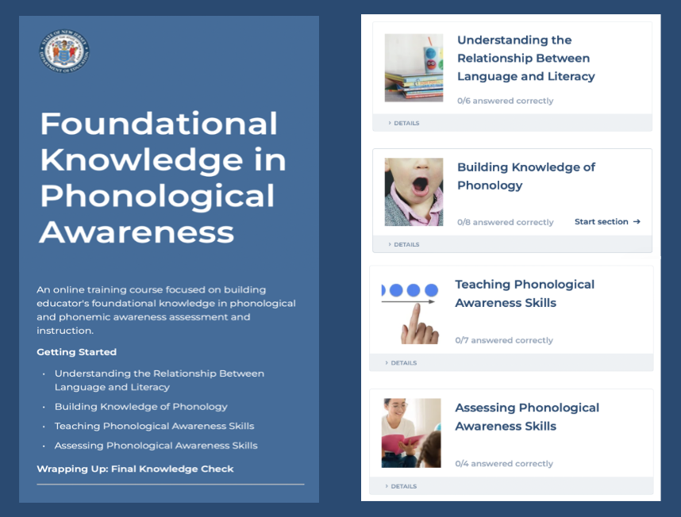
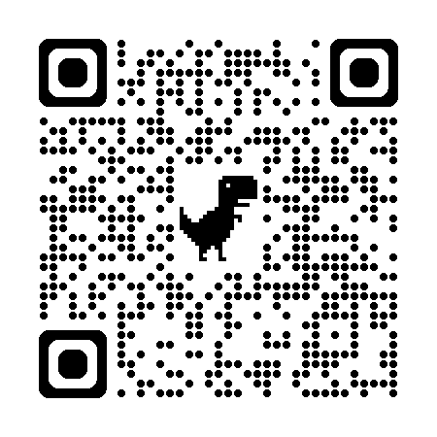
Thanks for participating!
Notes:
Facilitator Narration: This brings us to the end of our session today! If you are interested to learn more about phonological processing, phonological awareness and phonemic awareness instruction and assessment, you can enroll in the NJ Department of Education’s free SISEP online learning module titled Foundational Knowledge in Phonological Awareness.

Slide 16
Next Session in the PLC Series
Session 2 Phonics & Word Analysis
Date: [Add Date]
Time: [Add Time]
Notes:
Facilitator Narration: Up next is Session 2 Phonics & Word Analysis. This PLC session will focus on best practices in decoding and encoding strategies for phonics and word analysis instruction. We will meet on [add date and time]. See you then!

Slide 17
References
Building phoneme awareness: Know what matters. (2022). International Dyslexia Association. Retrieved from https://dyslexialibrary.org/wp-content/uploads/file-manager/public/2564/
phoneme-awareness-final-word-6-29-22.pdf
Cárdenas-Hagan, E. (2020). Literacy foundations for English learners: A comprehensive guide to evidence-based instruction. Paul Brookes Publishing Co.
Scarborough, H. S. (2001). Connecting early language and literacy to later reading (dis)abilities: Evidence, theory, and practice. In S. Neuman & D. Dickinson (Eds.), Handbook for research in early literacy (pp. 97–110). New York, NY: Guilford Press.

