Slide 1
LEARning about Literacy:
Professional Learning Community Series
Session 3 - Fluency as the Bridge to Comprehension
Office of Learning Equity and Academic Recovery (LEAR)
Division of Teaching and Learning
Notes:
Facilitator Narration: Welcome! We’re excited to have you join us for this third session in our Professional Learning Community Series. Today, we’ll be looking to strengthen our instructional practices based on the latest research in reading fluency.
Note to Facilitator: Turquoise highlights indicate a “click” is needed to advance the slide animation.

Slide 2
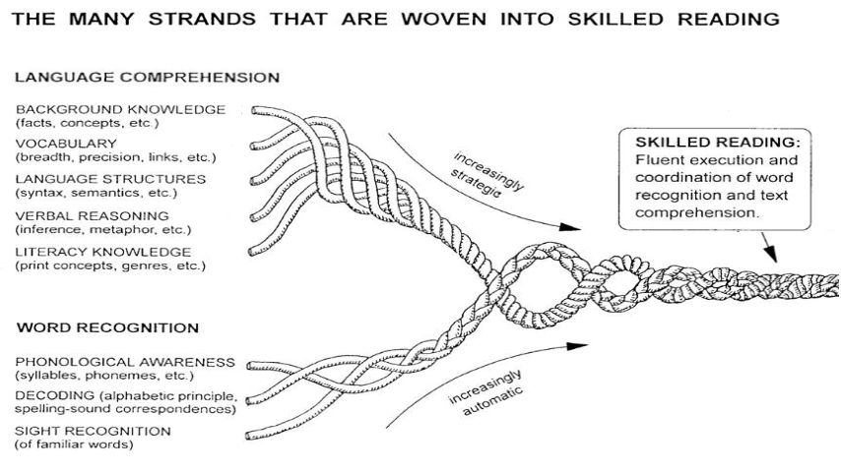
Session 1 - Phonological Awareness
Scarborough, 2001
Notes:
Facilitator Narration: Grounding our session once again in Scarborough’s Reading Rope, today we will get started with a short discussion of sight recognition.

Slide 3
Text version of Scarborough’s Rope
The many strands that are woven into skilled reading.
The Reading Rope consists of lower and upper strands. The word-recognition strands (phonological awareness, decoding, and sight recognition of familiar words) work together as the reader becomes accurate, fluent, and increasingly automatic with repetition and practice.
Language Comprehension (Upper Strands):
Strands include:
Background knowledge (facts, concepts, etc.)
Vocabulary (breadth, precision, links, etc.)
Language structures (syntax, semantics, etc.)
Verbal reasoning (inference, metaphor, etc.)
Literacy knowledge (print concepts, genres, etc.)
Word Recognition (Lower Strands)
Strands include:
Phonological awareness (syllable, phonemes, etc.).
Decoding (alphabetic principle, spelling-sound correspondences
Sight recognition (of familiar words).
Skilled Reading:
Language comprehension becomes increasingly strategic and word recognition becomes increasingly automatic in the progression to becoming a skilled reader.
A skilled reader displays fluent execution and coordination of word recognition and text comprehension.

Slide 4
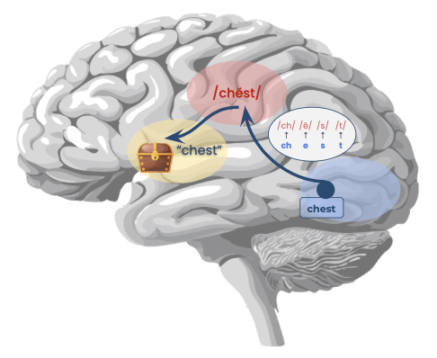
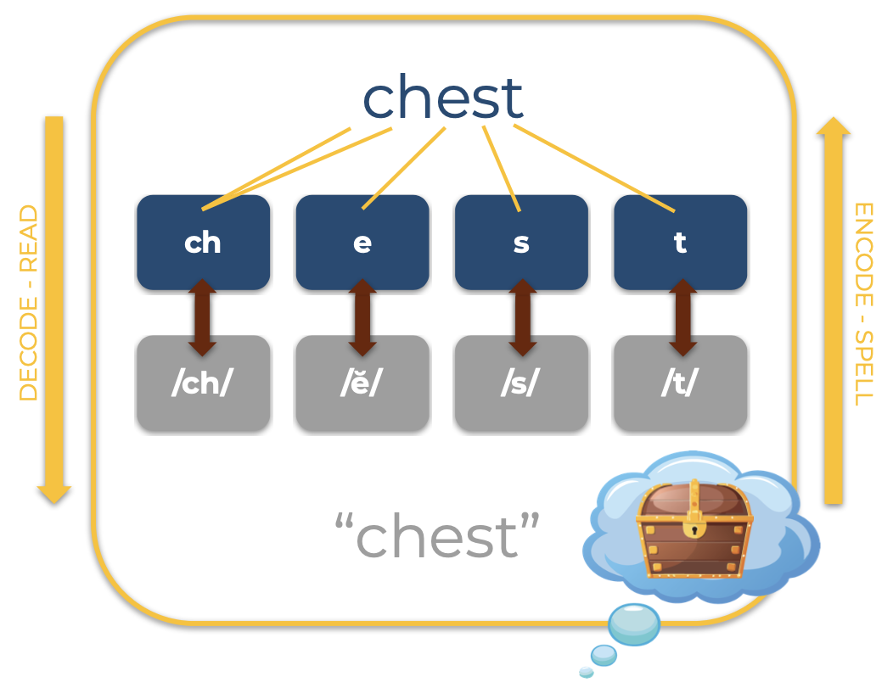
Sight Recognition & Orthographic Mapping
Building Sight Recognition through
Phonics & Word Analysis Instruction
Pronunciation
Meaning
Spelling
Orthographic Mapping
in the Reading Brain
Notes:
Facilitator Narration: Over time, as students receive explicit phonics instruction and lots of guided and independent practice in decoding and spelling words they begin to recognize words in print without having to consciously sound them out or think about their structure. This ability to instantly recognize familiar words is referred to as sight recognition.
Orthographic mapping is the mental process in the brain through which a word’s orthographic or written form is linked to its phonological or spoken form and its meaning.
As students’ decoding and encoding skills become more automatic, reading networks have formed that are more direct routes (note the turquoise arrow representing the neuronal network in the reading brain) that allow the reader to instantly recognize (on sight) the meaning of the words they read because the word’s pronunciation, spelling and meaning have been bound together and stored in long term memory for efficient retrieval when reading and spelling.
Phonics and word analysis instruction focus on teaching students about the correspondences and spelling patterns through a cumulative scope and sequence beginning with the most common correspondences and patterns and moving toward those that are less common and more complex.

Slide 5
Text Version: Building Sight Recognition through Phonics and Word Analysis Instructions
chest
ch
e
s
t
Decode - Read
Encode - Spell
/ch/
/ĕ/
/s/
/t/
“chest”

Slide 6
Text Version: Orthographic Mapping in the Reading Brain
Pronunciation: /chĕst/
Spelling: /ch/ /ĕ/ /s/ /t/ = chest
Meaning: treasure chest

Slide 7
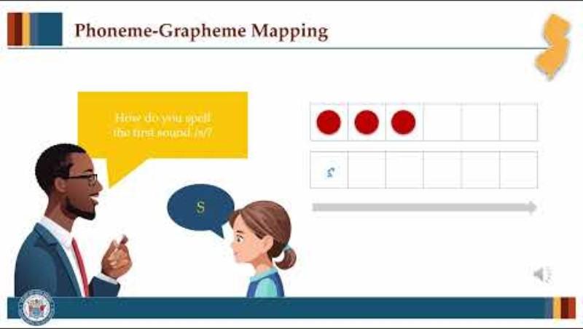
Mapping Irregular Words
Notes:
Facilitator Narration: It is important to understand, however, that ALL words including those that may contain irregular or unusual correspondences or patterns must be analyzed so that they can be similarly orthographically mapped into memory. Let’s watch this brief video demonstrating a phoneme-grapheme mapping routine for irregular words.
[Click red button to play video PLC Series Video - Phoneme-Grapheme Mapping: Irregular Words]

Slide 8
Reading Fluency (1 of 4)
Scarborough, 2001
Notes:
Facilitator Narration: As students’ word recognition skills (phonemic awareness, decoding, and sight recognition) become more and more automatic over time, they are building oral reading accuracy and automaticity at the word level.

Slide 9
Reading Fluency (2 of 4)
Accuracy
Rate
Expression
“Reasonably accurate reading, at an appropriate rate, with suitable expression, that leads to accurate and deep comprehension and motivation to read.”
Hasbrouck & Glaser, 2019
Notes:
Facilitator Narration: Researchers Hasbrouck and Glaser define fluency as reasonably accurate reading, at an appropriate rate, with suitable expression, that leads to accurate and deep comprehension and motivation to read.

Slide 10
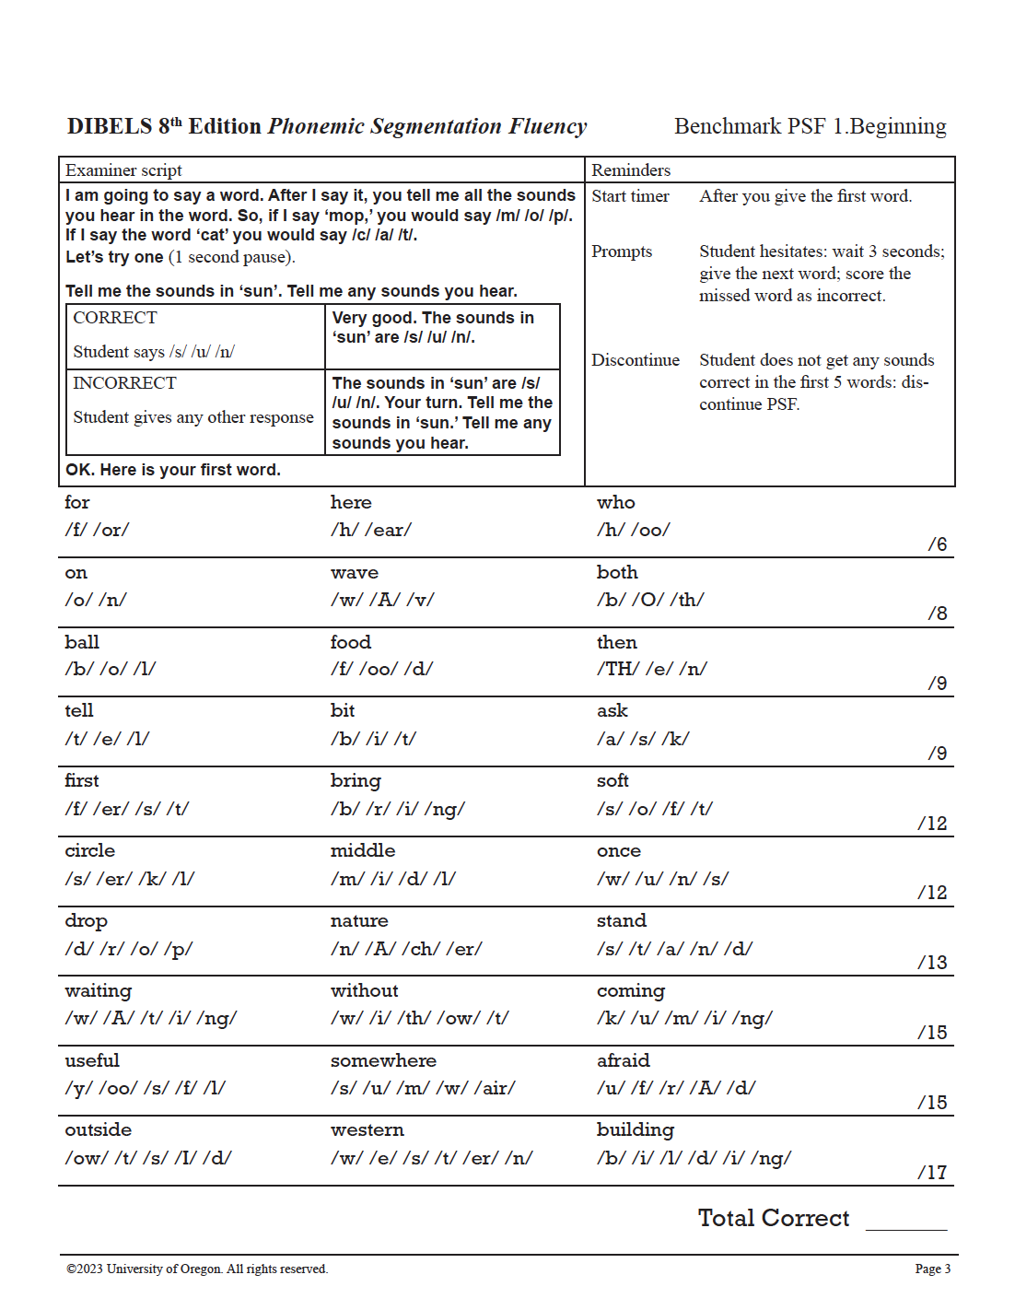
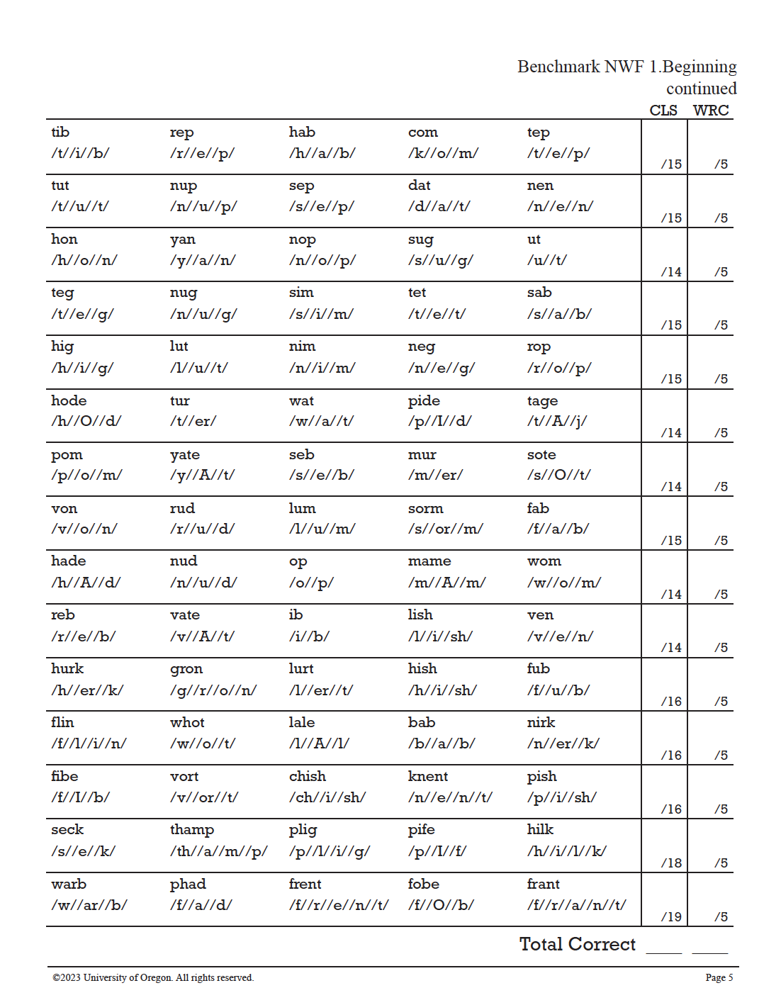
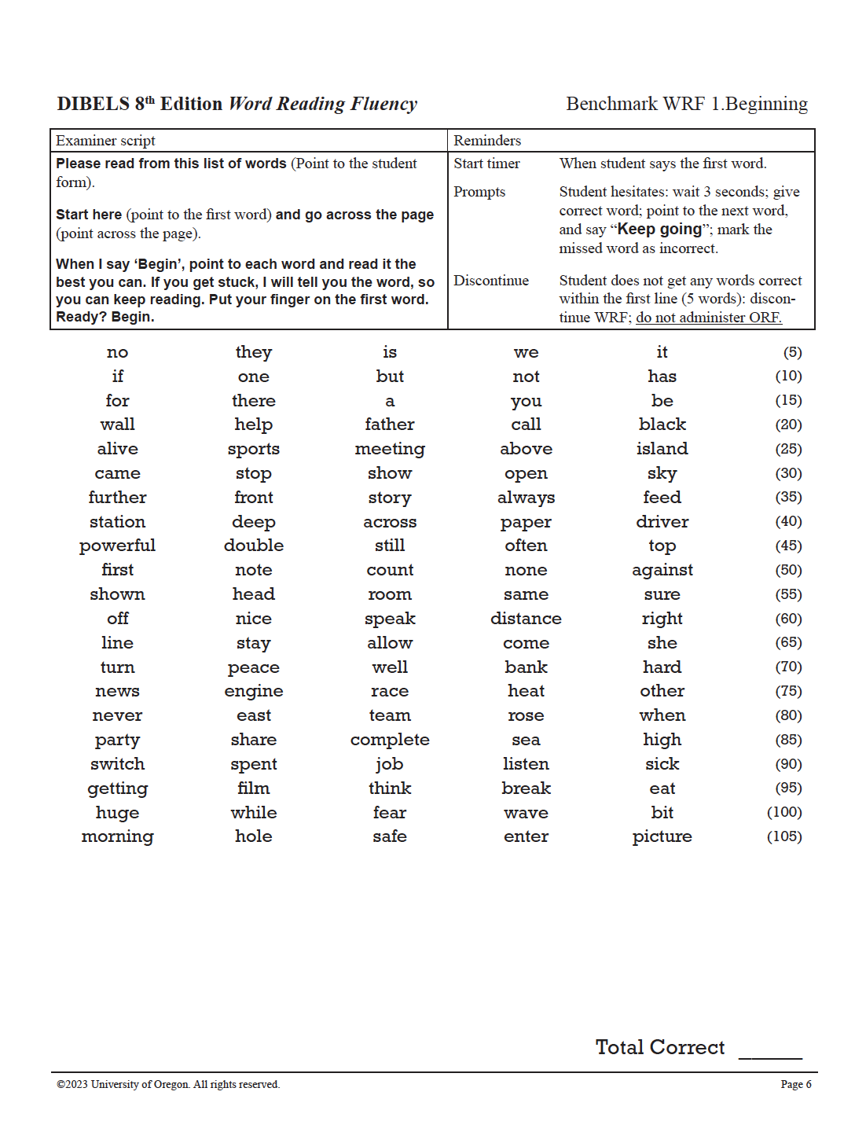
Reading Fluency (3 of 4)
Scarborough, 2001
Notes:
Facilitator Narration: These discrete word recognition skills can be measured and students’ accuracy and automaticity growth monitored using a universal screening assessment.
Phonological awareness is typically assessed through a measure of phoneme segmentation fluency, which determines the student’s ability to accurately and automatically segment the sound in words.
Decoding is typically assessed through a measure of nonsense word fluency, which determines the student’s ability to accurately apply phoneme-grapheme correspondence, or correct letter sounds, when reading made-up words as well as their ability to automatically blend those sounds together to read the whole word.
And sight recognition is typically assessed through a measure of word reading fluency, which determines the student’s ability to accurately and automatically read a list of real words.

Slide 11
Reading Fluency (4 of 4)
Scarborough, 2001
Notes:
Facilitator Narration: As instruction supports the growth of increasingly accurate and automatic word recognition skills, it should simultaneously be supporting the growth of strategic language comprehension skills in order to support students in their ability to read connected text with proper expression to support their reading comprehension.

Slide 12
The Simple View of Reading
Word
Recognition
(Print-Based)
Language
Comprehension
(Language-based)
Reading
Comprehension
(Print & Language-Based)
×
=
Gough & Tunmer, 1986; Hoover & Gough, 1990; Hoover & Tunmer, 2020
Notes:
Facilitator Narration: This is the perfect time to pause and discuss The Simple View of Reading that was explained in the brief video included in the reminder email.
Question: In what ways do the Reading Rope and the equation in the Simple View of Reading represent reading fluency?
Note to Facilitator: You might also consider watching the video together before launching into the discussion: The Simple View of Reading

Slide 13
Reading Fluency
Scarborough, 2001
Notes:
Facilitator Narration: The multiplying effect of these factors (automatic word recognition and strategic language comprehension) described in the Simple View’s equation is equivalent to the braiding and twisting shown in Scarborough’s Reading Rope. Skilled reading is the result of fluent execution and coordination of word recognition and text comprehension. Let’s now discuss some instructional strategies that support fluent reading.

Slide 14
Instruction to Support Reading Fluency
Utilize a logical scope and sequence for word recognition skill development
Notes:
Facilitator Narration: Structured Literacy programs introduce and reinforce the essential building blocks of word recognition in a carefully ordered scope and sequence that integrates the sounds (phonemes), letters (graphemes), and the phoneme-grapheme correspondences used for decoding and encoding words, as well as the introduction of frequently used irregular words. This scope and sequence ensures that students are cumulatively building their knowledge of these important skills.

Slide 15
Instruction to Support Reading Fluency (1 of 3)
Utilize a logical scope and sequence for word recognition skill development
Provide opportunities to practice skills for both accuracy and automaticity
Notes:
Facilitator Narration: Word recognition automaticity also requires lots of distributed, repeated practice opportunities so that students can build skill accuracy and automaticity. For example, activities such as using grapheme cards for lesson reviews that require students to recall phoneme-grapheme correspondences. The teacher would show the grapheme cards and students would provide the names and sounds for the graphemes shown. At the word level, explicit blending instruction and lesson activities that involve students reading lists of words with newly taught correspondences and patterns are helpful for building accuracy, and once reasonable accuracy is reached a timed element can be added to help students build automaticity or a reasonable word reading rate.

Slide 16
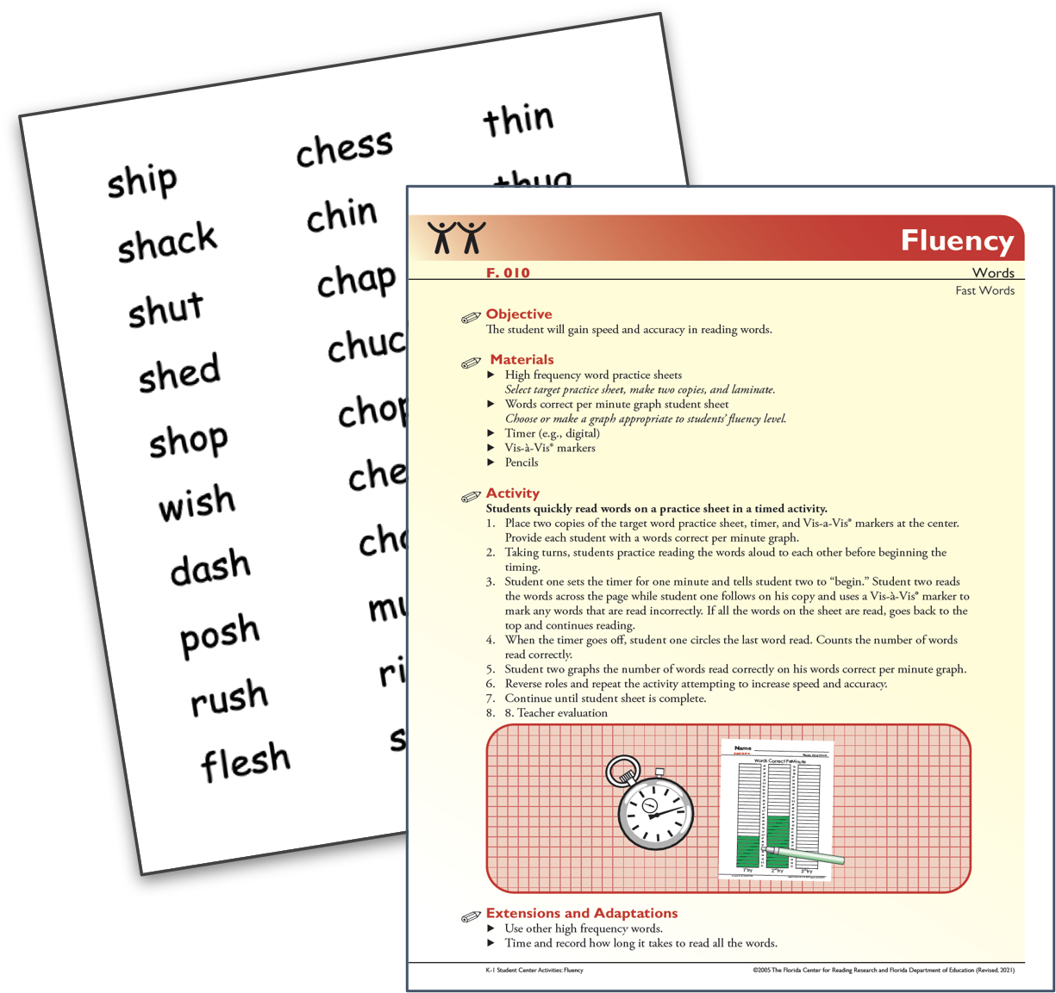
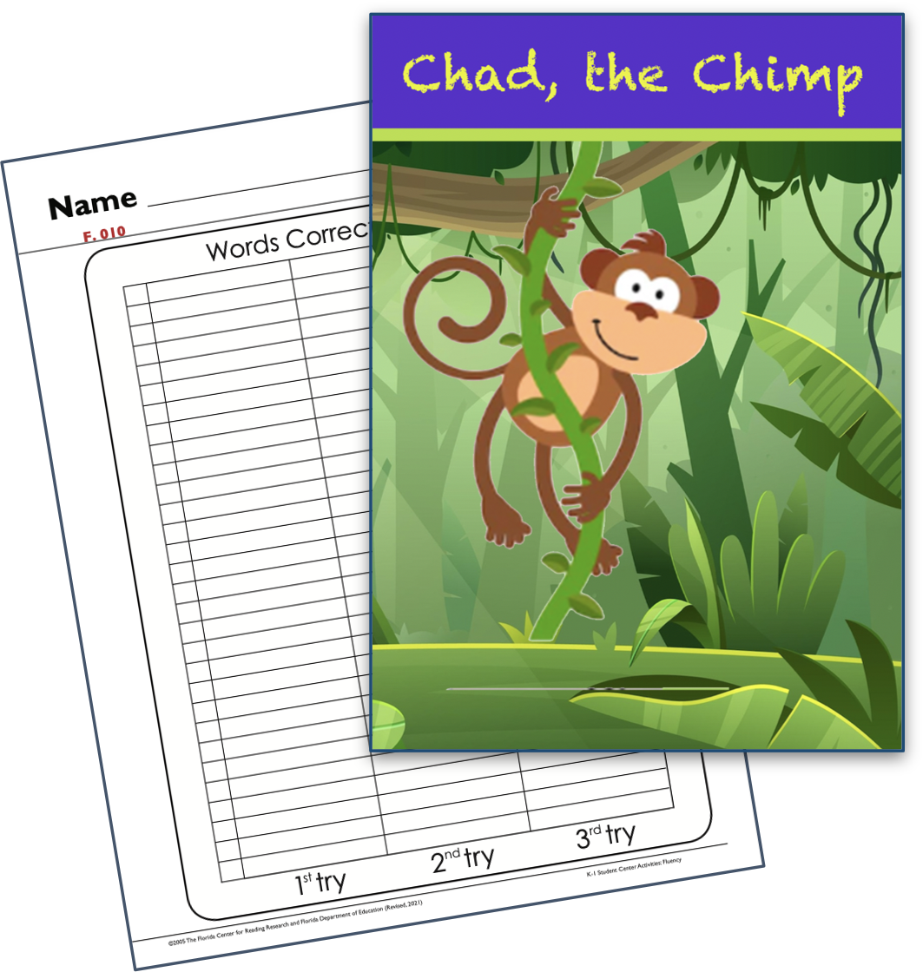
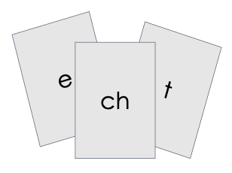
Instruction to Support Reading Fluency (2 of 3)
Correspondence Level
Connected Text Level
Word Level
Notes:
Facilitator Narration: For example, activities such as using grapheme cards for lesson reviews that require students to recall phoneme-grapheme correspondences. The teacher would show the grapheme cards and students would provide the names and sounds for the graphemes shown. At the word level, explicit blending instruction and lesson activities that involve students reading lists of words with newly taught correspondences and patterns are helpful for building accuracy, and once reasonable accuracy is reached a timed element can be added to help students build automaticity or a reasonable word reading rate. Once students are reading connected text with reasonable word recognition accuracy, they can be provided repeated reading practice, graphing their reading rate progress from the first cold read to the next warn read to a final hot read. It is important to introduce students to appropriate texts for for building fluent reading in connected text. An appropriate text for fluency practice is one which is relatively easy for a student, meaning no more than 1 in 20 words would be difficult, meaning an established reader can read with 95% accuracy. For emerging or beginning readers, they should be able to read the text with closer to 97 or 98% accuracy.

Slide 17
Instruction to Support Reading Fluency (3 of 3)
Teach using complex texts that introduce a variety of sentence and text structures
Encourage wide reading
Notes:
Facilitator Narration: In support of simultaneous language comprehension development, students should also be introduced to more complex connected texts with teacher support. As students listen to read alouds and learn about various sentence structures, they build their ability to group words into grammatical phrases to promote proper intonation and prosody. Reading with expression is another important part of reading fluency. At the sentence level, teachers can show students how to practice scooping words into phrases as needed to support mean-making.
And finally that bridge into reading comprehension requires that students read widely! Teachers can support and encourage wide reading using a variety of texts using both structured reading experiences and independent reading experiences. Teachers can even encourage students to read texts on similar topics, to capitalize on shared vocabulary words and themes.
Activity (10-15 min): Distribute copies of the supplemental resource from Student Achievement Partners titled Weekly 5 Day Reading Practice Routine for Fluency to all community members. Ask community members to pair off and review the routine.
Prompt with questions as needed:
What did you notice about the instructional routine?
Does our current reading program have a similar routine for integrating repeated oral readings?
How can this new routine be implemented to improve our current reading program or to help better coordinate existing programs already in use?
For younger students, does our current program offer enough fluency practice at the word level to support students word recognition skill development?

Slide 18
Adapting to Student Needs
Instruction that builds reading fluency can be especially helpful for students with language differences:
Multilingual learners become more familiar with the tone, phrasing, and accent patterns of English speech and vocabulary
Students with disabilities get targeted practice transferring new concepts taught into both accurate and automatic skills
Cárdenas-Hagan, 2020
Notes:
Facilitator Narration: These strategies used to build reading fluency also support the development of spoken English for multilingual learners. As students work on reading texts with accuracy, speed, and expression, they become more familiar with the tone, phrasing, and accent patterns of English speech. This practice also helps them build vocabulary, which strengthens their oral fluency and improves both their reading and listening comprehension. Students with disabilities benefit from the distributed skill practice targeting both skill accuracy and automaticity.
Optional Question: Describe how instruction designed to build fluency supports all students - those with language differences as well as those with disabilities?

Slide 19
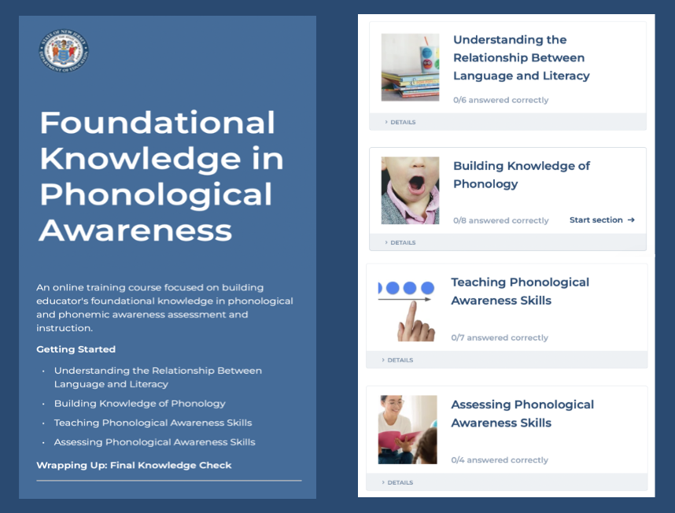
Thanks for participating!
ADD
QR CODE
COMING SOON
Notes:
Facilitator Narration: This brings us to the end of our session today! If you are interested to learn more about reading fluency, keep an eye out for the NJ Department of Education’s upcoming free SISEP online learning modules.

Slide 20
Next Session in the PLC Series
Session 4 Background Knowledge
Date: [Add Date]
Time: [Add Time]
Notes:
Facilitator Narration: Up next is Session 4 Background Knowledge. This PLC session will focus on best practices in building, activating, and connecting to student’s prior knowledge before and during reading to enhance comprehension. We will meet on [add date and time]. See you then!

Slide 21
References
Cárdenas-Hagan, E. (2020). Literacy foundations for English learners: A comprehensive guide to evidence-based instruction. Paul Brookes Publishing Co.
Gough P. B. & Tunmer W. E. (1986). Decoding, reading and reading disability. Remedial and Special Education, 7, pp. 6–10.
Hasbrouck, J. & Glaser, D. (2019). Reading fluency. New Rochelle, NY: Benchmark Education Company.
Hoover W. A. & Gough P. B. (1990). The simple view of reading. Reading and Writing, 2, pp. 127–160.
Hoover W. A. & Tunmer W. E. (2020). The cognitive foundations of reading and its acquisition: A framework for connecting teaching and learning. Springer.
Scarborough, H. S. (2001). Connecting early language and literacy to later reading (dis)abilities: Evidence, theory, and practice. In S. Neuman & D. Dickinson (Eds.), Handbook for research in early literacy (pp. 97–110). New York, NY: Guilford Press.

