Slide 1
LEARning about Literacy:
Professional Learning Community Series
Session 4 - Background Knowledge
Office of Learning Equity and Academic Recovery (LEAR)
Division of Teaching and Learning
Notes:
Facilitator Narration: Welcome! We’re excited to have you join us for this third session in our Professional Learning Community Series. Today, we’ll be looking to strengthen our instructional practices based on the latest research in background knowledge.
Note to Facilitator: Turquoise highlights indicate a “click” is needed to advance the slide animation.

Slide 2
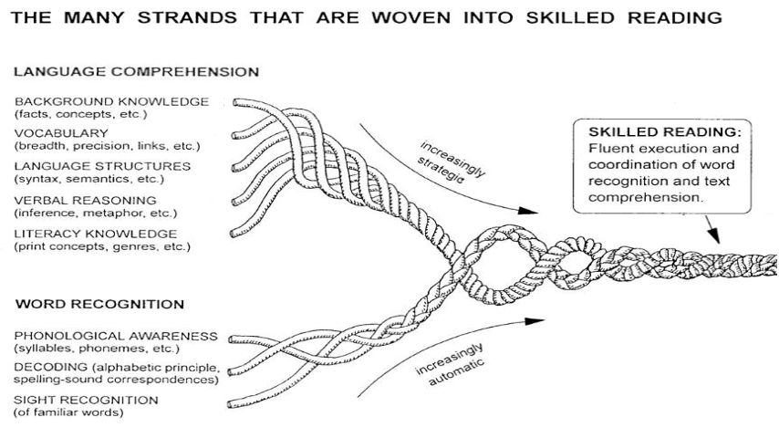
Session 4 - Background Knowledge
Scarborough, 2001
Notes:
Facilitator Narration: Beginning with our conceptual framework for skilled reading, Scarborough’s Reading Rope, let’s spend some time together exploring the role Background Knowledge plays in reading comprehension.
Note to Facilitator: You might also consider watching the video Teaching Content is Teaching Reading together before launching into the topic for this session.

Slide 3
Text version of Scarborough’s Rope
The many strands that are woven into skilled reading.
The Reading Rope consists of lower and upper strands. The word-recognition strands (phonological awareness, decoding, and sight recognition of familiar words) work together as the reader becomes accurate, fluent, and increasingly automatic with repetition and practice.
Language Comprehension (Upper Strands):
Strands include:
Background knowledge (facts, concepts, etc.)
Vocabulary (breadth, precision, links, etc.)
Language structures (syntax, semantics, etc.)
Verbal reasoning (inference, metaphor, etc.)
Literacy knowledge (print concepts, genres, etc.)
Word Recognition (Lower Strands)
Strands include:
Phonological awareness (syllable, phonemes, etc.).
Decoding (alphabetic principle, spelling-sound correspondences
Sight recognition (of familiar words).
Skilled Reading:
Language comprehension becomes increasingly strategic and word recognition becomes increasingly automatic in the progression to becoming a skilled reader.
A skilled reader displays fluent execution and coordination of word recognition and text comprehension.

Slide 4
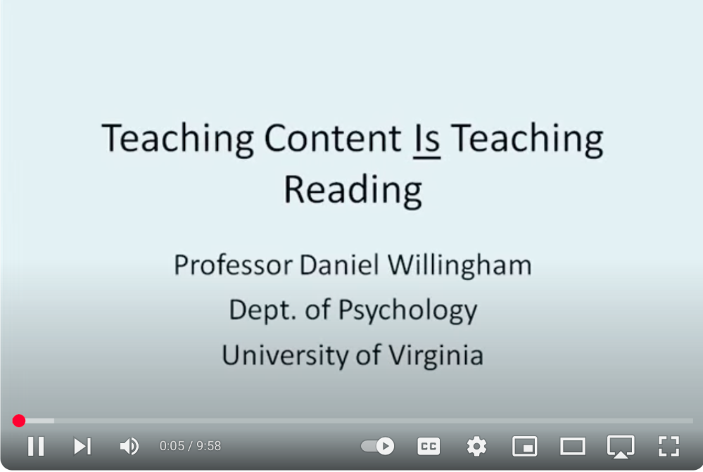
Teaching Content is Teaching Reading
Content Knowledge
Background Knowledge
Prior knowledge
Notes:
Facilitator Narration: As a pre-work activity for this session, we watched a video by Professor Daniel Willingham, Teaching Content is Teaching Reading. To get started with today’s session, we are going to discuss the video but first let’s think about what the terms content knowledge, prior knowledge, and background knowledge mean in relation to one another in the context of reading comprehension.
Content knowledge is the specific and structured body of information, facts, concepts, and principles that are associated with a particular subject or academic discipline. It represents the "what" of learning—what learners are expected to know and master.
Prior knowledge refers to the information, skills, experiences, and understandings that a learner brings to a new learning situation. It encompasses any pre-existing mental frameworks or conceptual understandings—whether accurate or flawed—that a learner activates when encountering new content.
With these definitions in mind, let’s imagine background knowledge functioning as the overarching framework that supports meaning-making of a particular, specific text. When we talk about background knowledge in relation to reading comprehension, we must account for our students’ pre-existing prior knowledge and acknowledge the discipline-specific content knowledge that is needed for a reader to fully understand the specific text.
Activity (10-15 min): Now that we’ve clarified the definitions of content knowledge, prior knowledge, and background knowledge, let’s take a few minutes to reflect on the video content together. Turn and Talk with a partner and discuss the following prompts. After your discussion, we’ll come back together and share a few insights with the whole group.
How do you see the relationship between content knowledge, prior knowledge, and background knowledge playing out in your classroom during reading instruction?
Can you think of a moment when a student struggled with comprehension not because they lacked strategy, but because they lacked key knowledge?
Note to Facilitator: You might also consider watching the video Teaching Content is Teaching Reading together before launching into the topic for this session.

Slide 5
The ABCs of Background Knowledge (1 of 4)
Activate and Assess
Build
Connect
What is necessary for understanding the critical topics and understandings represented in this text?
What did the author assume readers would bring to the text?
re my students bringing to the text?
What are the connections students can make to other readings/content?
How will I activate or gain access to my students’ knowledge?
Given what my students know, what else might my students need to know?
How will I facilitate the building of necessary knowledge?
How will I prompt students’ integration of background knowledge with the text?
Hennessy, 2014
Notes:
Facilitator Narration: Given the direct effect that background knowledge has on comprehension, let’s focus on the teacher’s role. Expert practitioner Nancy Hennessy has conceptualized The ABCs of Background Knowledge, a framework we can use to plan intentional instruction that Activates and Assesses, Builds, and Connects to the Background Knowledge student need for a text we are teaching in our classroom. Ms. Hennessy suggests we ask ourselves some important questions when planning instruction. Can I get some volunteers to read these suggested questions?
Volunteer(s) Read:
What is necessary for understanding the critical topics and understandings represented in this text?
What did the author assume readers would bring to the text?
What are my students bringing to the text?
What are the connections students can make to other readings/content?
How will I activate or gain access to my students’ knowledge?
Given what my students know, what else might my students need to know?
How will I facilitate the building of necessary knowledge?
How will I prompt students’ integration or connection of relevant background knowledge with the text?
Question: Reflect on this ABC framework and the guiding questions we just read aloud. How do you currently approach activating, building, and connecting background knowledge in your reading instruction? Which part of the ABCs feels most familiar or natural to you, and which part might require more intentional planning in your practice?
Facilitator Note: The ABCs of Background Knowledge framework and activity suggestions introduced here come from Nancy Hennessy’s book, The Reading Comprehension Blueprint: Helping Students Make Meaning from Text.

Slide 6
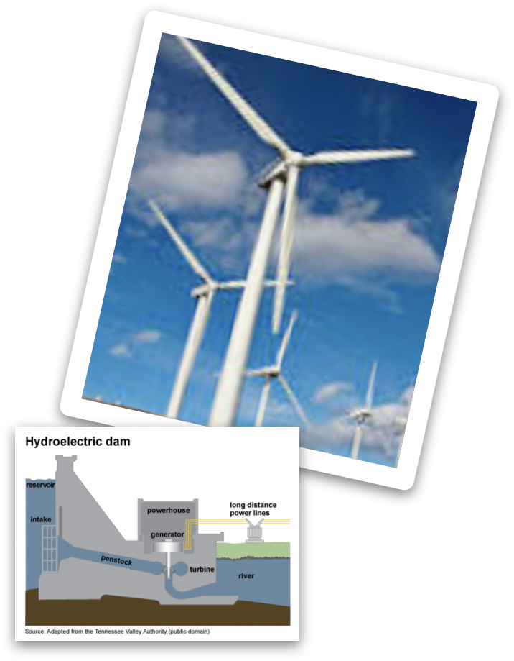
The ABCs of Background Knowledge (2 of 4)
Activate & Assess | Build | Connect
Anticipation Guides Questions and Prompts Charts, Webs, Maps Visual Images | Multiple Topical/Themed Texts Virtual or Real-Time Experiences Authentic Artifacts Vocabulary Connections | Anticipation Guides Questions and Prompts Charts, Webs, Maps Application to Other Readings
I Agree | Statement | I Disagree
K What do you know about [topic]? | W What do you want to know about [topic]? | L What have you learned about [topic]?
What do you already know about [topic/enduring understanding]?
Do you know what it is like to be [characteristic/quality]?
Hennessy, 2014
Notes:
Facilitator Narration: Now let’s explore some instructional activities aligned with each component of the ABCs of Background Knowledge framework. To Activate and Assess Students’ Background Knowledge:
Anticipation Guides can be used before reading to spark interest and activate prior knowledge. Students respond to a series of statements related to key ideas in the text—agreeing or disagreeing based on what they already know. These guides help surface students’ preconceptions and set a purpose for reading.
Open-ended Questions and Prompts can be posed that tap into relevant background knowledge before or during reading. These can help students make connections between what they already know and the new content in the text.
Visual Organizers such as concept maps, webs, or KWL charts can support students in organizing their existing knowledge, identifying gaps, and connecting ideas as they engage with a text.
And visual Images, such as photographs, illustrations, artwork, and other images—from picture books, media, or online sources—can be powerful tools to activate background knowledge. Pair them with guiding questions to prompt observation, discussion, and connections to the text’s content.
Questions:
Which of these strategies for activating and assessing background knowledge have you used before?
What worked well, and what challenges did you encounter?
Optional Follow-up Prompts for Deeper Conversation:
Are there particular texts or topics where these strategies have been especially helpful?
How do your students respond to these approaches?
Is there a strategy you’ve heard today that you haven’t used yet but would like to try? What might that look like in your context?

Slide 7
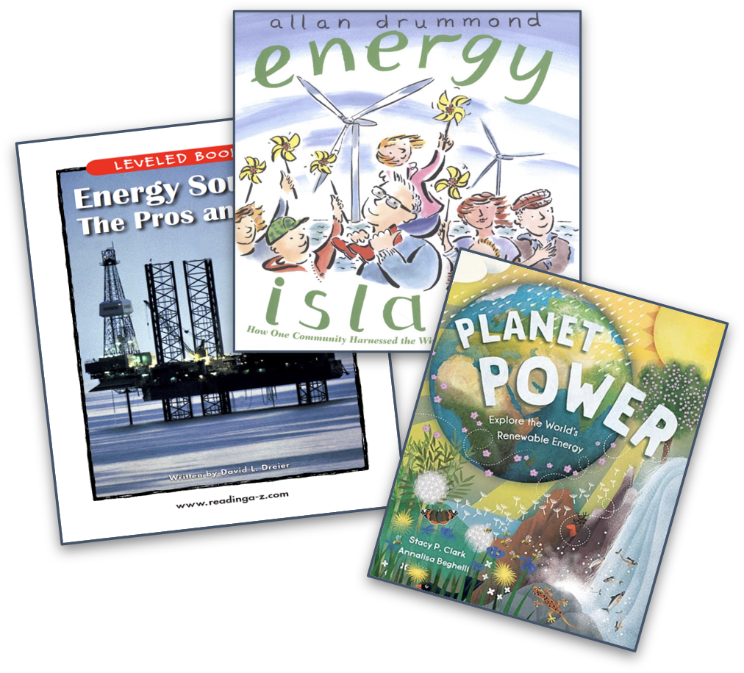

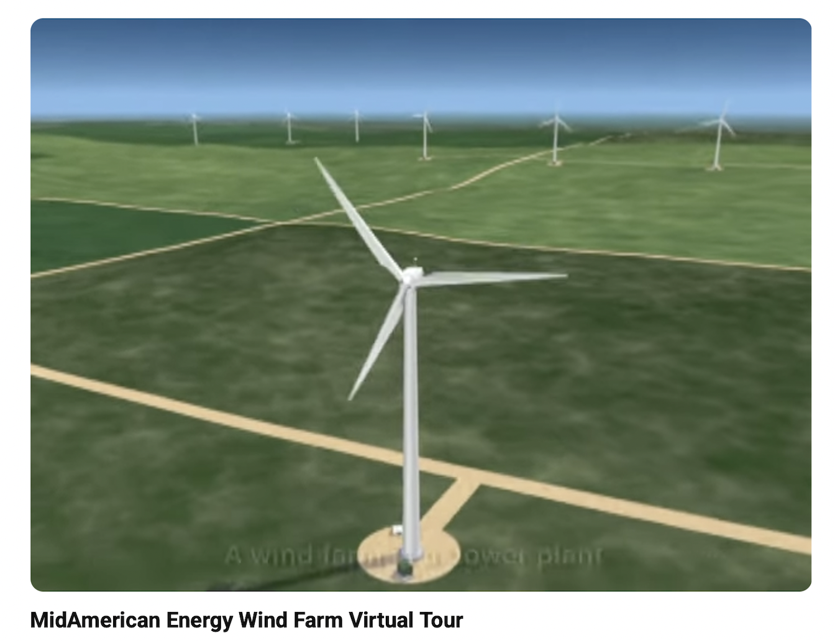


The ABCs of Background Knowledge (3 of 4)
Activate & Assess | Build | Connect
Anticipation Guides Questions and Prompts Charts, Webs, Maps Visual Images | Multiple Topical/Themed Texts Virtual or Real-Time Experiences Authentic Artifacts Vocabulary Connections | Anticipation Guides Questions and Prompts Charts, Webs, Maps Application to Other Readings
Hennessy, 2014
Notes:
Facilitator Narration: Let’s now turn to strategies that help build the background knowledge students need to engage deeply with a text:
Organizing instruction around Multiple Topical or Themed Texts allows students to explore content from different angles. This approach strengthens their understanding of language, vocabulary, and domain-specific concepts across genres and content areas.
Virtual or Real-Time experiences such as field trips, virtual museum tours, or guest speakers, bring abstract topics to life. Immersing students in real-world contexts can spark interest and provide concrete references for new learning.
With thoughtful guiding questions, Authentic Artifacts and real-world items like maps, objects, or primary documents can introduce key concepts in tangible ways and prepare students to engage with new information in texts.
Teaching Vocabulary Connections before and during reading helps students access and retain new information. Explicit instruction of key terms and the use of context clues to derive meaning of new words while reading builds the linguistic foundation students need to make meaning from text and repair comprehension when it breaks down.
Questions:
Which of these strategies for building background knowledge have you used in your instruction?
What impact did they have on student engagement or comprehension?
Optional Follow-up Prompts for Deeper Conversation:
Can you recall a time when one of these strategies helped a student make a breakthrough in understanding?
What challenges have you faced when trying to incorporate these approaches?
Which of these strategies would you like to try or expand on in your current instruction, and why?
Resource to Explore: Achieve The Core by Student Achievement Partners - Text Set Project: Building Knowledge and Vocabulary

Slide 8
The ABCs of Background Knowledge (4 of 4)
Activate & Assess | Build | Connect
Anticipation Guides Questions and Prompts Charts, Webs, Maps Visual Images | Multiple Topical/Themed Texts Virtual or Real-Time Experiences Authentic Artifacts Vocabulary Connections | Anticipation Guides Questions and Prompts Charts, Webs, Maps Application to Other Readings
Solar energy is power that comes from the sun. The sun gives off light and heat, and we can use special panels called solar panels to collect it. People put solar panels on rooftops or in big fields. Solar energy is good because it doesn’t run out like gas or coal. It also helps keep the air clear because it doesn’t make smoke. I think solar energy is cool because it comes from nature and can help us save the Earth.
K What do you know about [topic]? | W What do you want to know about [topic]? | L What have you learned about [topic]?
I Agree | Statement | I Disagree
Hennessy, 2014
Notes:
Facilitator Narration: Activating, assessing, and often building background knowledge are essential steps that pave the way for students to make meaningful connections with a text. Skilled readers consistently draw upon and integrate their knowledge before, during, and after reading. This ability is deeply supported by intentional instruction that ensures students have access to the knowledge they need in order to understand and engage with what they read. After reading, students can:
Revisit their anticipation guides to revise or expand on their initial responses in light of new information.
Complete the “Learned” sections of visual organizers (e.g., KWL charts or concept webs), helping them consolidate their understanding.
Respond to reflection prompts, either orally or in writing, that encourage them to connect what they’ve read to their own experiences, to other texts they’ve read, or to broader themes within the unit.
These post-reading activities not only deepen comprehension but also promote metacognitive habits—helping students become more thoughtful, reflective readers who see learning as a process of continuous connection-making.

Slide 9
Adapting to Student Needs
Deep comprehension depends on sufficient background knowledge; however, students differ in the knowledge they bring to the classroom:
  Some may have limited or inaccurate prior knowledge.
  Some may struggle to connect texts to their own experiences.
  Some may face barriers due to a cultural or linguistic mismatch.
Teachers must assess and then design instruction that builds and connects the relevant background knowledge needed for the text.
Notes:
Facilitator Narration: Students cannot be expected to comprehend deeply or excel academically if they lack the necessary background knowledge to engage with texts they are asked to read in the classroom. Research shows that struggling readers often have difficulty making connections between the texts they read and what they already know. These students may have limited world knowledge, hold incomplete or inaccurate understandings of certain topics, or experience challenges accessing or applying their prior knowledge—especially when their cultural or linguistic background differs from the dominant classroom expectations. As a result, it is critical that teachers differentiate their instruction to ensure all students have equitable access to the background knowledge required for comprehension.

Slide 10
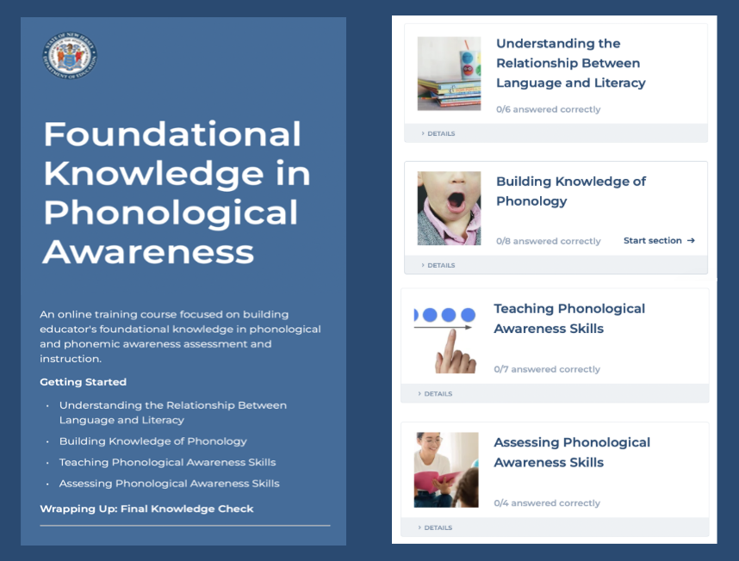
Thanks for participating!
Add
QR Code
COMING SOON
Notes:
Facilitator Narration: This brings us to the end of our session today! If you are interested to learn more about reading fluency, keep an eye out for the NJ Department of Education’s upcoming free SISEP online learning modules.

Slide 11
Next Session in the PLC Series
Session 5 Vocabulary
Date: [Add Date]
Time: [Add Time]
Notes:
Facilitator Narration: Up next is Session 5 Background Knowledge. This PLC session will focus on best practices in vocabulary. We will meet on [add date and time]. See you then!

Slide 12
References
Hennessy, N. L. (2021). The reading comprehension blueprint: Helping students make meaning from text. Paul Brookes Publishing Co.
Scarborough, H. S. (2001). Connecting early language and literacy to later reading (dis)abilities: Evidence, theory, and practice. In S. Neuman & D. Dickinson (Eds.), Handbook for research in early literacy (pp. 97–110). New York, NY: Guilford Press.

