Slide 1
LEARning about Literacy:
Professional Learning Community Series
Session 5 - Vocabulary
Office of Learning Equity and Academic Recovery (LEAR)
Division of Teaching and Learning
Notes:
Facilitator Narration: Welcome! We’re excited to have you join us for this fifth session in our Professional Learning Community Series.
Note to Facilitator: Turquoise highlights indicate a “click” is needed to advance the slide animation.

Slide 2
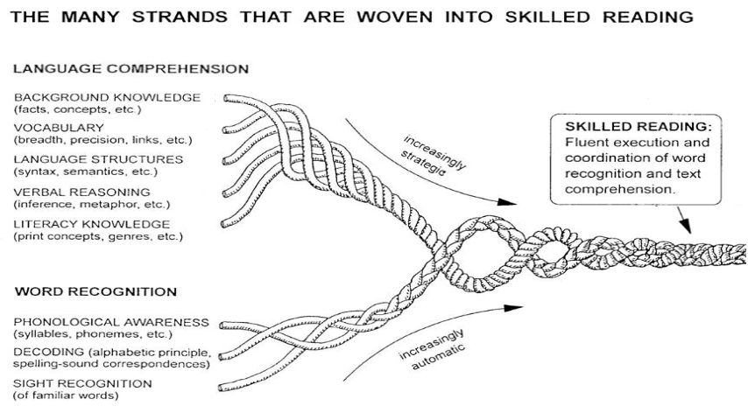
Session 5 - Vocabulary
Scarborough, 2001
Notes:
Facilitator Narration: Always starting with our conceptual framework for skilled reading, Scarborough’s Reading Rope, today’s session will explore the role of Vocabulary in reading comprehension.

Slide 3
Text version of Scarborough’s Rope
The many strands that are woven into skilled reading.
The Reading Rope consists of lower and upper strands. The word-recognition strands (phonological awareness, decoding, and sight recognition of familiar words) work together as the reader becomes accurate, fluent, and increasingly automatic with repetition and practice.
Language Comprehension (Upper Strands):
Strands include:
Background knowledge (facts, concepts, etc.)
Vocabulary (breadth, precision, links, etc.)
Language structures (syntax, semantics, etc.)
Verbal reasoning (inference, metaphor, etc.)
Literacy knowledge (print concepts, genres, etc.)
Word Recognition (Lower Strands)
Strands include:
Phonological awareness (syllable, phonemes, etc.).
Decoding (alphabetic principle, spelling-sound correspondences
Sight recognition (of familiar words).
Skilled Reading:
Language comprehension becomes increasingly strategic and word recognition becomes increasingly automatic in the progression to becoming a skilled reader.
A skilled reader displays fluent execution and coordination of word recognition and text comprehension.

Slide 4
The Importance of Vocabulary
Vocabulary knowledge predicts later reading comprehension performance. (Catts et al., 2014)
Multiple experiences with a word build deeper, richer word knowledge, making meanings more precise and easier to access. (Perfetti, 2007)
Students need to know 90–95% of the words in a text to understand it. (Nagy & Scott, 2000)
Notes:
Facilitator Narration: Vocabulary plays a crucial role in reading development.
Research shows that vocabulary knowledge is highly predictive of later reading comprehension — in fact, students with stronger vocabularies tend to score higher on comprehension assessments.
Knowledge of individual word meanings is essential for building understanding of larger texts, but it’s not enough to simply memorize definitions. To truly grasp texts, students need to deeply understand the words they encounter. This deep knowledge helps them navigate increasingly complex material throughout their academic and life journeys.
To truly understand what they read, students need to know 90 to 95 percent of the words in a text. Without that foundational word knowledge, making sense of connected ideas becomes much harder.

Slide 5
Vocabulary Instruction (1 of 2)
Breadth
Depth
Notes:
Facilitator Narration: Teachers should not assume that all students come to class with the same level of word knowledge. Students will bring varying levels of understanding based on their personal experiences. The goal of vocabulary instruction is to build breadth and depth. As a pre-work activity for this session, we read the Reading Universe’s Vocabulary Skill Explainer. Can I get some volunteers to describe what we mean by breadth and depth in relation to our vocabulary instruction?
Activity (5 minutes): Create a space to capture notes on the two terms. Facilitate the discussion to prompt community members for the following points:
Breadth refers to the number of words a student recognizes or knows at a certain level, which contributes to the overall size of their vocabulary. However, breadth alone doesn’t measure how well students understand each word.
Depth describes the richness of a student’s knowledge about a word. It’s not just about recognizing a word (breadth), but understanding its definition, context, and connections to other words. As depth increases, students can define words more thoroughly, grasp multiple meanings, and use the words more flexibly across contexts.

Slide 6
Vocabulary Instruction (2 of 2)
Breadth
the number of words a student recognizes or knows at a certain level, which contributes to the overall size of their vocabulary
Depth
the richness of a student’s knowledge about a word. It’s not just about recognizing a word (breadth), but understanding its definition, context, and connections to other words.
Notes:
Facilitator Narration: Great discussion! It is also important to note that as students’ vocabularies deepen and they encounter words in various contexts, they will become faster at recognizing and understanding word meanings, which directly enhances reading fluency and comprehension.

Slide 7


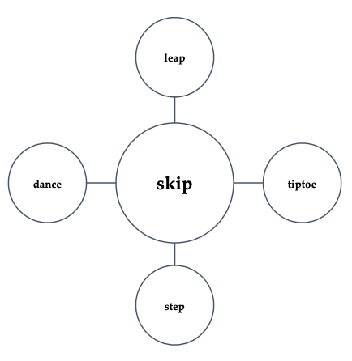
7 Features of a Word
Pronunciation
Spelling
Definitions
Function
Syntax
Semantic network
Morphological structure
skip
/skĭp/
<skip> + <s> → skips
<skip> + <ing> → skipping
<skip> + <er> → skipper
Notes:
Facilitator Narration: This brings us to the “7 Features of a Word” described in our pre-work activity - pronunciation, spelling, definitions, function, syntax, semantic network, and morphological structure. The example vocabulary word used in the skill explainer was skip. We were asked to choose a vocabulary word that we would be teaching this week and make note of these 7 features. Can I get 1-2 volunteers to share the word they choose and its 7 features?
Activity (5 minutes): Create a space for volunteers to share their words and features. This can be shared orally or displayed visually. Facilitate a discussion around the words and let the community members know that the rest of the session will focus on ways to explicitly think about teaching vocabulary that capitalizes on these features.
Facilitator Note: You may consider talking through the example skip provided in the Reading Universe’s Vocabulary Skill Explainer before starting the activity with community members.

Slide 8
Vocabulary Instruction (3 of 3)
word-rich environment
Explicit teaching of academic vocabulary
Incidental language experiences
Independent vocabulary strategies
Hennessy, 2021
Notes:
Facilitator Narration: Great work - you can see how our own understanding of word features can make vocabulary instruction richer and more explicit for our students! Now, let’s discuss instruction. When it comes to building vocabulary, children learn words in many ways, both inside and outside the classroom. As teachers, it’s important that we recognize there will be differences in our students’ vocabulary acquisition and intentionally design our instruction to support every student right from the start.
Effective classrooms foster a strong curiosity about language and actively create a word-rich environment, where students are regularly exposed to engaging discussions, playful interactions with language, and opportunities to notice, use, and enjoy words.
Within consciously word-rich classrooms, three key types of instruction work together:
Explicit teaching of academic vocabulary, where students learn meanings through direct explanations and examples;
Incidental language experiences, where students naturally pick up new words through conversations, read-alouds, and storytelling; and
Independent vocabulary strategies, where students are directly taught how to figure out unfamiliar words on their own when reading, such using context clues within the text, using the morphemes that make up the word, and/or using reference tools like glossaries or dictionaries, when needed.
It's important to remember that while we can explicitly teach a few hundred words a year, students on track for proficient reading are expected to learn thousands. To meet this challenge, we must balance deep, targeted instruction with rich exposure and equip students with the tools to independently grow their vocabulary for life. Let’s look more closely at some instructional strategies for our explicit teaching.

Slide 9
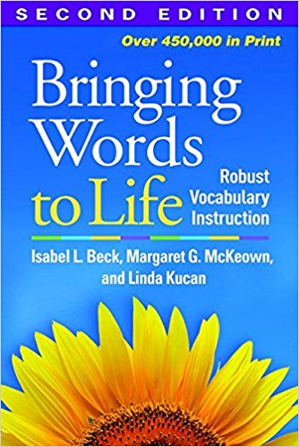
Explicit Teaching of Academic Vocabulary
Apply a Tiered Approach
Tier 1: Basic words most students know
Tier 2: High-utility words across subjects
Tier 3: Domain-specific words
Beck & McKeown, 2013
Notes:
Facilitator Narration: Academic language is more complex than everyday speech and students must be prepared to handle this complexity. In vocabulary instruction, word choice is critical and you may ask: Which words should I teach? In their book Bringing Words to Life researchers Beck and McKeown explain the benefits of applying a tiered approach.
Tier 1 includes basic, everyday words — words like house, run, or baby — that most students will already know when they enter school. These words usually don't require explicit instruction unless a student needs additional support.
Tier 2 words are high-utility words that appear across many subjects and contexts. These are words like analyze, establish, or contrast. Because they are common in academic texts and important for comprehension, Tier 2 words are prime targets for explicit instruction.
Tier 3 words are domain-specific — words tied to a particular subject area, like photosynthesis in science or legislature in social studies. These words are usually taught as needed, when students encounter them in specific lessons or units.
By understanding and applying this tiered approach, we can prioritize the words that will have the biggest impact on students’ academic success, making our vocabulary instruction more focused and effective. As you choose which words to teach, it can be helpful to ask yourself a few guiding questions:
Is this word useful beyond this one lesson or subject area?
Does it offer opportunities for rich discussion, deeper exploration, or connection to other words and ideas?
Can this word help students grow their vocabulary through patterns, roots, or related words?
And, is this word essential for understanding the key ideas of the text?

Slide 10
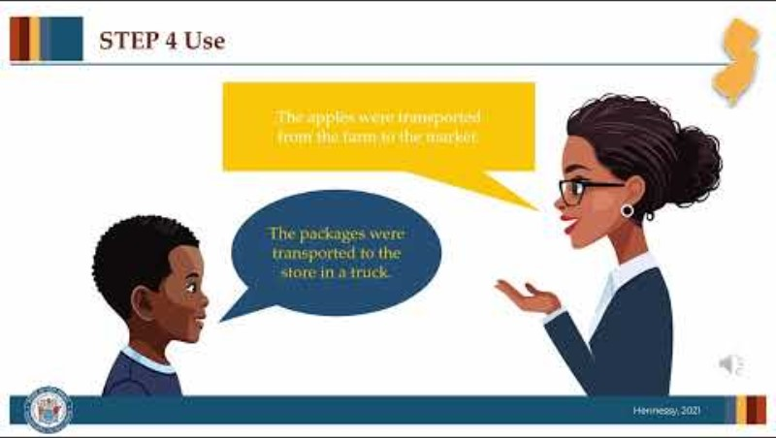
An Explicit Vocabulary Routine (1 of 2)
Notes:
Facilitator Narration: Once we know what words we want to teach, explicit instructional routines give students both definitional and contextual exposure to the features of new words. Let’s watch this short video.
[Click red button to play video PLC Series Video - An Explicit Vocabulary Routine]

Slide 11
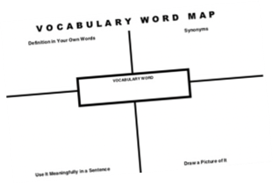
An Explicit Vocabulary Routine (2 of 2)
Listen — Teacher says the new word aloud and highlights word parts.
Repeat — Students echo the word back to the teacher.
Define — Teacher explains the word clearly, supports with images, and leads a discussion to deepen understanding.
Use — Teacher models the word in a sentence, and students create their own examples, keeping the focus on oral language.
See, Say, Write — Finally, students see the written word, say it again, and write it themselves, connecting pronunciation, spelling, and meaning.
child drawing of cargo ship
Sentence Stem
"The ______________ were transported
from ______________ to _____________ by _________________."
Notes:
Facilitator Narration: Given that vocabulary knowledge is a key predictor of reading comprehension, it’s essential that we implement effective vocabulary instruction to help students build a broad and deep vocabulary, enabling them to understand and engage with the complex texts they will encounter throughout their lives.
Optional Activity: Have community members work in pairs to discuss how they might introduce the vocabulary word they identified in the pre-work to students using this simple vocabulary routine and what extension activities they can plan to include to provide students practice and opportunities for deep processing.

Slide 12
Text Version: Vocabulary Word Map
Definition in Your Own Words
Synonyms
Vocabulary Word
Use it Meaningfully in a Sentence
Draw a Picture of It

Slide 13
Adapting to Student Needs
Students face extra demands when the English vocabulary used during reading instruction differs from their own home language/dialect. Instruction for Multilingual Learners should leverage their existing linguistic and cognitive resources (e.g., bilingual, English as a Second Language) and attend to linguistic similarities and differences across languages (cognates).
Students with disabilities may need additional scaffolding to support any weaknesses in receptive or expressive language development.
Cárdenas-Hagan, 2020
Notes:
Facilitator Narration: Students face extra demands when the English vocabulary used during reading instruction differs from their own home language/dialect. Instruction for Multilingual Learners should leverage their existing linguistic and cognitive resources (e.g., bilingual, English as a Second Language) and attend to linguistic similarities and differences across languages (cognates).
Students with disabilities may need additional scaffolding to support any weaknesses in receptive or expressive language development.

Slide 14

Thanks for participating!
Add
QR Code
Coming Soon
Cárdenas-Hagan, 2020
Notes:
Facilitator Narration: This brings us to the end of our session today! If you are interested to learn more about vocabulary, keep an eye out for the NJ Department of Education’s upcoming free SISEP online learning modules.

Slide 15
Next Session in the PLC Series
Session 7 Sentence Comprehension
Date: [Add Date]
Time: [Add Time]
Notes:
Facilitator Narration: Up next is Session 7 Sentence Comprehension. This PLC session will focus on syntax and semantics at the sentence level. We will meet on [add date and time]. See you then!

Slide 16
References
Beck, I., McKeown, M., & Kucan, L. (2002). Bringing words to life: Robust vocabulary instruction. The Guilford Press.
Cárdenas-Hagan, E. (2020). Literacy foundations for English learners: A comprehensive guide to evidence-based instruction. Paul Brookes Publishing Co.
Catts, H., Nielsen, D. C., Bridges, M. S., & Liu, Y. S. (2014). Early identification of reading comprehension difficulties. Journal of Learning Disabilities, 49 (5), pp. 451-462.
Nagy, W. E. & Scott, J. A. (2000). Vocabulary Processes. In M. L. Kamil, P. B. Mosenthal, P. D. Parson, & R. Barr (Eds.), Handbook of reading research (Vol. 3, pp. 269-284). Lawrence Erlbaum Associates.
Perfetti, C. (2007). Reading ability: Lexical quality to comprehension. Scientific Studies of Reading, 11(4), pp. 357-383.
Hennessy, N. L. (2021). The reading comprehension blueprint: Helping students make meaning from text. Paul Brookes Publishing Co.
Scarborough, H. S. (2001). Connecting early language and literacy to later reading (dis)abilities: Evidence, theory, and practice. In S. Neuman & D. Dickinson (Eds.), Handbook for research in early literacy (pp. 97–110). New York, NY: Guilford Press.

