Slide 1
LEARning about Literacy:
Professional Learning Community Series
Session 6 - Sentence Comprehension
Office of Learning Equity and Academic Recovery (LEAR)
Division of Teaching and Learning
Notes:
Facilitator Narration: Welcome! We’re excited to have you join us for this sixth session in our Professional Learning Community Series. Today, we’ll be looking to strengthen our instructional practices based on the latest research in sentence comprehension.
Note to Facilitator: Turquoise highlights indicate a “click” is needed to advance the slide animation.

Slide 2
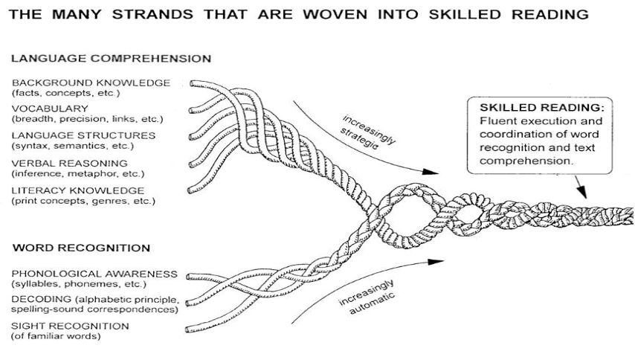
Session 6 - Language Structures
Scarborough, 2001
Notes:
Facilitator Narration: Always starting with our conceptual framework for skilled reading, Scarborough’s Reading Rope, in today’s session we will discuss language structures, the semantic and syntactic knowledge needed for sentence-level comprehension.

Slide 3
Text version of Scarborough’s Rope
The many strands that are woven into skilled reading.
The Reading Rope consists of lower and upper strands. The word-recognition strands (phonological awareness, decoding, and sight recognition of familiar words) work together as the reader becomes accurate, fluent, and increasingly automatic with repetition and practice.
Language Comprehension (Upper Strands):
Strands include:
Background knowledge (facts, concepts, etc.)
Vocabulary (breadth, precision, links, etc.)
Language structures (syntax, semantics, etc.)
Verbal reasoning (inference, metaphor, etc.)
Literacy knowledge (print concepts, genres, etc.)
Word Recognition (Lower Strands)
Strands include:
Phonological awareness (syllable, phonemes, etc.).
Decoding (alphabetic principle, spelling-sound correspondences
Sight recognition (of familiar words).
Skilled Reading:
Language comprehension becomes increasingly strategic and word recognition becomes increasingly automatic in the progression to becoming a skilled reader.
A skilled reader displays fluent execution and coordination of word recognition and text comprehension.

Slide 4
The Importance of Syntax
“There is a lot of evidence showing the importance of grammar in reading comprehension. Studies over the years have shown a clear relationship between syntactic or grammatical sophistication and reading comprehension; that is, as students learn to employ more complex sentences in their oral and written language, their ability to make sense of what they read increases, too.”
–Shanahan, 2013
Notes:
Facilitator Narration: Sentence comprehension requires an important foundation in grammar and syntax. Traditionally, grammar has been the larger term, made up of both syntax and morphology. Syntax is the study of how words and phrases are arranged to form sentences in a language, while grammar provides the rules for how sentences, clauses, and words are constructed. Both grammar and syntax are critical because they are the vehicle for conveying meaning. Research shows a strong link between grammatical knowledge and reading comprehension—students who can write and understand more complex sentences are better able to make sense of what they read.

Slide 5
Reflection Activity
How confident do you feel in identifying and explaining different types of grammar and sentence structures?
How prepared do you feel to help students understand and work through more complicated sentences?
How prepared do you feel to integrate sentence-level reading and writing instruction to support student’s reading comprehension?
Notes:
Facilitator Narration: Strong readers need to understand how sentences are built, especially when they encounter the more complex sentence structures that link multiple ideas together in academic text. Knowing how conjunctions connect ideas and how certain sentence features—like independent and dependent clauses, long noun phrases, and confusing pronoun references—can make comprehension harder for students can help us plan more effective instruction. When we understand what makes a sentence challenging, we can better anticipate where students might struggle and adjust our teaching to meet their needs.
As a pre-work activity for this session, we watched the video on Classroom Strategies for Sentence Combining which delved into independent and dependent clauses and activities for sentence combining, let's take a moment to reflect on our own knowledge of syntax and our ability to teach it to students.
Activity (5 min): Facilitate the discussion to prompt community members to reflect on the following questions before sharing their thoughts with the group:
How confident do you feel in identifying and explaining different types of grammar sentence structures?
How prepared do you feel to help students understand and work through more complicated sentences?
How prepared do you feel to integrate sentence-level reading and writing instruction to support student’s reading comprehension?
Facilitator Note: If community members feel anxious about their knowledge base, these two books may provide some background knowledge support:
The Reading Comprehension Blueprint: Helping Students Make Meaning from Text by Nancy Lewis Hennessy
The Writing Revolution: A Guide for Advancing Thinking Through Writing by Judith Hochman & Natalie Wexler

Slide 6
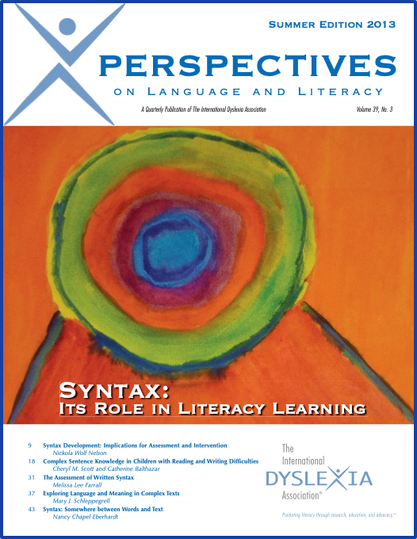
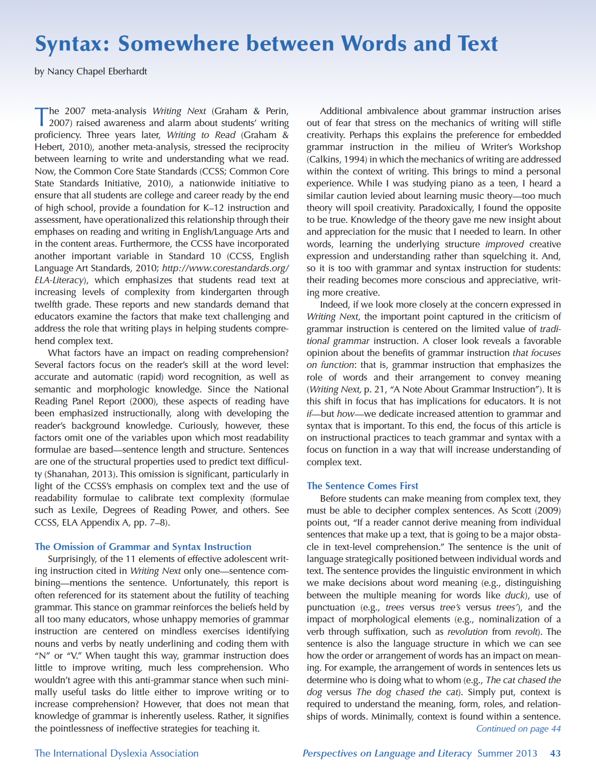
Effective Instructional Practices
Teaching skills explicitly
Emphasizing reading fluency
Developing metacognitive strategies
Presenting skills cumulatively & sequentially
Notes:
Facilitator Narration: To build strong readers, we need a solid foundation in how we teach sentence comprehension (and sentence composition). In her article, Syntax: Somewhere between Words and Text, Nancy Chapel Eberhardt identifies a few key instructional practices:
Teaching skills explicitly - making abstract concepts concrete and visual for students
Emphasizing reading fluency - supporting oral reading with meaningful phrasing and attention to punctuation
Developing metacognitive strategies - helping students think about how sentences work and apply strategies to new texts
Presenting skills cumulatively and sequentially - laying foundations early and building step-by-step
Let’s now dive into some instructional practices that help students unlock the meaning behind sentences — especially those that are more complex.
Activity (20 min): Provide copies of the article, Syntax: Somewhere between Words and Text by Nancy Chapel Eberhardt. Divide community members into small groups and have each read a short segment of the article that focuses on effective instructional practices. First, ask community members to read their assigned section independently. Then, each group will discuss and summarize the big takeaways of their assigned section. Finally, the groups will share what was learned with the full group, teaching all community members about instructional practices introduced. Be sure to end the discussion by asking participants why this is important for students with dyslexia.
Group 1 will read section “A Function-Based Instructional Approach” on pages 45-46.
Group 2 will read sections “A Reciprocal Process: Writing Based on Reading” and “Instruction to Increase Syntactic Complexity” on pages 46-47.
Group 3 will read sections “Sentence Combining—When, Why, How” and “I Don’t Understand This” on pages 47-48.

Slide 7
Lesson on Sentence Parsing
“After months of careful preparation, the anxious astronauts launched the powerful rocket toward the red planet.”
Which one, what kind, how many? | Who or what? | Is/was doing or happening? | To what, whom? | When, where, why, how?
the anxious | astronauts | launched | the powerful rocket | After months of preparation toward the red planet
Hennessy, 2021
Notes:
Facilitator Narration: Now let’s look more closely at a lesson connected to a text students have been reading, Mission to Mars, from a themed unit on exploration. This lesson focuses on building their understanding of parts of speech and sentence structure by using a questioning technique with a sentence frame. Sentence frames organize question words that correspond to different parts of speech — such as "who," "what," "where," and "when" — and help students map out the roles or functions of words, phrases, and clauses in a sentence.
Teachers should purposely select sentences either from the text itself or create new sentences that connect to the unit’s themes. Here we see the sentence: After months of careful preparation, the anxious astronauts launched the powerful rocket toward the red planet.
The teacher then models through think aloud, the following questions to parse and deconstruct the sentence into the frame:
Who is the sentence about? astronauts → This is the subject (noun).
Which words describe the astronauts? the anxious - (adjective)
What did the astronauts do? launched → This is the action (verb).
What did they launch? the powerful rocket → This is the object of the action.
When did this happen? after months of preparation → This prepositional phrase tells when.
Where was the rocket launched toward? toward the red planet → This prepositional phrase tells where.
After modeling the teacher will then provide another sentence for students to parse into a sentence frame as they are prompted with the same questions. As a close to the lesson, students will parse additional sentences on their own. The teacher will circulate and provide feedback on students responses to the questions they are asking themselves.
This lesson focuses on student’s identifying and understanding the FUNCTION of the words, phrases, and clauses and how they work together to create sentences.

Slide 8
Lesson on Sentence Combining
Comprehending a variety
of syntactic patterns
Adding adjectives and adverbs
Forming compound subjects or compound objects
Joining ideas with coordinating conjunctions (and, but, so)
Using possessive nouns
Creating adverbial clauses with subordinating conjunctions (because, since, after)
Embedding ideas into relative clauses (who, which, that)
Question:
What challenges did the astronauts face during their mission?
Kernel Sentences:
The astronauts had limited food supplies.
They also had to repair damaged equipment.
The astronauts had limited food supplies, and they had to repair damaged equipment.
Notes:
Facilitator Narration: Sentence combining is another powerful instructional tool traditionally discussed in the context of writing, but it also plays an important role in supporting reading comprehension. In sentence combining activities, students are given two or more kernel sentences — short, simple sentences — and asked to combine them into one well-formed, syntactically rich sentence. With a well-designed scope and sequence, students can learn to use a variety of syntactic patterns, such as:
Adding adjectives and adverbs
Forming compound subjects or compound objects
Joining ideas with coordinating conjunctions (and, but, so)
Using possessive nouns
Creating adverbial clauses with subordinating conjunctions (because, since, after)
Embedding ideas into relative clauses (who, which, that)
For this lesson, again teachers select or create kernel sentences and focused questions tied to the texts students are currently reading. The first step is to model through thinking aloud, using the question What challenges did the astronauts face during their mission? Showing these sentences to the student, the teacher will explain that in the passage the The astronauts had limited food supplies. and They also had to repair damaged equipment. The teacher will then ask the students to watch as she combines the two sentences into one, using a coordinating conjunction. The astronauts had limited food supplies, and they had to repair damaged equipment. While demonstrating the combination, the teacher can discuss punctuation and other options for coordinating conjunctions (like the FANBOYS discussion from the pre-work video). Different guiding questions and kernel sentences will require different coordinating conjunctions.
Once again after modeling, to ensure instruction is explicit and clearly integrating reading and writing instruction, the teacher will follow with guided and independent practice opportunities for students.

Slide 9
Adapting to Student Needs
Students face extra demands when the English syntax used during reading instruction differs from their own home language/dialect.
Multilingual Learners must develop awareness of sentence structures in English, including both familiar and unfamiliar patterns.
Dialects are rule-governed and linguistically valid variations of syntax patterns that require respectful, informed teaching.
Students with disabilities may need additional scaffolding to support any weaknesses in language processing.
Notes:
Facilitator Narration: Students face extra demands when the English syntax used during reading instruction differs from their own home language/dialect.

Slide 10
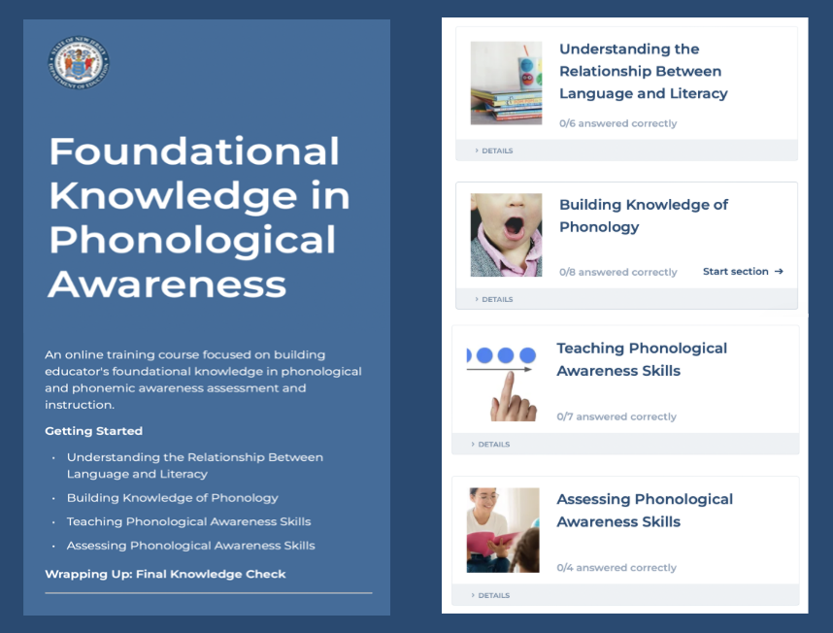
Thanks for participating!
Add
QR Code
Coming Soon
Cárdenas-Hagan, 2020
Notes:
Facilitator Narration: This brings us to the end of our session today! If you are interested to learn more about sentence comprehension, keep an eye out for the NJ Department of Education’s upcoming free SISEP online learning modules.

Slide 11
Next Session in the PLC Series
Session 7 Inference Skills
Date: [Add Date]
Time: [Add Time]
Notes:
Facilitator Narration: Up next is Session 7 Inference Skills. This PLC session will focus on verbal reasoning and instructional practices for teaching inference skills. We will meet on [add date and time]. See you then!

Slide 12
References
Cárdenas-Hagan, E. (2020). Literacy foundations for English learners: A comprehensive guide to evidence-based instruction. Paul Brookes Publishing Co.
Eberhardt, N. C. (2013). Syntax: Somewhere between words and text. Perspectives on Language and Literacy, 39(3). pp. 43-49.
Hennessy, N. L. (2021). The reading comprehension blueprint: Helping students make meaning from text. Paul Brookes Publishing Co.
Scarborough, H. S. (2001). Connecting early language and literacy to later reading (dis)abilities: Evidence, theory, and practice. In S. Neuman & D. Dickinson (Eds.), Handbook for research in early literacy (pp. 97–110). New York, NY: Guilford Press.
Shanahan, T. (2013). Grammar and comprehension: Scaffolding student interpretation of complex sentences. Shanahan on Literacy.

