Slide 1
Evidence-Based Literacy Instruction
Professional Learning Community Series
Session 7 - Inference
Office of Learning Equity and Academic Recovery (LEAR)
Division of Teaching and Learning
Notes:
Facilitator Narration: Welcome! We’re excited to have you join us for this seventh session in our Professional Learning Community Series. Today, we’ll be looking to strengthen our instructional practices based on the latest research on inferencing as a strategy for intentionally making sense of text.
Note to Facilitator: Turquoise highlights indicate a “click” is needed to advance the slide animation.

Slide 2
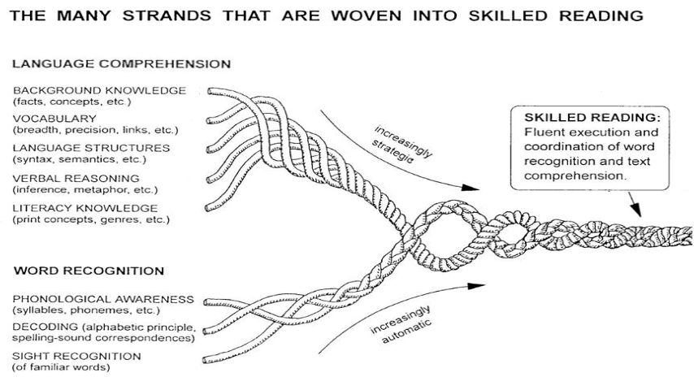
Session 7 - Verbal Reasoning
Hollis Scarborough, 2001
Notes:
Facilitator Narration: Always starting with our conceptual framework for skilled reading, Scarborough’s Reading Rope, in today’s session we will discuss verbal reasoning, specifically the tole inferencing plays in comprehending text. It is important to note that the ability to make inferences when reading requires the strategic integration of all the language comprehension skills.

Slide 3
Text version of Scarborough’s Rope
The many strands that are woven into skilled reading.
The Reading Rope consists of lower and upper strands. The word-recognition strands (phonological awareness, decoding, and sight recognition of familiar words) work together as the reader becomes accurate, fluent, and increasingly automatic with repetition and practice.
Language Comprehension (Upper Strands):
Strands include:
Background knowledge (facts, concepts, etc.)
Vocabulary (breadth, precision, links, etc.)
Language structures (syntax, semantics, etc.)
Verbal reasoning (inference, metaphor, etc.)
Literacy knowledge (print concepts, genres, etc.)
Word Recognition (Lower Strands)
Strands include:
Phonological awareness (syllable, phonemes, etc.).
Decoding (alphabetic principle, spelling-sound correspondences
Sight recognition (of familiar words).
Skilled Reading:
Language comprehension becomes increasingly strategic and word recognition becomes increasingly automatic in the progression to becoming a skilled reader.
A skilled reader displays fluent execution and coordination of word recognition and text comprehension.

Slide 4
Reflection Activity
What Do You Think:
Is Inference a Skill or Strategy?
Notes:
Facilitator Narration: As a pre-work activity for this session, we read the blog post What Does It Take to Teach Inferencing? by Timothy Shanahan. In it, Shanahan suggests that inferencing should be viewed not as a discrete skill, but as a strategy readers use intentionally to make meaning from a text.
Activity (5-10 min): Facilitate the discussion to prompt community members to reflect on the following points made by Timothy Shanahan.
Inferencing is not an isolated skill—it’s a complex process that depends on the reader’s ability to connect information within and between sentences in the text itself and to supplement information from the text with their own background knowledge.
Teaching students to “infer” through generic inferential questions or skill labels (like predicting or drawing conclusions) is ineffective, because these approaches don’t guide students toward concrete reading actions.
Effective instruction treats inferencing as a strategy—students should be taught to look for specific patterns in texts, such as character motivation, text structures, or cohesive devices like pronoun referents and synonyms.
Comprehension improves when students are shown how to think actively about the ideas, themes, or logic in a specific text.

Slide 5
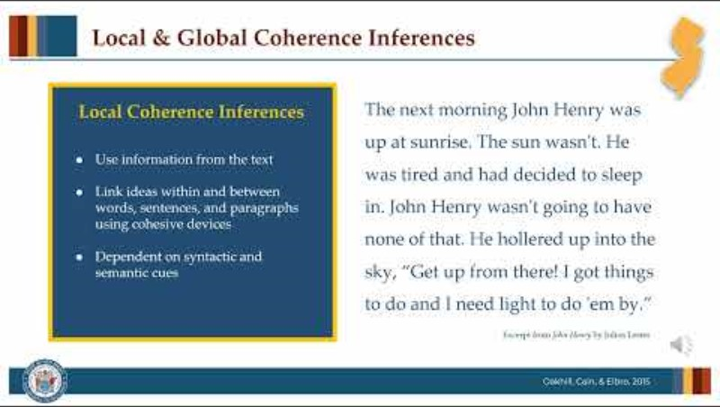
The Importance of Local & Global Coherence (1 of 2)
Notes:
Facilitator Narration: Effective reading comprehension relies on two essential types of inferences: local coherence inferences and global coherence inferences. Let’s watch this short video.
[Click red button to play video PLC Series Video - Local & Global Coherence Inferences]

Slide 6
The Importance of Local & Global Coherence (2 of 2)
“Local coherence inferences are necessary to integrate information from adjacent pieces of text, whereas global coherence inferences are used to fill in details not explicitly stated that are needed to construct a globally coherent representation of text meaning, for example, inferences about themes, morals, and settings.”
–Language and Reading Research Consortium, 2018
Notes:
Facilitator Narration: So, we’ve just seen how local coherence inferences help readers connect and make sense of information from nearby parts of a text, while global coherence inferences help readers fill in missing details that aren’t directly stated, such as understanding the overall theme, moral, or setting of the text.
Let’s now turn to a discussion of the instructional practices that will support students in drawing both types of inferences while reading.

Slide 7

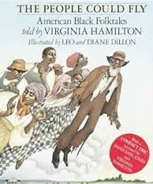
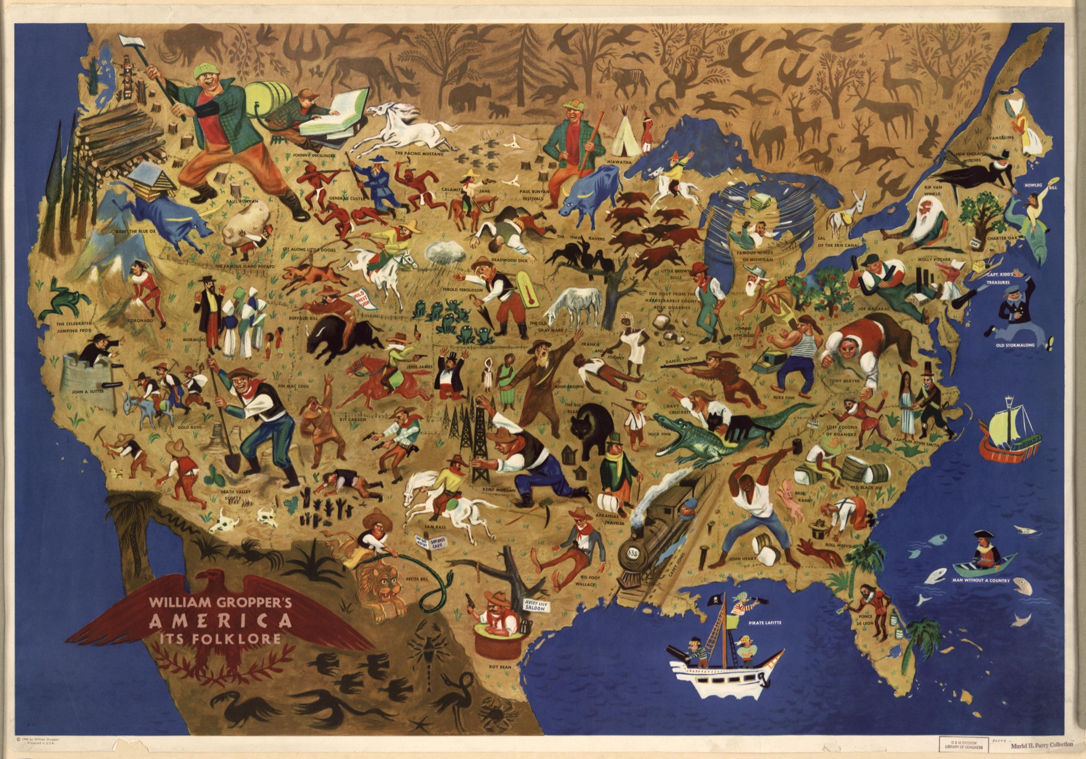
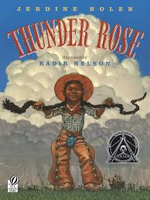
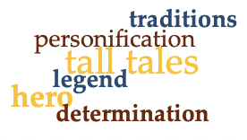
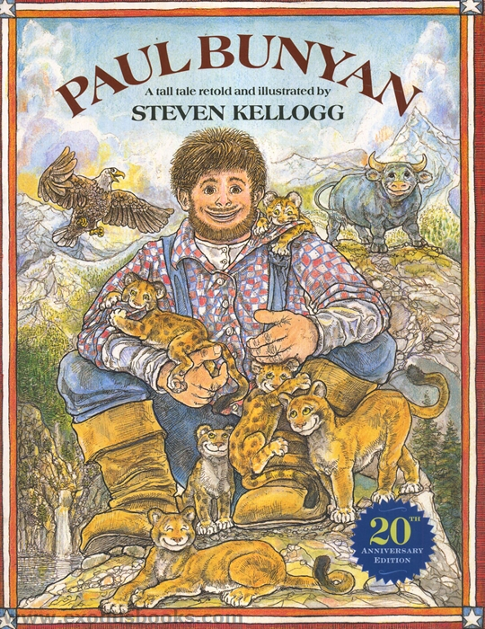

Global Coherence & the Role of Knowledge (1 of 2)
Activate & Assess | Build | Connect
Anticipation Guides Questions and Prompts Charts, Webs, Maps Visual Images | Multiple Topical/Themed Texts Virtual or Real-Time Experiences Authentic Artifacts Vocabulary Connections | Anticipation Guides Questions and Prompts Charts, Webs, Maps Application to Other Readings
Hennessy, 2014
Notes:
Facilitator Narration: In our PLC session on background knowledge, we already discussed some of the instructional strategies for activating, building, and connecting to student’s background knowledge in support of reading comprehension. After learning about the role knowledge plays in readers’ abilities to draw strong and accurate global coherence inferences, we can see how this attention to the background knowledge required to make-meaning of a text is key to supporting student’s inference making.
The video we just watched included an excerpt from the children’s picture book John Henry by Julius Lester. Think about the inference making potential that could be fostered in our students when a text selection like this is:
included in a themed unit on “Folk Storytelling & Oral Traditions” in which our lesson planning
introduced along with authentic artifacts, such as artist William Gropper’s map of America folklore (from 1946) or provides students the opportunity to experience the weight of a sledge-hammer;
and vocabulary is intentionally chosen to build meaningfully broad and deep connections that can be called upon time and time again to support mental models.

Slide 8
Global Coherence & the Role of Knowledge (2 of 2)
The next morning John Henry was up at sunrise. The sun wasn't. He was tired and had decided to sleep in. John Henry wasn't going to have none of that. He hollered up into the sky, “Get up from there! I got things to do and I need light to do 'em by.”
What does the author want me to understand about John Henry by showing him talking to the sun as if it were a person?
When the author shows John Henry yelling at the sun to wake up, it’s not just meant to be funny—it actually tells me something important about John Henry’s character. I know that the sun is a force of nature, something no one can control. But here, John Henry acts like he can control it, like he has the power to command it. This is an example of personification, where the sun is treated like a lazy person. But really, it’s helping me understand just how unstoppable John Henry is.
Hennessy, 2014
Notes:
Facilitator Narration: Effective instruction focuses on helping students build and then integrate the background knowledge needed for a given text. When preparing a text or a visual image to accompany a text, teachers can frame inferential questions and prompts, such as “What does the author want me to understand about John Henry by showing him talking to the sun as if it were a person?”
The teacher can then model the identification of clues and the integration of knowledge, by thinking out loud how she infers that the personification of the sun emphasizes John Henry’s determination, power, or larger-than-life character traits, even before the main action of the tall tale begins.
Then the teacher can provide opportunities for students to practice themselves by identifying other places in the story that help the reader understand just how unstoppable John Henry is based on their knowledge of tone and exaggeration in folk storytelling.

Slide 9
Global Coherence & the Role of Knowledge (2 of 2)
The next morning John Henry was up at sunrise. The sun wasn't. He was tired and had decided to sleep in. John Henry wasn't going to have none of that. He hollered up into the sky, “Get up from there! I got things to do and I need light to do 'em by.”
What does the author want me to understand about John Henry by showing him talking to the sun as if it were a person?
When the author shows John Henry yelling at the sun to wake up, it’s not just meant to be funny—it actually tells me something important about John Henry’s character. I know that the sun is a force of nature, something no one can control. But here, John Henry acts like he can control it, like he has the power to command it. This is an example of personification, where the sun is treated like a lazy person. But really, it’s helping me understand just how unstoppable John Henry is.
Hennessy, 2014
Notes:
Facilitator Narration: Effective instruction focuses on helping students build and then integrate the background knowledge needed for a given text. When preparing a text or a visual image to accompany a text, teachers can frame inferential questions and prompts, such as “What does the author want me to understand about John Henry by showing him talking to the sun as if it were a person?”
The teacher can then model the identification of clues and the integration of knowledge, by thinking out loud how she infers that the personification of the sun emphasizes John Henry’s determination, power, or larger-than-life character traits, even before the main action of the tall tale begins.
Then the teacher can provide opportunities for students to practice themselves by identifying other places in the story that help the reader understand just how unstoppable John Henry is based on their knowledge of tone and exaggeration in folk storytelling.

Slide 10
Local Coherence & Cohesive Devices (1 of 3)
Cohesive Devices
Connectives | Cohesive Ties
words or phrases that signal logical relationships within or between sentences and paragraph | devices that derive meaning from another part of the text, replacing a word or phrase within or across sentences
Conjunctions Transition words | Pronoun referents Lexical cohesion Ellipsis
Hennessy, 2014
Notes:
Facilitator Narration: Cohesive devices are the semantic and syntactic cues that help readers bridge and integrate information within and between sentences and paragraphs in a text. These include connectives and cohesive ties.
Connectives are words or phrases that signal logical relationships within or between sentences and paragraphs. These include conjunctions like we discussed in the sentence comprehension session which function to join words, phrases, or clauses within a sentence and transition words like "therefore" or "for example" which link ideas across sentences or paragraphs.
Cohesive ties derive their meaning from another part of the text, replacing a word or phrase within or across sentences. These include:
pronoun referents which refer back to or take the place of a specific noun already introduced;
lexical cohesion that is achieved through the repetition of words or phrases in a passage or the use of synonyms and substitutions which reduce repetition and introduce more precise or descriptive vocabulary; and
ellipsis, when words are deliberately left out because they are understood from earlier in the sentence or context, reducing repetition while maintaining meaning.
In our PLC session on sentence comprehension, we already discussed some of the instructional strategies for teaching students about parts of speech and sentence structure in support of sentence comprehension and construction, which addresses some of the use of connectives so let’s now show how our instruction can address cohesive ties.

Slide 11
Local Coherence & Cohesive Devices (2 of 3)
The next morning John Henry was
up at sunrise. The sun wasn't. He
was tired and had decided to sleep in. John Henry wasn't going to have none of that. He hollered up into the sky, “Get up from there! I got things to do and I need light to do 'em by.”
Excerpt from John Henry by Julius Lester
Just before that sentence, the text says, ‘The next morning John Henry was up at sunrise. The sun wasn't [up].’ That tells me John Henry was already awake, so the ‘he’ likely doesn’t refer to him. The next sentence says ‘He was tired and had decided to sleep in,’ which must be describing the sun. The author is using personification—giving the sun human traits like feeling tired or deciding to sleep in. So by using the information from the previous sentences, I can infer that ‘he’ refers to the sun, not John Henry.
[up]
Hennessy, 2014
Notes:
Facilitator Narration: Again when preparing a text, teachers can frame inferential questions and prompts to teach students about pronoun referents, such as “When I read the sentence, ‘He was tired and had decided to sleep in,’ I ask myself, ‘Who does “he” refer to?’ and “How do I know?”
The teacher can then model the identification of clues and the integration of knowledge, by marking up the text passage and thinking out loud about how she infers connections based on the pronoun referent. Listen to the teacher’s modeled response:
“When I read the sentence, I ask myself, ‘Who does “he” refer to?’ Just before that, the text says, ‘The next morning John Henry was up at sunrise. The sun wasn't.’ That tells me John Henry was already awake, so ‘he’ likely doesn’t refer to him. The next sentence says ‘He was tired and had decided to sleep in,’ which must be describing the sun. The author is using personification—giving the sun human traits like feeling tired or deciding to sleep in. So by using the information from the previous sentences, I can infer that ‘he’ refers to the sun, not John Henry.”

Slide 12
Local Coherence & Cohesive Devices (3 of 3)
The next morning John Henry was up at sunrise. The sun wasn't. He was tired and had decided to sleep in. John Henry wasn't going to have none of that. He hollered up into the sky, “Get up from there! I got things to do and I need light to do 'em by.”
What is the author leaving out in the sentence “The sun wasn't”, and how do you know what’s missing?
[up]
Who is John Henry telling to get up and how does “light to do ‘em by” help us know?
Excerpt from John Henry by Julius Lester
Hennessy, 2014
Notes:
Facilitator Narration: This same passage could be prepared to teach ellipsis → The sun wasn’t… what? up… or to discuss how the author is using substitutions, that let us know that John is yelling up at the sun because needs the sunlight to get started on his work.
After modeling and providing clear explanations for inferences drawn using the cohesive ties, the teacher can provide opportunities for students to practice themselves by identifying other places where those types of cohesive ties are working to connect meaning.

Slide 13
Local Coherence & Cohesive Devices (3 of 3)
The next morning John Henry was up at sunrise. The sun wasn't. He was tired and had decided to sleep in. John Henry wasn't going to have none of that. He hollered up into the sky, “Get up from there! I got things to do and I need light to do 'em by.”
Excerpt from John Henry by Julius Lester
What is the author leaving out in the sentence “The sun wasn't”, and how do you know what’s missing?
[up]
Who is John Henry telling to get up and how does “light to do ‘em by” help us know?
Hennessy, 2014
Notes:
Facilitator Narration: This same passage could be prepared to teach ellipsis → The sun wasn’t… what? up… or to discuss how the author is using substitutions, that let us know that John is yelling up at the sun because needs the sunlight to get started on his work.
After modeling and providing clear explanations for inferences drawn using the cohesive ties, the teacher can provide opportunities for students to practice themselves by identifying other places where those types of cohesive ties are working to connect meaning.

Slide 14
Apply Your Knowledge
John Henry decided it was time for him to go on down the big road. He went home and told his mama and daddy good-bye.
His daddy said, “You got to have something to make your way in the world with, Son. These belonged to your grandaddy.” And he gave him two twenty-pound sledgehammers with four-foot handles made of whale bone.
A day or so later John Henry saw a crew building a road. At least, that’s what they were doing until they came on a boulder right smack-dab where the road was supposed to go. This was no ordinary boulder. It was as hard as anger and so big around, it took half a week for a tall man to walk from one side to the other.
Excerpt from John Henry by Julius Lester
Notes:
Facilitator Narration: Now let’s apply our own knowledge of cohesive ties in this next activity.
Activity (5 min): Distribute copies of the excerpt and ask participants to prepare the passage for a lesson on one type of cohesive ties: pronoun referents, lexical cohesion (repetitions or synonyms/substitutes), or ellipsis. Then facilitate a discussion about the examples identified in the excerpt. Suggested examples are listed below:
Pronoun Referents:
…for “him,” “he” went home…, → refers to John Henry
“his” mama and daddy…, “his” daddy said… → refers to John Henry
“You” got to…, make “your” way → refers to John Henry
“these” belonged to your granddaddy… → refers to the sledgehammers
“he” gave “him” → both refer to John Henry’s father and John Henry, respectively
“they” were doing…, “they” came on a boulder → refers to the crew
“that’s what they were doing” → refers to building a road
“this” was no ordinary boulder → refers back to the boulder
“it” was as hard as anger… → refers to the boulder
Lexical Cohesion:
“John Henry” is repeated for clarity and continuity
“road” is repeated
“boulder” is repeated
“something to make your way in the world with” → synonym/substitution for “sledgehammers”
“Son” → synonym/substitution for “John Henry”
Ellipsis:
“from one side [of the boulder] to the other [side of the boulder]…” → omits the phrases shown but this excerpt would not be an exemplary example of ellipsis.
Optional Activity: Ask community members to identify two sentences in the excerpt that could be used for a sentence combining activity focused on connectives. Suggested examples: John Henry decided it was time for him to go on down the big road. He went home and told his mama and daddy good-bye.
Facilitator Note: This excerpt may also bring up a discussion of teaching the figurative language as a means to support students verbal reasoning (e.g., simile, hyperbole, metaphor/symbolism).

Slide 15
Adapting to Student Needs
All students need the specific syntactic and semantic knowledge as well as the content specific background knowledge required to make sense of the text they are reading.
Multilingual learners may need visual supports or explicit explanations when their linguistic and/or cultural knowledge is different from the text.
Students with disabilities may need more scaffolding to retrieve knowledge from their working or long-term memory in order to make connections.
Dialect speakers whose linguistic and/or cultural knowledge is different from the text may benefit from explicit explanations.
Hennessy, 2014
Notes:
Facilitator Narration: Great discussion! As we close, let’s remember that all students need the specific syntactic and semantic knowledge as well as the content specific background knowledge required for the text they are reading. But not all students enter the classroom with the same prior knowledge or ability to access that knowledge. Multilingual learners, students with disabilities, and students who speak in a dialect variation that differs from the features in the text being read may need targeted support to draw both local and global coherence inferences. Explicit instruction helps ensure all students have an equal chance to draw the inferences needed to make sense of the text they are reading.

Slide 16

Thanks for participating!
Add
QR Code
Coming Soon
Notes:
Facilitator Narration: This brings us to the end of our session today! If you are interested to learn more about inference strategies, keep an eye out for the NJ Department of Education’s upcoming free SISEP online learning modules.

Slide 17
Next Session in the PLC Series
Session 8 Text Structures & Comprehension Strategies
Date: [Add Date]
Time: [Add Time]
Notes:
Facilitator Narration: Up next is Session 8 Text Structures & Comprehension Strategies. This PLC session will focus on text structures and the comprehension strategies that support students’ meaning making. We will meet on [add date and time]. See you then!

Slide 18
References
Hennessy, N. L. (2021). The reading comprehension blueprint: Helping students make meaning from text. Paul Brookes Publishing Co.
Language and Reading Research Consortium. (2018). The dimensionality of inference making: Are local and global inferences distinguishable? Scientific Studies in Reading, 22(2), pp. 117–136.
Lester, J. (1994). John Henry. Dial Books.
Scarborough, H. S. (2001). Connecting early language and literacy to later reading (dis)abilities: Evidence, theory, and practice. In S. Neuman & D. Dickinson (Eds.), Handbook for research in early literacy (pp. 97–110). New York, NY: Guilford Press.
Shanahan, T. (2021). What Does It Take to Teach Inferencing? Shanahan on Literacy.

