Slide 1
Evidence-Based Literacy Instruction
Professional Learning Community Series
Session 8 - Text Structures & Comprehension Strategies
Office of Learning Equity and Academic Recovery (LEAR)
Division of Teaching and Learning
Notes:
Facilitator Narration: Welcome! We’re excited to have you join us for this eighth and last session in our Professional Learning Community Series. Today, we’ll be looking to strengthen our instructional practices across various text structures, by focusing on the comprehension strategies best situated to help students make meaning from various kinds of texts.

Slide 2
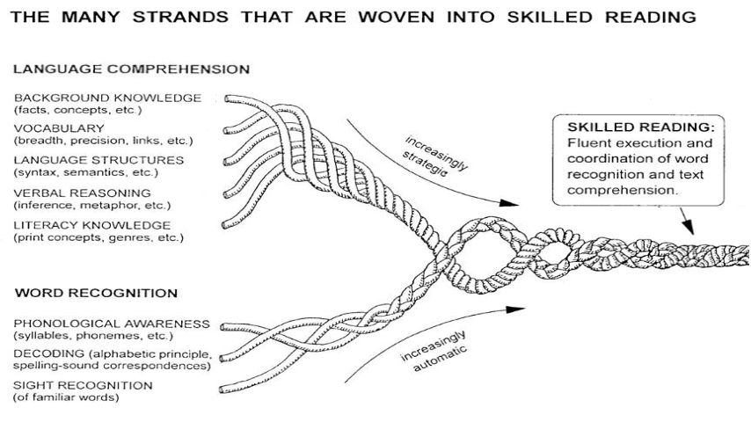
Session 8 - Literacy Knowledge
Scarborough, 2001
Notes:
Facilitator Narration: Literacy knowledge is the specialized background knowledge that supports how students learn to read. Scarborough’s Reading Rope highlights literacy knowledge—like print concepts, genre, and text structures—as essential components of skilled reading.

Slide 3
Text version of Scarborough’s Rope
The many strands that are woven into skilled reading.
The Reading Rope consists of lower and upper strands. The word-recognition strands (phonological awareness, decoding, and sight recognition of familiar words) work together as the reader becomes accurate, fluent, and increasingly automatic with repetition and practice.
Language Comprehension (Upper Strands):
Strands include:
Background knowledge (facts, concepts, etc.)
Vocabulary (breadth, precision, links, etc.)
Language structures (syntax, semantics, etc.)
Verbal reasoning (inference, metaphor, etc.)
Literacy knowledge (print concepts, genres, etc.)
Word Recognition (Lower Strands)
Strands include:
Phonological awareness (syllable, phonemes, etc.).
Decoding (alphabetic principle, spelling-sound correspondences
Sight recognition (of familiar words).
Skilled Reading:
Language comprehension becomes increasingly strategic and word recognition becomes increasingly automatic in the progression to becoming a skilled reader.
A skilled reader displays fluent execution and coordination of word recognition and text comprehension.

Slide 4

Print Concepts
Print awareness or print concepts refer to the recognition that written text conveys meaning and follows specific conventions that aid in both reading and writing.
Print is read from left to right and top to bottom – Directionality of reading in English.
Books have parts – Cover, title, author, illustrator, spine, and pages.
Spaces separate words – Recognizing word boundaries.
The difference between letters, words, and sentences – Understanding units of print.
Punctuation has purpose – Periods, question marks, and exclamation points signal how to read.
Notes:
Facilitator Narration: One early and crucial element is print awareness (or print concepts), which develops through both early interactions with books and print materials and formal classroom instruction. Young students learn that print conveys meaning and follows specific conventions—like reading left to right, parts of a book, and recognizing units of print such as letters, words, and sentences. This critical awareness lays the groundwork for understanding how texts are structured.
Text structure will be the topic of our session today.

Slide 5


Text Structures
Text structure refers to how information is organized within a text.
Understanding how a text is structured helps students identify the author’s purpose and message.
Explicit instruction in text structures improves reading comprehension and writing by helping students organize and express ideas more effectively.
When students learn to recognize the features and purpose of narrative and informational texts, they can better navigate complex language and retain key information.
Notes:
Facilitator Narration: Text structure refers to how information is organized within a text. Students who grasp how texts are constructed become more strategic readers and writers. Research shows that instruction in text structure improves both comprehension and written expression because an understanding of these structures helps students identify the author’s purpose and organize information effectively.
Academic texts both narrative and informational often contain complex sentence structures and academic language that can be challenging without explicit instruction. However, when students are taught the purpose and features of these text structures, they can better anticipate, locate, and retain key information.

Slide 6
Reflection Activity
How do graphic organizers help make the structure of a text visible to students?
In what ways can these tools support students in both understanding what they read and organizing their writing?
Which text structure(s) do your students struggle with most and why? How might a graphic organizer scaffold their learning?
Notes:
Facilitator Narration: As we’ve been discussing throughout this PLC Series, reading teachers should be planning lessons that integrate skill building within a broader goal of knowledge building. When it comes to explicit instruction in text structures, teaching it as a generic, stand-alone skill—disconnected from rich, complex texts—is a missed opportunity to deepen comprehension and build content knowledge. Instead, teachers should frame text structure as a strategic tool that helps students make sense of the content-rich, often complex texts they are expected to read across the curriculum—in science, social studies, and even math.
As a pre-work activity for this session, we looked at Reading Universe’s Graphic Organizers for Reading Comprehension. Let’s reflect on how graphic organizers can support student understanding of specific text structures in both reading comprehension and writing development.
Activity (5 minutes): Facilitate the discussion to prompt community members for the following points:
How do graphic organizers help make the structure of a text visible to students?
In what ways can these tools support students in both understanding what they read and organizing their writing?
Which text structure(s) do your students struggle with most and why? How might a graphic organizer scaffold their learning?

Slide 7
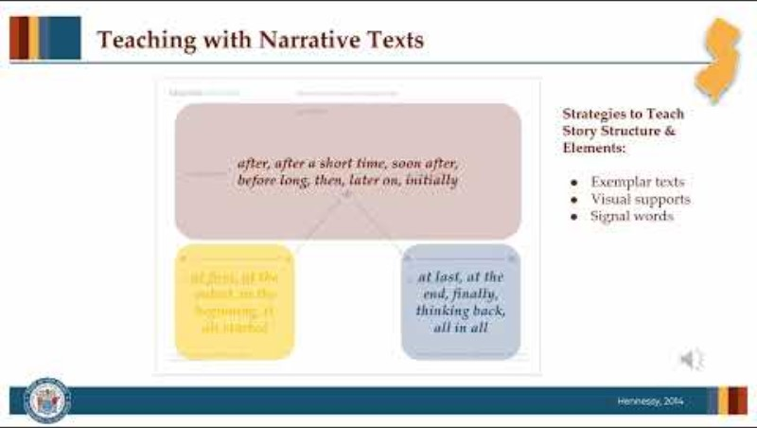
Teaching About Text Structures
Notes:
Facilitator Narration: Great discussion, we can see how graphic organizers—when intentionally matched to specific text structures—provide a visual scaffold that helps students see how structure can be used as a strategy for understanding text. Rather than simply labeling a passage as "compare and contrast" or "cause and effect," graphic organizers make the underlying logic of the text visible, helping students engage more purposefully with what they read. Let’s now watch this video on instructional strategies for teaching students about text structure.
[Click red button to play video PLC Series Video - Teaching Text Structures: Narrative & Informational Text]

Slide 8
Practice Activity (1 of 2)
Saving the City’s Water Supply
In a small town near the river, people began noticing that their tap water was turning brown and had an unusual smell. Scientists discovered that pollution from nearby factories was leaking into the river, which was the town’s main water source. This created a serious health concern for the community.
To address the issue, city officials worked with the factories to install better waste filters and stronger regulations. As a result, the amount of pollution decreased. In addition, the town built a new water treatment plant to clean the river water before it reached people’s homes. These actions helped restore the town’s clean water supply.
Notes:
Facilitator Narration: Now that we’ve learned about the role text structure can play in supporting comprehension, let’s try this Practice Activity for Analyzing Informational Text Structure.
Activity (5-10 min): Ask community members to read the passage "Saving the City’s Water Supply" shown on the slide and then ask for a volunteer to identify the type of text structure and explain what clues led them to that decision.
1. What text structure does this passage follow? [problem and solution]
2. How do you know? [signal words include discovered that, concern, To address the issue, and As a result.]
Once the structure is identified as problem and solution, ask:
3. Which visual organizer would best support students’ comprehension of this structure and how might you label its sections? [A Problem–Solution Organizer with labeled sections for Problem, Who/what it affects, Solutions, Result/Outcome. This may spark a conversation about how the organizer included in the Reading Universe template may need to be modified to more precisely scaffold this specific passage.]
Then, have community members, practice crafting guiding questions at both basic and advanced levels and share out their work.
Sample basic questions: What problem did the town face? What were two things the town did to fix it?
Sample advanced questions: Why did the city need to take multiple actions? How do the solutions reflect cooperation within the community?

Slide 9
Practice Activity (2 of 2)
Breaking the Mold: Clara’s First Game
Clara laced up her scuffed sneakers and looked around the crowded gym. The year was 1978, and she was one of the first girls in her city to play in a newly formed women’s basketball league. Until now, she had only practiced in secret, borrowing the school gym early in the mornings before the boys' team arrived.
When the referee blew the whistle, Clara's nerves vanished. She sprinted down the court, passing and shooting with a team that had trained just as hard as any of the boys. The crowd—mostly families and curious onlookers—watched in silence at first. But by halftime, they were cheering loudly.
After the game, Clara’s coach smiled and clapped her on the back. "That," she said, “was history in the making.”
Notes:
Facilitator Narration: Let’s try one more!
Optional Activity (5-10 min): Ask community members to read the passage "Breaking the Mold: Clara’s First Game" shown on the slide and then ask for a volunteer to identify the type of text structure and explain what clues led them to that decision.
1. What text structure does this passage follow? [narrative]
2. How do you know? [story grammar cues—such as characters, setting, and events]
Once the structure is identified as narrative, ask:
3. Describe the elements of story grammar that could be visualized in a narrative story map organizer?
Background information:
Characters - Clara, her coach, the team, the crowd
Setting: Gym, 1978
Conflict: First girls’ basketball game, uncertainty about support
Sequence of Events:
Rising action - Practice in secret
Climax - plays in game and crowd reaction
Falling Action: coach’s praise
Outcome: Clara plays successfully; first step in women’s sports progress
Theme: Courage, breaking barriers
Then, have community members, practice crafting guiding questions at both basic and advanced levels and share out their work.
Sample basic questions: Who is Clara and what did she do in the story? What happened during the game?
Sample advanced questions: What does Clara’s experience tell us about sports and gender roles at the time? How does the author build emotion and tension in the story?

Slide 10
Reading & Writing: A Reciprocal Relationship
Understanding Text Structure Strengthens Both
Reading and writing are interconnected
Recognizing text structure helps students
Explicit instruction in text structure supports reading comprehension and writing development.
Notes:
Facilitation Narration: Let’s take a moment to talk about the reciprocal relationship between reading and writing, and why understanding text structure is so powerful for students. When we teach students how to analyze the structure of a text—whether it’s cause and effect, sequence, problem and solution, or compare and contrast—we’re not just supporting their reading comprehension. We’re also giving them tools to become better writers. As students learn to recognize how authors organize their ideas, they internalize those patterns. This allows them to more effectively plan, organize, and express their own thinking when they write. In other words, the same structures that help them make meaning while reading also help them communicate meaning when writing. That’s why explicit instruction in text structure serves double duty—it helps students become strategic readers and confident, coherent writers. So as you model and discuss text structures in your classroom, consider how you can make that bridge to writing. Show students that the way a text is built is not just something to identify—it’s something they can use themselves to share their own ideas with clarity and purpose.

Slide 11
Adapting to Student Needs
Understanding text structure as a strategy for comprehension helps all students navigate increasingly complex texts and builds meaning-making abilities across varied content areas.
Acknowledge and bridge cultural differences in narrative structures for students from non-linear storytelling traditions.
Use visual supports and targeted scaffolds to help multilingual learners and students with disabilities access and organize complex informational texts.
Notes:
Facilitator Narration: Understanding text structure as a strategy for comprehension helps all students navigate increasingly complex texts and builds meaning-making abilities across varied content areas. To meet the needs of all learners:
Acknowledge diverse narrative experiences, especially for students who come from cultural and linguistic backgrounds where stories follow non-linear or cyclical patterns. These students may need explicit comparisons between familiar structures and those used in English texts to support their understanding.
Provide scaffolds to support multilingual learners and students with disabilities around informational text structures, which often include dense language, abstract ideas, and unfamiliar formats. Tools like sentence frames, signal word charts, and graphic organizers can help these students access, organize, and express their understanding more effectively across all content areas.

Slide 12
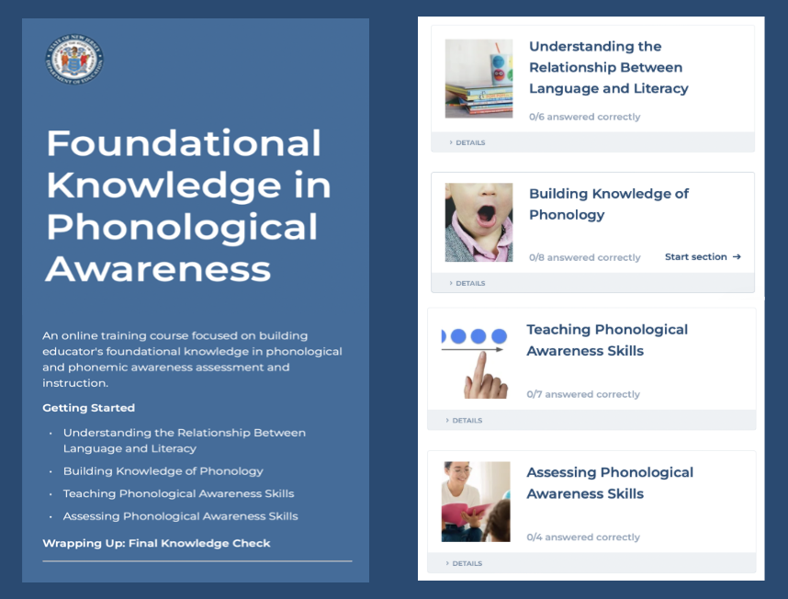
Thanks for participating!
Add
QR Code
Coming Soon
Cárdenas-Hagan, 2020
Notes:
Facilitator Narration: This brings us to the end of our session today! If you are interested to learn more about strategies for teaching text structure, keep an eye out for the NJ Department of Education’s upcoming free SISEP online learning modules.

Slide 13
Congratulations!
Congratulations on completing the PLC series! Your dedication to growing as educators will have a lasting impact. Thank you for your engagement and commitment!
Notes:
Facilitator Narration: Congratulations on completing our 8-part Professional Learning Community series! Your commitment to deepening your understanding and refining your practice is something to be proud of. We hope you leave this series feeling more empowered, equipped, and inspired to support all readers—especially those who need it most. Thank you for showing up, engaging fully, and being part of this learning journey. We can’t wait to see the impact you’ll make!

Slide 14
References
Cárdenas-Hagan, E. (2020). Literacy foundations for English learners: A comprehensive guide to evidence-based instruction. Paul Brookes Publishing Co.
Hennessy, N. L. (2021). The reading comprehension blueprint: Helping students make meaning from text. Paul Brookes Publishing Co.
Scarborough, H. S. (2001). Connecting early language and literacy to later reading (dis)abilities: Evidence, theory, and practice. In S. Neuman & D. Dickinson (Eds.), Handbook for research in early literacy (pp. 97–110). New York, NY: Guilford Press.

