Slide 1
Introduction to the
Evidence-Based Literacy Instruction
Professional Learning Community Series
Office of Learning Equity and Academic Recovery (LEAR)
Division of Teaching and Learning
Notes:
Greetings! We’re excited to introduce you to the Evidence-Based Literacy Instruction Professional Learning Community Series. As outlined in New Jersey Statute (N.J.S.A. 18A:6-131), the NJ Department of Education’s Office of Learning Equity and Academic Recovery provides access to this PLC series at no cost to you or your district. This series offers a valuable opportunity to strengthen your instructional practice based on the latest research in reading and learning.
Note to Video Recorder: Turquoise highlights indicate a “click” is needed to advance the slide animation.

Slide 2
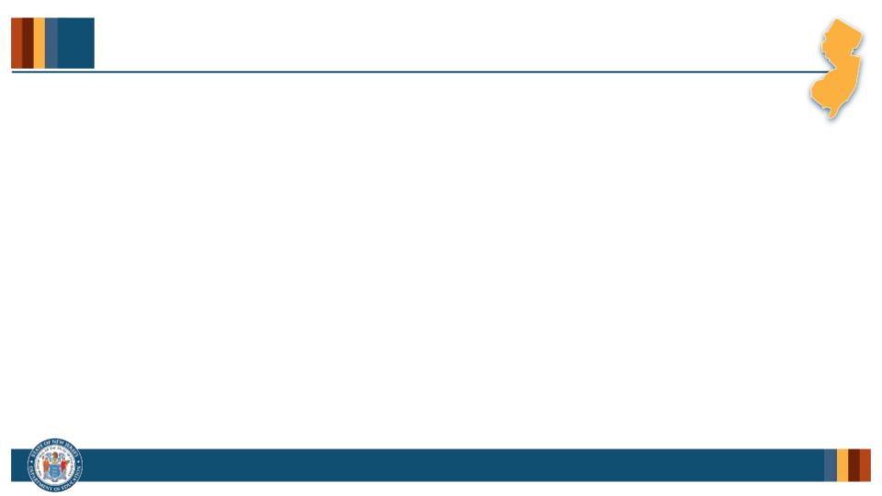
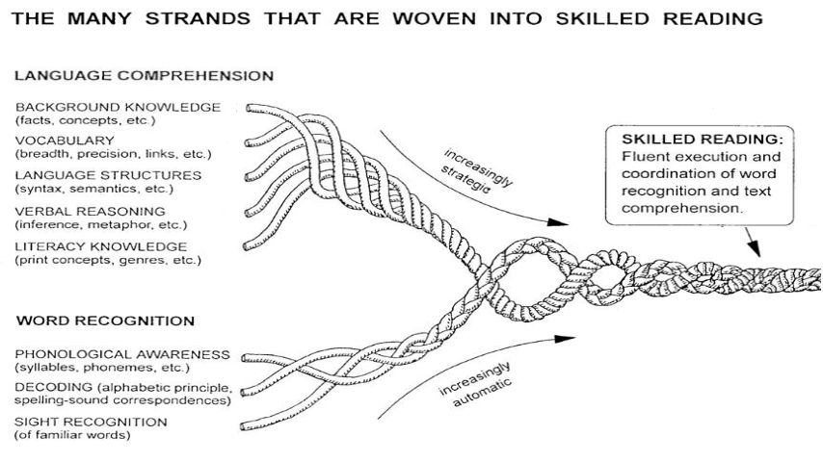
Evidence-Based Literacy Instruction PLC Series (1 of 6)
Over Time
Scarborough, 2001
Notes:
The PLC Series consists of 8 curated sessions, each designed to facilitate collaborative group learning around instructional practices that support students’ fluent execution and coordination of word recognition and language comprehension skills. The series will build your knowledge on topics connected to the critical components of literacy development illustrated in Hollis Scarborough’s Reading Rope and encourages all community members to share insights and strategies for effective literacy instruction.
In the Reading Rope, each strand represents an important component of reading proficiency. The bottom strands—Phonological Awareness, Decoding, and Sight Recognition—are key to word recognition, while the top strands—Background Knowledge, Vocabulary, Language Structures, Verbal Reasoning, and Literacy Knowledge—support language comprehension.
The key idea is that over time students’ language skills need to become more strategic, while their word recognition skills need to become increasingly automatic. Both sets of skills are essential for reading proficiency and must work together seamlessly.

Slide 3
Text version of Scarborough’s Rope
The many strands that are woven into skilled reading.
The Reading Rope consists of lower and upper strands. The word-recognition strands (phonological awareness, decoding, and sight recognition of familiar words) work together as the reader becomes accurate, fluent, and increasingly automatic with repetition and practice.
Language Comprehension (Upper Strands):
Strands include:
Background knowledge (facts, concepts, etc.)
Vocabulary (breadth, precision, links, etc.)
Language structures (syntax, semantics, etc.)
Verbal reasoning (inference, metaphor, etc.)
Literacy knowledge (print concepts, genres, etc.)
Word Recognition (Lower Strands)
Strands include:
Phonological awareness (syllable, phonemes, etc.).
Decoding (alphabetic principle, spelling-sound correspondences
Sight recognition (of familiar words).
Skilled Reading:
Language comprehension becomes increasingly strategic and word recognition becomes increasingly automatic in the progression to becoming a skilled reader.
A skilled reader displays fluent execution and coordination of word recognition and text comprehension.

Slide 4
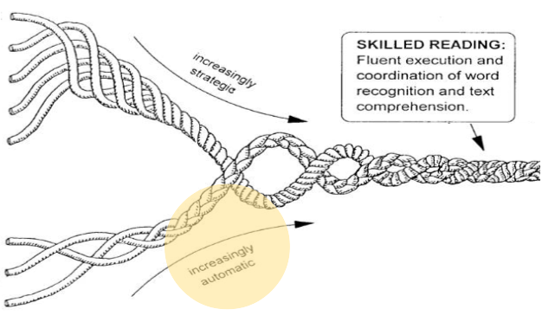
Evidence-Based Literacy Instruction PLC Series (2 of 6)
The many strands that are woven into skilled reading
Language Comprehension
Background knowledge (facts, concepts, etc.)
Vocabulary (breadth, precision, links, etc.)
Language structures (syntax, semantics, etc.)
Verbal reasoning (inference, metaphor, etc.
Literacy knowledge (print concepts, genres, etc.)
Word Recognition
Phonological awareness (syllable, phonemes, etc.).
Decoding (alphabetic principle, spelling-sound correspondences
Sight recognition (of familiar words).
Scarborough, 2001
Notes:
Let’s take a closer look at the word recognition skills. The first strand, Phonological Awareness, involves the ability to attend to and manipulate the sound units in language. This includes awareness of words in sentences, syllables in words, and eventually more discrete individuals sounds or phonemes in words. Phonemic awareness is critical skill for learning to read.
Next is Decoding, which involves linking these individual phonemes in spoken words to the graphemes–the letters and letter combinations–in printed words. Phonics instruction helps students understand the relationship between phonemes and graphemes, supporting their ability to decode unfamiliar words.
The final strand is Sight Recognition—the ability to instantly recognize familiar words. Over time, students need to be able to recognize words without having to consciously sound them out, creating an smooth and efficient word reading process.

Slide 5
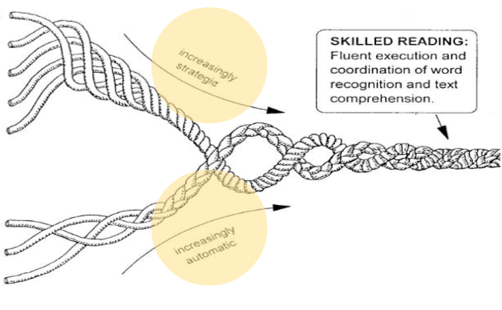
Evidence-Based Literacy Instruction PLC Series (3 of 6)
The many strands that are woven into skilled reading
Language Comprehension
Background knowledge (facts, concepts, etc.)
Vocabulary (breadth, precision, links, etc.)
Language structures (syntax, semantics, etc.)
Verbal reasoning (inference, metaphor, etc.
Literacy knowledge (print concepts, genres, etc.)
Word Recognition
Phonological awareness (syllable, phonemes, etc.).
Decoding (alphabetic principle, spelling-sound correspondences
Sight recognition (of familiar words).
Scarborough, 2001
Notes:
While students are developing this automaticity in their word recognition skills, they also need to be build their language comprehension, specifically for the types of language and structures needed in the school context for reading written texts. This is where the upper strands of the Reading Rope come in. These include:
Background Knowledge: The prior knowledge students need to bring to a text, which helps them make inferences and connections.
Vocabulary: The knowledge of words and their meanings, which is crucial for understanding text.
Language Structure: The ability to understand how words and sentences fit together, specifically in written language.
Verbal Reasoning: The ability to make inferences, understand the metaphors, and predict meanings in a written text.
Literacy Knowledge: The understanding of how different genres and written text structures work.
All of these skills play an important strategic role in helping students make meaning from what they read.

Slide 6
Evidence-Based Literacy Instruction PLC Series (4 of 6)
Hollis Scarborough, 2001
Notes:
Now, let’s talk about Fluency. Fluency is the ability to read words accurately and automatically, and with the proper expression to support comprehension. It’s the bridging process where word recognition skills and language comprehension abilities come together into coordinated, fluent, meaning-making. Students who are fluent readers can allocate their cognitive resources to understanding the written text rather than focusing on decoding the words on the page.

Slide 7
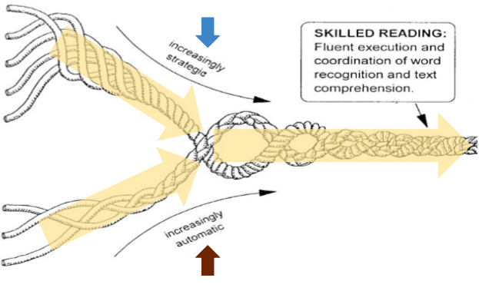
Evidence-Based Literacy Instruction PLC Series (5 of 6)
The many strands that are woven into skilled reading
Language Comprehension
Background knowledge (facts, concepts, etc.)
Vocabulary (breadth, precision, links, etc.)
Language structures (syntax, semantics, etc.)
Verbal reasoning (inference, metaphor, etc.
Literacy knowledge (print concepts, genres, etc.)
Word Recognition
Phonological awareness (syllable, phonemes, etc.).
Decoding (alphabetic principle, spelling-sound correspondences
Sight recognition (of familiar words).
Scarborough, 2001
Notes:
Now, let’s talk about Fluency. Fluency is the ability to read words accurately and automatically, and with the proper expression to support comprehension. It’s the bridging process where word recognition skills and language comprehension abilities come together into coordinated, fluent, meaning-making. Students who are fluent readers can allocate their cognitive resources to understanding the written text rather than focusing on decoding the words on the page.

Slide 8
Evidence-Based Literacy Instruction PLC Series (6 of 6)
Over Time
Scarborough, 2001
Notes:
As educators, your role is to help students build fluency in all of these skills over time. This Evidence-Based Literacy PLC Series is designed to give you the research, tools, and practical strategies to strengthen these areas in your own teaching. We’re excited to have you join us for this opportunity to collaborate with your colleagues and dive deeper into proven literacy practices that will make a real difference in your classroom.

Slide 9
References
Scarborough, H. S. (2001). Connecting early language and literacy to later reading (dis)abilities: Evidence, theory, and practice. In S. Neuman & D. Dickinson (Eds.), Handbook for research in early literacy (pp. 97–110). New York, NY: Guilford Press.

