Slide 1
Professional Learning series:
New Jersey Tiered System of Supports (NJTSS) Overview
Office of Student Support Services
Division of Educational Services

Slide 2
Quote
“Learning is the eye of the mind.”
French Proverb

Slide 3
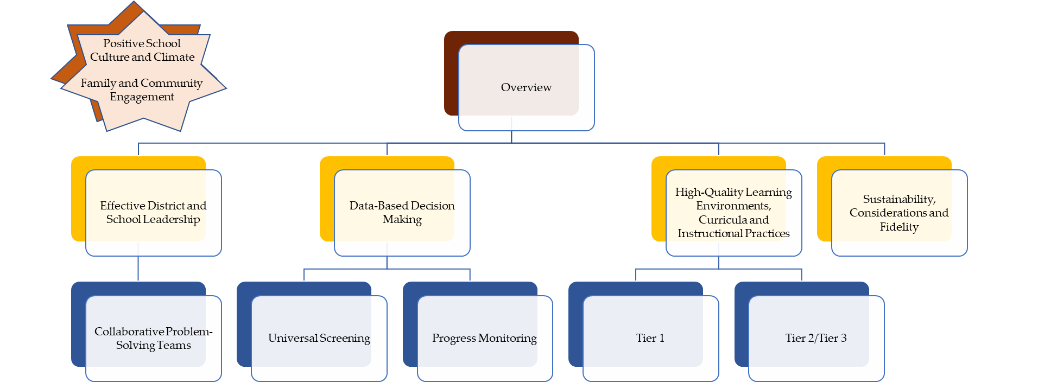

NJTSS series: Navigation

Slide 4
Purpose
After this presentation, you will better understand how to get started with the New Jersey Tiered System of Supports (NJTSS) framework.

Slide 5
NJTSS: Highlights
Student first approach, but always keeping the system in mind.
Designed to provide districts a systematic way to support all learners in meeting New Jersey Student Learning Standards (NJSLS).
The right interventions to the right students at the right time.
Source: https://www.nj.gov/education/njtss/guidelines.pdf

Slide 6

NJTSS: Defined
New Jersey Tiered System of Supports: A framework for supporting the academic, behavioral, social-emotional and health needs of all students through a layered continuum of evidence-based practices, interventions and services.
Source: https://www.nj.gov/education/njtss/guidelines.pdf

Slide 7
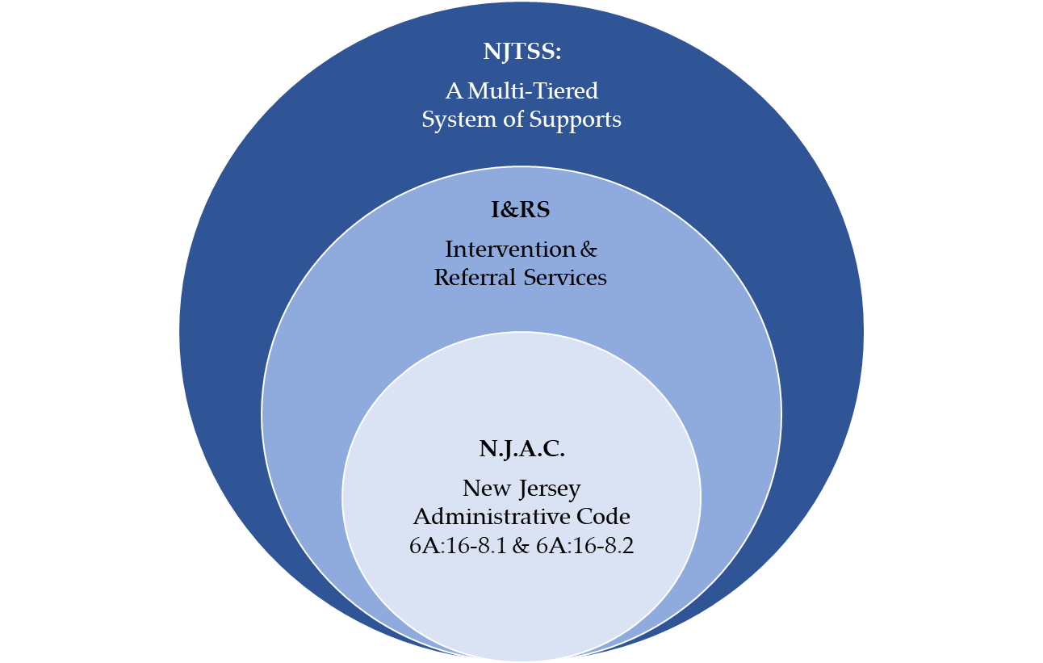
New Jersey Administrative Code (N.J.A.C.), Intervention & Referral Services (I&RS), and NJTSS
NJTSS bolsters traditional I&RS procedures with the inclusion of universal screening, progress monitoring and data-based decision making.
When implemented with fidelity, the NJTSS framework can fulfill the I&RS requirements.
Source: https://www.nj.gov/education/njtss/guidelines.pdf

Slide 8
NJTSS and Intervention & Referral Services (I&RS)
6A:16-8.1 Establishment of intervention and referral services
  District boards of education shall establish and implement in each school building in which general education students are served a coordinated system for planning and delivering intervention and referral services designed to assist students who are experiencing learning, behavior, or health difficulties, and to assist staff who have difficulties in addressing students’ learning, behavior, or health needs. District boards of education shall choose the appropriate multidisciplinary team approach, such as the Response to Intervention (RTI) or a Multi-Tiered System of Support (MTSS) model, for planning and delivering the services required under this subchapter.
Source: https://www.state.nj.us/education/code/current/title6a/chap16.pdf

Slide 9
History of NJTSS
Developed in 2015.
Reflects the voices of educators, administrators, experts in higher education and parents.
Designed to provide districts a systematic way to support all learners in meeting New Jersey Student Learning Standards (NJSLS).
Source: https://www.nj.gov/education/njtss/guidelines.pdf

Slide 10
Essential Components
Effective district and school leadership
Family and community engagement
Positive school culture and climate
High-quality learning environments, curricula, and instructional practices
Universal screening
Data-based decision making
Collaborative problem-solving teams
Progress monitoring
Staff professional development

Slide 11

Growth Mindset
Support within multi-tiered systems is intended to be fluid and responsive to student progress. Not a label that identifies a “red zone kid” (Goodman & McIntosh, 2016).
Shift in thinking

Slide 12
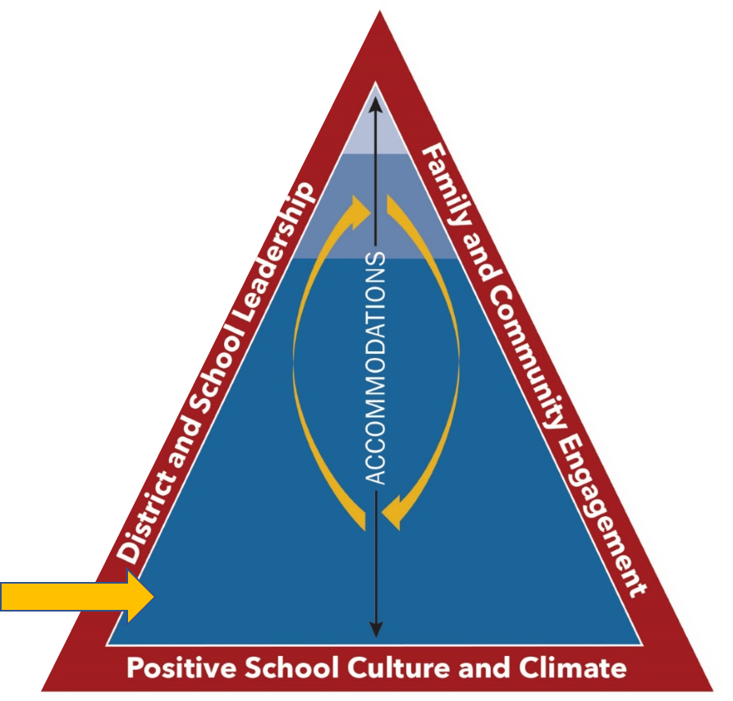
Tier 1
Tier 1 provides high-quality learning environments, evidence-based curricular and instructional practices, and a continuum of supports and interventions in general education classrooms, including bilingual classrooms, delivered with fidelity by trained teachers with the support of other professionals.
TIER 1

Slide 13
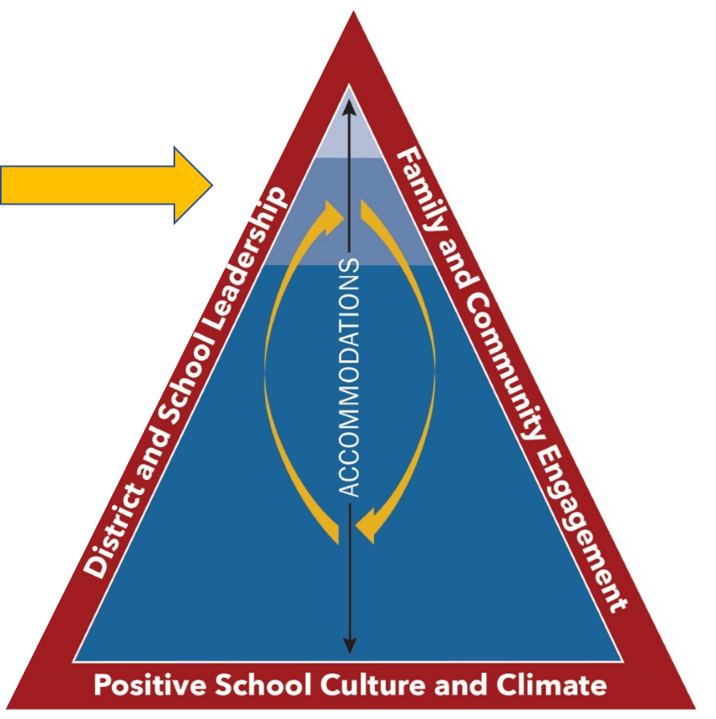
Tier 2
Tier 2 provides supplemental supports and interventions that may be delivered in small-group instruction, provided in either the general classroom or during an intervention period. Interventions include evidence-based instructional practices and interventions that increase in intensity, frequency and duration based upon the review of data during regular progress monitoring intervals.
TIER 2

Slide 14
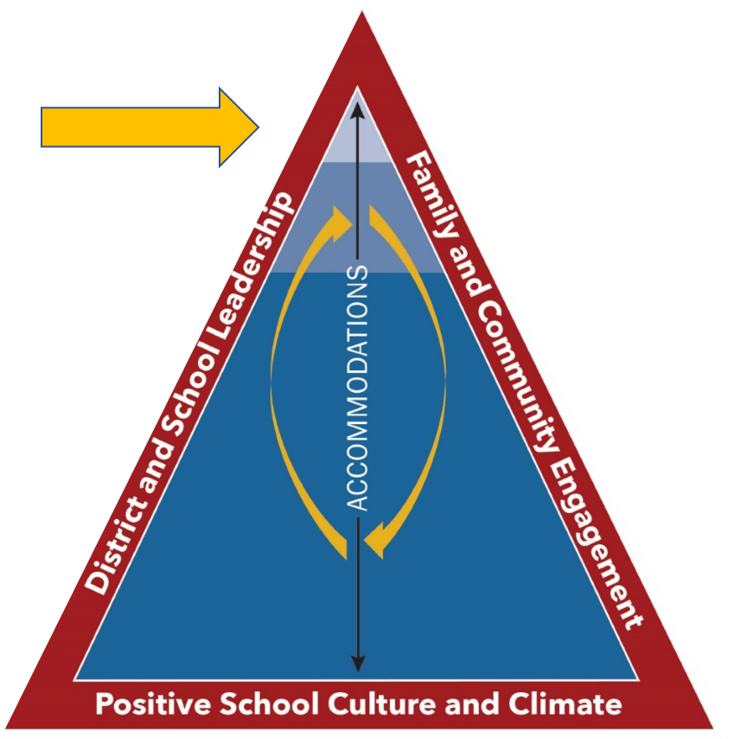
Tier 3
Tier 3 provides intensive supports and interventions that may be delivered individually and provided in or outside of the classroom after the delivery of core instruction. There may be adaptations of supports and interventions based on an individual student's performance using data that are reviewed during frequent progress monitoring intervals.
TIER 3

Slide 15
Reflective Questions
Can our current I&RS system support and sustain an NJTSS framework?
What prerequisites would our district need in place to begin implementation?
How will NJTSS support District current educational or professional goals?

Slide 16
NJTSS: Start Where You Are
District-level leadership team:
  Guide the district in assessing what is needed to implement and maintain a cohesive system that engages all students, staff, families and community resources.
  Review the NJTSS Manual.
  Implement using Getting Started with NJTSS.
NJTSS Manual - https://www.state.nj.us/education/njtss/guidelines.pdf
Getting Started with NJTSS - https://www.state.nj.us/education/njtss/started.pdf

Slide 17






Thank You
New Jersey Department of Education
@NewJerseyDOE
@newjerseydoe
Thank You!
New Jersey Department of Education
New Jersey Department of Education
@newjerseydoe

