Slide 1
Professional Learning series: New Jersey Tiered System of Supports (NJTSS) Data-Based Decision Making
Office of Student Support Services
Division of Educational Services

Slide 2
Quote
“Every student can learn, just not on the same day, or the same way.”
George Evans

Slide 3
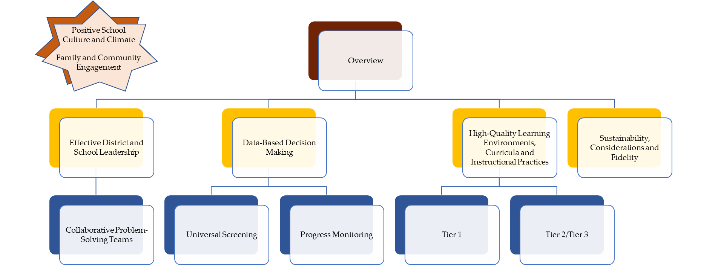
NJTSS series: Navigation

Slide 4
Purpose
After this presentation, you will better understand Data-Based Decision Making, an Essential Component of the New Jersey Tiered System of Supports (NJTSS) framework.

Slide 5

NJTSS: Defined
New Jersey Tiered System of Supports: A framework for supporting the academic, behavioral, social-emotional and health needs of all students through a layered continuum of evidence-based practices, interventions and services.
Source: https://www.nj.gov/education/njtss/guidelines.pdf

Slide 6
Diving Deeper into Data-Based Decision Making
Effective district and school leadership
Family and community engagement
Positive school culture and climate
High-quality learning environments, curricula, and instructional practices
Universal screening
Data-based decision making
Collaborative problem-solving teams
Progress monitoring
Staff professional development

Slide 7
Data-Based Decision Making (1 of 2)
Definition
Data-based decision making involves systemic analysis of data within multiple levels of instruction and interventions to identify students’ strengths and areas of need, appropriate interventions and determine the effectiveness of interventions. This ensures the health of the whole system is taken into account.
Source: https://www.nj.gov/education/njtss/guidelines.pdf

Slide 8
Data-Based Decision Making (2 of 2)
An ongoing, outcomes driven approach.
Analyze screening and progress monitoring data to determine how to best address system and students’ skill needs.
Clearly-specified, data-based decision rules are used to guide intervention selection and modification.
Data are organized, maintained and displayed using an online student database that enable school teams to make school wide, grade-level, class-wide, and individual student decisions.
Source: https://www.nj.gov/education/njtss/guidelines.pdf

Slide 9

Successful Data-Based Decision Making Example
“Data do a great job of breaking a problem apart, and a lousy job of telling us what to do next.” (Cave, 2019)
How to use data to make a hit TV show
Sebastian Wernicke (7:57- 10:55)
Amazon Studios
Roy Price, Senior Executive
Created first episodes for free and watched millions of people watch these shows. Analyzed all viewing data to determine which show they should make.
Created sitcom about four US Senators, Alpha House.
Netflix
Ted Sarandos, Chief Content Officer
Utilized existing data- ratings, viewing histories, etc.
Created a drama series about one US Senator.
House of Cards received critical acclaim, 33 Emmy nominations and 8 Golden Globe nominations.
https://www.youtube.com/watch?v=vQILP19qABk&t=478s
https://www.pbisapps.org/articles/the-best-decisions-take-guts-and-data

Slide 10
What are Different Types of Student Assessment Data?
Universal Screening Assessments
Diagnostic Assessments
Formative Assessments
Universal screening involves assessing all students to identify their performance relative to benchmark expectations. It includes administering reliable brief assessments that measure specific skills or behaviors that are highly predictive of future outcomes (e.g., Glover & Albers, 2007; Jenkins, 2003).
Assessments which provide more in-depth information about an individual student’s knowledge, skill, and understanding for the purpose of guiding future instructional supports. (National Implementation Research Network)
Formative assessment is a planned, ongoing process used by all students and teachers during teaching and learning to elicit and use evidence of student learning to improve student understanding of intended disciplinary learning outcomes and support students to become self-directed learners. (Council of Chief State School Officers)
Progress Monitoring Assessments
Interim Assessments (e.g., benchmarks, common assessments, unit assessments)
Summative Assessments (e.g., Final Assessments, State Assessments)
Progress monitoring assessments evaluate student performance through brief assessments, used to determine students' rate of improvement or response to intervention and to evaluate the effectiveness of instruction (Center on Response to Intervention).
An assessment used to assess how students are progressing in a particular content or needs area. These assessments gauge whether students are on track to perform in future summative assessments.
Measures used to gather information about student performance compared to grade-level standards that are typically administered at the end of the semester or year. (National Implementation Research Network)

Slide 11
Prioritizing your System’s Data
Teacher attendance rates
Student attendance rates
Meeting frequency for MTSS and/or I&RS
Suspension rates
Any data demonstrating significant challenges to the mental health and/or well-being of students and/or staff
Scope and sequence for all programming
Scheduling reviews
Staffing capacity
District performance on standardized and formative assessments
School Climate Assessment data
Data indicating challenges to physical safety
*Not intended to be an exhaustive list

Slide 12

How do you collect Student Assessment Data? (1 of 5)
Universal Screening Assessment
All students participate to identify student needs.
Students identified as "at-risk" during the universal screening assessment participate in diagnostic assessments to identify exact skill needs or conceptual gaps.
Diagnostic Assessment
Vast majority of students are successful receiving Core Instruction, which includes differentiation and learning acceleration.
Some students are provided moderate interventions.
Few students are provided with intense interventions
Data-Driven Instruction/Intervention
Assessments to gauge daily student learning
Interim assessments are administered to measure student's mastery of interim content.
Frequent assessments are administered to students receiving intervention to assess if interventions are having intended effect.
Formative/Interim Assessment/Progress Monitoring
Summative Assessment
Final assessments are administered to measure student mastery of grade level standards.

Slide 13
How do you collect Student Assessment Data? (2 of 5)
Universal Screening Assessment
All students participate to identify student needs.
Students identified as "at-risk" during the universal screening assessment participate in diagnostic assessments to identify exact skill needs or conceptual gaps.
Diagnostic Assessment
Vast majority of students are successful receiving Core Instruction, which includes differentiation and learning acceleration.
Some students are provided moderate interventions.
Few students are provided with intense interventions
Data-Driven Instruction/Intervention
Assessments to gauge daily student learning
Interim assessments are administered to measure student's mastery of interim content.
Frequent assessments are administered to students receiving intervention to assess if interventions are having intended effect.
Formative/Interim Assessment/Progress Monitoring
Summative Assessment
Final assessments are administered to measure student mastery of grade level standards.

Slide 14
How do you collect Student Assessment Data? (3 of 5)
Universal Screening Assessment
All students participate to identify student needs.
Students identified as "at-risk" during the universal screening assessment participate in diagnostic assessments to identify exact skill needs or conceptual gaps.
Diagnostic Assessment
Vast majority of students are successful receiving Core Instruction, which includes differentiation and learning acceleration.
Some students are provided moderate interventions.
Few students are provided with intense interventions
Data-Driven Instruction/Intervention
Assessments to gauge daily student learning
Interim assessments are administered to measure student's mastery of interim content.
Frequent assessments are administered to students receiving intervention to assess if interventions are having intended effect.
Formative/Interim Assessment/Progress Monitoring
Summative Assessment
Final assessments are administered to measure student mastery of grade level standards.

Slide 15
How do you collect Student Assessment Data? (4 of 5)
Universal Screening Assessment
All students participate to identify student needs.
Students identified as "at-risk" during the universal screening assessment participate in diagnostic assessments to identify exact skill needs or conceptual gaps.
Diagnostic Assessment
Vast majority of students are successful receiving Core Instruction, which includes differentiation and learning acceleration.
Some students are provided moderate interventions.
Few students are provided with intense interventions
Data-Driven Instruction/Intervention
Assessments to gauge daily student learning
Interim assessments are administered to measure student's mastery of interim content.
Frequent assessments are administered to students receiving intervention to assess if interventions are having intended effect.
Formative/Interim Assessment/Progress Monitoring
Summative Assessment
Final assessments are administered to measure student mastery of grade level standards.

Slide 16
How do you collect Student Assessment Data? (5 of 5)
Universal Screening Assessment
All students participate to identify student needs.
Students identified as "at-risk" during the universal screening assessment participate in diagnostic assessments to identify exact skill needs or conceptual gaps.
Diagnostic Assessment
Vast majority of students are successful receiving Core Instruction, which includes differentiation and learning acceleration.
Some students are provided moderate interventions.
Few students are provided with intense interventions
Data-Driven Instruction/Intervention
Assessments to gauge daily student learning
Interim assessments are administered to measure student's mastery of interim content.
Frequent assessments are administered to students receiving intervention to assess if interventions are having intended effect.
Formative/Interim Assessment/Progress Monitoring
Summative Assessment
Final assessments are administered to measure student mastery of grade level standards.

Slide 17
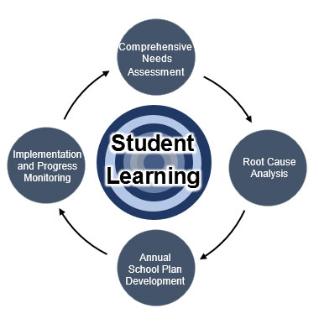

New Jersey Annual School Planning Process
What do you do with Data?
Identify needs for instructional system improvements
Identify needs for students
Source: https://www.state.nj.us/education/ESSA/asp/

Slide 18
Data-Based Decision Making
Use data drawn from multiple sources and analyzed at multiple levels to set goals and monitor progress.
Apply decision rules that clearly define movement between tiers and determine whether interventions are effective or need to be modified.
An approach that integrates academic and behavioral supports
Involves more frequent and precise progress monitoring
Source: https://www.nj.gov/education/njtss/guidelines.pdf

Slide 19
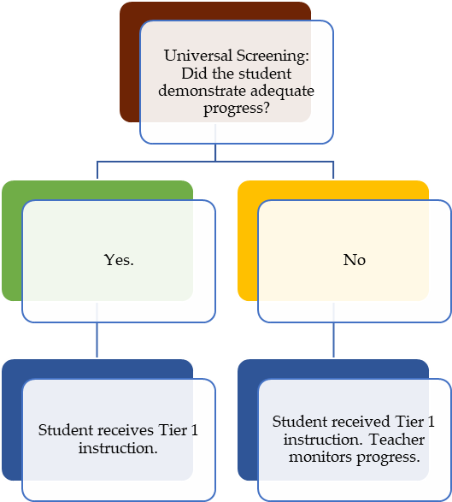
Universal Screening & Progress Monitoring Process (1 of 3)

Slide 20
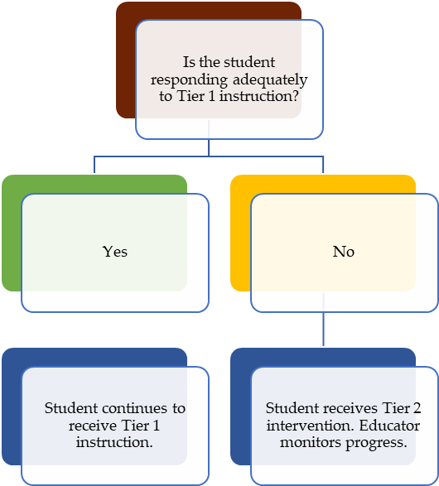

Universal Screening & Progress Monitoring Process (2 of 3)

Slide 21
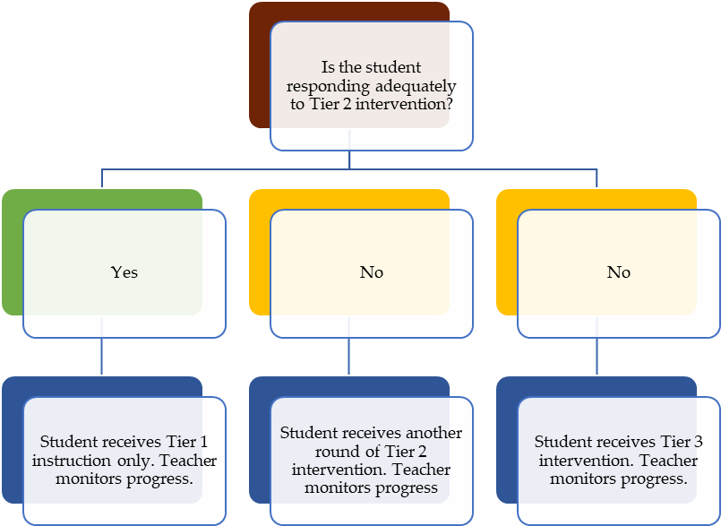
Universal Screening & Progress Monitoring Process (3 of 3)

Slide 22
Data-Based Decision Making Process
Step 1: Assess
Step 2: Build and Reflect
Step 3: Implement and Monitor

Slide 23
Procedural Practices
Administer a universal screening and implement a diagnostic process.
Examine the need for core instructional changes before allocating resources to intervention.
Use disaggregated data by demographic variables to determine group trends/needs.
Use data tracking and analytic tools that enable school personnel to access current information and trend data easily.
Source: https://www.nj.gov/education/njtss/guidelines.pdf

Slide 24
Reflective Questions
How can we use data to inform student needs?
Which types of data do we currently collect?
How can we implement reliable Universal Screening measures as well as Diagnostics and Progress Monitoring measures?
How can we increase staffing capacity (professional development, available staff, etc.) to identify and meet the needs of our students?

Slide 25
NJTSS: Start Where You Are
District-level leadership team:
Guide the district in assessing what is needed to implement and maintain a cohesive system that engages all students, staff, families and community resources.
Review the NJTSS Manual.
Implement using Getting Started with NJTSS.
NJTSS Manual - https://www.state.nj.us/education/njtss/guidelines.pdf
Getting Started with NJTSS - https://www.state.nj.us/education/njtss/started.pdf

Slide 26






Thank You
New Jersey Department of Education
@NewJerseyDOE
@newjerseydoe
Thank You!
New Jersey Department of Education
New Jersey Department of Education
@newjerseydoe

