Slide 1
1
Elementary Data Literacy Overview
Division of Teaching and Learning Services
Office of Standards
Dr. Deidre Richardson, Ed.D.
October 17, 2024
November 19, 2024
December 12, 2024

Slide 2
Agenda
K–5 Structural Revision
Measurement vs. Data Literacy
Grades 3-5 Content Emphases
GAISE II Report
Understanding the Standards
Resources and Opportunities

Slide 3
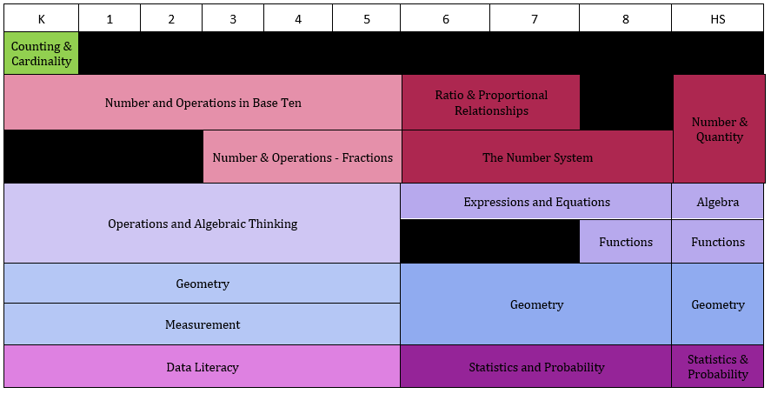
K–HS Domain Progression

Slide 4
Text Version: K–HS Domain Progression
Key:
A: Algebra
CC: Counting and Cardinality
DL: Data Literacy
F: Functions
G: Geometry
M: Measurement
NBT: Number and Operations in Base Ten
NF: Number and Operations – Fractions
OA: Operations and Algebraic Thinking
SP: Statistics and Probability
K | 1 | 2 | 3 | 4 | 5 | 6 | 7 | 8 | HS
CC | - | - | - | - | - | - | - | - | -
NBT | NBT | NBT | NBT | NBT | NBT | RP | RP | - | NQ
- | - | - | NF | NF | NF | NS | NS | NS | NQ
OA | OA | OA | OA | OA | OA | EE | EE | EE | A
OA | OA | OA | OA | OA | OA | - | - | F | F
G | G | G | G | G | G | G | G | G | G
M | M | M | M | M | M | G | G | G | G
DL | DL | DL | DL | DL | DL | SP | SP | SP | SP

Slide 5
Measurement vs. Data Literacy — K
Data literacy: The ability to reason with and about data—including what data are and where data come from. This includes the ability to make good decisions based on data, to ask questions of data, and to use appropriate reasoning.
K.M.A.1 Describe measurable attributes of objects, such as length or weight. Describe several measurable attributes of a single object.
K.M.A.2 Directly compare two objects with a measurable attribute in common, to see which object has “more of”/“less of” the attribute, and describe the difference. For example, directly compare the heights of two children and describe one child as taller/shorter.
K.DL.A.1 Classify objects into given categories; count the numbers of objects in each category and sort the categories by count. (Clarification: Limit category counts to be less than or equal to 10)

Slide 6
Measurement vs. Data Literacy – Grade 1
1.M.A.1 Order three objects by length; compare the lengths of two objects indirectly by using a third object.
1.M.A.2 Express the length of an object as a whole number of length units, by laying multiple copies of a shorter object (the length unit) end to end; understand that the length measurement of an object is the number of same-size length units that span it with no gaps or overlaps. Limit to contexts where the object being measured is spanned by a whole number of length units with no gaps or overlaps.
1.DL.A.1 Organize, represent, and interpret data with up to three categories; ask and answer questions about the total number of data points, how many in each category, and how many more or less are in one category than in another.

Slide 7
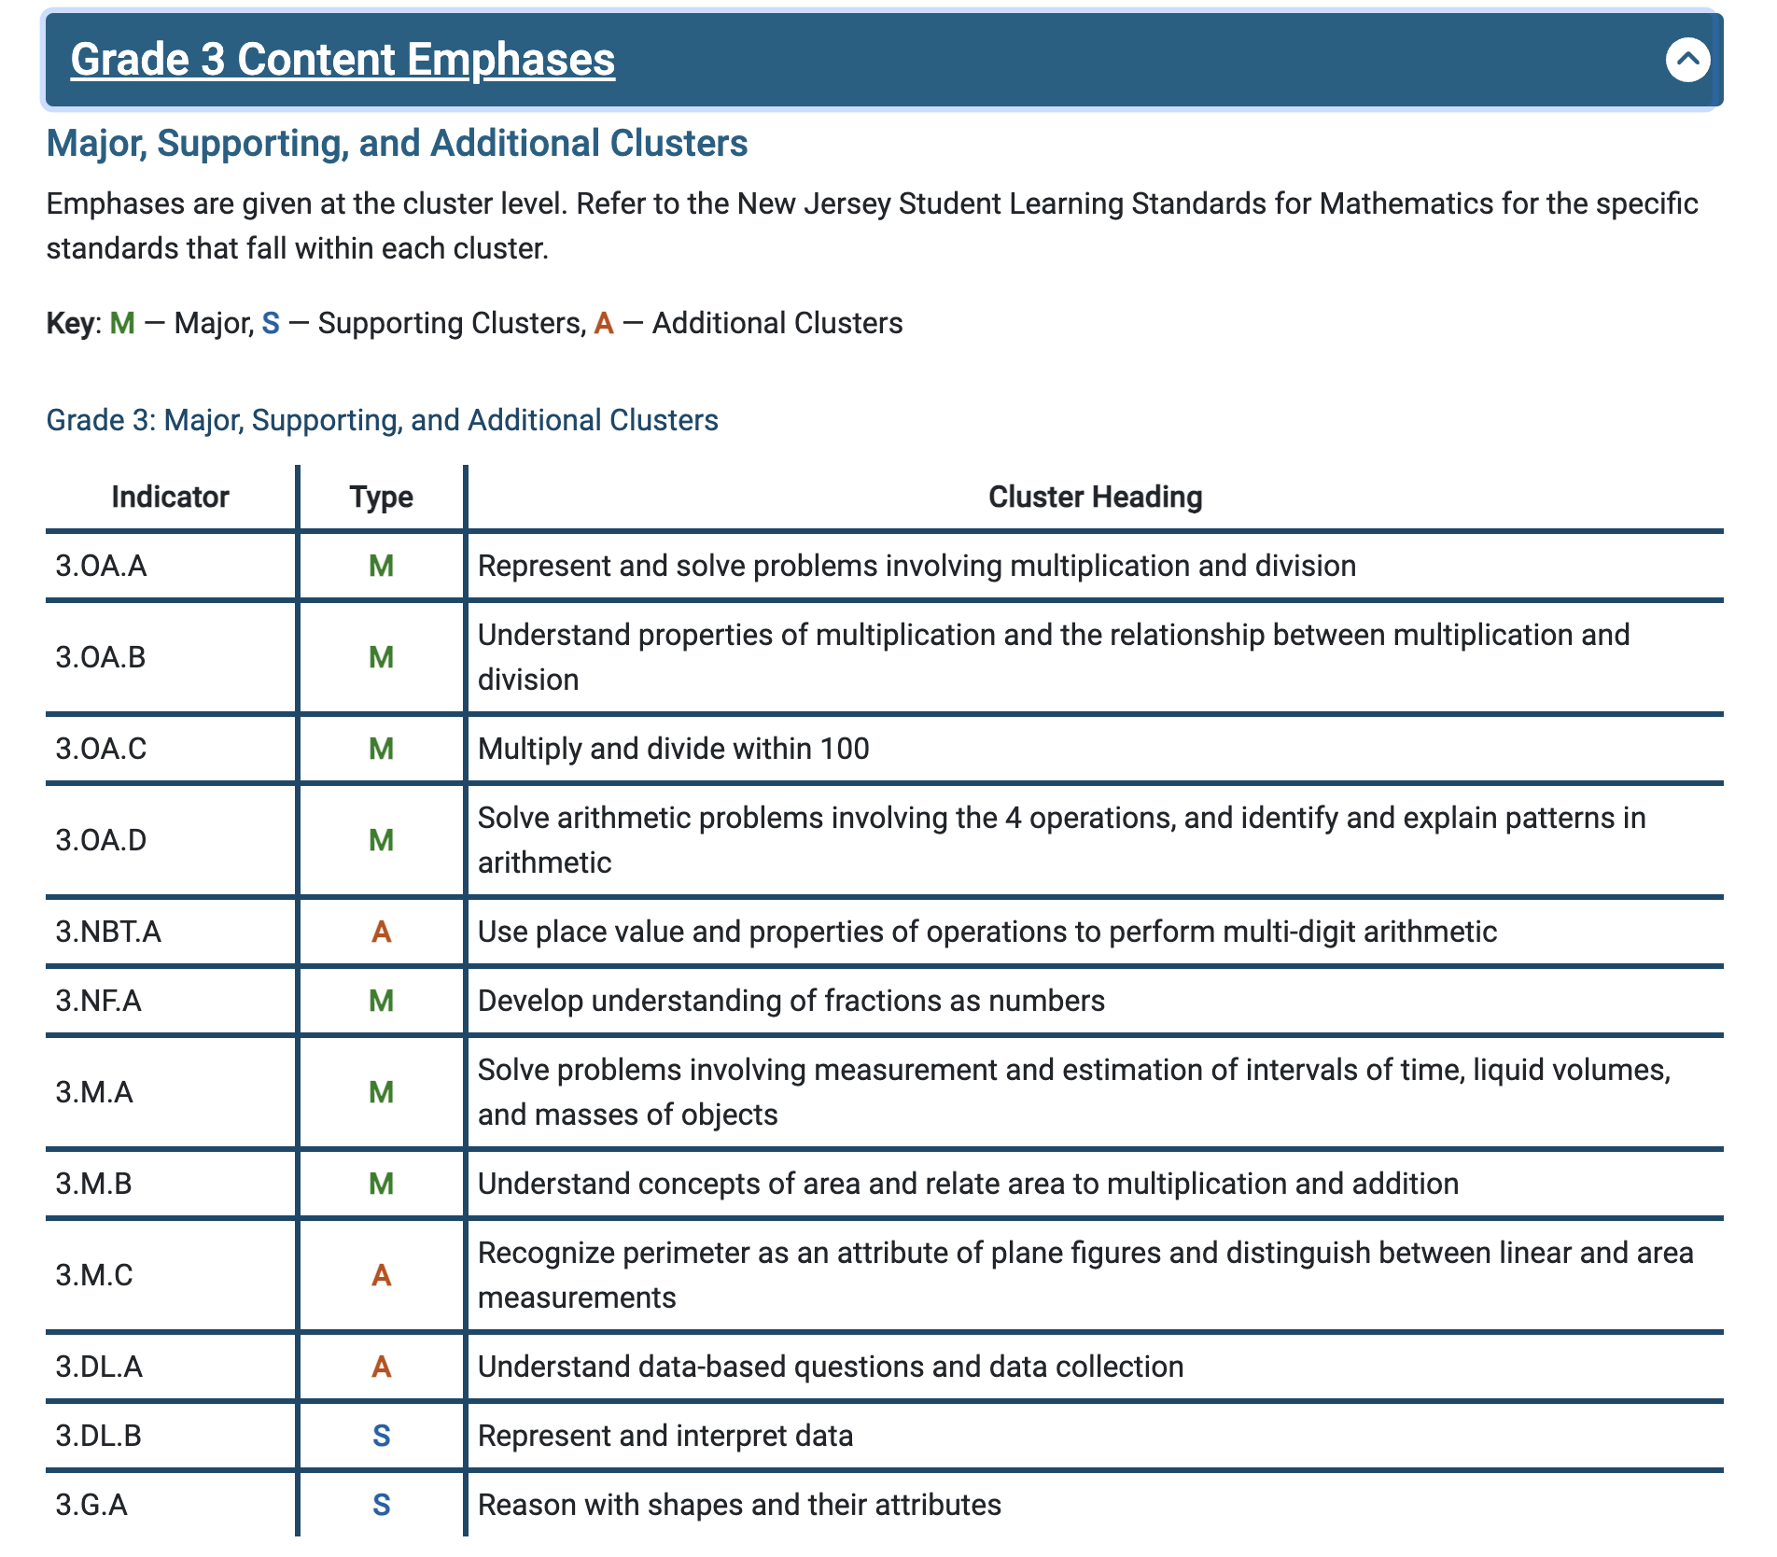
Content Emphases: Grade 3
Some things have greater emphasis
No standards can be neglected or omitted. Neglecting material will:
leave gaps in student skill and understanding
leave students unprepared for later grades.
https://tinyurl.com/K8ContEmph

Slide 8
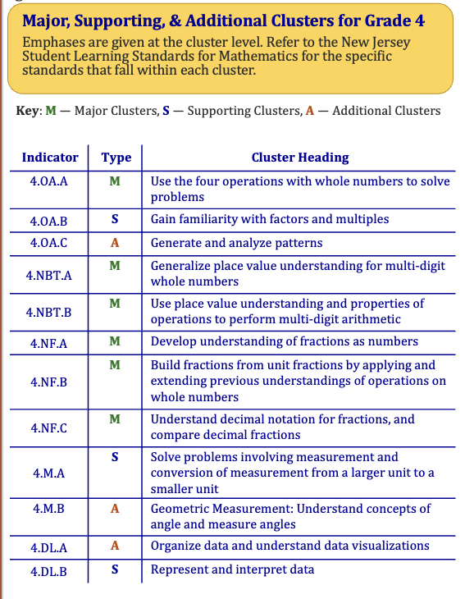
Content Emphases: Grade 4 and 5

Slide 9
The GAISE Report
The Guidelines for Assessment and Instruction in Statistics Education II report (GAISE II) reminds us that working with data is an inquiry process that has multiple components. They suggest this image of the data inquiry process.
Data literacy: The ability to reason with and about data—including what data are and where data come from. This includes the ability to make good decisions based on data, to ask questions of data, and to use appropriate reasoning.

Slide 10
New Grades 2–5 Data Literacy Standards
Data literacy: The ability to reason with and about data—including what data are and where data come from. This includes the ability to make good decisions based on data, to ask questions of data, and to use appropriate reasoning.
Foundational Definitions
Data: information gathered to answer a question
Attribute: a characteristic of an object or event that is observed, obtained by questioning or measuring
Select Foundational Skills and Concepts
Formulating questions
Grouping and organizing data
Variability

Slide 11
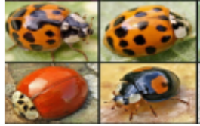
Importance of Questioning
Formulate Investigative Questions
How many spots do ladybugs typically have?
Collect Data (e.g. survey question)
How many spots are on the ladybug?
What color is the ladybug?
Analyze Data (e.g. ask questions about the visualization)
What number of spots were most common for the ladybugs?
Interpret the Results
Do red ladybugs tend to have more spots than black ladybugs?

Slide 12
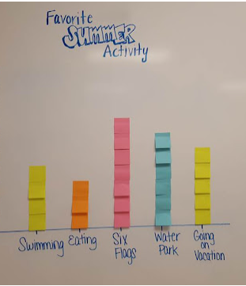
New Grade 2 Data Literacy Standards
2.DL.A.1 Understand that people collect data to answer questions. Understand that data can vary.
What is our class’s favorite game to play at recess?
Will the data that we need to collect - every student’s response to the question “What is your favorite game to play at recess?” – be the same? Or should we expect answers from some students to differ?

Slide 13
New Grade 3 Data Literacy Standards
3.DL.A.1 Develop data-based questions and decide what data will answer the question (e.g., “What size shoe does a 3rd grader wear?”, “How many books does a 3rd grader read?”).
What if we wanted to learn about bedtimes?
What are some ways we could find out about bedtimes in this class? What questions could we ask one another to collect that data? Are there different questions you could ask that would get different information?

Slide 14
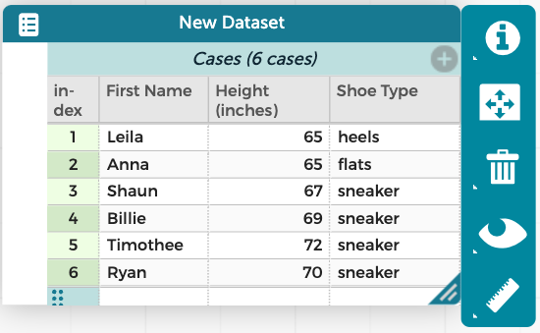
New Grade 4 Data Literacy Standards
4.DL.A.2 Develop strategies to collect various types of data and organize data digitally.

Slide 15
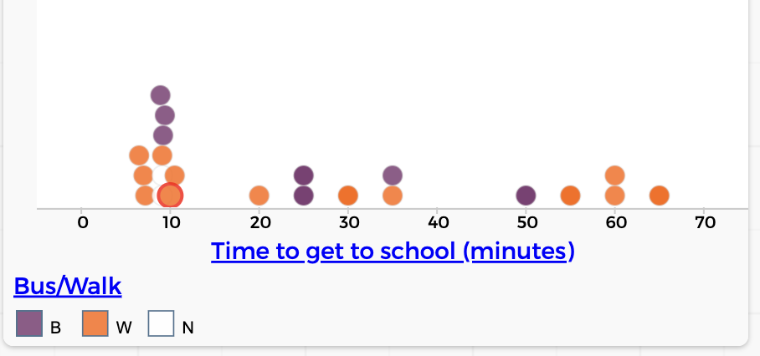
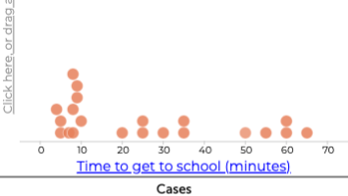
New Grade 5 Data Literacy Standards
5.DL.A.1 Understand how different visualizations can highlight different aspects of data. Ask questions and interpret data visualizations to describe and analyze patterns.

Slide 16
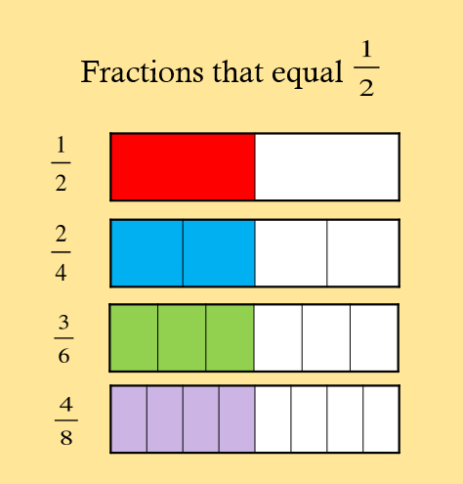
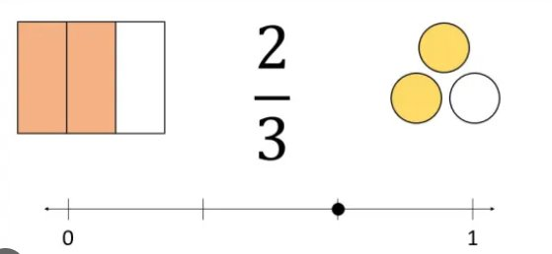
Representing Fractions
Visual fraction models include tape diagrams, number lines, and area models.
Clarification: Set models, including those defined as the whole, are excluded at this grade band.​
3.NF.A.3b Recognize and generate simple equivalent fractions by reasoning about their size, (e.g., , ). Explain why the fractions are equivalent with the support of a visual fraction model.

Slide 17
Clarification to Data Literacy Standards
New clarification to the new Data Literacy cluster in grades 4 and 5: Analysis of data and visualizations at these grades excludes ratio, rate, proportion and percentages. These concepts are introduced in Grade 6.

Slide 18
Some early Do’s and Don’ts
Do:
Engage students in exploring data on topics about which they are curious and topics that are relevant to them.
Make connections to contexts from other disciplines.
Do not:
Reduce elementary data literacy to a series of activities. If you are focused on activities, reorient yourself to focus on concepts and what students understand
let others convince you that these standards are more complicated than they are

Slide 19
Opportunities: NJDOE Webinars
See NJDOE Events Registration Page
Revisions and Key Perspectives in Middle School Mathematics
November 14 and December 17, 2024
Elementary Data Literacy Overview
October 17, November 19 and December 12, 2024
Exploring Fractions in Grades 3 to 5
November 21 and December 5, 2024
Note: The webinars begin at 3:15pm

Slide 20
Thank You!
Dr. Deidre Richardson, Ed.D.
deidre.richardson@doe.nj.gov

Slide 21
Follow Us on Social Media!
Facebook: @njdeptofed
Instagram: @newjerseydoe
LinkedIn: New Jersey Department of Education
Threads: @NewJerseyDOE
X: @NewJerseyDOE
YouTube: @newjerseydepartmentofeduca6565

