Slide 1
Exploring Fractions in Grades 3 to 5
Division of Teaching and Learning Services
Office of Standards
Dr. Deidre Richardson, Ed.D.
November 21, 2024
December 5, 2024

Slide 2
Agenda
K–5 Structural Revision
Grades 3-5 Content Emphases
Revisions to Fractions Standards
Conceptual Understandings
Resources and Opportunities
https://bit.ly/NJMath

Slide 3
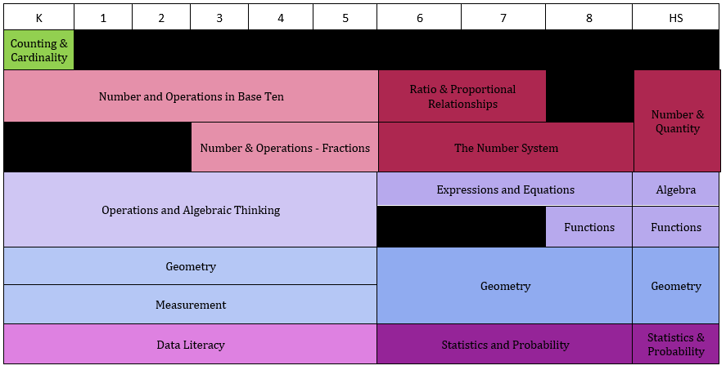
K–HS Domain Progression

Slide 4
Text Version: K–HS Domain Progression
Key:
A: Algebra
CC: Counting and Cardinality
DL: Data Literacy
F: Functions
G: Geometry
M: Measurement
NBT: Number and Operations in Base Ten
NF: Number and Operations – Fractions
OA: Operations and Algebraic Thinking
SP: Statistics and Probability
K | 1 | 2 | 3 | 4 | 5 | 6 | 7 | 8 | HS
CC | - | - | - | - | - | - | - | - | -
NBT | NBT | NBT | NBT | NBT | NBT | RP | RP | - | NQ
- | - | - | NF | NF | NF | NS | NS | NS | NQ
OA | OA | OA | OA | OA | OA | EE | EE | EE | A
OA | OA | OA | OA | OA | OA | - | - | F | F
G | G | G | G | G | G | G | G | G | G
M | M | M | M | M | M | G | G | G | G
DL | DL | DL | DL | DL | DL | SP | SP | SP | SP

Slide 5
Content Emphases: Grade 3
Some things have greater emphasis
No standards can be neglected or omitted. Neglecting material will:
leave gaps in student skill and understanding
leave students unprepared for later grades.
https://tinyurl.com/K8ContEmph

Slide 6
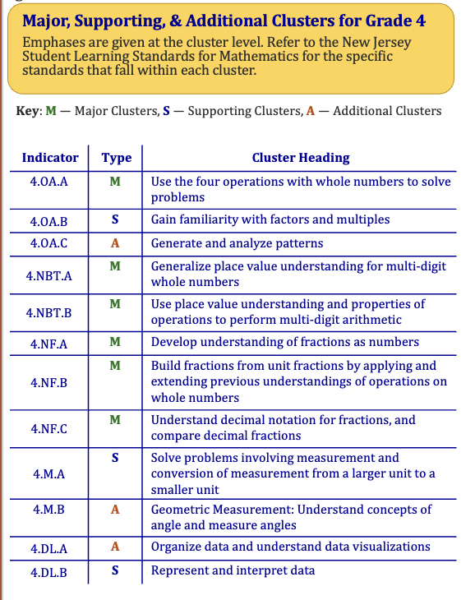
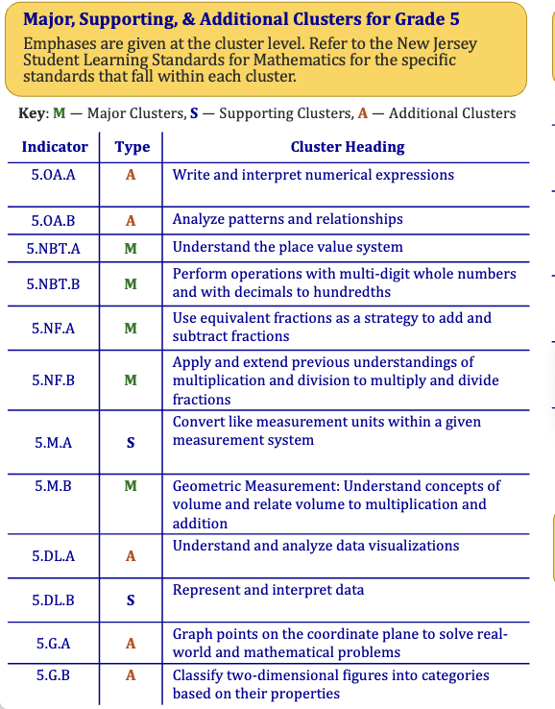
Content Emphases: Grade 4 and 5

Slide 7
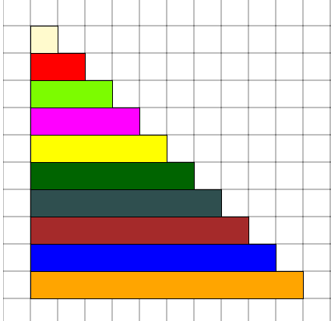
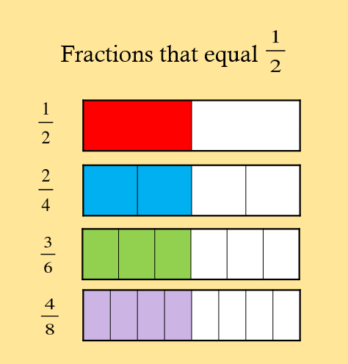
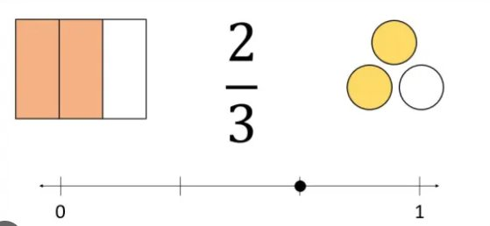
Visual Fraction Models
Visual fraction models include tape diagrams, number lines, and area models.
Clarification: Set models, including those defined as the whole, are excluded at this grade band.​

Slide 8
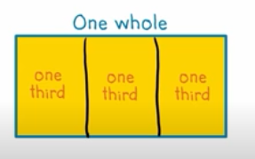
Fractions Revisions — Grade 3 (3.NF.A.1)
3.NF.A.1 Understand a fraction 1/b as the quantity formed by 1 part when a whole is partitioned into b equal parts; understand a fraction a/b as the quantity formed by a parts of size 1/b. For example: If a rectangle (i.e., the whole) is partitioned into 3 equal parts, each part is 1/3. Two of these parts would be 2/3.

Slide 9
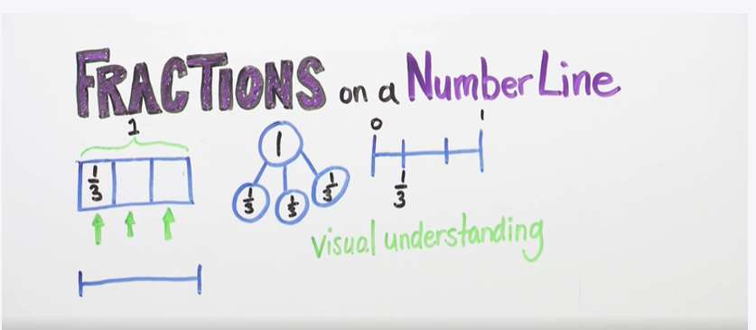
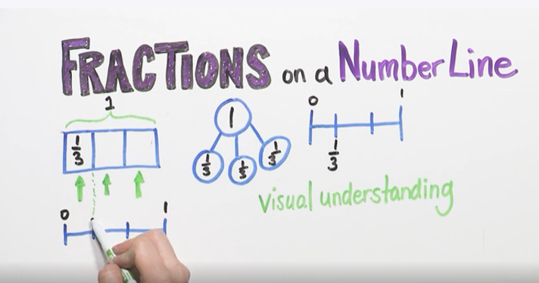
Fractions Revisions — Grade 3 (3.NF.A.2a)
3.NF.A.2a Represent a fraction 1/b on a number line diagram by defining the interval from 0 to 1 as the whole and partitioning it into b equal parts. Recognize that each part has size 1/b and that the endpoint of the part based at 0 locates the number 1/b on the number line. For example, partition the number line from 0 to 1 into 3 equal parts, represent 1/3 on the number line and show that each part has a size 1/3.
Notes:
https://whyy.pbslearningmedia.org/resource/ed402c08-329f-417d-b050-f3bf03365596/fractions-on-a-number-line/

Slide 10
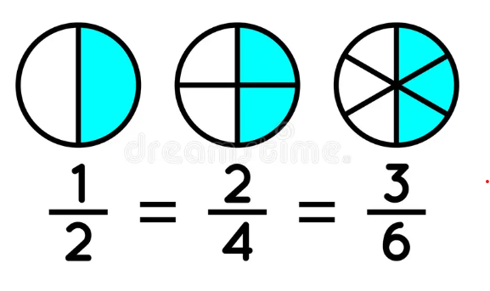
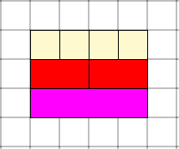
Fractions Revisions — Grade 3 (3.NF.A.3b)
3.NF.A.3b Recognize and generate simple equivalent fractions by reasoning about their size, (e.g., , ). Explain why the fractions are equivalent with the support of a visual fraction model.

Slide 11
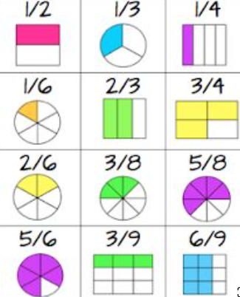
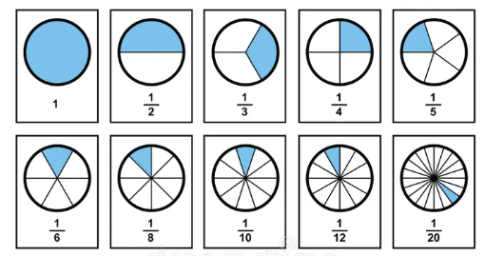
Representing Fractions
Caution: Fractions circles for small denominators only
Visual fraction models include tape diagrams, number lines, and area models.

Slide 12
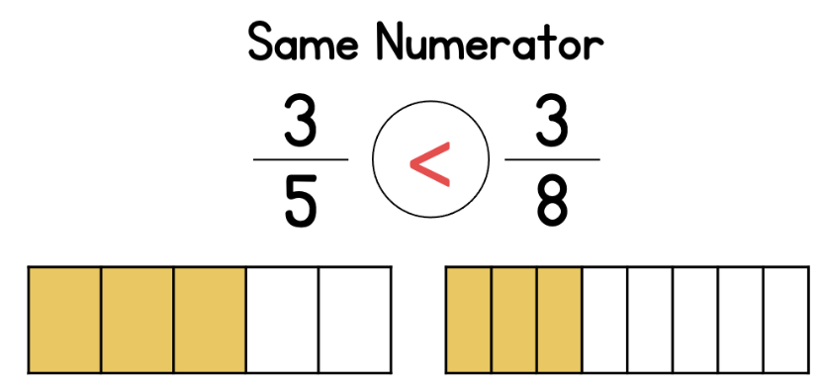
Fractions Revisions — Grade 3
3.NF.A.3d Compare two fractions with the same numerator or the same denominator by reasoning about their size. Recognize that comparisons are valid only when the two fractions refer to the same whole. Record the results of comparisons with the symbols >, =, or <, and justify the conclusions with the support of a visual fraction model
For example, let’s compare 3/5 and 3/8. These two fractions have the same numerator. Since these two fractions have the same numerator, we can compare their denominators. In this example, since 5 is less than 8, 3/5 is greater than 3/8.

Slide 13
Understanding Fraction Equivalence
Clarification: Set models, including those defined as the whole, are excluded at this grade.
4.NF.A.1 Explain why a fraction a/b is equivalent to a fraction (n x a)/(n x b) by using visual fraction models, with attention to how the number and size of the parts differ even though the two fractions themselves are the same size. Use this principle to recognize and generate equivalent fractions.

Slide 14
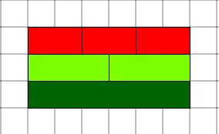
Fractions — Grade 4 (4.NF.B.3a)
B. Build fractions from unit fractions …
4.NF.B.3 Understand a fraction a/b with a > 1 as a sum of fractions 1/b.
2.G.A.3. Partition circles and rectangles into two, three, or four equal shares, describe the shares using the words halves, thirds, half of, a third of, etc., and describe the whole as two halves, three thirds, four fourths. Recognize that equal shares of identical wholes need not have the same shape.
4.NF.B.3a Understand addition and subtraction of fractions as joining and separating parts referring to the same whole.

Slide 15
Fractions — Grade 4 (4.NF.B.3b)
B. Build fractions from unit fractions …
4.NF.B.3 Understand a fraction a/b with a > 1 as a sum of fractions 1/b.
4.NF.B.3a Understand addition and subtraction of fractions as joining and separating parts referring to the same whole.
4.NF.B.3b Decompose a fraction into a sum of fractions with the same denominator in more than one way, recording each decomposition by an equation. Justify decompositions, e.g., by using a visual fraction model.
Examples: 3/8 = 1/8 + 1/8 + 1/8 ;
3/8 = 1/8 + 2/8 ;
2 1/8 = 1 + 1 + 1/8 = 8/8 + 8/8 + 1/8.

Slide 16
Fractions — Grade 5
B. Apply and extend previous understandings of multiplication and division to multiply and divide fractions.
5.NF.B.3 Interpret a fraction as division of the numerator by the denominator (i.e., $\frac{a}{b}=a÷b$). Solve word problems involving division of whole numbers leading to answers in the form of fractions or mixed numbers, e.g., by using visual fraction models or equations to represent the problem.

Slide 17
Fractions — Grade 5 Example
5.NF.B.3 Interpret a fraction as division of the numerator by the denominator (i.e., $\frac{a}{b}=a÷b$). Solve word problems involving division of whole numbers leading to answers in the form of fractions or mixed numbers, e.g., by using visual fraction models or equations to represent the problem. For example, interpret $\frac{3}{4}$ as the result of dividing 3 by 4, noting that $\frac{3}{4}$ multiplied by 4 equals 3, and that when 3 wholes are shared equally among 4 people each person has a share of size $\frac{3}{4}$ . If 9 people want to share a 50-pound sack of rice equally by weight, how many pounds of rice should each person get? Between what two whole numbers does your answer lie?

Slide 18
Fractions — Grade 5 Example continued
5.NF.B.3 Interpret a fraction as division of the numerator by the denominator (i.e., $\frac{a}{b}=a÷b$). Solve word problems involving division of whole numbers leading to answers in the form of fractions or mixed numbers, e.g., by using visual fraction models or equations to represent the problem. For example, interpret $\frac{3}{4}$ as the result of dividing 3 by 4, noting that $\frac{3}{4}$ multiplied by 4 equals 3, and that when 3 wholes are shared equally among 4 people each person has a share of size $\frac{3}{4}$ . If 9 people want to share a 50-pound sack of rice equally by weight, how many pounds of rice should each person get? Between what two whole numbers does your answer lie?

Slide 19
Fractions — Grade 5 (5.NF.A.1)
A. Use equivalent fractions as a strategy to add and subtract fractions.
5.NF.A.1 Add and subtract fractions with unlike denominators (including mixed numbers) by replacing given fractions with equivalent fractions in such a way as to produce an equivalent sum or difference of fractions with like denominators. For example, $\frac{2}{3}+\frac{5}{4}=\frac{8}{12}+\frac{15}{12}=\frac{23}{12}$ (In general, $\frac{a}{b}+\frac{c}{d}=\frac{ad+bc}{bd}$).

Slide 20
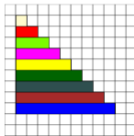
Fractions — Grade 5 (5.NF.A.2)
5.NF.A.2 Solve word problems involving addition and subtraction of fractions referring to the same whole, including cases of unlike denominators, e.g., by using visual fraction models or equations to represent the problem. Use benchmark fractions and number sense of fractions to estimate mentally and assess the reasonableness of answers. For example, recognize an incorrect result $\frac{2}{5}+\frac{1}{2}=\frac{3}{7}$ by observing that $\frac{3}{7}<\frac{1}{2}$.
Incorrect result.
$\frac{2}{3}+\frac{1}{2}=\frac{3}{5}$

Slide 21
Fractions — Grade 5 (5.NF.A.2) continued
5.NF.A.2 Solve word problems involving addition and subtraction of fractions referring to the same whole, including cases of unlike denominators, e.g., by using visual fraction models or equations to represent the problem. Use benchmark fractions and number sense of fractions to estimate mentally and assess the reasonableness of answers. For example, recognize an incorrect result $\frac{2}{5}+\frac{1}{2}=\frac{3}{7}$ by observing that $\frac{3}{7}<\frac{1}{2}$.
Incorrect result.
$\frac{2}{3}+\frac{1}{2}=\frac{3}{5}$

Slide 22
Opportunities
Exploring Fractions in Grades 3 to 5
December 5, 2024
Elementary Data Literacy Overview
December 12, 2024
Revisions and Key Perspectives in Middle School Mathematics
December 17, 2024

Slide 23
Thank You!
Dr. Deidre Richardson, Ed.D.
deidre.richardson@doe.nj.gov

Slide 24
Follow Us on Social Media!
Facebook: @njdeptofed
Instagram: @newjerseydoe
LinkedIn: New Jersey Department of Education
Threads: @NewJerseyDOE
X: @NewJerseyDOE
YouTube: @newjerseydepartmentofeduca6565

