Slide 1
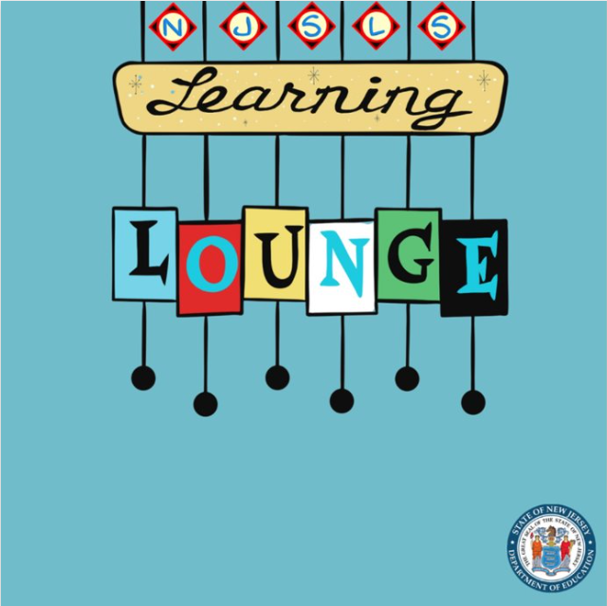
Revisions and Key Perspectives in
Middle School Mathematics
Division of Teaching and Learning Services
Office of Standards
Dr. Deidre Richardson, Ed.D.
October 24, 2024
November 14, 2024
December 17, 2024

Slide 2
Agenda
K–HS Domain Progression
Grades 6-8 Content Emphases
Statistics & Probability: Progressions and Key Concepts
  Grades 2-5 Elementary Data Literacy Connections
  High School Connections
Revisions in Grade 8
Resources and Opportunities

Slide 3
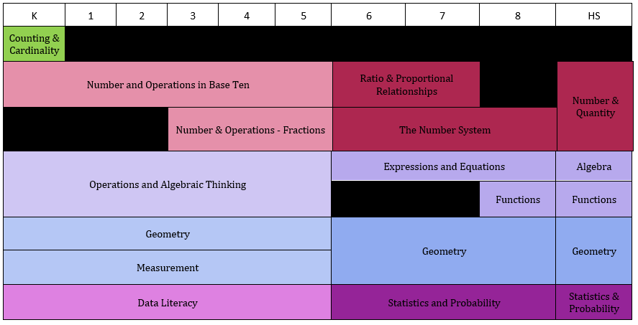
K–HS Domain Progression

Slide 4
Text Version: K–HS Domain Progression
Key:
A: Algebra
CC: Counting and Cardinality
DL: Data Literacy
F: Functions
G: Geometry
M: Measurement
NBT: Number and Operations in Base Ten
NF: Number and Operations – Fractions
OA: Operations and Algebraic Thinking
SP: Statistics and Probability
K | 1 | 2 | 3 | 4 | 5 | 6 | 7 | 8 | HS
CC | - | - | - | - | - | - | - | - | -
NBT | NBT | NBT | NBT | NBT | NBT | RP | RP | - | NQ
- | - | - | NF | NF | NF | NS | NS | NS | NQ
OA | OA | OA | OA | OA | OA | EE | EE | EE | A
OA | OA | OA | OA | OA | OA | - | - | F | F
G | G | G | G | G | G | G | G | G | G
M | M | M | M | M | M | G | G | G | G
DL | DL | DL | DL | DL | DL | SP | SP | SP | SP

Slide 5
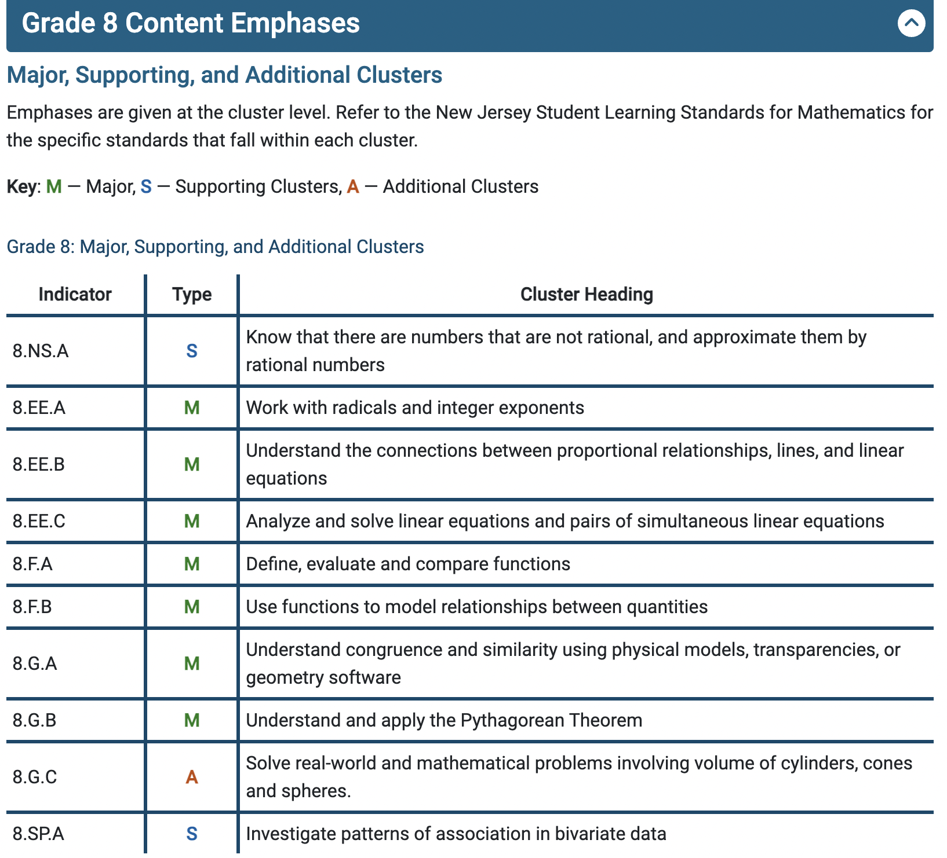
Content Emphases Grade 8
Some things have greater emphasis
No standards can be neglected or omitted
Neglecting material will
leave gaps in student skill and understanding
leave students unprepared for later grades.

Slide 6
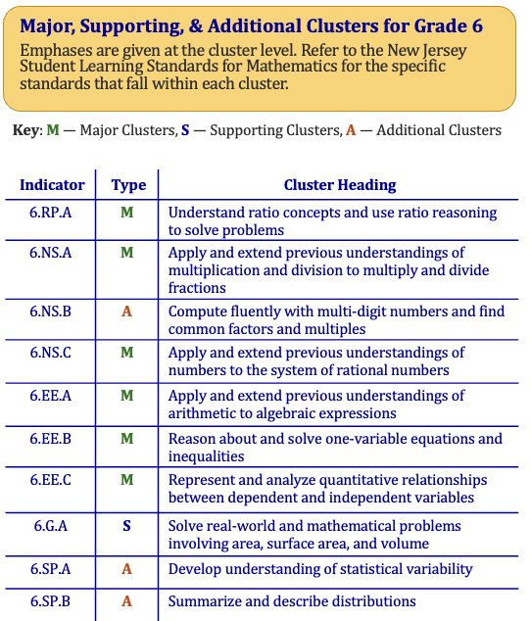
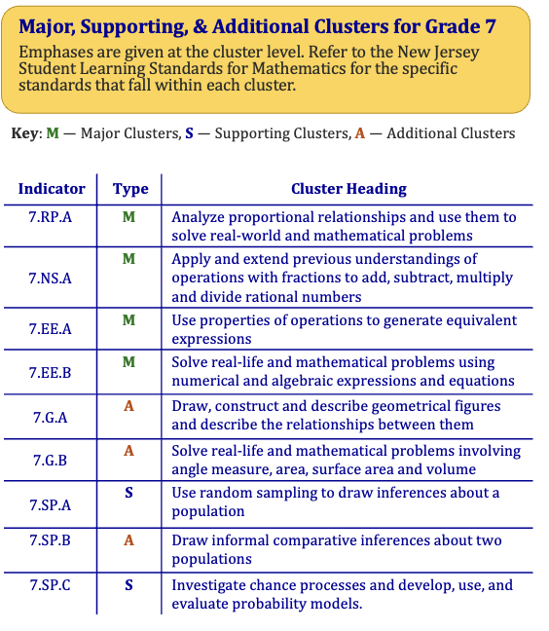
Content Emphases: Grade 6 and 7

Slide 7
MS Statistics & Probability

Slide 8
Progression of Key Concepts (Cluster Level)
Grade 6:
Develop understanding of statistical variability
Summarize and describe distributions
Grade 7
Use random sampling to draw inferences about a population
Draw informal comparative inference
Investigate chance processes and develop, use, and evaluate probability models
Grade 8
Investigate patterns of association in bivariate data

Slide 9
Progression of Key Concepts (Grade 6-7)
Grade 6:
6.SP.A.1 Recognize a statistical question as one that anticipates variability in the data related to the question and accounts for it in the answers.
6.SP.A.2 Understand that a set of data collected to answer a question has a distribution which can be described by its center, spread and overall shape.
Grade 7:
7.SP.A.1 Understand that statistics can be used to gain information about a population by examining a sample of the population …
7.SP.A.4 Use measures of center and measures of variability for numerical data from random samples to draw informal comparative inferences about two populations.

Slide 10
Progression of Key Concepts (Grade 7-8)
Grade 7 cont’d
7.SP.C.5 Understand that probability of a chance event is a number between 0 and 1 that expresses the likelihood of the event occurring. Larger numbers indicate greater likelihood. A probability near 0 indicates an unlikely event, a probability around ½ indicates an event that is neither unlikely nor likely, and a probability near 1 indicates a likely event.
Grade 8
8.SP.A.4 Understand that patterns of association can also be seen in bivariate categorical data by displaying frequencies and relative frequencies in a two-way table. Construct and interpret a two-way table summarizing data on two categorical variables collected from the same subjects. Use relative frequencies calculated for rows or columns to describe possible association between two variables.

Slide 11
Grades 2–5 Data Literacy Connections
Data literacy: The ability to reason with and about data—including what data are and where data come from. This includes the ability to make good decisions based on data, to ask questions of data, and to use appropriate reasoning.
Foundational Definitions
Data: information collected to answer a question
Select Foundational Skills and Concepts
Formulating questions
Variability (i.e., ‘data vary’)
Consider data that has already been collected (e.g., second-hand data)
Grouping and organizing data
Interpreting data

Slide 12
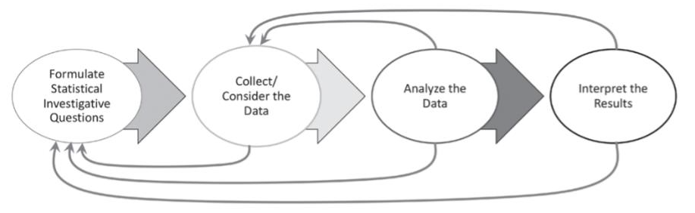
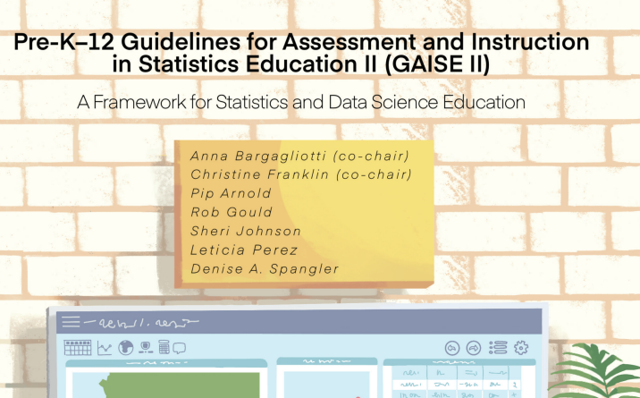
The GAISE Report
The Guidelines for Assessment and Instruction in Statistics Education II report (GAISE II) reminds us that working with data is an inquiry process that has multiple components. They suggest this image of the data inquiry process.
Data literacy: The ability to reason with and about data—including what data are and where data come from. This includes the ability to make good decisions based on data, to ask questions of data, and to use appropriate reasoning.

Slide 13
Select Grades 2-5 Data Literacy Standards
  2.DL.A.1 Understand that people collect data to answer questions. Understand that data can vary.
  3.DL.A.1 Develop data-based questions and decide what data will answer the question. (e.g., “What size shoe does a 3rd grader wear?”, “How many books does a 3rd grader read?”).
  3.DL.A.2 Collect student-centered data (e.g. collect data on students’ favorite ice cream flavor) or use existing data to answer data-based questions
  4.DL.A.2 Develop strategies to collect various types of data and organize data digitally.

Slide 14
Select Data Literacy Standards continued
  4.DL.A.4 Analyze visualizations of a single data set, share explanations and draw conclusions that the data supports.
  5.DL.A.1 Understand how different visualizations can highlight different aspects of data. Ask questions and interpret data visualizations to describe and analyze patterns.
  informal language such as “clumps”, “holes” and “unusual values” is used.
  5.DL.A.4 Using appropriate visualizations (i.e., double line plot, double bar graph), analyze data across samples.

Slide 15
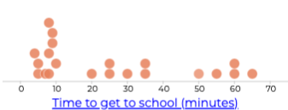
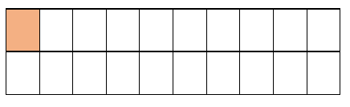
Clarification to Data Literacy Standards
Clarification to the new Data Literacy cluster in grades 4 and 5:
“Analysis of data and visualizations at these grades excludes ratio, rate, proportion and percentages. These concepts are introduced in Grade 6.”
Implications for middle school:
  Ensure that interpreting distributions includes the use of ratios and leverages proportional reasoning

Slide 16
Implications for Grade 6
  Some implications for grade 6, given the new data literacy standards :
6.SP.A.1. Recognize a statistical question as one that anticipates variability in the data related to the question and accounts for it in the answers. For example, “How old am I?” is not a statistical question, but “How old are the students in my school?” is a statistical question because one anticipates variability in students’ ages.

Slide 17
Implications for Grade 6 continued
  Some implications for grade 6, given the new data literacy standards :
    Summarize numerical data sets in relation to their context, such as by:
      6.SP.B.5b. describing the nature of the attribute under investigation, including how it was measured and its units of measurement.
      6.SP.B. 5c. giving quantitative measures of center (median and/or mean) and variability (interquartile range and/or mean absolute deviation), as well as describing any overall pattern and any striking deviations from the overall pattern

Slide 18
Implications Grade 7
  Some implications for grade 7, given the new data literacy standards :
    7.SP.A.2 Use data from a random sample to draw inferences about a population with an unknown characteristic of interest. Generate multiple samples (or simulated samples) of the same size to gauge the variation in estimates or predictions. For example, estimate the mean word length in a book by randomly sampling words from the book; predict the winner of a school election based on randomly sampled survey data. Gauge how far off the estimate or prediction might be.

Slide 19
Implications Grade 7 continued
  Some implications for grade 7, given the new data literacy standards :
7.SP.B.4 Use measures of center and measures of variability for numerical data from random samples to draw informal comparative inferences about two populations. For example, decide whether the words in a chapter of a seventh-grade science book are generally longer than the words in a chapter of a fourth-grade science book.

Slide 20
Implications Grade 8
  Some implications for grade 8, given the new data literacy standards :
    8.SP.A.1 Construct and interpret scatter plots for bivariate measurement data to investigate patterns of association between two quantities. Describe patterns such as clustering, outliers, positive or negative association, linear association, and nonlinear association.

Slide 21
Implications Grade 8 continued
  Some implications for grade 8, given the new data literacy standards :
8.SP.A.4 Understand patterns of association can also be seen in bivariate categorical data by displaying frequencies and relative frequencies in a two-way table. Construct and interpret a two-way table summarizing data on two categorical variables collected from the same subjects. Use relative frequencies calculated for rows or columns to describe possible association between two variables. For example, collect data from students on whether or not they have a curfew on school nights and whether or not they have assigned chores at home. Is there evidence that those who have a curfew also tend to have chores?

Slide 22
Connection to High School Statistics
Algebra 1 and/or 2
S.ID.A.1 Represent data with plots on the real number line (dot plots, histograms, and box plots).
  S.ID.A.2 Use statistics appropriate to the shape of the data distribution to compare center (median, mean) and spread (interquartile range, standard deviation) of two or more different data sets
S.ID.B.5 Summarize categorical data for two categories in two-way frequency tables. Interpret relative frequencies in the context of the data (including joint, marginal and conditional relative frequencies). Recognize possible associations and trends in the data.

Slide 23
Connection to High School Advanced Statistics
Advanced Statistics/ Data Science
  S.IC.A.1 Understand statistics as a process for making inferences about population parameters based on a random sample.
  S.IC.B.3 Recognize the purposes and differences among sample survey, experiments, and observational studies. Explain how randomization relates to each.
S.CP.A.1 Describe events as subsets of a sample space (the set of outcomes) using characteristics of the outcomes …

Slide 24
Revisions in Grade 8

Slide 25
Rational and Irrational Numbers - Grade 8
Foundational work with rational and irrational numbers culminates in grade 8.
2023 NJSLS-M | 2016 NJSLS-M
8.NS.A.3 Understand that the sum or product of two rational numbers is rational; that the sum of a rational number and an irrational number is irrational; and that the product of a nonzero rational number and an irrational number is irrational. | N.RN.B.3 Understand that the sum or product of two rational numbers is rational; that the sum of a rational number and an irrational number is irrational; and that the product of a nonzero rational number and an irrational number is irrational.

Slide 26
Radical Expressions - Grade 8
Foundational work simplifying numerical radicals is proposed in grade 8.
2023 NJSLS-M | 2016 NJSLS-M
8.EE.A.2 Use square root and cube root symbols to represent solutions to equations of the form x² = p and x³ = p, where p is a positive rational number. a. Evaluate square roots of small perfect squares and cube roots of small perfect cubes. Know that √2 is irrational. b. Simplify numerical radicals, limiting to square roots (i.e., nonperfect squares). For example, simplify √8 to 2√2. | 8.EE.A.2 Use square root and cube root symbols to represent solutions to equations of the form x² = p and x³ = p, where p is a positive rational number. Evaluate square roots of small perfect squares and cube roots of small perfect cubes. Know that √2 is irrational.

Slide 27
Linear Systems – Grade 8
2023 NJSLS-M | 2016 NJSLSM
8.EE.C.8b Solve systems of two linear equations in two variables using the substitution method and estimate solutions by graphing the equations. Solve simple cases by inspection. For example: by inspection, conclude that 3x + 2y = 5 and 3x + 2y = 6 have no solution because 3x + 2y cannot simultaneously be 5 and 6. Solve 3x + y = 30 and y = 2x using the substitution method; Solve y = 3x + 1 and y = -2x +7 using the substitution method. | 8.EE.C.8b Solve systems of two linear equations in two variables algebraically and estimate solutions by graphing the equations. Solve simple cases by inspection. For example: 3x + 2y =5 and 3x + 2y = 6 have no solution because 3x + 2y cannot simultaneously be 5 and 6.

Slide 28
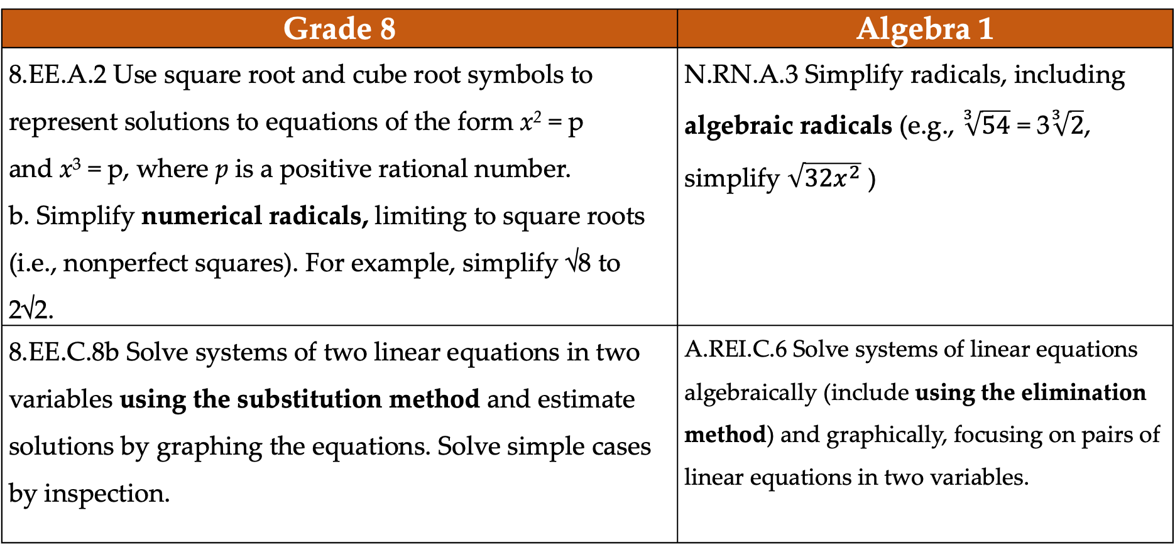
Sample Progression 1: Grade 8 to HS
Grade 8 | Algebra 1
8.EE.A.2 Use square root and cube root symbols to represent solutions to equations of the form x² = p and x³ = p, where p is a positive rational number. b. Simplify numerical radicals, limiting to square roots (i.e., nonperfect squares). For example, simplify √8 to 2√2. | N.RN.A.3 Simplify radicals, including algebraic radicals (e.g., $\sqrt[3]{54}$ = 3$\sqrt[3]{2}$, simplify $\sqrt{32x^{2}}$ )
8.EE.C.8b Solve systems of two linear equations in two variables using the substitution method and estimate solutions by graphing the equations. Solve simple cases by inspection. | A.REI.C.6 Solve systems of linear equations algebraically (include using the elimination method) and graphically, focusing on pairs of linear equations in two variables.

Slide 29
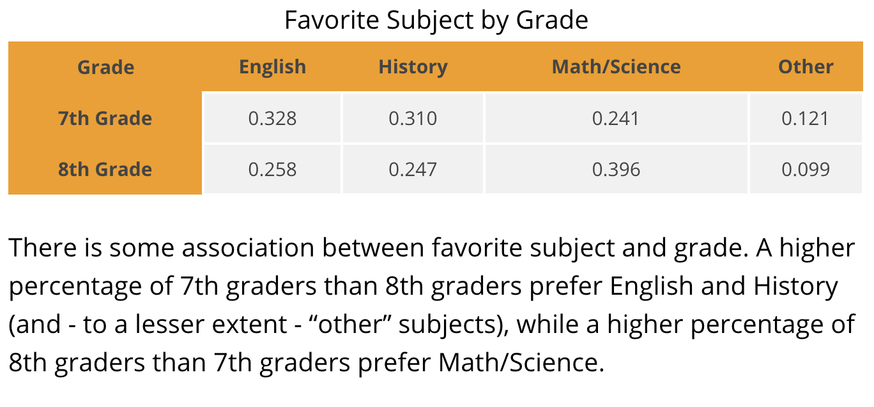
Sample Progression 2: Grade 8 to HS
Grade 8 | Algebra 1
8.SP.A.4 Understand patterns of association can also be seen in bivariate categorical data by displaying frequencies and relative frequencies in a two-way table. Construct and interpret a two-way table summarizing data on two categorical variables collected from the same subjects. Use relative frequencies calculated for rows or columns to describe possible association between two variables. | Summarize categorical data for two categories in two-way frequency tables. Interpret relative frequencies in the context of the data (including joint, marginal, and conditional relative frequencies). Recognize possible associations and trends in the data.

Slide 30
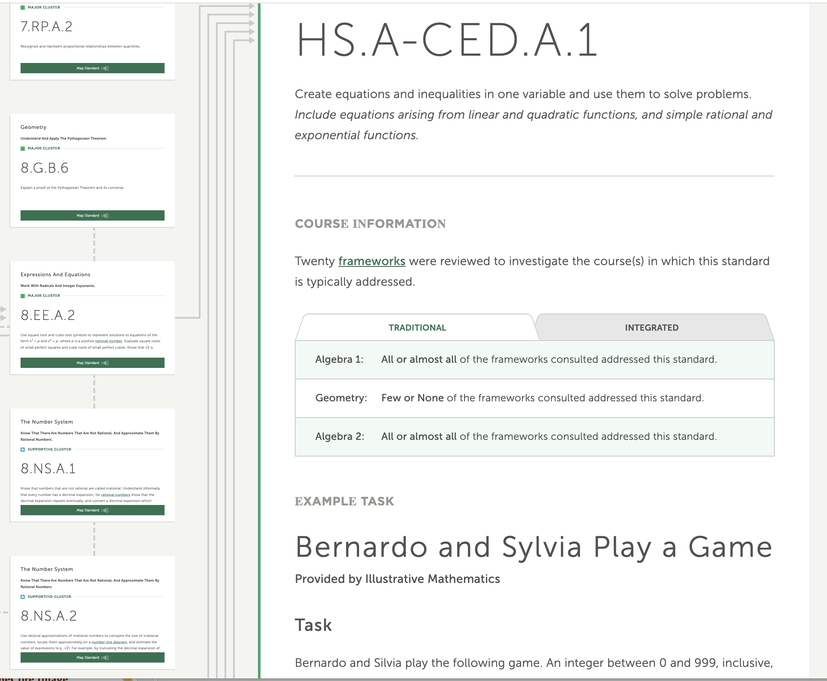
Algebra 1 Prerequisites: Example 1

Slide 31
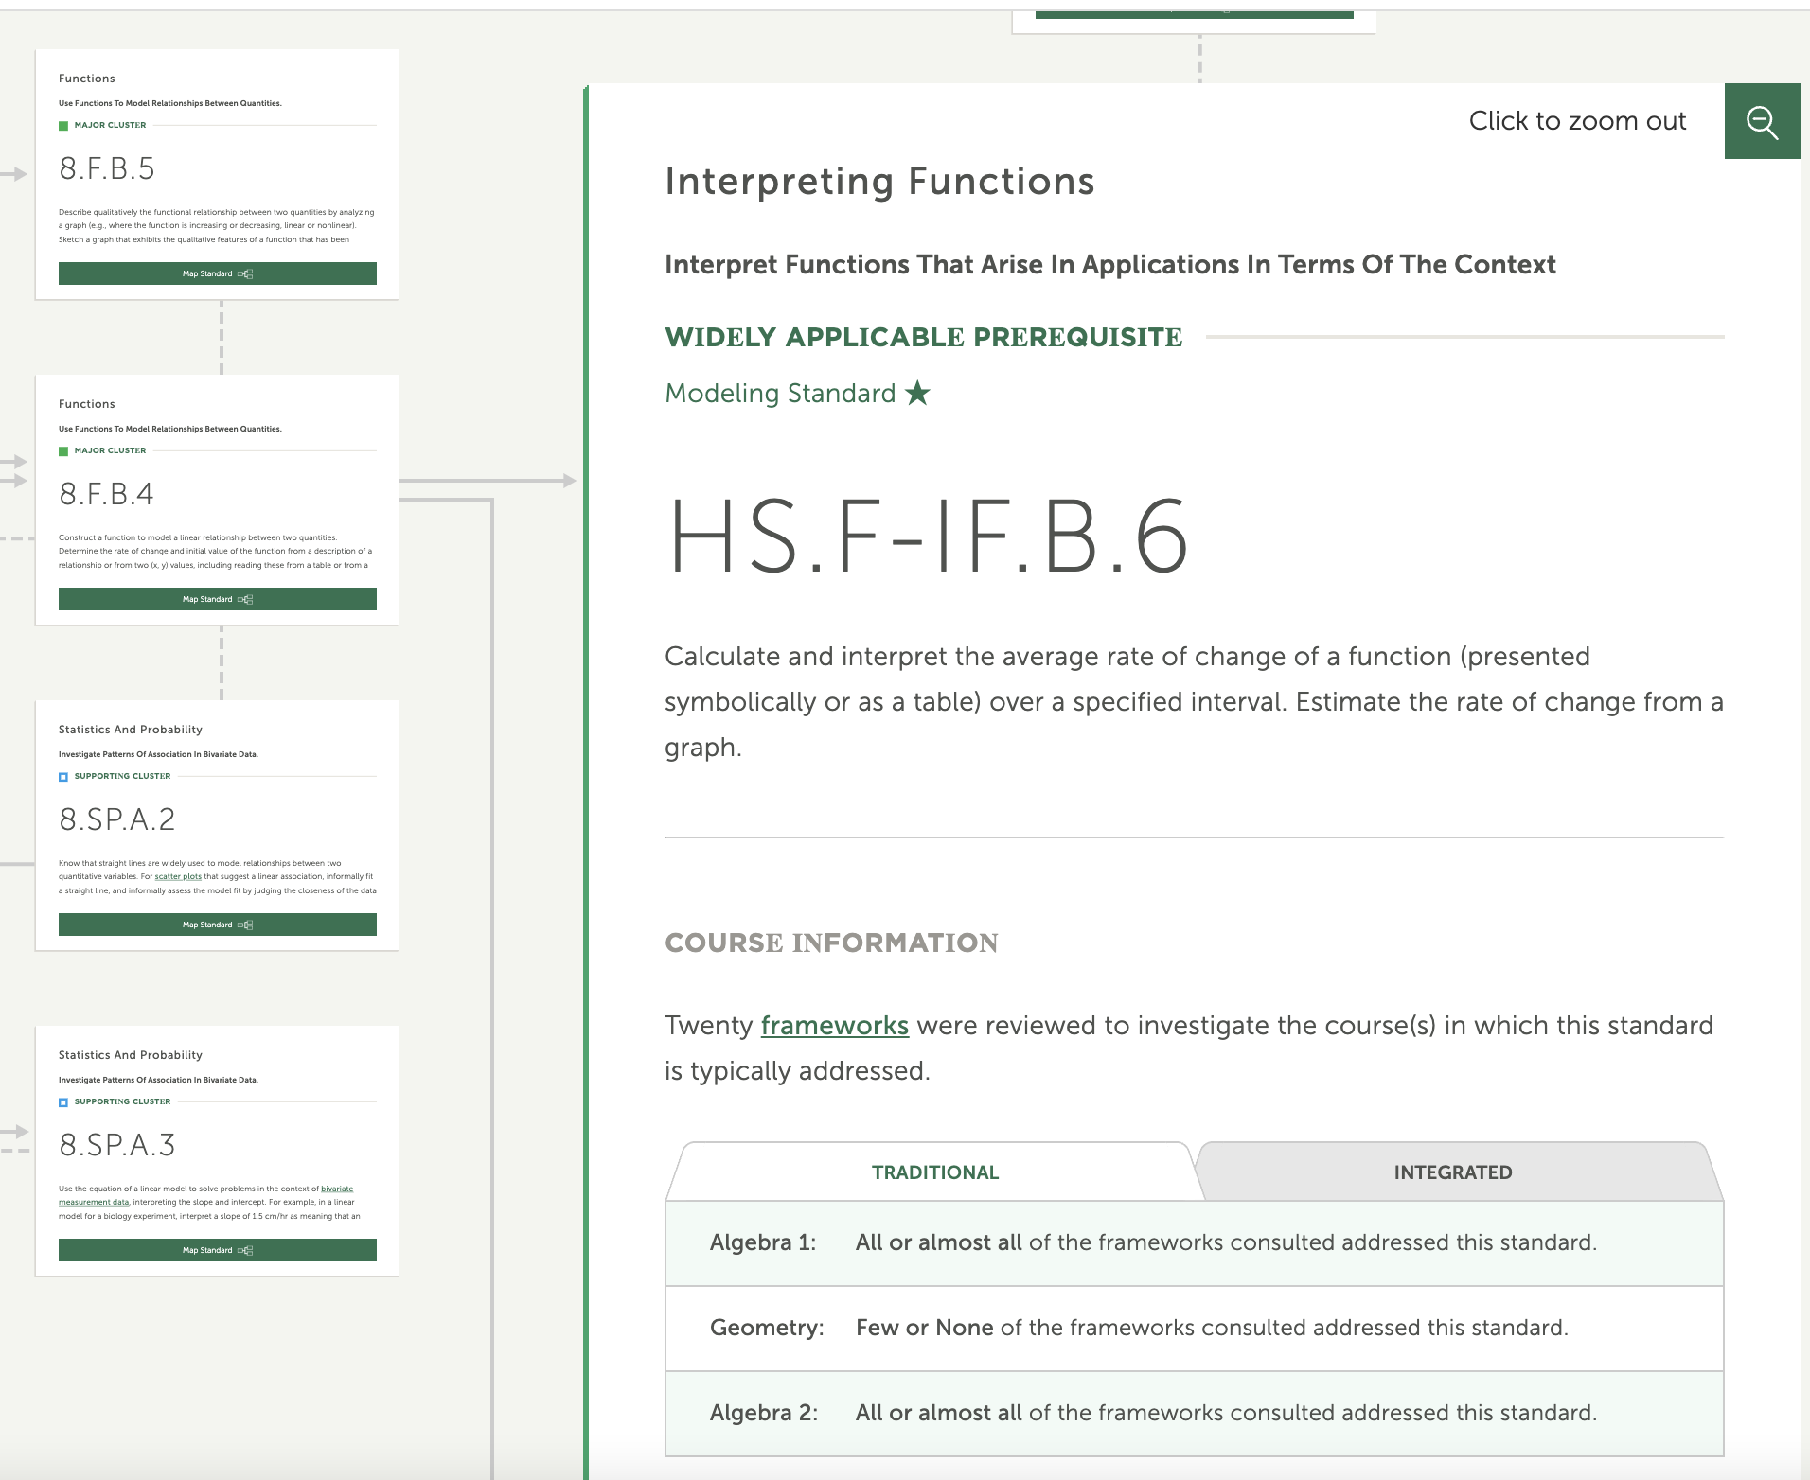
Algebra 1 Prerequisites: Example 2

Slide 32
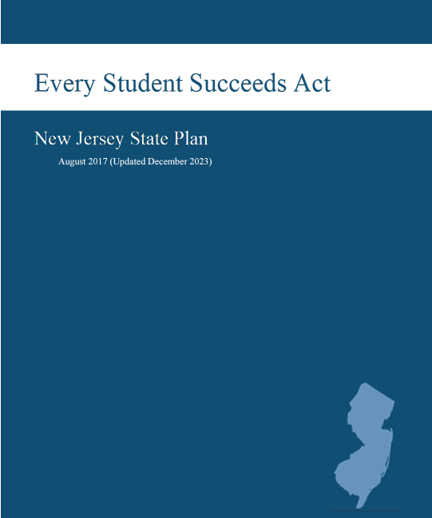
Advanced Math Coursework
Section 3, subsection on Advanced Mathematics Coursework
Describes the State Education Agency’s strategies to provide all students in the State the opportunity to be prepared for and to take advanced math coursework in middle school

Slide 33

Opportunities
See NJDOE Events Registration Page
Revisions and Key Perspectives in Middle School Mathematics
  October 24 and December 17, 2024
Elementary Data Literacy Overview
  November 19 and December 12, 2024
Exploring Fractions in Grades 3 to 5
  November 21 and December 5, 2024
Note: The webinars begin at 3:15pm

Slide 34
Thank You!
Dr. Deidre Richardson, Ed.D.
deidre.richardson@doe.nj.gov

Slide 35
Follow Us on Social Media!
Facebook:
@njdeptofed
Instagram:
@newjerseydoe
LinkedIn:
New Jersey Department of Education
Threads:
@NewJerseyDOE
X: @NewJerseyDOE
YouTube: @newjerseydepartmentofeduca6565

